Slide 1
MCCPTA Action on Ballot Measures
Proposal
MCCPTA Board of directors has voted to advise the Delegates approve our participation in an effort to defeat question B on the upcoming ballot. This is a coalition called Montgomery County Neighbors against Question B. It consists of several unions including MCEA and SEIU which represents our teachers and staff, local businesses, Greater Capital Area Association of Realtors, past Republican and Democratic legislators and concerned citizens.

Slide 2
Background:
There are 4 county charter amendments being offered in this general election. The two that directly affect the county budget are question A and question B.
Question A
Keeps the property tax rate at the current rate, unless there is a unanimous county council vote. It allows revenues to exceed the rate of inflation and which meant that the county could realize any economic growth beyond inflation. Today’s revenue is tied to inflation. This results in the actual rate being reduced, which has happened for the last 3 years. The MCCPTA BOD decided that we would remain neutral on this proposal.
Question B
Forbids the council from ever raising the property tax rate beyond inflation. MCCPTA BOD voted against Question B.

Slide 4
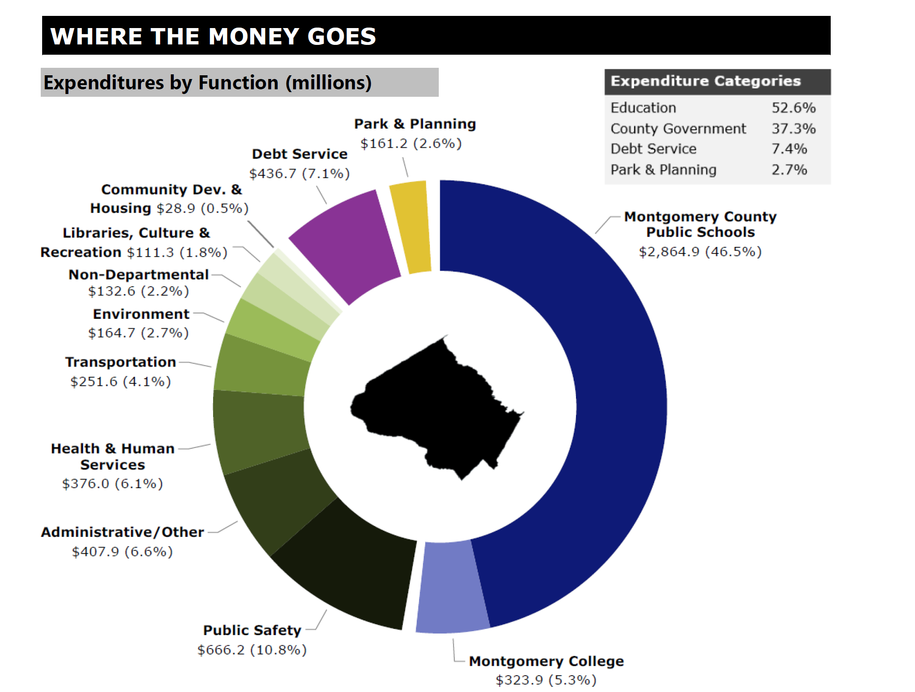

Slide 5
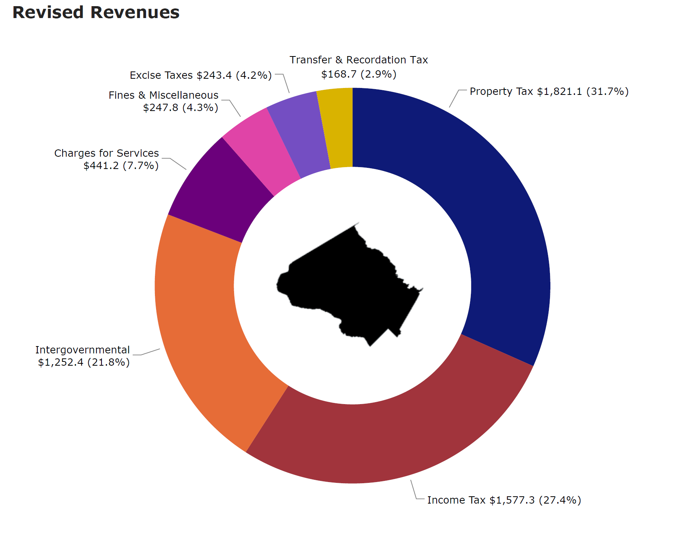

Slide 6
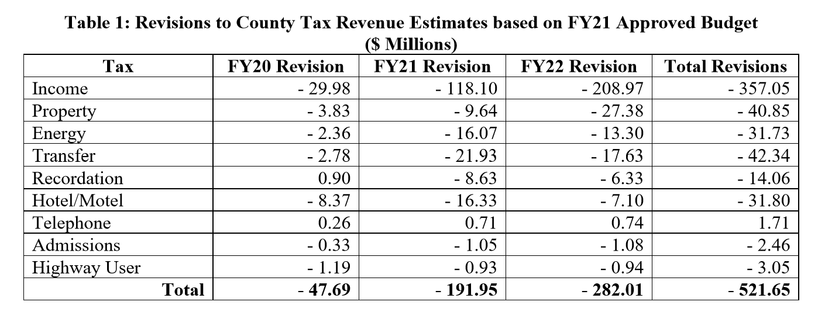

Slide 7
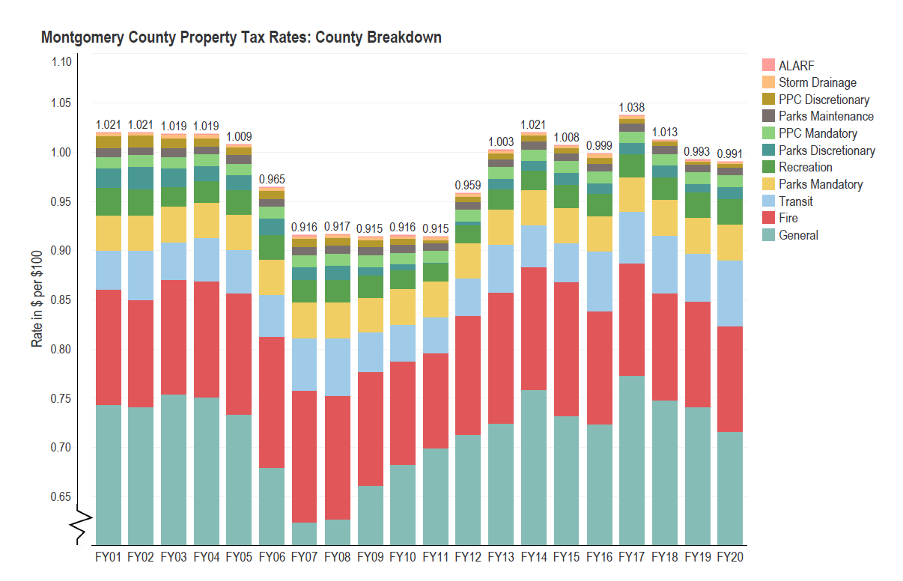
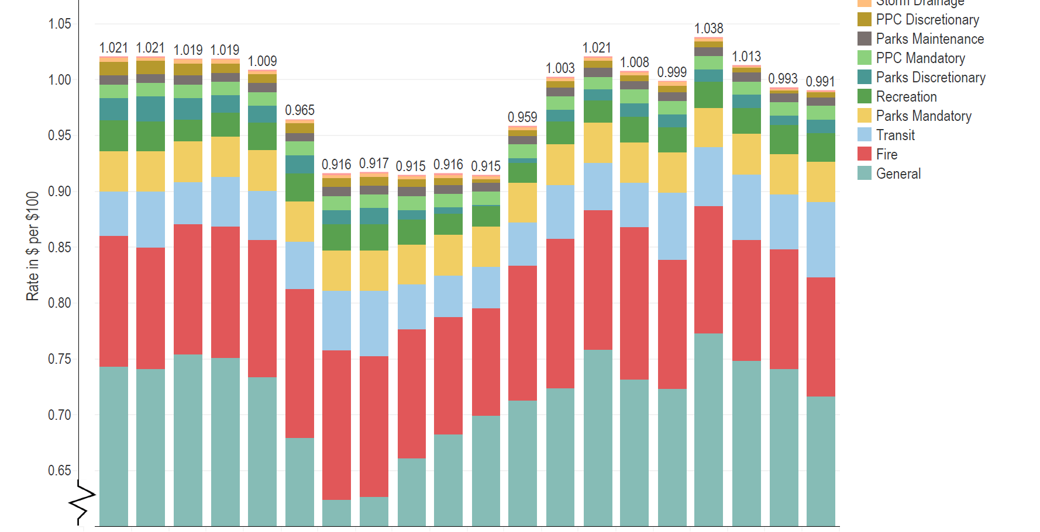

Slide 8
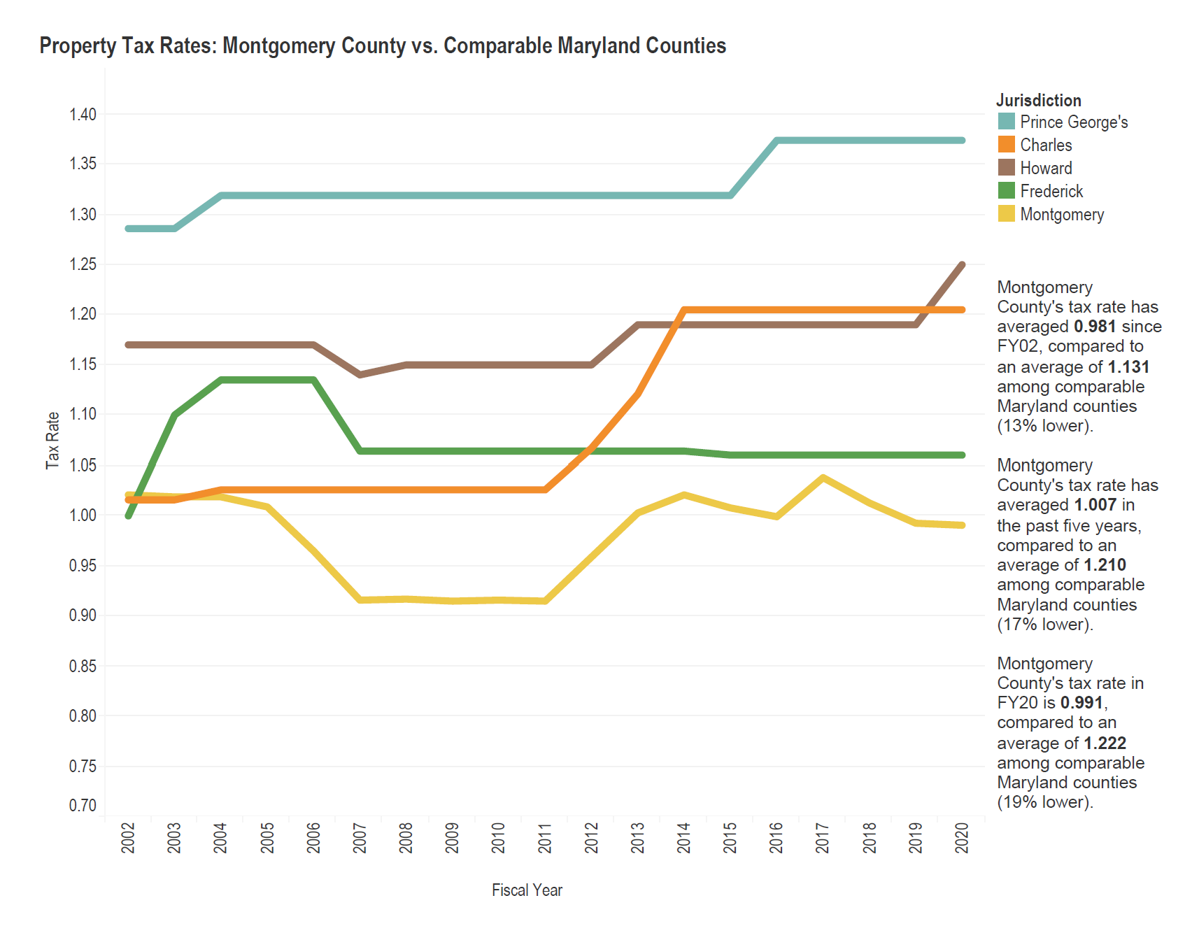

Slide 9
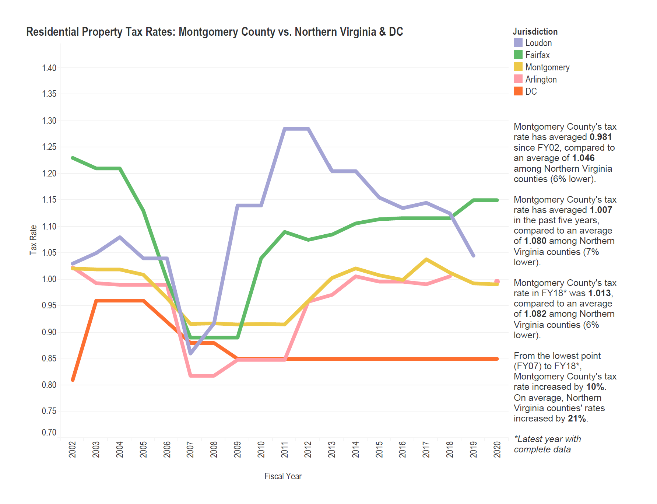

Slide 10
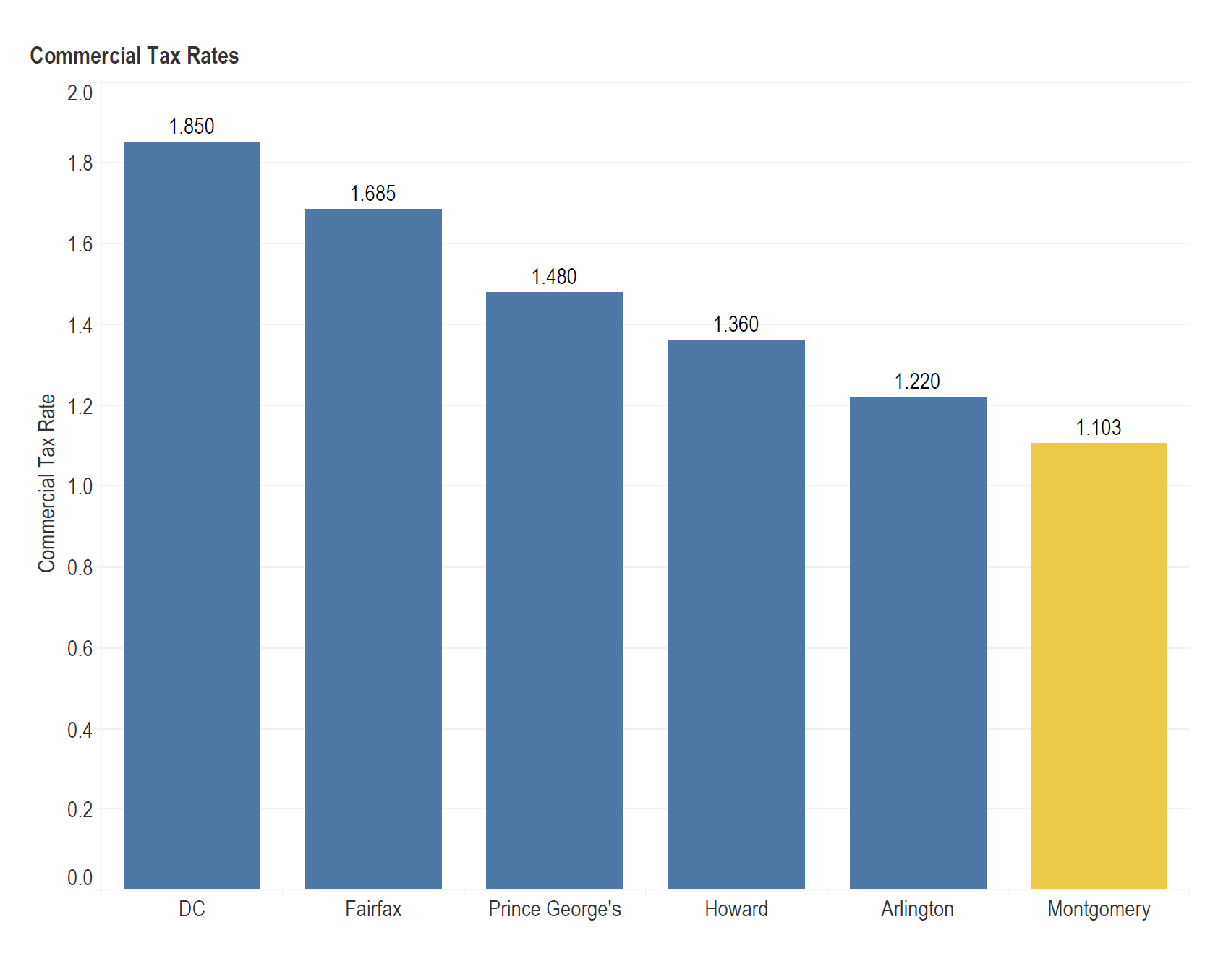

Slide 11
Potential Consequences of passing Question B: New Ficker Amendment
Abolishing all discretion to set property tax rates, regardless of the fiscal circumstances that the County may experience in the future, is reckless, imprudent and unnecessary.
Over the last ten years, the County has consistently held the line on property taxes. Meeting the critical needs of our students and our school system in fiscal year 2017 was the only exception.
This funding resulted in students and parents receiving more teachers, paraeducators and counselors as well as expanded programs to support achievement goals and enhanced college and career readiness

Slide 12
The proposal would permanently eliminate the County's ability to consider setting property tax rates each year beyond inflationary growth and would jeopardize funding for our schools, public health and core community services.
If this amendment had been in place for the last 10 years, the County would have approximately $110 million less in cumulative revenue (or $11 million per year) to fund critical services.
A permanent reduction of $110 million in resources is equivalent to eliminating the entire budget for more than one of the following critical functions – Public Health Service ($80 million), Behavioral Health and Crisis Services ($44.9 million), Libraries ($43.6 million), Corrections and Rehabilitation ($72.6 million), Housing and Community Affairs ($66.3 million), and Recreation ($47.5 million).
$11 million per year is equivalent to being able to pay the starting salaries for up to 217 MCPS Teachers, 228 Firefighters, 200 Social Workers, 182 Therapists, 200 Librarians, 232 Corrections Officers, 200 School Health Nurses, or 240 Code Enforcement Inspectors.

Slide 13
The proposal will likely strip the County of its Triple-A bond rating with potentially devastating financial consequences. Losing the County's Triple-A bond rating, which the County has held since 1973, would dramatically increase borrowing costs and drive up prices for school construction and renovations, roads and other community projects like libraries and recreation centers.
The County's Triple-A bond rating keeps the cost of borrowing low and is a testament to the County's ongoing, long-term and strategic fiscal management. On July 9, the three bond rating agencies reaffirmed the County's Triple-A bond rating, even in the midst of the global pandemic which confirms the County's strong fiscal management.
If the County sold $295 million of general obligation bonds as an AA+ rated issuer instead of a AAA issuer, it could increase the County’s debt service cost in the 6-year CIP program by $27 million (assuming a 15 basis points difference between AAA and AA+ market rates).
Debt service payments must be paid and is funded though the operating budget, and any increase in debt service takes away from resources that could fund critical services.

