Slide 1




Dream Coloring Book
Color Your Dreams
and
Then Live Your Dream

Slide 2

Make Your Dream Come True!!!
The Purpose of this coloring book is for you and your child to think about all the things that they can be. All it takes for you to do is dream your dreams and then live them. Color the pictures of the various things that people would like to be when they grow up then draw and color your own dreams of what you would like to be.

Slide 3


There are so many wonderful things that you can be all you have to do is follow your dreams.
Policemen
Firemen

Slide 4
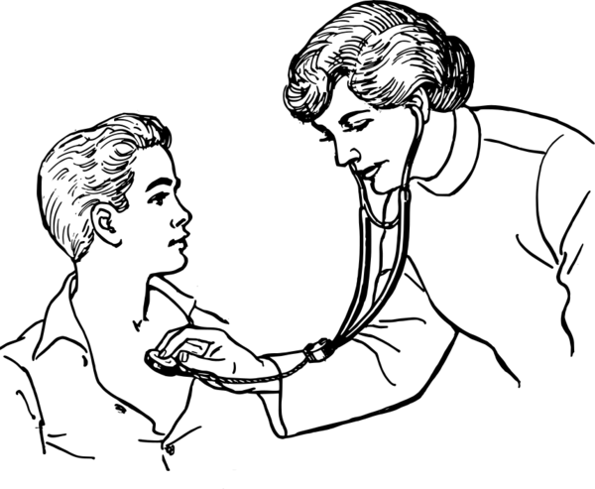

There are so many wonderful things that you can be all you have to do is follow your dreams.
Doctor
Nurse

Slide 5


There are so many wonderful things that you can be all you have to do is follow your dreams.
Welder
Clerk

Slide 6
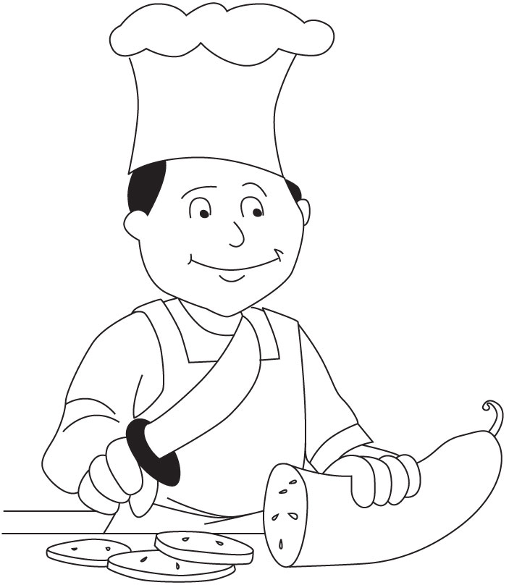

There are so many wonderful things that you can be all you have to do is follow your dreams.
Chef or Cook
Farmer

Slide 7


There are so many wonderful things that you can be all you have to do is follow your dreams.
Military
Professional Sports Player

Slide 8



There are so many wonderful things that you can be all you have to do is follow your dreams.
Business Person
Scientist or Engineer

Slide 9
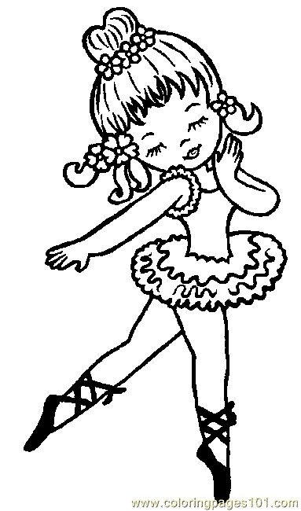

There are so many wonderful things that you can be all you have to do is follow your dreams.
An Entertainer
Picture Yourself as a Star

Slide 10
Now its time for you to draw and color your dream of what you would like to be.

Slide 11
Now its time for you to draw and color your dream of what you would like to be.

Slide 12


Make Your Dream Come True!!!
Your dreams are important. Everyone needs to dream and believe they can reach those dreams. We want you to dream BIG and COLORFUL. So color your dreams and be the best person that you can be.
Rhonda D. Brooks Breanne E. Brooks
Executive Director Co-Founder
BBV2M LLC W.I.?J.A.

Slide 13



The Dream Coloring Book is a product of W.I.?J.A. (What If? Just A.S.K.) which is a division of
Brothers Brooks Vision 2 Mission LLC .

