Slide 1
MLCA
Board of Directors Meeting
April 20, 2021
6:00 pm

Slide 2
Robert’s Rules of Order (Current Edition, Sept. 2020)
Zoom Protocols:
5 Minute technical startup
Do not multi-task
Microphone on mute when not speaking
Limit use of Chat for side conversations
Commit to civility and respect
Wave hand or use virtual hand to ask questions
Note: Roberts Rules restrict everyone to speaking twice on any debatable motion.

Slide 3
Roll Call
Neighborhood | Member
Beacon Village | Margaret Garland
Between the Greens | Peggy Hilton
Bridgewater | Ken Willis
Carrington | Carey McBride
Chestnut Creek | Derrick Perdue
Chipping Court | Ed Buhler
Club Pointe
Enclave | Suvess Ricks
Fairway Seven | Rodney Alston
Gateway | W. Vernon Reedy
Gold Creek
Golfers Way | Tom Flowers
Harmon Springs | Melissa Frederick
Magnolia | Stephen Adams
Northwoods | Tyler Barr
Overlook | Richard Glass
Park Place | Polly Oliver
Parkview | Warren Scandrick
Reflections | Ken Johns
Somersport | Carmen Williams
South Harbour | Oliver Clifton
Southwoods | Fred Molnar
Spyglass | Judy Whitley
Stillwater | Mike McCrary
Watermist | DeAngela Dothard
Woodcliff | Carolyn Nelson
At Large | Sherri Kelley

Slide 4
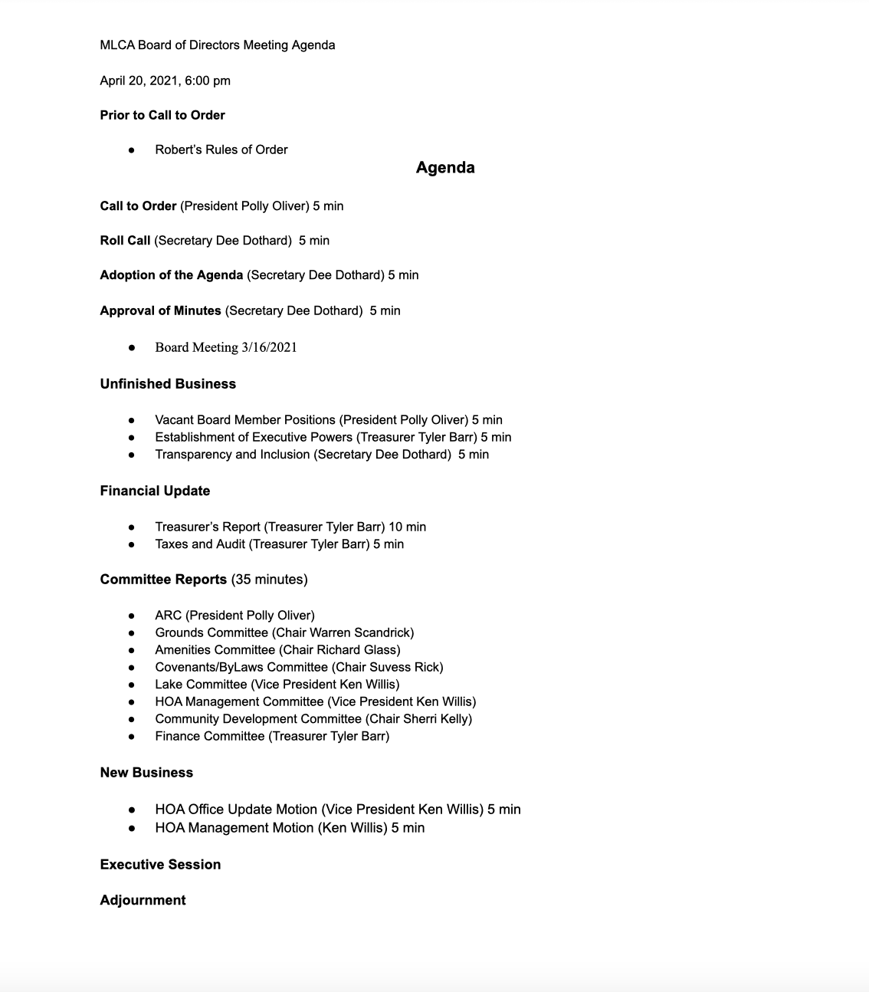
Adoption of the Agenda

Slide 5
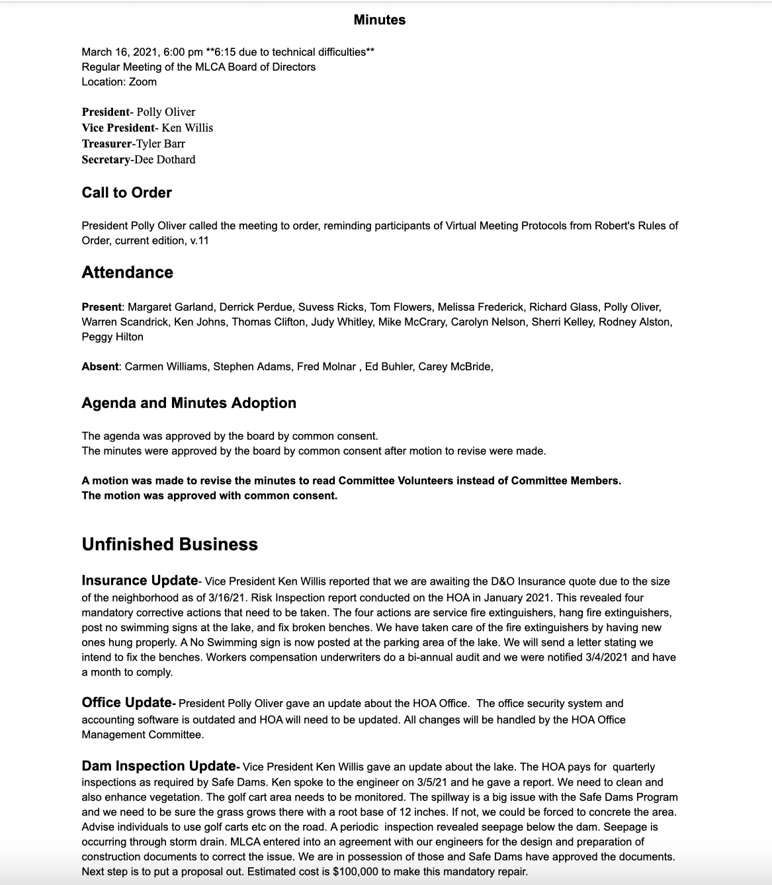
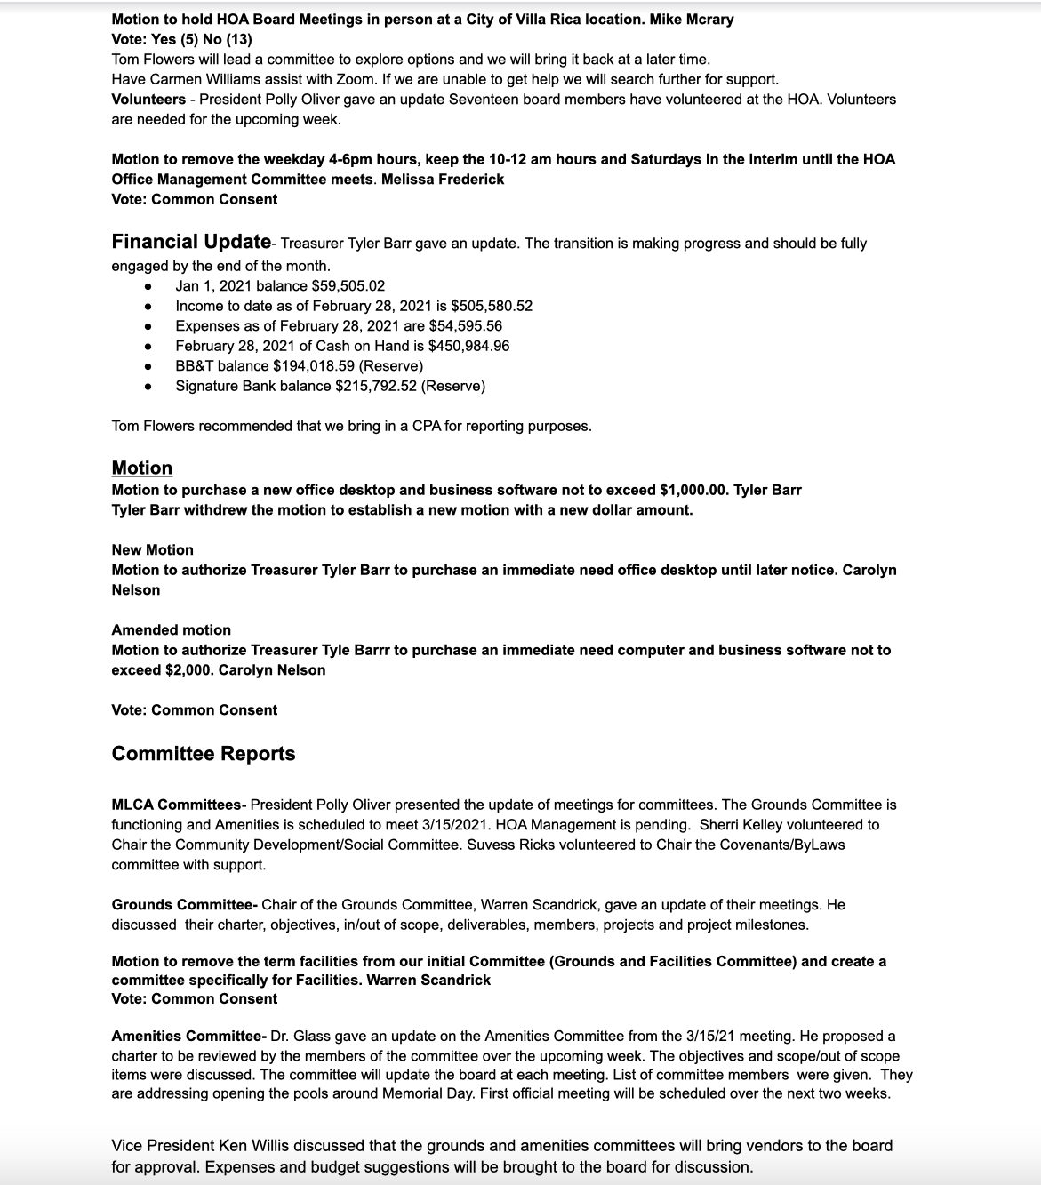
Adoption of the Minutes

Slide 6
Unfinished Business

Slide 7
Unfinished Business
Vacant Board Member Positions
(President, Polly Oliver)

Slide 8
Unfinished Business
Executive Powers
(Treasurer, Tyler Barr)
The Executive Committee is responsible for the day to day oversight and operation of the Mirror Lake Community Association. During the course of normal affairs we have experienced numerous occasions where lack of decision and spending authority has created a situation where necessary work or purchases needed to appropriately manage the MLCA affairs have put the executive committee at odds with fulfilling day to day oversight responsibilities and the achievement of compliance with the Board’s wishes for all activity to be voted upon by the full board of directors.
Motion to Adopt a Resolution to Establish and Grant Authority to Executive Committee
The members of the executive committee shall be the President, Vice President, Secretary, and Treasurer. The executive committee shall have the full authority of the board of directors to the extent necessary to support the day to day business of the MLCA. This authority is intended to support unanticipated business and shall not be used to enable the circumvention of the Board’s rightful oversight of MLCA management operation and spending. The executive committee spending authority related to this motion will be limited to $10,000 per occurrence and all such activity must be reported to the full Board of Directors at the first Board meeting following the decision and/or expenditure.

Slide 9
Unfinished Business
Transparency and Inclusion (Five Minutes)
Secretary Dee Dothard
Communication Reminder

Slide 10
Financial Update
Treasurer’s Report (Ten Minutes)
Treasurer Tyler Barr

Slide 11
Financial Update
Taxes and Audit (Five Minutes)
Treasurer Tyler Barr

Slide 12
MLCA Committees
Grounds Committee
- Warren Scandrick (Chair), Mike McCrary, Margaret Garland, Carmen Williams, Jan McCrary, Marshall Smith
Lake Committee
- Ken Willis (Chair), Derrick Perdue, Richard Glass, Greg Jones, John Yacup
Amenities Committee- Richard Glass (Chair), Fred Molnar, Jayne Lubrano, Bill Johnson, Jonathan Dothard, Danielle Burgin
HOA Management Committee- Ken Willis (Chair), Dee Dothard, Polly Oliver, Ken Willis, Suvess Ricks
Community Development/Social Committee
Sherri Kelly (Chair), Dee Dothard, Celeste Corpening, Marilyn Glass, Stefanie Wood, Evelyn Ortega, Judy Whitley
Covenants/ByLaws Committee
Suvess Ricks (Chair), Warren Scandrick, Tyler Barr, Carmen Williams,
Finance – Tyler Barr, Chair

Slide 13
Committee Reports 35 min

Slide 14
Architectural Review Committee (ARC)
Committee Charter:
Committee Members:
Article 6 – Architectural Standards in the Covenants. Review all exterior construction, alteration or addition of any improvements of any nature whatsoever, prior to any work performed on behalf of a homeowner. Approvals must be submitted in writing to and be approved by the ARC to oversee architectural guidelines. Any improvement made in violation of this article shall be non-conforming and may require restoration to the previous condition and subject to a fine.
Polly Oliver, Chair
Connie Flowers
Debbie Jones
Kay Smith
Kevin Spindel, Agent for JLC at Mirror Lake
Carolyn Nelson, Ad Hoc
Projects: Status: Due Date:
Objectives:
Refine ARC Request form to ensure all requests are clear as to supporting documentation & material samples required.
Increase frequency of meetings to provide quicker turnaround for homeowners (meetings were not previously scheduled, but approved “ad hoc”); Eff Feb – monthly mtgs scheduled
Version 1.0 on website (4/3)
Bi-weekly meetings scheduled (effective 4/1)
Ensure homeowner changes to external property, including additions, fencing, paint color changes, major landscape renovations, sculpture, water features, pools/spas, etc conform to individual neighborhood architecture and do not adversely affect neighbors.
In Scope:
Out of Scope:
Homeowner changes to external property as cited above and/or stated in the Covenants.
New home construction
Property Inspections
Deliverables:
Project Milestones: Due:
Written approval or rejection of all ARC requests, within 30 days after receipt of the completed ARC form and required documentation, including photos and site plans
Approved requests are good for one year from approval.
First bi-weekly meeting held 4/16
4/16
Project Status Key:
Planned
Discovery
Underway/on Track
At Risk
Stopped – Need Assistance or Direction from Board

Slide 17
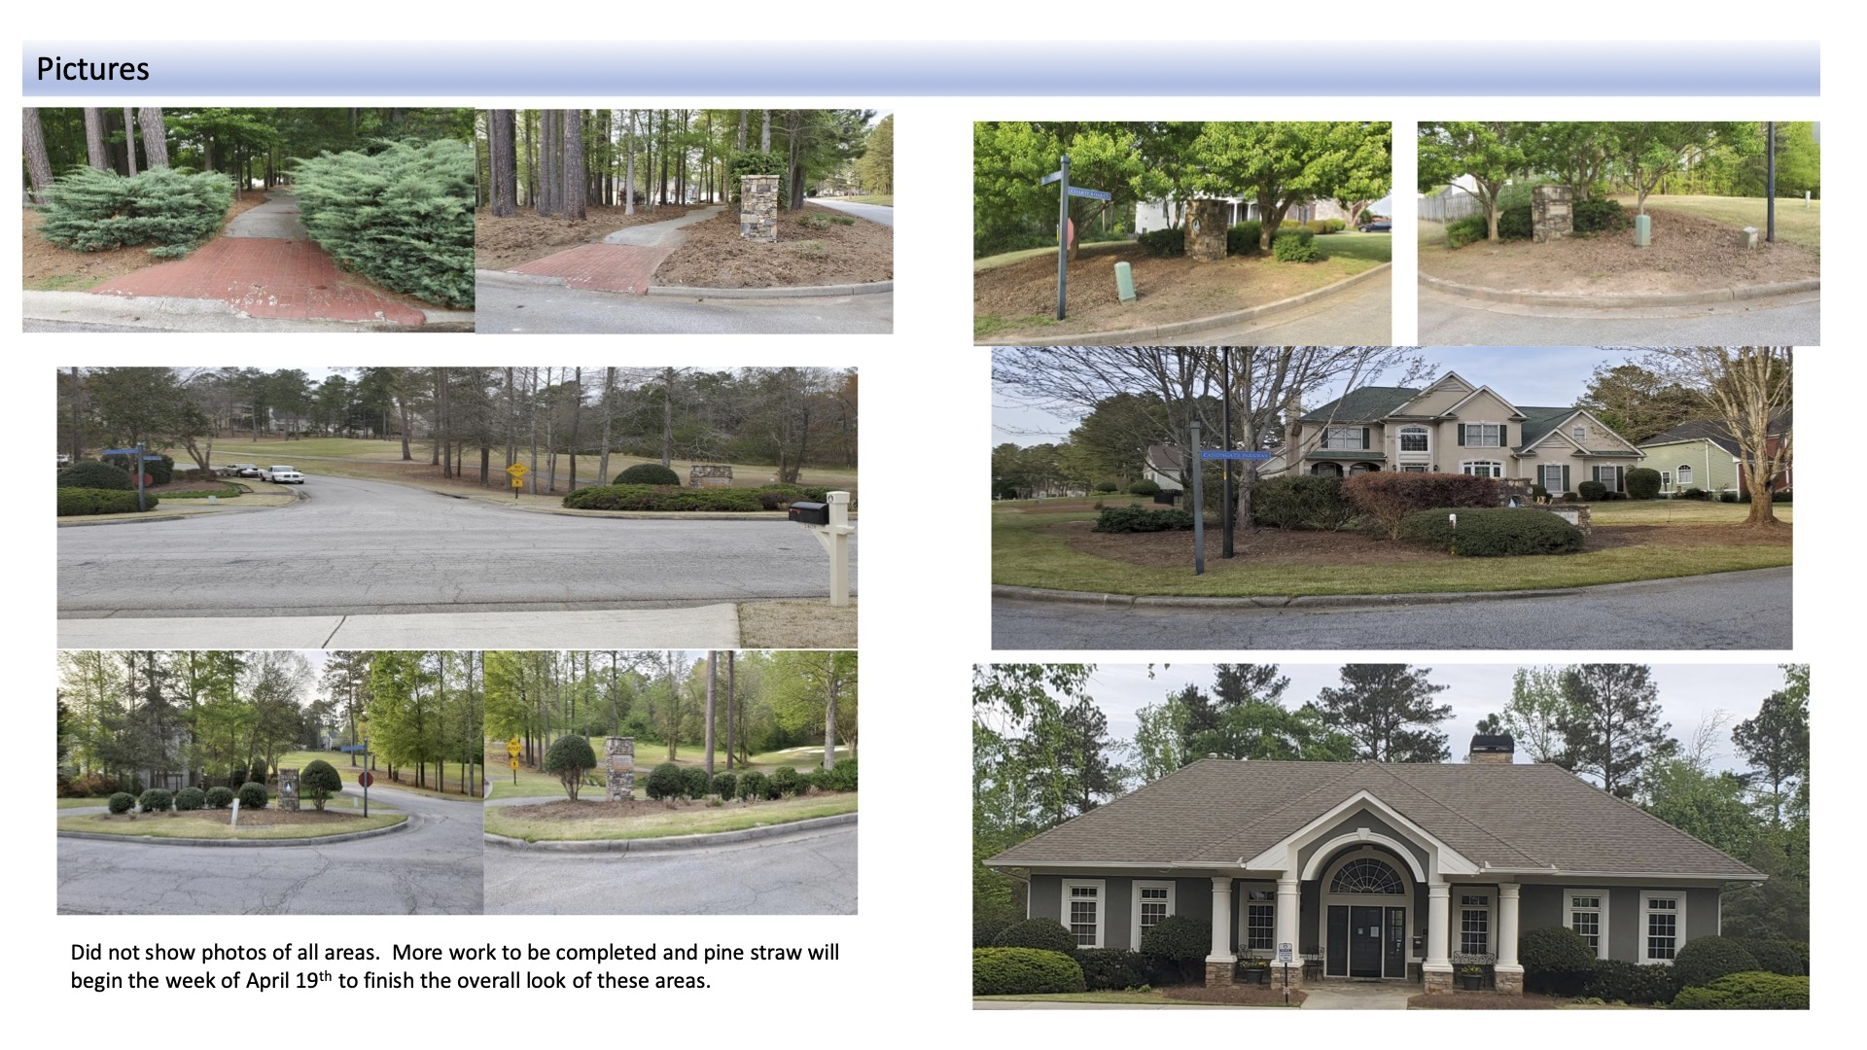

Slide 18
Caption

Slide 20
Lake Committee
Committee Charter:
Committee Members:
Intended to provide oversight and improvement opportunities for Mirror Lake to include relationship management and compliance obligations imposed by the Safe Dams authority, lake use management, lake aesthetics and fisheries management.
Ken Willis, Chair
Derrick Perdue
Greg Jones
Richard Glass
John Yacup
Projects: Status: Due Date:
Objectives:
Ensure compliance with all Safe Dams requirements.
Consider options for improvement or enhancements enabling ease of lake access for homeowners.
Provide general oversight and recommended improvement options for all lake management practices.
TBD
TBD
Deliverable Status: Due:
Deliverables:
TBD
Project Status Key:
Planned
Discovery
Underway/on Track
At Risk
Stopped – Need Assistance or Direction from Board

Slide 21
HOA Management Committee
Committee Charter:
Committee Members:
HOA Management Committee, (temporary committee) intended to review existing HOA management practices and explore opportunities for improvements to include consideration of continued on-site HOA management or the possible engagement of an external management services provider. This committee will be expected to provide a recommendation and proposed course of action.
Ken Willis, Chair
Suvess Ricks
Sherri Kelly
Dee Dothard
Fred Molnar
Polly Oliver
Projects: Status: Due Date:
Objectives:
Review existing Mirror Lake HOA management practices and the documented policies and procedures prescribed for those practices.
Review industry standard activities and practices associated with management responsibilities performed by in-house HOA property managers.
Review industry standard services and service level expectations associated with external property management companies.
As outlined within stated objectives and deliverables:
Review Existing Practices
Review Industry Standard Practices
Review Industry Standard Services
Identify recommended approach
Identify recommended source
Complete negotiations and confirm engagement
Deliverables:
Identify and recommended a preferred approach for future management of the Mirror Lake Community Association. (In-house or External)
Identify and recommend a preferred source/vendor for engagement of management services supporting the Mirror Lake Community Association.
Perform final negotiations and completion of vendor engagement as approved by the Board of Directors.
Deliverable Status: Due:
Recommendations Pending
04/20
Project Status Key:
Planned
Discovery
Underway/on Track
At Risk
Stopped – Need Assistance or Direction from Board

Slide 22
HOA Management Committee Recommendations
The Mirror Lake Community Association should establish a full service property management relationship with a professional third party service provider.
Introduction of Industry best practices and established policies and procedures
Availability of property management expertise
Securing property management with an external and non-affiliated service provider ensures the integrity of management actions
The Mirror Lake Community Association should establish a full service property management relationship with the service provider that provided both the low cost proposal and offers the greatest ongoing flexibility for contracted services and cost control.
Enables introduction of web based services and added on-line and convenience capabilities for homeowners
Ensures consistent management availability allowing rapid emergency response and added backup support
Ensures homeowners access to industry best practices and the benchmarking of services to other HOAs
Anticipated to be fully supported within existing budget and not require increased homeowner fees

Slide 23
HOA Management Committee Recommendations
The Mirror Lake Community Association should secure Temp Agency support for HOA Office assistance covering a potential four to six week transition period for implementation of external services.
Relieves Board of Directors and other volunteers of on-site obligations for office support
Ensures the availability of on-site services and amenity tag availability for residents leading up to the opening of pool season
Confirmed availability of un-affiliated temporary staff with HOA management experience
Provides opportunity for consistent messaging
Fully supported within existing budget
Motion:
The HOA Management Committee should be granted full authority to proceed with the recommended efforts identified within the committee report;
Enter final negotiations and agreement with the provider of the low cost proposal for full service HOA Management Services
Secure temp agency support for HOA management office staffing and support during transition period

Slide 25
Finance

Slide 26
New Business

Slide 27
New Business
Motion to approve an electronic keypad, cameras, and alarm system for the HOA Office.

Slide 28
Executive Session

Slide 29
Adjournment

