Slide 1
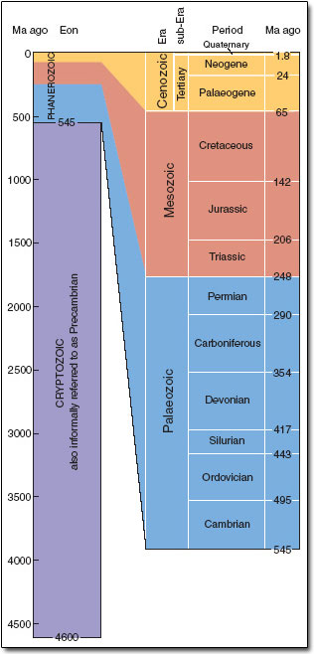
EXCEPTIONAL PRESERVATION
LA BREA TAR PITS
Cenozoic era
Quaternary (Pleistocene) period / system
10,000 – 40,000 ya
BALTIC AMBER
Cenozoic era
40mya
SOLENHOFEN LIMESTONE
Mesozoic era
Jurassic period / system
150mya
BURGESS SHALE
Palaeozoic era
Lower Cambrian period / system
540 mya

