Slide 1

The Case of the Scarlet Tag
Is it unconstitutional?
These materials have been adapted, with permission from The Florida Bar Benchmarks Adult Civic Education Program, for use in Louisiana. Principal authors of the Florida Benchmarks Program are Annette Boyd Pitts and Richard Levenstein. For assistance with adaptation in other states, contact staff@flrea.org

Slide 2

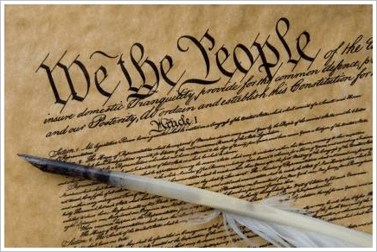
What is a constitution?
Similar to a rule book for government
  Outlines structure and function of government
  Limits the powers of government
  Lists some of our rights
  Reflects principles and values
  Fundamental law

Slide 3
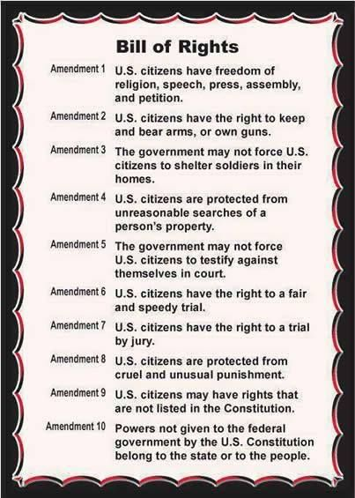
The Bill of Rights
The right of the people to be secure in their persons, houses, papers, and effects, against unreasonable searches and seizures… but upon probable cause.
Excessive bail shall not be required, nor excessive fines imposed, nor cruel and unusual punishments inflicted.
Notes:
In evaluating the proposed legislation, determine if you think it is unconstitutional. What specific provisions do you think the proposal violates?

Slide 4
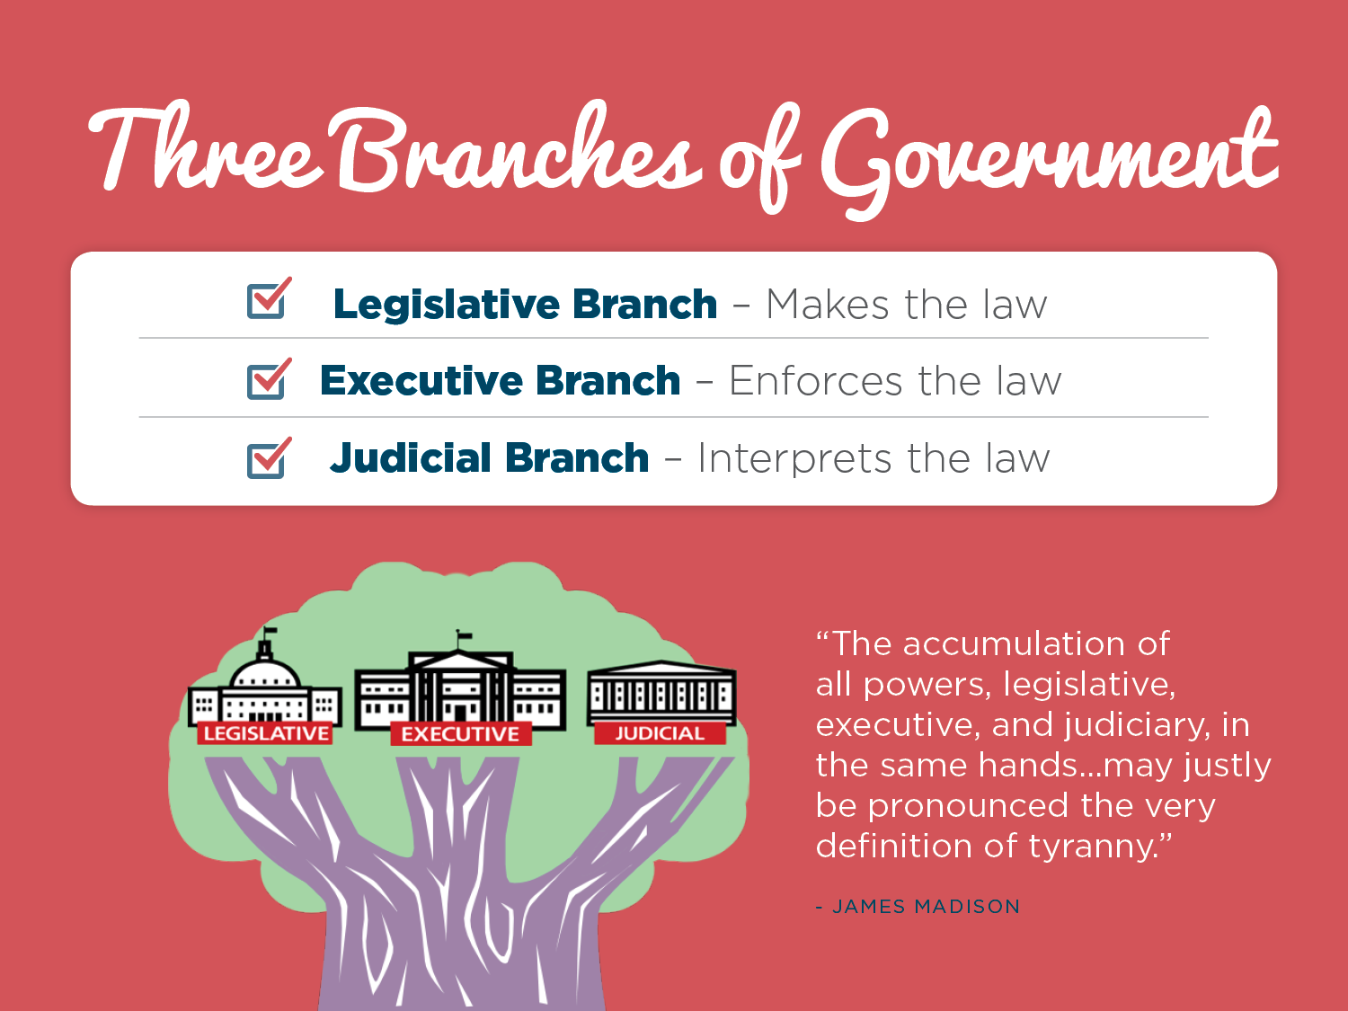
Interprets and applies the law
Notes:
Highlight the three branches of government and the role of each. Highlight checks and balances.
*

Slide 5
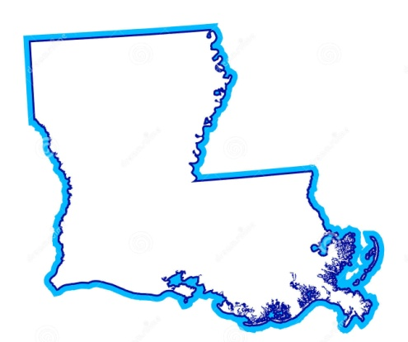
The Scarlet Tag
Louisiana
DUI 123
Sportsmen's Paradise
Notes:
Present Scarlet Tag scenario and discuss with audience.

Slide 6
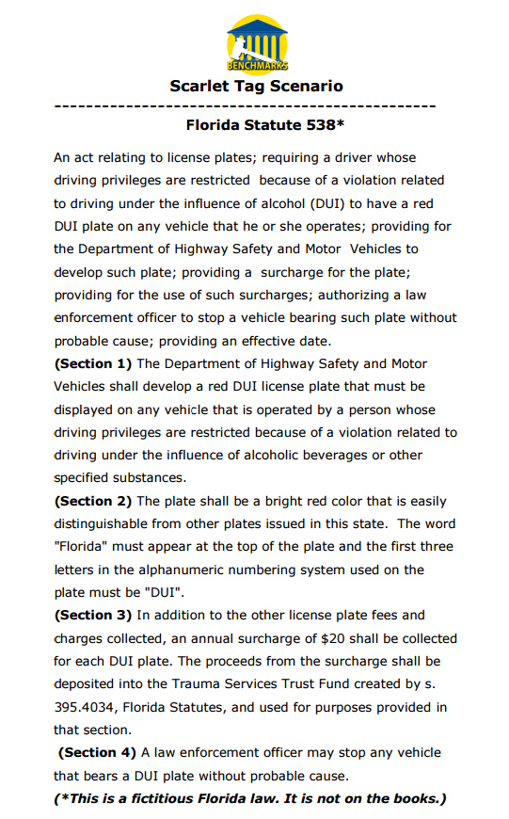
Language of Bill
Louisiana Statute 538*
What is the problem this piece of legislation is trying to solve? Is it fair? Is it reasonable? What are the strengths and weaknesses?
Notes:
Highlight language of hypothetical legislation. Utilizing evaluating legislation chart, determine if you think this legislation is unconstitution? Would you keep it, modify it or ditch it? What are some of the problems with this legislation? Would you support this type of legislation? What if it passed and you were stopped because you had the tag?

Slide 7
The Bill of Rights
The right of the people to be secure in their persons, houses, papers, and effects, against unreasonable searches and seizures… but upon probable cause.
Excessive bail shall not be required, nor excessive fines imposed, nor cruel and unusual punishments inflicted.
Notes:
In evaluating the proposed legislation, determine if you think it is unconstitutional. What specific provisions do you think the proposal violates?

Slide 8
Role of the Judicial Branch
Resolve disputes through a legal process;
Interpret and apply the law;
Determine if a law is unconstitutional;
Protect our rights.
But our courts do not automatically review proposed legislation like in some countries. In the United States, proposed legislation if passed in the legislative branch becomes law and must be challenged in the courts.
Notes:
America's courts play a crucial, unique role in our democracy. They resolve criminal and civil cases, and they protect our constitutional rights. The role of the judicial branch is to resolve disputes through a legal and fair process. The courts also have the duty of interpreting the law (or statutes etc) as well as determining if a law is unconstitutional if a party brings the case to court. (Give an example of interpreting the law here or later in the presentation. Ex: could use No Vehicles in the Park – see slide 36). Sometimes cases or issues that come before the courts to determine their constitutionality are controversial and emotionally charged. Judges need to be neutral and apply the law in making their decisions. If a law is determined to be unconstitutional, components of the law may be redrafted by the legislative branch to ensure the specific problems are addressed. Cases have to be brought before the courts in the United States to challenge the constitutionality of a law. In many countries, a Constitutional Court previews a law before it is finalized to determine if it is constitutional.
Judicial review is the idea, fundamental to the US system of government, that the actions of the executive and legislative branches of government are subject to review and possible invalidation by the judicial branch. Judicial review allows the Supreme Court to take an active role in ensuring that the other branches of government abide by the constitution. Judicial review was established in the classic case of Marbury v. Madison, 5 US 137 (1803).
*

Slide 9

The Scarlet Tag
Louisiana
DUI 123
Sportsmen's Paradise
Notes:
End with discussion on constitutionality of the hypothetical legislation and discuss the modification of the scenario as actually presented in the state legislature as well as actual enacted legislation in other states.

Slide 10

Peggy Cotogno
Executive Director
Peggy.cotogno@lsba.org
These materials have been adapted, with permission from The Florida Bar Benchmarks Adult Civic Education Program, for use in Louisiana. Principal authors of the Florida Benchmarks Program are Annette Boyd Pitts and Richard Levenstein. For assistance with adaptation in other states, contact staff@flrea.org
Notes:
For additional information on the Benchmarks program, please contact The Florida Law Related Education Association, Inc. at staff@flrea.org. We are so appreciative of all of the volunteers that made this program a success. Thank you for your dedication to educating the public about the role of the Constitution and the judicial branch throughout Florida.

