Slide 1
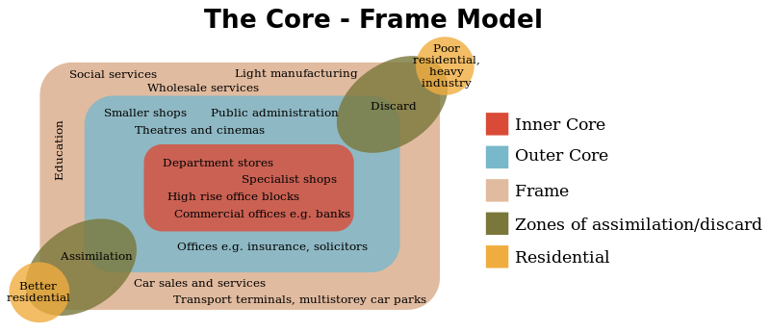
INVESTIGATING THE INTERNAL MORPHOLOGY OF A CBD
An A level Geography student investigated the Central Business District (CBD) of Lincoln, a Cathedral city and capital city of Lincolnshire.
Her aim was to investigate the internal structure of the CBD, to find out if distinct functional zones could be identified and to see if it exhibited any of the features of the Core-Frame model.

Slide 2
The Core-Frame model shows that certain functions locate themselves in particular parts of the CBD. Higher order functions can afford the higher rents and rates found in the Inner Core of the CBD where Bid-Rent is higher and middle and lower order functions tend to be found in the Outer Core and/or Frame.
Large shops, Department stores, specialist stores and other comparison services tend to be found clustered together in the core and near the main streets where not only are rents high but also pedestrian densities are high.
Lower order services and convenience stores such as newsagents, sweet shops and cafes are often found off the main streets where bid rent is lower as are pedestrian densities.
Some linked activities need close personal contacts and may be visited by the same clientele; so services such as solicitors, estate agents and insurance agents tend to be clustered in the same part of the CBD.

Slide 3
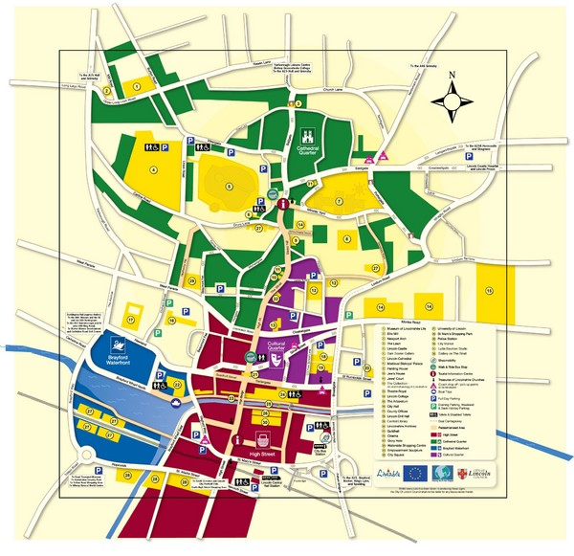
Initial investigations using City centre plans, GOAD land use maps, Google Earth street view and Lincoln City Council’s own maps and plans identified 4 possible land use / functional zones
CATHEDRAL QUARTER
CULTURAL QUARTER
THE HIGH STREET
BRAYFORD WATERFRONT
FUNCTIONAL ZONES IN THE CBD OF LINCOLN

Slide 4
CATHEDRAL
QUARTER
BRAYFORD
WATERFRONT
CULTURAL QUARTER
HIGH STREET

Slide 5
To investigate the theory that functional zones exist in the CBD of Lincoln the student asked a question “To what extent does Lincoln City Centre have distinct functional zones?” which was then developed as a hypothesis.
Lincoln CBD has distinct functional zones which have different patterns of land use
A null hypothesis will be that: There are no differences in the patterns of land use in the zones of Lincoln’s CBD
She collected land use fieldwork data (primary data) from each of the 4 zones of the CBD of Lincoln using a systematic sampling system based on a plan of the city centre that produced 50 sets of data for each of the 4 zones. Land use was classified in 10 different ways, including shopping, commercal, tourism, education and transport.

Slide 6
Some of the land use data collected for each of the 4 zones of Lincoln, showing the number of premises classified by their function.
 | CATHEDRAL | BRAYFORD | HIGH STREET | CULTURAL
SHOPPING | 6 | 8 | 25 | 6
EDUCATION | 2 | 10 | 0 | 0
FOOD AND DRINK | 7 | 10 | 6 | 4
TOURISM | 8 | 5 | 0 | 6
COMMERCIAL | 1 | 9 | 4 | 15

Slide 7
One way of testing the null hypothesis to see if it can be rejected and the alternative hypothesis accepted is to use the Chi square test.
This test compares the observed data collected in the fieldwork with data we would expect if the null hypothesis was true. If the null hypothesis was true we would expect to find no difference in the land use between the 4 zones and that any difference we did find could be explained by chance.
We can only reject the null hypothesis if the probability of the deviation from expected results being due to chance is less than 0.05, or that the we have a 95% or more confidence that the differences we find are significant enough to accept the alternative hypothesis, that is that distinct functional land use zones do exist.

Slide 8
Lets look at the data for shops :-
 | CATHEDRAL | BRAYFORD | HIGH STREET | CULTURAL
SHOPPING | 6 | 8 | 25 | 6
The total number of shops OBSERVED in the sample is 45.
If these were equally spread through the four zones we would EXPECT each to have
45 divided by 4 =11.25
 | CATHEDRAL | BRAYFORD | HIGH STREET | CULTURAL
OBSERVED | 6 | 8 | 25 | 6
EXPECTED | 11.25 | 11.25 | 11.25 | 11.25

Slide 9
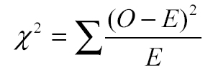
The Chi Square test looks at the difference between the OBSERVED data and the data EXPECTED if the null hypothesis is true.
The table below shows a worked example:-
SHOPPING | CATHEDRAL | BRAYFORD | HIGH STREET | CULTURAL
OBSERVED (O) | 6 | 8 | 25 | 6
EXPECTED (E) | 11.25 | 11.25 | 11.25 | 11.25
(O – E) | -5.25 | -3.25 | 13.25 | -5.25
(O – E)² | 27.6 | 10.6 | 189.1 | 27.6
(O – E)² E | 2.45 | 0.94 | 16.8 | 2.45
In this case = 22.6
The Chi square,

Slide 10
But what does the result Chi Square = 22.6 mean?
Obviously if the OBSERVED and EXPECTED results were the same the Chi Square value would be 0, and the null hypothesis would be accepted.
Therefore the higher the value the more the OBSERVED and EXPECTED results differ and we are more likely to be able to accept the alternative hypothesis, in this case that distinct functional / land use zones do exist in the Lincoln CBD.
We need to look the result up on a Chi Square probability table. To prove the alternative hypothesis the value needs to be higher than the figure for 0.05 probability (95%confidence level) for the correct degrees of freedom (n – 1),In this case 3 (4 – 1).
Degrees of freedom | 0.1 Probability | 0.05 Probability | 0.01 Probability
3 | 6.25 | 7.81 | 11.34

Slide 11
So we have a value of 22.6
Compare this to the Probability table:-
Degrees of freedom | 0.1 Probability | 0.05 Probability | 0.01 Probability
3 | 6.25 | 7.81 | 11.34
Our value is higher than 11.34
So we are able to reject the null hypothesis and accept the hypothesis that there are distinct differences in the numbers of shops in each of the zones with a 99% confidence
Lets do the same calculation for other land uses.

Slide 12
TOURISM
Total of 19 examples, divided by 4 = 4.75 expected number
TOURISM | CATHEDRAL | BRAYFORD | HIGH STREET | CULTURAL
OBSERVED (O) | 8 | 5 | 0 | 6
EXPECTED (E) | 4.75 | 4.75 | 4.75 | 4.75
(O – E) | 3.25 | 0.25 | -4.75 | 1.25
(O – E)² | 10.56 | 0.062 | 22.56 | 1.56
(O – E)² E | 2.22 | 0.013 | 4.74 | 0.32
= 7.29
What does this mean?

Slide 13
So we have a value of 7.29
Compare this to the Probability table:-
Degrees of freedom | 0.1 Probability | 0.05 Probability | 0.01 Probability
3 | 6.25 | 7.81 | 11.34
Our value is less than that needed for 0.05 probability and we cannot therefore reject the null hypothesis. Tourism is not proved to show any functional zoning in Lincoln.

Slide 14
COMMERCIAL
Total of 29 examples, divided by 4 = 7.25 expected number
COMMERCIAL | CATHEDRAL | BRAYFORD | HIGH STREET | CULTURAL
OBSERVED (O) | 1 | 9 | 4 | 15
EXPECTED (E) | 7.25 | 7.25 | 7.25 | 7.25
(O – E) | -6.25 | 1.75 | -3.25 | 7.75
(O – E)² | 39.06 | 3.06 | 10.56 | 60.06
(O – E)² E | 5.38 | 0.42 | 1.45 | 8.28
= 15.53
What does this mean?

Slide 15
So we have a value of 15.53
Compare this to the Probability table:-
Degrees of freedom | 0.1 Probability | 0.05 Probability | 0.01 Probability
3 | 6.25 | 7.81 | 11.34
Our value is more than that needed for 0.01 probability and we can therefore reject the null hypothesis. Commercial activities are proven to show functional zoning in Lincoln at the 99% confidence level.

Slide 16
EDUCATION
Total of 12 examples, divided by 4 = 3 expected number
EDUCATION | CATHEDRAL | BRAYFORD | HIGH STREET | CULTURAL
OBSERVED (O) | 2 | 10 | 0 | 0
EXPECTED (E) | 3 | 3 | 3 | 3
(O – E) | -1 | 7 | -3 | -3
(O – E)² | 1 | 49 | 9 | 9
(O – E)² E | 0.33 | 16.33 | 3 | 3
= 22.66
What does this mean?

Slide 17
So we have a value of 22.66
Compare this to the Probability table:-
Degrees of freedom | 0.1 Probability | 0.05 Probability | 0.01 Probability
3 | 6.25 | 7.81 | 11.34
Our value is more than that needed for 0.01 probability and we can therefore reject the null hypothesis. Educational activities are proven to show functional zoning in Lincoln at the 99% confidence level.

Slide 18
FOOD AND DRINK
Total of 27 examples, divided by 4 = 6.75 expected number
COMMERCIAL | CATHEDRAL | BRAYFORD | HIGH STREET | CULTURAL
OBSERVED (O) | 7 | 10 | 6 | 4
EXPECTED (E) | 6.75 | 6.75 | 6.75 | 6.75
(O – E) | 0.25 | 3.25 | -0.75 | -2.75
(O – E)² | 0.062 | 10.56 | 0.56 | 7.56
(O – E)² E | 0.0091 | 1.56 | 0.082 | 1.12
= 2.77
What does this mean?

Slide 19
So we have a value of 2.77
Compare this to the Probability table:-
Degrees of freedom | 0.1 Probability | 0.05 Probability | 0.01 Probability
3 | 6.25 | 7.81 | 11.34
Our value is less than that needed for 0.05 probability, and we cannot therefore reject the null hypothesis. Food and Drink premises are not proven to show functional zoning in Lincoln.

Slide 20
What are we able to conclude using the data collected by an A level student looking at functional zones in the CBD of Lincoln?
The Chi Square test shows that in general we can reject the null hypothesis that there are no zones within the CBD of Lincoln based on function and land use.
It has allowed us to prove that certainly for Shopping, Educational and Commercial land use there are statistically significant differences in the land use of particular zones.
The case is not proven for Food and Drink or Tourism, although for Tourism the figure is only just below the 0.05 probability level, and a larger sample may indeed show that Tourist functions are clustered in a certain area.
Cluster analysis using the Nearest Neighbour technique for specific land uses may shed more light on the issue.

