Slide 1
Managing older patients with isolated brain injuries or spinal fractures at TUs.
Nicola Dixon
23/09/19

Slide 2
Major Trauma networks
Ethos from a rehab perspective.
Cohort acute specialty skills so work is regular and familiar which in turn should improve skill sets, service development and outcomes.
Encourage timely ‘Care closer to home’.
Support management of trauma patients at local hospitals.

Slide 3
Isolated TBI or spinal fractures managed at TUs 2018-19 across the Tri network.
 | Age Band
Site | 0-10 | 10-20 | 20-30 | 30-40 | 40-50 | 50-60 | 60-70 | 70-80 | 80-90 | 90-100 | 100-110 | Grand Total
Heartlands Hospital | 2 | 3 | 7 | 7 | 6 | 10 | 13 | 19 | 39 | 10 |  | 116
Hereford County Hospital |  |  | 3 | 1 | 1 | 1 | 3 | 2 | 8 | 2 |  | 21
Manor Hospital | 1 | 2 | 5 |  | 4 | 5 | 15 | 16 | 30 | 2 |  | 80
New Cross Hospital | 6 | 2 | 6 | 5 | 5 | 7 | 11 | 17 | 26 | 20 |  | 105
Russells Hall Hospital | 3 | 2 | 3 | 3 | 3 | 11 | 9 | 19 | 29 | 12 | 1 | 95
Sandwell General Hospital | 1 | 3 | 5 | 9 | 8 | 7 | 10 | 22 | 20 | 7 |  | 92
Worcestershire Royal Hospital | 1 | 2 | 6 | 3 | 3 | 7 | 13 | 25 | 26 | 14 |  | 100
Kettering General Hospital |  | 1 | 2 | 5 | 2 | 9 | 8 | 16 | 25 | 18 |  | 86
Northampton General Hospital | 5 | 3 | 3 | 7 | 7 | 6 | 9 | 19 | 41 | 12 | 1 | 113
Leighton Hospital |  | 1 | 3 | 4 | 6 | 5 | 3 | 15 | 28 | 11 |  | 76
Glan Clwyd |  | 1 | 2 | 1 | 4 | 3 | 1 | 2 | 1 |  |  | 15
Royal Shrewsbury Hospital |  |  |  |  |  | 2 | 3 | 7 | 11 | 2 |  | 25
Wrexham Maelor Hospital |  |  | 2 | 1 |  | 1 | 3 | 5 | 5 | 4 |  | 21
Ysbyty Gwynedd District General |  |  |  |  |  | 4 | 1 | 2 | 1 | 2 |  | 10
Grand Total | 19 | 20 | 47 | 46 | 49 | 78 | 102 | 186 | 290 | 116 | 2 | 955
Tri-network = 955
CETN = 199 in total

Slide 4
Factoring in age.
Tri-network; 70 years plus = 594 / 955 (62%)
CETN; 70 years plus = 131/ 199 (66%)
 | Age Band
Site | 0-10 | 10-20 | 20-30 | 30-40 | 40-50 | 50-60 | 60-70 | 70-80 | 80-90 | 90-100 | 100-110 | Grand Total
Heartlands Hospital | 2 | 3 | 7 | 7 | 6 | 10 | 13 | 19 | 39 | 10 |  | 116
Hereford County Hospital |  |  | 3 | 1 | 1 | 1 | 3 | 2 | 8 | 2 |  | 21
Manor Hospital | 1 | 2 | 5 |  | 4 | 5 | 15 | 16 | 30 | 2 |  | 80
New Cross Hospital | 6 | 2 | 6 | 5 | 5 | 7 | 11 | 17 | 26 | 20 |  | 105
Russells Hall Hospital | 3 | 2 | 3 | 3 | 3 | 11 | 9 | 19 | 29 | 12 | 1 | 95
Sandwell General Hospital | 1 | 3 | 5 | 9 | 8 | 7 | 10 | 22 | 20 | 7 |  | 92
Worcestershire Royal Hospital | 1 | 2 | 6 | 3 | 3 | 7 | 13 | 25 | 26 | 14 |  | 100
Kettering General Hospital |  | 1 | 2 | 5 | 2 | 9 | 8 | 16 | 25 | 18 |  | 86
Northampton General Hospital | 5 | 3 | 3 | 7 | 7 | 6 | 9 | 19 | 41 | 12 | 1 | 113
Leighton Hospital |  | 1 | 3 | 4 | 6 | 5 | 3 | 15 | 28 | 11 |  | 76
Glan Clwyd |  | 1 | 2 | 1 | 4 | 3 | 1 | 2 | 1 |  |  | 15
Royal Shrewsbury Hospital |  |  |  |  |  | 2 | 3 | 7 | 11 | 2 |  | 25
Wrexham Maelor Hospital |  |  | 2 | 1 |  | 1 | 3 | 5 | 5 | 4 |  | 21
Ysbyty Gwynedd District General |  |  |  |  |  | 4 | 1 | 2 | 1 | 2 |  | 10
Grand Total | 19 | 20 | 47 | 46 | 49 | 78 | 102 | 186 | 290 | 116 | 2 | 955

Slide 5
Lots of Questions
How many 70 plus with isolated TBI/ spinal fractures directly to UHCW? 4!
How many secondary transfers?
How many of the199 are even discussed with UHCW? Who’s making the decisions? Rv of neurosurgery ‘refer a patient’ data possibly?
How are they being managed? We are a ‘TU’ for Coventry patients. What do we do vs what do NGH/KGH do? What can we learn from each other?
Previous Hospital | Total
George Eliot Hospital | 8
Warwick Hospital | 7
Worcestershire Royal Hospital | 6
Kettering General Hospital | 5
Alexandra Hospital | 3
Northampton General Hospital | 2
Hospital of St.Cross Rugby | 1
Grand Total | 32

Slide 6
70 plus Coventry patient admission route to UHCW as local hospital.
Likely low MOI so may be alerted as silver trauma but more likely ambulance triage. May not be brought in as a person having experienced trauma at all.
May be a late diagnosis. Admitted as reduced coping, UTI, increased drowsiness etc. Injuries picked up from investigations for other reasons eg CXR for CI, CTH for possible stroke.
MT team identify a significant number of cases by twice weekly screening the electronic ward handover system.
Benefits of your local hospital also being an MTC – MT team will pick up and facilitate management, ‘quick’ access to Neurosurgery advice, MDT skill sets eg cognition, orthotics.
Possible negative of your local hospital also being an MTC – over management/ less pragmatism to management planning.

Slide 7
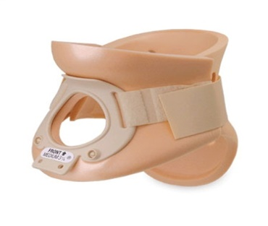
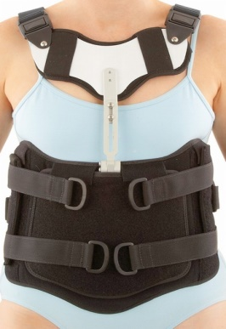
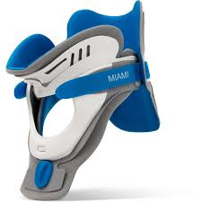
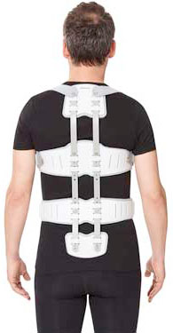
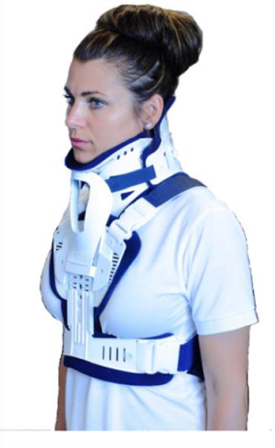
70 plus Coventry patient with isolated spinal fractures
Likely be admitted under medicine.
Once diagnosed will be seen by Spinal O/C team. Positive = immediate management plan, negative is likely FBR until MRI and also maybe discussion in spinal meeting. Likely conservative management regardless …….
MT rehab co-ord input. Push for timely holistic management planning/ Cons reviews if required.
Knowledge of bracing/ collar options and practical implications for the patient. MDT can fit most of these.

Slide 8
PT/ OT input re mobility and function in regards to discharge planning
IDT links with a local care service that is familiar and happy to work with patients in our area without support structures to deliver collar and brace care.
Unlikely to require Rehabilitation prescription for the injury but significant number require them as referred on for mobility / falls management.
Follow up in medical OPD clinics re brace/ collar removal.

Slide 9
70 plus Coventry patient with isolated traumatic brain injury.
Majority are small and often an incidental finding. No surgical requirements so again managed on medical wards.
48 hour neuro obs and cease any thromboprophyaxsis.
Re-scan at 7/7 if of decent size to ensure no expansion
Small number will transfer to Neuro if neurological deterioration and require burr holes.
MT rehab co-ord input. Push for timely holistic management planning/ Cons reviews if required.
Pragmatic and functionally based assessments by PT/OT. Small number may have MoCA scoring to inform discharge decision making along with functional tasking picture.

Slide 10
Montreal Cognitive assessment
The Montreal Cognitive Assessment (MoCA) was designed as a rapid screening instrument for mild cognitive dysfunction. It assesses different cognitive domains: attention and concentration, executive functions, memory, language, visuoconstructional skills, conceptual thinking, calculations, and orientation.

Slide 11
Small number of previously high level functioning cases may get a Consultant of Rehabilitation review regarding specialised inpatient care/ community level follow up.
No automatic access to Neuropsychology assessment.
Unlikely to require Rehabilitation prescription for the injury but a number require them as referred on for mobility / falls management.

Slide 12
In summary
Availability of MTS is an advantage (obviously !)
Some benefits around infuencing and fast tracking decisions but some issues with over management / loss of holistic view by using standards you may apply to younger population.
No more likely to get surgical intervention or primary management by specialty team.
Rehabilitation is functionally based and core Therapy skills based.
Do not access Rehab Cons or Neuropsychology as a standard

Slide 13
Future work
Look into the numbers discussed with UHCW and advice given including timeliness.
? Shared pathways, patient information and education.
Closer links with TUs/ DGHs re Silver trauma management as a whole

