Slide 1
Early and Structured Rehabilitation in Critical Care
David McWilliams
Clinical Specialist Physiotherapist - UHB

Slide 2
What do we know…
Experimental Studies show a 4-5% loss of muscle strength per week of bed rest in healthy and well-nourished subjects
For ICU patients muscle strength may decrease as much as 20% after one week of bed rest, with an additional 20% loss of remaining strength each subsequent week
A strong correlation between muscular weakness and prolonged mechanical ventilation has been observed
Persistent functional disability demonstrated over 5 years following discharge in ARDS patients
Notes:
Looking more specifically at the physiological impact of bed rest we know our patients lose muscles at an average of 2 percent per day. Now this may sound like a relatively small figure, but if we put that into perspective that could be as much as a third of there total muscle in just 2 weeks of an intensive care admission. Maximal fitness level also declines at a rate of almost 1 percent per day, leaving patients tired with reduced energy levels and reduced stamina. The lack of weight bearing also leads to a reduction of approximately 6mg of calcium per day, equating to 2 percent of total bone mass. Again, although this sounds like a relatively small figure, when you realize it can take 2 years to regain this degree of bone density it demonstrates the long term consequences of a period of critical illness. The heart, like all other muscles in the body becomes weaker, with stroke volume reducing by 28 percent after just 10 days of bed rest. It is also important to note that much of the physiological data is taken from healthy individuals, usually those in the armed forces who are strapped to a bed for a time period to observe the effects. When you add in the impact of critical illness, malnutrition and the use of paralytic agents to name but a few the negative effects may be even worse, for example where muscle decline has been demonstrated as high as 5 percent per day!

Slide 3
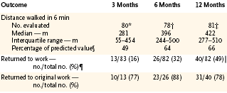
One-year outcomes in survivors
of ARDS
Med Age 45yrs Med ICU LOS 25 days Med Hosp LOS 47 days
Herridge et al NEJM 2003;348:683

Slide 4
Ventilated ≥ 5 days
24 month period
CPET performed within first month following hospital discharge
no adverse events seen
 | n=50
Age | 57 (31-82)
Days ventilated | 18 (5-60)
Days Critical Care | 31 (8-120)
Days in Hospital | 38 (15-168)
Anaerobic threshold | 41% predicted
Peak VO2 | 56% predicted
Values are median unless otherwise stated
Notes:
What are patients like functionally following ICU hospital discharge?

Slide 5
Classification of heart failure using CPET
Functional Class of Heart Failure | VO₂ – peak ml/min/kg | Anaerobic Threshold ml/min/kg
A (no impairment) | >20 | >14
B (mild – moderate impairment) | 16 – 19.9 | 11 – 13.9
C (moderate-severe impairment) | 10 – 15.9 | 9 – 10.9
D (severe impairment) | <10 | <9
Weber KT and Janicki JS. Am J Cardiol 1985;55:22A-31A

Slide 6
The negative effects of intensive care may take months to recover and are more likely with prolonged ICU stays and longer hours of ventilation
……EVERY DAY COUNTS!!

Slide 7
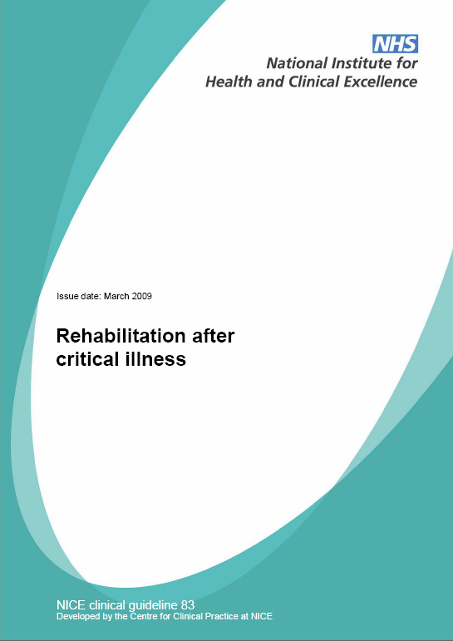
NICE CG83
Advocated early and structured rehabilitation programmes for patients admitted to critical care
Importance of Key workers
MDT working / Communication
Closer links to ward and community

Slide 8
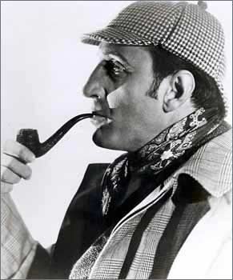
The evidence

Slide 9
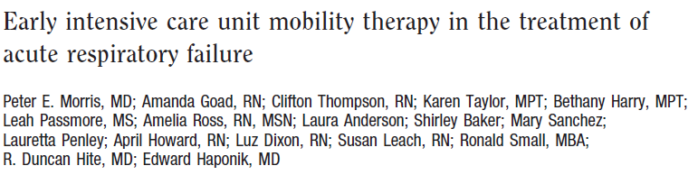
Morris et al (2008)
University Medical ICU in USA
Does mobility protocol increase proportion of patients receiving physical therapy
330 subjects recruited and randomised
An ICU Mobility team initiated protocol within 48 hours of mechanical ventilation
Notes:
The next Major study was completed by Pete Morris in 2008 in the United States. Now Morris wanted to see whether the initiation of a mobility protocol increased the proportion of patients receiving physical therapy. This is important as current standard care in the United States is not to receive routine physiotherapy within intensive care, with physio being delivered on physicians orders.
330 subjects were recruited and randomised so much larger numbers this time.
And for those in the treatment group An ICU Mobility team initiated the mobility protocol within 48 hours of mechanical ventilation

Slide 10
Morris et al - Early Therapeutic Mobility Protocol.
LEVEL 1
LEVEL 2
LEVEL 3
LEVEL 4
Unconscious | Conscious | Conscious | Conscious
Turn every 2hr | Turn every 2hr | Turn every 2hr | Turn every 2hr
Passive ROM exercises | Sitting position min 20 minutes 3x daily | Sitting position min 20 minutes 3x day. | Sitting position min 20 minutes 3x day. Sitting on edge of bed with Physical therapist
 | Active resistance range of motion (ROM) with physical therapy or RN daily | Sitting on edge of bed with Physical therapist | Active Transfer to Chair (OOB) with Physical Therapist Minimum 20 minutes
Can move arms against gravity
Can move legs against gravity
Notes:
This was the protocol they used. Whilst patients were unconscious they were turned every 2 hours and received passive range of movement exercises.
When they awoke, the were placed in the chair position in bed for 20 minutes, 3 times daily and performed active exercises.
When they could lift there arms, they started to sit on the edge of the bed with the physical therapist, then when they could lift there legs against gravity they started to actively transfer out to a chair.
Now in my opinion this protocol is a little slow, and certainly in my hospital we would start sitting patients on the edge of bed at the point of waking, but this was the first time anybody had written a protocol such as this so this should still be commended.

Slide 11
Results
Outcome | Protocol | Control | P Value
Proportion of patients receiving physical therapy | 80% | 47% | p<0.001
Therapy initiated on ICU | 91% | 13% | p<0.001
Ventilator days | 8.8 | 10.2 | p=0.163
ICU LOS (days) | 5.5 | 6.9 | p=0.025
Hospital LOS (days) | 11.2 | 14.5 | p=0.006
Notes:
But, with the introduction of physical therapy and a mobility protocol this did lead to patients being sat out of bed significantly earlier, on day 5 as opposed to day 11. This earlier mobilisation was associated with a reduced ICU length of stay and ultimately a reduced hospital length of stay.

Slide 12
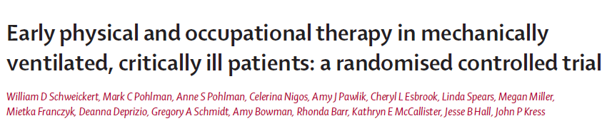
Schweickert et al (2009)
“Early physical and occupational therapy in
Mechanically ventilated, critically ill patients: a
randomised controlled trial”
>18 years
Ventilated <72hrs but expected to cont >24hrs
Randomly assigned to:
  Intervention (PT & OT with daily sedation holds) n=49
  Control (Physician ordered sedation holds and therapy sessions) n=55
Notes:
The next study was carried out by Schweikert et al in 2009, looking at the effect of Early physical and occupational therapy in
Mechanically ventilated, critically ill patients
Patients were randomly assigned to a treatment group receiving daily physiotherapy and occupational therapy woth sedation holds or a control group, who received sedation holds and physician ordered therapy sessions

Slide 13
Schweickert et al (2009)
Primary endpoints
  No. of patients returning to Indep function at hosp d/c
  (Defined as ability to perform 6 ADL’s incl. dressing and grooming as well as ability to walk Indep)
Secondary
  Duration of delirium
  Ventilator free days in 1st 28 days of admission
Notes:
Primary endpoints for the study were a return to independent function at hospital discharge, with secondary outcomes of duration of delirium and ventilator free days

Slide 14
Results
 | Intervention (n=49) | Control (n=55) | p value
Time from intubation to first OT / PT session | 1.5 days (1.0 – 2.1) | 7.4 days (6.0 – 10.9) | <0.0001
Return to independent functional status at hospital discharge | 29 (59%) | 19 (35%) | 0.02
Barthel Index score at hospital discharge | 75 (75-95) | 55 (0-85) | 0.05
Duration of delirium | 2.0 days | 4.0 days | 0.02
Ventilator free days | 23.5 (7.4–25.6) | 21.1 (0.0-23.8) | 0.05
Length of stay in ICU (days) | 5.9 (4.5-13.2) | 7.9 (6.1-12.9) | 0.08
Hospital mortality | 9 (18%) | 14 (25%) | 0.53
Data are n (%), median (IQR), or mean (SD).
Notes:
So to the results,
Subjets receiving physiotherapy and occupational therapy were significantly more independent at hospital discharge, 60 percent vs 35 percent.
There was also a significantly reduced duration of delirium (4 days as opposed to 2 days) and more ventilator free days, in other words the additional rehabilitation was associated with faster weaning as well as a trend to shorter stays in ICU, although this didn’t reach a level of significance.
What is important to note however is even with the additional therapy only 60 percent of patients were independent at hospital discharge, again highlighting the long term problems faced by this patient group.

Slide 15
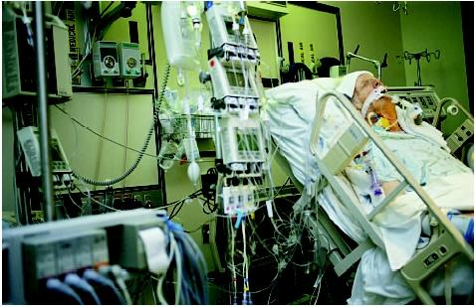
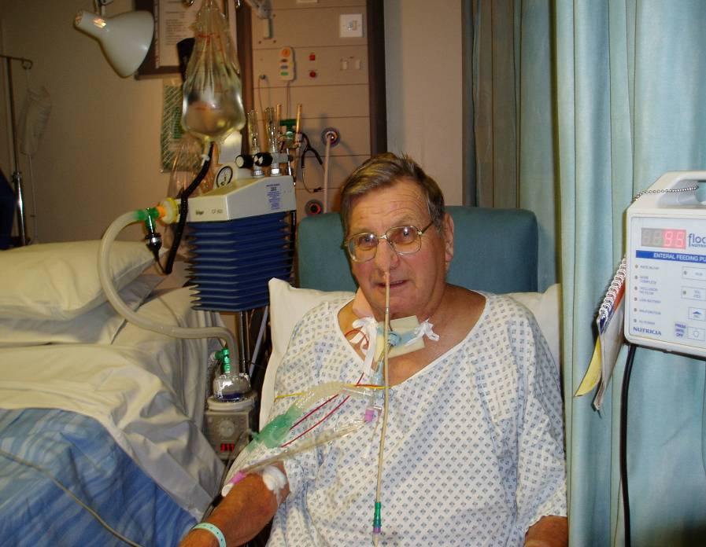
But…..
What does early really mean and how can we measure it?????

Slide 16

Time To Mobilise

Slide 17
Time To Mobilise
Morris et al 2008
- 1st day out of bed
Day 5 vs day 11 (p<0.001)
Doesn’t then however show ongoing rehab level achieved

Slide 18
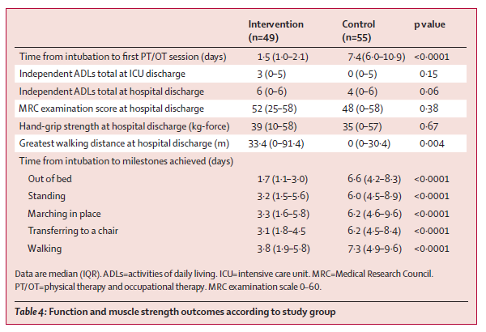
Schweickert et al (2009)

Slide 19

Current position in the UK
Despite the increasing evidence base for early rehabilitation strategies uptake and delivery of such interventions in the UK has been variable.
  Lack of UK Based RCT’s
  Difficult control groups given already daily physio
  Issues with funding

Slide 20
Morris et al - Early Therapeutic Mobility Protocol.
LEVEL 1
LEVEL 2
LEVEL 3
LEVEL 4
Unconscious | Conscious | Conscious | Conscious
Turn every 2hr | Turn every 2hr | Turn every 2hr | Turn every 2hr
Passive ROM exercises | Sitting position min 20 minutes 3x daily | Sitting position min 20 minutes 3x day. | Sitting position min 20 minutes 3x day. Sitting on edge of bed with Physical therapist
 | Active resistance range of motion (ROM) with physical therapy or RN daily | Sitting on edge of bed with Physical therapist | Active Transfer to Chair (OOB) with Physical Therapist Minimum 20 minutes
Can move arms against gravity
Can move legs against gravity
Notes:
This was the protocol they used. Whilst patients were unconscious they were turned every 2 hours and received passive range of movement exercises.
When they awoke, the were placed in the chair position in bed for 20 minutes, 3 times daily and performed active exercises.
When they could lift there arms, they started to sit on the edge of the bed with the physical therapist, then when they could lift there legs against gravity they started to actively transfer out to a chair.
Now in my opinion this protocol is a little slow, and certainly in my hospital we would start sitting patients on the edge of bed at the point of waking, but this was the first time anybody had written a protocol such as this so this should still be commended.

Slide 21
Service Improvement Projects
Needham et al. Early Physical Medicine and Rehabilitation for Patients With Acute Respiratory failure: A Quality Improvement Programme. Arch Phys Med Rehabil Vol 91, April 2010
Engel et al. ICU Early Mobilization: From recommendations to implementation at three medical centres. Critical Care Medicine 2013

Slide 22
Needham et al, 2010
57 patients ventilated ≥ 4 days at a MICU in USA
Objectives. MDT focussed on
reducing deep sedation and delirium to permit mobilization, (2)
increasing the frequency of rehabilitation consultations and treatments to improve patients’ functional Mobility
evaluate effects on length of stay.

Slide 23
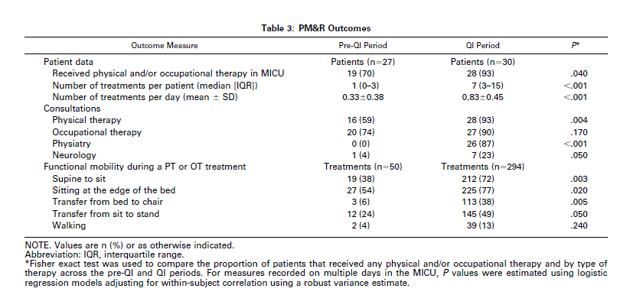

Slide 24
Results
There were a greater median number of rehabilitation treatments per patient (1 vs 7, P<0.001)
with a higher level of functional mobility (treatments involving sitting or greater mobility, 56% vs 78%, P.03).
Hospital administrative data demonstrated that across all MICU patients,
  there was a decrease in intensive care unit and hospital length of stay by 2.1 and 3.1 days, respectively
  20% increase in MICU admissions compared with the same period in the prior year

Slide 25
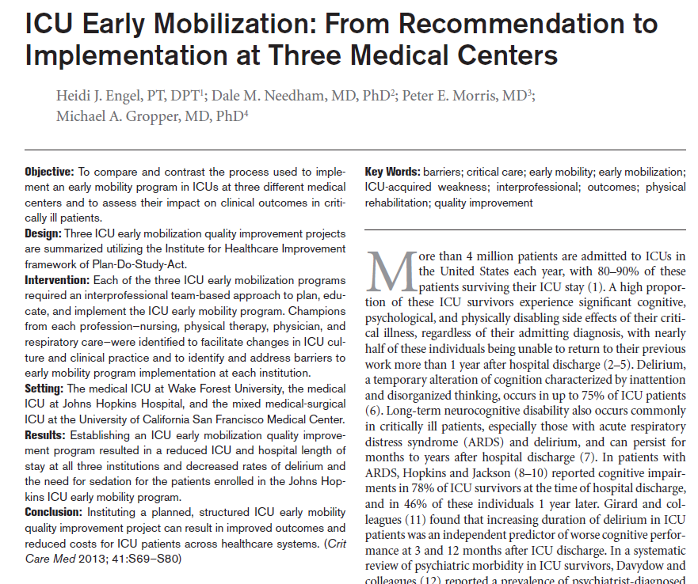

Slide 26
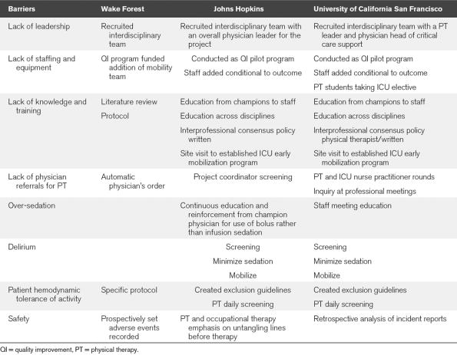
Barriers to Early Mobility and Solution Strategies
4

Slide 27
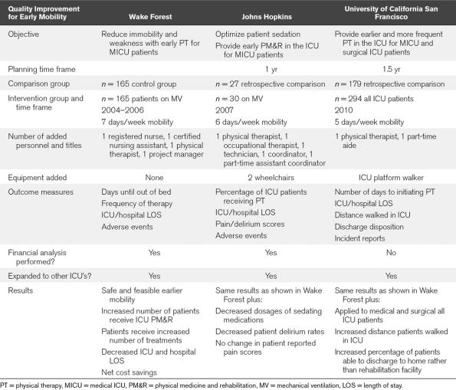
Overview
5

Slide 28
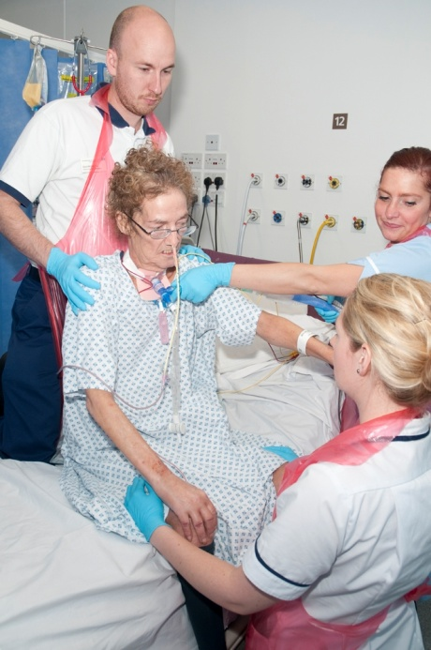
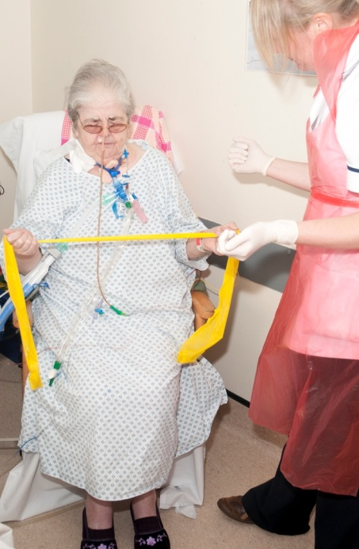
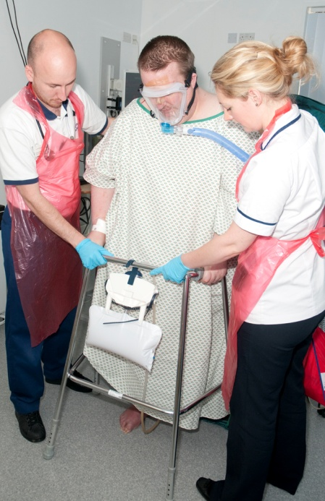
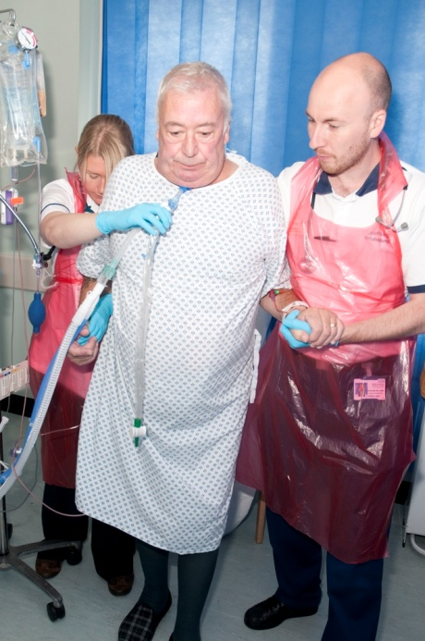
So what do we know about what’s happening currently

Slide 29
Nydahl et al (2014)
1 Day point prevalence survey for early rehabilitation in mechanically ventilated patients
116 ICU’s in Germany
Collected data for treatment of 783 patients

Slide 30
Key messages
185 (24%) were mobilised out of bed
4% stood, marched or walked
55% passively turned only

Slide 31
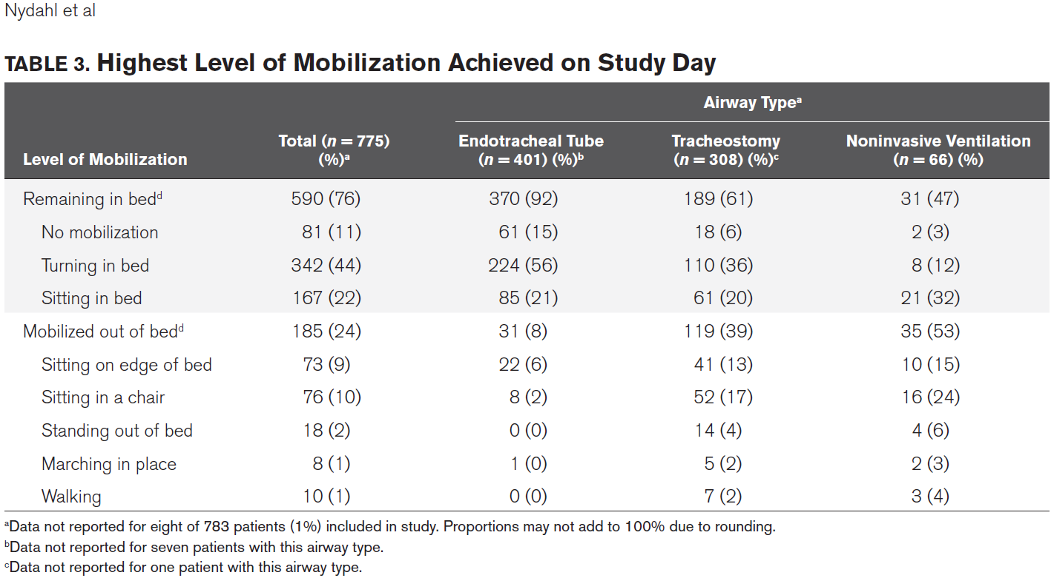

Slide 32
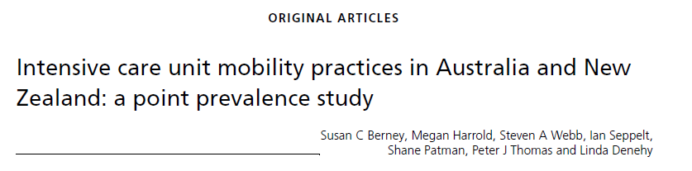
514 patients from 38 Australian and New Zealand ICUs at 10 am on one of three designated days in 2009 and 2010
  Mean age was 59.2 years
  45% were mechanically ventilated
  391 (76%) were on ICU > 48 hours
  76 (15%) > 7 days

Slide 33
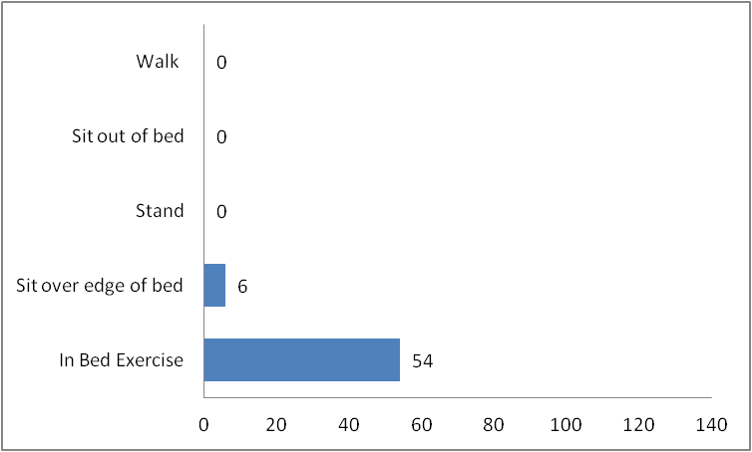
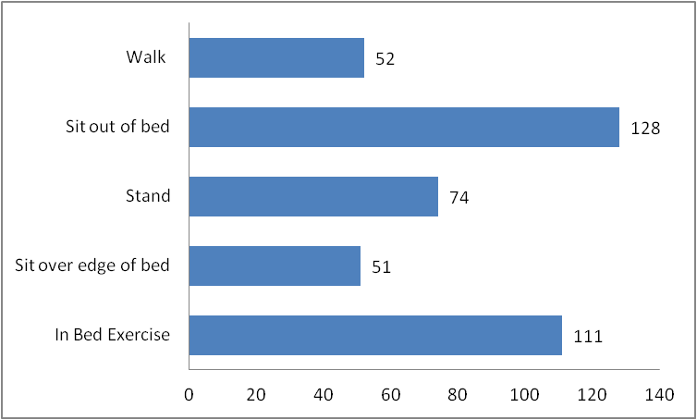
Frequency of mobilisation activities for patients in ICU > 48 hours (n=391)

Slide 34
Thomas et al (2009)
Incidence of rehabilitation in general ICU population
82 Patients (mean age 59) admitted consecutively to an 8-bed district general ICU over a 3-month period were included.
 | ET (N = 185) | Trache (N = 308) | Self Ventilating (N = 194) | NIV (N = 35) | CPAP (N = 53) | Controlled Ventilation (N = 131) | Inotropes (N = 101)
Passive transfers | 2 | 34 | 17 | 20 | 4 | 3 | 7
Active assisted exercise | 9 | 35 | 26 | 29 | 19 | 7 | 9
Free active exercise | 6 | 26 | 63 | 40 | 15 | 3 | 9
Sitting on the bed edge | 2 | 12 | 48 | 34 | 2 | <1 | 1
Sitting to standing | 0.5 | 12 | 49 | 31 | 2 | 0 | 1
Standing transfer | 0.5 | 8 | 35 | 26 | 2 | 0 | 1
Walking | 0 | 2 | 16 | 3 | 0 | 0 | 0

Slide 35
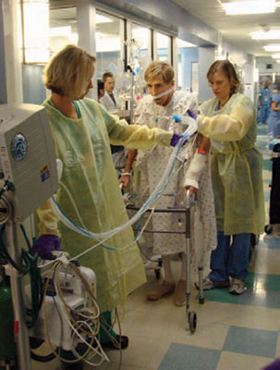
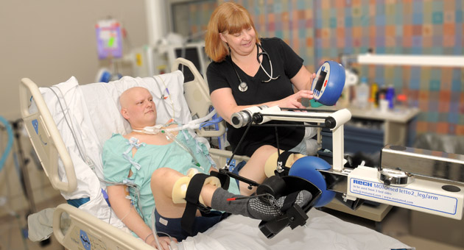
Perception…..

Slide 36

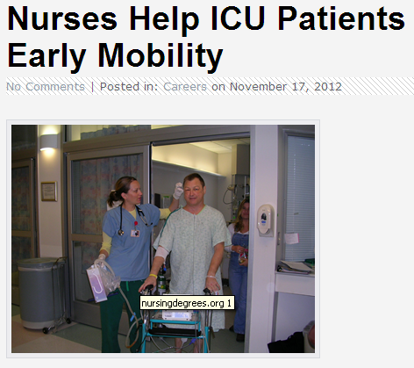
Reality

Slide 37
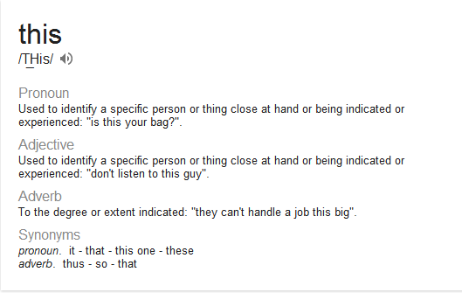

Slide 38
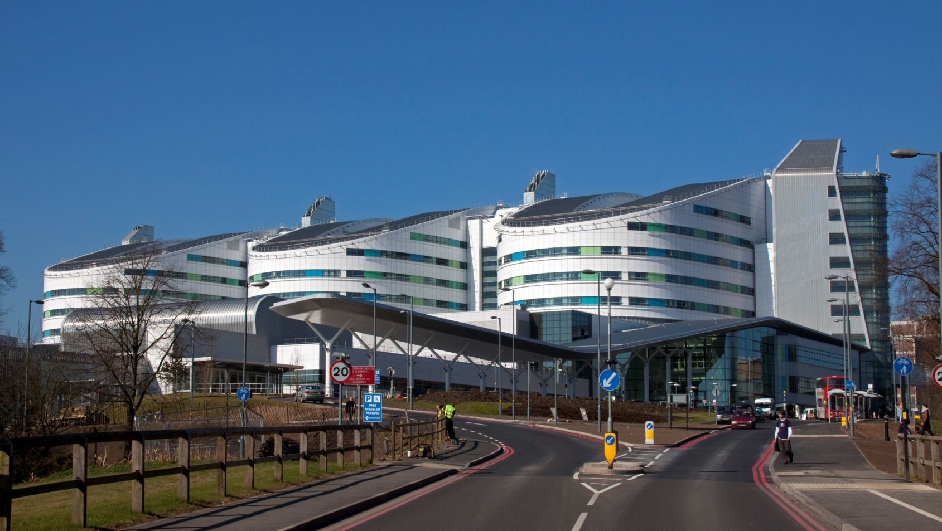
Birmingham
  Feb 2012 Rehabilitation service still in infancy
  Lack of coordination across 4 areas
  Staffing within critical care was reduced following a service
  evaluation = ratio of 1 physiotherapist to 10 patients.

Slide 39
Aim
This trial aims to assess the impact of an increased level of physiotherapy with a focus on early and structured rehabilitation programmes

Slide 40
Barriers
Lack of leadership / responsibility
Insufficient staffing levels
Lack of knowledge and training
Lack of communication between MDT with regards to rehabilitation
Lack of standardisation of assessment and documentation
Concerns regarding patient safety and appropriate equipment

Slide 41
Method
Lack of leadership / responsibility
New clinical specialist physiotherapist appointed with a focus on rehabilitation
A key worker system was introduced for patients ventilated > 5 days
Insufficient staffing levels
Additional funding for 2 band 6 rehabilitation physiotherapists supported by QEHB charities
Led to the creation of a new supportive rehabilitation team for critical care on 1st April 2012.

Slide 42
Lack of knowledge and training
Regular training sessions provided to physiotherapists and MDT on importance of early rehabilitation
Staff induction
Lack of communication between MDT with regards to
rehabilitation
Weekly goal setting at specific therapy rehabilitation meetings.
Documented rehab plans using magic whiteboards at bed space
MDT meeting was also introduced for patients ventilated > 14 days to allow more collaborative plans for weaning and rehabilitation.

Slide 43
Lack of consistency of assessment and documentation
New comprehensive assessment performed
Standardised documentation and milestones created
Concerns regarding patient safety and appropriate
equipment
Early mobility guideline developed
Education regarding safety of mobilisation and safe levels for activity
Supportive equipment for rehabilitation
  New Stretcher chairs and a Portable ventilator
  Increased use of avialable equipment Tilt tables, over bed bikes, adjustable chairs, mobile hoists

Slide 44
Method
Baseline data was collected retrospectively for the period from 1st April 2011 – 31st March 2012
Data the collected prospectively for the period from 1st April 2012 – 31st March 2013.

Slide 45
Outcomes
Primary outcome
- Mean physical function at ICU discharge - assessed via the Manchester Mobility Score (MMS)
Secondary
  Mean ICU LOS
  Number of days ventilated
  Post ICU LOS
  Mortality

Slide 46
Manchester Mobility Score
Developed due to a lack of robust / useful outcome measures in ICU
Looks at stages of rehabilitation
Quick and simple bedside measurement
1 – Passive Movements, Active exercise, chair position in bed
2 – Sit on edge of bed
3 – Hoisted to chair (incl. standing Hoist)
4 – Standing practice
5 – Step Transfers with assistance
6 – Mobilising with or without assistance
7 – Mobilising > 30m
A – Agitated
U - Unwell

Slide 47
Baseline Info
 | Pre QI | QI phase
Total number of patients | 290 | 292
Age, median (IQR) years | 58 (45-69) | 55 (44-67) | p= 0.24
Female | 117 (40) | 111 (38) | p=0.69
Apache II score, median (IQR) | 16 (13-20) | 18 (13-23) | p< 0.05
Charlson Comorbidity Index, median (IQR) | 2 (1-4) | 2 (1-4) | p=0.45
Admission Diagnosis: General Surgery Cardiac Neuro Respiratory Liver Trauma Other | 77 (26) 24 (8) 19 (7) 67 (23) 49 (17) 20 (7) 34 (12) | 67 (23) 18 (6) 17 (6) 72 (25) 42 (14) 22 (7) 54 (19)
NOTE. Values are n (%) or as otherwise indicated.

Slide 48
Physiotherapy activity levels and physical outcomes
 | Pre Quality improvement n=290 | Quality improvement n=292 | p value
Received Physiotherapy within ICU | 290 (100%) | 292 (100%)
Number of treatments per day Mean (+/- SD) | 0.95 (+/- 0.49) | 1.3 (+/-0.64) | p=0.054
Time to 1st Mobilisation (days)* | 9.3 (7.8–11.1) | 6.2 (5.2–7.5) | p<0.001
Manchester Mobility Score on ICU discharge, median (IQR) | 3 (2-5) | 5 (3-6) | P<0.05
* geometric means and 95% confidence intervals

Slide 49
Results
 | Pre Quality improvement | Quality improvement | P value
ICU LOS (days)* | 16.9 (15.4-18.5) | 14.4 (13.5-15.4) | p=0.007
Post ICU LOS (days)* | 14.5 (12.4-17.1) | 12.6 (11.0-14.5) | p=0.197
Total hospital LOS (days)* | 35.3 (31.9-39.0) | 30.1 (27.7-32.8) | p=0.016
Advanced respiratory support days* | 11.7 (10.7-12.9) | 9.3 (8.5-10.2) | p<0.05
Sedation days* | 5.9 (5.3-6.5) | 5.2 (4.8-5.8) | p=0.12
Readmission during same hospital episode | 21 (10%) | 19 (8%) | p=0.45
ICU mortality | 88 (30%) | 67 (23%) | p=0.091
In-Hospital mortality | 114 (39%) | 83 (28%) | p=0.028
* geometric means and 95% confidence intervals

Slide 50
In financial terms
Patients leaving critical care sooner
A more mobile patient leaving critical care also spends less time in hospital
= reduced cost per patient
Based on a day in critical care costing £1312 a day, a 2.5 day saving per patient represents considerable savings to the trust £951,200
In real terms this also frees up capacity and leads to increased throughput in both ITU and on the wards
Better long term recovery = reduced need for community / social services

Slide 51
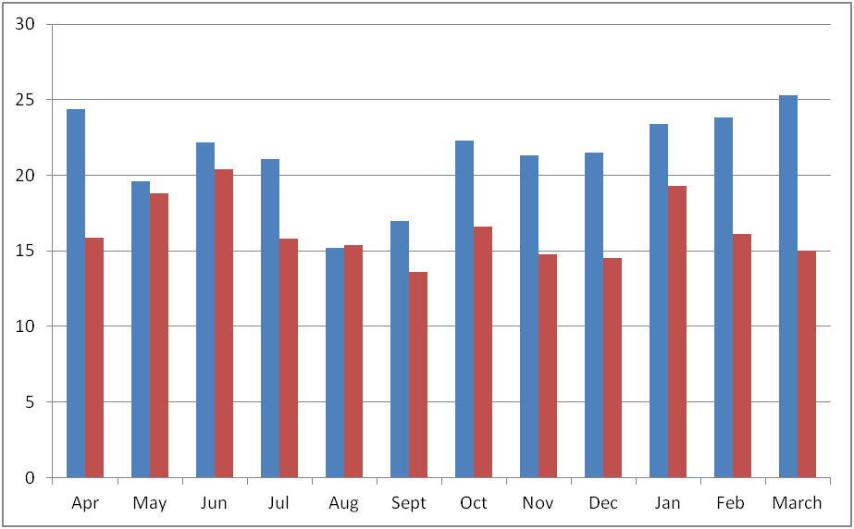
ICU Length of stay per month
 | Total days saved | Daily Equivalent
Critical Care | 1363 | 3.7 beds
Wards | 928 | 2.5 beds

Slide 52
Ward Impact…………
Length of stay figures according to MMS at critical care discharge
 | Post critical care LOS
3. Hoist Transfer | 35.7 days
4. Standing practice | 22.9 days
5. Step transfers | 16.2 days

Slide 53
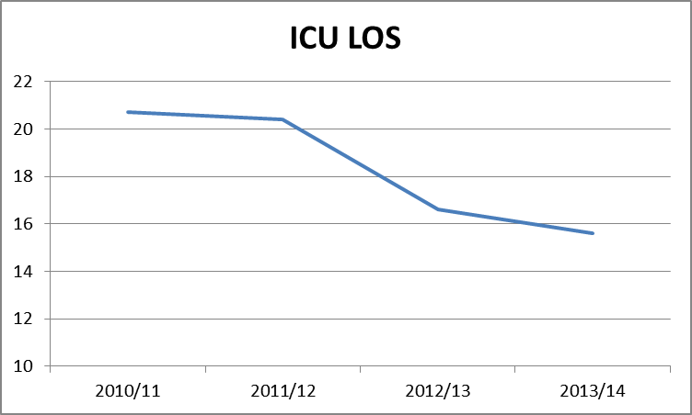

Slide 54
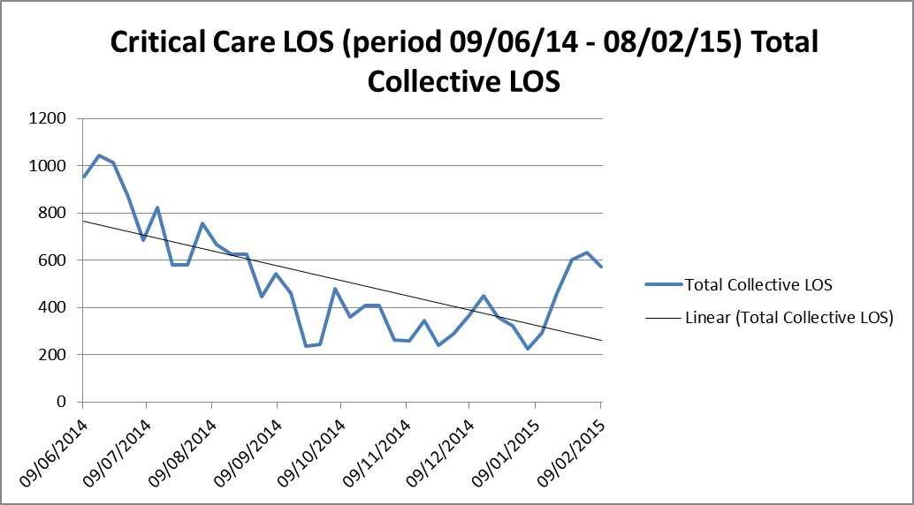
Long term patient ward round impact - UHB

Slide 55
Conclusion
Increased focus on early rehabilitation has led to an increased level of function at critical care discharge
This was associated with reductions in length of stay figures and mortality
Close MDT working and communication is crucial to success
Literature is positive but needs to be seen in perspective
Within organisations key is to benchmark current service and objectively evaluate change

Slide 56

Thank you
David.mcwilliams@uhb.nhs.uk

