Slide 1

NYS On-Site Consultation Program
OSHA Region 2
AMPUTATION STAND DOWN
The Consultation Program in New York came into existence in July 1975
More than 50,000 on-site consultation visits have been performed

Slide 2
On-Site Consultation Program
- a Safety and Health Resource

Slide 3
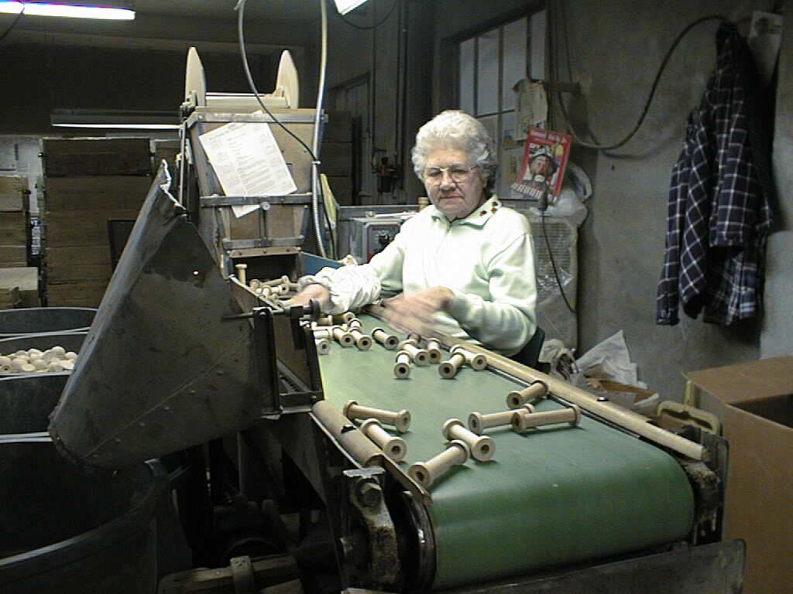
Mission of the Consultation Program
The mission of the Consultation Program is to reduce the incidence of injury or illness to workers by enhancing the employer’s ability to identify and control safety and health hazards

Slide 4
Consultation Program
At the employer’s request, we will provide safety and health technical assistance to private sector employers.
  In NYS, OSHA has jurisdiction for enforcement of occupational safety and health regulations.

Slide 5
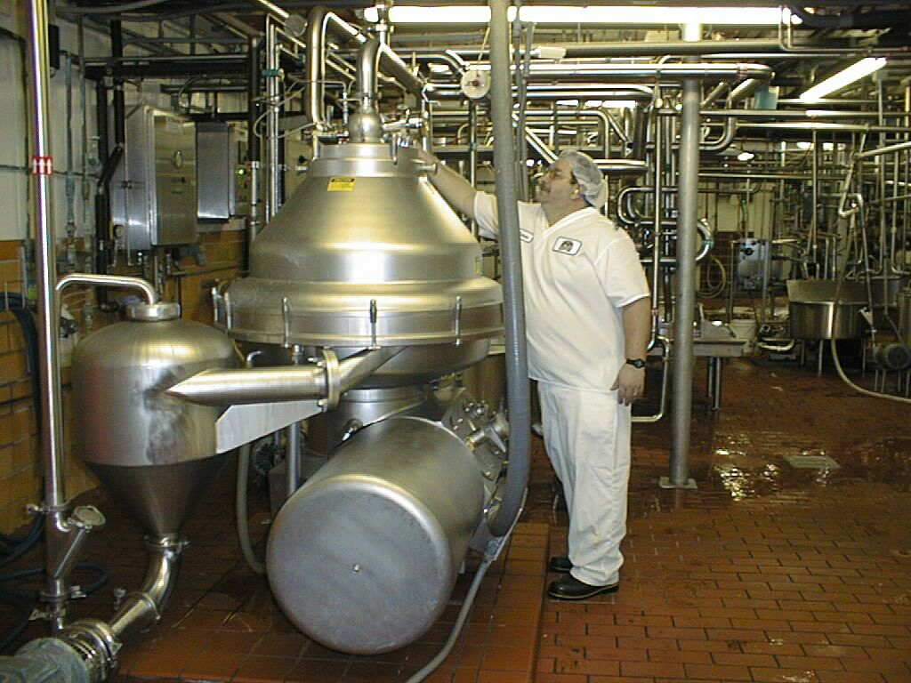
Consultation Program
Funding for the Program is provided by both OSHA (90%) and the NYS Department of Labor (10%)

Slide 6
Consultation Services
All services are free.
Confidential and completely separate from OSHA.
Employer participation is voluntary.
Employer decides on the scope of the visit.
No citations or penalties.

Slide 7
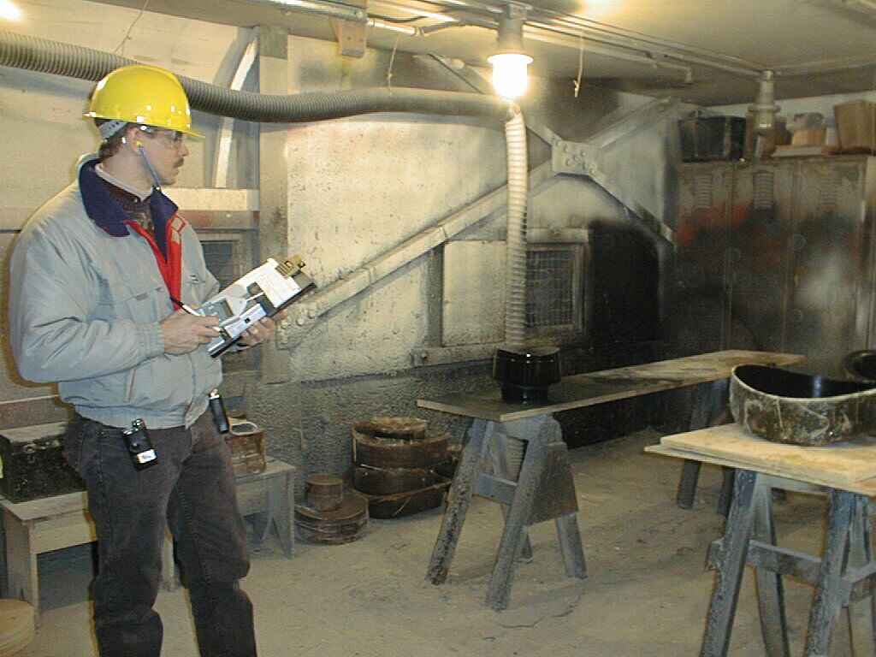
Employer Responsibilities
The employer must agree to correct any serious hazards identified within an agreed timeframe
Request an extension if can not meet the agreed upon date.
Following the written report, employer must post the “List of Serious Hazards” in a prominent location
Allow for union participation, if applicable

Slide 8
Our Staff:
On-Site Safety & Health Consultants
Safety Consultants and Industrial Hygienists are professionals with many years of experience in general industry (1910) and construction (1926).
Well-trained in identification and control of hazards and have attended advanced training at the OSHA Training Institute.
Safety Consultants identify physical safety hazards, Industrial Hygienists can sample for air contaminants & noise levels and provide written exposure determinations, as well as identify other health hazards.
Both safety and health consultants provide resources and suggestions for mitigating, controlling or eliminating safety and health hazards.
Notes:
21d Consultants follow the Consultation Policies and Procedures Manual (CPPM) developed and overseen by Federal OSHA.
IH airborne contaminant sampling examples such as: 1) Silica from granite or sand; 2) Organic Solvents from spraying operations; 3) Respirable Dust and/or Combustible Dust from woodworking; Chromium 6 hazards during welding on stainless steel.

Slide 9
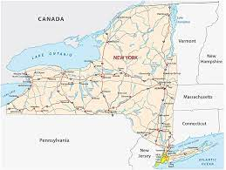
Our Locations
Albany (518) 457-2810
Binghamton (607) 721-8019
Buffalo (716) 847-7166
Garden City (516) 228-3959
New York City (212) 775-3526
Rochester (716) 847-7166
Syracuse (315) 479-3205
Utica (315) 793-2319
White Plains (914) 997-9511
Notes:
First come, first serve,
Sometimes a safety consultant will recommend a Health consultation visit, and /or consultation training, or the other way around.

Slide 10
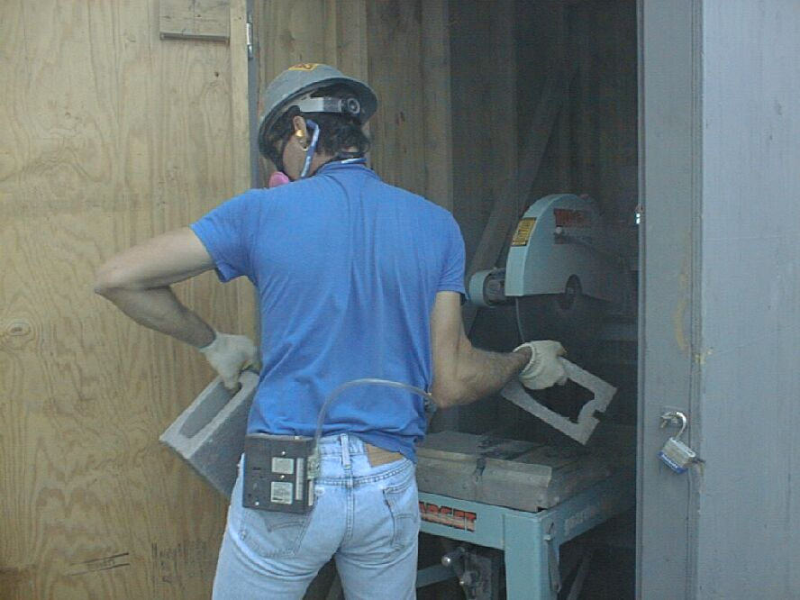
Scheduling
First-come, first serve
Again, our priority is to service small employers in high hazard activities.
Priority for training is given to existing clients and multiple employer training events.

Slide 11
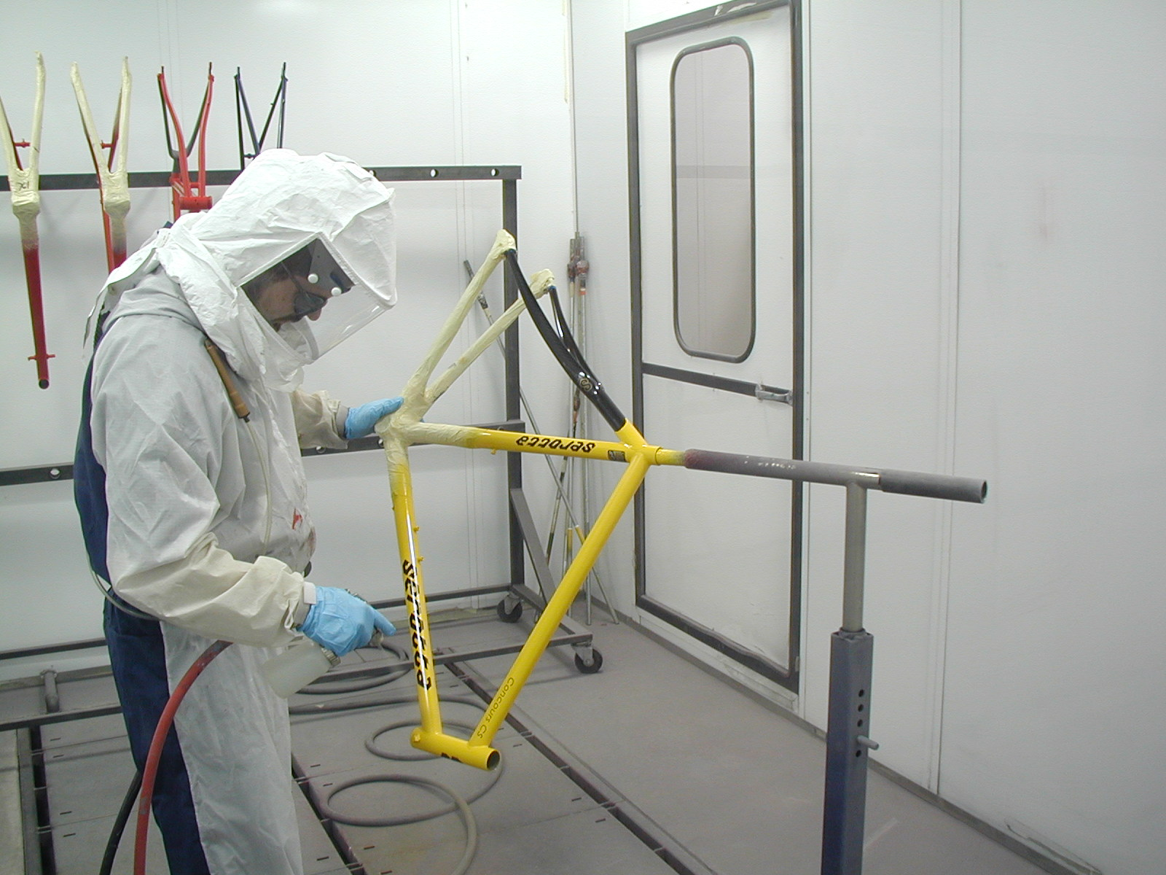
Scope Of Services
Full Service
Limited Service
Training
Compliance Assistance Activities
“SHARP” Employer (Inspection Deferral Program)

Slide 12
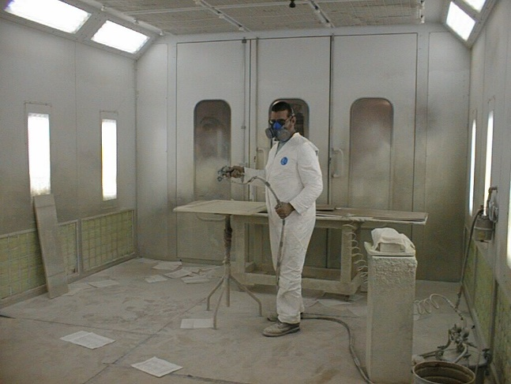
Full Service Survey
Comprehensive (wall to wall) to:
Identify hazards,
Evaluate and/or provide written safety & health programs,
Provide recommendations for correction,
Recommend and/or conduct on-site informal training,
May recommend scheduling consultation formal training.
Notes:
Serious and Other than serious hazards

Slide 13
Limited Visit Survey
Focuses the consultation services on a specific process, machine/equipment, department/area, jobsite, etc.
Assist employers with hazard correction, and provide S&H resources
A limited visit can also consist of a referral from OSHA:
    Informal Complaint
    Abatement Assistance
Notes:
Limited is performed at the employers request

Slide 14
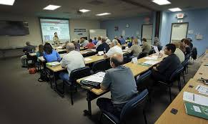
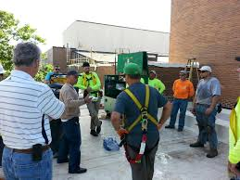
FREE Training Services Offered

Slide 15
Some of Our Free Training Topics include:
Forklift | Recordkeeping | Hand & Power Tool Safety | Accident Investigation | Excavation & Trenching Safety
Silica Prevention | Emergency Evacuation & Fire Prevention | Lockout/Tagout | Ergonomics | Slips, Trips & Falls
Hearing & Noise Management | Chemical Hazard Communication & GHS | Scaffolding | Job Hazard Analysis (JHA) | Personal Protective Equipment
Respiratory Protection | Lead in Construction | Ergonomics for Manufacturing & Construction | Bloodborne Pathogens | Fall Protection
Electrical Safety Awareness | Permit-required Confined Space | Machine Guarding | Nursing Home Ergonomics | Preventing Workplace Violence
Training tailored to fit the needs of the employer

Slide 16

Compliance Assistance
Presentation for an employer group, association, etc.
Provide assistance to employers and/or employees over the phone/email and that is not connected to a on-site visit

Slide 17

Safety and Health Achievement Recognition Program
Requirements:
Comprehensive safety and health visits,
Correct all identified hazards,
Institute an effective Safety & Health Program,
Have and maintain injury/illness rates below national averages.
Pre-SHARP program also available.
SHARP – allows for a deferral (up to 2 years) from OSHA programmed inspection schedule.
Notes:
Again, 250 ee’s or less (500 corporate wide.
(for initial approval); and to up to 2 years exemption subsequent renewals)
No pending or open contested citations, no willful citations (during 12 months prior), fatality, not on Severe enforcement violators program(SVEP),
Had consultation visits, Form (2’s and higher) on Form 33 on all 50 basic attributes and 8 stretch items , injury/illness rates (DART, TRC) are below BLS rates ,
Various steps to qualify to become eligible for SHARP (small business, 1 year of operating history, full-service safety and health visits, submit OSHA 300 & 300A records for current year and 3 preceding calendar years, 2 or better on Form 33, and ER must submit a request to participate.
No incentive programs that discourage employees to report injuries/illnesses.
Anti-Retaliation Program (ARP)– ER has a system for listening to (receiving and responding) to employee’s S&H concerns, train employees & plan for program oversite.

Slide 18
Compliance vs. SHARP
Comprehensive
Above and beyond compliance
Best Practices
Safety and Health Management System aimed at hazard prevention & continuous improvement
Requirements:
The minimum required by law
Meet OSHA Standards
“Find and Fix” hazards

Slide 19


Slide 20
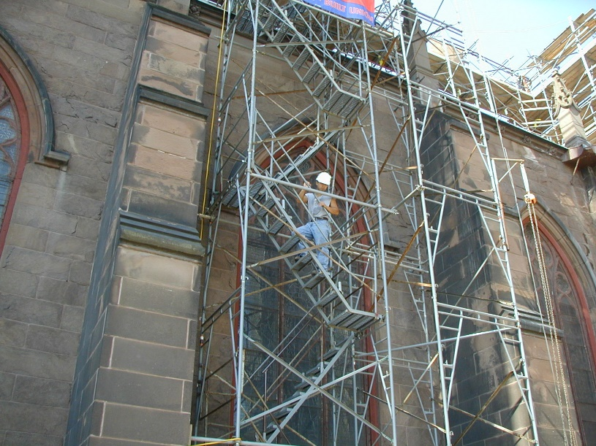
On-Site Survey Process
Opening Conference,
Review of Injury & Illness Recordkeeping,
Review of Written S&H programs,
Walk around inspection,
Interview employees.
Closing Conference,
Written Report,
Feedback on Employer’s Safety & Health Management System,
Follow-up (if necessary).

Slide 21
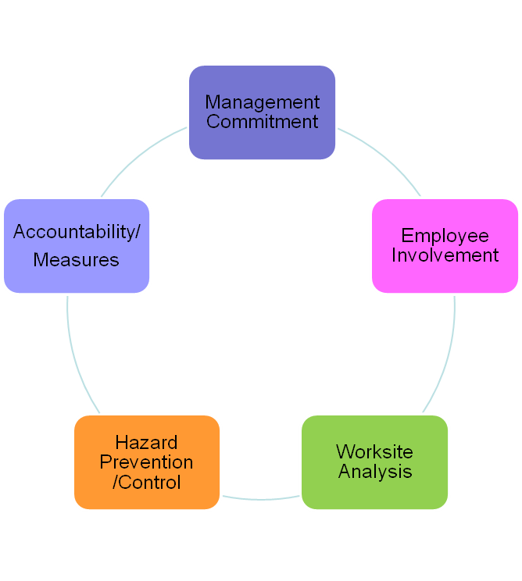
Safety and Health Management System
System is a set of components that work together to achieve a certain objective, i.e., prevent accidents in the workplace
All the components are interconnected and affect each other.
A failure in one is a failure in all.
Notes:
Discuss SHMS vs. written programs

Slide 22

All Components are Inter-related
            “58 marbles in a bowl”
Hard to move one without affecting the others
Notes:
Although there are distinct components and attributes on the form, they are quite interdependent.

Slide 23
Safety and Health Program Assessment Worksheet
Notes:
This is a safety and health assessment tool.
The consultant uses professional judgement to evaluate the employer’s overall safety and health management system,
There 58 total (50 are basic attributes & 8 are considered “stretch items” (or recommended)
There is a legend:
0 = no;
1 = No needs major improvement;
2 = yes, needs minor improvement;
3 = yes;
3 is the best you can get.

Slide 24
North American Industry Classification System (NAICS) Lookup Tool
Notes:
BLS Rates
The North American Industry Classification System (NAICS) is the standard used by Federal statistical agencies in classifying business establishments for the purpose of collecting, analyzing, and publishing statistical data related to the U.S. business economy.
NAICS was developed under the auspices of the Office of Management and Budget (OMB), and adopted in 1997 to replace the Standard Industrial Classification (SIC) system.

Slide 25

OSHA 1904 Recordkeeping Documents Review
 |  |  |  |  |  | Attention: This form contains information relating to employee health and must be used in a manner that protects the confidentiality of employees to the extent possible while the information is being used for occupational safety and health purposes.
OSHA's Form 300 (Rev. 01/2004) |  |  |  |  |  |  |  |  |  |  |  | Year
Log of Work-Related Injuries and Illnesses |  |  |  |  |  |  |  |  |  |  | U.S. Department of Labor
 |  |  |  |  |  |  |  |  |  |  | Occupational Safety and Health Administration
You must record information about every work-related injury or illness that involves loss of consciousness, restricted work activity or job transfer, days away from work, or medical treatment beyond first aid. You must also record significant work-related injuries and illnesses that are diagnosed by a physician or licensed health care professional. You must also record work-related injuries and illnesses that meet any of the specific recording criteria listed in 29 CFR 1904.8 through 1904.12. Feel free to use two lines for a single case if you need to. You must complete an injury and illness incident report (OSHA Form 301) or equivalent form for each injury or illness recorded on this form. If you're not sure whether a case is recordable, call your local OSHA office for help. |  |  |  |  |  |  |  |  |  |  |  | Form approved OMB no. 1218-0176
 |  |  |  |  |  |  |  | Establishment name
 |  |  |  |  |  |  |  | City |  |  |  | State
Identify the person |  | Describe the case |  |  |  | Classify the case
 |  |  |  |  |  | CHECK ONLY ONE box for each case based on the most serious outcome for that case: |  |  |  | Enter the number of days the injured or ill worker was: |  | Check the "injury" column or choose one type of illness:
(A) | (B) | (C) | (D) | (E) | (F)
Case No. | Employee's Name | Job Title (e.g., Welder) | Date of injury or onset of illness | Where the event occurred (e.g. Loading dock north end) | Describe injury or illness, parts of body affected, and object/substance that directly injured or made person ill (e.g. Second degree burns on right forearm from acetylene torch)
 |  |  |  |  |  |  |  |  |  |  |  | (M) | Skin Disorder | Respiratory Condition | Poisoning | Hearing Loss | All other illnesses
 |  |  |  |  |  | Death | Days away from work | Remained at work |  | Away From Work (days) | On job transfer or restriction (days) | Injury
 |  |  | (mo./day)
 |  |  |  |  |  |  |  | Job transfer or restriction | Other record- able cases
 |  |  |  |  |  | (G) | (H) | (I) | (J) | (K) | (L) | (1) | (2) | (3) | (4) | (5) | (6)
 |  |  |  |  | Page totals | 0 | 0 | 0 | 0 | 0 | 0 | 0 | 0 | 0 | 0 | 0 | 0
 |  |  |  |  | Be sure to transfer these totals to the Summary page (Form 300A) before you post it. |  |  |  |  |  |  | Injury | Skin Disorder | Respiratory Condition | Poisoning | Hearing Loss | All other illnesses
Public reporting burden for this collection of information is estimated to average 14 minutes per response, including time to review the instruction, search and gather the data needed, and complete and review the collection of information. Persons are not required to respond to the collection of information unless it displays a currently valid OMB control number. If you have any comments about these estimates or any aspects of this data collection, contact: US Department of Labor, OSHA Office of Statistics, Room N-3644, 200 Constitution Ave, NW, Washington, DC 20210. Do not send the completed forms to this office.
 |  |  |  |  |  |  |  |  | Page | 1 of 1 |  | (1) | (2) | (3) | (4) | (5) | (6)
Notes:
See where your injury and illness patterns, look for trends
Look for accuracy, ensure that you are not over / under reporting
Provide training

Slide 26


Slide 27
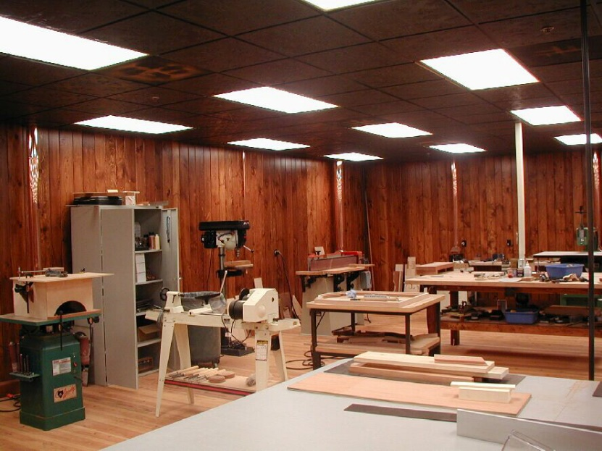
Why have a S&H Survey?
Save lives, injuries, illnesses, and near misses
Good business investment
Avoid direct & indirect costs of accidents
Avoid OSHA fines
Free resource (a second opinion)
Improve employee morale
Notes:
Lower worker’s comp costs
OSHA is not in business to put employers out of business.

Slide 28

So, why don’t employers use our services?
Some Employer’s might say:
“It’s government and they are not here to help”
“It will cost me more $”
Notes:
Rough estimates:
10 ee’s - $50k in WC
50 ee’s - $250k
100 ee’s - $100k
200 ee’s – 1, 000,000
Use a MOD RATE of 1 or less for ER’s
With few injuries/illnesses
Over 1 MOD RATE adds to the w/c costs
WC costs are used for previous 4 years

Slide 29

Some employees might say:
  “I know what I’m doing. I’ve done it a thousand times.”
  “It can’t happen to me.”
  “Safety training is for the inexperienced.”
  “Nothing could possibly go wrong, right?”

Slide 30



Think Again.

Slide 31
Common Pitfall
Thinking that you have “finished” the safety process

Slide 32

Questions?
https://dol.ny.gov/site-consultation-program
Phone (315)479-3364
E-mail: Donna.haley@labor.ny.gov
Thank you!

