Slide 1
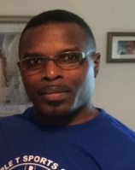
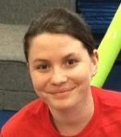
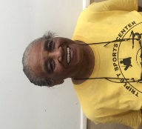
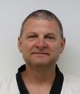
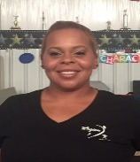
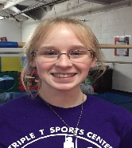
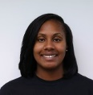
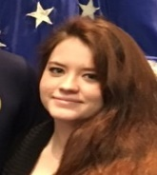
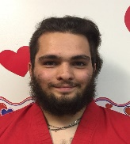
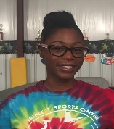
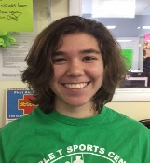
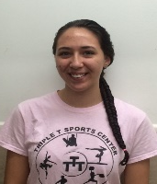
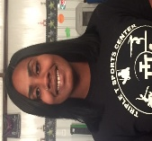
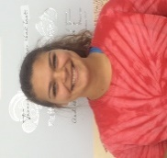
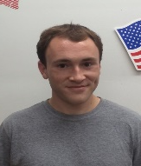
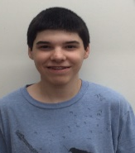
Triple T’s Amazing Staff
Tyrone Burks: Head Gymnastics Team Coach/Owner
Cheryl Burks: Business Manager/Owner
Team Gymnastics Coaches
Recreational Gymn. Instructors
Childcare Staff
Taekwondo
Tyrone Burks
Head Boys Team Coach
Kaitlyn Sabatino
Parent &Tot, Tots, Bears, Lions, Adv. Bears/Adv. Lions
Instructor
Martha Harrison
Childcare Director
Kaitlyn Sabatino
Lead Teacher
Asst Childcare Director
Master Ron Gilbar,
TKD Director
Jami Edwards
Compulsory/Optional
Girls Team Coach
Ella Bronaugh
Bears/Lions Instructor
Asst. Childcare Teacher
Dashea
Lead Teacher
Sydney Woods
Lead Teacher
Blackbelt Instructor
Jason Voelker
Loni Lane
Compulsory / Optional Girls Team Coach
Riane Smith
Bears/Lions Instructor
Asst. Childcare Teacher
Aaron Hommel
Lead Teacher
Kylia Luna
Lead Teacher
Dance Instructor
Amanda Pacitto Lead Dance Instructor
Program Director
Dashea Taylor
Compulsory Girls / Xcel Team Coach
Derk Gregory
Boys Fitness, Rec Boys, Hot Shots / PreTeam Instructor
Matthew Palagyi
Asst. Teacher
Hannah Calhoun
Asst. Teacher
Cheerleading
Michael Laskey
Asst. Teacher
Amirah Jones
Lead Cheer Instructor
Office
Sydney Woods
Office Customer Service

