Slide 1

WHAT TO DO WHEN YOU DON’T KNOW WHAT TO DO
FRANKIE LANE, MS.Ed

Slide 2
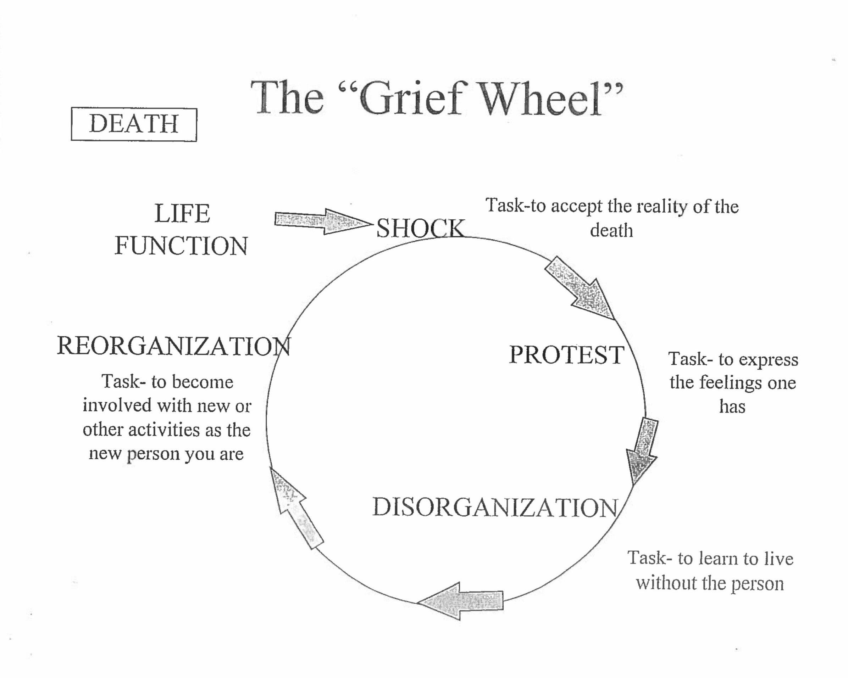

Slide 3
HOW WE FAKE IT UNTIL WE MAKE IT
Smiley face
Playing the game
Let’s be real

Slide 4
MYTHS ON GRIEF
“You should be through it by now, It’s been six months.”
“The way you get through it is…...”
“If you’re young you can get through it quicker than me because I’m older.”

Slide 5
THE ONLY WAY OUT IS THROUGH IT
You must take one day at a time
You must deal with the pain
Every journey is different

