Slide 1
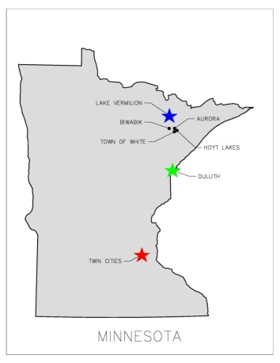
EAST MESABI JOINT WATER SYSTEM A JOINT VENTURE BETWEEN THE east range communities
REQUEST
A $6 million request for State Funding in 2019 to build a comprehensive
municipally owned cooperative joint drinking water system serving the
East Range.
POTENTIAL
Phase One ensures the ability to provide essential water services to citizens
of the City of Aurora and the Town of White. Phase Two will provide
essential water services to the cities of Biwabik and Hoyt Lakes.
PROJECT HISTORY
Aurora treatment plant built in 1953 serves both Township & City of Aurora residents
In 1997, planning began to serve an extended area on the East Range (Pineville, Scenic Acres) with investment in new infrastructure
In 2011, planning began for a Joint Water Facility on the East Range
In 2013, production tax money was awarded to the City of Biwabik for planning for a new water source
In 2018, $2.5 million of bond money was authorized for the joint water project
Extensive preliminary engineering has been completed
Favorable pilot studies at the water source have been completed
Funding is needed for transition from preliminary project planning to implementation
CONSOLIDATION OF ESSENTIAL SERVICES
East Range Joint Powers Board established in 1984 among cities of Aurora, Biwabik, Hoyt Lakes, and the Town of White; actively provides economic development & governance for projects
East Range has consolidated many essential services for economic and financial impact (police, ambulance, EMT, recreation, equipment/major purchases, comprehensive planning and shared staff)
This project aligns with those existing strategic initiatives that provide essential shared services to the East Range Communities
Cost savings for new project will be achieved by using Township owned property at new plant location; current water tower owned by Aurora; and extensive current infrastructure of water lines, lift stations, and pumps
COMPELLING CRITICAL NEEDS:
Potential Imminent failure of current well at Scenic Acres location serving 92 homes
Antiquated Aurora intake facility (1953) threatened by rising pit waters
Arcelor Mital’s mining operations will displace Biwabik’s current water intake system
Targeted new joint water source assures a higher quality and inexhaustible supply of water

