Slide 1
Virtual Desktop Environment
Danny Edwards-Rockingham Community College

Slide 2
Virtual Desktop Environment
Selected Citrix VDI-in-a-Box
3 virtual labs created to date.
Long term investment to cut costs.
Help to manage wave of updates from Adobe, Java, etc.
Can create and use multiple images for a single lab.

Slide 3
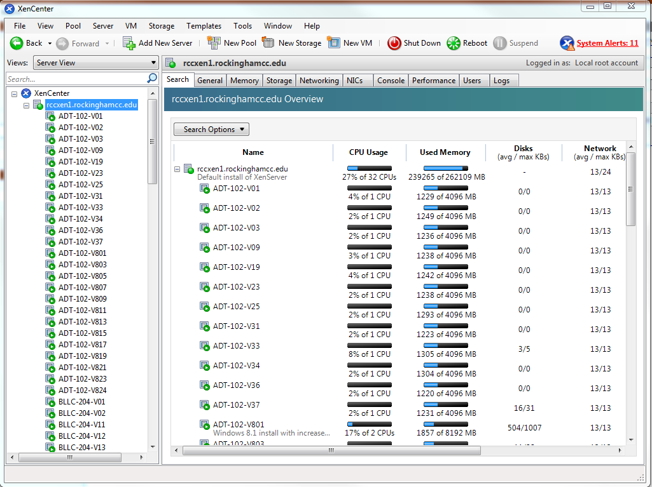
XenCenter

Slide 4
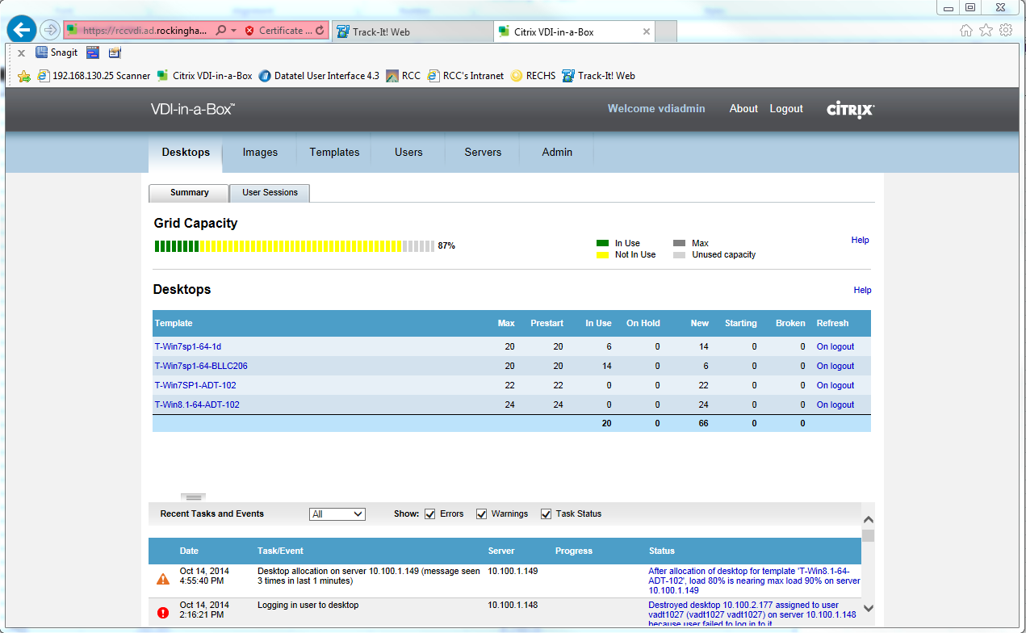
VDI-in-a-Box

Slide 5
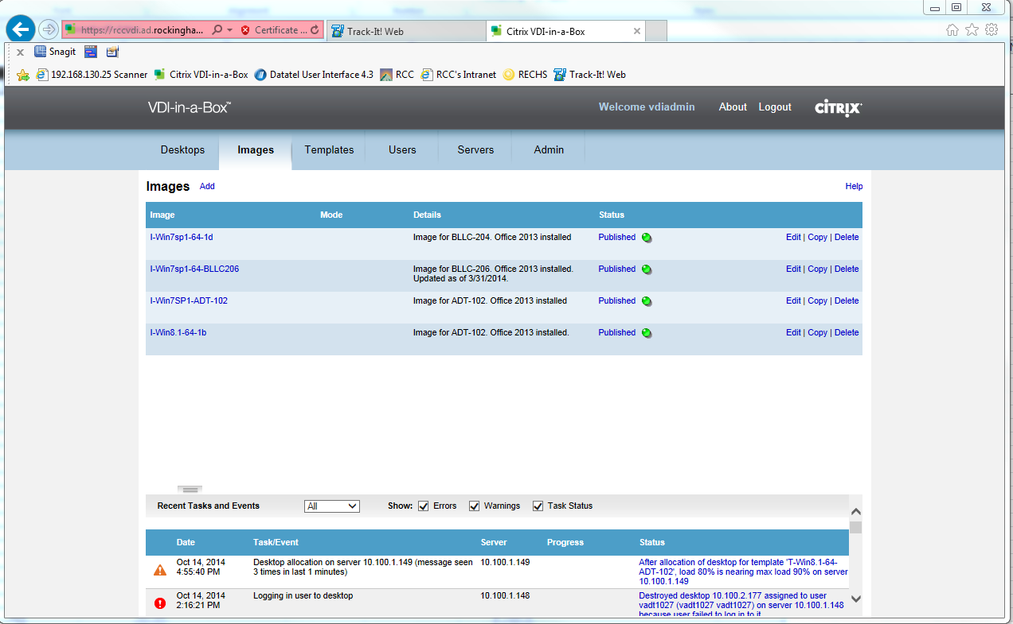
VDI-in-a-Box Images

Slide 6
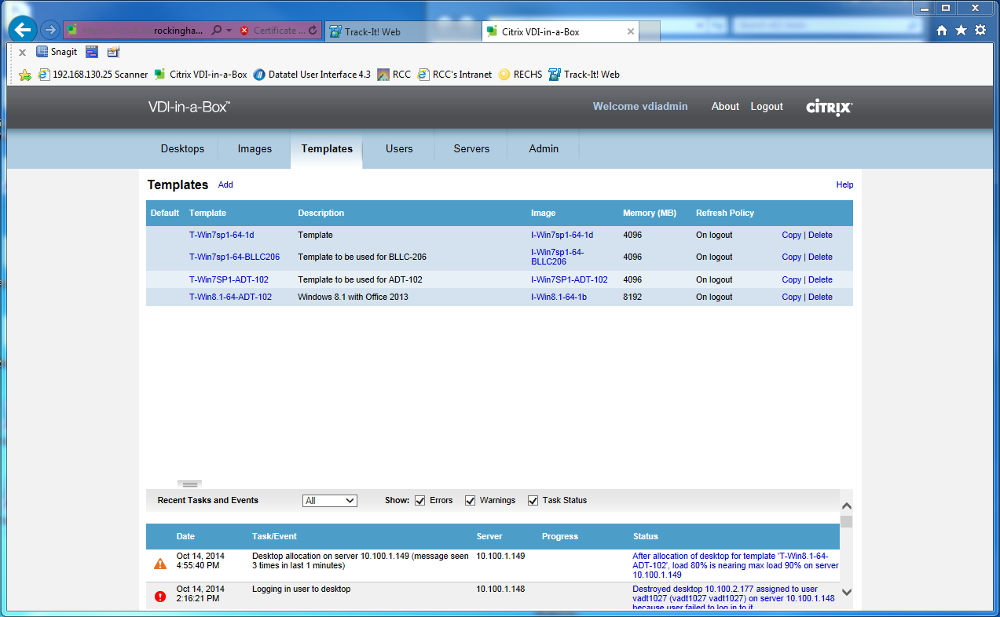
VDI-in-a-Box Templates

Slide 7
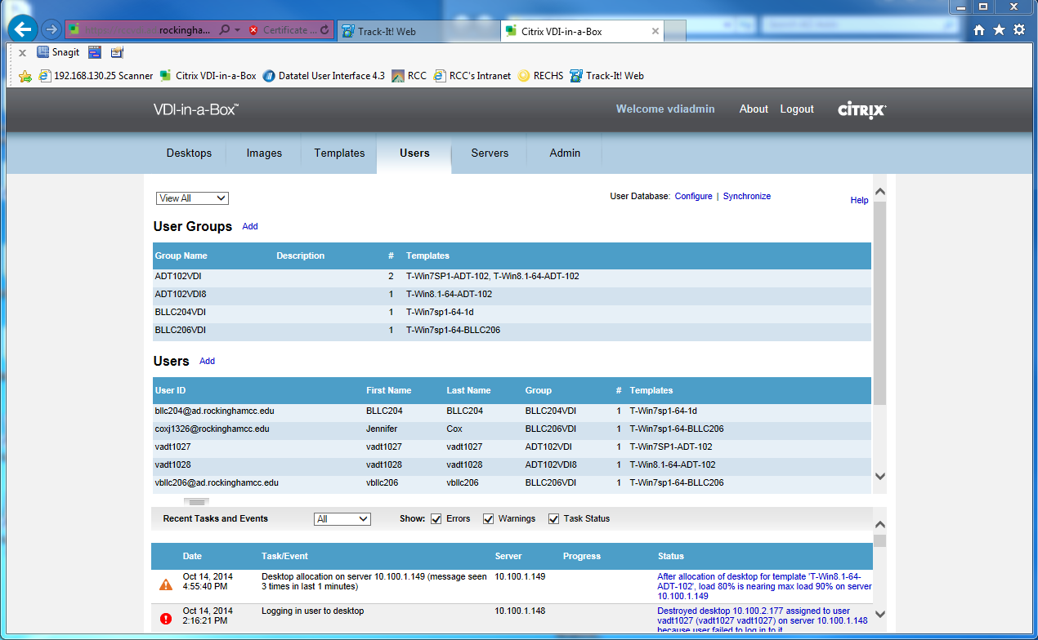
VDI-in-a-Box Users

