Slide 1
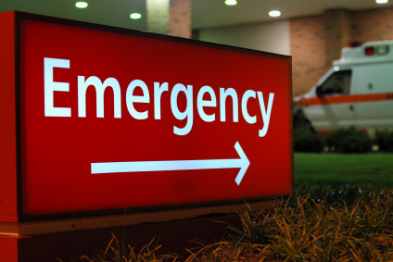
Emergency Medicine Donation Update
Regional Data
Ben Cole and Emma Lawson
Team Managers
MOSDT
NHSBT

Slide 2
NHS Blood and Transplant
Regional Teams
Regional manager
Susan Richards
Regional clinical lead
Jonathan Thompson
Nilesh Parekh
Team managers
Ben Cole
Anne-Marie Hill
Jackie Brander
Emma Lawson
18 Trusts
25 SNODs
1 PDS
19 CLODs
14 ODC Chairs (4 vacancies).
Autumn Collaboratives, 2016
Notes:
2
Give History to Big Win Project

Slide 3
Midlands Successes
MODST.
Largest potential Nationally:
5 Level Hospitals
4 PICU’s
4 Neuro Centres
QEUHB Milatary/Trauma Centre.
Year 2015-2016 One of the highest performing teams with 148 proceeding donors.
October 2016 Saw the largest number of proceeding donors Nationally (19).
One of 4 teams who have been involved in Phase 1 of Specialist Requester Role Implementation.
Autumn Collaboratives, 2016
Notes:
3
Give History to Big Win Project

Slide 4
Actual deceased donors
1 April 2016 to 30 September 2016, data as at 10 October 2016
Autumn Collaboratives, 2016

Slide 5
DBD referral rate
1 April 2016 to 30 September 2016, data as at 10 October 2016
Autumn Collaboratives, 2016

Slide 6
DCD referral rate
1 April 2016 to 30 September 2016, data as at 10 October 2016
Autumn Collaboratives, 2016

Slide 7
Midlands Consent Rate 65%
With SNOD 66%; Without SNOD 57%
DBD SNOD involved
1 April 2016 to 30 September 2016, data as at 10 October 2016
Autumn Collaboratives, 2016

Slide 8
Midlands Consent Rate 51%
With SNOD 57%; Without SNOD 40%
DCD SNOD involved
1 April 2016 to 30 September 2016, data as at 10 October 2016
Autumn Collaboratives, 2016

Slide 9
Autumn Collaboratives, 2016
Notes:
9
Give History to Big Win Project

Slide 10
National referral from ED Data
April 2015-March 2016
Autumn Collaboratives, 2016

Slide 11
Percentage of Total Donors from ED Referrals April 2015-March 2016
Autumn Collaboratives, 2016

