Slide 1


Scan now to
complete the pretest
Metastatic Breast Cancer:
Enhancing Treatment Tolerability, Adherence, and Patient-Centered Care
Scan the QR here or on the front of your i3 Health folder to complete the pretest OR use the paper assessment included in your i3 Health folder
To scan the QR code:
FOR IPHONE:
Open the camera & focus it to QR code
Your internet browser should pop up with a link
Click the link and complete
FOR ANDROID:
Open the camera & focus it to QR code
Hold ‘Home’ button
The pretest comes visible to complete

Slide 2

Metastatic Breast Cancer:
Enhancing Treatment Tolerability, Adherence, and Patient-Centered Care
Sarah Donahue, MPH, NP, AOCNP®
Carol Franc Buck Breast Cancer Center
Helen Diller Family Comprehensive Cancer Center
University of California, San Francisco

Slide 3
Provided by i3 Health
ACCREDITATION
i3 Health is accredited with distinction as a provider of nursing continuing professional development by the American Nurses Credentialing Center’s Commission on Accreditation.
A maximum of 1.0 contact hour may be earned by learners who successfully complete this continuing nursing education activity.
INSTRUCTIONS TO RECEIVE CREDIT
An activity evaluation has been distributed. To claim credit, you must submit a completed and signed evaluation form at the conclusion of the program. Your certificate of attendance will be emailed to you in approximately 2 weeks.
UNAPPROVED USE DISCLOSURE
This educational activity may contain discussion of published and/or investigational uses of agents that are not indicated by the FDA. The planners of this activity do not recommend the use of any agent outside of the labeled indications.
The opinions expressed in the educational activity are those of the faculty and do not necessarily represent the views of the planners. Please refer to the official prescribing information for each product for discussion of approved indications, contraindications, and warnings.
DISCLAIMER
The information provided at this NCPD activity is for continuing education purposes only and is not meant to substitute for the independent medical/clinical judgment of a healthcare provider relative to diagnostic and treatment options of a specific patient’s medical condition.
COMMERCIAL SUPPORT
This educational activity is supported by independent educational grants from Bristol-Myers Squibb and Eisai.

Slide 4
Disclosures
Ms. Donahue discloses the following commercial relationships:
  Advisory board or panel: Novartis, Sanofi
  Speaker’s bureau: SeaGen
  Salary or contractual services: Genentech
  i3 Health has mitigated all relevant financial relationships.

Slide 5
Learning Objectives
Identify prognostic markers that impact treatment selection and treatment goals to individual patients with MBC
Evaluate the efficacy and safety profiles of novel therapies for HER2-positive, HER2-negative, and triple-negative MBC
Assess strategies to manage treatment-related adverse events, promote adherence to therapy, and ensure patient-centered MBC care
MBC = metastatic breast cancer; HER2 = human epidermal growth factor receptor 2.

Slide 6
Agenda
Review the scope of MBC
Stratify MBC by prognostic and biologic features
Review evidence-based treatment recommendations
Discuss treatment advances by biomarker
Identify best practice management of adverse events
Highlight patient resources
Summarize key learnings
Q&A

Slide 7
Metastatic Breast Cancer
More than 168,000 women living with MBC in the US in 2020
Of the estimated 268,600 new breast cancer diagnoses in 2019, 6% (16,000) presented as de novo metastatic disease
Approximately 1 in 3 live at least 5 years after diagnosis
Goals of care focus on improving survival and quality of life
Treatment guided by biology (subtype specific), patient symptoms, comorbidities, and prior therapies
Multiple new treatment options
ACS, 2020; Susan G. Komen, 2020; Mariotto et al, 2017.

Slide 8
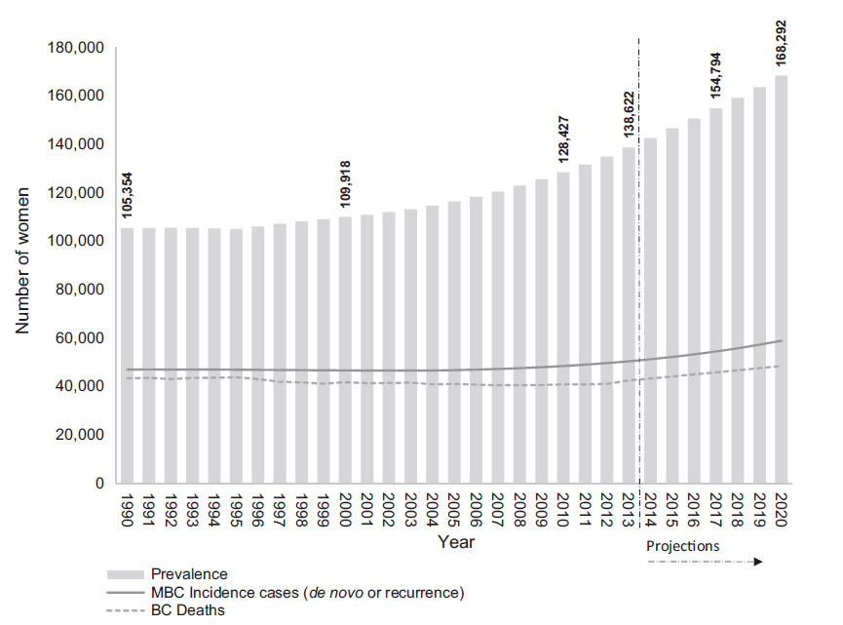
MBC Prevalence
BC = breast cancer.
Mariotto et al, 2017.
Notes:
This figure represents the estimates and projections of metastatic breast cancer (MBC) in the US from 1990-2020: the observed number of breast cancer deaths (dashed line), and the estimated number of new cases with de novo and recurrent breast cancer.
MBC prevalence (number of women living with MBC) increased 4% from 1990-2000 and 17% from 2000-2010. It is projected to increase by 31% from 2010-2020
About 20% of women will experience local or distant recurrence at some point in time, even after 5-10 years from diagnosis, mainly due to disease resistance to therapy (Corona & Generali, 2018)

Slide 9
Strategy: Using Biology and Genetics to Determine Treatment

Slide 10
MBC: Prognostic Factors
Age
Performance status
Site of disease (CNS, visceral, bone, soft tissue)
Disease burden (oligo vs disseminated)
Metastasis-free interval
  <24 months
  >24 months
  De novo MBC
Subtype (ER, PR, and HER2)
IHC = immunohistochemistry; CNS = central nervous system; ER = estrogen receptor; PR = progesterone receptor.
Lobbezoo et al, 2015; NCCN, 2021b.
Notes:
A metastasis-free interval (MFI) of >24 months and de novo metastatic presentation are considered more favorable than an MFI <24 months. MFI is defined as time from primary breast cancer diagnosis to time of metastatic diagnosis.

Slide 11
Biology & Genetics: Testing for Targets
Biopsy of suspected site is highly recommended
Testing for therapeutic options
  IHC: ER, PR, HER2, PD-L1
  Molecular: HER2 by FISH, PIK3CA
  Germline genetic: gBRCA
PD-L1 = programmed death ligand 1; FISH = fluorescence in situ hybridization; MSI = microsatellite instability; MMR = mismatch repair;
gBRCA = germline BRCA.
NCCN, 2020b.

Slide 12





Therapies by Biomarker
ER/PR-positive
  Endocrine therapy
    Tamoxifen
    Aromatase inhibitors (anastrozole, exemestane, letrozole)
    Fulvestrant
  CDK4/6 inhibitor (abemaciclib, palbociclib, ribociclib) + endocrine therapy
PIK3CA-mutated and HR-positive
  Alpelisib/fulvestrant
gBRCA-mutated
  Olaparib
  Talazoparib
HER2-positive
  Trastuzumab
  Pertuzumab
  Trastuzumab emtansine
  Trastuzumab deruxtecan
  Neratinib
  Lapatinib
  Tucatinib
TNBC
  Sacituzumab govitecan
  Cytotoxic chemotherapy
HR = hormone receptor; TNBC = triple-negative breast cancer.
NCCN, 2021b.

Slide 13
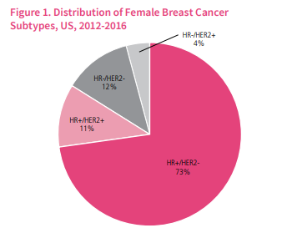
Breast Cancer by Subtype
Prevalence of PIK3CA mutation:
28% of HR-positive/HER2-negative
10% of TNBC
ACS, 2020; Mosele et al, 2020.

Slide 14
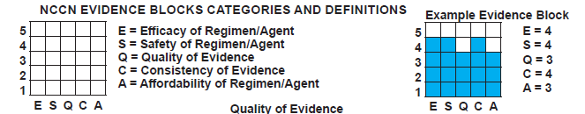
What to Use: NCCN Evidence Blocks
Provides evidence-based recommendations
  5 key criteria
  Strength of evidence for each criterion
NCCN = National Comprehensive Cancer Network.
NCCN, 2021b.

Slide 15
NCCN Recommendations by Biomarker
Endocrine therapy
  Premenopausal vs post-menopausal
  HER2-positive vs HER2-negative
Chemotherapy and/or biotherapy
  HER2-negative disease
    Monotherapy
    Combination therapy
  HER2-positive disease
NCCN, 2021b.

Slide 16
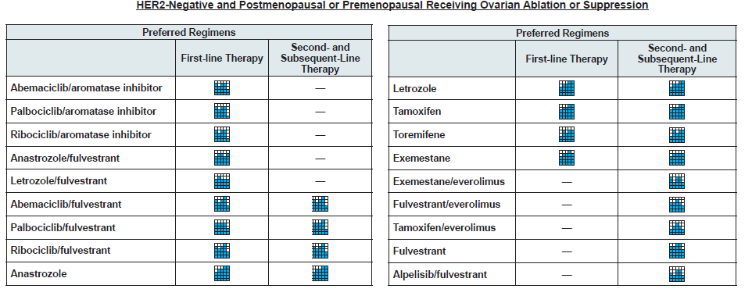
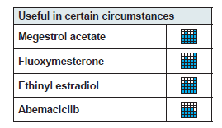
NCCN Evidence Block: HR-Positive/HER2-Negative
= recently approved
NCCN, 2021b.
Notes:
(AL-peh-LIH-sib)

Slide 17
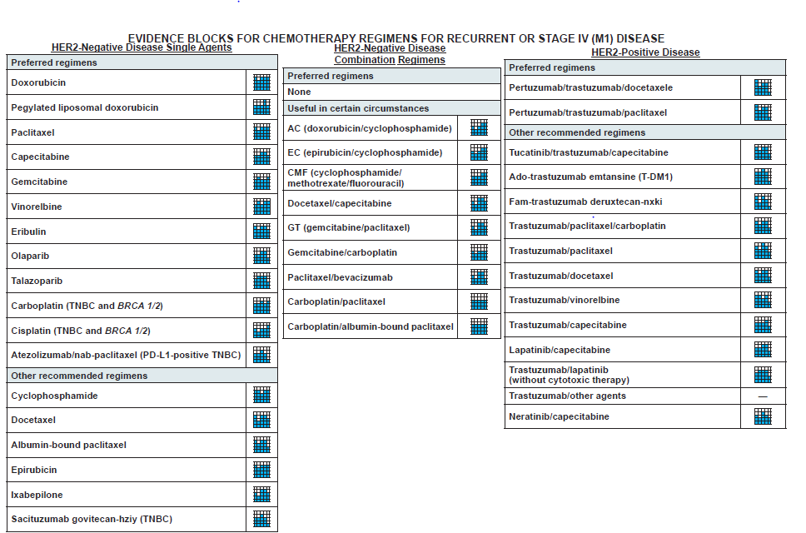
NCCN Evidence Block: Chemotherapy and Biotherapy
Recently approved
NCCN, 2021b.

Slide 18
HER2-Positive Breast Cancer
Notes:
We have now reviewed the essential clinical considerations that drive treatment selection: tumor biology, genetics, disease burden, and clinical status.
Now let’s take a look at recent treatment advances which led to changes in recommendations by subtype.

Slide 19
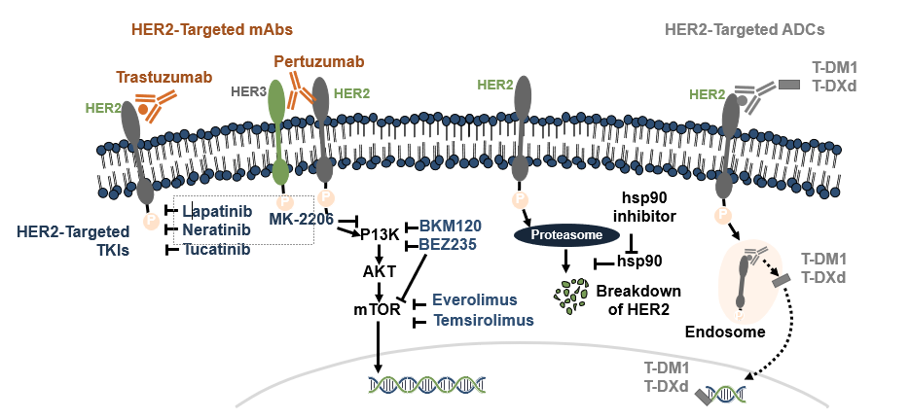
HER2 Therapy by MOA
Monoclonal antibody
  Trastuzumab
  Pertuzumab
Tyrosine kinase inhibitor
  Lapatinib
  Neratinib
  Tucatinib
Antibody drug conjugate (ADC)
  T-DM1
  Fam-trastuzumab deruxtecan-nxki (T-DXd)
MOA = mechanism of action.
Gajria et al, 2011; Pernas & Tolaney, 2019.

Slide 20
Evolution of HER2-Directed Therapy
T-DM1
(2013)
Tucatinib
(2020)
T-DXd
(2019)
Trastuzumab(1998)
Lapatinib
(2007)
Pertuzumab
(2012)
Neratinibª
(2020)
1995
2000
2005
2010
2015
2020
ªAdjuvant approval 2017.
US FDA, 2020b.

Slide 21
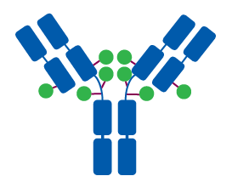
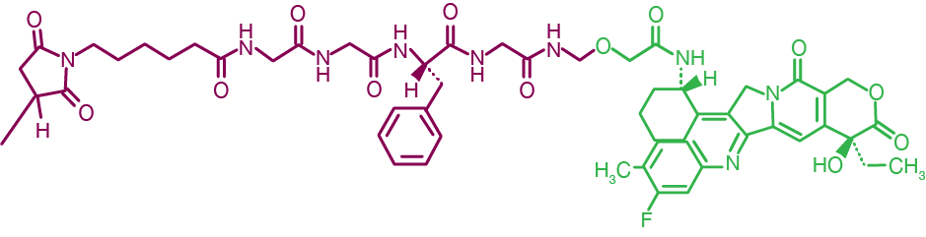
Trastuzumab Deruxtecan
An ADC composed of:
  HER2 antibody with the same amino acid sequence same as trastuzumab
  A tetrapeptide-based cleavable linker
  Topoisomerase I payload
Humanized anti-HER2
IgG1 mAb
Deruxtecan
Tetrapeptide-based cleavable linker
IgG1 = immunoglobulin G1; mAb = monoclonal antibody.
Nakada et al, 2019; Trail et al, 2018.

Slide 22
DESTINY-Breast01: T-DXd
Study Design: An Open-Label, Multicenter, Phase 2 Study
PART 1
PART 2
Population
≥18 years of age
Unresectable and/or metastatic BC
HER2-positive (centrally confirmed)
Prior T-DM1
Excluded patients with history of significant ILD
Stable, treated brain metastases allowed
PK Stage
(n=65)
Dose-Finding Stage
(n=54)
Continuation Stage
(n=134)
T-DM1
resistant/refractory
(n=249)
5.4 mg/kg
(n=22)
R
1:1:1
5.4 mg/kg
(n=28)
PART 2a
5.4 mg/kg
(n=130)
6.4 mg/kg
(n=22)
R
1:1
6.4 mg/kg
(n=26)
7.4 mg/kg
(n=21)
T-DM1
intolerant
(n=4)
PART 2b
5.4 mg/kg
(n=4)
184 patients
enrolled at 5.4 mg/kg
Primary end point: confirmed ORR
Secondary end point: investigator-assessed ORR, DCR, DOR, CBR, PFS, OS, PK, and safety
ILD = interstitial lung disease; n = subgroup population; R = randomized; ORR = overall response rate; RECIST = Response Evaluation Criteria in Solid Tumors;
v = version; DCR = disease control rate; DOR = duration of response; CBR = clinical benefit rate; PFS = progression-free survival; PK = pharmacokinetic;
OS = overall survival.
Modi et al, 2020.
Notes:
Population:
1/CCDS_Sep_27_2019/p5/sec4.1
Treatment:
1/CCDS_Sep_27_2019/p5/sec4.2/para2/ln1-2
footnote: CCDS_Sept_27_2019/p16/para1/ln4-5;
2/DOF/DS8201-A-U201 StudyDeck_09Sept2019/slide10

Slide 23

DESTINY-Breast01: T-DXd (cont.)
Best Change in Tumor Size
Best % Change From Baseline in the Sum
of Diameters of Measurable Tumors
40
20
0
-20
-40
Confirmed ORR: 60.9%
(95% CI, 53.4%-68.0%)
11 CRs
Median PFS: 16.4 months
-60
-80
n=168ª
-100
ªPatients for whom data from both baseline and postbaseline assessments of target lesions by independent central review were available.
CI = confidence interval; CR = complete response.
Modi et al, 2020.

Slide 24
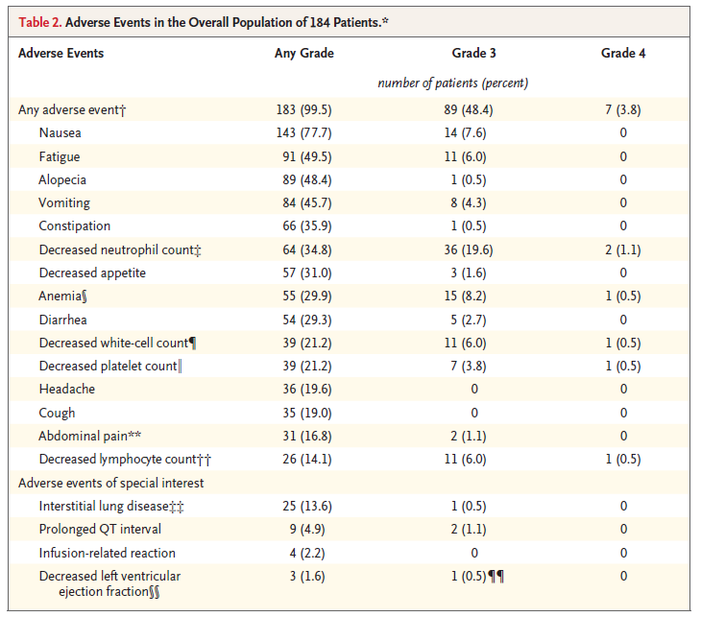
DESTINY-Breast01: T-DXd (cont.)
☨
Adverse Events
☆AEs in ≥15% of patients.
†Investigator-reported grade ≥3 AEs in ≥6% of patients.
‡Includes preferred terms neutrophil count decreased, neutropenia.
∬Includes hematocrit decreased, hemoglobin decreased, red cell count decreased, anemia.
¶Includes white cell count decreased, leukopenia.
‖Includes platelet count decreased, thrombocytopenia.
☆☆Includes abdominal discomfort, abdominal pain, abdominal pain lower, abdominal pain upper.
††Includes lymphocyte count decreased, leukopenia.
‡‡ILD determined by independent adjudication committee. 4 patients with grade 5 AEs included in the category of Any Grade.
∬∬LVEF measured on ECG or multigated acquisition scans every 4 treatment cycles.
¶¶In this patient, LVEF was ≥55% during treatment.
AEs = adverse events; LVEF = left ventricular ejection fraction; ECG = electrocardiography.
Modi et al, 2020.
Notes:
Reported for adverse events (AEs) in 15% of population or AEs of special interest. Think of AEs as similar to irinotecan, which is also a topoisomerase inhibitor.
Interstitial lung disease (ILD) had 4 patients, with grade 5 (death) included in “Any Grade.”

Slide 25
DESTINY-Breast01: T-DXd (cont.)
AEs of Special Interest
Patients Who Received T-DXd 5.4 mg/kg (n=184) | Patients Who Received T-DXd 5.4 mg/kg (n=184)
 | Grade 1 | Grade 2 | Grade 3 | Grade 4 | Grade 5 | All Grades/ Total
Interstitial lung disease, n (%) | 5 (2.7%) | 15 (8.2%) | 1 (0.5%) | 0 | 4 (2.2%) | 25 (13.6%)
Among the 25 total events:
Median time to investigator-reported onset was 193 days (range, 42-535 days)
17 of 20 patients with grade ≥2 ILD received corticosteroids
7 patients recovered, 2 were recovering, 12 were either outcome unknown or not followed until resolution, and 4 died
Of the 4 fatal cases, onset was from 63-148 days: 3 patients received steroids as part of treatment, and death occurred 9-60 days after diagnosis
AE = adverse event.
Modi et al, 2020.

Slide 26
Tucatinib: HER2CLIMB Phase 2 Study Design
21-day cycles
Randomized, double-blind, placebo-controlled, active comparator phase 2 trial at 155 sites in 15 countries
Median follow-up: 14.0 mos
Stratification: brain mets (yes vs no), ECOG PS (0 vs 1), region (US/Canada vs rest of world)
Primary end point: PFS
Secondary end points: OS, PFS with brain mets, ORR with measurable disease, safety
Tucatinib 300 mg PO BID +
trastuzumab 6 mg/kg Q3W (loading dose: 8 mg/kg c1 d1) +
capecitabine 1,000 mg/m² PO BID, d 1-14
(n=410)
Patients:
HER2-positive MBC;
prior trastuzumab, pertuzumab, and T-DM1; ECOG PS 0/1;
brain mets allowedª
(N=612)
Placebo PO BID +
trastuzumab 6 mg/kg Q3W
(loading dose: 8 mg/kg c1 d1) +
capecitabine 1,000 mg/m² PO BID, d 1-14
(n=202)
Mos = months; ECOG = Eastern Cooperative Oncology Group; PS = performance status; N = study population; PO = orally; BID = twice a day;
Q3W = every 3 weeks; c = cycle; d = day.
Murthy et al, 2020.
Notes:
Essentially a third-line human epidermal growth factor receptor 2 (HER2)-positive MBC trial after progression on trastuzumab, pertuzumab, and trastuzumab emtansine (T-DM1).
Brain metastases (mets) include previously treated stable mets, untreated mets not needing immediate local therapy (tx), and previously treated progressing mets not needing immediate local tx.

Slide 27
HER2CLIMB: Tucatinib (cont.)
PFS in Primary End Point Population (First 480 Randomized Patients)
 | Events/n | Median PFS, mos (95% CI) | 1-Yr PFS rate (95% CI)
Tucatinib + trastuzumab/cape | 178/320 | 7.8 (7.5-9.6) | 33.1% (27%-40%)
Placebo + trastuzumab/cape | 97/160 | 5.6 (4.2-7.1) | 12.3% (8%-21%)
100
80
62.9
60
Patients Alive and Free from
Disease Progression (%)
40
46.3
46% reduction in risk of disease progression
(P<0.00001)
33.1
Tucatinib + trastuzumab/cape
20
12.3
Placebo + trastuzumab/cape
0
0
3
6
9
12
15
18
21
24
27
30
33
36
Mos Since Randomization
cape = capecitabine.
Murthy et al, 2020.

Slide 28
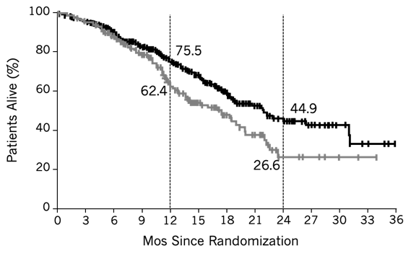
HER2CLIMB: Tucatinib (cont.)
OS (Total Population)
 | Events/n | Median OS, mos (95% CI) | 2-Yr OS rate (95% CI)
Tucatinib + trastuzumab/cape | 130/410 | 21.9 (18.3-31.0) | 44.9% (37%-53%)
Placebo + trastuzumab/cape | 85/202 | 17.4 (13.6-19.9) | 26.6% (16%-39%)
Tucatinib + trastuzumab/cape
34% reduction in risk of death
(P=0.0048)
Placebo + trastuzumab/cape
Murthy et al, 2020.

Slide 29
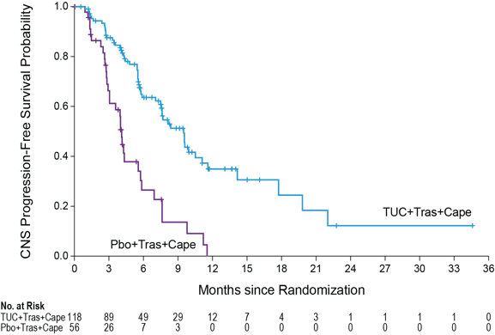
HER2CLIMB: Tucatinib (cont.)
CNS-PFS Benefit in Patients With Active Brain Metastases
CNS-PFS: time from randomization to disease progression in the brain or death (per investigator assessment)
 | Events/n | HR (95% CI) | P Value
Tuc/tras/cape | 54/118 | 0.36 (0.22-0.57) | <0.0001
Pbo/tras/cape | 33/56
n=174
Median
35.0%
Risk of CNS progression or death was reduced by 64% in patients with active brain metastases
At 12 months: 35% vs 0%
Tuc/tras/cape
0%
Pbo/tras/cape
Pbo = placebo; tuc = tucatinib; tras = trastuzumab; HR = hazard ratio.
Murthy et al, 2020.

Slide 30
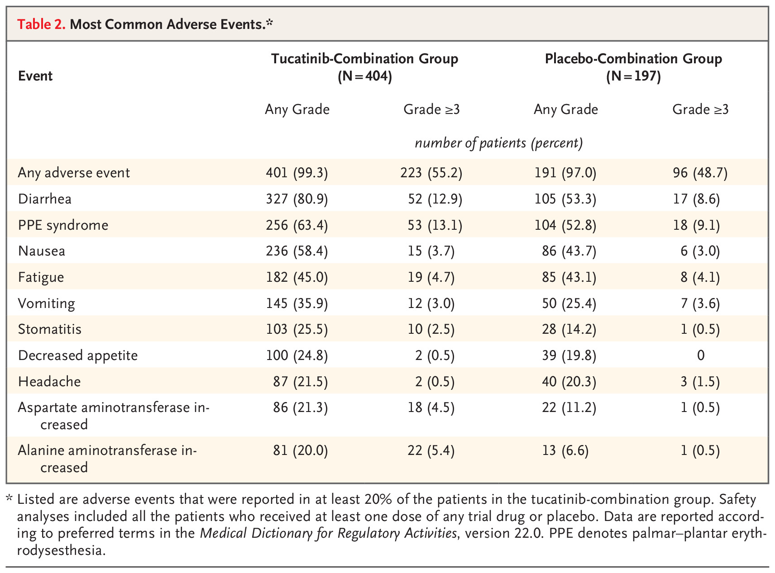
HER2CLIMB (cont.): Adverse Events
AEs led to discontinuation of: Tucatinib in 5.7%
Placebo in 3.0%
Capecitabine in 9.8%
Murthy et al, 2020.

Slide 31
Neratinib: NALA
Study Design
Inclusion criteria
MBC
Centrally confirmed HER2-positive disease
≥2 lines of HER2-directed therapy for MBC
Asymptomatic and stable brain
metastases permitted
Neratinib 240 mg/d +
capecitabine 1,500 mg/m² 14/21 d
Loperamide (cycle 1)ª
Follow-up
(survival)
PD
R
(1:1)
No endocrine therapy permitted
N=621
Lapatinib 1250 mg/d +
capecitabine 2000 mg/m² 14/21 d
PD
Stratification variables
Number of prior HER2 therapies for MBC
Disease location
HR status
Geographic location
End points
Coprimary: PFS (centrally confirmed) and OS
Secondary: PFS (local), ORR, DOR, CBR, intervention for CNS metastases, safety, and health outcomes
ªLoperamide 4 mg with first dose of neratinib, followed by 2 mg every 4 h for first 3 d, then loperamide 2 mg every 6–8 h until end of Cycle 1; thereafter PRN.
PD = progressive disease; h = hours; PRN = as needed.
Saura et al, 2019.
Notes:
Represents an all-oral option for select patients; also does not come with risk of heart failure.

Slide 32
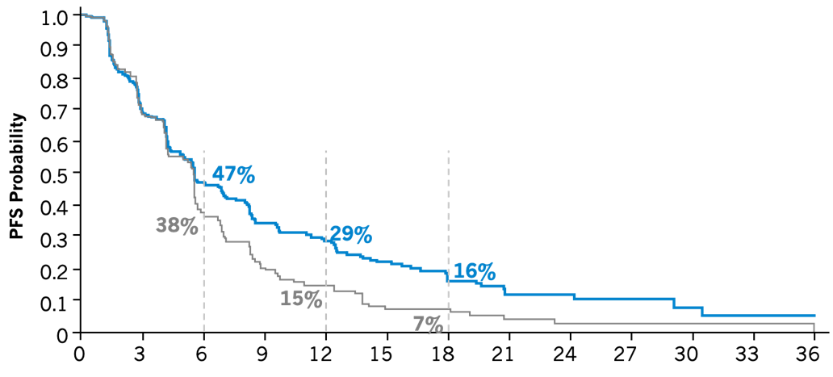
Neratinib: NALA (cont.)
PFS
Hazard Ratio (95% CI) | Log-Rank P Value
0.76 (0.63-0.93) | 0.0059
Neratinib/capecitabine
Lapatinib/capecitabine
Time since randomization (months)
N+C
307
183
113
69
54
35
20
13
9
7
3
2
2
L+C
314
183
82
39
24
9
8
3
2
2
2
2
1
N = neratinib; C = capecitabine; L = lapatinib.
Saura et al, 2019.
No. at risk:

Slide 33
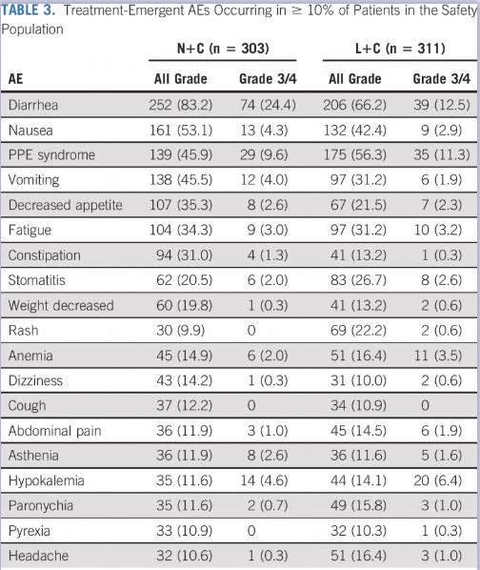
Neratinib: NALA (cont.)
TEAEs Occurring in ≥10% of Patients in the Safety Population
Diarrhea resulted in permanent discontinuation:
N+C Arm: 8 patients (2.6%)
L+C Arm: 7 patients (2.3%)
Antidiarrheal medication:
N+C Arm: 298 patients (98.3%)
L+C Arm: 193 patients (62.1%)
Most commonly used antidiarrheal regimens:
Loperamide: 54% overall
(N+C 77%; L+C 31%)
Lomotil: 8% overall
(N+C 10%; L+C 6%)
TEAE = treatment-emergent AE.
Saura et al, 2020.

Slide 34
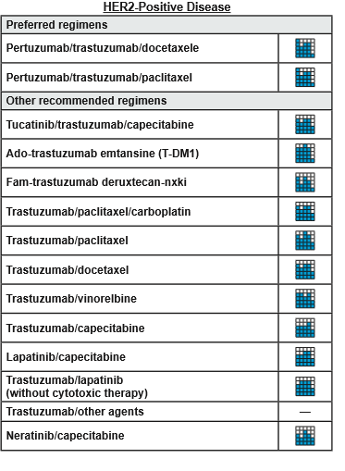
NCCN Evidence Block: HER2-Positive MBC
CLEOPATRA: docetaxel + trastuzumab/pertuzumab
  8-year median OS
    57.1 months with DHP
    40.8 months with HP/placebo
DHP = docetaxel/trastuzumab/pertuzumab; HP = trastuzumab/pertuzumab.
NCCN, 2021b; Swain et al, 2019.
Notes:
The preferred status of trastuzumab/pertuzumab (HP) + taxane is based on the results of the CLEOPATRA trial, which at 8 years demonstrated median OS of 57.1 vs 40.8 months in comparison with HP + placebo.
We have also reviewed 3 new HER2-directed therapies which have been approved within the last year. So the question becomes, besides the clear first-line therapy of taxane + HP, how do we sequence subsequent lines of therapy?

Slide 35
HER2-Positive MBC: Sequencing Strategy
Current Approach for Sequencing Therapy
First line
Second line
≥Third line
Trastuzumab/
pertuzumab/taxane
T-DM1
Tucatinib/capecitabine/trastuzumab
Lapatinib/capecitabine
CT/trastuzumab
Trastuzumab plus eribulin, vinorelbine, gemcitabine, or capecitabine, CMF
Lapatinib/trastuzumab
Hormonal therapy + anti-HER2 therapy (for HR-positive)
Trastuzumab/pertuzumab or T-DM1, if not received prior
Trastuzumab deruxtecan
Neratinib/capecitabine
Tucatinib/capecitabine/
trastuzumab
CT = chemotherapy; CMF = cyclophosphamide/methotrexate/5-fluorouracil.
Giordano et al, 2018; NCCN, 2020b.

Slide 36
HER2+ MBC: Sequencing Strategy (cont.)
New treatments after POD
  DESTINY: T-DXd demonstrated ORR >60% after Tras, Pertuz & T-DM1
  HER2CLIMB: tucatinib/cape/tras > cape/tras, especially in CNS
  NALA: neratinib superior to lapatinib as a partner with capecitabine
Enhanced patient-centered treatment
  CNS disease vs no CNS
  Oral vs IV
  HR-positive vs HR-negative
  Prior GI toxicity/comorbidity
  Prior pulmonary toxicity/comorbidity
  Decreased ejection fraction
POD = progression of disease; topo = topoisomerase; IV = intravenous; GI = gastrointestinal.
Murthy et al, 2020; Saura et al, 2019; Modi et al, 2020; Giordano et al, 2018; NCCN, 2021b.

Slide 37
Case Study 1
Ms. SG is a 39-year-old woman with HR-negative/HER2-positive MBC to the liver (biopsy proven) with recurrence 2 years after adjuvant TCHP
  First-line THP x 6 months then maintained on HP for 3 years
  POD in liver without new sites of disease
  Started on second-line T-DM1 18 months ago
  Recent CT scan shows new lesions in the lung
  Clinically, she complains of grade 1 DOE
TCHP = docetaxel/carboplatin/trastuzumab/pertuzumab; THP = docetaxel/trastuzumab/pertuzumab; CT = computed tomography scan;
DOE = dyspnea on exertion.

Slide 38
Case Study 1 (cont.)
Which of the following regimens would be most appropriate for this patient?
  Neratinib/capecitabine
  Lapatinib/capecitabine
  Trastuzumab deruxtecan
  Tucatinib/trastuzumab/capecitabine
  Uncertain
Notes:
Preferred answers:
a. Neratinib/capecitabine
c. Trastuzumab deruxtecan
d. Tucatinib/trastuzumab/capecitabine

Slide 39
Case Study 1 (cont.)
Preferred Regimens for Patient
Neratinib/capecitabine
Lapatinib/capecitabine (inferior to neratinib/cape)
Trastuzumab deruxtecan
Tucatinib/trastuzumab/capecitabine
Uncertain
Notes:
Preferred answers:
Neratinib/capecitabine
Trastuzumab deruxtecan
Tucatinib/trastuzumab/capecitabine

Slide 40
Case Study 1 (cont.)
Factors to Consider
Oral vs IV (simplicity vs convenience vs. oral cost)
Clinical DOE, risk of ILD
Current ejection fraction
CNS disease

Slide 41
Case Study 1 (cont.)
What Treatment Do You Recommend for This Patient?
Neratinib/capecitabine
Lapatinib/capecitabine
Trastuzumab deruxtecan
Tucatinib/trastuzumab/capecitabine
Uncertain
Notes:
Preferred answer: d. Tucatinib/trastuzumab/capecitabine.
Rationale: HER2CLIMB study population for the combination of tucatinib/trastuzumab/capecitabine had prior trastuzumab and prior T-DM1, so treatment D demonstrated benefit in a population exactly like this patient’s prior treatment (Murthy et al, 2020). Answer A would also be acceptable, but the study population in NALA of 2 prior HER2 therapies, not necessarily T-DM1, is not as close a match to this patient’s prior treatment (Saura et al, 2019). Also, central nervous system (CNS) data in HER2CLIMB was compelling, and while this patient does not yet have CNS disease, it would be nice to get coverage against that.
Trastuzumab deruxtecan could be a choice, but in a patient with lung disease and clinical dyspnea on exertion, it would be more complicated to identify interstitial lung disease.

Slide 42
HR-Positive/HER2-Negative Breast Cancer

Slide 43
NCCN Evidence Block: HR-Positive/HER2-Negative
= recently approved
NCCN, 2021b.

Slide 44
SOLAR-1
Fulvestrant + Alpelisib or Placebo
Stratification by presence of liver/lung mets, prior CDK4/6 inhibitor therapy
Alpelisib 300 mg QD PO + fulvestrant 500 mg IMª
(n=169)
PIK3CA-
mutant cohort
(n=341)
Men or postmenopausal women with HR-positive/HER2-negative advanced BC with recurrence or progression on/after prior AI, measurable disease or
≥1 predominantly lytic bone lesion, ECOG PS 0/1
(N=572)
Placebo QD PO + fulvestrant 500 mg IMª
(n=172)
Alpelisib 300 mg QD PO + fulvestrant 500 mg IMª
(n=115)
PIK3CA-nonmutant cohort
(n=231)
Placebo QD PO + fulvestrant 500 mg IMª
(n=116)
Primary end point: PFS (locally assessed) in all patients randomized to PIK3CA-mutant cohort
Secondary end points: OS in PIK3CA-mutant cohort; PFS in PIK3CA-nonmutant cohort (proof of concept); PFS in ctDNA and ORR/CBR for both cohorts; safety for patients with ≥1 dose study drug
ªFulvestrant given on Days 1 and 15 of 28 in Cycle 1, then Day 1 thereafter.
AI = aromatase inhibitor; QD = once a day; IM = intramuscular; ctDNA = circulating tumor deoxyribonucleic acid.
André et al, 2019; Juric et al, 2018.
Notes:
Population is after AI failure but NOT CDK4/6 use.
Prevalence of PIK3CA mutation:
28% of HR-positive/HER2-negative
10% of TNBC

Slide 45
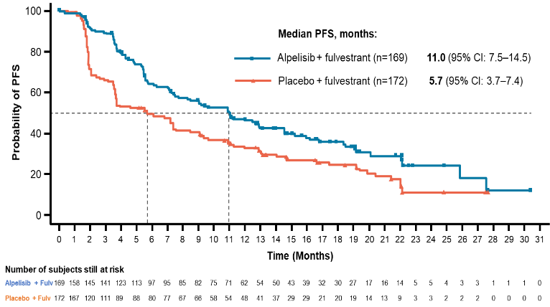
SOLAR-1: Alpelisib/Fulvestrant (cont.)
PFS in Patients With PIK3CA Mutations
HR 0.65 (0.50-0.85)
P value: <0.001
André et al, 2019; Juric et al, 2019.

Slide 46
SOLAR-1: Alpelisib/Fulvestrant (cont.)
Select Adverse Events
AEs ≥20% in either arm: n, % | Alpelisib/ful (n=284) |  |  | Placebo/ful (n=287)
 | All-Grade | Grade 3 | Grade 4 | All-Grade | Grade 3 | Grade 4
Any AE | 282 (99.3%) | 183 (64.4%) | 33 (11.6%) | 264 (92.0%) | 87 (30.3%) | 15 (5.2%)
Hyperglycemia | 181 (63.7%) | 93 (32.7%) | 11 (3.9%) | 28 (9.8%) | 1 (0.3%) | 1 (0.3%)
Diarrhea | 164 (57.7%) | 19 (6.7%) | 0 | 45 (15.7%) | 1 (0.3%) | 0
Nausea | 127 (44.7%) | 7 (2.5%) | 0 | 64 (22.3%) | 1 (0.3%) | 0
Decreased appetite | 101 (35.6%) | 2 (0.7%) | 0 | 30 (10.5%) | 1 (0.3%) | 0
Rash | 101 (35.6%) | 28 (9.9%) | 0 | 17 (5.9%) | 1 (0.3%) | 0
Vomiting | 77 (27.1%) | 2 (0.7%) | 0 | 28 (9.8%) | 1 (0.3%) | 0
Weight decreased | 76 (26.8%) | 11 (3.9%) | 0 | 6 (2.1%) | 0 | 0
Fatigue | 69 (24.3%) | 10 (3.5%) | 0 | 49 (17.1%) | 3 (1.0%) | 0
Stomatitis | 70 (24.6%) | 7 (2.5%) | 0 | 18 (6.3%) | 0 | 0
Asthenia | 58 (20.4%) | 5 (1.8%) | 0 | 37 (12.9%) | 0 | 0
ful = fulvestrant.
Rugo, André et al, 2020.

Slide 47
Case Study 2
Ms. RA is a 62-year-old woman with a history of HR+/HER- stage II breast cancer who completed TC 3 years ago
Has received letrozole since
She presents to clinic with a 3-month history of worsening back pain
PET demonstrates multiple lytic lesions in the spine which are biopsied with IHC ER 40%, PR 20% and HER 2 0.
TC = docetaxel/cyclophosphamide; PET = positron emission tomography scan.

Slide 48
Case Study 2 (cont.)
What is your most likely recommended first-line treatment?
  Tamoxifen
  Fulvestrant
  CDK4/6 inhibitor + fulvestrant
  Alpelisib + fulvestrant
  Other
Notes:
Preferred answer: c. CDK4/6 inhibitor + fulvestrant.
Both CDK4/6 and PIK3CA inhibitors demonstrate activity in the second line after an aromatase inhibitor (AI) in combination with fulvestrant
More favorable side effect profile of CDK4/6 inhibitors which have also demonstrated OS in this scenario

Slide 49
Case Study 2 (cont.)
Factors to Consider
MBC arose in the setting of AI
All CDK4/6 inhibitors demonstrated benefit (2 with OS) in 2nd line with fulvestrant vs. fulvestrant monotherapy.
No genetic testing has been performed
Body mass index, comorbidities
No data on sequencing CDK4/6 inhibitors or PIK3CA inhibitors after progression on prior CDK4/6 inhibitors
Where are you currently seeing alpelisib utilized?
Notes:
Data on use of alpelisib after CDK4/6 inhibitors + AI progression has been presented but is not in FDA prescribing information.

Slide 50
Triple-Negative, gBRCA+
Breast Cancer
Notes:
In this section, we will review not only triple-negative breast cancer (TNBC) but also another class of drugs which is often associated with triple-negative disease but is not exclusively used in TNBC. That class of drugs is the PARP inhibitors, which are approved for treatment of MBC in germline BRCA patients.

Slide 51
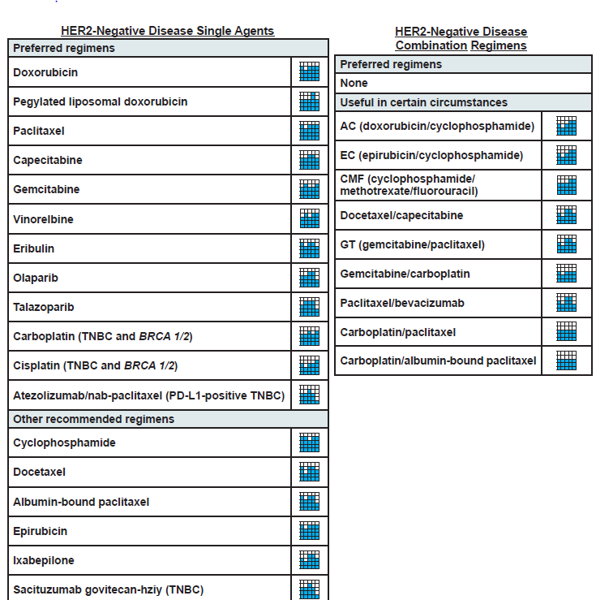
NCCN Evidence Block: Chemotherapy
Approved 1/2018
Approved 10/2018
Withdrawn 8/2021
NCCN, 2021b.
Approved 4/2020
Notes:
You will note that the vast majority of regimens for hormone receptor (HR)–negative and human epidermal growth factor receptor 2 (HER2)–negative disease are classic chemotherapies that have been around for a long time. However, in recent years, 4 new regimens have been approved. The PARP inhibitors olaparib and talazoparib were approved in January and October 2018, respectively. Then, in March 2019, an immune therapy, atezolizumab, a programmed death ligand 1 (PD-L1) monoclonal antibody, was approved in combination with nab-paclitaxel for PD-L1–positive TNBC. In April 2020, sacituzumab govitecan, an antibody-drug conjugate, was approved (US FDA, 2020b). Recently, in August 2021, atezolizumab/nab-paclitaxel was voluntarily withdrawn by Genentech for PD-L1–positive TNBC (Genentech, 2021).

Slide 52
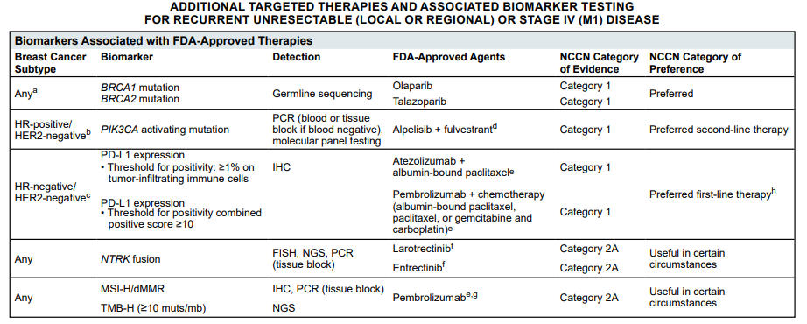
NCCN Guidelines: Additional Targeted Therapies
PIK3CA = phosphatidylinositol-4,5-bisphosphate 3-kinase catalytic subunit alpha; PCR = polymerase chain reaction; NGS = next-generation sequencing;
MSI-H = MSI-high; dMMR = deficient MMR; TMB-H = tumor mutational burden–high.
NCCN, 2021a.
Notes:
The National Comprehensive Cancer Network (NCCN) Blocks of Evidence have yet to incorporate these recommendations in the grid on the prior page. For the triple-negative metastatic patient, we see that immune therapy is a preferred first-line treatment. We also know that based on IMpassion131, which did not support the interim analysis of IMpassion130, the indication for atezolizumab plus albumin-bound paclitaxel has been withdrawn, leaving only pembrolizumab in combination with chemotherapy as the preferred first-line therapy in programmed death ligand 1 (PD-L1)-positive patients with an eligible combined positivity score.

Slide 53
KEYNOTE-355: Pembrolizumab/Chemotherapy
Trial Design
Key Eligibility Criteria
Age ≥18 years
Central determination of TNBC and PD-L1 expression
Previously untreated locally recurrent inoperable or metastatic TNBC
Completion of treatment with curative intent ≥6 months prior to first disease recurrence
ECOG PS 0 or 1
Life expectancy ≥12 weeks from randomization
Adequate organ function
No systemic steroids
No active CNS metastases
No active autoimmune disease
Pembrolizumab^{a/}chemotherapy^{b}
Progressive disease/cessation of study therapy
R
2:1
Placebo/chemotherapy^{b}
Stratification factors:
Chemotherapy on study (taxane vs gemcitabine/carboplatin)
PD-L1 tumor expression (CPS ≥1 vs CPS <1)
Prior treatment with same class chemotherapy in the neoadjuvant or adjuvant setting (yes vs no)
ªPembrolizumab 200 mg IV Q3W.
^{b}Chemotherapy dosing regimens are as follows: nab-paclitaxel 100 mg/m² IV on Days 1, 8, and 15 every 28 days; paclitaxel 90 mg/m² IV on Days 1, 8, and
15 every 28 days; gemcitabine 1,000 mg/m² + carboplatin AUC 2 on Days 1 and 8 every 21 days.
CPS = combined positive score; IV = intravenous; AUC = area under the curve.
Cortes et al, 2020.

Slide 54
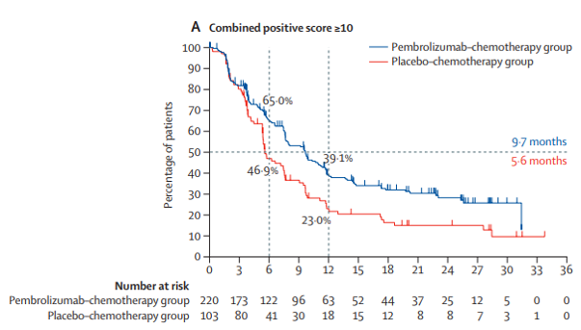
KEYNOTE-355: Pembrolizumab/Chemotherapy (cont.)
PFS for CPS ≥10
Pembrolizumab plus chemotherapy: 9.7 months
Chemotherapy: 5.6 months
(HR 0.65, 95% CI: 0.49-0.86, P=0.0012)
Cortes et al, 2020.
Notes:
Above is the progression-free survival (PFS) for patients who met the CPS of ≥10. We will focus on that, given the National Comprehensive Cancer Network (NCCN) recommendation and FDA approval for this criteria.
The CPS score is a complex calculation in which the pathologist divides the number of programmed death ligand 1 (PD-L1)–positive cells plus the PD-L1 positive mononuclear inflammatory cells (MIC) by the total number of cells and then adjusts the score for the percentage of the tumor that is stained. This is different than immunohistochemistry (IHC) and requires very good pathologists.

Slide 55
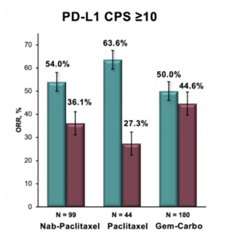
KEYNOTE-355: Pembrolizumab/Chemotherapy (cont.)
ORR for CPS ≥10 by Chemotherapy
PD-L1 CPS ≥10
70
63.6%
60
54.0%
50.0%
50
44.6%
ORR, %
36.1%
40
27.3%
30
20
10
0
n=99
n=44
n=180
Nab-paclitaxel
Paclitaxel
Gem/carbo
Gem = gemcitabine; carbo = carboplatin.
Rugo, Schmid et al, 2020.

Slide 56
KEYNOTE-355: Pembrolizumab/Chemotherapy (cont.)
Adverse Events
 | Pembrolizumab/chemotherapy group (n=562) |  | Placebo/chemotherapy group (n=281)
 | Any grade | Grade ≥3 | Any grade | Grade ≥3
Any adverse event | 554 (99%) | 438 (78%) | 276 (98%) | 207 (74%)
Treatment-related adverse events
Total | 541 (96%) | 383 (68%) | 267 (95%) | 188 (67%)
Anemia | 275 (49%) | 92 (16%) | 129 (46%) | 41 (15%)
Neutropenia | 231 (41%) | 167 (30%) | 107 (38%) | 84 (30%)
Nausea | 221 (39%) | 9 (2%) | 115 (41%) | 4 (1%)
Alopecia | 186 (33%) | 5 (1%) | 94 (33%) | 3 (1%)
Fatigue | 160 (28%) | 16 (3%) | 83 (30%) | 7 (2%)
Neutrophil count decreased | 125 (22%) | 98 (17%) | 74 (26%) | 57 (20%)
ALT increased | 115 (20%) | 33 (6%) | 46 (16%) | 13 (5%)
ALT = alanine aminotransferase.
Cortes et al, 2020.
Notes:
You will note that the toxicities are very similar in the pembrolizumab vs placebo groups, until you get to the immune-related adverse events (IRAEs), of which thyroid disorders are the more common in the immune therapy arm

Slide 57
KEYNOTE-355: Pembrolizumab/Chemotherapy (cont.)
Immune-Mediated Adverse Events
Immune-mediated adverse event | Pembrolizumab/chemotherapy group (n=562) |  | Placebo/chemotherapy group (n=281)
Total | 144 (26%) | 29 (5%) | 17 (6%) | 0
Hypothyroidism | 87 (15%) | 2 (<1%) | 9 (3%) | 0
Hyperthyroidism | 27 (5%) | 1 (<1%) | 3 (1%) | 0
Pneumonitis | 14 (2%) | 6 (1%) | 0 | 0
Colitis | 10 (2%) | 2 (<1%) | 4 (1%) | 0
Severe skin reactions | 10 (2%) | 10 (2%) | 1 (<1%) | 0
Cortes et al, 2020.
Notes:
You will note that the toxicities are very similar in the pembrolizumab vs placebo groups, until you get to the immune-related adverse events (IRAEs), of which thyroid disorders are the more common in the immune therapy arm

Slide 58
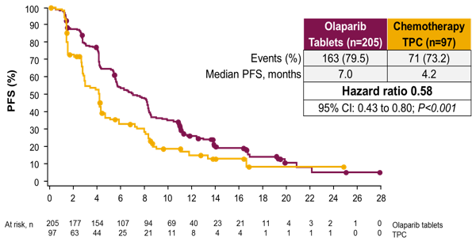
PARP Inhibitors: Olaparib
PFS Benefit in gBRCA-Mutant Disease
OlympiAD
TPC = treatment of physician’s choice.
Robson et al, 2017.

Slide 59
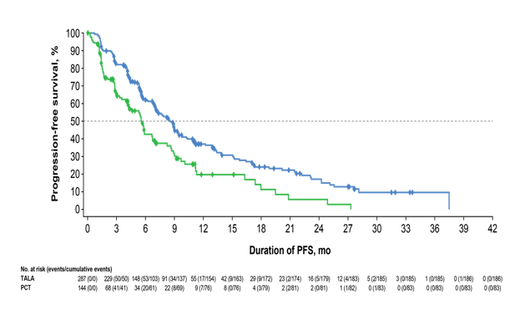
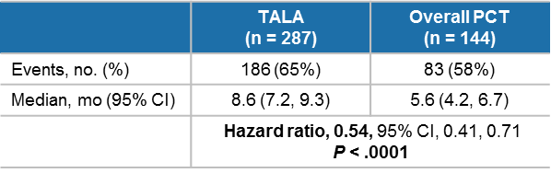
PARP Inhibitors: Talazoparib
PFS Benefit in gBRCA-Mutant Disease
EMBRACA
mo = months; TALA = talazoparib; PCT = physician’s choice of chemotherapy.
Litton et al, 2018.

Slide 60
IMpassion130: Atezolizumab + nab-Paclitaxel
First Approval of Immunotherapy for Breast Cancer
Key eligibility criteria
  Histologically documented metastatic or inoperable, locally advanced TNBC
  No prior therapy for advanced TNBC
    Prior chemotherapy, including taxanes, allowed in curative setting if treatment-free interval ≥12 mos
  ECOG PS 0-1
  Eligible for taxane monotherapy
  Tumor tissue for PD-L1 testing
  (N=902)
Atezolizumab
+ nab-paclitaxel
Treatment until progression or unacceptable toxicity
R
1:1
Double blind
Placebo +
nab-paclitaxel
  Coprimary end points:
  PFS and OS (hierarchically tested in ITT and PD-L1 IC+ populations)
  Stratification factors
  Liver metastases (yes vs no)
  Prior taxanes (yes vs no)
  PD-L1 status (positive vs negative)
ITT = intention to treat; IC = immune cells.
Emens et al, 2020.

Slide 61
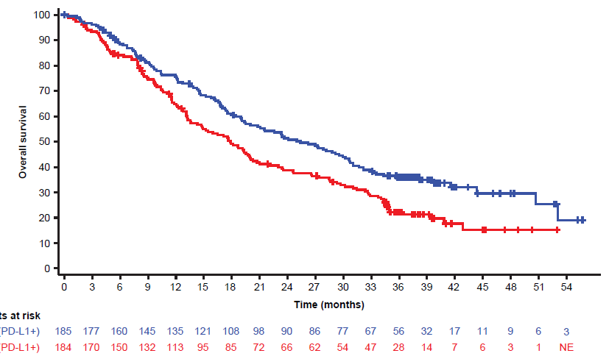
IMpassion130: Atezolizumab + nab-Paclitaxel (cont.)
Final OS in the PD-L1 IC+ Population
 | PD-L1 Population
 | A + nP (n=185) | P + nP (n=184)
OS events, n (%) | 120 (65) | 139 (76)
Stratified HR (95% CI) | 0.67 (0.53, 0.86)
Median 17.9 mos
(95% CI: 13.6, 20.3)
36%
Median 25.4 mos
(95% CI:19.6, 30.7)
22%
3-year OS
Patients at risk
(PD-L1 IC+ population):
A + nP
P + nP
A = atezolizumab; nP = nab-paclitaxel; P = placebo.
Emens et al, 2020.

Slide 62
IMpassion131: Atezolizumab + nab-Paclitaxel
Withdrawal of Approval
Atezolizumab + nab-paclitaxel did not improve PFS or OS in the PD-L1–positive population or the ITT population
August 27, 2021: Genentech withdrew accelerated approval
Miles et al, 2021; Genentech, 2021.

Slide 63
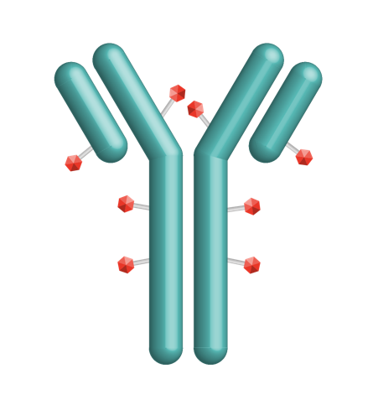

Sacituzumab Govitecan
First-in-Class Trop-2‒Directed ADC
Trop-2 is expressed in all subtypes of breast cancer and linked to poor prognosis
Granted accelerated approval by the FDA for metastatic TNBC and fast-track designation in metastatic urothelial cancer
Linker for SN-38
Hydrolyzable linker for payload release
High drug-to-antibody ratio (7.6:1)
Humanized anti‒Trop-2 antibody
Directed toward Trop-2, an epithelial antigen expressed on many solid cancers
SN-38 payload
SN-38 metabolite 1,000x more potent than parent compound, irinotecan
Vidula et al, 2017; Ambrogi et al, 2014; US FDA, 2020a.

Slide 64
ASCENT: Sacituzumab Govitecan
A Phase 3 Confirmatory Study in Relapsed/Refractory mTNBC
Metastatic TNBC
(per ASCO/CAP)
≥2 chemotherapies for advanced disease
No upper limit; 1 of the required prior regimens could be from progression that occurred within a 12-month period after completion of (neo)adjuvant therapy
N=529
Sacituzumab Govitecan (SG)
10 mg/kg IV Days 1 & 8, every 21-day cycle
(n=235)
Continue treatment until progression or unacceptable toxicity
R 1:1
Treatment of Physician’s Choice (TPC)ª
(n=233)
Primary end point: PFS assessed by central review in the brain metastases–negative population, as predefined in the study protocol
Key secondary end points: overall survival, overall response rate according to RECIST v1.1, and safety
Data cutoff: March 11, 2020
ªTPC: eribulin, vinorelbine, gemcitabine, or capecitabine.
mTNBC = metastatic TNBC; ASCO = American Society of Clinical Oncology; CAP = College of American Pathologist; TTR = time to treatment response.
Bardia et al, 2020.
Notes:
3rd or greater line of therapy

Slide 65
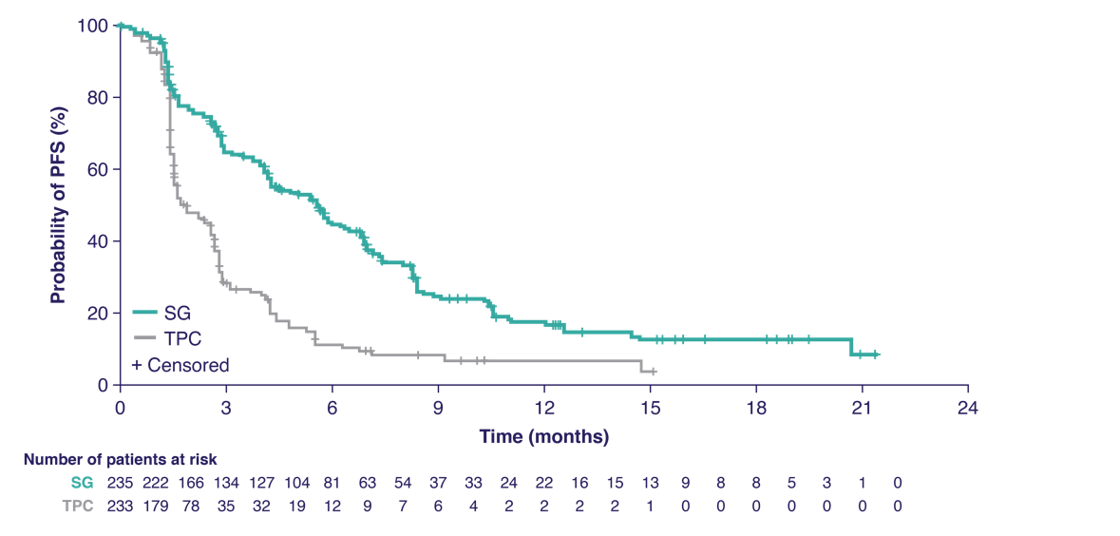
ASCENT: Sacituzumab Govitecan (cont.)
Progression-Free Survival (BICR Analysis)
BICR Analysis | SG (n=235) | TPC (n=233)
Median PFS | 5.6 mos | 1.7 mos
HR, P value | 0.41, P<0.0001
Trial halted early due to compelling evidence of efficacy per unanimous DSMC recommendation
BICR = blinded independent central review; DSMC = data safety monitoring committee.
Bardia et al, 2020.

Slide 66
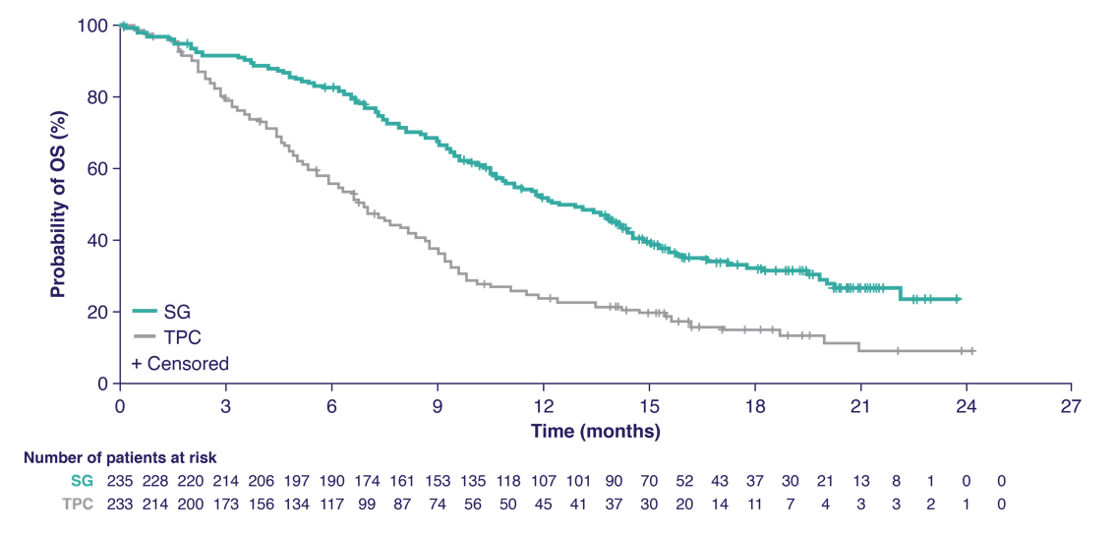
ASCENT: Sacituzumab Govitecan (cont.)
Overall Survival
 | SG (n=235) | TPC (n=233)
Median OS | 12.1 mos | 6.7 mos
HR, P value | 0.48, P<0.0001
Assessed by independent central review in the brain metastases-negative population
Bardia et al, 2020.

Slide 67
ASCENT: Sacituzumab Govitecan (cont.)
TRAEs (All Grade, >20%; Grade 3/4, >5% of Patients)
 |  |  | SG (n=258) |  |  | TPC (n=224)
TRAEª |  |  | All grade | Grade 3 | Grade 4 | All grade | Grade 3 | Grade 4
Hematologic | Neutropenia^{b} | Neutropenia Febrile neutropenia Anemia Leukopenia | 63% | 46% | 17% | 43% | 27% | 13%
 | Anemia^{c} |  | 34% | 8% | 0% | 24% | 5% | 0
 | Leukopenia^{d} |  | 16% | 10% | 1% | 11% | 5% | 1%
 | Febrile neutropenia |  | 6% | 5% | 1% | 2% | 2% | <1%
Gastrointestinal | Diarrhea |  | 59% | 10% | 0% | 12% | <1% | 0
 | Nausea |  | 57% | 2% | <1% | 26% | <1% | 0
 | Vomiting |  | 29% | 1% | <1% | 10% | <1% | 0
Other | Fatigue | Fatigue Alopecia Decreased appetite Hyperglycemia Hypomagnesemia Hypophosphatemia | 45% | 3% | 0 | 30% | 5% | 0
 | Alopecia |  | 46% | 0 | 0 | 16% | 0 | 0
ªPatients may report more than 1 event per preferred term. AEs were classified according to the MedDRA systems of preferred terms and system organ class and according to severity by NCI
CTCAE v4.03.
^{b}Combined preferred terms of “neutropenia” and “decreased neutrophil count.”
^{c}Combined preferred terms of ”anemia” and “decreased hemoglobin.”
^{d}Combined preferred terms of “leukopenia” and “decreased white blood cell count.”
TRAE = treatment-related adverse event; G-CSF = granulocyte colony stimulating factor; MedDRA = Medical Dictionary for Regulatory Activities; NCI = National
Cancer Institute; CTCAE = Common Terminology Criteria for Adverse Events.
Bardia et al, 2020.

Slide 68
Case Study 3
Ms. TR a 58-year-old woman diagnosed in 2017 with a left breast T2N2 IDC: ER 30%, PR 5%, and HER2-negative. TC x 4.
She has received adjuvant letrozole since February 2018
Recent lab work notable for increase in LFTs with AST of 89, ALT 104, and T bili 1.8
A CT scan of the chest, abdomen, and pelvis (CAP) is ordered and demonstrates multiple lesions in the liver, with the largest 2.5 x 1.5 cm
The rest of the exam is unremarkable
IDC = invasive ductal carcinoma; LFT = liver function test; AST = aspartate aminotransferase; T bili = total bilirubin;

Slide 69
Case Study 3
She returns to clinic today to review the scan and discuss next steps
What diagnostic testing should be ordered?
What biomarker and genetic results do you need to know, and why?
Notes:
Diagnostics:
Labs: complete blood count (CBC), comprehensive metabolic panel (CMP), tumor markers
Biopsy
Biomarkers: estrogen receptor (ER), progesterone receptor (PR), HER2, and PD-L1
Genetic: germline BRCA, somatic PIK3CA

Slide 70
Case Study 3 (cont.)
A liver biopsy is ordered, along with germline and somatic genetic testing. Results are as follows:
  IHC: ER <1%, PR 0%, HER2-negative, and PD-L1 CPS=12
  Germline genetic results: BRCA1 positive
  Somatic tumor genetic results: BRCA and ATM positive, PIK3CA-negative
  Markers: CA 15-3 75, CEA 44
CA = cancer antigen; CEA = carcinoembryonic antigen.

Slide 71
Case Study 3 (cont.)
Based on these results, which of the following would you anticipate as her initial therapy?
  PARP inhibitor
  Pembrolizumab + chemotherapy
  Gemcitabine + carboplatin
  Capecitabine
  Sacituzumab govitecan
  Eribulin
Notes:
Preferred answer: b.) Pembrolizumab + chemotherapy
Rationale:
Pembrolizumab + chemo is the National Comprehensive Cancer Network (NCCN) preferred first-line therapy
Sacituzumab has shown overall survival benefit; however, the benefit was in patients with ≥2 prior lines of therapy, so it’s nice to save this for later
There may be cases when a patient wants an oral-only treatment. In those cases, a.) or d.) would be reasonable
Choices c) and f) are 2 “classic” chemotherapies that have activity in triple-negative breast cancer (TNBC) but have not demonstrated overall survival (OS) benefit. Eribulin has demonstrated progression-free survival (PFS) and OS comparable to capecitabine (NCCN, 2021b)

Slide 72
Managing Side Effects and Promoting Adherence

Slide 73
New Treatments and Key Toxicities
 | Diarrhea | Rash | Immune Reactions | Hyperglycemia | ILD / Pneumonitis | Nausea | Mucositis
T-DXd | x |  |  |  | x | X
Tucatinib | x
Neratinib | x
Alpelisib | x | x |  | x | x | x | x
Pembrolizumab |  |  | x
Sacituzumab govitecan | x | x |  |  |  | x
Enhertu® prescribing information, 2019; TukysaTM prescribing information, 2020; Nerlynx® prescribing information, 2020; Piqray® prescribing information, 2019;
Tecentriq® prescribing information, 2020; Keytruda® prescribing information, 2021; TrodelvyTM prescribing information, 2020.

Slide 74
Diarrhea: CONTROL trial
Learning from Neratinib
An international, open-label, sequential cohort phase 2 study investigating the effects of prophylactic anti-diarrheal regimen to improve the tolerability of neratinib as reported in ExteNET, with 40% grade 3 diarrhea and a 17% discontinuation rate
Primary end point: incidence of grade ≥3 diarrhea
Barcenas et al, 2020.

Slide 75
Managing Diarrhea With Neratinib: CONTROL Trial
An international, open-label, sequential cohort phase 2 study investigating the effects of prophylactic anti-diarrheal regimen to improve the tolerability of neratinib as reported in ExteNET, with 40% grade 3 diarrhea and a 17% discontinuation rate
Treatment arms (cycles 1 and 2):
  Arm 1: loperamide
  Arm 2: budesonide/loperamide
  Arm 3: colestipol/loperamide
  Arm 4: colestipol + PRN loperamide
  Arm 5: titration of neratinib from 1/2 dose to full dose over 14 days + PRN loperamide
Barcenas et al, 2020.
Notes:
The CONTROL trial looked at 5 strategies for prophylactic management of diarrhea for the first 2 cycles. These were then compared to the experience in the adjuvant ExteNET Trial as the control arm.
Budesonide is a locally acting corticosteroid often used for inflammatory gastrointestinal conditions (irritable bowel syndrome, ulcerative colitis, etc)
Colestipol is a bile acid sequestrant used in the management of hyperlipidemia (Barcenas et al, 2020)

Slide 76
CONTROL (cont.)
Results
LPM
Discontinuation
due to diarrhea
17%
20%
8%
4%
3%
Adj = adjuvant; LPM = loperamide.
Barcenas et al, 2020.
Notes:
Key learnings:
Prophylaxis matters
Dose titration may be a strategy
Apply to other diarrhea situations: tucatinib, pertuzumab, sacituzumab govitecan, alpelisib, and abemaciclib

Slide 77
Alpelisib
Baseline Data and Prophylaxis
Hyperglycemia:
  Obtain baseline labs: fasting blood glucose (FBG) and Hgb A1c
  Optimize blood glucose control prior to initiation including lifestyle
  Monitoring FBG weekly x 2 then every 4 weeks and as clinically indicated
Diarrhea: consider prophylaxis
Rash: consider use of prophylactic antihistamines
Mucositis: consider prophylactic dexamethasone rinses
Pneumonitis: consider baseline diagnostic CT scan if no prior
Hgb = hemoglobin.
Rugo, Lerebours et al, 2020; Rugo et al, 2017; Piqray® prescribing information, 2019.

Slide 78
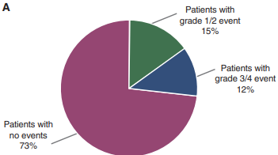
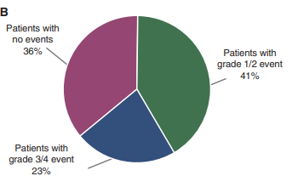
Alpelisib (cont.)
Rash Prophylaxis in the SOLAR 1 Trial
Prophylaxis (n=86)
No prophylaxis (n=198)
Of the 86 patients who received rash prophylaxis, 60 (69.8%) received antihistamines, of which 38% experienced any-grade rash. Other prophylactic treatments included steroids and hydroxyzine
Rugo, André et al, 2020.
Notes:
In total, 86 patients in the alpelisib group received anti-rash medication before the onset of rash, with antihistamines being the most frequent treatment (60 of 86 patients, or 69.8%). Of the 60 patients who received antihistamines (specifically as anti-rash medication) before the development of rash, 23 patients (38.3%) experienced any-grade rash, compared with 130 patients (58.0%) of the 198 patients who did not receive an antihistamine in advance.

Slide 79
Pembrolizumab
Immune-Related AEs (IRAEs)
Eye problems
Blurry or double vision or other vision problems; eye pain or redness
Brain inflammation
(encephalitis)
Fever; confusion; changes
in mood or behavior; neck stiffness; seizures; extreme
sensitivity to light
Hormone gland problems (especially the thyroid, pituitary, adrenal glands, pancreas)
Persistent or unusual headaches; extreme tiredness; weight loss or gain; rapid heartbeat; increased sweating; hair loss; constipation; dizziness or fainting
Skin problems
Rashes; itching; blistering;
painful sores or ulcers
Lung problems (pneumonitis)
New or worsening cough; shortness of breath
Heart problems (myocarditis, arrhythmia)
Inflammation of the heart muscle; irregular heartbeat
Liver problems (hepatitis)
Yellowing of the skin or the whites of the eyes; severe nausea or vomiting;
Pain on the right side of the stomach area; dark urine; bleeding or bruising more easily than normal
Intestinal problems (colitis)
Diarrhea or more bowel movements than usual; stools that have blood or are dark, tarry, or sticky; severe stomach-area pain
Kidney problems
Decrease in the amount of urine; blood in the urine
Nerve problems
Numbness or tingling in hands or feet; unusual weakness in legs, arms, or face
Joint or muscle problems
Severe or persistent muscle or
joint pain; severe muscle weakness
Image courtesy of NCCN.
Notes:
NCCN has an entire resource for IRAE

Slide 80
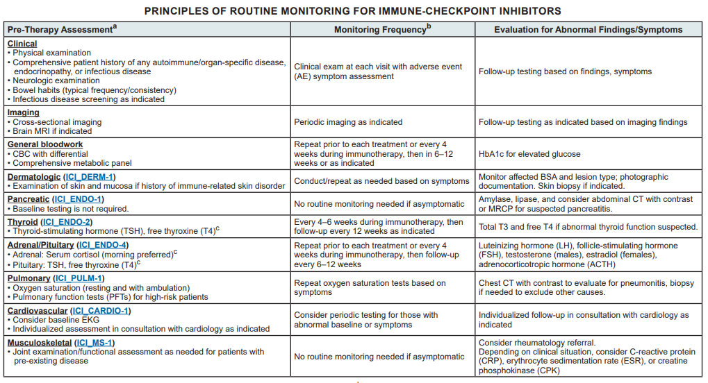
Pembrolizumab (cont.)
IRAEs
BSA = body surface area; MRCP = magnetic resonance cholangiopancreatography; EKG = electrocardiogram.
NCCN, 2021b.

Slide 81






Interstitial Lung Disease Management for T-DXd
T-DXd Clinical Trial Protocol Guidance
Dose Interruption/ Discontinuation
Monitoring
Confirm
Advise patients to immediately report cough, dyspnea, fever, and/or any new or worsening respiratory symptoms
Promptly investigate evidence of ILD
Evaluate patients with suspected ILD by
radiographic imaging
Consider consultation with a pulmonologist
Evaluations should include:
High-resolution CT scan
Pulmonologist consultation
Blood culture and CBC
Consider bronchoscopy
PFTs and pulse oximetry
For grade 1 (asymptomatic):
Delay dose until recovery (grade 0)
For grade ≥2 (symptomatic):
Permanently discontinue
Corticosteroid Treatment
Resume Therapy
(Grade 1 only)
Dose
Modification
For grade 1 (asymptomatic):
Consider corticosteroid treatment as soon as ILD is suspected
  Eg, ≥0.5 mg/kg prednisolone or equivalent
For grade ≥2 (symptomatic):
Promptly initiate corticosteroid treatment as soon as ILD/pneumonitis is suspected
  Eg, ≥1 mg/kg prednisolone or equivalent
Do not re-escalate the T-DXd dose after a dose reduction is made
4.4 mg/kg
If resolved in ≤28 days from date of onset:
Maintain dose
If resolved in >28 days from date of onset:
Reduce dose 1 level
Initial dose reduction
Final dose reduction
3.2 mg/kg
CBC = complete blood count; PFT = pulmonary function test.
Powell et al, 2018; Enhertu® prescribing information, 2019.
Notes:
Interstitial lung disease was an AE of interest that emerged during early fam-trastuzumab deruxtecan (T-DXd) studies
An independent ILD adjudication committee was formed to review all reported cases of ILD in patients who received ≥1 dose of T-DXd from 7 ongoing studies across multiple tumor types (Powell et al, 2018)
Data cutoff was October 15, 2019
The current management guidelines from principal investigator evolved from the findings of this committee, as well as additional discussions with multidisciplinary experts
There is ongoing research to further understand additional effective monitoring and management strategies, as well as to identify which patients are at a higher risk of developing ILD
Step 1: Monitor
Interrupt drug
Rule out ILD if a patient develops radiographic changes potentially consistent with ILD or develops an acute onset of new or worsening pulmonary or other related signs/symptoms, such as dyspnea, cough, or fever (ENHERTU® prescribing information, 2019)
Step 2: Confirm
Evaluations should include:
High-resolution computed tomography (CT)
Pulmonologist consultation (infectious disease consultation as clinically indicated)
Blood culture and complete blood count (CBC); other blood tests could be considered as needed
Consider bronchoscopy and bronchoalveolar lavage if clinically indicated and feasible
Pulmonary function tests (PFTs) and pulse oximetry
Arterial blood gases if clinically indicated
One blood sample collection for pharmacokinetic analysis as soon as ILD is suspected, if feasible
All events of ILD, regardless of severity or seriousness, should be followed until resolution including after drug discontinuation (ENHERTU® prescribing information, 2019)
Step 3: Dose Interruption and Modification
Drug must be interrupted for any ILD events regardless of grade
Grade 1: T-DXd can be restarted only if the event is fully resolved:
If resolved in ≤28 days from day of onset, maintain dose
If resolved in >28 days from day of onset, reduce dose by 1 level
However, if the grade-1 ILD event occurs beyond cycle day 22 and has not resolved within 49 days from the last infusion, the drug should be discontinued
Grade ≥ 2: Permanently discontinue patient from T-DXd treatment (Enhertu® prescribing information, 2019)
Step 4: Manage
Grade 1
Monitor and closely follow-up in 2-7 days for onset of clinical symptoms and pulse oximetry
Consider follow-up imaging in 1-2 weeks (or as clinically indicated)
Consider starting systemic steroids (eg, ≥0.5 mg/kg/day prednisone or equivalent) until improvement, followed by gradual taper over ≥4 weeks
If worsening of diagnostic observations despite initiation of corticosteroids, then follow grade 2 guidelines
If the patient is asymptomatic, then they should still be considered as grade 1 even if steroid treatment is given
Grade 2
Promptly start systemic steroids (eg, ≥1 mg/kg/day prednisone or equivalent) until clinical improvement, followed by gradual taper over ≥4 weeks
Monitor symptoms closely
Reimage as clinically indicated
If worsening or no improvement in clinical or diagnostic observations in 5 days:
Consider increasing dose of steroids (eg, 2 mg/kg/day prednisone or equivalent); also, administration may be switched to intravenous (eg, methylprednisolone)
Reconsider additional workup for alternative etiologies as described above
Escalate care as clinically indicated
Grade 3/4
Hospitalization required
Promptly initiate empiric high-dose methylprednisolone intravenous (IV) treatment (eg, 500-1,000 mg/day for 3 days), followed by at least 1.0 mg/kg/day of prednisone or equivalent until clinical improvement, followed by gradual taper over ≥4 weeks
Reimage as clinically indicated
If still no improvement within 3-5 days:
Reconsider additional workup for alternative etiologies as described above
Consider other immunosuppressants and/or treat per local practice (Enhertu® prescribing information, 2019)

Slide 82
Nausea and Mucositis
New Agents, Familiar Solutions
Nausea
  Common with sacituzumab govitecan, T-DXd, and alpelisib
  Consider NCCN guidelines for highly emetogenic agents
    Olanzapine
    NK-1 RA (eg, fosaprepitant)
    5-HT₃ RA (eg, palonosetron)
    Dexamethasone
Mucositis
  Common with alpelisib
  Consider prophylactic dexamethasone rinses per everolimus SWISH study
    Prophylactic use of 10 mL dexamethasone 0.5 mg/5 mL 4x daily x 8 weeks
    Grade 2 mucositis in 2% of patients, compared with 33% of historical controls in BOLERO-2
RA = receptor antagonist.
NCCN, 2020a; Piqray® prescribing information, 2019; TukysaTM prescribing information, 2020; Rugo, Lerebours et al, 2020.

Slide 83
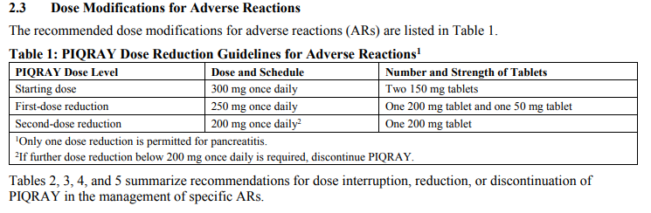
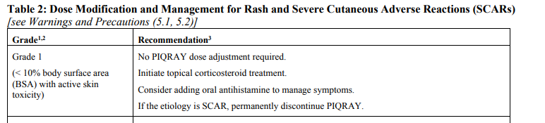
Prescribing Information: The Indispensable Resource
Alpelisib
Alpelisib Dose Level
alpelisib
alpelisib
No alpelisib
alpelisib
Piqray® prescribing information, 2019.

Slide 84
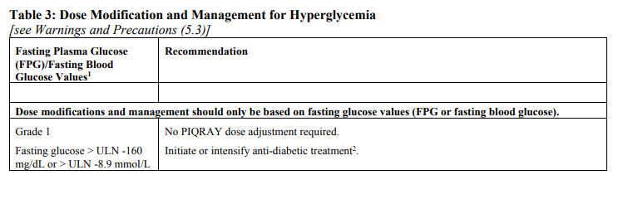
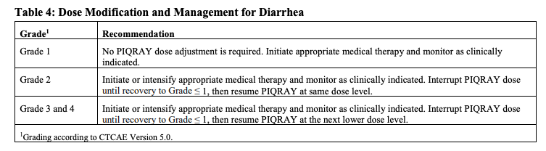
Prescribing Information: The Indispensable Resource (cont.)
alpelisib dose adjustment required
alpelisib
alpelisib
alpelisib
alpelisib
alpelisib
ULN = upper limit of normal.
Piqray® prescribing information, 2019.

Slide 85
Promoting Adherence
Personalized approach: side effect mitigation
Monitor for drug interactions (→ increased toxicity)
Monitor for prescription “stretching”
Check in early and often
Alerts, alarms or text messaging
Address cost and “financial toxicity”
Patient education prior to starting; consistently reinforce
Enhance patient belief in benefit of treatment
Casey, 2017.
Notes:
Prescription stretching is the practice of taking less than full dose to make oral medications last longer and reduce out-of-pocket costs.

Slide 86
Case Study 3 (cont.)
Ms. TR is a 60-year-old woman with BRCA1-mutant, ER/PR/HER2-negative, PD-L1 negative breast cancer with liver metastasis
  1/2019 to 11/2020: first-line paclitaxel. Discontinued due to neuropathy
  12/2020 to 8/2021: second-line olaparib until POD
  10/2020: started third-line sacituzumab govitecan
She returns to the clinic today for Cycle 2 Day 1. Interval history and assessment are notable for:
  No transfusion reaction prior cycle
  Grade 2 diarrhea (5 stools/day), limited benefit with loperamide (took up to 8 tabs)
  Grade 2 nausea 3 days after infusion, 3 episodes of emesis. Optimized PRN antiemetics
  ANC 1,600. Patient is afebrile without S&S of infection
IRAE = immune-related adverse event; ANC = absolute neutrophil count; S&S = signs and symptoms.

Slide 87
Case Study 3 (cont.)
What Are Key Considerations/Interventions for Cycle 2?
Transfusion reaction
Diarrhea
Nausea
Neutropenia

Slide 88
Case Study 3 (cont.)
Key Considerations: Transfusion Reaction
First infusion
  Administer over 3 hours
  Observe patients during infusion and for ≥30 minutes following the initial dose for S/S of infusion-related reactions
Subsequent infusions
  Administer over 1-2 hours if prior infusions were tolerated
  Observe patients during the infusion and for ≥30 minutes following
  Premedication with antipyretics, H1 and H2 blockers prior to infusion, and corticosteroids for patients who had prior infusion reactions
S/S = signs and symptoms.
TrodelvyTM prescribing information, 2020

Slide 89
Case Study 3 (cont.)
Key Considerations: Diarrhea, Nausea, Neutropenia
Diarrhea
  Consider use of prophylactic anti-diarrhea meds, including colestipol
Nausea
  Consider use of olanzapine per NCCN guidelines for highly emetogenic regimens. Package insert recommends premedication with a two or three drug combination regimen (e.g., dexamethasone with either a 5-HT3 receptor antagonist or an NK1 receptor antagonist, as well as other drugs as indicated)
Neutropenia
  Black box warning to hold if ANC <1500 or febrile neutropenia
  Consider use of filgrastim after Day 1 and pegfilgrastim after Day 8
TrodelvyTM prescribing information, 2020; NCCN, 2020a.

Slide 90
Adverse Event Management: Summary
Baseline assessments are critical
  Imaging: chest CT, pulse ox
  Labs: Hgb A1c, fasting glucose, CBC, CMP
Prophylaxis improves tolerability
  Diarrhea: CONTROL trial (loperamide, colestipol, and budesonide)
  Rash: SOLAR 1 trial (histamine blockers)
  Mucositis: SWISH study (dexamethasone rinse)
Flexibility to extrapolate
  Colestipol for diarrhea (eg, tucatinib, pertuzumab, sacituzumab, abemaciclib, etc)
  Olanzapine for refractory nausea
  Dexamethasone rinses for diffuse mucositis
Follow the prescribing information
QOL is the second main goal of treatment

Slide 91
Patient Resources
NCCN Guidelines for Patients: Metastatic Breast Cancer
  nccn.org/patients/guidelines/content/PDF/stage_iv_breast-patient.pdf
American Cancer Society
  cancer.org/cancer/breast-cancer.html
CancerCare
  cancercare.org/diagnosis/breast_cancer
His Breast Cancer
  hisbreastcancer.org
Susan G. Komen
  komen.org

Slide 92
Key Learning Takeaways
Full characterization of biologic and genetic attributes is required for strategically planning lines of therapy
New agents require continuous learning
Antibody-drug conjugates require understanding of target and payload
Anticipation and prophylaxis of common side effects is critical
In supportive care, the ability to extrapolate side effect management across treatments is an opportunity to innovate
Think outside the box!

Slide 93
Scan now to complete the
posttest and evaluation
Thank you joining us!
Scan the QR here or on the front of your i3 Health folder to complete the posttest and evaluation OR use the paper assessment and paper evaluation included in your i3 Health folder
To scan the QR code:
FOR IPHONE:
Open the camera & focus it to QR code
Your internet browser should pop up with a link
Click the link and complete
FOR ANDROID:
Open the camera & focus it to QR code
Hold ‘Home’ button
The pretest comes visible to complete

Slide 94
References
Ambrogi F, Fornili M, Boracchi P, et al (2014). Trop-2 is a determinant of breast cancer survival. PLOS ONE, 9(5):e96993. DOI:10.1371/journal.pone.0096993
American Cancer Society (2020). Breast cancer facts & figures 2019-2020. Available at: https://cancer.org
André F, Ciruelos E, Rubovszky G, et al (2019). Alpelisib for PIK3CA-mutated, hormone receptor-positive advanced breast cancer. N Engl J Med, 380:1929-1940. DOI:10.1056/NEJMoa1813904
Barcenas CH, Hurvitz SA, Di Palma JA, et al (2020). Improved tolerability of neratinib in patients with HER2-positive early-stage breast cancer: the CONTROL trial. Ann Oncol, 31(9):1223-1230. DOI:10.1016/j.annonc.2020.05.012
Bardia A, Tolaney SM, Loirat D, et al (2020). ASCENT: a randomized phase III study of sacituzumab govitecan (SG) vs treatment of physician’s choice (TPC) in patients (pts) with previously treated metastatic triple-negative breast cancer (mTNBC). Ann Oncol (ESMO Virtual Congress Abstracts), 31(suppl_4):S1142-S1215. Abstract LBA17. DOI:10.1016/annonc/annonc325
Casey, A (2017). 7 oral adherence tips from nurses and pharmacists. Oncology Nursing News. Available at: https://www.oncnursingnews.com/web-exclusives/7-oral-adherence-tips-from-nurses-and-pharmacists
Corona SP & Generali D (2018). Abemaciclib: a CDK4/6 inhibitor for the treatment of HR+/HER2- advanced breast cancer. Drug Des Devel Ther, 12:321-330. DOI:10.2147/DDDT.S137783
Cortes J, Cescon DW, Rugo HS, et al (2020). KEYNOTE-355: Randomized, double-blind, phase III study of pembrolizumab + chemotherapy versus placebo + chemotherapy for previously untreated locally recurrent inoperable or metastatic triple-negative breast cancer. J Clin Oncol (ASCO Annual Meeting Abstracts), 38(suppl_15). Abstract 1000. DOI:10.1200/JCO.2020.38.15_suppl.1000
Enhurtu® (fam-trastuzumab dertuxtecan-nxki) prescribing information (2019). Daiichi Sankyo. Available at: https://dsi.com/prescribing-information-portlet/getPIContent?productName=Enhertu&inline=true
Gajria D & Chandarlapaty S (2011). HER2-amplified breast cancer: mechanisms of trastuzumab resistance and novel targeted therapies. Expert Rev Anticancer Ther, 11(2):263-275. DOI:10.1586/era.10.226
Genentech (2021). Genentech provides update on Tecentriq U.S. indication for PD-L1-positive, metastatic triple-negative breast cancer. Available at: https://www.gene.com/media/press-releases/14927/2021-08-27/genentech-provides-update-on-tecentriq-u
Giordano SH, Temin S, Chandarlapaty S, et al (2018). Systemic therapy for patients with advanced human epidermal growth factor receptor 2-positive breast cancer: ASCO clinical practice guideline update. J Clin Oncol, 36(26):2736-2740. DOI:10.1200/JCO.2018/79/2697
Ibrance® (palbociclib) prescribing information (2019). Pfizer. Available at: https://www.accessdata.fda.gov/drugsatfda_docs/label/2019/207103s008lbl.pdf

Slide 95
References (cont.)
Juric D, Ciruelos E, Rubovszky G, et al (2019). Alpelisib + fulvestrant for advanced breast cancer: subgroup analyses from the phase III SOLAR-1 trial. Cancer Res (San Antonio Breast Cancer Symposium Abstracts), 79(suppl_4). Abstract GS3-08. DOI:10.1158/1538-7445.SABCS18-GS3-08
Keytruda® (pembrolizumab) prescribing information (2021). Merck. Available at: https://www.merck.com/product/usa/pi_circulars/k/keytruda/keytruda_pi.pdf
Litton JK, Rugo HS, Ettl J, et al (2018). Talazoparib in patients with advanced breast cancer and a germline BRCA mutation. N Engl J Med, 379:753-763. DOI:10.1056/NEJMoa1802905
Lobbezoo DJA, van Kampen RJW, Voogd A, et al (2015). Prognosis of metastatic breast cancer: are there differences between patients with de novo and recurrent metastatic breast cancer? Br J Cancer, 112(9):1445-1451. DOI:10.1038/bjc.2015.127
Mariotto AB, Etzioni R, Hurlbert M, et al (2017). Estimation of the number of women living with metastatic breast cancer in the United States. Cancer Epidomiol Biomarkers Prev, 26(6):809-815. DOI:10.1158/1055-9965.EPI-16-0889
Modi S, Saura C, Yamashita T, et al (2020). Trastuzumab deruxtecan in previously treated HER2-positive breast cancer. N Engl J Med, 382:610-621. DOI:10.1056/NEJMoa1914510
Mosele F, Stefanovska B, Lusque A, et al (2020). Outcome and molecular landscape of patients with PIK3CA-mutated metastatic breast cancer. Ann Oncol, 31(3):377-386. DOI:10.1016/j.annonc.2019.11.006
Murthy RK, Loi S, Okines A, et al (2020). Tucatinib, trastuzumab, and capecitabine for HER2-positive metastatic breast cancer. N Engl J Med, 382:597-609. DOI:10.1056/NEJMoa1914609
Nakada T, Sugihara K, Jikoh T, et al (2019). The latest research and development into the antibody-drug conjugate, [fam-] trastuzumab deruxtecan (DS-8201a), for HER2 cancer therapy. Chem Pharm Bull (Tokyo), 67(3):173-185. DOI:10.1248/cpb.c18-00744
National Comprehensive Cancer Network (2020a). Clinical Practice Guidelines in Oncology: antiemesis. Version 2.2020. Available at: https://nccn.org
National Comprehensive Cancer Network (2020b). Guidelines for Patients: breast cancer metastatic. Available at: https://nccn.org
National Comprehensive Cancer Network (2021a). Clinical Practice Guidelines in Oncology: breast cancer. Version 7.2021. Available at: https://www.nccn.org/professionals/physician_gls/pdf/breast.pdf
National Comprehensive Cancer Network (2021b). Clinical Practice Guidelines in Oncology: breast cancer: NCCN evidence blocks. Version 5.2021. Available at: https://www.nccn.org/professionals/physician_gls/pdf/breast_blocks.pdf
Nerlynx® (neratinib) prescribing information (2020). Puma Biotechnology. Available at: https://nerlynx.com/pdf/full-prescribing-information.pdf
Pernas S & Tolaney SM (2019). HER2-positive breast cancer: new therapeutic frontiers and overcoming resistance. Ther Adv Med Oncol, 11:1758835919833519. DOI:10.1177/1758835919833519

Slide 96
References (cont.)
Piqray® (alpelisib) prescribing information (2019). Novartis. Available at: https://www.accessdata.fda.gov/drugsatfda_docs/label/2019/212526s000lbl.pdf
Powell CA, Camidge DR, Gemma A, et al (2018). Characterization, monitoring, and management of intersititial lung disease in patients with metastatic breast cancer: analysis of data available from multiple studies of DS-8201a, a HER2-targeted antibody drug conjugate with a topoisomerase I inhibitor payload. Poster presented at: San Antonio Breast Cancer Symposium. Poster P6-17-06. DOI:10.1158/1538-7445.SABCS18-P6-17-06
Robson M, Im SA, Senkus E, et al (2017). Olaparib for metastatic breast cancer in patients with a germline BRCA mutation. N Engl J Med, 377:523-533. DOI:10.1056/NEJMoa1706450
Rugo HS, André F, Yamashita T, et al (2020). Time course and management of key adverse events during the randomized phase III SOLAR-1 study of P13K inhibitor alpelisib plus fulvestrant in patients with HR-positive advanced breast cancer. Ann Oncol (ESMO Virtual Congress Abstracts), 31(suppl_8). Abstract 1006. DOI:10.1016/j.annonc.2020.05.001
Rugo HS, Lerebours F, Ciruelos E, et al (2020). Alpelisib (ALP) + fulvestrant (FUL) in patients (pts) with PIK3CA-mutated (mut) hormone receptor-positive (HR+), human epidermal growth factor receptor 2-negative (HER2–) advanced breast cancer (ABC) previously treated with cyclin-dependent kinase 4/6 inhibitor (CDKi) + aromatase inhibitor (AI): BYLieve study results. J Clin Oncol (ASCO Virtual Scientific Program Abstracts), 38(suppl_15). Abstract 1006. DOI:10.1200/JCO.2020.38.15_suppl.1006
Rugo HS, Schmid P, Cescon DW, et al (2020). Additional efficacy from the phase 3 KEYNOTE-355 study of pembrolizumab plus chemotherapy vs placebo plus chemotherapy as first-line therapy for locally recurrent inoperable or metastatic triple-negative breast cancer. 2020 San Antonio Breast Cancer Symposium Abstracts. Abstract GS3-01.
Rugo HS, Seneviratne L, Beck JT, et al (2017). Prevention of everolimus-related stomatitis in women with hormone receptor-positive, HER2-negative metastatic breast cancer using dexamethasone mouthwash (SWISH): a single-arm, phase 2 trial. Lancet Oncol, 18(5):654-662. DOI:10.1016/S1470-2045(17)30109-2
Saura C, Oliveira M, Feng YH, et al (2019). Neratinib + capecitabine versus lapatinib + capecitabine in patients with HER2+ metastatic breast cancer previously treated with ≥ 2 HER2-directed regimens: findings from the multinational, randomized, phase III NALA trial. J Clin Oncol (ASCO Annual Meeting Abstracts), 37(suppl_15). Abstract 1002. DOI:10.1200/JCO.2019.37.15_suppl.1002
Saura C, Oliveira M, Feng YH, et al (2020). Neratinib plus capecitabine versus lapatinib plus capecitabine in HER2-positive metastatic breast cancer previously treated with ≥2 HER2-directed regimens: phase III NALA trial. J Clin Oncol, 38(27):3138-3149. DOI:10.1200/JCO.20.00147
Swain SM, Miles D, Kim SB, et al (2019). End-of-study analysis from the phase III, randomized, double-blind, placebo (pla)-controlled CLEOPATRA study of first-line (1L) pertuzumab (P), trastuzumab (H), and docetaxel (D) in patients (pts) with HER2-positive metastatic breast cancer (MBC). J Clin Oncol (ASCO Annual Meeting Abstracts), 37(suppl_15). Abstract 1020. DOI:10.1200/JCO.2019.37.15_suppl.1020
Talzenna® (talazoparib) prescribing information (2020). Pfizer. Available at: http://labeling.pfizer.com/ShowLabeling.aspx?id=11046
Trail PA, Dubowchik GM & Lowinger TB (2018). Antibody drug conjugates for treatment of breast cancer: novel targets and diverse approaches in ADC design. Pharmacol Ther, 181:126-142. DOI:10.1016/j.pharmthera.2017.07.013

Slide 97
References (cont.)
TrodelvyTM (sacituzumab govitecan) prescribing information (2020). Immunomedics. Available at: https://www.accessdata.fda.gov/drugsatfda_docs/label/2020/761115s000lbl.pdf
TukysaTM (tucatinib) prescribing information (2020). Seattle Genetics. Available at: https://seagendocs.com/TUKYSA_Full_Ltr_Master.pdf
US Food & Drug Administration (2020a). FDA grants accelerated approval to sacituzumab govitecan-hziy for metastatic triple negative breast cancer. Available at: https://www.fda.gov/drugs/drug-approvals-and-databases/fda-grants-accelerated-approval-sacituzumab-govitecan-hziy-metastatic-triple-negative-breast-cancer
US Food & Drug Administration (2020b). Hematology/oncology (cancer) approvals & safety notifications. Available at: https://fda.gov
Vidula N, Yau C, Rogo HS, et al (2017). Trop2 gene expression (Trop2e) in primary breast cancer (BC): correlations with clinical and tumor characteristics. J Clin Oncol (ASCO Annual Meeting Abstracts), 35(suppl_15). Abstract 1075. DOI:10.1200/JCO.2017.35.15_suppl.1075

