Slide 1
CONTROL OF HAZARDOUS ENERGY
LOCKOUT / TAGOUT
29 CFR 1910.147

Slide 2
OSHA FACT
OSHA estimates that 10% of serious industrial accidents result from failure to properly control energy during servicing and maintenance of machinery.

Slide 3
THE “FATAL FIVE”
Failure to stop equipment.
Failure to disconnect from power source.
Failure to dissipate residual energy.
Accidental restarting.
Failure to clear work areas before restarting.

Slide 4
APPLICATION
Standard applies to the control of energy during servicing and/or maintenance.
1910.147(a)(2)

Slide 5
Servicing and/or Maintenance
  Constructing
  Installing
  Setting up
  Adjusting
  Inspecting
  Modifying

Slide 6
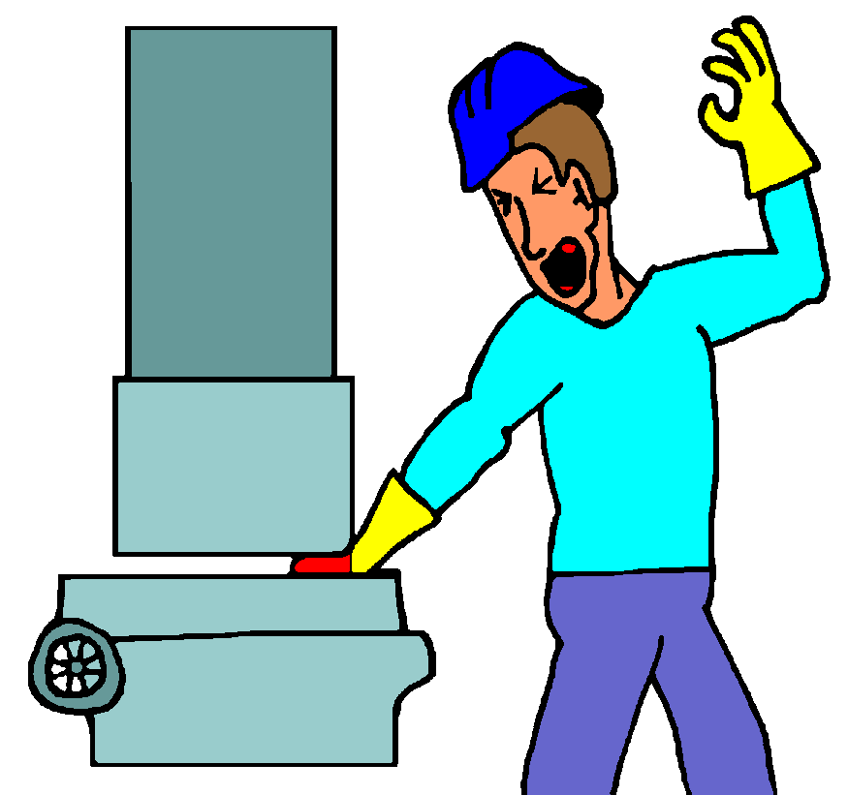
HAZARDOUS ENERGY SOURCES
Electrical
Pneumatic
Hydraulic
Gas
Mechanical
Springs
Water
Wind
Steam
Thermal
Nuclear
Radioactive
Gravity
Lasers
Elevated parts

Slide 7
APPLICATION
STANDARD DOES NOT APPLY TO:
Normal production operations.
Work on cord and plug connected equipment (when you can control the plug).
Hot tap operations (making a connection to existing piping or pressure vessels without the interrupting or emptying of that section of pipe or vessel).
1910.147(a)(2)(ii) & (iii)

Slide 8
NORMAL PRODUCTION OPERATIONS
The utilization of a machine or equipment to perform its intended production function.
1910.147(b)

