Slide 1


Infant and Child Nutrition, Inc.
Welcome
TO THE CHILD CARE FOOD PROGRAM
2019 ANNUAL TRAINING!
Please hold all questions during the presentation. There is an
opportunity at the end of each section for questions and answers.

Slide 2


Child Care Food Program
Child Care Food Program
Each day, more than 4.2 million children receive nutritious meals and snacks each day through the Child and Adult Care Food Program

Slide 3


Child Care Food Program
It is because of you that the Child Care Food Program is successful. When we work as a team, we can do great things.
We at Infant and Child Nutrition appreciate all the hard work that each of you do

Slide 4
CERTIFICATE OF COMPLETION
We will have your Certificate of Completion
available at the end of this training.
Your 1099 for taxes will be emailed
In January 2019. If you do not
want your 1099 emailed, please
note it on the enclosed 1099 form.
We will send it USPS, but it could take
longer for you to receive.

Slide 5


Pages to Follow Power Point Training
Please find this booklet below in your packet. Each page is numbered in the Power Point and in your packet. Please refer to each page during the Presentation

Slide 6

USDA RECORD KEEPING REQUIREMENT
You are required to keep copies of all food program related records for 3 years plus the current year, this includes but is not limited to:
    Meal Count Worksheets
    Menus
    Enrollment Forms
    Infant Feeding Forms
    Review Forms
    All other CCFP related paperwork
You must keep the previous 12 months on-site. The previous years may be stored off-site but must be made available within 5 business days if requested.
Any records dated prior to October 1, 2016 can now be discarded on October 1, 2019
SUBMITTED FORMS

Slide 7

Review Reminders
Your reviewer will ask to see this folder at every review. Please ensure you haver all paperwork sent in to us and all paperwork you receive from us in this folder. Please make sure it is organized by month. It should be easy to keep as long as you put the paperwork in each month. If you already have a method of saving it, you can continue with that method.
If you save your disallowance letters and payment schedule in your computer, please make sure you have them backed up to a thumb drive or some other form or back up. If you save them to a folder from your server, you do not have to back them up.

Slide 8

REIMBURSEMENT RATES
PER CHILD PER DAY
TIER I TIER II
BREAKFAST $1.31 $0.48
LUNCH/SUPPER $2.46 $1.48
SNACK $0.73 $0.20
The above rates are effective 7/1/19 – 6/30/20.

Slide 9

REIMBURSEMENT PAYMENTS
THERE IS NO SET PAYMENT DATE. You can normally expect to receive your reimbursement between the 12th and the 25th of the following month. The state has 45 days to pay our claim.
Claims are processed as quickly as they are received. It is extremely important that you submit your paperwork in a timely manner. We request that you send your claims on the last day of the month. Our staff works on the first weekend of every month as well as holidays if needed. Our fax machine and email are available 24/7.
CALL THE OFFICE AFTER THE 25TH IF YOU HAVE NOT RECEIVED YOUR PAYMENT.

Slide 10
VPK AND HEADSTART
Children enrolled in VPK and Headstart are to be counted in your Pre-school ratio even if they are attending VPK at a public elementary school.
DCF REGULATIONS STATE THE FOLLOWING
“School-age Child” refers to any child who is at least five years old by September 1st of the beginning of the school year and who is enrolled in and attending a kindergarten program or grades one through five during a school district’s calendar year.

Slide 11
HOME-SCHOOLED CHILDREN
A new Home-school letter must be submitted annually to Infant and Child Nutrition for any school-age child whose meals are being claimed during school hours. (AM Snack or Lunch)
Documentation must come from the school board and can no longer be a parent letter.
Documentation is due at the beginning of EVERY school year, even if one was sent for the previous year

Slide 12

QUESTIONS?

Slide 14
UNUSUAL CLAIMING PATTERNS
Suspicious or unusual claiming practices are identified when a review of the documentation does not provide a plausible or logical explanation for the claim (Block Claiming)
Block claims submitted where all children are present and claimed for any meal 15 days in a row, no one is ever late, no one ever leaves early, etc…are being flagged for additional review. This additional review can include parental contacts, review of ELC program documentation, DCF inspection documentation and sign in and sign out sheets.
All of these state agencies have access to each other’s records. Please make certain you are only claiming meals for the children when they are actually present and served.

Slide 15
UNUSUAL CLAIMING PATTERNS
- But my kids are always here!
These parents don’t ever take
off or miss work…and if they do
they still bring their children!
They still bring their children
even when they are sick!

Slide 16
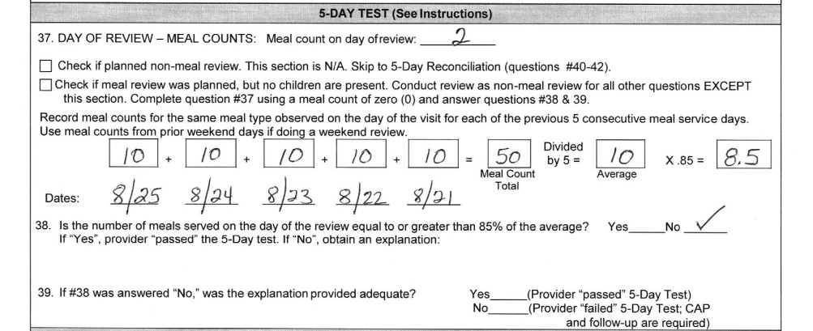
5-DAY TEST

Slide 17
QUESTIONS?

Slide 18

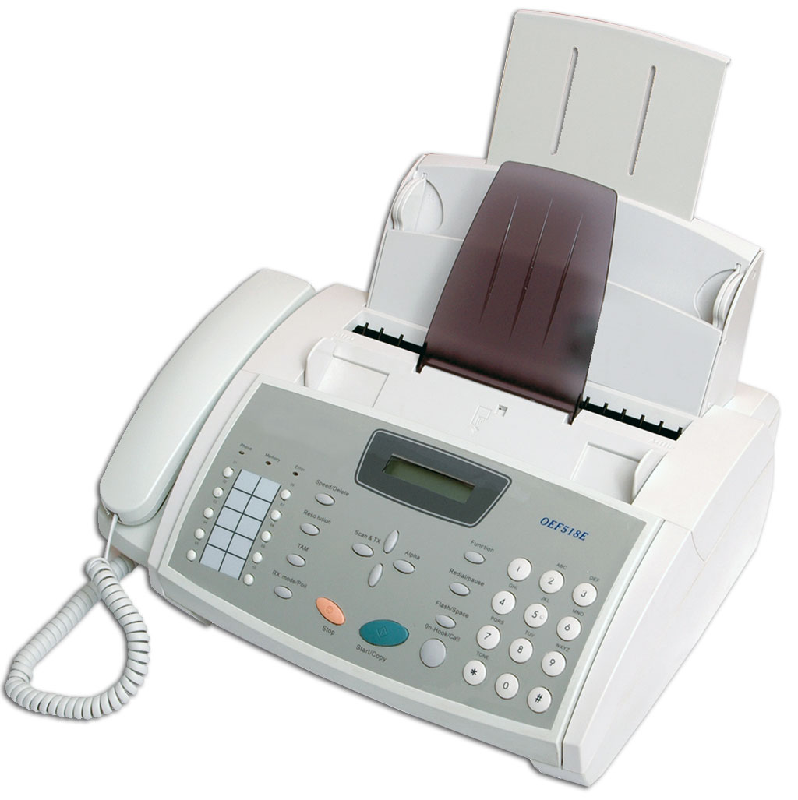



FORMS AND PAPERWORK SUBMISSION

Slide 19
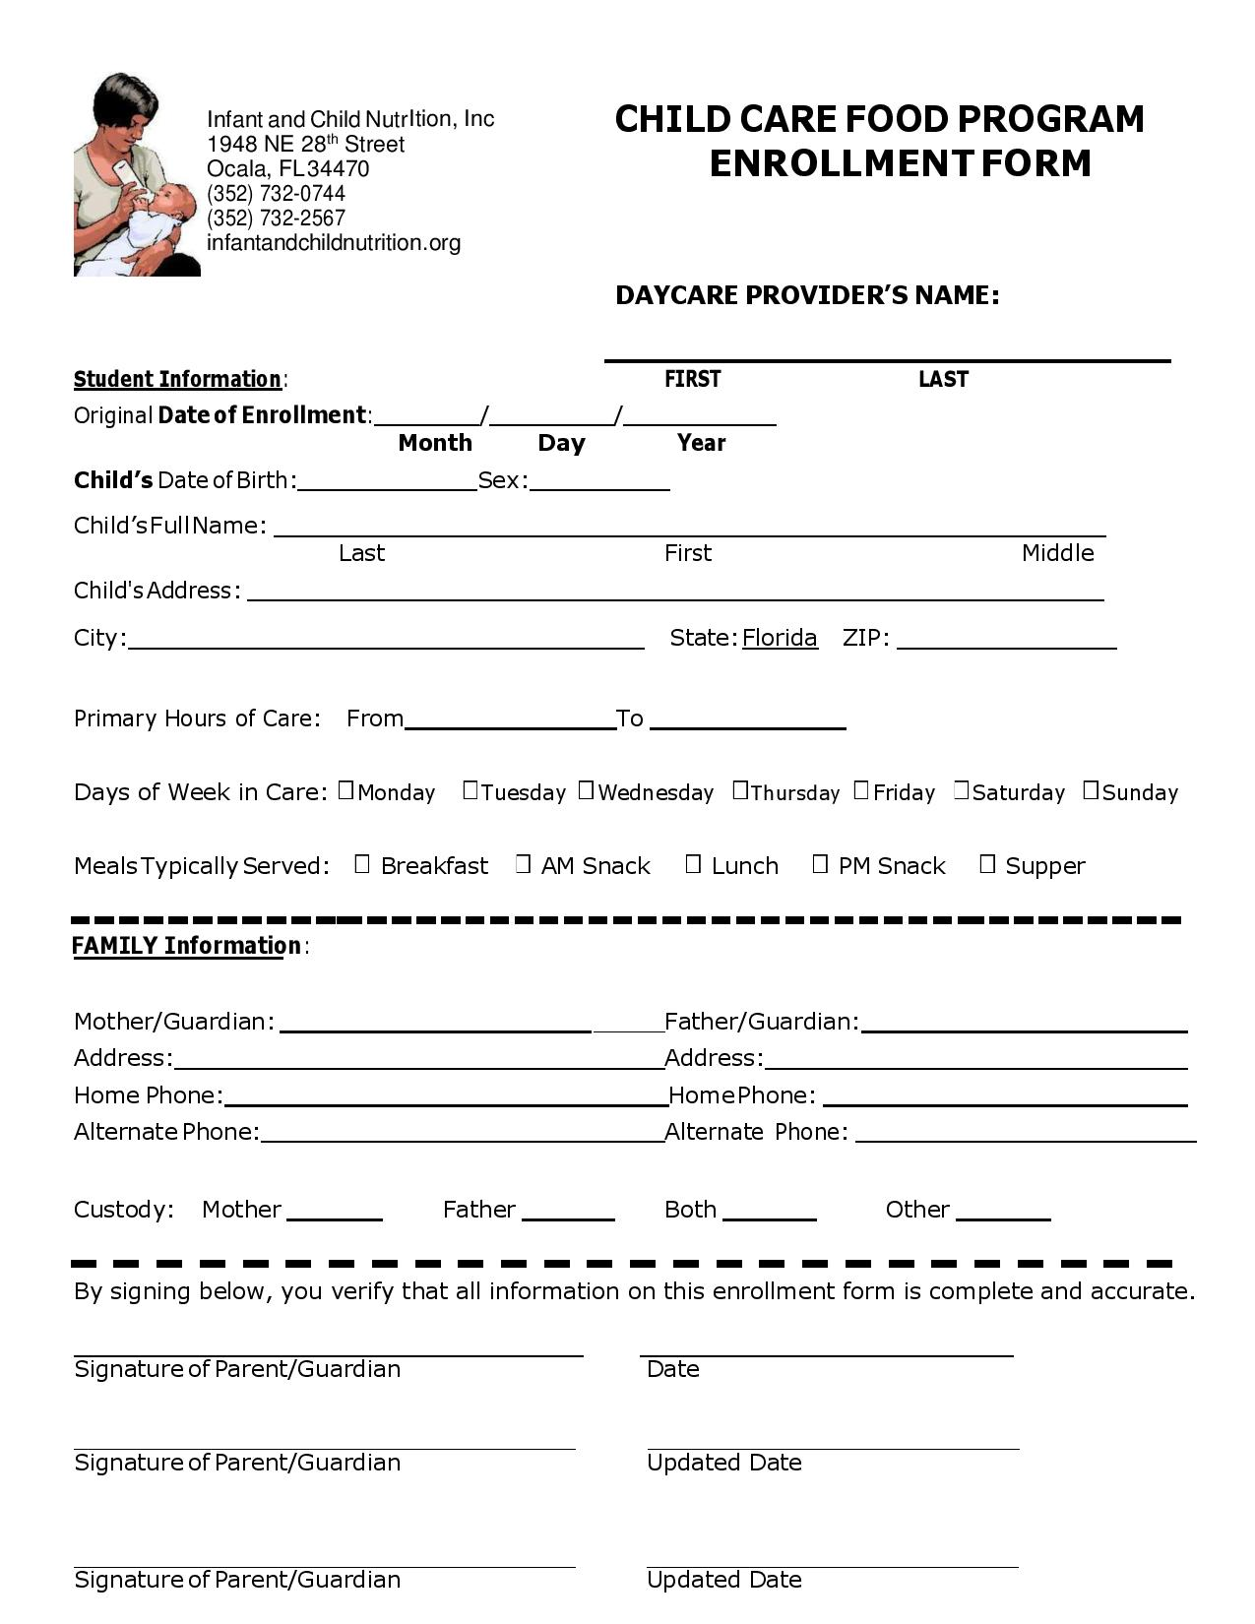
Page 1

Slide 20
ENROLLMENT FORM
Please inform the parent to include all hours the student
could ever attend. Usually 6:00am to 6:00pm would cover all
meals.
The parent should write that their child will be in care M-F or
if claiming weekends M-Sun.
If the student could be at your daycare for various meals
during the year such as summer or school closures, please
inform the parent to check all meals that could ever apply.
Many times parents days and times change. You are
required to send in a new enrollment form which reflects the
changes. A good deal of time is spent each month calling
you regarding this issue.
If you claim meals that are not included on
the enrollment sheet, those meals will be
disallowed.

Slide 21
ENROLLMENT FORM
Enrollment forms must be submitted for all children being claimed and updated annually in July.
Enrollment forms are due on the 1st day that you claim that student for a meal. Do not wait till the end of the month to send in enrollment sheets
Verify that parents have correctly completed the entire form.
The enrollment date and the signature date must be on or before the day you begin claiming the child on your Meal Count Worksheet. The meals served and the days of the week in care must be checked. The primary hours of care on the sheet is also a requirement.
Please keep a copy of each student’s form with your CCFP records. The CCFP requires our form, and DCF will require their sheet as well

Slide 22
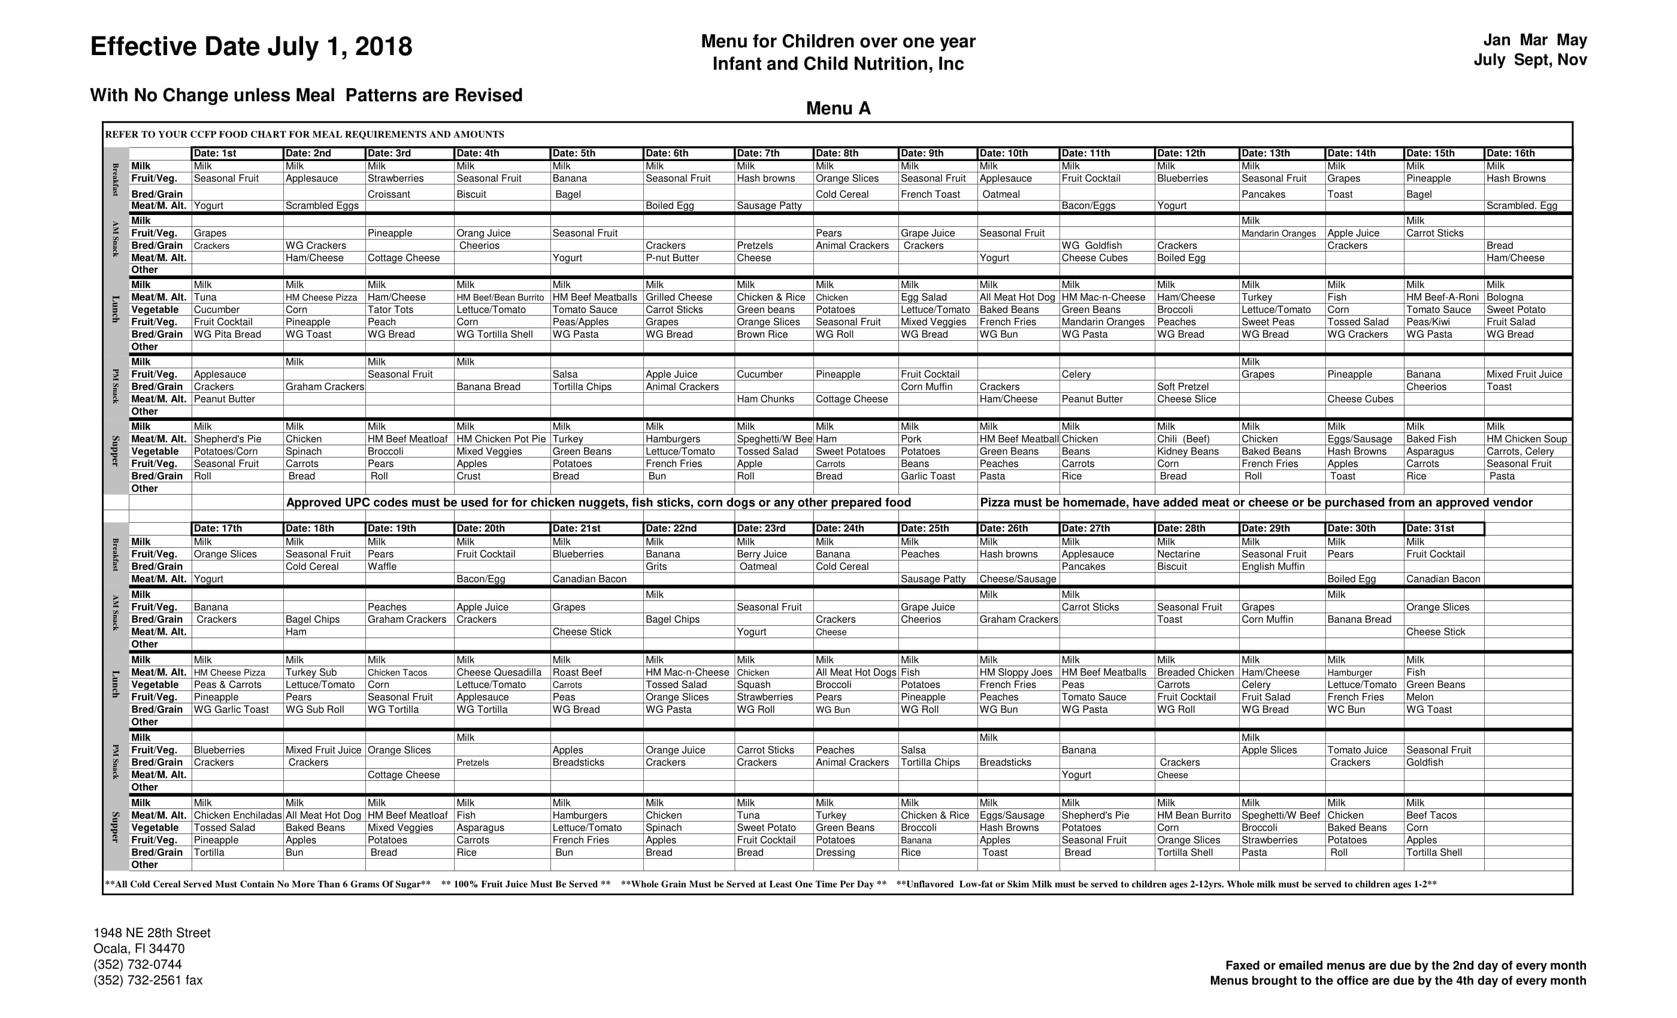
Menu A
Please post this Standard Menu at your daycare. All others are outdated and cannot be used
Page 2

Slide 23
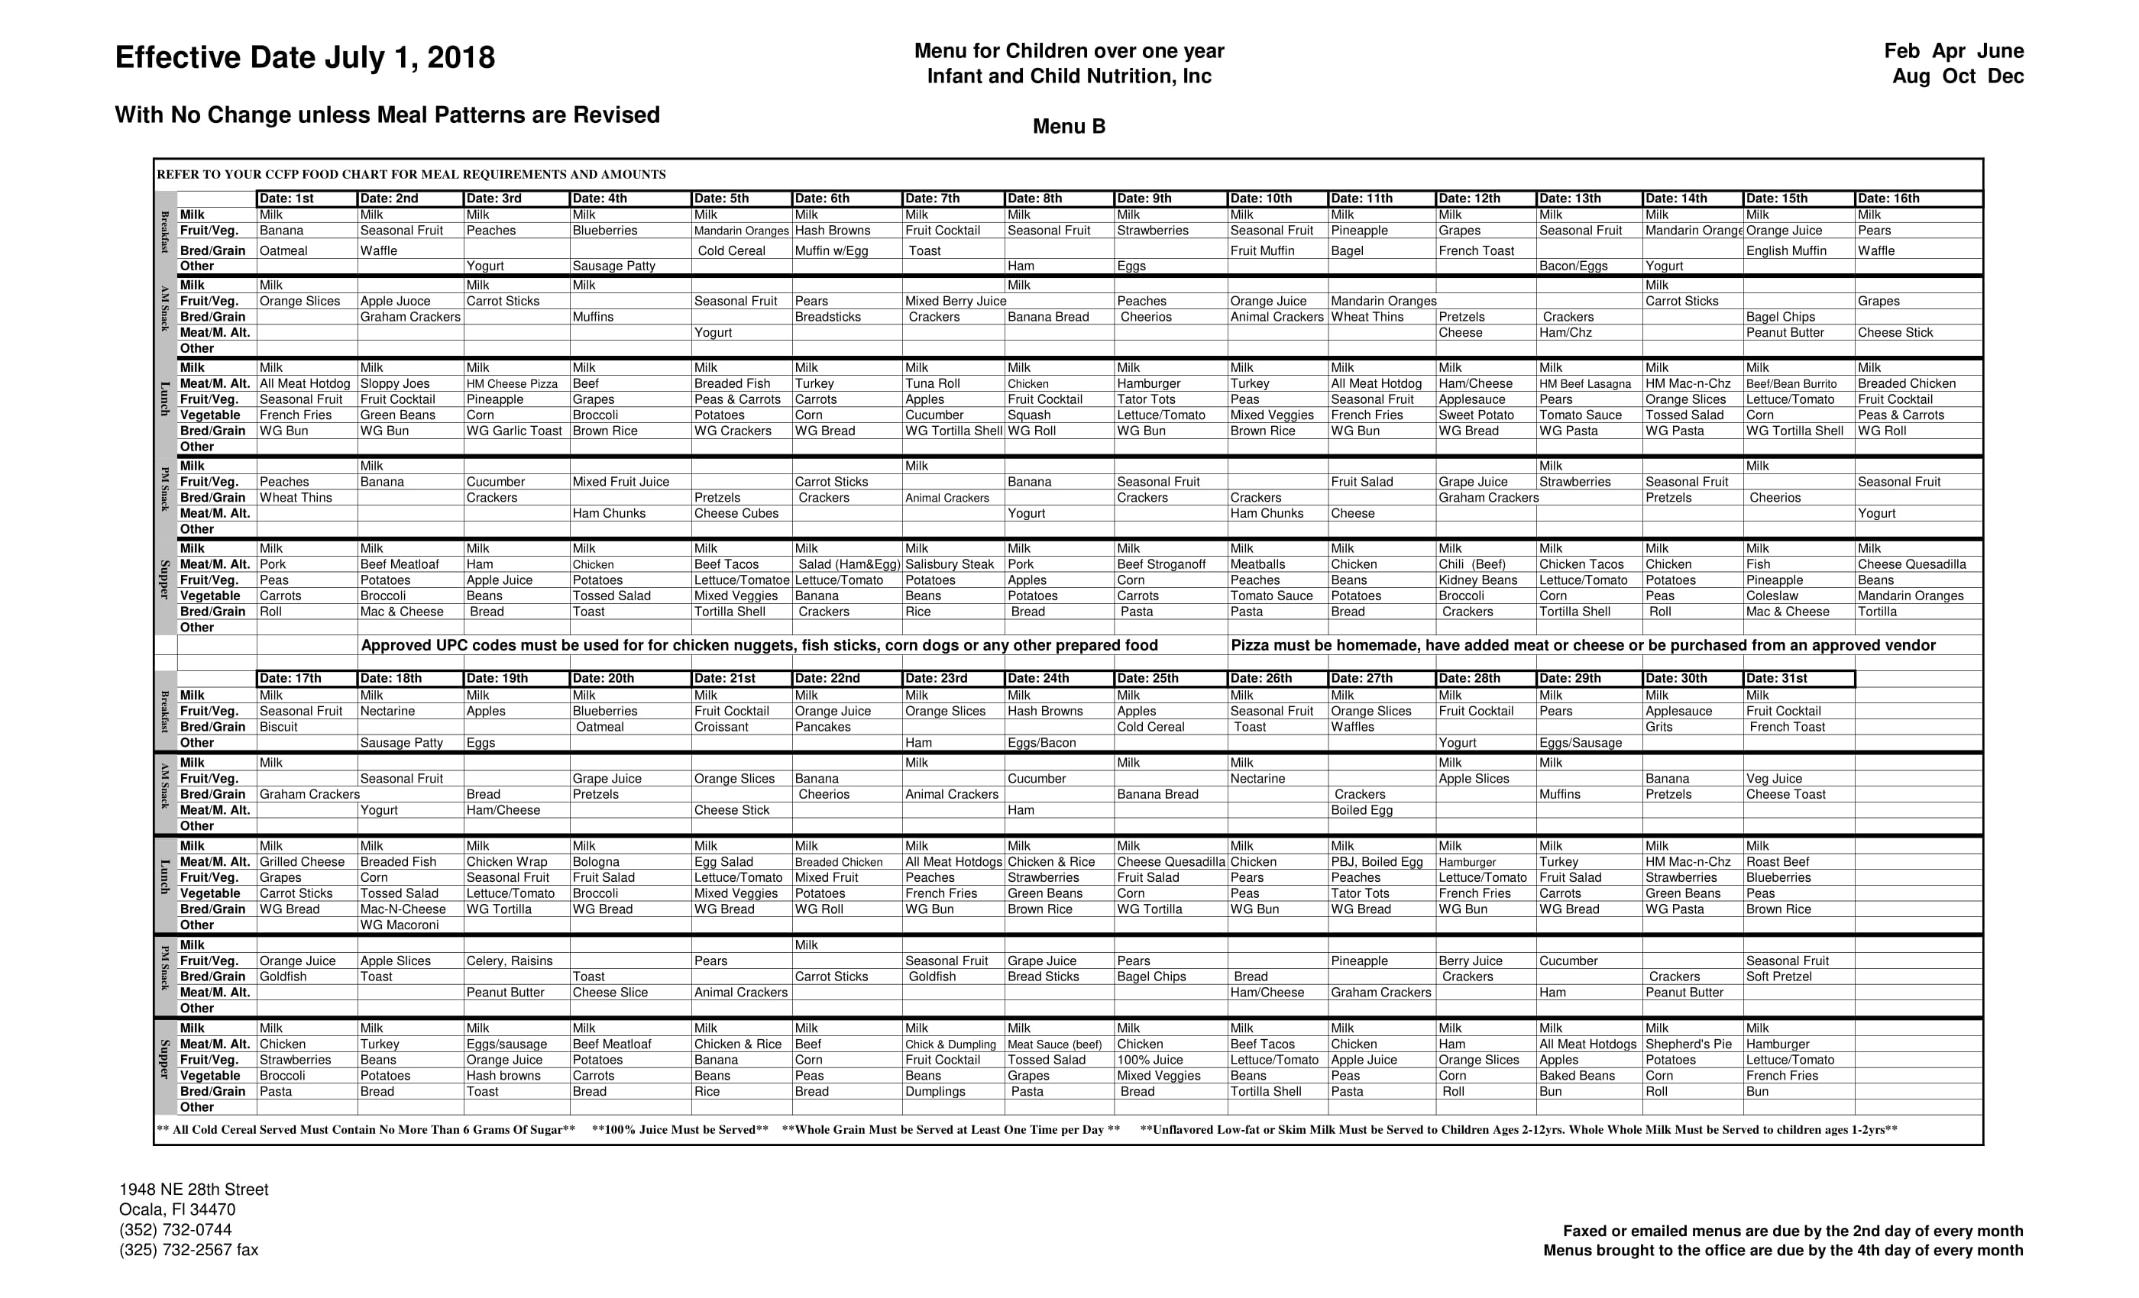
Menu B
Please post this Standard Menu at your daycare. All others are outdated and cannot be used.
Page 3

Slide 24
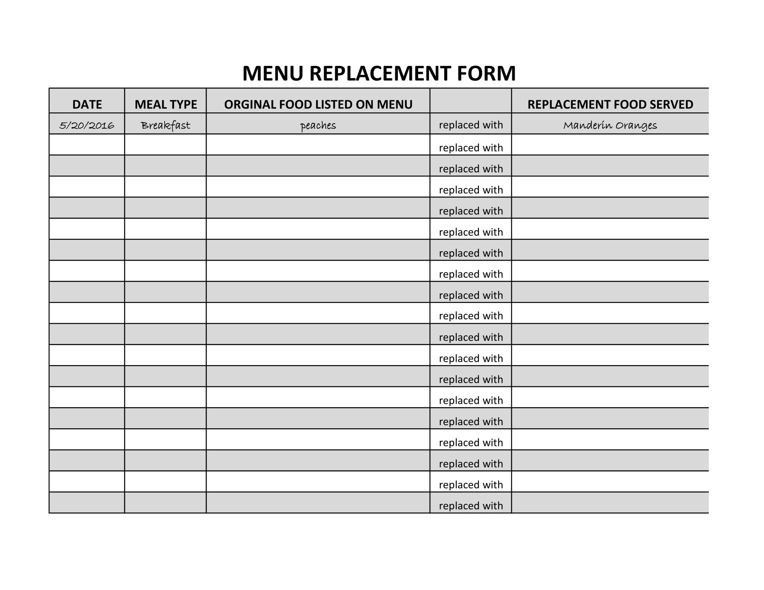
Menu Replacement Form
The Menu Replacement Form can be found at infantandchildnutrition.org and a copy is also enclosed with your packet
Page 4

Slide 25

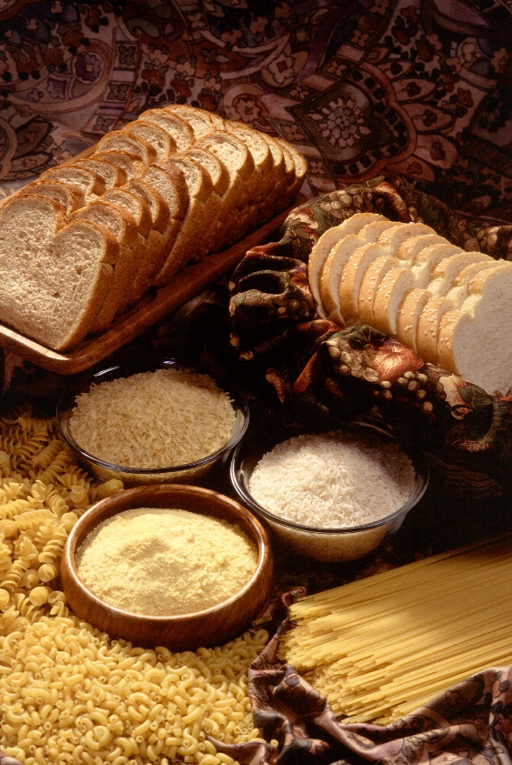
Menu Reminders
Please note that
When you change
the Standard Menu
on a meal with
Whole Grain listed,
the substitute must
also be a Whole
Grain.
If you make your
own menus please
make sure a Whole
Grain is listed one
time per day.

Slide 26
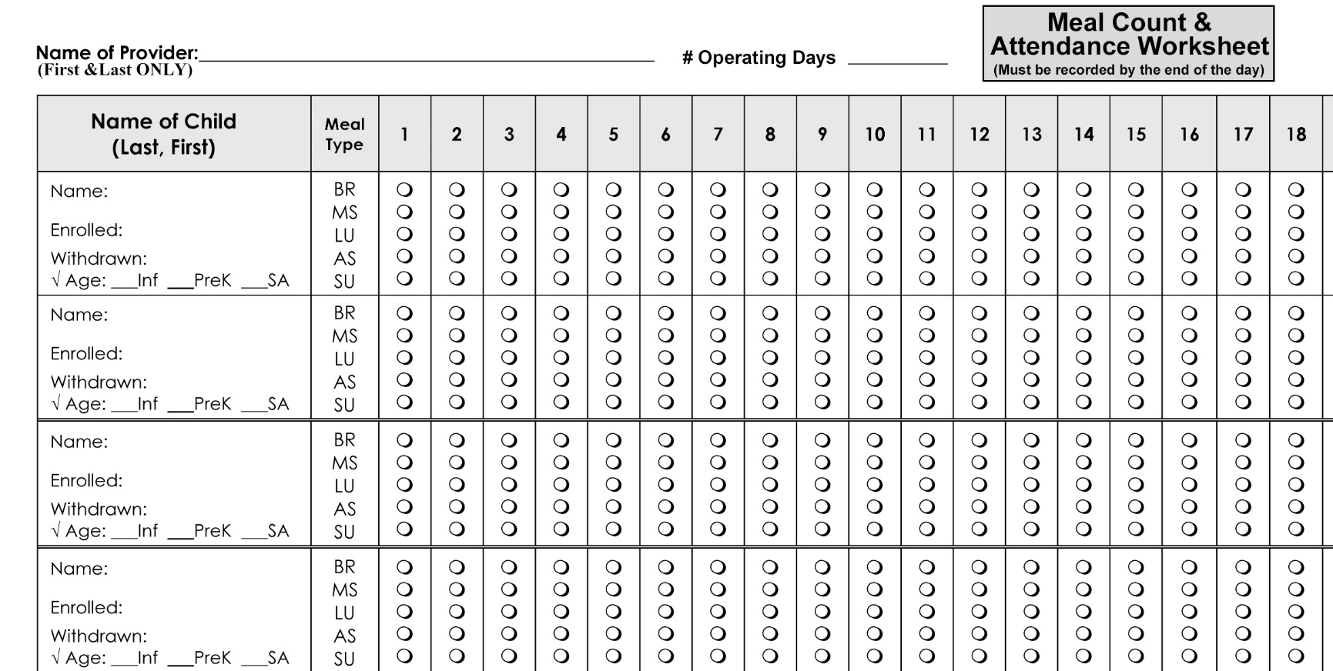
Meal Count Worksheet
22
John Doe
4-5-18
X
Jane Doe
3-12-19
X
Page 5

Slide 27
AUTOMATED MEAL COUNT WORKSHEET
Please be aware that meal counts must be entered DAILY. Failure to do so will result in meal disallowances during any reviews and may cause the forfeiture of your privilege to use the automated Meal Count Worksheet.
You must also have the capability to print a copy of the Meal Count Worksheet during every on-site review conducted by our representatives, DOH or USDA staff. Having faulty equipment (computer, printer, no ink, etc…) is not an acceptable excuse for your inability to produce the Meal Count Worksheet during any review.
In the case of equipment malfunctions, you must use the manual paper Meal Count Worksheet until your equipment meets all of the requirements regarding the automated Meal Count Worksheet.
Failure to adhere to these guidelines may result in the forfeiture of your right to use the automated Meal Count Worksheet, Meal Disallowances and may require further Correction Action Plans.
If you have technical difficulties you must have a manual system in place at all times

Slide 28
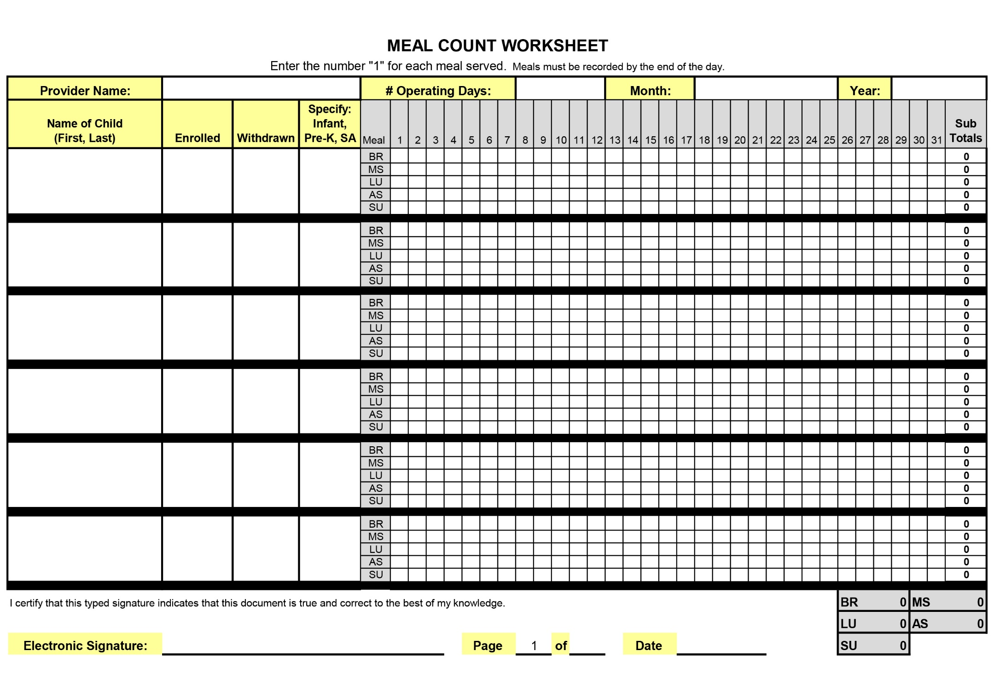
22
John Doe
4-15-18
SA
Jane Doe
3-11-18
PK
1
2
Page 6

Slide 29
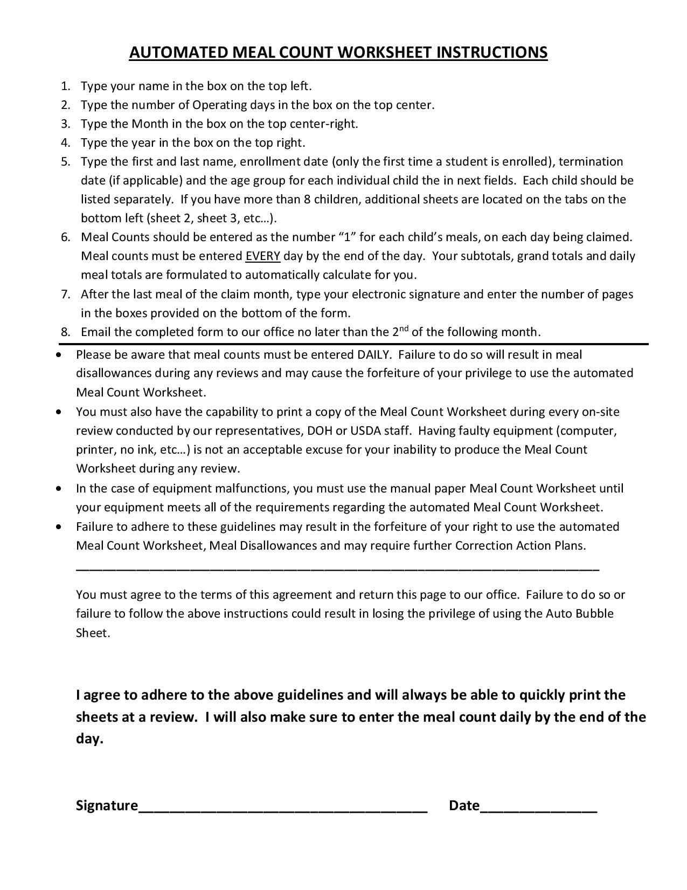
Page 7

Slide 30
Shifts
We are required to stay for the entire shift when at a review of your daycare
If you are no longer serving shifts, please do not check shifts on your Provider Data Sheet which is enclosed in your packet. Please call or email us with any changes during the year.
If you have shifts you will need to do the following:
  1. Every student that is clamed at a shift meal must appear on the shift schedule (if you claim a child a shift meal and their name does not appear on the shift schedule, the meals will be disallowed)
  2. If during the month there are holidays, weekends or non-school days, please send a separate shift begins)
  3. If your shift schedules are not complete each month, you could lose the privilege to claim shift meals

Slide 31
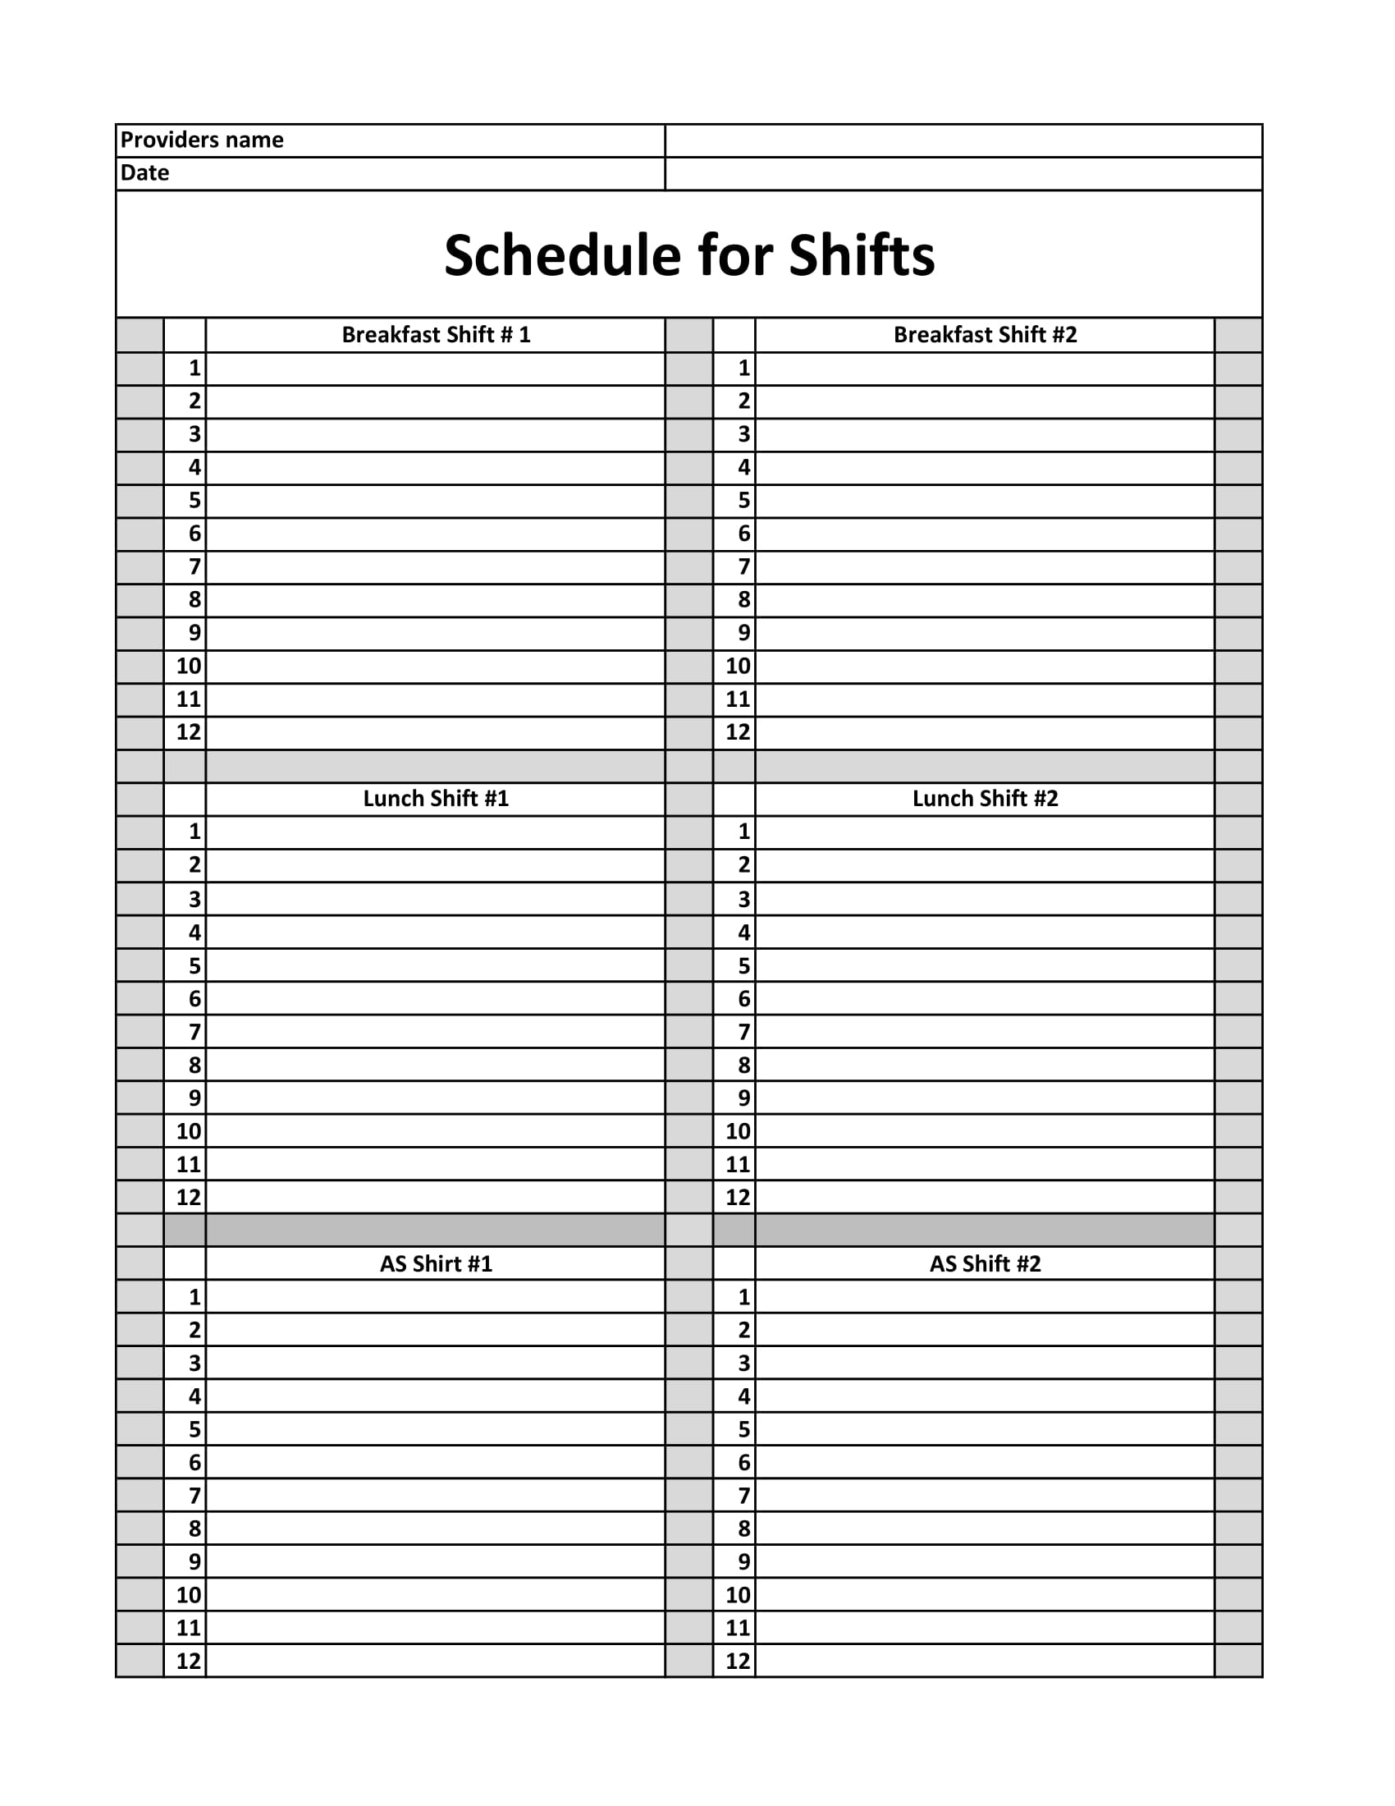
Page 8

Slide 32
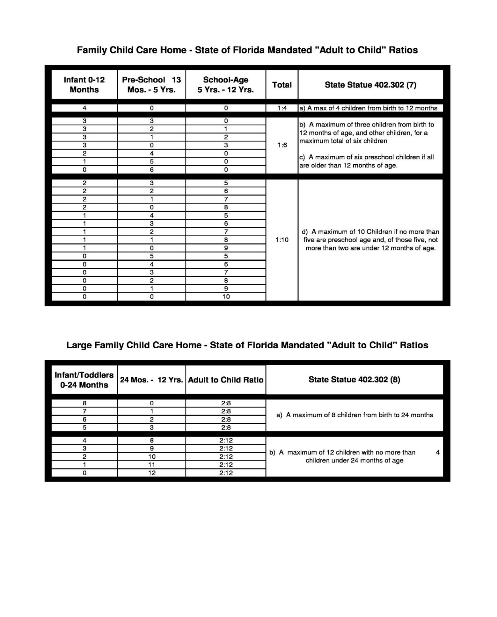
State of
Florida
Mandated "Adult to Child Ratios"
Page 9

Slide 33
QUESTIONS?

Slide 34
Infant and Child Nutrition, Inc.
Reviews

Slide 35

ITEMS TO BE POSTED IN YOUR HOME
BUILDING FOR THE FUTURE POSTER
WIC FLYER
STANDARD INFANT MENU
CHILDREN’S MENU
DCF LICENSE
SPONSOR/PROVIDER AGREEMENT

Slide 36

ON-SITE REVIEWER
It is your responsibility to train your substitute regarding the Food Program. They must allow your reviewer to conduct a meal review even if you are not home. Your substitute must be capable of answering questions, be able to locate all Food Program related documents, as well as perform an approved meal service.
If you are frequently in the “back” area of your home and can not easily hear the door, you must notify the office so we can update your files to call or attempt a different door during visits.
It is imperative that we have your most updated phone numbers!

Slide 37
COMMON REVIEW FINDINGS
No one home during scheduled meal time and no prior notice given
Not serving meal at scheduled meal time
Claiming children’s meals who are not present (serving breakfast to
a school-ager prior to meal time before they leave for school)
Claiming a child’s meal under a different child’s name (Accidentally
using the wrong last name, etc.)
Not submitting Menu Change Form when changes are recorded at review
Not serving proper milk or having correct milk on hand or not serving
required amount
Cleaning supplies are stored separately from food
Notes:
EXAMPLE:

Slide 38
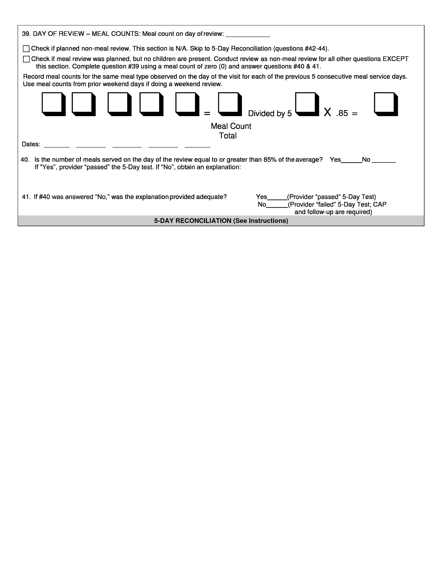
5-DAY TEST
4
6
6
5
2
3
22
4
3.5
5-8
5-9
5-10
5-11
5-12
Be careful to claim these exact numbers on your Meal Count Worksheet
Do not change your Meal Count Worksheet after a review

Slide 39
Review Reminders
Give reviewer your Meal Count Worksheet (Bubble Sheet) Begin to print
immediately if you use the Auto Bubble Sheet
Give reviewer your menus and make sure unflavored milk appears on the
menu if you make your own menus
Find your thermometers in all refrigerators and freezers you use for daycare. Make sure your refrigerator is 41 degrees or below and the freezer is 0 degrees or below
Always have your Sponsor/Provider agreement posted with other
Food Program documents
Make sure that processed foods have a code which appear on the Approved Commercially Processed Combination Food List or have a CN label
At reviews, we are required to make sure your home is sanitary, insect and
rodent free

Slide 40
Review Reminders
Make sure prepared food in refrigerator is stored in clean covered containers which are labeled and dated if you plan to use it for daycare
Wash your hands as well as all children's hands with soap and water.
If you change your menu, it must be changed and posted in advance of the meal. A Menu Replacement form is on our website for your convenience
You could receive an inspection from CCFP personnel at any time without our staff. They will have badges and will be looking at the same things we observe at our reviews.
Make sure you can produce one year’s copies of all CCFP materials and that this information is organized

Slide 41
QUESTIONS?

Slide 42
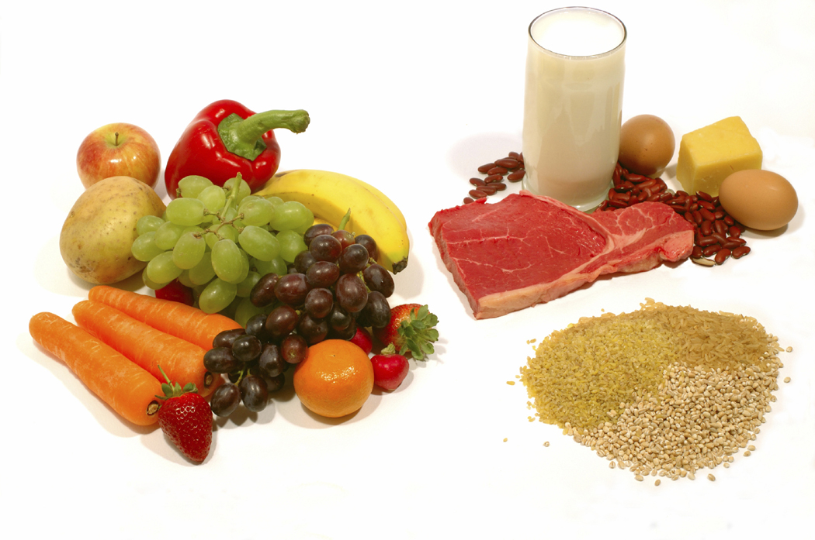
NUTRITION

Slide 43

NUTRITION
Creditable and Non-Creditable
Foods
Fiscal Year 2019 – 2020
Infant and Child Nutrition, Inc.
1948 NE 28th Street
Ocala, Fl 34470
Phone 352-732-0744
Fax 352-732-2567
Web Site infantandchildnutrition.org
Please find this booklet from your packet
2019

Slide 44
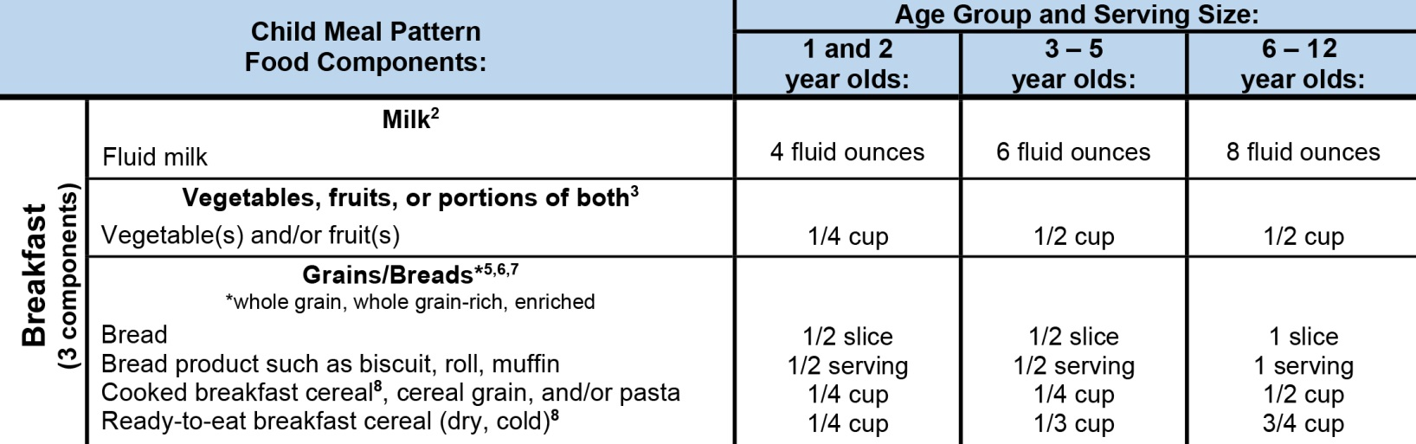
BREAKFAST MEAL PATTERN
Age Groups
3 Components
Page 10

Slide 45
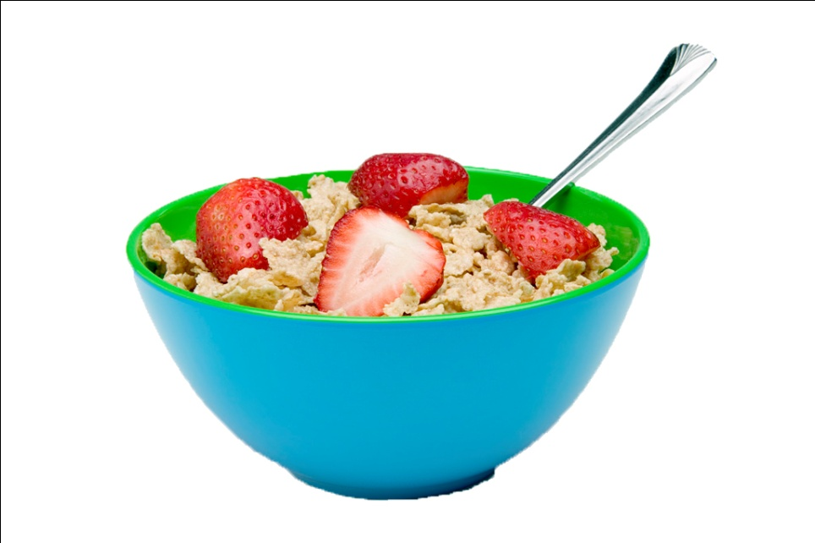
BREAKFAST
Breakfast must consist of at least 3 of the following components:
  Fluid milk
  A vegetable, fruit or 100% juice
  A grain or a bread
A fruit or vegetable must be served. This can be fresh, canned of frozen
Bread/Grain component may be replaced with Meat/Meat Alternate component up to 3 times per week
Cereal may contain no more than 6 grams of sugar per dry oz.

Slide 46
QUESTIONS?

Slide 47
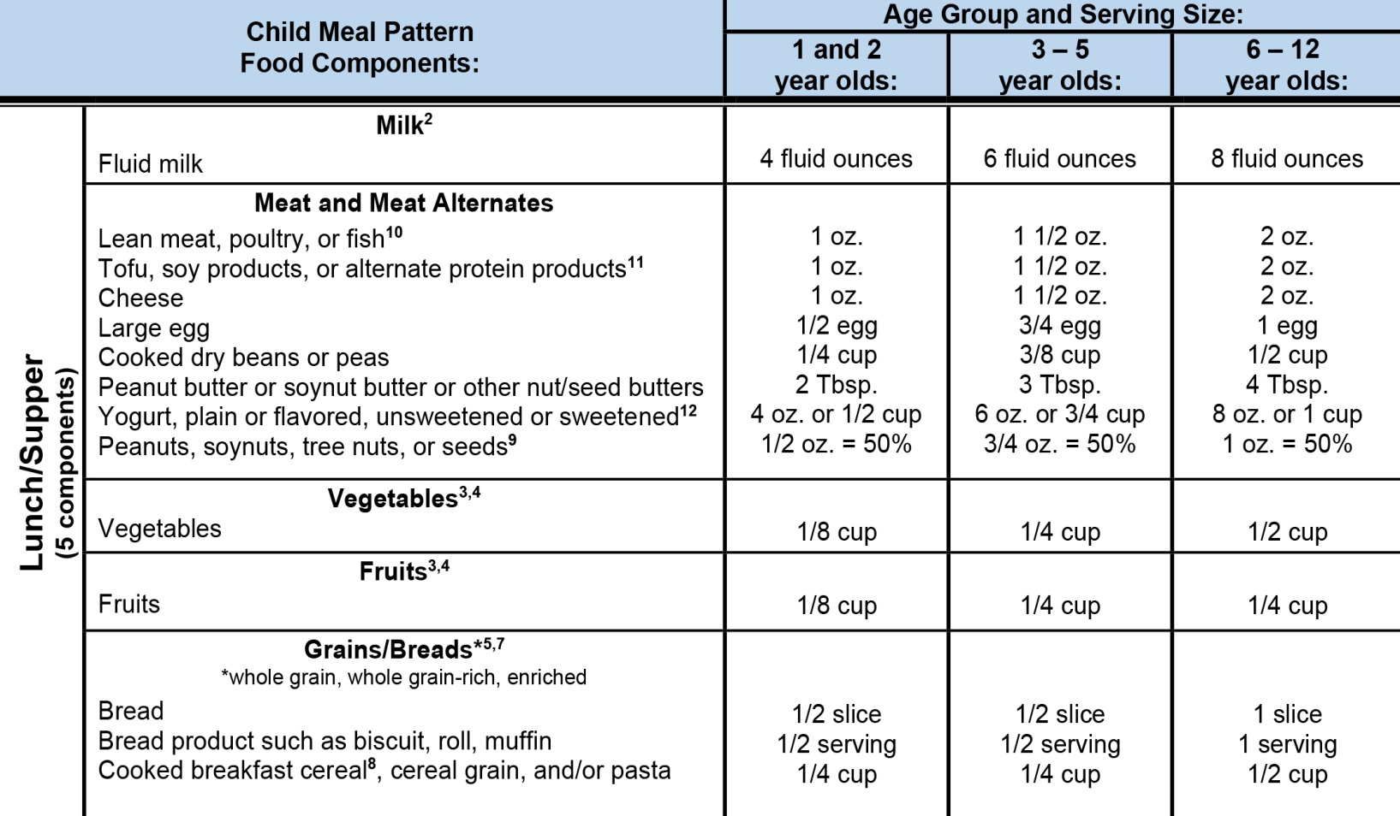
LUNCH AND SUPPER MEAL PATTERN
Age Groups
5 Components
Page 10

Slide 48

LUNCH AND SUPPER
Lunch and Supper must contain 5 items. These 5 items must include at least 2 vegetables or one fruit/100% juice and one vegetable
Fluid Milk
Vegetable
Fruit/Vegetable/100% Juice
Grains/Breads
Meat/Meat Alternate
Can’t serve 2 fruits in same meal. Lunch and Supper must contain at least one vegetable. You may serve 2 vegetables as long as they are different

Slide 49
QUESTIONS?

Slide 50
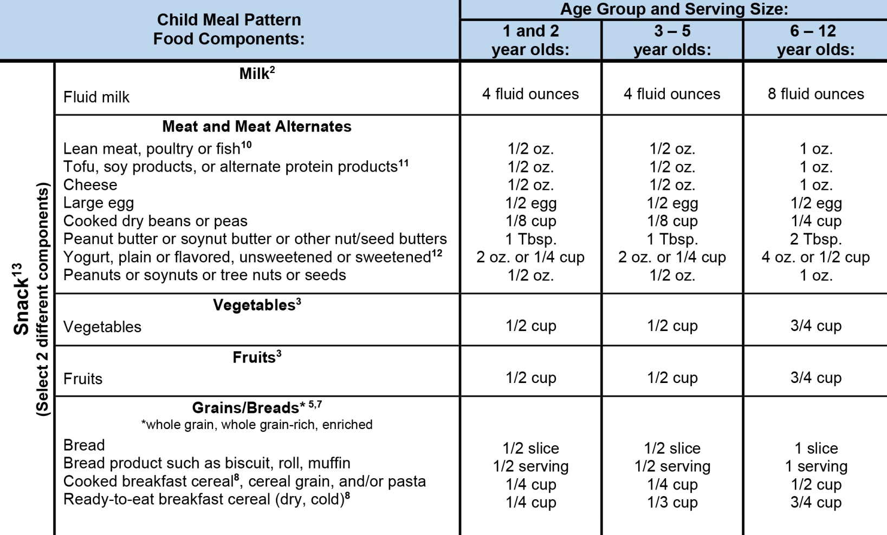
SNACK MEAL PATTERN
Age Groups
Components
(select 2)

Slide 51

SNACK
Grains and Breads
Meat and Meat Alternate
Snack must contain at least 2 different components:
Fluid Milk
Vegetable
Fruit
A fruit or vegetable must be served at least
twice a week at snack. This can be fresh,
canned of frozen
You may claim a vegetable and a fruit,
a fruit and 100% vegetable juice or a
vegetable and 100% fruit juice at snack
Only one beverage can be claimed at snack

Slide 52
QUESTIONS?

Slide 53

MILK
You are REQUIRED to serve one year old children
UNFLAVORED Whole Milk
You are REQUIRED to serve children ages 2 through 5
years old UNFLAVORED 1% Low or Fat Free Milk
You are REQUIRED to serve children ages 6 through
12 years old UNFLAVORED or FLAVORED 1% Milk
or Fat Free milk
2% Milk is NOT creditable for any student on the USDA
Food Program
If you make your own menus, UNFLAVORED FAT FREE, 1%
or whole milk must appear on your menu

Slide 54

OTHER CREDITABLE MILK
Buttermilk
Goats Milk
UHT (Ultra High Temperature) Milk
Commercial Eggnog
Acidified Milk
Lactose-free and Lactose-reduced Milk
Soy or Soybean Milk - A parent letter or doctor’s note must be on file if soy milk is being served in place of cow’s milk.

Slide 55

MILK
If a child is unable to have milk, will I still be reimbursed for the child’s breakfast, lunch or supper?
YES. You must obtain a medical statement from a doctor stating the disability, what foods need to be replaced and what they can be replaced with. Please contact our office with any child specific questions/concerns.

Slide 56
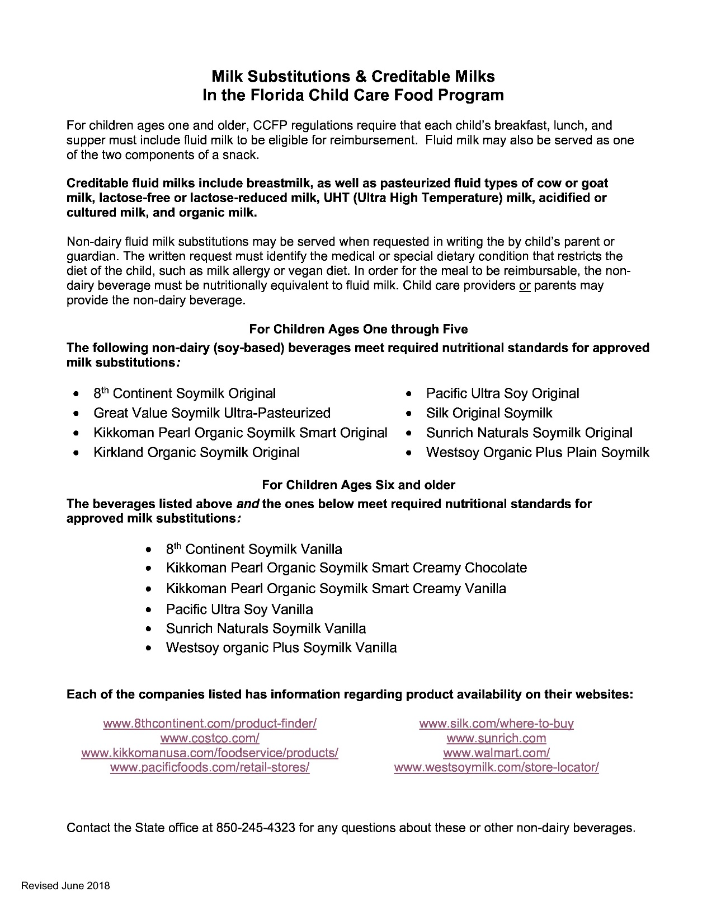
Page 11

Slide 57

FRUITS & VEGETABLES
The vegetable and fruit components are separate. There is a fruit component and a vegetable component.
A fruit or vegetable must be served twice a week at breakfast and twice a week at snack
Fruits and vegetables can be fresh, canned or frozen

Slide 58

Page 12

Slide 59
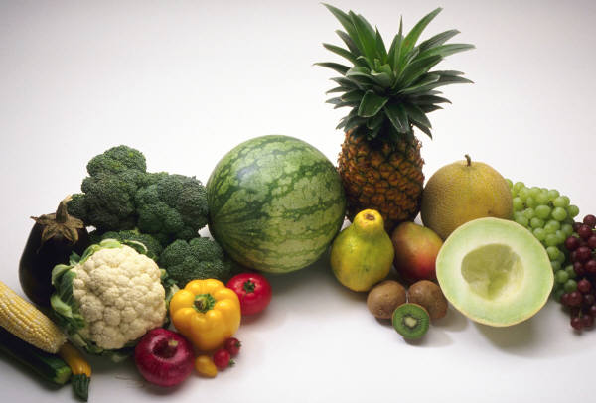
FRUITS & VEGETABLES
Lunch and supper must contain at least one vegetable.
You may serve 2 vegetables as long as they are different.
Fruits or vegetables containing
Vitamin A must be served at
least twice a week.
Fruits or vegetables containing
Vitamin C must be served daily.

Slide 60


FRUIT/VEGETABLE JUICE
Juice may be used as a fruit or
vegetable at any meal
Juice may only be claimed
ONCE PER DAY
Only 100% juice is allowed
Juice can not be served
to infants

Slide 61
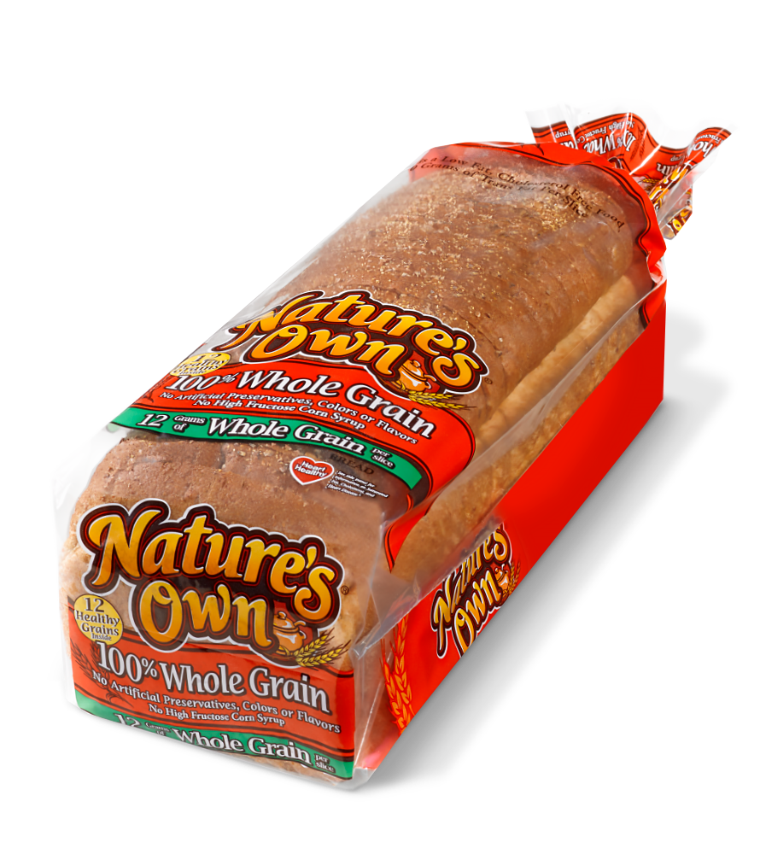
GRAINS AND BREADS
At least one serving per day must be 100% whole grain
Grains and bread must be whole
grain, enriched, or made from
whole grain or enriched meal/flour

Slide 62
Page 13
 | Whole Grains* |  | Not Whole Grains
• | Amaranth | • | All-Purpose Flour
• | Barley (whole, hulled, or hull-less) | • | Bread Flour
• | Bromated Whole-Wheat Flour | • | Bromated Flour
• | Bulgur | • | Cake Flour
• | Buckwheat | • | Corn
• | Cracked Wheat | • | Corn Grits
• | Crushed Wheat | • | Degerminated Corn Meal
• | Einkorn | • | Durum Flour
• | Freekeh | • | Enriched Flour
• | Graham Flour | • | Enriched Rice
• | Millet | • | Enriched Self-Rising Flour
• | Quinoa | • | Enriched Wheat Flour
• | Rice (Brown, Black, Red, Wild) | • | Farina
• | Rye Berries (or whole rye) | • | lnstantized Flour
• | Sorghum | • | Long-Grain White Rice
• | Teff | • | Pearled Barley
• | Triticale | • | Phosphated Flour
• | Wheat Berries | • | Rice Flour
• | Whole Corn | • | Rice (White)
• | Whole Durum Wheat Flour | • | Rye
• | Whole Farro | • | Self-Rising Flour
• | Whole Grain Barley | • | Self-Rising Wheat Flour
• | Whole Spelt | • | Unbleached Flour
• | Whole Wheat Flour | • | Wheat Flour
• | Whole Wheat Pasta | • | White Flour
 | (Macaroni, Spaghetti, or other
 | Whole Grains Noodles)
IS IT WHOLE GRAIN?
Step 1 Is it a creditable grain (made with
whole grain)?
Check the Credible and Non-
Creditable list. If yes, you can serve
this grain
Step 2 Is this a naturally occurring grain
like brown rice, wild rice, or oatmeal?
If yes, you have found a 100% whole
grain. If no continue to step 3
Step 3 Does the front of the package
state 100% Whole Grain or 100%
Whole Wheat? If yes, If yes, you found
a product that will meet your 100%
whole grain product.
Step 4 If you check the ingredients
label and ALL the grain ingredients
are whole grain, you can count this
product
Please find the Is It a Grain in your packet
Page 13

Slide 63
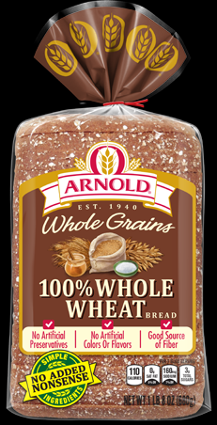
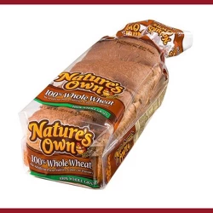
Whole Grain Bread
Natures Own 100 % Whole Wheat
Whole Wheat Flour, Water, Wheat Gluten, Sugar, Yeast, Brown Sugar, Contains 2% or Less of Each of the Following: Flax Seed, Whole Rye Flour, Sunflower Seed, Vinegar, Monoglycerides, Enzymes, Ascorbic Acid, Wheat Starch, Whole Amaranth, Hulled Whole Millet, Whole Khorasan Wheat Flour, Whole Brown Rice Flour, Whole Buckwheat Flour, Whole Mile Corn, Whole Spelt Flour, Monocalcium Phosphate, Soy Lecithin, Calcium Sulfate, Topped with Whole Amaranth Seed, Flaxseed, and Wheat Bran.
Arnolds 100% Whole Wheat
WHOLE WHEAT FLOUR, WATER, BULGUR WHEAT, SUGAR, WHEATGLUTEN, HONEY, SOYBEAN OIL, YEAST, WHOLE WHEAT, SALT, PRESERVATIVES (CALCIUM PROPIONATE, SORBIC ACID), MONOGLYCERIDES, GRAIN VINEGAR, DATEM, CALCIUM SULFATE, SOY LECITHIN, NATURAL FLAVORS.

Slide 64
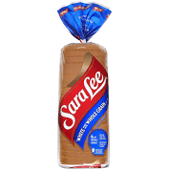
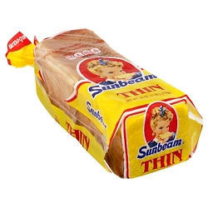
Non-Whole Grain Bread
Sara Lee Whole Wheat White Bread
Sunbeam White Bread
Enriched Bleached Flour [Wheat Flour, Malted Barley Flour, Niacin, Iron, Thiamin Mononitrate (Vitamin B1), Riboflavin (Vitamin B2), Folic Acid], Water, Whole Grain [Whole Wheat Flour, Brown Rice Flour (Rice Flour, Rice Bran)], Wheat Gluten, Skim Milk, High Fructose Corn Syrup, Sugar, Yeast, Butter (Cream, Salt), Contains 2% or Less of Each of the Following: Calcium Sulfate, Salt, Dough Conditioners (May Contain One or More of the Following: Mono- and Diglycerides, Ethoxylated Mono- and Diglycerides, Sodium Stearoyl Lactylate, Calcium Peroxide, Datem, Ascorbic Acid, Azodicarbonamide, Enzymes), Guar Gum, Calcium Propionate (Preservative), Distilled Vinegar, Yeast Nutrients (Monocalcium Phosphate, Calcium Sulfate, Ammonium Sulfate and /or Calcium Carbonate), Corn Starch, Vitamin D3, Soy Lecithin, Soy Flour.
Unbleached Enriched Flour (Wheat Flour, Malted Barley Flour, Niacin, Reduced Iron, Thiamin Mononitrate, Riboflavin, Folic Acid), Water, High Fructose Corn Syrup, Contains 2% or Less of Each of the Following: Yeast, Salt, Soybean Oil Wheat Gluten, Dough Conditioners (Contains One or More of the Following: Sodium Stearoyl Lactylate, Calcium Stearoyl Lactylate, Monoglycerides and/or Diglycerides, Calcium Peroxide, Calcium Iodate, DATEM, Ethoxylated Mono- and Diglycerides, Azodicarbonamide, Enzymes), Soy Flour, Yeast Food (Ammonium Sulfate), Monocalcium Phosphate Calcium Sulfate Soy Lecithin, Calcium Propionate (to Retard Spoilage).

Slide 65
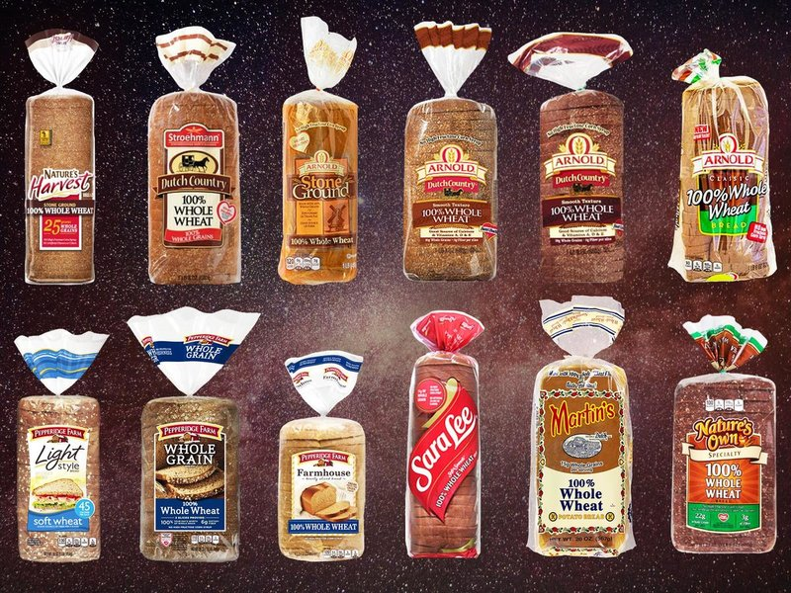
Whole Grain Bread
Ensure the label says 100% whole grain meal, whole grain flour, bran or germ in order to be creditable

Slide 66

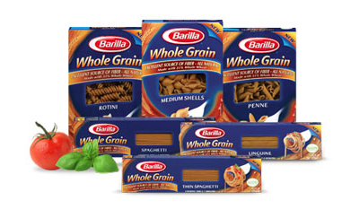



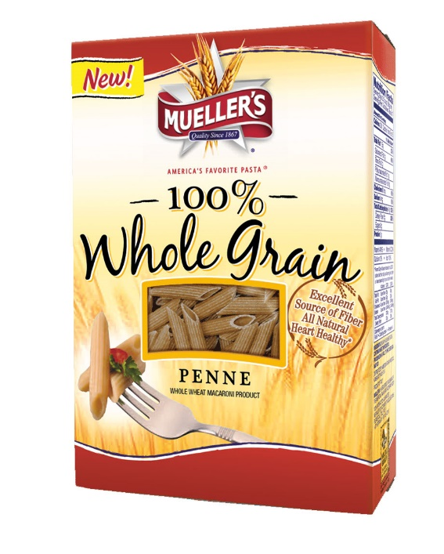
Whole Grain Pasta
Must say whole wheat or whole grain

Slide 67



GRAIN-BASED DESSERTS & CEREAL
Sweet grains or breads are not creditable or reimbursable
This includes:
Cake
Brownies
Cookies
Iced Crackers
Donuts
Honey Buns
Pop Tarts
Fruit Bars
Granola Bars
Cereal Bars
Pastries
Vanilla Wafers
French toast, waffles and pancakes are
creditable if served plain or with a small
amount of syrup.
Cereal must contain 6 grams or less
of sugar to be creditable.
Animal Crackers, Graham Crackers and Muffins are the only allowable sweets

Slide 68
Which items are 100% whole grain based on the ingredients?
A) Bread Ingredients: Wheat Flour, Malted Barley Flour, Soybean Oil, Salt, Honey, Wheat Starch, Thiamin, Niacin, Iron, Riboflavin, Folic Acid
B) Tortilla Ingredients: Whole Wheat Flour, Soybean Oil, Salt, Whole Corn, Starch, Wheat Starch
C) Dry Cereal Ingredients: Whole Corn Meal, Oats, Corn Starch, Canola Oil, Cinnamon, Brown Sugar
D) Cracker Ingredients: Whole Grain Brown Rice Flour, Sesame Seeds, Potato Starch, Safflower Oil, Quinoa Seeds, Flax Seeds, Salt
E) Roll Ingredients: Unbleached Enriched Wheat Flour, Sugar, Salt, Soybean Oil, Oat Bran, Yellow Corn Meal, Salt
Page 14

Slide 69
Which items are 100% whole grain based on ingredients?
A) Bread Ingredients: Whole Wheat Flour, Enriched Wheat Flour, Soybean Oil, Salt, Honey, Wheat Starch, Thiamin, Niacin, Iron, Riboflavin, Folic Acid
B) Roll Ingredients: Unbleached Enriched Wheat Flour, Sugar, Salt, Soybean Oil, Oat Bran, Yellow Corn Meal, Salt
C) Tortilla Ingredients: Whole Wheat Flour, Enriched Corn, Soybean Oil, Salt, Wheat Starch
D) Tortilla Ingredients: Corn, Enriched Flour, Soybean Oil, Salt
Page 14

Slide 70
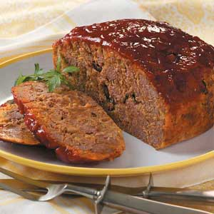
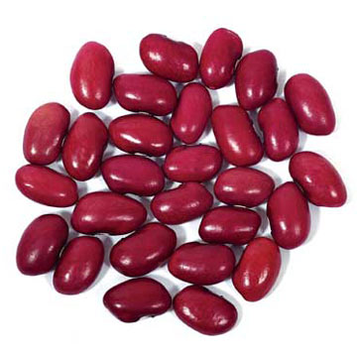
MEAT AND MEAT ALTERNATIVES
Lean Meat
Poultry
Fish
Cheese
Eggs
Yogurt
Dried Beans or Peas
Nuts, but they may fulfill no more than ½
of the meat alternated requirement for
lunch/supper

Slide 71

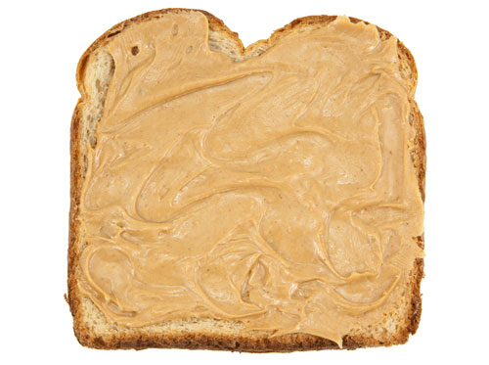
Peanut Butter
It is a requirement that you serve peanut
butter to ages and amounts below.
Lunch
Ages 1 to 2 Two Tablespoons
Ages 3 to 5 Three Tablespoons
Ages 6 to 12 Four Tablespoons
Snack
Ages 1 to 2 One Tablespoons
Ages 3 to 5 Three One
Ages 6 to 12 Two Tablespoons

Slide 72

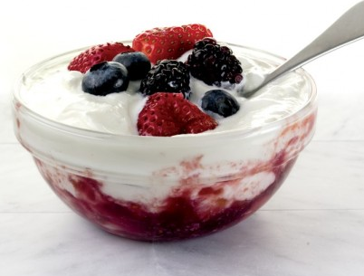
YOGURT
Yogurt must contain no more than 23 grams of sugar per 6 oz. to be creditable meat/meat alt.
4 oz – 15 grams or less
6 oz – 23 grams or less
8 oz – 30 grams or less

Slide 73
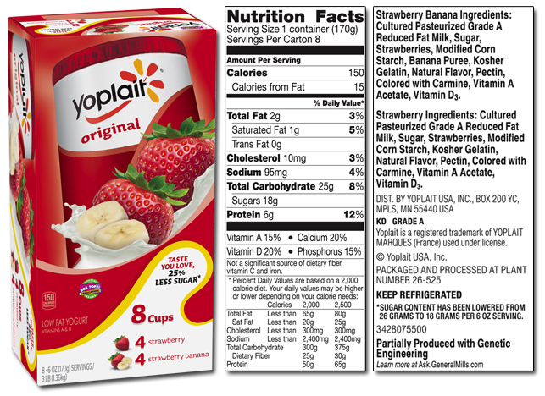
Serving size is 6 oz. 18 grams sugar cannot be more than 23
This Yogurt is Approved

Slide 74
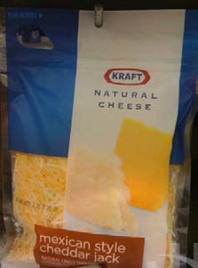
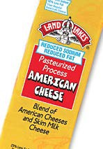
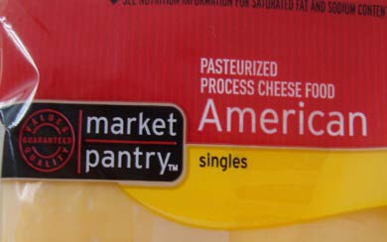




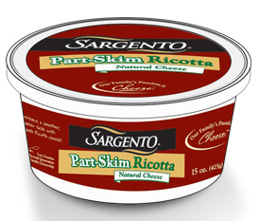
Creditable & Non-Creditable Cheeses in the CCFP
Credible Cheeses
Natural Cheese
Pasteurized Cheese (100% Cheese
Credible Cheeses
Cheese Food Ricotta Cheese
Cottage Cheese Cheese Spread
1 ounce serving = 1 ounce meat/meat alternative
2 ounce serving = 1 ounce meat/meat alternative
*cheese food and cheese spreads are not creditable for infants

Slide 75
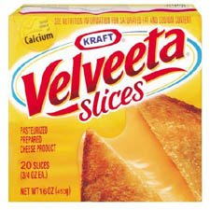
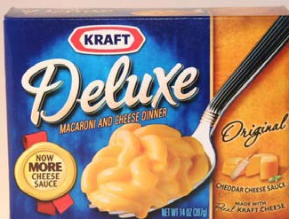
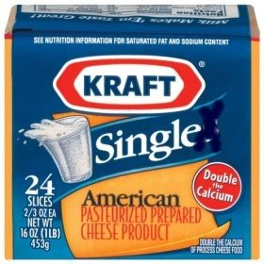
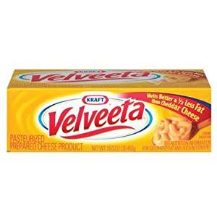
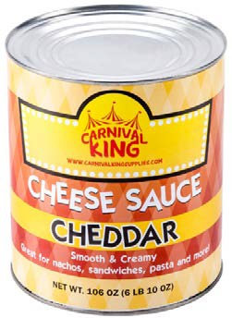

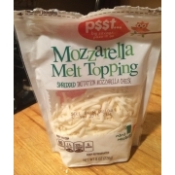
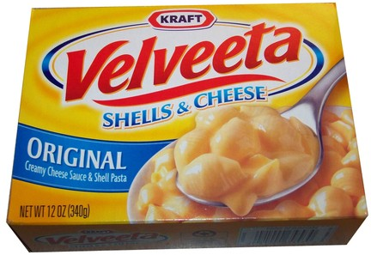
Creditable & Non-Creditable Cheeses in the CCFP
Non-Creditable Cheese
Imitation Cheese
Cheese Product (contains <51% cheese)
Velveeta
Non-Creditable Cheese
Cheese Sauces need a Child Nutrition Label
(CN Label)

Slide 76
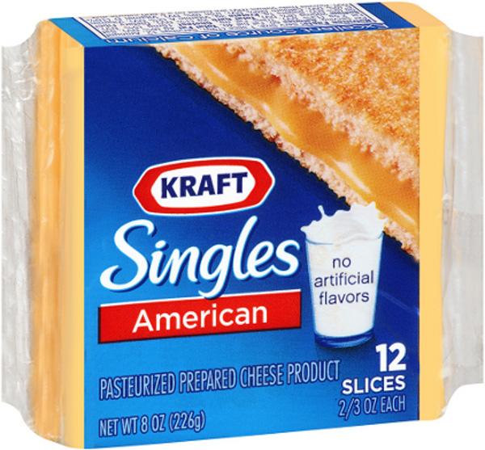

Creditable & Non-Creditable Cheeses in the CCFP

Slide 77
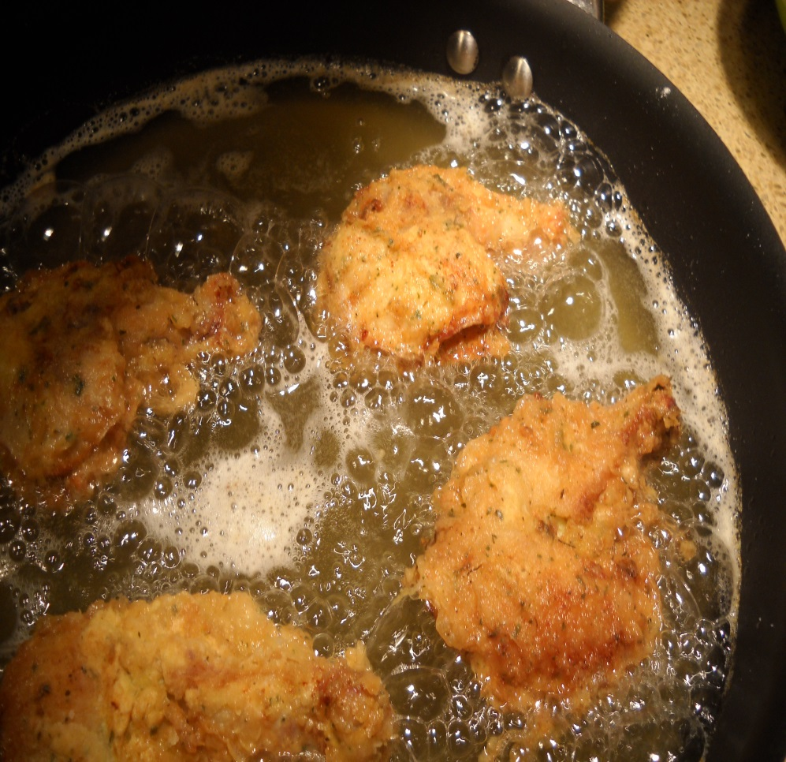
DEEP FRIED FOODS
Deep frying is not allowed as a way of preparing foods

Slide 78
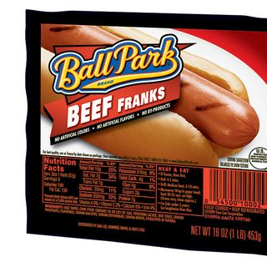
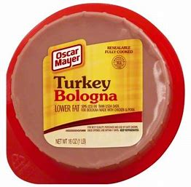
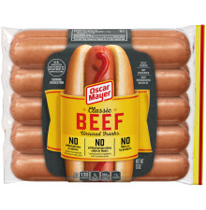
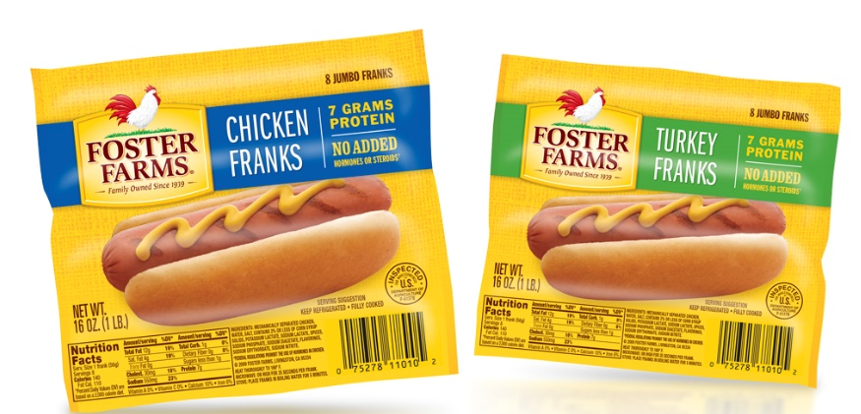

HOT DOGS AND BOLOGNA
Hotdogs and bologna must be all meat and poultry products with no by-products, cereal or extenders.

Slide 79


CN LABELS
COMMERCIALLY PROCESSED FOODS
Main dish combination products that are commercially processed,
such as ravioli, beef stew, spaghetti with meat sauce, egg rolls,
pizza, chicken nuggets, fish sticks, etc., must contain a CN Label or
Manufacturer’s Analysis Sheet to show that the product contains
sufficient quantities of meat/meat alternate, grains/breads,
to meet the meal pattern. Otherwise, it may not be
counted towards a reimbursable meal.

Slide 80

APPROVED COMMERCIALLY PROCESSED COMBINATION FOOD LIST
Page 15

Slide 81



Ages 1 to 2
Ages
3 to 5
Ages
6 to 12
Gorton's | Breaded Fish Sticks | 44400104100 | 3 Sticks |  |  | .50 oz. | 6 Sticks | 9 Sticks | 12 Sticks
Gorton's | Breaded Fish Sticks | 4440010500 | 3 Sticks |  |  | .50 oz. | 6 Sticks | 9 Sticks | 12 Sticks
Gorton's | Breaded Fish Sticks | 44400104700 | 3 sticks |  |  | .50 oz. | 6 Sticks | 9 Sticks | 12 Sticks
Trident Seafoods | The Ultimate Fish Stick (w) Panko Breading | 419644 | 4 Sticks |  |  | 2.00 oz. | 2 Sticls | 3 Sticks | 4 Sticks
Tyson | Chicken Nuggets | 014390-6910 | 7 Nuggets |  |  | 2.00 oz | 4 Nuggets | 5.5 Nuggets | 7 Nuggets
Tyson | Fun Nuggets | 2370001452 | 4 Nuggets |  |  | 1.25 oz. | 4 Nuggets | 5 Nuggets | 7 Nuggets
Tyson | Chicken Nuggets | 883746-0910 | 7 Nuggets |  |  | 2.00 oz. | 4 Nuggets | 6 Nuggets | 7 Nuggets
Tyson | Chicken Patties | 003747-1220 | 1 Patty |  |  | 1.25. | 1 Patty | 1.5 Patties | 2 Patties

Slide 82
Ages 1 to 2
Ages
3 to 5
Ages
6 to 12
Gorton's | Breaded Fish Sticks | 44400104100 | 3 Sticks |  |  | .50 oz. | 6 Sticks | 9 Sticks | 12 Sticks
Gorton's | Breaded Fish Sticks | 4440010500 | 3 Sticks |  |  | .50 oz. | 6 Sticks | 9 Sticks | 12 Sticks
Gorton's | Breaded Fish Sticks | 44400104700 | 3 sticks |  |  | .50 oz. | 6 Sticks | 9 Sticks | 12 Sticks
Trident Seafoods | The Ultimate Fish Stick (w) Panko Breading | 419644 | 4 Sticks |  |  | 2.00 oz. | 2 Sticls | 3 Sticks | 4 Sticks
Tyson | Chicken Nuggets | 014390-6910 | 7 Nuggets |  |  | 2.00 oz | 4 Nuggets | 5.5 Nuggets | 7 Nuggets
Tyson | Fun Nuggets | 2370001452 | 4 Nuggets |  |  | 1.25 oz. | 4 Nuggets | 5 Nuggets | 7 Nuggets
Tyson | Chicken Nuggets | 883746-0910 | 7 Nuggets |  |  | 2.00 oz. | 4 Nuggets | 6 Nuggets | 7 Nuggets
Tyson | Chicken Patties | 003747-1220 | 1 Patty |  |  | 1.25. | 1 Patty | 1.5 Patties | 2 Patties

Slide 83
Ages 1 to 2
Ages
3 to 5
Ages
6 to 12
Gorton's | Breaded Fish Sticks | 44400104100 | 3 Sticks |  |  | .50 oz. | 6 Sticks | 9 Sticks | 12 Sticks
Gorton's | Breaded Fish Sticks | 4440010500 | 3 Sticks |  |  | .50 oz. | 6 Sticks | 9 Sticks | 12 Sticks
Gorton's | Breaded Fish Sticks | 44400104700 | 3 sticks |  |  | .50 oz. | 6 Sticks | 9 Sticks | 12 Sticks
Trident Seafoods | The Ultimate Fish Stick (w) Panko Breading | 419644 | 4 Sticks |  |  | 2.00 oz. | 2 Sticls | 3 Sticks | 4 Sticks
Tyson | Chicken Nuggets | 014390-6910 | 7 Nuggets |  |  | 2.00 oz | 4 Nuggets | 5.5 Nuggets | 7 Nuggets
Tyson | Fun Nuggets | 2370001452 | 4 Nuggets |  |  | 1.25 oz. | 4 Nuggets | 5 Nuggets | 7 Nuggets
Tyson | Chicken Nuggets | 883746-0910 | 7 Nuggets |  |  | 2.00 oz. | 4 Nuggets | 6 Nuggets | 7 Nuggets
Tyson | Chicken Patties | 003747-1220 | 1 Patty |  |  | 1.25. | 1 Patty | 1.5 Patties | 2 Patties

Slide 84
Ages 1 to 2
Ages
3 to 5
Ages
6 to 12
Gorton's | Breaded Fish Sticks | 44400104100 | 3 Sticks |  |  | .50 oz. | 6 Sticks | 9 Sticks | 12 Sticks
Gorton's | Breaded Fish Sticks | 4440010500 | 3 Sticks |  |  | .50 oz. | 6 Sticks | 9 Sticks | 12 Sticks
Gorton's | Breaded Fish Sticks | 44400104700 | 3 sticks |  |  | .50 oz. | 6 Sticks | 9 Sticks | 12 Sticks
Trident Seafoods | The Ultimate Fish Stick (w) Panko Breading | 419644 | 4 Sticks |  |  | 2.00 oz. | 2 Sticls | 3 Sticks | 4 Sticks
Tyson | Chicken Nuggets | 014390-6910 | 7 Nuggets |  |  | 2.00 oz | 4 Nuggets | 5.5 Nuggets | 7 Nuggets
Tyson | Fun Nuggets | 2370001452 | 4 Nuggets |  |  | 1.25 oz. | 4 Nuggets | 5 Nuggets | 7 Nuggets
Tyson | Chicken Nuggets | 883746-0910 | 7 Nuggets |  |  | 2.00 oz. | 4 Nuggets | 6 Nuggets | 7 Nuggets
Tyson | Chicken Patties | 003747-1220 | 1 Patty |  |  | 1.25. | 1 Patty | 1.5 Patties | 2 Patties

Slide 85
Ages 1 to 2
Ages
3 to 5
Ages
6 to 12
Gorton's | Breaded Fish Sticks | 44400104100 | 3 Sticks |  |  | .50 oz. | 6 Sticks | 9 Sticks | 12 Sticks
Gorton's | Breaded Fish Sticks | 4440010500 | 3 Sticks |  |  | .50 oz. | 6 Sticks | 9 Sticks | 12 Sticks
Gorton's | Breaded Fish Sticks | 44400104700 | 3 sticks |  |  | .50 oz. | 6 Sticks | 9 Sticks | 12 Sticks
Trident Seafoods | The Ultimate Fish Stick (w) Panko Breading | 419644 | 4 Sticks |  |  | 2.00 oz. | 2 Sticls | 3 Sticks | 4 Sticks
Tyson | Chicken Nuggets | 014390-6910 | 7 Nuggets |  |  | 2.00 oz | 4 Nuggets | 5.5 Nuggets | 7 Nuggets
Tyson | Fun Nuggets | 2370001452 | 4 Nuggets |  |  | 1.25 oz. | 4 Nuggets | 5 Nuggets | 7 Nuggets
Tyson | Chicken Nuggets | 883746-0910 | 7 Nuggets |  |  | 2.00 oz. | 4 Nuggets | 6 Nuggets | 7 Nuggets
Tyson | Chicken Patties | 003747-1220 | 1 Patty |  |  | 1.25. | 1 Patty | 1.5 Patties | 2 Patties

Slide 86
Ages 1 to 2
Ages
3 to 5
Ages
6 to 12
Gorton's | Breaded Fish Sticks | 44400104100 | 3 Sticks |  |  | .50 oz. | 6 Sticks | 9 Sticks | 12 Sticks
Gorton's | Breaded Fish Sticks | 4440010500 | 3 Sticks |  |  | .50 oz. | 6 Sticks | 9 Sticks | 12 Sticks
Gorton's | Breaded Fish Sticks | 44400104700 | 3 sticks |  |  | .50 oz. | 6 Sticks | 9 Sticks | 12 Sticks
Trident Seafoods | The Ultimate Fish Stick (w) Panko Breading | 419644 | 4 Sticks |  |  | 2.00 oz. | 2 Sticls | 3 Sticks | 4 Sticks
Tyson | Chicken Nuggets | 014390-6910 | 7 Nuggets |  |  | 2.00 oz | 4 Nuggets | 5.5 Nuggets | 7 Nuggets
Tyson | Fun Nuggets | 2370001452 | 4 Nuggets |  |  | 1.25 oz. | 4 Nuggets | 5 Nuggets | 7 Nuggets
Tyson | Chicken Nuggets | 883746-0910 | 7 Nuggets |  |  | 2.00 oz. | 4 Nuggets | 6 Nuggets | 7 Nuggets
Tyson | Chicken Patties | 003747-1220 | 1 Patty |  |  | 1.25. | 1 Patty | 1.5 Patties | 2 Patties

Slide 87
Ages 1 to 2
Ages
3 to 5
Ages
6 to 12
Gortons | Breaded Fish Sticks | 44400104100 | 3 Sticks |  |  | .50 oz. | 6 Sticks | 9 Sticks | 12 Sticks
Gorton's | Breaded Fish Sticks | 4440010500 | 3 Sticks |  |  | .50 oz. | 6 Sticks | 9 Sticks | 12 Sticks
Gorton's | Breaded Fish Sticks | 44400104700 | 3 sticks |  |  | .50 oz. | 6 Sticks | 9 Sticks | 12 Sticks
Trident Seafoods | The Ultimate Fish Stick (w) Panko Breading | 419644 | 4 Sticks |  |  | 2.00 oz. | 2 Sticls | 3 Sticks | 4 Sticks
Tyson | Chicken Nuggets | 014390-6910 | 7 Nuggets |  |  | 2.00 oz | 4 Nuggets | 5.5 Nuggets | 7 Nuggets
Tyson | Fun Nuggets | 2370001452 | 4 Nuggets |  |  | 1.25 oz. | 4 Nuggets | 5 Nuggets | 7 Nuggets
Tyson | Chicken Nuggets | 883746-0910 | 7 Nuggets |  |  | 2.00 oz. | 4 Nuggets | 6 Nuggets | 7 Nuggets
Tyson | Chicken Patties | 003747-1220 | 1 Patty |  |  | 1.25. | 1 Patty | 1.5 Patties | 2 Patties

Slide 88




Drinking Water in the CCFP
Child care providers must make water available to children upon request through out the day

Slide 89


MEASURING FOOD
You are strongly encouraged to measure/weigh the food being served with measuring cups or a food scale to ensure you are serving the proper required amount.
Our reviewers may measure the amounts served during a review.

Slide 90
SAFE FOOD HANDLING AND STORAGE
You are required to have a working thermometer in your refrigerator and your freezer at all times. The refrigerator must be maintained at 41 degrees or less and the freezer must be maintained at 0 degrees or less.
Prepared food used for your daycare must be stored in clean, covered containers that are clearly labeled and marked with date of preparation. If your own food is in your refrigerator, and you are asked, please let the reviewer know that is not used for daycare children
Food must be cooked and served at the proper temperature to avoid foodborne illnesses.
Cleaning supplies must be stored separately from food.
There must be no evidence of rodent or insect infestation.
Providers, children and staff must wash hands properly, frequently and before food preparation, service and eating.

Slide 91
QUESTIONS?

Slide 92



INFANT NUTRITION
INFANT NUTRITION

Slide 93

You are required to offer a formula from the CCFP Approved Formula List. (Usually Parent’s Choice from Walmart). If the parent wishes to use another formula, they can supply their own by writing in the name of the formula they wish to supply on the Infant Feeding Form. An Infant Feeding form is required for all infants.
Page 16

Slide 94

Page 17

Slide 95

Beverly Wilks Home Daycare
Parent’s Choice Walmart
Parent’s Choice Walmart

Slide 96

INFANT FEEDING
Age Groups:
Meal:
Page 18

Slide 97


Slide 98
(only)

Slide 100
(3 Items)
1

Slide 101
(3 Items)
2
Meat/Meat Alternate
(Protein)

Slide 102
(3 Items)
3

Slide 103


(3 Items)
1

Slide 104
(3 Items)
2
Bread/Grain

Slide 105
(3 Items)
3

Slide 106
INFANT FEEDING
Infants Birth – 5 mos. may only be served formula or breast milk.
You must have documentation on file in your DCH from the parent
allowing any infant under 5 months to be served anything other
than formula or breastmilk.
You are allowed to claim meals when a mother directly
breastfeeds her infant in your DCH.
Juice is not creditable for infants.
A vegetable or fruit or combination of both must be served to
Infants at every meal, including snack.

Slide 107
QUESTIONS?

Slide 108

INFANT FEEDING
Fruit or vegetable juice can not be served to infants.
NEVER serve honey to infants less than one year of age. Honey may contain botulinum spores.

Slide 109

INFANT FEEDING
Jar food - the first ingredient must be the actual fruit or vegetable to be creditable.
Combination foods and dinners are not creditable.
Baby food can be either home-prepared or commercially prepared.

Slide 110


INFANT FEEDING

Slide 111

INFANT FEEDING
The Standard Infant Menu must be
posted. The “Formula Offered”
section on the top must be complete.
Remember an Infant Feeding
Form is required in addition to
the Enrollment Form to enroll all
children under 12 months of age.

Slide 112
QUESTIONS?

Slide 113
2019-20 Renewal
It is once again time to renew
your paperwork for next year
Below is a checklist of the
items needed to complete
your renewal. All paper work
is due into our office by:
Sept.15, 2019
Provider Data Sheet
Updated Enrollment
Forms
1099 Authorization
Holiday's Open
Schedule
Alternate Phone
Number
Sponsor/Provider Agreement
It does not need to be
updated if the date on the
bottom left reads Revised
2/2015, but you will need to
staple Attachment 2 Revised
5/20/18 to the back of your
contract. We will be looking
for this sheet at this at your
future reviews.
Page 19

Slide 114

Sponsor-Provider Agreement
If you do not have this page with the box on the top right of the sheet, please attach this page to your Sponsor/Provider Agreement
Page 20

Slide 115
Website Information
All forms can be accessed on our website:
infantandchildnutrition.org
This presentation is now available at the website for your convenience or for future reference from this training

Slide 116

Notice of
Right to
Administrative
Review
Page 21

Slide 117
QUESTIONS?

Slide 118
Thank
you!
Infant and Child
Nutrition, Inc

