Slide 1

RSAI Region Meeting
NW Region
April 5, 2022

Slide 2

RSAI Team
Justin Daggett, NW Region Rep
Brian Johnson, Legislative Rep
Dennis McClain, At-Large Rep to be elected at Annual Meeting in October
Jen Albers, Administrator
Larry Sigel, ISFIS Partner
Margaret Buckton, Professional Advocate
Dave Daughton, Legislative Advocate

Slide 3
Agenda:
Introductions
RSAI Overview and Processes
Election of Legislative Committee Rep
RSAI Proposed Bylaws, if any
Review of the 2022 Legislative Session
NW Region Priorities for 2023 Session

Slide 4
Introductions
Name ____________________________________
District Role ____________________________________
One Sentence: What’s the best thing happening in your school district today?
________________________________________________________
________________________________________________________
________________________________________________________

Slide 5
History of RSAI
The Rural School Advocates of Iowa began with a few rural school leaders getting together in 2013 to discuss many things:
  Why were rural school voices not represented in statewide decision-making?
  Why did funding formulas not recognize transportation and sparsity factors?
  Why did state policy always seem to have a “one-size-fits-all” approach that left little flexibility to rural schools?
  What could rural school leaders do to change this situation to benefit students in rural schools?

Slide 6
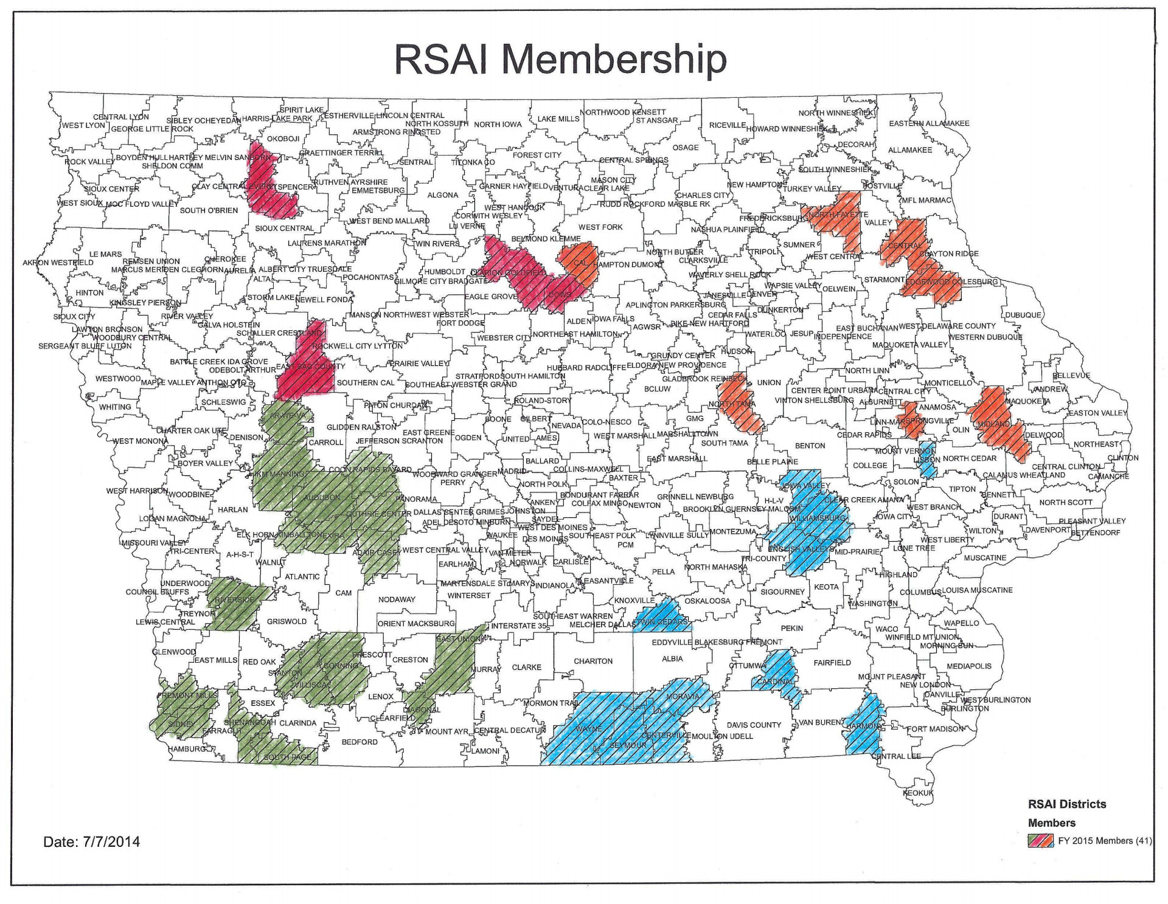
July 1, 2014

Slide 7

Why RSAI?

Slide 8
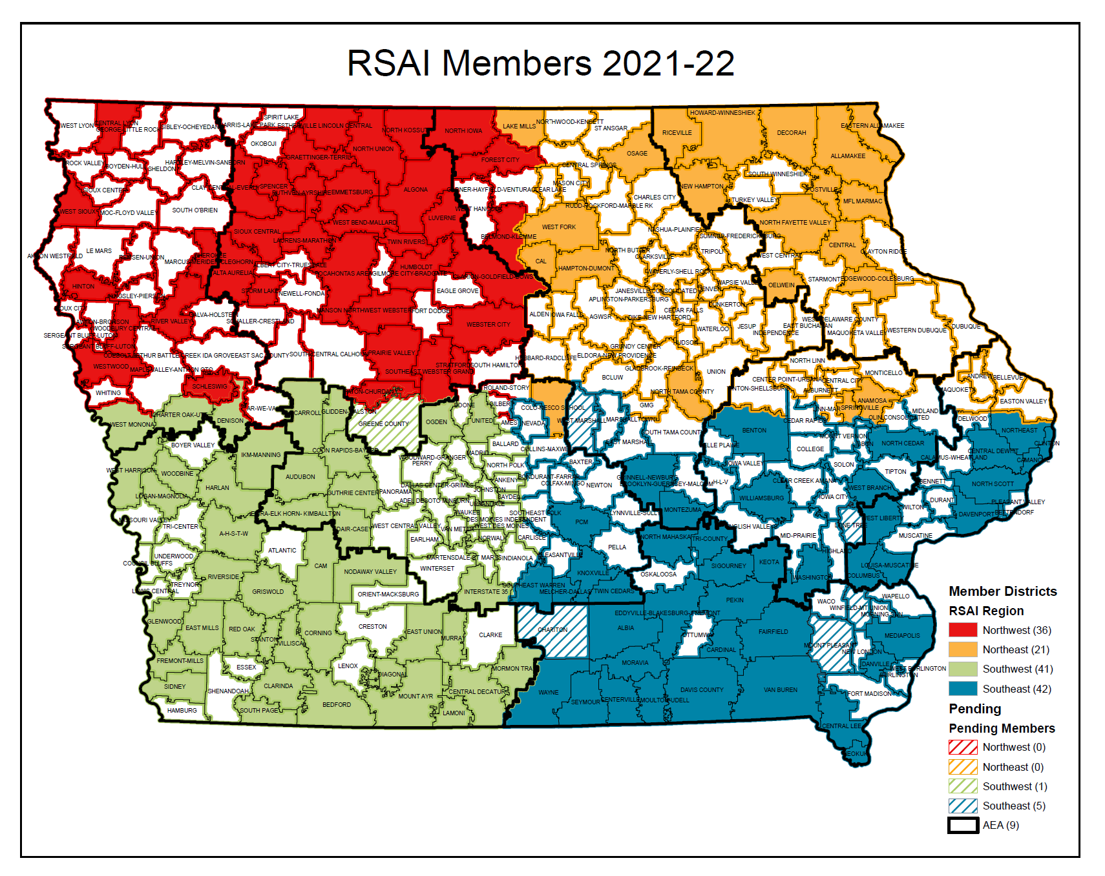

Slide 9



RSAI Relationships
RSAI is recognized as the Iowa affiliate of the National Rural Education Association (NREA) connecting members to rural school leaders nationwide, an annual conference focused on the needs and successes of rural schools
Lends Iowa’s voice to a collective effort in our nation’s Capitol through membership in the Rural Schools Collaborative.
Joins the Iowa Rural Development Council to network and collaborative with rural leaders across all areas of economic development.

Slide 10
Member Benefits
Advocacy presence at the Iowa Capitol focused on RSAI priority issues
Weekly legislative update reports and recap videos to share the latest news from the statehouse and calls to action when needed
A voice to advocate with the executive branch and represent rural schools on various task forces and stakeholder committees convened by DE.
Advocacy resources for local leaders to use, including position papers, advocacy tool kits, talking points, maps, and school finance estimates
Assistance with communications, letters to the editor or sample letters to legislators
Easy to share information, such as RSAI Legislative Priorities Video, to inform school boards, staff, and stakeholders.
RSAI is the state affiliate of the National Rural Education Association, which brings access to NREA research, updates about happenings in Washington, networking
Free Summer regional meetings and RSAI annual conference in October.
Authentic grassroots development of legislative priorities in a one district one vote democratic process.
Free access to NASDTEC teacher licensure checks with your RSAI membership. Learn more about the program here.
Discount on ISFIS Policy-hosting Service
Collective purchasing power as a group, attracting needed supports at discounted prices
Networking, Sharing, Best Practice Connections with other like districts

Slide 11










www.rsaia.org/corporate-sponsors

Slide 12

https://www.rsaia.org/annual-meeting.html

Slide 13
Election of RSAI Regional Representative to the Leadership Group.
Ongoing office is a 3-year term.
No election this year for NW Region.
Thanks to Justin Daggett!
Justin’s term expires in 2023

Slide 14
Election of RSAI Regional Representative(s) to the Legislative Committee.
Office is a 1-year appointment. By-laws changed to allow additional representatives such that each AEA has at least one.
Thanks to Brian Johnson, Prairie Valley & Southeast Webster Grand, for serving during the 2022 Session!
Representative attends Legislative Committee Meeting in Des Moines during August (date TBD), attends the Annual Meeting in Ankeny, October 26, and supports legislative advocacy efforts during the 2022 Session.

Slide 15
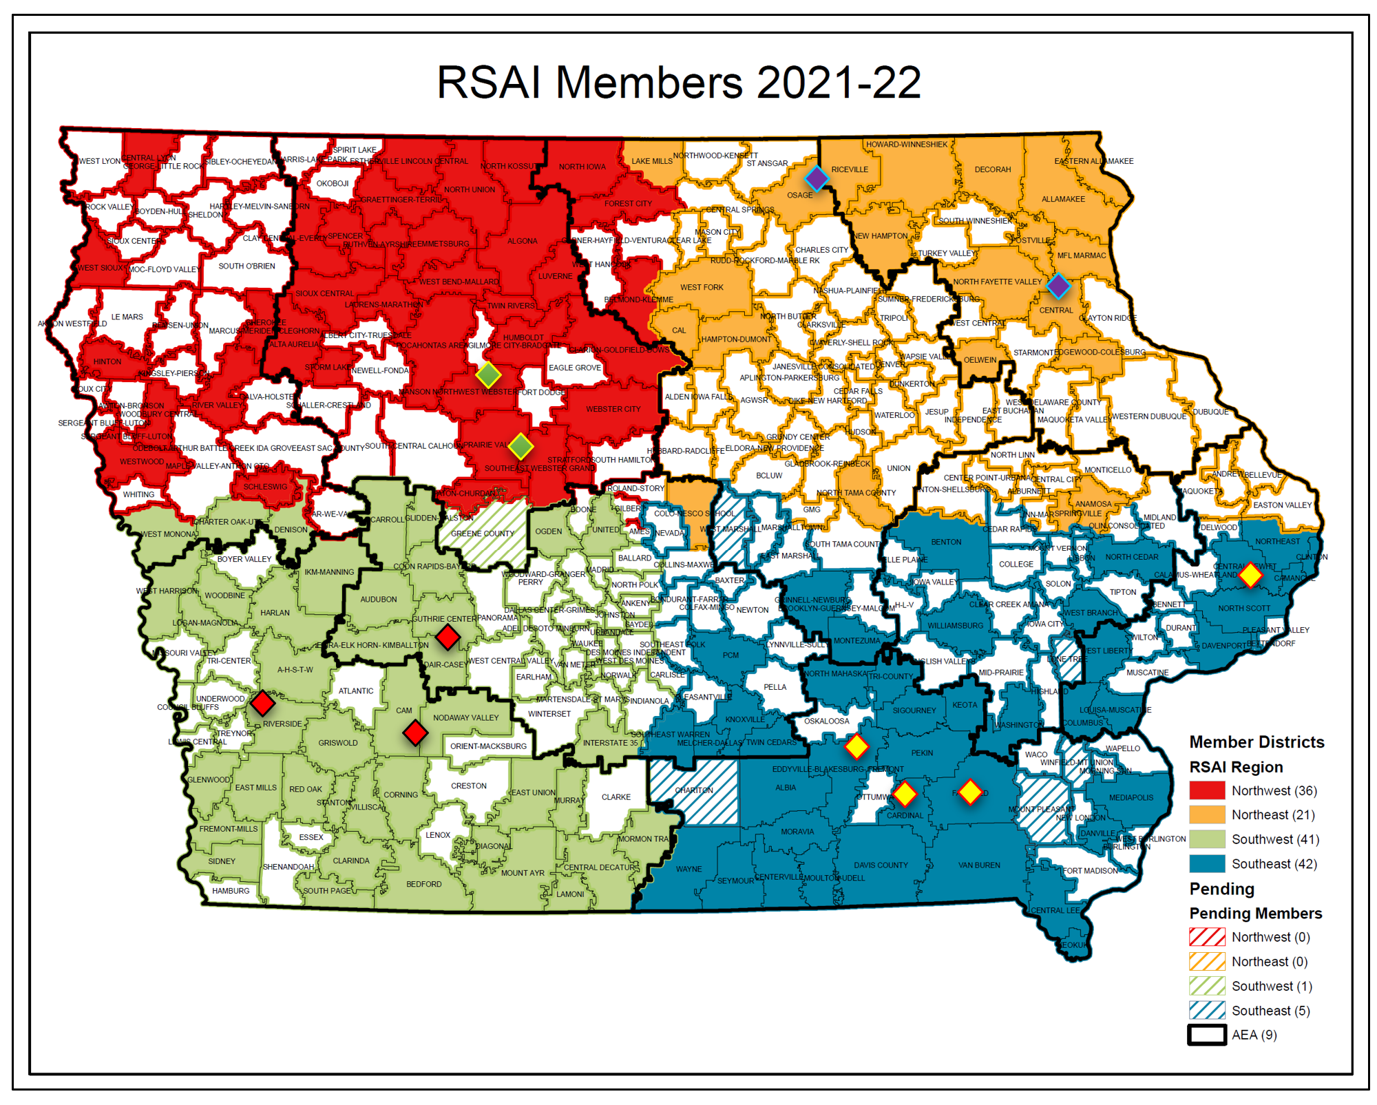

Slide 16
Accomplishments
Benefiting Rural Districts
Before 2018:
  Management fund authority to pay for retirements over age 65 and costs of arbitration
  PPEL flexibility to pay for repairs over $1,500
  DoP Flexibility
  Home Rule Statute
  Categorical Fund Flexibility
In 2018 Session
  Even more DoP Flexibility
  Even more Categorical Fund Flexibility
  Staff Flexibility – CTE options for hard-to-staff content and local offerings of on-line learning
  Progress on Transportation (grants) and Formula Equality
  Extension of Operational Sharing Incentives

Slide 17
Accomplishments
Benefiting Rural Districts
In 2019 Session
  Transportation in the Formula
  Formula Equity
  Extension of WGS/reorganization Incentives
  State Penny Extension
  Teacher shortage flexibility: Praxis waiver, concurrent enrollment STEM offer and teach, online learning flexibility
In 2020 Session
    Transportation in the Formula Continued (all the state average)
    Formula Equity – another $10 per pupil
    2.3% SSA (highest in 10 years)
    Mental Health: Telehealth services at school, Therapeutic Classroom Pilots, $2.1 million AEA funding for MH First Aid Training
    Staffing Flexibility: Online allowed for financial literacy, world languages and computer science to meet O&T, Praxis eliminated as entrance test to teaching, AA degrees for some CTE teachers, Licensure reciprocity with other states.
    Poverty: bill through House Education to study poverty weightings did not advance further

Slide 18
Accomplishments 2021
Benefiting Rural Districts
Empower Rural Iowa Broadband Grant Fund was created (HF 848) and $100 million was appropriated as a down payment for first-year implementation (HF 867).
Equity: transportation equity payments and additional reduction of $10 per pupil in the formula equity gap (SF 269).
Preschool: New process, for this fall only, to apply to the SBRC for modified supplemental amount for PK enrollment growth compared to Oct. 2020 provided (HF 868).
Operational Sharing: Work-based learning coordinator, special education director, and mental health professional with a statement of professional recognition were all positions added to operational sharing (HF 847 & HF 868) (WARNING: reduction of the supplementary weightings for operational sharing beginning in the FY 2023 school year.)
Student Mental Health: $3.2 million appropriation to AEAs for mental health training and student supports and services (HF 868). $2.1 million to begin implementation of therapeutic classrooms (SF 2360 in 2020 and HF 868 in 2021). Parity for insurance payments for telehealth services and state funds to reduce property taxes for Iowan’s mental health system (SF 619).
Flexibility for Staffing: Substitute qualifications (AA degree or 60 hours of post-secondary credit and process to extend beyond 10 days in a classroom in HF 675), allowing occupational therapists to provide concussion management services (SF 466), and direction that BOEE develop a statement of professional recognition for licensed behavior therapists and mental health professionals (SF 532). Warning: Online learning SF 467 does not advance.
Local Control: expanded flexibility to transfer TLC ending balances to the Flexibility Account and creation of a new FS3 (Flexible Student and School Support Program) which allows innovative programs and waivers of some offer and teach and other regulations (HF 847).

Slide 19
Summary of 2022 Legislative Session (so far)
RSAI Priority Action

Slide 20
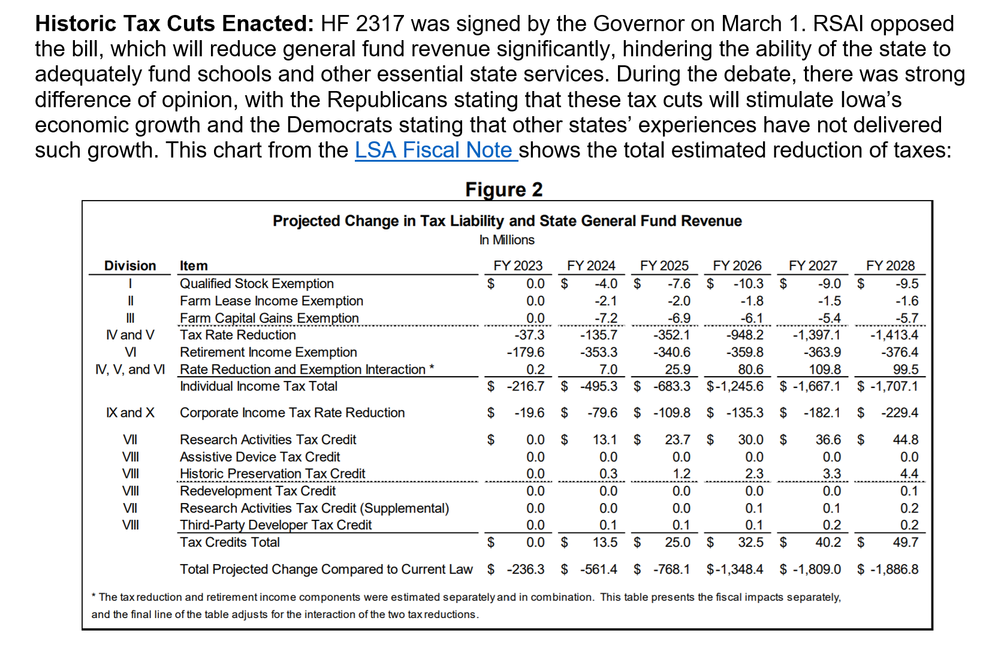
Priorities Update: Status
Funding & Formula/Transportation Equity

Slide 21
Adequate School Resources
Priority Action: HF 2316 State Supplementary Assistance (SSA). The bill was signed by the Governor on Feb. 17. The bill does the following:
  Establishes a 2.50% growth rate to be applied to the State cost per pupil (SCPP) for FY 2023, for an SSA of $181 per pupil.
  Establishes a 2.50% growth rate to be applied to each of the State categorical cost per pupil amounts for FY 2023 (TLC, PD, TSS, EICS, and Transportation Equity).
  Provides an additional increase of $5 to the FY 2023 regular program SCPP, separate from the SSA, to reduce the difference between the SCPP and district cost per pupil to $140.
  Freezes the additional levy portion of the FY 2023 SCPP at $685 per pupil, regardless of the per pupil increase for FY 2023 (property tax relief)
  Increases the appropriation to the Transportation Equity Program to equal the amount necessary to make all transportation equity aid payments.
RSAI opposed HF 2416, Historic Tax Cuts, under consideration at the same time as HF 2316 School Funding. The Legislature and Governor could have set the SSA rate at 3.75% and funded other RSAI priorities and still cut taxes significantly.
HF 2315, Supplemental Education Funding, provides $19.2 million in supplemental funding to help schools with inflationary costs. The bill was approved in the House, 94:1, but is still in the Senate Appropriations Committee at the time of this writing.

Slide 22
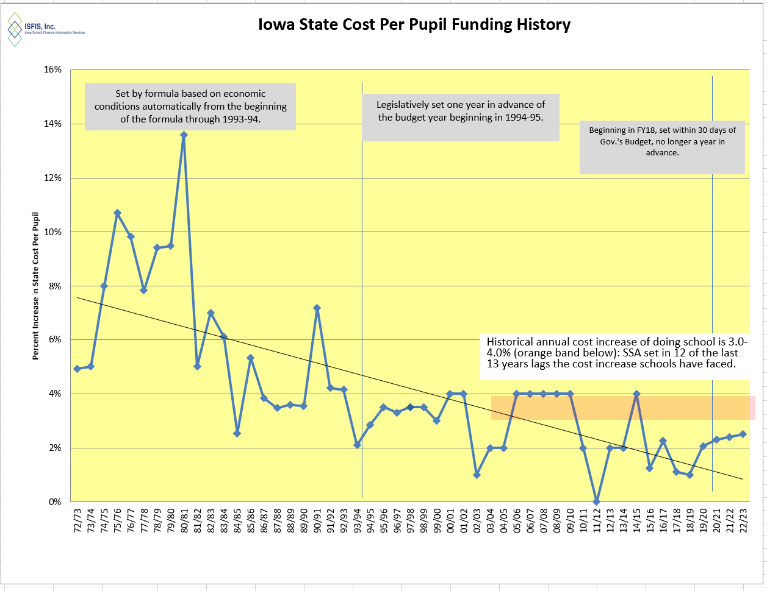
2.5% is second lowest in 13 years.
Inflation is running over 8%.
Teacher and other staff pay is not keeping up.

Slide 23
Question of the day:
How many of our other RSAI legislative priorities would fall off the list if schools had been adequately funded in the past or were adequately funded going forward?

Slide 24



Educator Shortage and Quality Instruction
Bill Number | Bills to Address Teacher/Substitute Shortage/ Alternative Licensure | Status (4/4/2022)
HF 2493 | Para-educators may substitute in any classroom except Drivers’ Education with a waiver from BOEE 2021-22 school year (ARRC). Requires the individual be paid the higher of the substitute per diem or their para wage. Approved in the House 99:0 and in the Senate 47:0, sending it to the Governor. RSAI supports. | To the Governor
SF 2296 | IPERS Income Threshold for Re-employment is increased to $50,000 and the school board member conflict of interest threshold is increased to $20,000. RSAI supports. | Signed by the Governor
SF 2377 | Teach Iowa scholar program eligibility, Teacher Intern license for grades 6-12 issued by the BOEE, and the use of revenues from the district management levy for teacher recruitment costs (limited to 10% of minimum teacher pay per teacher, no more than 5 years, and either early retirement or teacher recruitment each 5-year period. RSAI supports. | Approved by Senate. In House W&M Committee.
SF 2356 | Allows school boards to engage certain specified individuals to serve without compensation as substitute teachers. Approved in the Senate 38:7, on 2.28.22. RSAI is undecided. | House Calendar

Slide 25
Educator Shortage and Quality Instruction
Bill Number | Bills to Address Teacher/Substitute Shortage/ Alternative Licensure | Status (4/4/2022)
HF 2083 | Changes eligibility for Teach Iowa Scholar Program (no longer must be in top 25% of class) and specifies that half of the grants go to teachers in districts, charter and private school below 1,200 enrollment and half above. RSAI supports. | Senate Calendar. (In Governor’s School Choice SF 2369)
HF 2081 | Eliminates requirement for PRAXIS test for entry to college education program and requires higher education institutions to notify graduates with PRAXIS scores below the cutoff that they may apply for an initial license. Passed the House 94:0 on 2.28.22. RSAI supports. | Senate Calendar. (In Governor’s School Choice SF 2369)
HF 2165 | Last Dollar Scholars: makes part-time student eligible for Last Dollar Scholars financial support. Approved 99:0 in the House on 3.2.22. Attached to companion SF 2129 on the Senate Calendar. RSAI supports. | Senate Calendar
HF 2398 | Permanent Teacher License for master’s or doctoral degree educators (no CEU’s required.) Requires charter schools and private schools to conduct background checks, adds a minimum ten-year work requirement for these teachers before waiving future licensure renewals, requires the BOEE to do a background check on these permanent teachers every 5 years and allows BOEE to charge a reasonable fee for the background check. Approved 99:0 in the House. RSAI is undecided. | Senate Calendar

Slide 26
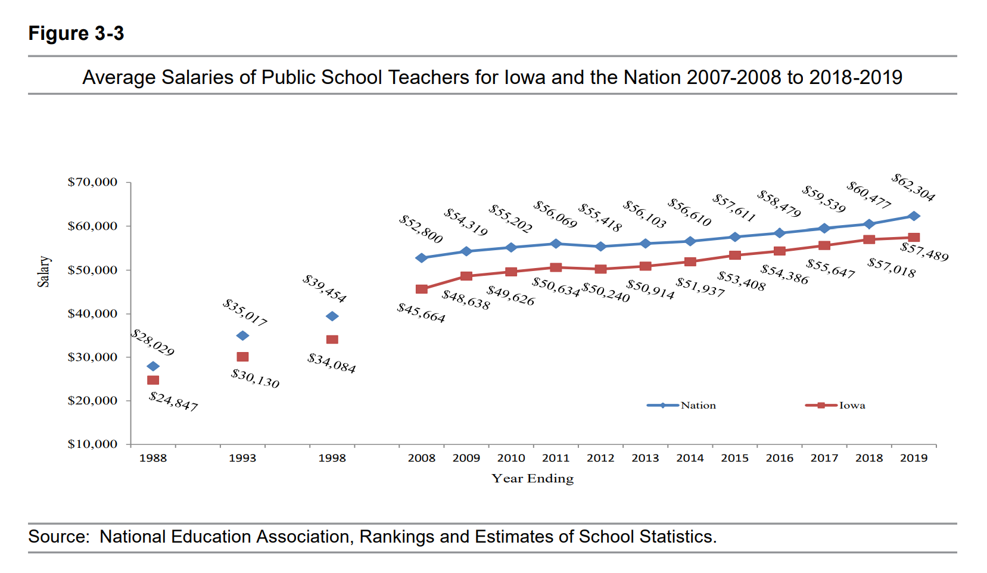
Gap between Iowa Average Teacher Salary and the National Average in 2019 is $4,815 (in 1988, the gap was $3,182). With significant teacher shortages across the nation, beginning teacher pay is also a critical comparison.
DE Annual Condition of Education 2020
 | 2018-19 | 2019-20 | Change
Iowa | $ 57,489 | $ 58,184 | $ 695
USA | $ 62,355 | $ 64,133 | $ 1,778

Slide 27
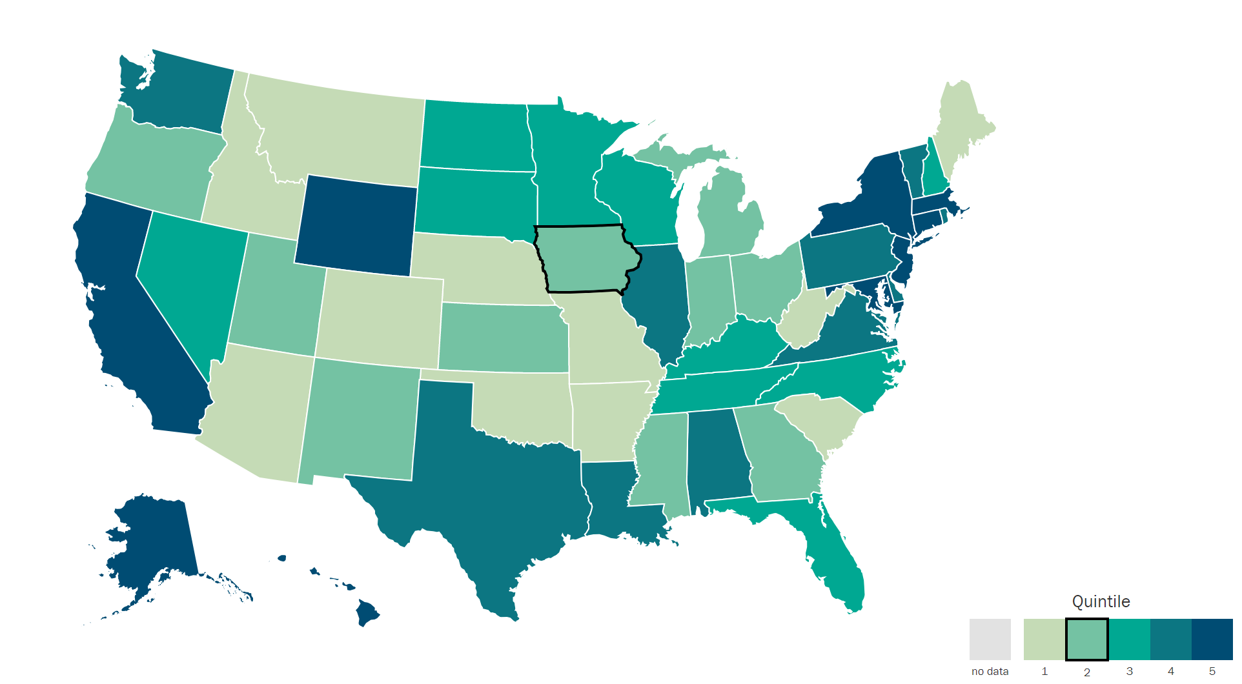
Understanding Teacher Shortages: 2018 Update
A State-by-State Analysis of the Factors Influencing Teacher Supply, Demand, and Equity https://learningpolicyinstitute.org/product/understanding-teacher-shortages-interactive
IL | $38,820
ND | $38,032
MN | $37,644
SD | $37,419
WI | $36,983
IA | $35,766
KS | $34,883
MO | $31,842
IA 6 out of 8 in Midwest.
IA is in the second to lowest quintile, ranking 30th in starting teacher pay.

Slide 28
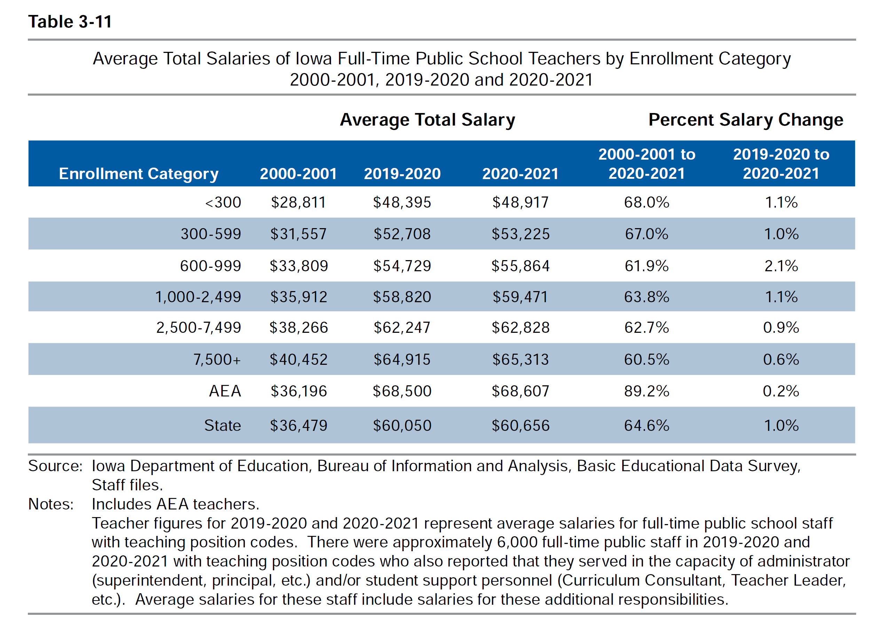
DE’s Annual Condition of Education Report shows average salary by school size (which is a good but not perfect predictor of rural districts), showing a growing difference in pay between the averages of the smallest and largest category of school size, now at $16,396, and more than $11,000 below the state average.
Rural schools tend to have younger teachers and lower class sizes, both of which can contribute to lower pay.

Slide 29
Geography and Sparsity Impacts Recruitment and Retention
Young teachers are not always willing to locate in a community with long commutes to amenities, so something has to make up for the lack of access to entertainment, housing, and other services.
Recent college graduate debt requires a high enough starting pay or other resource to help offset young teachers’ student loan payments.
Multiple preps and wearing many hats (teaching, coaching, etc.) may make it hard to keep young teachers drawn to other districts by higher salaries and fewer responsibilities.
Need for multiple certifications may require additional coursework, which can be a heavy lift for a new teacher/administrator

Slide 30

Local School Board Authority

Slide 31

Board Authority/Local Control
HF 2412 Radon Testing and Mitigation: pending Governor’s Signature. Requires testing every 5 years, mitigation under certain circumstances. Allows school employees to do the testing and mitigation if trained appropriately. Allows use of SAVE at board discretion to pay for testing and mitigation. RSAI undecided.
HF 2416 Transgender Girls Sports: signed by the Governor on March 3. Prohibits transgender girls from participating in girls’ sports contests. RSAI opposed.
HF 2527 and SF 2361 Governor’s Workforce Development: requires 8th grade plan to include work-based learning opportunities (regardless of whether the school district has them or is prepared to offer them to students.) Still pending action in both the House and Senate at the time of this writing. RSAI undecided.
SF 2369 Governor’s School Choice Omnibus: mandates high stakes civics test for graduation, transparency provisions regarding parents’ and community access to materials (unfunded mandate) and several appeals steps for library book decision-making process (overrides local district and school board determinations.) Senate improved the transparency provision with a parents’ rights bill that is more flexible for school compliance and does not include appeals. HF 2577 Transparency removes the high stakes test but still requires annual reporting of test scores and allows compliance by providing parents’ access to instructional management system. Still requires posting of core materials. This bill is currently assigned to the House Appropriations Committee at the time of this writing. RSAI opposed to Governor’s bill and original provisions in House. Undecided on HF 2577 and Parent’s Rights SF 2205 which is now part of SF 2369 School Choice.
HF 2254 Online Learning: would have allowed school board to use up to 5 virtual days to make up snow days. The bill did not progress out of the House Education Committee. RSAI supported this bill.
HSB 574 Start Date: would have allowed schools to start school as determined by the school board, but did not even progress out of the subcommittee. RSAI supported this bill.

Slide 32

Quality Preschool

Slide 33
Preschool Funding/Policy
Priority Action: note about COVID-19 Impact: PK enrollments fell in the Fall 2020. PK does not have an on-time funding component or budget guarantee, so the 2021-22 PK budgets were based on the Oct. 1, 2020 enrollment count. FY 2022-23 PK budgets will be based on this Oct. 1 PK head count. PK enrollment bounced up last October, but Iowa is still 2,000 preschool students below pre-pandemic levels. DE guidance prohibits school districts from using general fund for PK expansion. Note: Federal ESSER or ARP funds could be used for PK if funding for this fall. Funds transferred to the Flexibility Account and Title I funds could also be used for PK expansion. However, there were no bills that moved forward out of a subcommittee and no process for spending authority or direct state appropriation for the FY 2022-23 school year.
HF 318 PK for Young 5s: would have allowed districts to serve and count young 5-year-olds in PK, was approved by the full House, Senate Education Committee and Senate Appropriations Committee, but died on the Senate Calendar in the 2021 Session. Although the bill remained alive for consideration this year, did not survive the second funnel deadline. RSAI supports this bill.

Slide 34
Opportunity Equity for At-risk Students/Poverty

Slide 35

Student Inequities and At-risk Needs
Priority Action: despite the School Finance Interim Committee recommending in 2019 and the House Education Committee approving a bill, HF 2490, the study of the impact of poverty on education and funding formula options to meet the needs of students did not advance out of House Appropriations Committee in 2020.
No bill was moved forward in either the House or Senate in 2021 or 2022, taking a step backwards in the policy discussions. Bills were introduced in both the House and Senate Education Committees to bring equity in the DoP ceiling. HF 2008 and SF 2003. Subcommittees recommended forward motion, but neither Education Committee took up the bill.
FYI: Children from families with incomes at or below 130% of the poverty level are eligible for free lunch and those with income from 130-185% are eligible for reduced lunch. (Contrast: threshold for “low-income” for voucher eligibility is 400% of the FPL, or $111,000 for a family of 4)

Slide 36
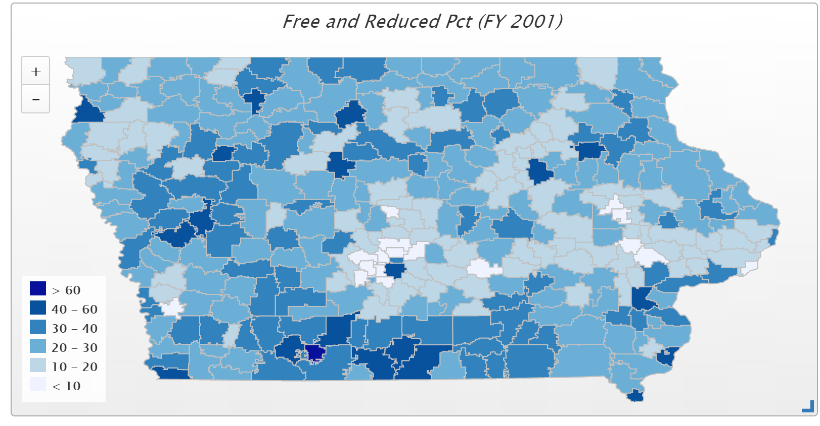
In 2001, only 4 districts had more than 50% of students eligible for FRPL (Waterloo, Keokuk, Wayne and Diagonal. Diagonal was the state high at 60.2% and the only district above 60%)

Slide 37
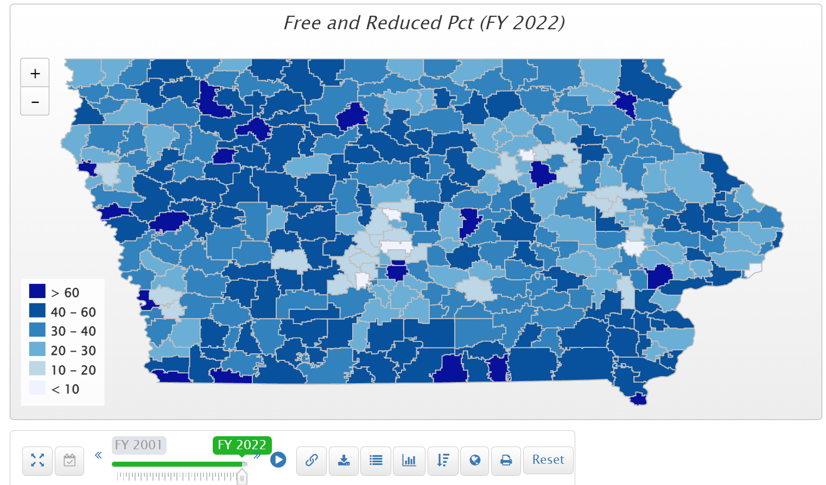
In FY 2022, of the 63 districts with more than half of their student on FRPL, 54 are rural. 18 districts have more than 60% of students eligible for FRPL. Those above 70% include Postville, Storm Lake, Council Bluffs, Waterloo, South Page, Hamburg, Des Moines.

Slide 38
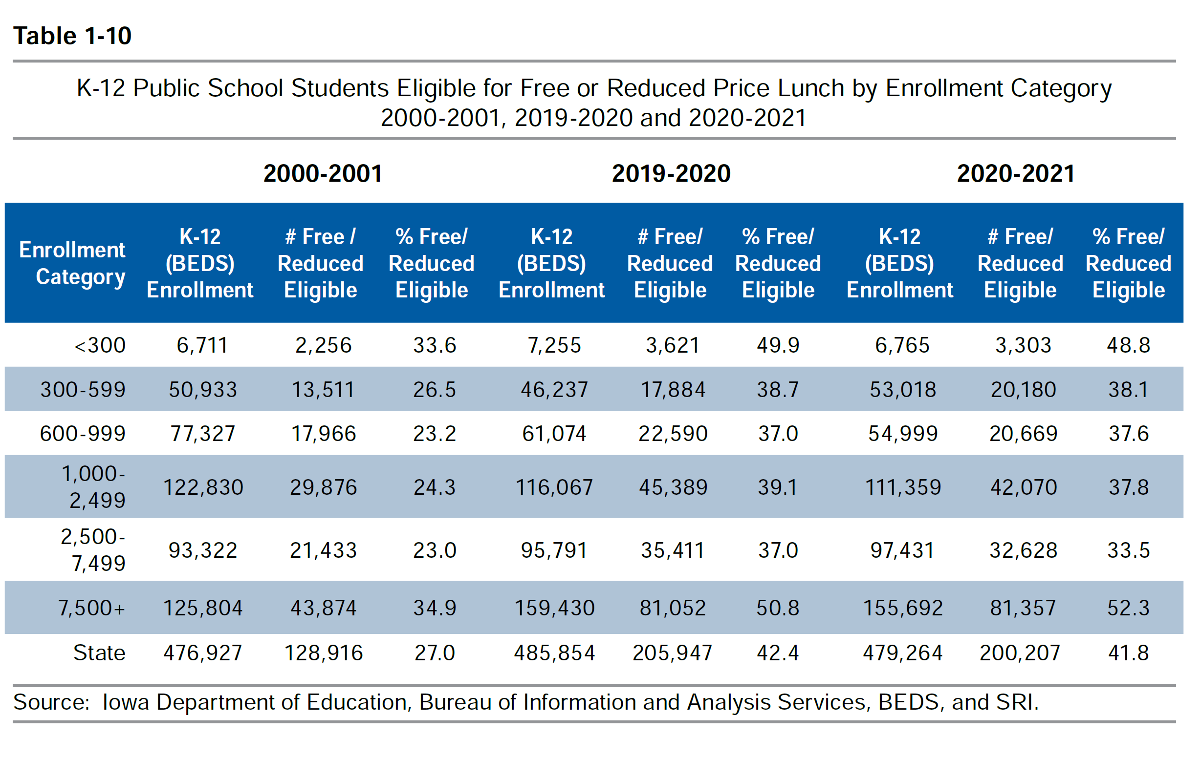
Districts in the largest and smallest enrollment categories had the highest percentage of students eligible for free or reduced price lunch (DE Annual Condition of Education Report Table 1-10).

Slide 39
Poverty Concentration & $$
The McCourt School of Public Policy, Georgetown, FutureEd, State Education Funding; The Poverty Equation, March 2020, states,
  “What’s more, when poverty is concentrated in a school—that is, when a significant portion of students in a school come from low-income households—the impact on performance is compounded.
  A body of research suggests that there is a ‘tipping point,’ somewhere between 50 to 60 percent of a school’s students living in poverty, where performance for all students there drastically declines.”
Nevada Study in Oct. 2018 studied successful school systems and costed out the staffing models of instruction and other services to determine the appropriate weighting commensurate with the programs needed at around .35 (would equate to $2,595 per low-income student in Iowa’s 2023 formula)
Nevada School Finance Study, Augenblick, Palaich and Associates, Education Commission of the States, Picus Odden and Associates October 22, 2018

Slide 40
Funding Formulas in Iowa and Other States
Iowa’s formula provides a total of $148.9 million in 2022-23 for at-risk and dropout prevention programs
  Dropout Prevention MSA: $136.5 million
  At-risk weighting in the formula: $17.2 million
Total funding equates to $786 per Iowa low income student, except that funding is distributed to all districts with little weighting for low income.
  Dropout Prevention is between 2.5% and 5% of regular program district cost, based on enrollment and history.
  At-risk funding is partially based on FRPL percentage of the state’s total FRPL enrollment and partially based on total enrollment.
  If it were all allocated to low income students, it would equate to 10.6% weighting, less than 1/2 of the 26 state’s average commitment to at-risk students in 2012.
  By 2018, 47 states provided at-risk funding based on poverty or other metrics, for a national average weighting of .22.

Slide 41
Iowa’s Resources are Enrollment Driven
Comparison of Van Meter and Cardinal funding for at-risk and dropout prevention per low income student exemplifies the formula:
School District | 2020-21 Enrollment | % FRPL eligible | FRPL Eligible Students | At-risk $$ | DoP$$ | Total $$ | $ per Low Income Student
Van Meter | 929 | 7.16% | 71 | $ 13,445 | $100,500 | $ 113,945 | $ 1,605
Cardinal | 949 | 55.22% | 522 | $ 22,215 | $146,132 | $ 168,347 | $ 323
Weighting of .35 = $2,467 in 2021, so even Van Meter’s funding is below the experts’ recommendations of resources to close the gap.

Slide 42
Sharing and Reorganization Incentives
HF 2080 Superintendent Weighting – would have increased the shared superintendent weighting to the equivalent of 9 students. Approved 94:0 in the House. On the Senate Calendar. HF 2009 SRO Operational Sharing would have added the SRO position for equivalent of 3 students (meaning 2), but failed to get support of a subcommittee in the House Education Committee.
SF 2369 Governor’s School Choice Omnibus: creates a new Students First Operational Sharing Fund, extends the incentives for 10 years (through 2034), adds SRO as a position which qualifies for weighting of 3 students (which is really 2) and creates a new process to go before the SBRC to expand the cap to 24 students. District must justify the need for the position. Although RSAI supports the extension, we do not support the bureaucratic process of SBRC approval and really do not support tying this program’s extension to a voucher program.
Note: Sharing incentives are currently authorized for submission with the Fall BEDS enrollment Oct. 1, 2023 which provides funding for the 2024-25 school year.

Slide 43
Reorganization and Whole Grade Sharing Incentives Extension
  2018: Extension of Operational Sharing Incentives through budget year beginning July 1, 2024
  2019: Extension of WGS and Reorganization Incentives for reorgs effective no later than July 1, 2024
  Incentives provide an impetus for districts to work together to deliver greater educational opportunities for students through WGS, either one-way, which 43 districts used in the 2019-20 school year or with two-way agreements, which 14 districts used. Three districts that previously participated in whole grade sharing were reorganized effective July 1, 2019, lowering the total number of school districts in Iowa to 327.
  In the 2020-21 school year, 255 districts also received operational sharing supplementary weighting. Of those, 101 districts qualified for the full 21 student weighting, or $148,008 per district.

Slide 44
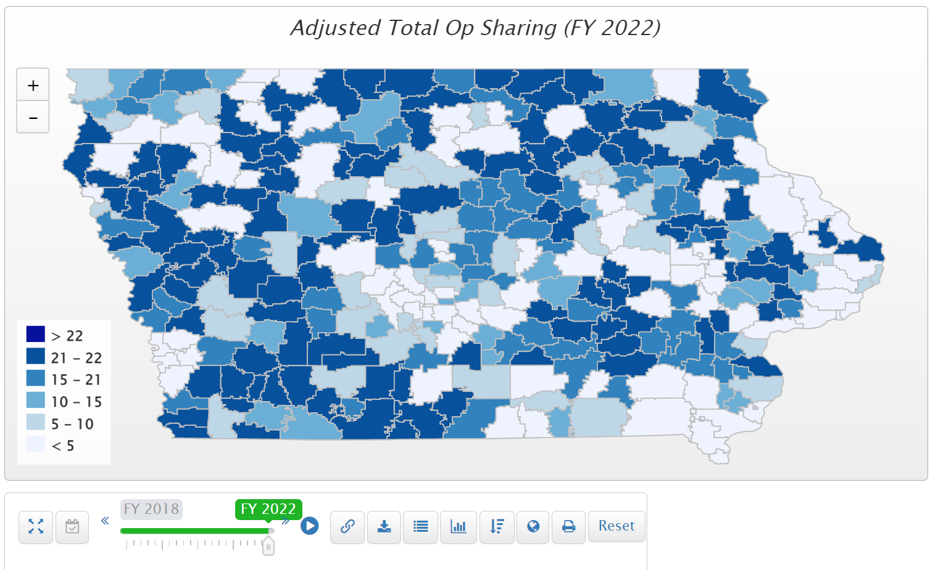
264 districts receive operational sharing incentives in the 2022 fiscal year. $29.3 million total. 115 districts are already at the 21 student cap.

Slide 45

Student Mental Health

Slide 46
Assessing and Addressing Social Emotional Health
Priority Actions SF 2195 & HF 2459 MH Loan Repayment Program: creates a new student loan forgiveness program for mental health professionals working in Iowa. House version approved 94:0, and both bills are on the Senate Calendar.
HF 2245 Telehealth Insurance Coverage/Out of State Providers: approved 94:0 in the House. Did not make it out of the Senate Human Resources Committee.
HF 2575 Education Appropriations: Provides a new $1.5 million appropriation to the College Student Aid Commission for the purpose of supporting a newly created Mental Health Practitioner Loan Repayment Program. Also appropriates $3.4 million, an increase of $200,000 to AEAs to provide mental health awareness training for educators and support mental health needs of students. Requires $200,000 to be used to implement a children's grief and loss rural pilot program to serve Iowa children in rural school districts or accredited nonpublic schools. The pilot program will be administered by, and $200,000 will be allocated to, an existing statewide not-for-profit health care organization that currently provides grief and loss services to children. Requires DE, in collaboration with the organization, to prepare a report detailing the expenditure of moneys used for the purposes of the program and its outcomes to the General Assembly by Sep. 30, 2023. Also appropriates $500,000 to DE for therapeutic classroom reimbursements and $1.7 million for the therapeutic classroom incentive fund (an increase of $40,000).

Slide 47
Internet Connectivity
No additional action has been taken this year, but last year’s investment of state and federal resources was significant. RSAI is currently monitoring status as broadband Internet expands across the state.
Iowa was ranked 45th in the nation before state and federal investment.

Slide 48
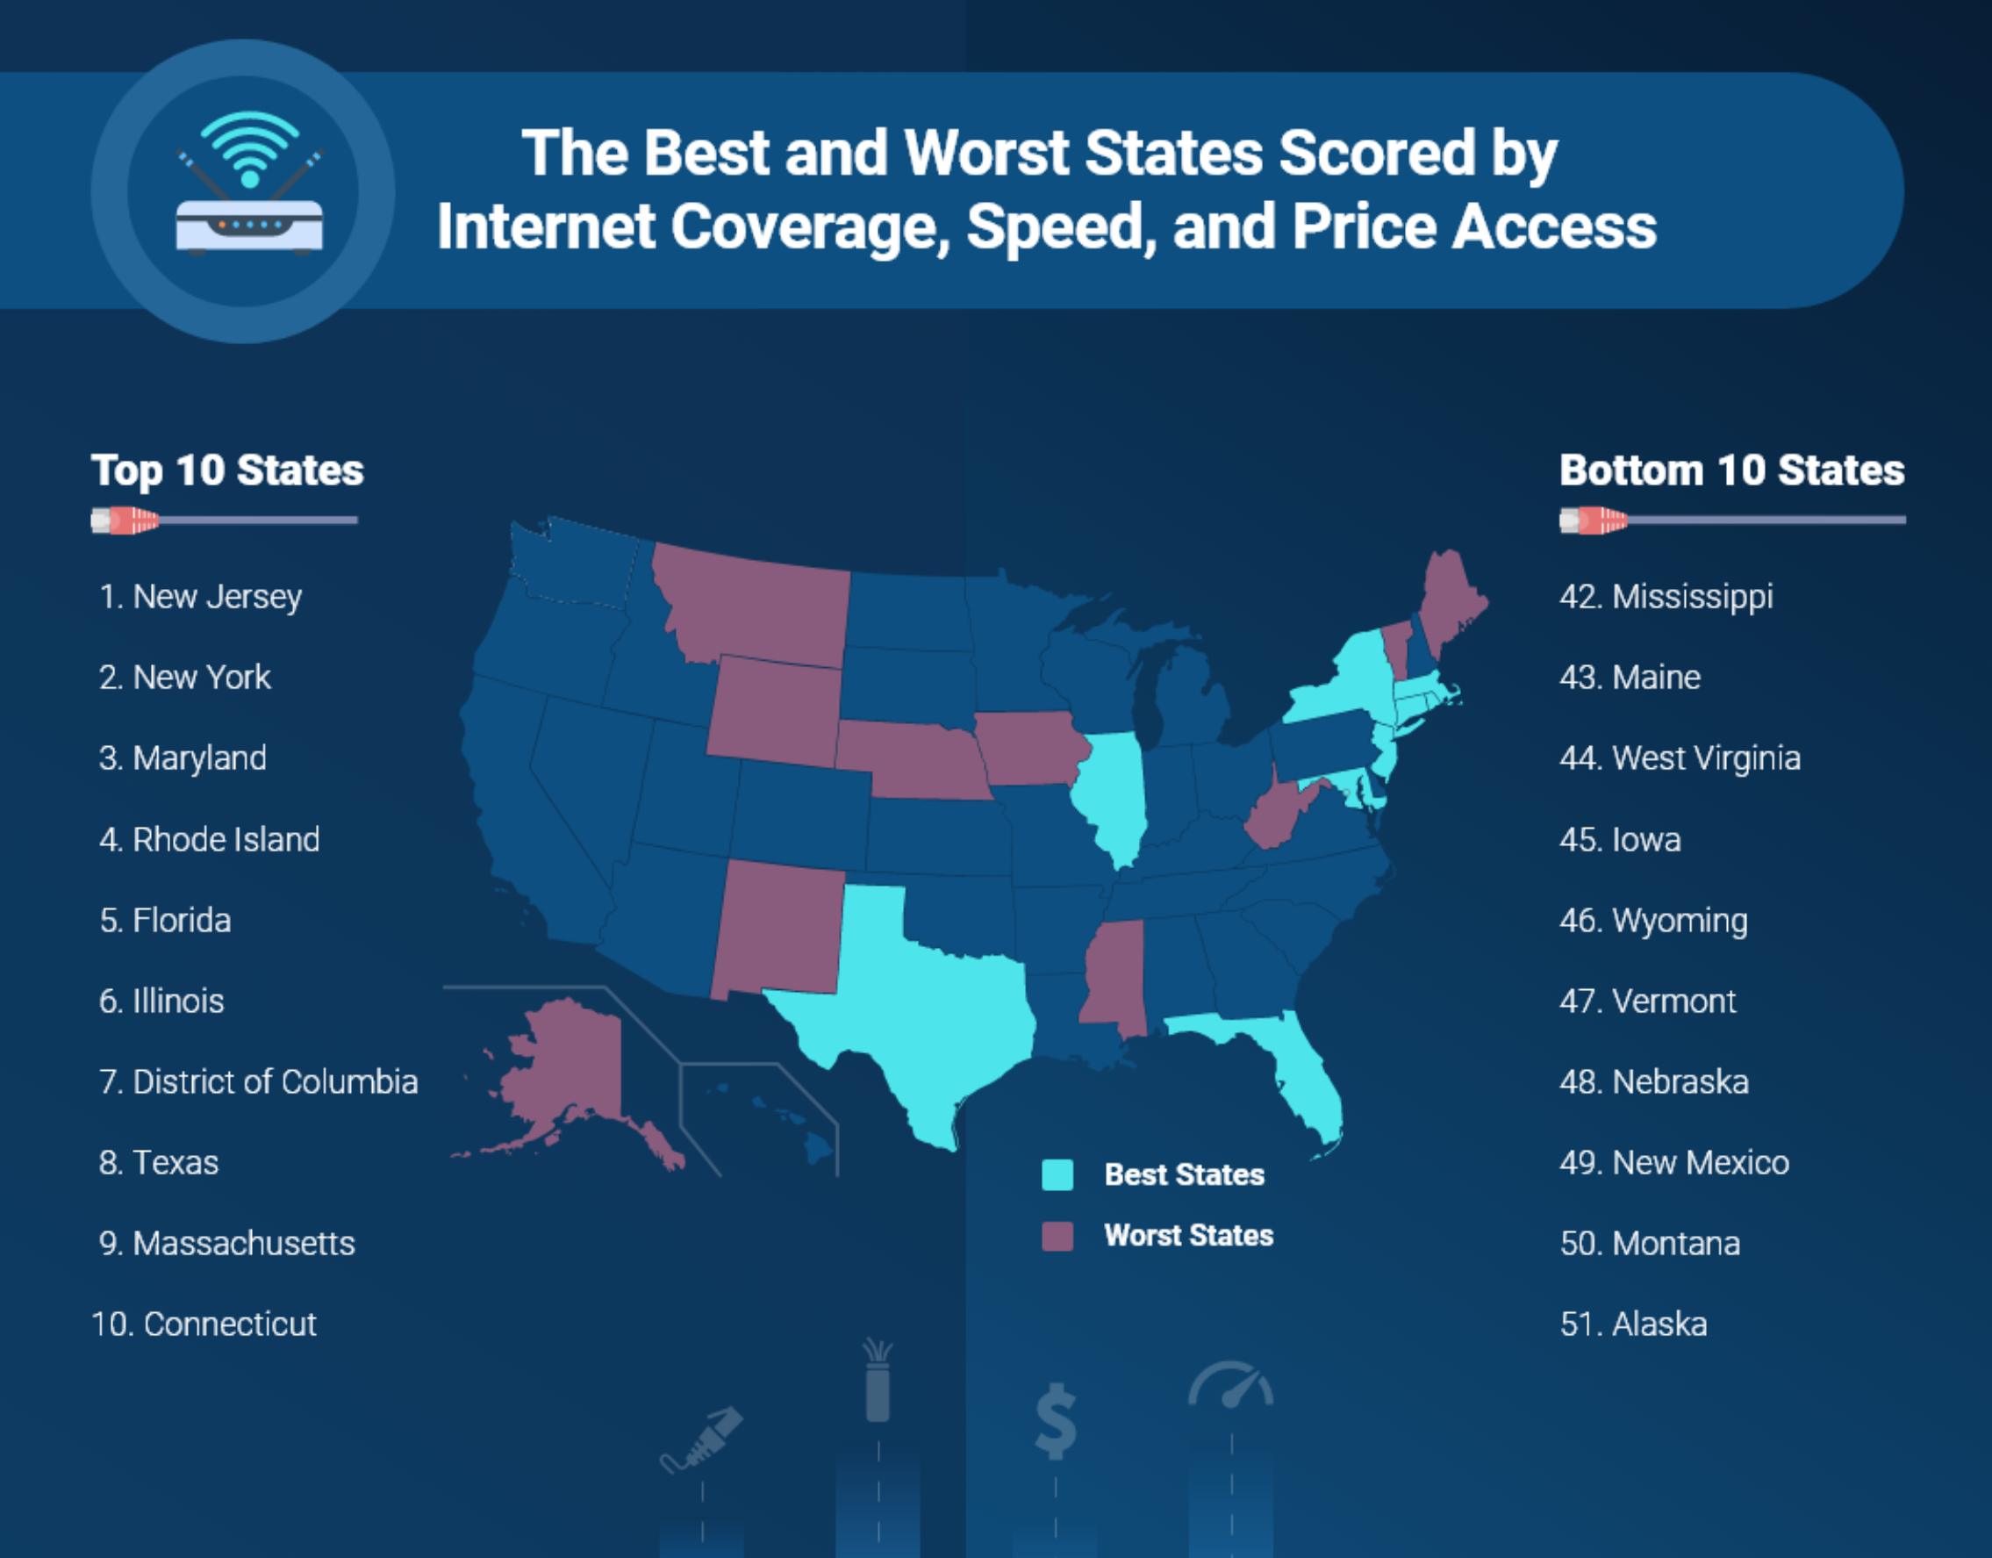
https://broadbandnow.com/research/best-states-with-internet-coverage-and-speed

Slide 49
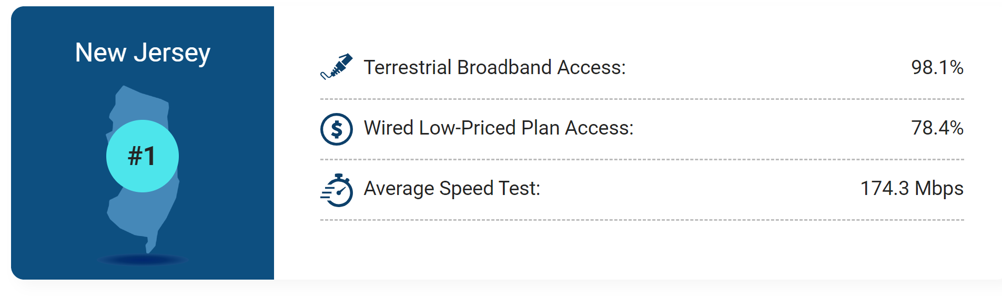
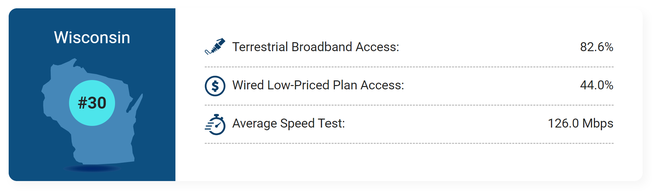
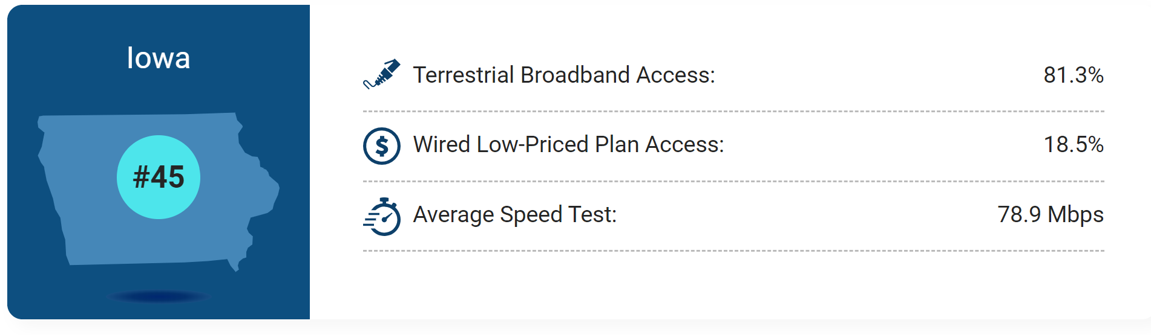
Access
Price
Speed

Slide 50
Time to Discuss Legislative Priorities
On your agenda see the 2022 list or on the RSAI website https://www.rsaia.org/2022-legislative-session.html
    1. Are there any that need to be removed?
    2. Any that need to be added?
    3. Any significant (or suggested) wording changes on those already on the list?
Small group or whole group discussion. We can go through them one at a time or consider the whole list with one vote. It’s completely up to the attendees to decide how to proceed.

Slide 51
RSAI 2023 Legislative Priorities
See the RSAI website meeting tab for more information such as RSAI Legislative Digest, Position Papers which will be updated after language is finalized during the process, Legislative Priorities, and this PPT and meeting minutes on the Regional Meeting tab. More information about the Oct. 25 Annual Meeting Coming later this Summer!
http://www.rsaia.org/

Slide 52
THANK YOU FOR YOUR VOICE on behalf of rural students!
Watch for RSAI Legislative Digest
RSAI Priority Survey later this Summer
Stay connected through the Interim
Let us know what you need to beef up your advocacy efforts.
See you at the Oct. 25 Annual Meeting!
Professional Advocate
Margaret Buckton, margaret@iowaschoolfinance.com
1201 63rd Street, Des Moines, IA 50311 (515) 201-3755 cell
Grassroots Advocate
Dave Daughton, dave.daughton@rsaia.org
(641) 344-5205

