Slide 1
WRITING- Informational/ Explanatory
Literacy TOOLS
www.kbumreading.com
Cut out each of the 6 Steps in the Walk.
Glue them onto large index cards or card stock.
After laminating individual cards, join them together to make a sequential line of steps in writing an INFORMATIONAL/EXPLANATORY paper.

Slide 2
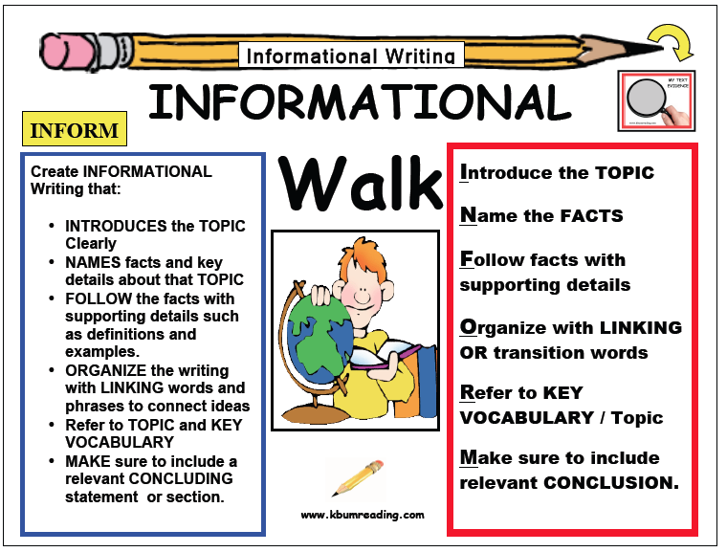
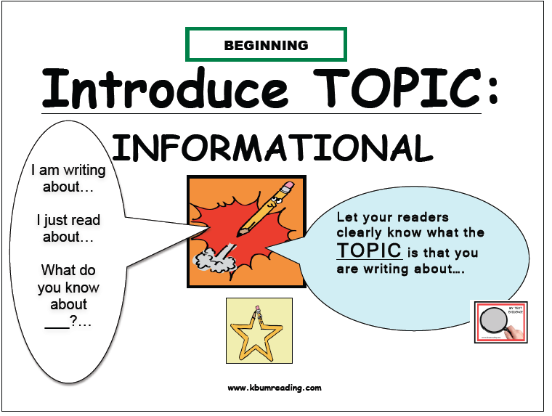
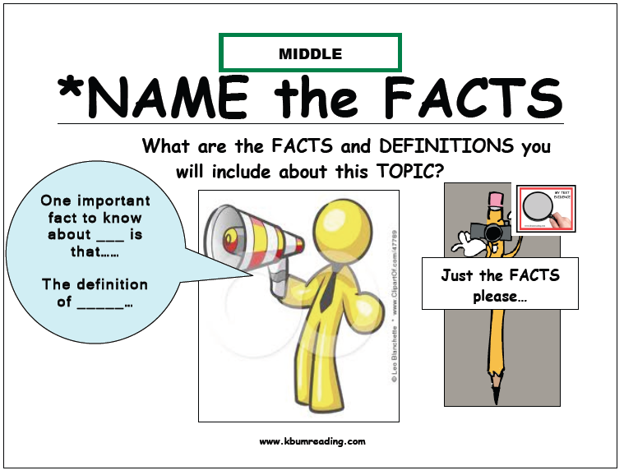
1
2

Slide 3
