Slide 1
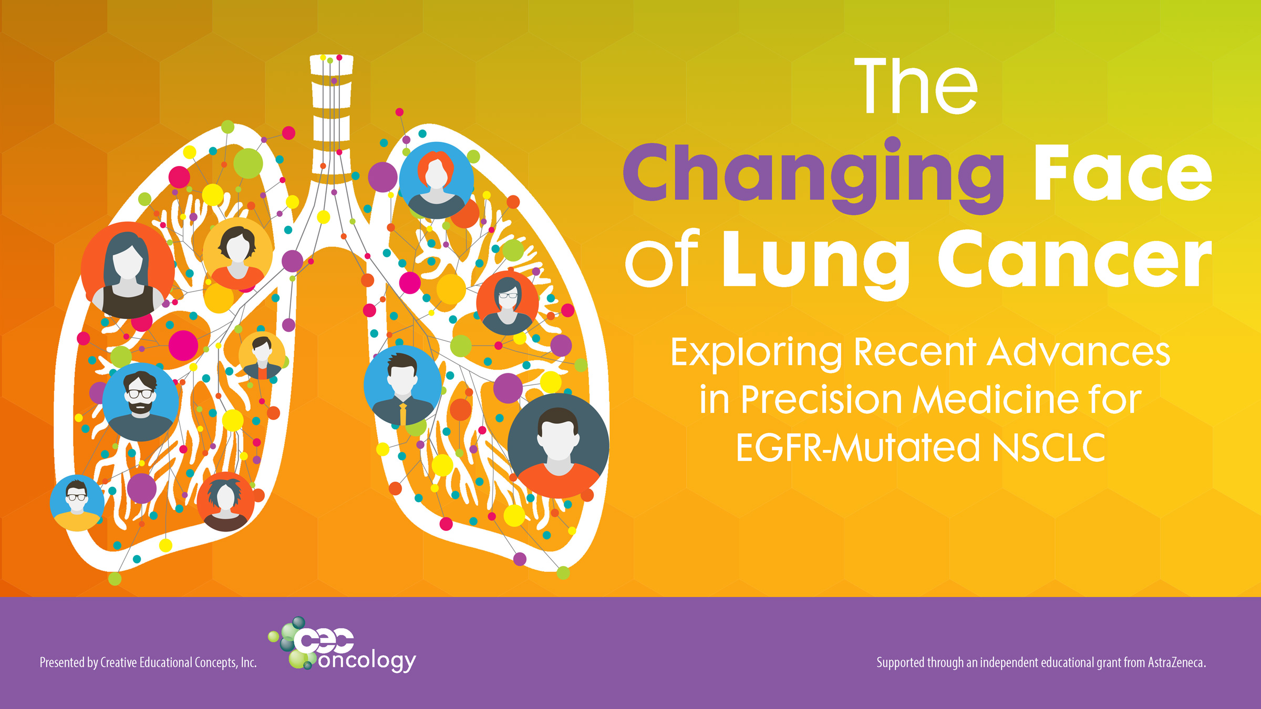

Slide 2

Welcome & Introductions/Pre-test
Suzanne Walker, MSN, CRNP, AOCN, BC
Certified Registered Nurse Practitioner (CRNP),
Coordinator for Thoracic Malignancies
Abramson Cancer Center, Penn Presbyterian Medical Center
Philadelphia, PA

Slide 3

Special Thanks!
Presented by
Supported by an independent
educational grant from AstraZeneca.

Slide 4

Accreditation
To receive up to 1.0 ANCC contact hour, please complete the CNE Request and Evaluation Form located in the pocket of your folder.
You may return your completed form at the registration desk.

Slide 5
ONCC/ILNA Certification Information
The program content has been reviewed by the Oncology Nursing Certification Corporation (ONCC) and is acceptable for recertification points. OCN®, AOCNP®, and AOCNS® nurses may apply 1.0 points in Coordination of Care, Disease-Related Biology, Health Promotion/Screening and Early Detection, Navigation, Oncologic Emergencies, Professional Practice, Psychosocial, Scientific Basis for Practice, Symptom Management, and Treatment categories.
Disclaimer: ONCC review is only for designating content to be used for ILNA points and is not for CNE accreditation. CNE programs must be formally approved for contact hours by an acceptable accreditor/approver of nursing CE to be used for recertification by ONCC. If the CNE provider fails to obtain formal approval to award contact hours by an acceptable accrediting/approval body, no information related to ONCC recertification or ILNA categories may be used in relation to the program.

Slide 6
Learning Objectives
Review the molecular pathology of advanced non-small cell lung cancer (NSCLC) and identify clinically relevant mutations that impact treatment selection.
Examine strategies oncology nurses can employ to help coordinate care in the community setting to improve adherence to guideline recommendations for molecular testing in NSCLC and discuss the utility of newer technologies, such as next generation sequencing and ctDNA liquid biopsy, in clinical practice.
Evaluate targeted treatment options for EGFRm NSCLC, focusing on differences in safety and efficacy profiles of EGFR tyrosine kinase inhibitors (TKIs) and appropriate selection of EGFR-TKI therapy in the first-line setting.
Identify current barriers to targeted therapy in the management of advanced NSCLC and discuss strategies nurses can employ to optimize therapy, anticipate and manage toxicities, improve quality of life, and patient adherence to oral chemotherapies.
Effectively educate NSCLC patients and caregivers on disease diagnosis, testing, and treatment recommendations to enable patients to actively participate in shared decision-making regarding treatment selection and care.

Slide 7

Audience Response Keypads
Please utilize the keypad at your table to answer questions throughout the program.
You will have 10 seconds to answer the question.
Please leave the keypad at your table or return it to staff at the registration desk at the conclusion of the program.

Slide 8

Follow-up Survey
Watch for an email in the coming weeks to participate in a follow-up survey regarding this activity. Your feedback is invaluable and will help us improve future CE activities.
The survey should take no more than 2-3 minutes to complete and you will be entered into a drawing to win a $25 Amazon gift card!

Slide 9
Pre-test Questions

Slide 10
Current Practice Question
My main specialty is:
Breast Cancer
Gastrointestinal Cancers
General Oncology
Genitourinary Cancers
Gynecologic Cancers
Head and Neck Cancers
Hematologic Cancers
Lung Cancer
Pediatric Cancers
Skin Cancers
Other

Slide 11
Current Practice Question
My main practice setting is:
Academic Medical Center
Community Cancer Center/Hospital
Government (e.g., VA)
Private Practice
Other

Slide 12
Current Practice Question
My greatest educational need related to EGFRm NSCLC is:
Biomarker testing
Decision making strategies for first-line treatment
The latest clinical trial data and treatment recommendations
Practical side effect management approaches for EGFR TKIs
Communication strategies for shared-decision making with patients
Early intervention with palliative care

Slide 13
Current Practice Question
At diagnosis of locally advanced or widespread NSCLC, how does your facility approach biomarker testing?
Tissue biopsy with NGS (next generation sequencing) with RNA analysis
Tissue biopsy with NGS-unsure how extensive
Tissue biopsy with reflex panels (is, EGFR/ALK/ROS first, then others if needed)
Liquid biopsy (blood test)
We don’t routinely test for biomarkers
Unsure of how we test for biomarkers at diagnosis

Slide 14
Current Practice Question
If you responded that you test for biomarkers at diagnosis, how long do you find that most patients will wait before starting a treatment?
Until actionable biomarkers are known or negative (EGFR, ALK, etc)
Until PD-L1 status is known
Two weeks max
One week max
My patients are anxious and want treatment immediately

Slide 15
Current Practice Question
What best describes the use of blood-based biomarkers (“liquid biopsy”) for NSCLC in your facility?
Use both at new diagnosis and upon progression
Use only at new diagnosis
Use only at progression
Use throughout treatment in addition to scans to monitor progress
We don’t use liquid biopsy
None of the above

Slide 16
Current Practice Question
Upon progression, if liquid biopsy is negative, does your institution do a tissue biopsy?
Yes
No
I am unsure

Slide 17
Pre-Test 1: For which of the following clinical applications can a liquid biopsy be used?
Biomarker testing at the time of disease progression or acquired resistance
To detect tumor burden in early stage NSCLC patients
Analysis for presence of PD-L1 biomarker
All of the above
Notes:
Correct Answer: Biomarker testing at the time of disease progression or acquired resistance

Slide 18
Pre-Test 2: Which of the following agents is NOT approved for first-line treatment in EGFR-mutant NSCLC?
Erlotinib
Afatinib
Crizotinib
Osimertinib
Notes:
Correct Answer: Crizotinib

Slide 19
Pre-Test 3: Which of the following agents best crosses into the CNS in treatment for brain mets with EGFR-mutant NSCLC?
Erlotinib
Afatinib
Dacomitinib
Osimertinib
Notes:
Correct Answer: Osimertinib

Slide 20
Pre-Test 4: Which of the following is a common side effect of EGFR TKIs in NSCLC?
Acneiform rash
Peripheral neuropathy
Alopecia
Nausea/anorexia
Notes:
Correct answer: Acneiform rash

Slide 21
Pre-Test 5: 67-yr old female who is taking erlotinib for EGFRm NSCLC comes to clinic with a painful R great toe. You explain that paronychia is a common side effect.
As a nurse, what else may help your patient?
Encourage more frequent pedicures
Start course of prophylactic antibiotics
Soak feet in diluted vinegar
Avoid hot showers or baths
Notes:
Correct Answer: Soak feet in diluted vinegar

Slide 22
NSCLC and Precision Medicine:
Implications and Recommendations for
Molecular Testing in 2019

Slide 23
Why Is Biomarker Testing Important in NSCLC?
Other
~25%
Squamous
~25%
Jordan EJ, et al. Cancer Discov. 2017.

Slide 24
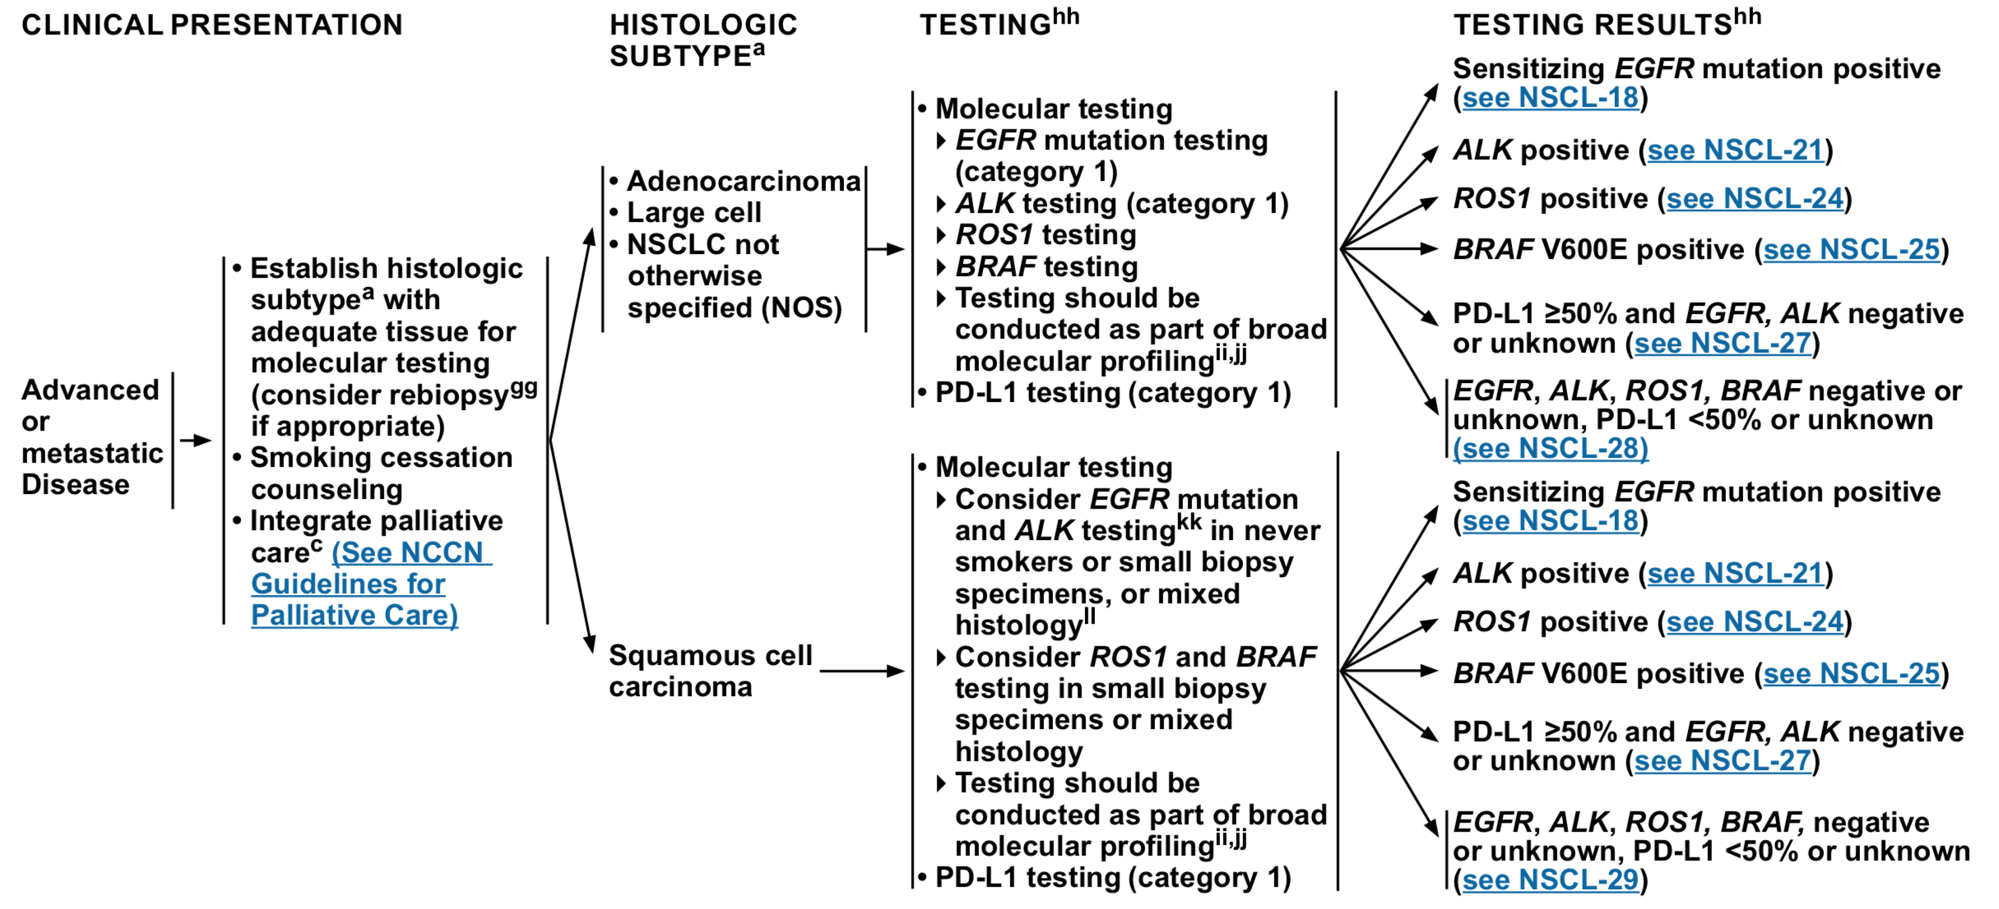
Who Should Get Tested?
NCCN. Non-small cell lung cancer. Version 3.2019.

Slide 25
2019 Targeted Therapies in the United States
EGFR mutation#
  Erlotinib*
  Gefitinib*
  Afatinib*
  Dacomitinib*
  Osimertinib*
ALK rearrangement
  Crizotinib*
  Ceritinib*
  Alectinib*
  Brigatinib
  Lorlatinib
ROS1 rearrangement
  Crizotinib
BRAF V600E mutation
  Dabrafenib + trametinib*
MET amplification or MET exon 14 mutation
  Crizotinib‡
HER2 (ERBB2) mutations
  Ado-trastuzumab emtansine (TDM-1)‡
RET rearrangement
  Cabozantinib‡
  Vandetanib‡
NTRK gene fusion
  Larotrectinib
*FDA approved in the first-line setting; #EGFR exon 19 deletions and L858R; ‡off-label use
NCCN Guidelines Non–Small-Cell Lung Cancer. Version 2.2019; FDA Prescribing Information.
Notes:
Lung cancer trial data for new targeted therapies was presented at ASCO for KRAS, RET, MET, HER2, and exon 20, so stay tuned!

Slide 26
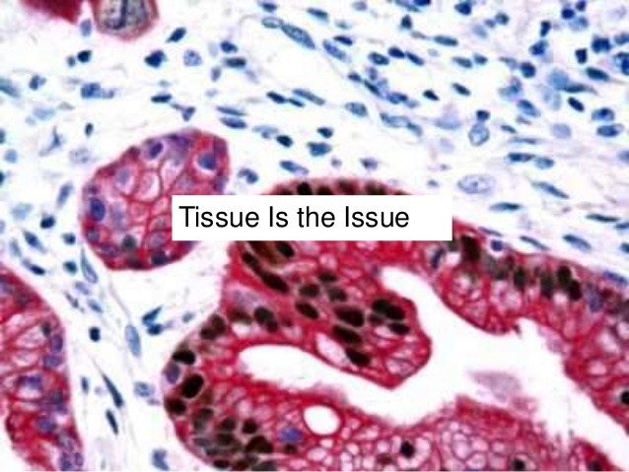
Barriers to Testing
Bone biopsies (decalcification process degrades DNA)
Anatomic location challenging for biopsy
Insufficient tissue
Patient comorbidities, which increase risk associated with biopsy (COPD, cardiac issues, etc.)

Slide 27
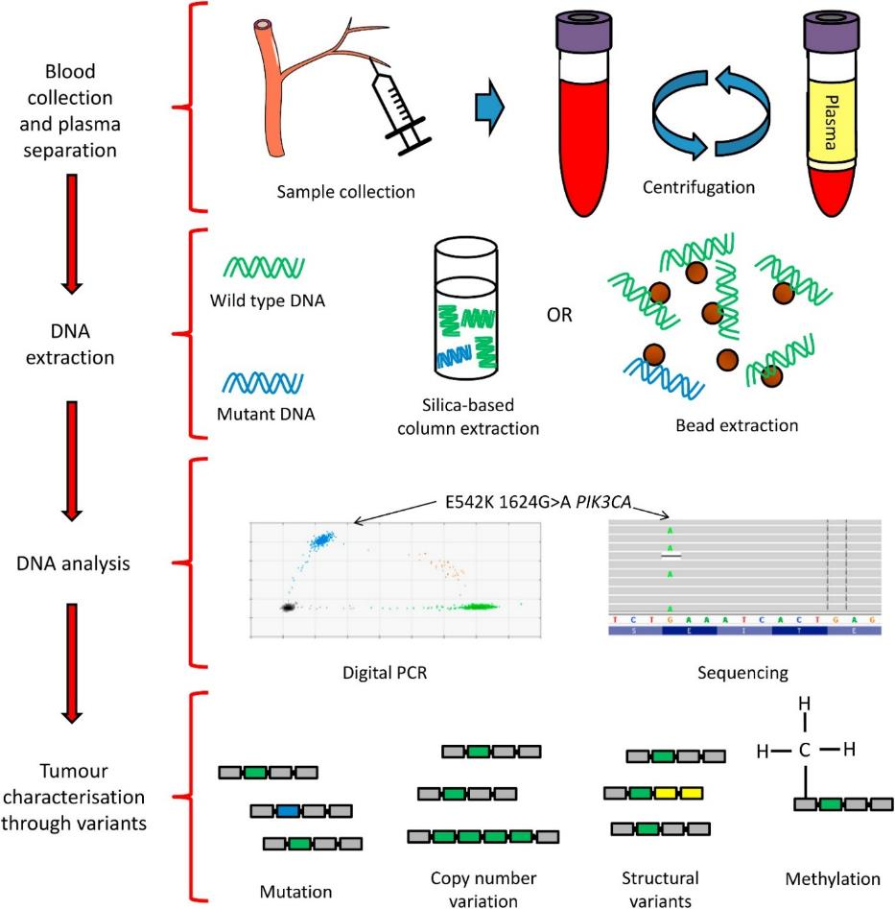
Liquid Biopsies in Biomarker Testing
Isolation and Analysis of cfDNA
A non-invasive approach to evaluation of tumor mutations (and other alterations)
Sequencing of circulating, cell-free circulating tumor DNA (cfDNA) released by cancers into the plasma
Multiple CLIA-certified clinical liquid biopsy assays exist; methods can be highly targeted or more comprehensive
O'Leary B, Turner NC. Clin Oncol (R Coll Radiol). 2016.

Slide 28
NILE Study
(Non-invasive versus Invasive Lung Evaluation)
General consensus among clinical practice guidelines to test eight biomarkers:
  EGFR mutations, ALK fusions, ROS1 fusions, BRAF V600E mutation, RET fusions, MET amplification and MET exon 14 skipping variants, and ERBB2 (HER2) mutations
    The most recent NCCN guidelines also include NTRK fusion testing as well
Despite these recommendations, significant numbers of patients are not receiving complete genotyping, because of insufficient tissue for testing, or because sequential testing is being done, which leads to insufficient tissue available for testing
The NILE study was a head to head study comparison of cfDNA testing (liquid biopsy) vs. standard of care tissue biopsy to determine “in the clinical practice setting, whether a validated (17, 18) and highly sensitive comprehensive cfDNA test utilized at diagnosis of mNSCLC is noninferior to physician discretion SOC tissue genotyping to identify guideline recommended genomic biomarkers and to evaluate potential advantages of cfDNA testing over physician discretion SOC given the known challenges with tissue-based molecular testing.”
Leighl NB, et al. Clin Cancer Res. 2019.

Slide 29
NILE Study
(Non-invasive versus Invasive Lung Evaluation)
100%
90%
80%
70%
60%
50%
40%
Positive
30%
Negative
20%
Quantity Not Sufficient (QNS)
10%
0%
EGFR
Mutation
ALK
Fusion
ROS1
Fusion
BRAF
V600E
RET
Fusion
MET
Amplification
MET
Exon 14 skipping
ERBB2
Mutation
All 8 Guideline biomarkers
Percentage of patients with completed tissue assessment for the guideline-recommended biomarkers. Only 18% of patients had complete tissue genotyping for all eight guideline-recommended genomic biomarkers. Most patients completed testing for EGFR mutations and ALK fusions (83%, 80%), followed by ROS1 fusions (58%). Complete testing for BRAF V600E mutation (35%), RET fusions (22%), MET amplifications (23%) and exon 14 skipping alterations (22%), and ERBB2 (HER2) mutations (20%) was rare. The QNS rates demonstrate where testing was attempted but was QNS for the biomarker of interest. For the eight guideline-recommended biomarker category, QNS denotes where tissue was QNS for all eight recommended biomarkers.
Leighl NB, et al. Clin Cancer Res. 2019.

Slide 30
NILE Study
(Non-invasive versus Invasive Lung Evaluation)
Results:
  cfDNA detected >90% of guideline recommended biomarkers that have FDA approved treatments, which is a rate similar to tissue testing (P<0.0001)
    In the cohort looking at detection of the eight guideline-recommended biomarkers by tissue vs. cfDNA testing first: 67% of patients with a guideline-recommended biomarker would have been detected with 33% of patients identified on reflex cfDNA testing. If cfDNA was the first genomic testing modality, significantly more patients would be identified (87% detected with 13% identified on reflex tissue genotyping (P<0.0001)
Detection of the eight guideline-recommended biomarkers by
tissue versus cfDNA first
Tissue First
67%
33%
cfDNA First
87%
13%
0%
10%
20%
30%
40%
50%
60%
70%
80%
90%
100%
Detected
Incremental add
Leighl NB, et al. Clin Cancer Res. 2019.

Slide 31
Role of Liquid Biopsies in Biomarker Testing
When Should Liquid Biopsies Be Used?
If tissue is insufficient for molecular testing at diagnosis
Liquid biopsies are increasingly used instead of a tissue biopsy at the time of acquired resistance
In patients who are not eligible for tissue biopsy
Limitations of Liquid Biopsies:
Liquid biopsies cannot be used to make a cancer diagnosis
They cannot be used to:
  Determine histology (adenocarcinoma, squamous cell, small cell, etc.)
  Establish PD-L1 status
“Non-shedders” A negative liquid biopsy may represent a false negative and should be followed by a tissue biopsy

Slide 32
EGFR-Targeted Therapies:
Personalizing Patient Care in NSCLC

Slide 33
Lynch, et al. N Engl J Med. 2004.
Activating Mutations in the Epidermal Growth Factor Receptor Underlying Responsiveness on Non–Small-Cell Lung Cancer to Gefitinib.
WHAT’S NEXT?
Defining resistance to osimertinib
Combination therapies
Further improvement in first-line therapy
Plasma-based cobas v2
FDA approved as companion diagnostic for erlotinib (activating EGFR mutations)
ERLOTINIB and AFATINIB FDA approval for first-line EGFRm+ NSCLC
EGFR mutations described
as oncogenic drivers of NSCLC¹
GEFITINIB
FDA approval for first-line EGFRm+ NSCLC
DACOMITINIB
FDA approval for first-line EGFRm+ NSCLC⁶
T790M resistance mutation described²
2003
2004
2005
2009
2013
2014
2015
2016
2017
2018
2019
Plasma-based cobas v2 FDA approved as companion diagnostic for osimertinib (T790M)
ERLOTINIB
FDA approved for NSCLC after failure
of ≥1 prior therapy
Ph1 studies of T790M-specific third-gen EGFR TKIs start (osimertinib, rociletinib)
OSIMERTINIB
FDA approval for first-line EGFRm+ NSCLC⁵
GEFITINIB
accelerated FDA approval for NSCLC after failure of docetaxel (later lost full approval for this indication)
iPASS³
OSIMERTINIB
FDA approval for second-line, T790M+ EGFRm+ NSCLC⁴
FLAURA
first-line Osimertinib
¹Lynch TJ, et al. N Engl J Med. 2004; ²Pao W, et al. PLoS Medicine. 2005; ³Mok TS, et al. N Engl J Med. 2009; ⁴Jänne PA, et al. N Engl J Med. 2015; ⁵https://www.fda.gov/drugs/informationondrugs/approveddrugs/ucm605113.htm; ⁶https://www.accessdata.fda.gov/drugsatfda_docs/nda/2018/211288Orig1s000TOC.cfm.

Slide 34

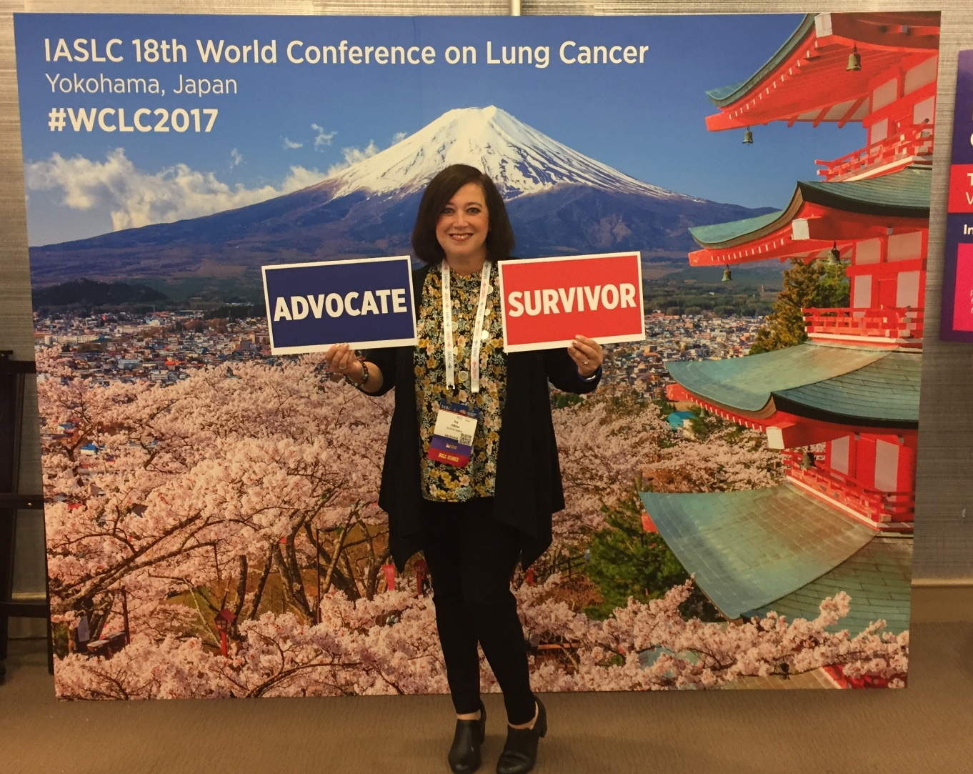


Patients Driving Research to Save Lives
Ivy Elkins
Lung Cancer Patient and Advocate

Slide 35




Case Study 1
The patient is a 47-year-old female who previously worked in finance and marketing; currently staying home as a full-time mom. She enjoys traveling, reading, walking, and playing mahjong.
She has never smoked, and is married with 2 children (ages 10 and 13).
In summer 2013, she noted elbow and neck pain. Her PCP felt it was from overuse and ordered an x-ray of her elbow (negative) and MRI of her neck (showed some degenerative joint disease changes).
The PCP prescribed ibuprofen and physical therapy.

Slide 36


Case Study 1 (cont.)
After several months of PT, there was improvement in her neck but not in her elbow.
She saw an orthopedist who found that besides having tennis elbow, she was “perfectly healthy.” The doctor prescribed additional PT.
The pain in her elbow persisted, so she sought another opinion from another orthopedist. An MRI of the elbow was ordered.

Slide 37
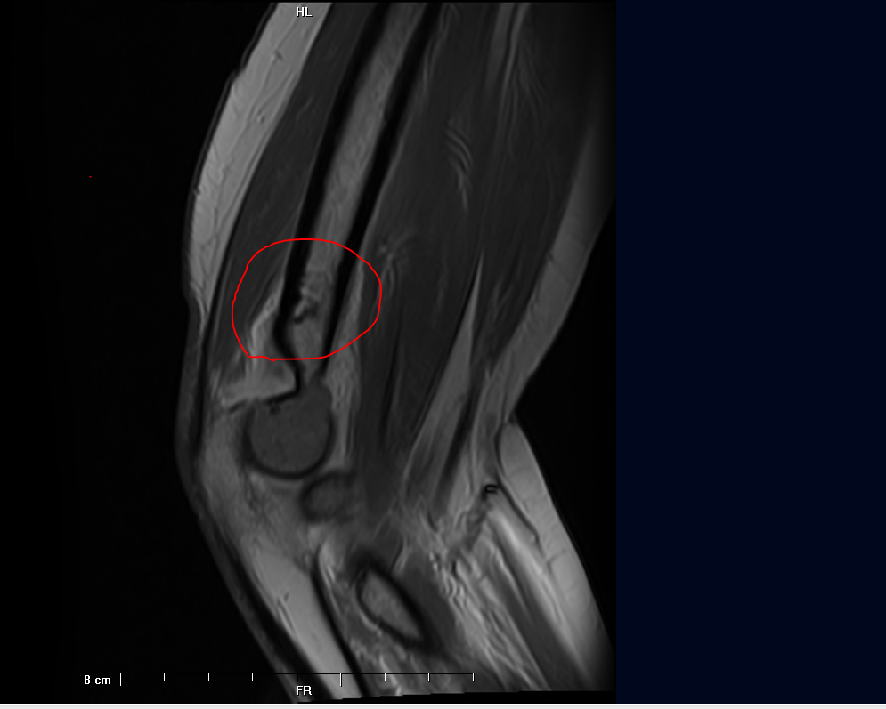
Case Study 1 Work-up
An MRI of the elbow showed a 1.5x3.7cm mass in the distal humerus with anterior cortical humeral breakthrough and extension into the joint space; a PET scan found a large right upper lobe mass, multiple bone mets (C2 and C3, 7th and 8th ribs, right iliac bone, and right humerus); and a brain MRI showed multiple brain metastases.

Slide 38


Case Study 1 Biopsy and Diagnosis
FNA of the distal humerus revealed adenocarcinoma of the lung (TTF-1+ and P63-). Molecular profiling found EGFR Exon 19 deletion.
Stage IV EGFR-mutant lung adenocarcinoma metastatic to bones and brain.

Slide 39
FDA-approved EGFR Inhibitors in 2019
Drug | Generation | Starting Dose | T790M Activity? | Major Toxicities (% all grades/% Gr 3–5)
Erlotinib (Tarceva) | 1st | 150 mg QD | No | Rash (85/14), Diarrhea (62/5)
Gefitinib (Iressa) | 1st | 250 mg QD | No | Rash (47/2), Diarrhea (29/3)
Afatinib (Gilotrif) | 2nd | 40 mg QD | No | Diarrhea (96/15), Rash (90/16), Stomatitis (71/9), Paronychia (58/11)
Dacomitinib (Vizimpro) | 2nd | 45 mg QD | No | Diarrhea (87/8), Paronychia (64/8), Rash (69/23), Stomatitis (45/4.4)
Osimertinib (Tagrisso) | 3rd | 80 mg QD | Yes | Diarrhea (58/2.2), Dry skin (36/0.4), Nail Toxicity (35/0.4), Stomatitis (29/0.7), Rash (58/1.1)
Pneumonitis/ILD is a rare but serious side effect that can occur with any of the EGFR TKIs
FDA Prescribing Information.

Slide 40
Selecting First-line Therapy
FLAURA Trial
Patients with locally advanced
or metastatic NSCLC
FLAURA Double-blind Study Design
Osimertinib
(80 mg PO QD)
(n=279)
RECIST 1.1 assessment every 6 weeks¶ until objective progressive disease
Key inclusion criteria
≥18 years*
WHO performance status 0/1
Exon 19 deletion/L858R (enrollment by local# or central‡ EGFR testing)
No prior systemic anticancer/EGFR-TKI therapy
Stable CNS metastases allowed
Stratification by
mutation status
(Exon 19 deletion/ L858R) and race (Asian/non-Asian)
EGFR-TKI SoC§
Gefitinib (250 mg PO QD) or
Erlotinib (150 mg PO QD)
(n=277)
Crossover was allowed for patients in the SoC arm, who could receive open-label osimertinib upon central confirmation of progression and T790M positivity
Endpoints
Primary endpoint: PFS based on investigator assessment (according to RECIST 1.1)
  The study had a 90% power to detect a hazard ration of 0.71 (representing a 29% improvement in median PFS from 10 months to 14.1 months) at a 2-sided alpha level of 5%
Secondary endpoints: objective response rate, duration of response, disease control rate, depth of response, overall survival, patient reported outcomes, safety
*≥20 years in Japan; #With central laboratory assessment performed for sensitivity; ‡cobas EGFR Mutation Test (Roche Molecular Systems); §Sites to select either gefitinib or erlotinib as the sole comparator prior to site initiation; ¶Every 12 weeks after 18 months.
Ramalingam SS, et al. ESMO. 2017. Abstract LBA2_PR; Soria JC, et al. N Engl J Med. 2018.

Slide 41
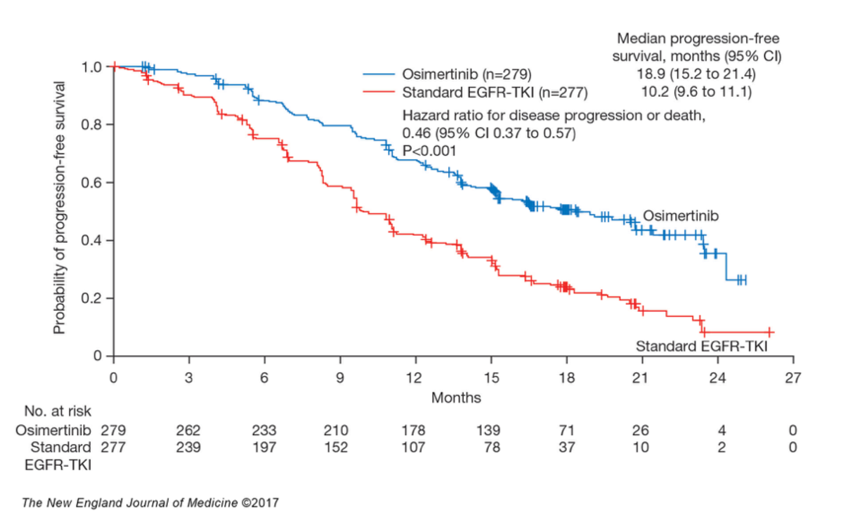
FLAURA: Progression Free Survival (PFS)
Soria JC, et al. N Engl J Med. 2018.
Notes:
Table 11.2.2.3, Table 11.2.2.2 Figure 11.2.2.4

Slide 42
Management of EGFR-mutant NSCLC
Initial
Diagnosis
First-line Therapy
Second-line Therapy
Third-line Therapy
EGFRm+ NSCLC
Exon 19 deletion
L858R
Erlotinib
Gefitinib
Afatinib
T790M+ : Osimertinib
MET^{amp}: EGFR + MET TKI
SCLC: Platinum/Etoposide
Other: Carboplatin/Pemetrexed
?
2016
EGFRm+ NSCLC
Exon 19 deletion
L858R
Osimertinib
?
2018
Courtesy of Zofia Piotrowska, MD, MHS.

Slide 43
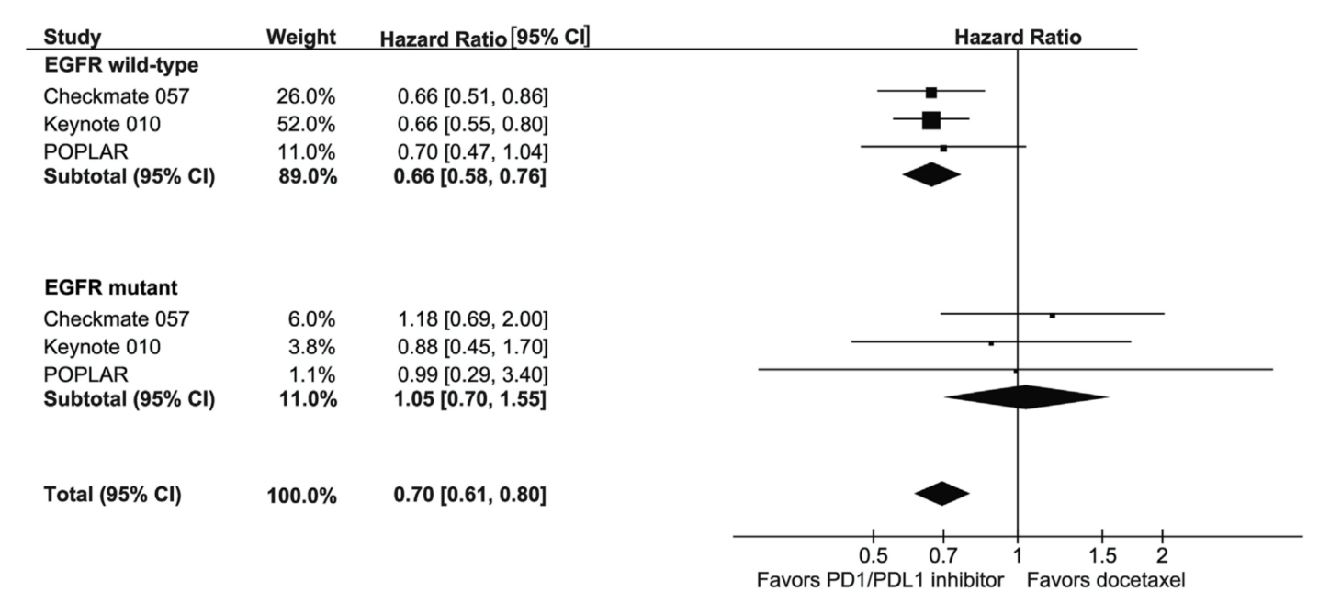
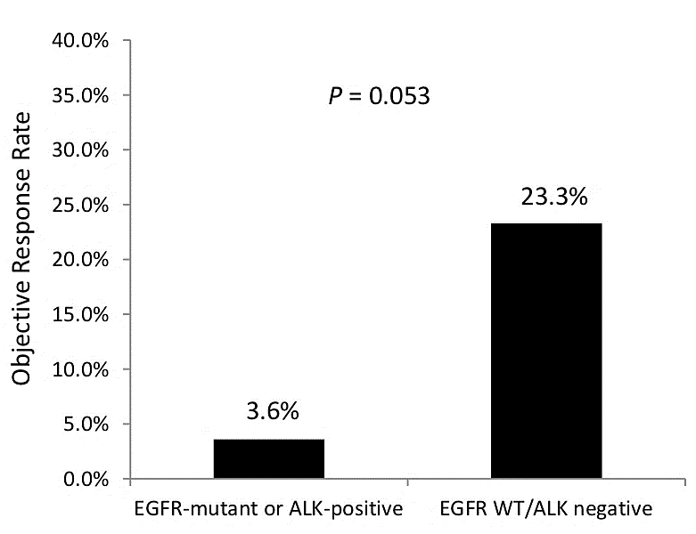
Immunotherapy for EGFR-mutant Patients
P=0.053
n=28
Meta-Analysis of Outcomes across ph3 RCTs of Nivo (CM057), Pembro (KN010), Atezo (POPLAR) among EGFR+ vs EGFR-wt pts¹
ORR to PD1/PD-L1 inhibitors
(confirmed and unconfirmed)²
¹Lee CK, et al. J Thorac Oncol. 2016; ²Gainor JF, et al. Clin Cancer Res. 2016.

Slide 44
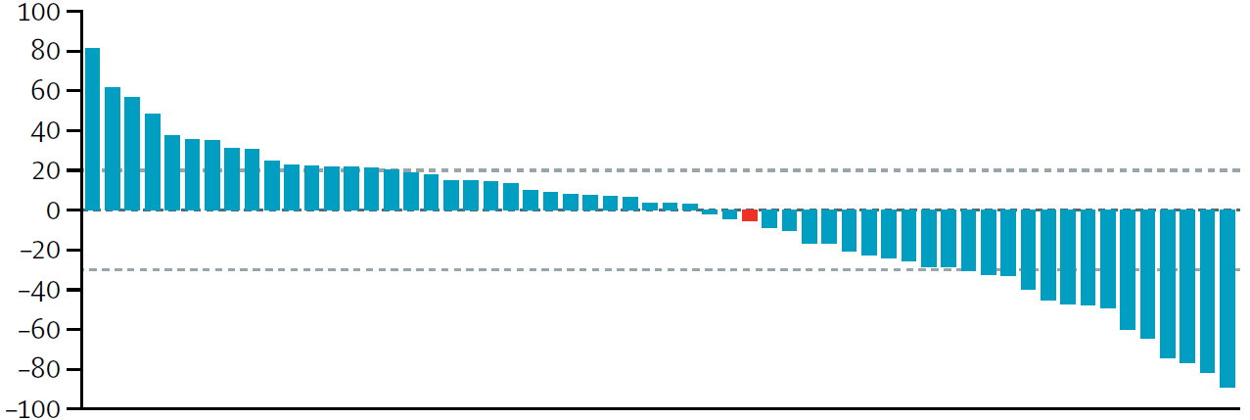
What About PD-L1–positive EGFR-mutant Patients?
Lisberg Study (J Thorac Oncol, 2018)
    11 patients with EGFR-mutant NSCLC and PD-L1 >50% received first-line pembrolizumab in a phase 2 trial
    1/11 patients responded, but was found NOT to have EGFR (hence, 0/10 responses in EGFR-mutants)
    2 patients died within 6 months, including one due to pneumonitis
    Data suggests that EGFR-mutant PD-L1-positive pts should NOT get first-line pembrolizumab
ATLANTIC trial (Durvalumab; Garassino, Lancet Oncol, 2017)
    ORR 9% among EGFR+/ALK+ with ≥25% (n=74)
Best change from baseline in
Target lesion size (%)
Lisberg A, et al. J Thorac Oncol. 2018; Garassino MC, et al. Lancet Oncol. 2018.

Slide 45
Osimertinib in EGFR-mutant NSCLC with Brain Metastases
PFS* in Patients with and without CNS Metastases at Study Entry
With CNS metastases
(n=116)
Without CNS metastases
(n=440)
Ramalingam SS, et al. ESMO. 2017. Abstract LBA2_PR; Vansteenkiste J, et al. Ann Oncol. 2017.

Slide 46
Osimertinib in EGFR-mutant NSCLC with Brain Metastases
Sakai H, et al. ESMO Open. 2017.
Notes:
*Creative Commons Open Access paper*
A Japanese woman aged 70 years with no smoking history was diagnosed with stage IV lung adenocarcinoma and brain and lumbar vertebral metastases. Given that the primary tumour was found to harbour an EGFR
L858R mutation, the patient was treated with gefitinib as a first-line therapy and subsequently received erlotinib, the combination of pemetrexed and carboplatin, S-1, and docetaxel over the course of 4 years. She also underwent stereotactic radiosurgery for the brain metastasis four times during the treatment course. After subsequent disease progression, a rebiopsy of the primary lesion revealed the EGFR T790M mutation. Erlotinib was again administered for 8 months until disease progression in a clinical trial.
Six days after erlotinib discontinuation, the patient was urgently hospitalised as a result of severe fatigue, appetite loss and a slight headache. Her ECOG performance status (PS) had deteriorated to 3 on the day of admission. MRI of the brain revealed LMC and multiple brain metastases (figure 1A, B).
Progression at extracranial sites was not observed. As a seventh-line treatment, osimertinib was administered at
a dose of 80 mg, resulting in relief of symptoms within a few days. MRI at 7 weeks after initiation of osimertinib
showed shrinkage of the multiple nodular deposits in the brain (figure 1C, D), and treatment is currently ongoing and well tolerated.
Key: Brain MRI scans for the patient. (A,B) Brain MRI (fat-suppressed T1-weighted contrast MRI) before the initiation of osimertinib showed leptomeningeal enhancement, multiple nodular deposits in the subarachnoid space, and multiple nodules in the cerebral parenchyma. (C,D) A scan performed 7 weeks after the initiation of osimertinib revealed shrinkage of the multiple nodular deposits (arrows).

Slide 47
Summary
Testing for EGFR and other targetable mutations (ALK, ROS1, BRAF, RET, MET, and others) should be performed at diagnosis to guide treatment decisions in stage IV adenocarcinomas.
Tissue testing is standard, but plasma-based “liquid biopsies” can be used when tissue is unavailable (with an understanding of their limitations).
Five EGFR inhibitors are FDA-approved in the United States.
Osimertinib is well-tolerated, highly CNS penetrant, and is the preferred first-line therapy for EGFR-mutant NSCLC or upon T790 mutation.
Osimertinib has excellent CNS activity.
Immunotherapy has limited activity in EGFR-mutant NSCLC and should be avoided (or reserved to later lines of therapy).

Slide 48
Optimizing Targeted Therapies in NSCLC:
Key Strategies and Perspectives for the Oncology Nurse

Slide 49
TKI Toxicities
Most Common
• Rash
• Diarrhea
• Paronychia
Common
• Hair changes
• Xerosis
• Fissures of the skin
• Hypertrichosis
Less Common
• Mucositis
• Interstitial lung disease (ILD)
• Transaminitis
• Fatigue
• Cardiomyopathy
Notes:
Aberrant hair growth on the face
Thick and matted hair on the head
Scalp irritation

Slide 50
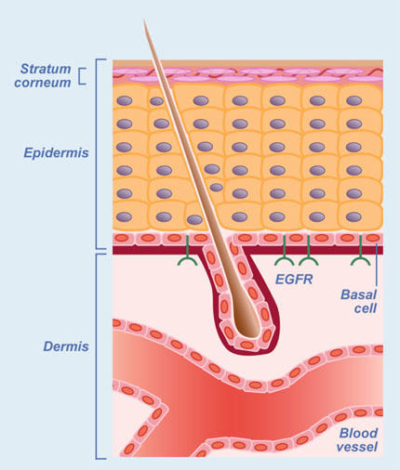
Why Does EGFR Inhibitor Rash Occur?
The epidermis relies on EGFR
The keratinocytes located in the basal layers of the epidermis express elevated level of EGFR
Inhibition of EGFR will result in negative effects on cell growth in this layer of the epidermis
This results in thinning, which decreases ability of skin to hold in moisture
The damage also causes recruitment of the immune system response and thus, a pustular eruption
Adapted from Lacouture ME. Nat Rev Cancer. 2006.

Slide 51
EGFR TKI Rash
Most common “toxicity” associated with EGFR TKIs
Tends to appear on the face and chest, but can be seen on any part of the body
Can range from mild to severe
Often described as a “papulopustular eruption”
Lacouture ME, et al. Support Care Cancer. 2011.

Slide 52
Rash Incidence by TKI
EGFR inhibitor | Any grade rash | Grade 3/4 rash
Gefitinib | 43% | 4%
Erlotinib | 85% | 14%
Afatinib | 90% | 16%
Osimertinib | 58% | 1%
Dacomitinib | 69% | 23%
FDA Prescribing Information.

Slide 53
EGFR TKI Toxicity (CTCAE v5.0)
Rash acneiform*
*Rash is defined as a disorder characterized by an eruption of papules and pustules, typically appearing in face, scalp, upper chest, and back.
Grade 1 | Grade 2 | Grade 3 | Grade 4 | Grade 5
Mild | Moderate | Severe or medically significant, but not immediately life-threatening | Life-threatening consequences | Death related to AE
Papules and/or pustules covering <10% BSA, which may or may not be associated with symptoms of pruritus or tenderness | Papules and/or pustules covering 10%–30% BSA, which may or may not be associated with symptoms of pruritus or tenderness; associated with psychosocial impact; limiting instrumental ADL; papules and/or pustules covering >30% BSA with or without mild symptoms | Papules and/or pustules covering >30% BSA with moderate or severe symptoms; limiting self-care ADL; associated with local superinfection with oral antibiotics indicated | Life-threatening consequences; papules and/or pustules covering any % BSA, which may or may not be associated with symptoms of pruritus or tenderness and are associated with extensive superinfection with IV antibiotics indicated | Death
Instrumental ADL—preparing meals, shopping for groceries or clothes, using the telephone, managing money, etc.
Self-care ADL—bathing, dressing and undressing, feeding self, using the toilet, taking medications, and not bedridden.
https://ctep.cancer.gov/protocoldevelopment/electronic_applications/docs/CTCAE_v5_Quick_Reference_8.5x11.pdf.

Slide 54
Suggestions for Rash Prevention
Moisturizers and/or urea-containing skin care products: ointments/creams without dyes or fragrances (e.g., Eucerin, Aveeno, Sarna Ultra, Neutrogena)—no lotions or gels
    SPF 15 or higher with zinc recommended
Avoid very hot showers or baths, try lukewarm water with bath oils
Generally avoid direct sunlight and extreme temperatures; wear protective clothing
Avoid activities that mechanically stress the skin (e.g., garden work, carrying heavy objects, hot hair drying)

Slide 55
Multinational Association of Supportive Care in Cancer (MASCC) Rash Prevention and Treatment Guideline
 | Recommended | Not Recommended | Level of Evidence | Recommendation Grades | Comments
Preventive
Topical | Hydrocortisone 1% cream with moisturizer and sunscreen BID | Pimecrolimus 1% cream Tazarotene 0.05% cream Sunscreen as single agent | IIª | C
Systemic | Minocycline 100 mg daily Doxycycline 100 mg BID | Tetracycline 550 mg BID | IIª | A | Doxycycline is preferred in patients with renal impairment. Minocycline is less photosensitizing.
Treatment
Topical | Alclometasone 0.05% cream Fluocinonide 0.05% cream BID Clindamycin 1% | Vitamin K1 cream | IVª | C | Fluocinonide 0.05% cream BID should not be used on the face for more than 2 weeks at a time.
Systemic | Doxycycline 100 mg BID Minocycline 100 mg daily Isotretinoin at low doses (20–30 mg/d) | Acitretin | IVª | C | Isotretinoin is photosensitizing and can cause xerosis. Monitor lipids and liver enzymes with retinoids.
ªEGFRI study
Lacouture ME, et al. Support Care Cancer. 2011.

Slide 56
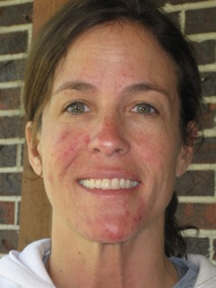
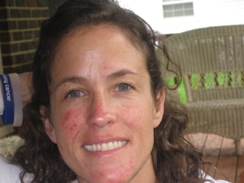
Mild to Moderate EGFR TKI Rash
Grade 1 rash on chin and cheeks
Continue TKI
Prescribe topical clindamycin gel 1%
Encourage to moisturize

Slide 57
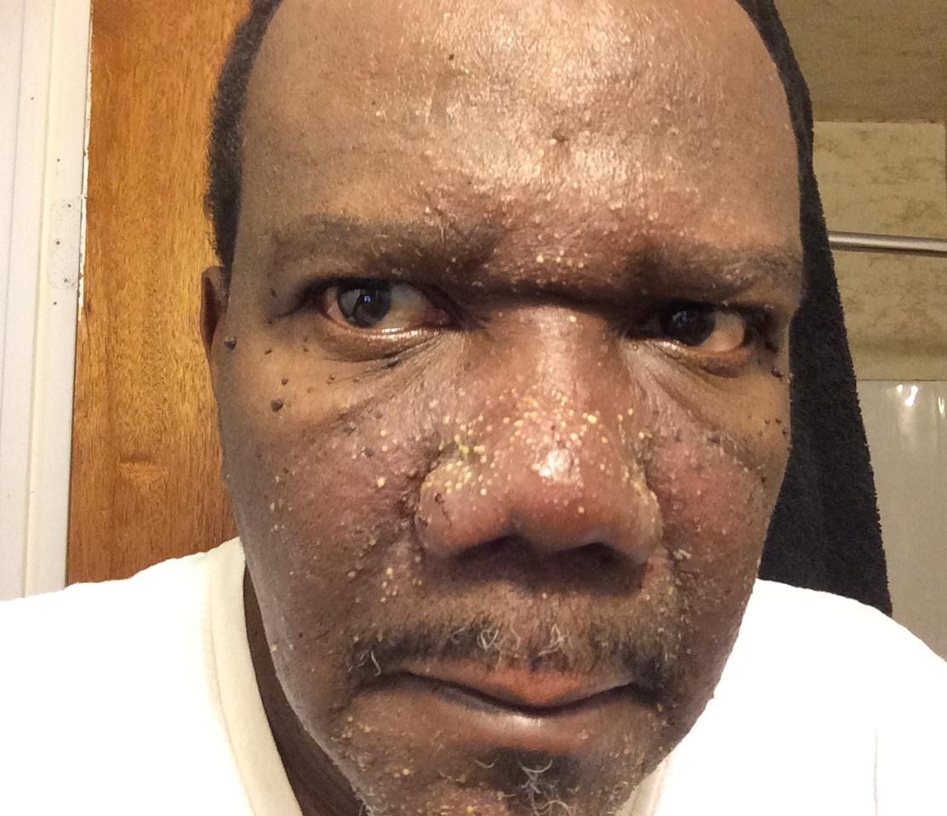
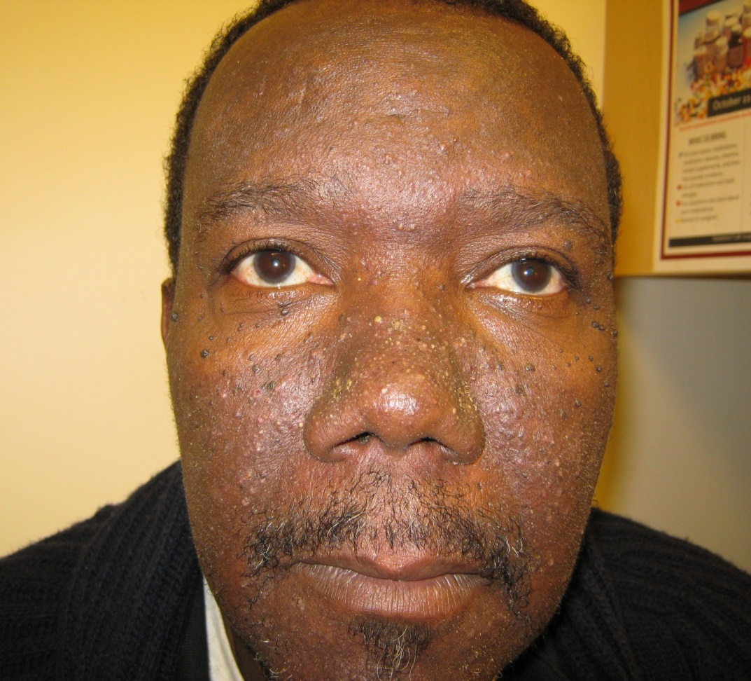
EGFR TKI Rash Grade 3 to Grade 1 or 2
Treated with oral
doxycycline and
topicals.

Slide 58
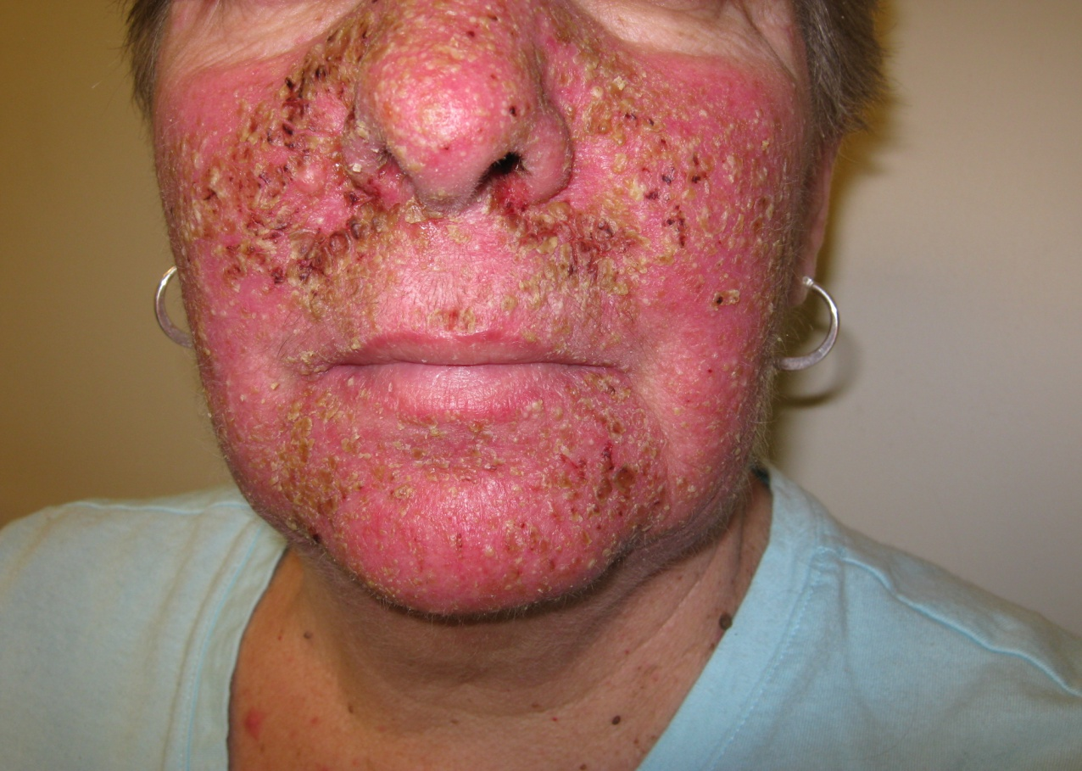
Grade 3/4 EGFR Rash
Grade 3 rash with significant erythema
Recommendation is to hold TKI and treat with oral minocycline (if not started prophylactically) and change topical hydrocortisone cream to alclometasone 0.05% cream
Restart agent at decreased dose
Be sure the patient is using sunscreen

Slide 59
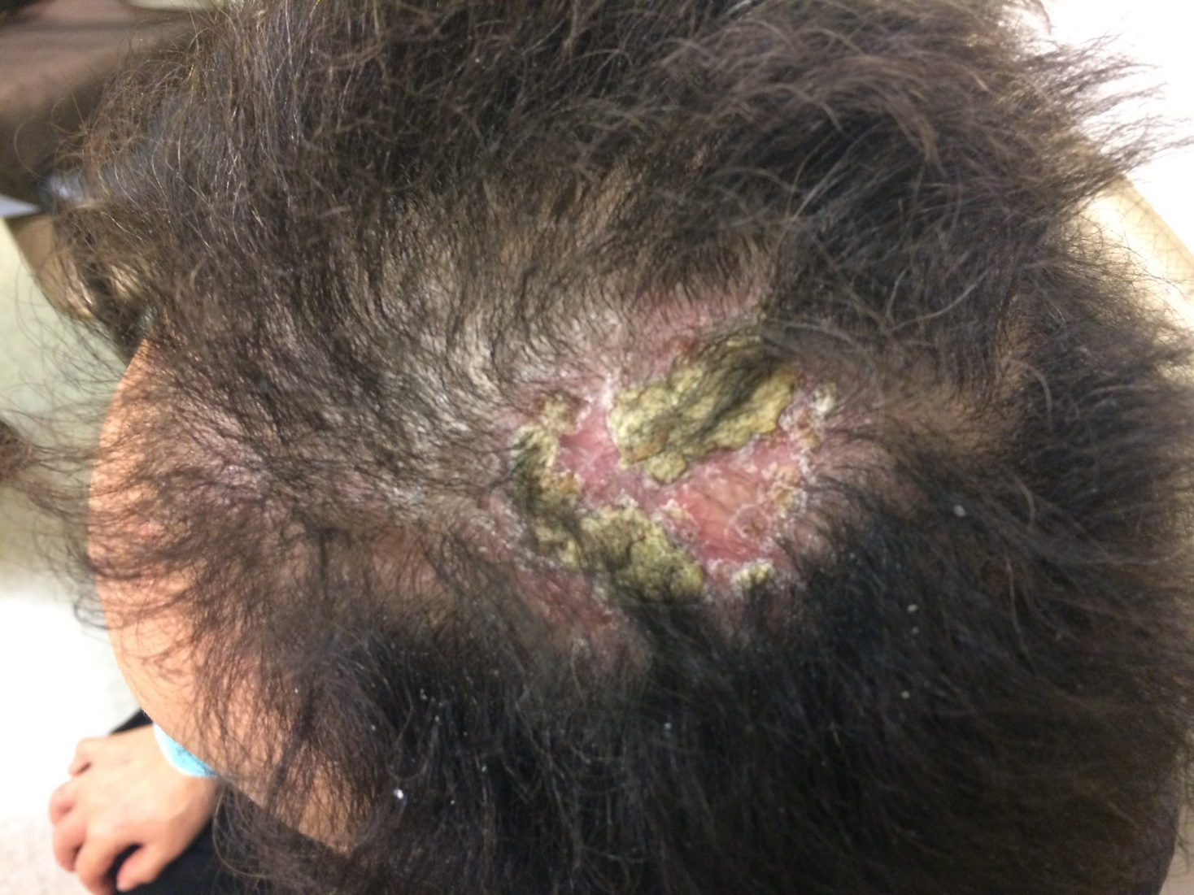
EGFR TKI
Scalp Rash
Systemic rash management
Selenium-based shampoos
Fluocinonide solution/shampoo
Lacouture et al, 2011;
Lacouture ME, et al. Support Care Cancer. 2011; Eaby-Sandy B, et al. J Adv Pract Oncol. 2012;
Picture courtesy of Beth Eaby-Sandy, MSN, CRNP. Abramson Cancer Center, University of Pennsylvania.

Slide 60
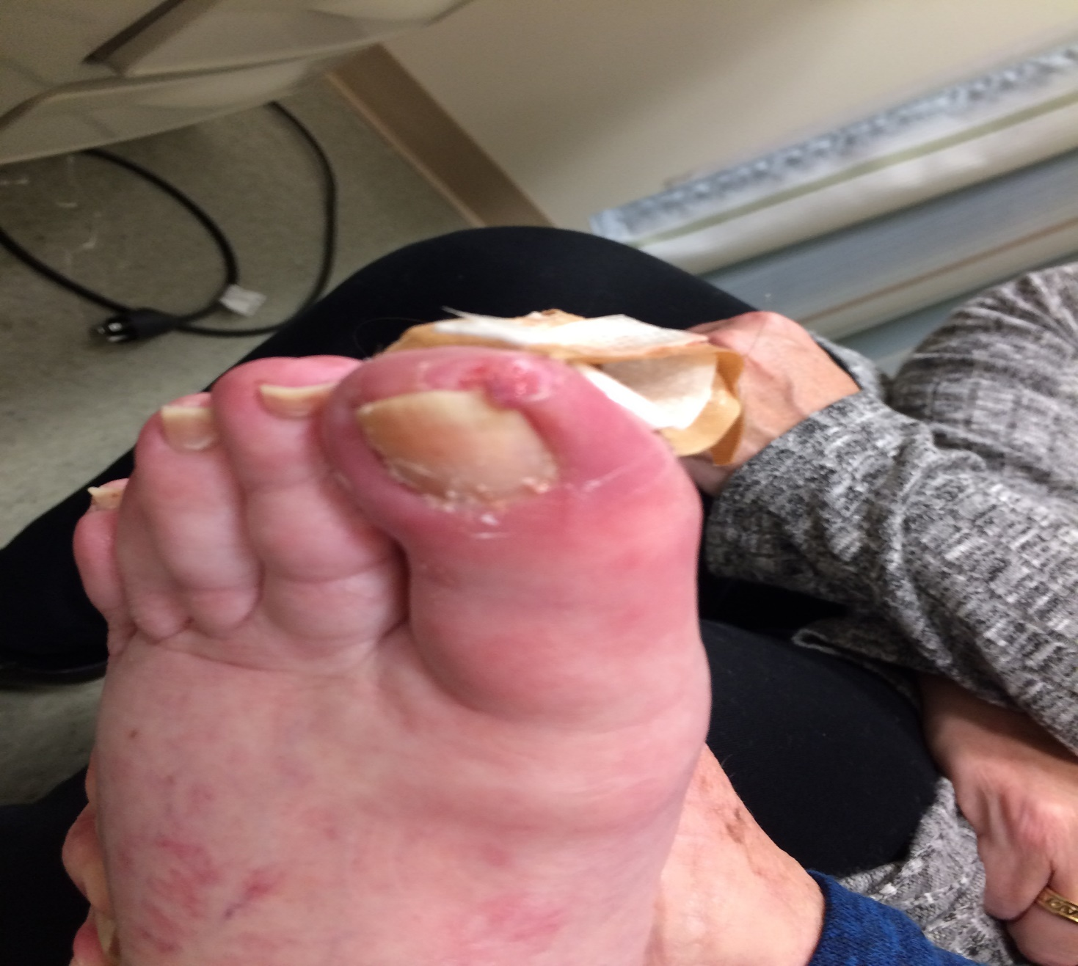
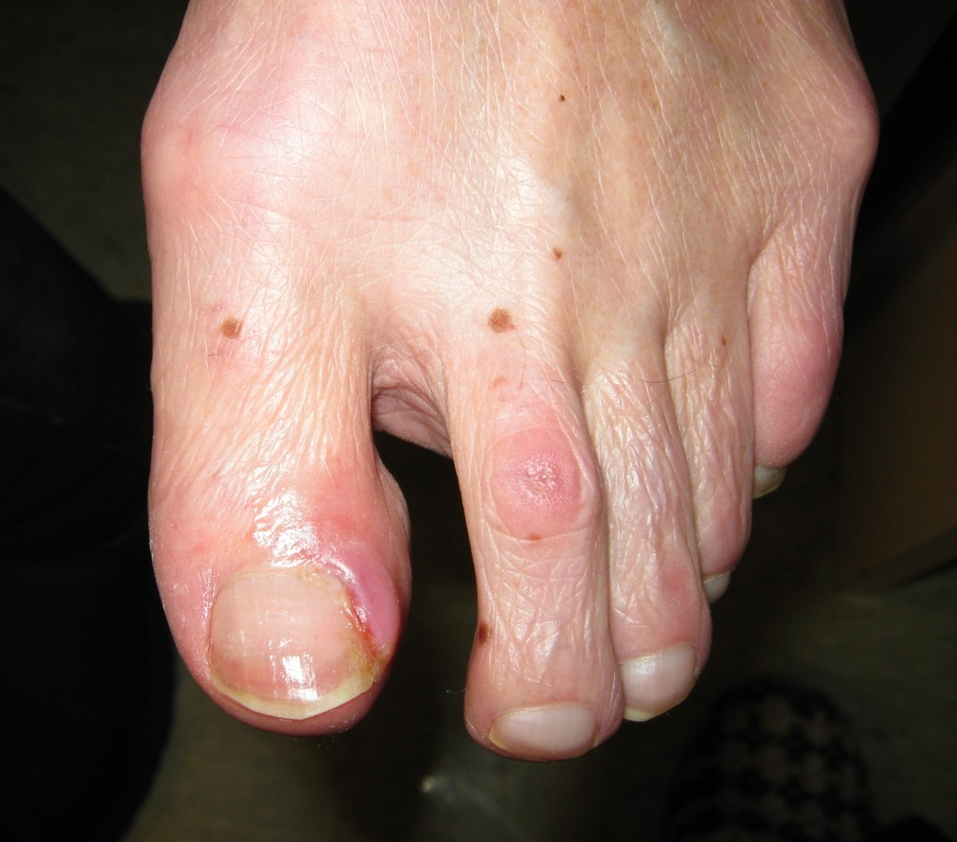
EGFR TKI Toxicity
Paronychia

Slide 61
Paronychia with EGFR Inhibitors
Diluted vinegar soaks
Mostly inflammatory, but still important to culture bacterial component to guide systemic therapy
Topical steroids or cauterization with silver nitrate sticks may be used for inflammation
For difficult cases, consult dermatologist or podiatrist for consideration of nail avulsion
Lacouture ME, et al. Support Care Cancer. 2011.

Slide 62
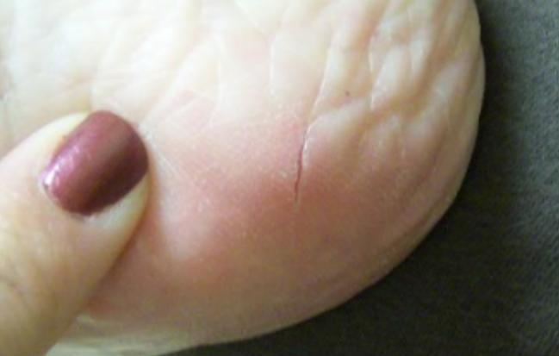
Fissures/Cracking
Moisturize with thick cream
Protect the areas
Glue together with agent of choice
    Liquid bandages
    Superglue, etc.
Lacouture ME, et al. Support Care Cancer. 2011;
Picture courtesy of Beth Eaby-Sandy, MSN, CRNP. Abramson Cancer Center, University of Pennsylvania.

Slide 63
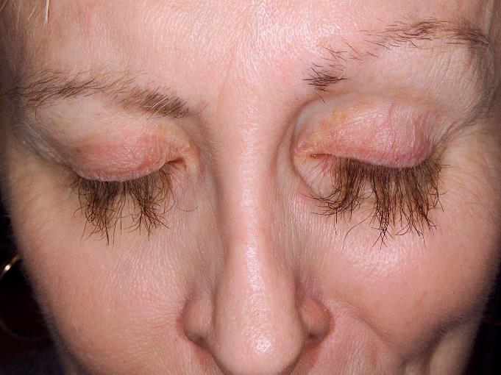
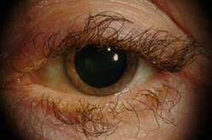
EGFR TKI Toxicity
Ophthalmic
Trichomegaly
Figure: MSKCC, Ann Culkin, RN, OCN
Figure: MSKCC, Mary Elizabeth Davis, MSN, RN, AOCNS

Slide 64
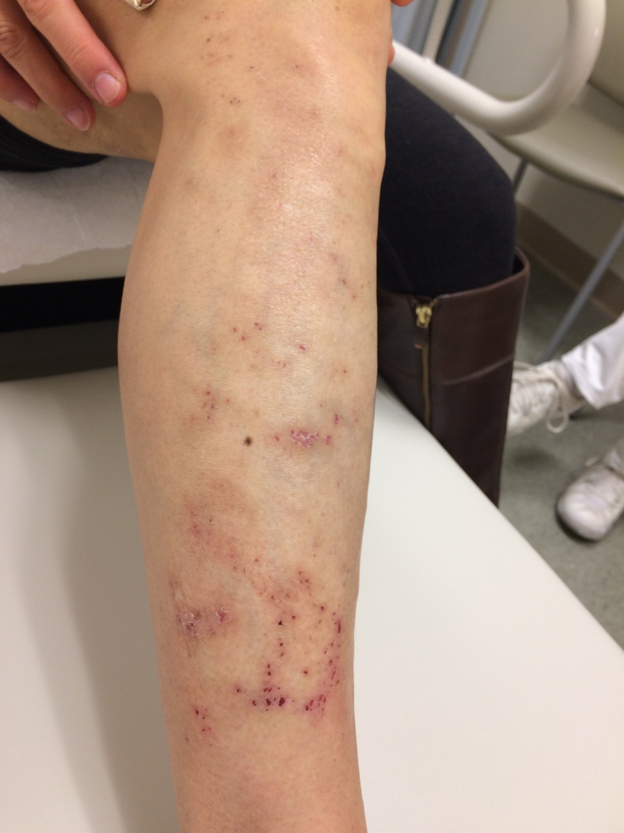
EGFR TKI
Pruritus and Xerosis
Antihistamines
    Topical or oral
Moisturize
Aprepitant?
Gabapentin/pregabalin?
Lacouture ME, et al. Support Care Cancer. 2011; Santini D, et al. Lancet Oncol. 2012; Matsuda KM, et al. J Am Acad Dermatol. 2016.
Notes:
Aprepitant – small trial (N=45), Italy Aprepitant (125 mg on day 1; 80 mg on day 3; 80 mg on day 5); still in clinical trials

Slide 65
Diarrhea
Drug | Diarrhea all grades | Diarrhea grade 3/4/5
Gefinitib | 43% | 4%
Erlotinib | 62% | 5%
Afatinib | 96% | 15%
Osimertinib | 58% | 2%
Dacomitinib | 87% | 8%

Slide 66
EGFR TKI Toxicity
Diarrhea
NCI CTCAE v5.0 diarrhea
Adverse event | Grade 1 | Grade 2 | Grade 3 | Grade 4 | Grade 5
Diarrhea | Increase of less than four stools per day over baseline | Increase of four to six stools per day over baseline | Increase of seven or more stools per day over baseline; incontinence; hospitalization indicated; limiting self-care activities of daily living | Life-threatening consequences; urgent intervention indicated | Death
https://ctep.cancer.gov/protocoldevelopment/electronic_applications/docs/CTCAE_v5_Quick_Reference_8.5x11.pdf.

Slide 67
EGFR TKI Toxicity
Diarrhea
Grade | Intervention
1 Mild | Stop laxatives. Drink 8–10 glasses of clear fluids daily. Immediately start loperamide: 4 mg (2 tablets) followed by 2 mg (1 tablet) after each loose stool (up to 20 mg daily) until bowel movements cease for 12 hours Maintain dose level of EGFR TKI
2 Moderate | See grade 1 Continue loperamide. Assess for dehydration and electrolyte imbalance. Consider intravenous fluids and electrolyte replacement If diarrhea does not improve after 48 hours, temporarily discontinue EGFR TKI. Upon improvement to grade 1, restart EGFR TKI at a reduced dose (except gefitinib, which should be restarted at the original dose)
3 Severe | See grade 2 Plus: Use stool cultures to rule out an infectious process. Apply aggressive intravenous fluid replacement for 24 hours or more. Use hospitalization to monitor the patient’s progress. Consider prophylactic antibiotics if the patient is also neutropenic Temporarily discontinue EGFR TKI. Upon improvement to grade 1, restart EGFR TKI at a reduced dose (except gefitinib, which should be restarted at the original dose). Permanently discontinue EGFR TKI if diarrhea does not return to grade 1 within 14 days despite treatment discontinuation and best supportive care
4 Life-threatening | See grade 3
5 Death
Hirsch V, et al. Curr Oncol. 2014.

Slide 68
Other Toxicities of EGFR TKIs
ILD/Pneumonitis
  1%–2% for EGFRIs
  3.9% for osimertinib
Cardiomyopathy
  On osimertinib, 2.6%
  ECHO recommended monitoring
Transaminitis
  Usually transient and not symptomatic
  Should be monitored
  Can require dose delays or dose reductions

Slide 69
Hematologic Side Effect Profiles of TKIs vs. Osimertinib
Hematology AE | Osimertinib (N=279) |  | EGFR TKI Comparator (N=277)
 | Change from Baseline All Grades (%) | Change from Baseline to Grade 3 or 4 (%) | Change from Baseline All Grades (%) | Change from Baseline to Grade 3 or 4 (%)
Lymphopenia | 63 | 5.6 | 36 | 4.2
Anemia | 59 | 0.7 | 47 | 0.4
Thrombocytopenia | 51 | 0.7 | 12 | 0.4
Neutropenia | 41 | 3.0 | 10 | 0
FDA Prescribing Information.

Slide 70

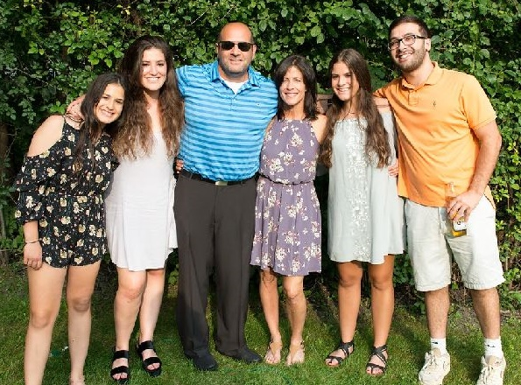

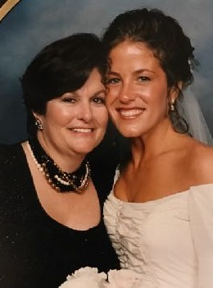
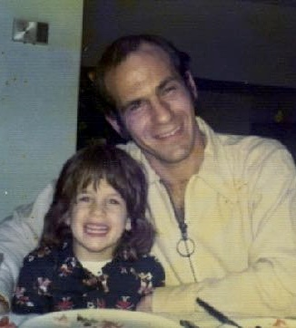
Patients Driving Research to Save Lives
Jill Feldman
Lung Cancer Patient and Advocate

Slide 71
Case Study 2
The patient is a 39-year-old female who enjoys reading, walking her dogs, working at camp, and watching college basketball. She is the president of LUNGevity.
She has never smoked, and is married with 4 children (ages 6, 8, 10, and 12). Her maternal grandmother (62), paternal grandfather (72), mother (54), father (41), and aunt (56) are all deceased from lung cancer.

Slide 72

Case Study 2 (cont.)
Starting at age 28 years, the patient proactively had a chest CT every 3 years x 10 years due to her family history. A chest CT in 2009 revealed a RUL 2cm nodule with a satellite nodule on left side.
A right upper lobectomy was performed. Pathology showed NSCLC adenocarcinoma; molecular profiling revealed an Exon 19 deletion.
She was diagnosed with Stage I NSCLC.
She began treatment with adjuvant erlotinib 150 mg (off-label).
Notes:
Started getting CT chest when mom was diagnosed

Slide 73


Case Study 2 (cont.)
Within 48 hours, the patient developed a rash on her chest, back, and face, as well as scalp pustules. She had mouth sores that resulted in a 5-pound weight loss (and she was already underweight).
She lost a fingernail and a toenail. She developed severe dry skin that was so painful on her heels that she slept with a pillow under her lower legs to keep her feet from touching the bed.
The patient did not immediately advise her oncology team of the severity of her reaction. However, after 6 months, her treatment dosage was decreased to 100 mg, and then again reduced to 50 mg.
After 18 months, erlotinib was discontinued.
Notes:
I did not admit how miserable I was to my team. I needed to be able to look my kids in the eyes and know I did everything in my power so I was determined. I did finally agree to lower the dose about 6 months in. And then after a year I took 50mg for the last 3 months.

Slide 74
Case Study 2 (cont.)
Six months after erlotinib was discontinued, a new 8mm lesion was found. Wedge resection was performed showing NSCLC, adenocarcinoma, exon 19 deletion.
At post-op appointment a few weeks later, multiple new nodules were seen on CT scan.
Three lesions were treated with Stereotactic Body Radiation Therapy (SBRT), and no oral therapy x 5 years.

Slide 75
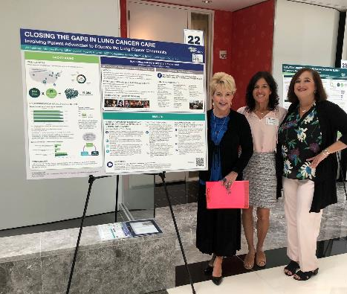


Patients Collaborating to Ensure Success

Slide 76
Patients Driving Research to Save Lives: EGFR Resisters
How to Learn More and Join the EGFR Resisters Community
Visit the website at www.egfrcancer.org
Get support and answers from your EGFR+ community at facebook.com/groups/EGFRResisters
Follow on Twitter for the latest advances in research @EGFRResisters
Email with any questions at EGFRResisters@gmail.com

Slide 77




 | info@alkpositive.org | alkpositive.org
 | exon20@exon20group.org | exon20group.org
 | ros1cancer.patient@gmail.com | ros1cancer.com
 | egfrresisters@gmail.com | egfrcancer.org
RET Renegades | retrenegades@gmail.com

Slide 78
Additional Resources
Organization | Website
LUNGevity | lungevity.org
GO2 Foundation for Lung Cancer (formerly Bonnie Addario Foundation) | go2foundation.org
LCFA (Lung Cancer Foundation of America) | lcfamerica.org
Lung Cancer Research Foundation | lungcancerresearchfoundation.org
LungCancer.net | lungcancer.net
American Lung Association LUNGFORCE | lungforce.org
Cancer Support Community | cancersupportcommunity.org

Slide 79
Post-test Questions

Slide 80
Post-Test 1: For which of the following clinical applications can a liquid biopsy be used?
Biomarker testing at the time of disease progression or acquired resistance
To detect tumor burden in early stage NSCLC patients
Analysis for presence of PD-L1 biomarker
All of the above
Notes:
Correct Answer: Biomarker testing at the time of disease progression or acquired resistance

Slide 81
Post-Test 2: Which of the following agents is NOT approved for first-line treatment in EGFR-mutant NSCLC?
Erlotinib
Afatinib
Crizotinib
Osimertinib
Notes:
Correct Answer: Crizotinib

Slide 82
Post-Test 3: Which of the following agents best crosses into the CNS in treatment for brain mets with EGFR-mutant NSCLC?
Erlotinib
Afatinib
Dacomitinib
Osimertinib
Notes:
Correct Answer: Osimertinib

Slide 83
Post-Test 4: Which of the following is a common side effect of EGFR TKIs in NSCLC?
Acneiform rash
Peripheral neuropathy
Alopecia
Nausea/anorexia
Notes:
Correct Answer: Acneiform rash

Slide 84
Post-Test 5: 67-yr old female who is taking erlotinib for EGFRm NSCLC comes to clinic with a painful R great toe. You explain that paronychia is a common side effect.
As a nurse, what else may help your patient?
Encourage more frequent pedicures
Start course of prophylactic antibiotics
Soak feet in diluted vinegar
Avoid hot showers or baths
Notes:
Correct Answer: Soak feet in diluted vinegar

Slide 85
Conversations with the Expert and
Audience Q&A

