Slide 1

Long-Term Financial Planning
CSMFO Weekend Training
November 22, 2014

Slide 2
Long-Term Financial Planning
Why do it?
Some tips on doing it.

Slide 3
Different Reasons
Pismo Beach
  Assess financial condition and ability to fund “new initiatives”
  Prepare for revenue ballot measure
San Luis Obispo
  Framework for Decision-Making
    Introduce the budget process: framework for goal-setting and budget process to follow; ability to fund “new initiatives”
    Prepare for revenue ballot measure
    Contingency planning
Fairfield, San Clemente
  Formal integration into the Budget
Sunnyvale
  Ten-year budget balancing
Salinas and Bell
  Better assessment of long-term impact of short-tem budget decisions

Slide 4
Common Feature
They all require making long-term forecasts about revenues and expenditures.
And this requires making assumptions about revenues and expenditures.
  Many which will be out-of-date before the laser jet ink is dry . . . . .

Slide 5
Long-Term Financial Planning
Is it really worth it?
“ Never make forecasts, especially about the future.”
. . . . Sam Goldwyn

Slide 6
Why You Don’t Want to Do This
It’s Risky!
  It’s hard to predict what’s going to happen next week, let alone next year – or even more daunting, five or ten years from now
  The chances you’ll get the number wrong are far greater than you’ll get it right.

Slide 7
Why You Do
Effective forecasts and plans require clearly-stated assumptions.
  This forces you to think about the factors that affect your fiscal health.
  And what you can and can’t do about them.
Making good resource decisions today requires taking into account their impact on your fiscal condition tomorrow.
The question of “how are we doing” can only be answered in the context of “compared with what?”
Forecasts are the best way to frame the policy decisions ahead of you: you can’t fix a problem you haven’t defined.

Slide 8
Forecasting
The secret to successful forecasts . . . .
  Give ‘em a number
  Give ‘em a date
  But never give ‘em both at the same time!

Slide 9


Slide 10
Forecasting
The real secret to success . . . . .
  Recognize perils
  Act anyway
  Have clear assumptions.
  Identify where you’re likely to be wrong
“Life is what happens while you’re busy making other plans.”
. . . . . John Lennon

Slide 11
Where to Start: In the Past
Environment
  Inflation
  Population growth
  Business & job growth
  New construction
  State economic and demographic trends
  Regional trends
  Legal & intergovernmental
Fiscal Factors
  Revenue trends
  Expenditure trends
  Debt trends
  Fund balance trends

Slide 12
About the Past
The past does not determine the future.
But if the future is going to be different than the past . . . . why?

Slide 13
Key Components
Revenues
  Focus on top revenues
Expenditures
  Operating
  Debt service
  CIP: Toughest component
    Average from the past
    Different scenarios
    “Forecast CIP”
      Maintenance only?
      New stuff?
      Combination?
One “forecast?”
Or several scenarios?

Slide 14
What Do the Results Tell You?
What’s the problem?
What are the best options for solving it?
What is the best one
  . . . . . and why?
“ A problem well-stated is a problem half-solved.”
. . . . . . . Charles Kettering

Slide 15

General Fund
Five Year Forecast: 2005-10
Tough Fiscal Past, Tough Fiscal Future
December 2004

Slide 16
Forecast Purpose
Identify “order of magnitude” ability over the next 5 years (2005-10) to:
  Continue current day-to-day services.
  Maintain existing infrastructure and facilities.
  Preserve our fiscal health.
Approach
  Project revenues.
  Subtract operating, debt service and CIP costs
  Remaining balance is available for “new initiatives.”
  Or if negative, shows the “Budget Gap.”

Slide 17
Tough Fiscal Past
2003-05 Budget toughest in over 10 years
Facing $7 million gap – closed with
  Expenditure cuts (74%)
  New revenues (15%)
  Reserves (11%)
Expenditures: 74%

Slide 18
Tough Fiscal Past, Redux
Had to revisit the two-year budget in 2004-05 due to added State raids ($1.5 million)
  More expenditure cuts (most notably in our paving program: $200,000)
  Reinstated hiring and travel “chill”
  Went below minimum reserve policy for first time since we adopted one 15 years ago.
    Significant, but consistent with our budget strategy if the State took away even more.

Slide 19
One Bright Spot: Passage of Prop 1A
Improves stability and certainty by shielding us from added State raids.
But it only helps prevent more cuts in the future; it doesn’t return any past takeaways.
  $22 million over last 16 years.
  $3 million each and every year.
Not an impervious firewall: State raids can still happen, but much harder:
  2/3’s emergency declaration by State Legislature.
  Loan, must be repaid in 3 years.
  Can’t be more than $1.3 billion.
  Can’t occur more often than twice in years.
  No new takeaways if past one outstanding.

Slide 20
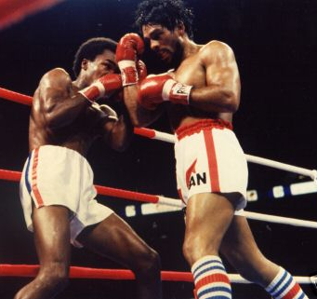
Prop 1A Summary
“No Mas, No Mas” assurance (but not guarantee) is critical to our future fiscal health and stability.
But it doesn’t improve our current situation: it just keeps it from getting worse.

Slide 21
Tough Fiscal Future
Key Actors in Our 2005-07 Fiscal Story
  Uncertain revenue outlook
  Operating cost pressures
  Infrastructure and facility maintenance

Slide 22
Forecast: The Good News

Slide 23
The Bad News
There is no “order of magnitude” ability to fund “new initiatives.”
In fact, we are looking at another significant “forecast gap” if we maintain current service levels and continue to severely limit infrastructure and facility maintenance.

Slide 24
Forecast Summary

Slide 25
Forecast Summary
Assuming CIP based on 2003-05 two-year average (about $3.1 million per year) and significant new sales tax and TOT outlets:
  2005-07 Annual Gap (Excluding carryover gap from 2004-05): $2.4 million
  Out-Year Annual Gap: $700,000

Slide 26
Background
Forecast Is Not a Budget
  It doesn’t make expenditure decisions.
  It doesn’t make revenue decisions.
  It doesn’t answer the question: can we afford . . . . . “x”?
  This is a question of priorities, not fiscal capacity.

Slide 27
So What Does the Forecast Do?
Identifies key factors that affect our fiscal outlook.
Assesses how difficult balancing the budget will be.
Helps us understand the fiscal challenges facing us as we make trade-offs between funding priorities.
Which is what the budget is all about: determining the highest priority uses of our limited resources.

Slide 28
Some Context: 2004-05 Expenditures

Slide 29
General Fund Budget By Type

Slide 30
Operating Costs By Function

Slide 31
Operating Costs By Type

Slide 32
General Fund Revenues

Slide 33

Demographic and Financial Trends
Past doesn’t determine the future.
But if the future won’t look like the past, why not?
Took a detailed look at 15 year trends.
Demographics
  Population, Housing, CPI
Revenues
  Top Eight = 80% of Total: Sales tax, property tax, TOT, UUT, “VLF Swap,” business tax, franchise fees, gas tax
Expenditures
  Operating, CIP, Debt Service
“Hindsight is an exact science.”
. . . . . . . . Guy Bellamy

Slide 34
Annual Growth Rates
0.8% Last 5 Years
0.2% Last 10 Years
0.5% Last 15 Years

Slide 46
Balancing Past Budgets
Every Financial Plan since 1991 has relied upon new, Council-approved revenues to balance the budget and fund major City goals.
Very limited revenue options remain for the Council under Proposition 218.
  And if they were easy, we would probably have done them already.

Slide 47
Overview of Forecast Assumptions
State Budget
  $680,200 takeaway each year in 2004-05 and 2005-06.
  Repayment of 2003-04 “VLF Gap Loan” in 2006-07: $756,500.
  No booking fee reimbursements in 2005-10 ($105,400 annually).

Slide 48
Some “Anomalies”
Triple Flip
  State takes away 25% of our sales tax (City rate now ¾% instead of 1%)
  State adopts “new” ¼% tax dedicated to repayment of deficit reduction bonds
  State promises to backfill lost city revenues with transfer from ERAF (now required)
VLF for Property Tax Swap

Slide 49
VLF-for-Property Tax Swap

Slide 50
Revenue Assumptions
How Did We Prepare Them?
  Long and short-term trends: key City revenues.
  Economic forecasts (UCLA, UCSB).
  Economic trends reported in national media.
  Fiscal and economic data developed by the LAO, State Department of Finance and State Controller.
  Legislative analysis by the League.
  Ultimately, staff’s best judgment about economic, fiscal and legislative outlook for the next five years.
www.lao.ca.gov

Slide 51
Uncertain Revenue Outlook
At best, mixed results in our two of our top three revenues:
  Sales tax
  TOT

Slide 52
Sales Tax: Recent Trends

Slide 53
Sales Tax: Cars Are Important
Statewide, “business-to-business” sales are 35% of the total.
Four categories - autos, general consumer goods, “business-to-business” and restaurant - account for about 75% of the total.

Slide 54
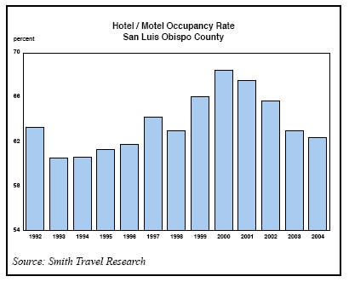
TOT Revenues
City
  2001-02: Down 3%
  2002-03: Up 1%
  2003-04: Up 2%

Slide 55
TOT Revenues: Recent Trends
Projected for 2004-05: 3%

Slide 56
Interest Earnings
Actual in 2001-02: $700,800
Actual in 2002-03: $766,000
Actual in 2003-04: $220,000
  Historically low yields (less than 2%)
  Lower investable balances

Slide 57
Key Revenue Assumptions

Slide 58
Sales Tax Assumptions
Underlying Growth:
  2004-05: Flat
  2005-10: 2.5%
New Outlets:
  Costco: $500,000 in 2005-06.
  Copeland’s/Court Street: $200,000 in 2005-06.
  Airport Area Annexation: $450,000 in 2006-07.
  San Luis Marketplace: $580,000 “net” after transfer affects/interchange revenue-sharing in 2007-08.

Slide 59
TOT Assumptions
Underlying Growth
  2004-05 and 2005-06: 3%
  2006-07: 4%
  2007-08, 2008-09 and 2009-10: 5%
Plus
  Marriott Courtyard in 2006-07: $225,000
  Hampton Inn in 2007-08: $150,000
  San Luis Marketplace in 2007-08: “net” $177,000.

Slide 60
Other Key Revenue Assumptions
Interest earnings at $220,000 annually.
Development review fees: 2003-04 level.
  Down by $780,000 from 2004-05 budget estimate.
Airport Area Specific Plan reimbursements: $323,800 in 2005-06.
Margarita Area park fee reimbursements: $650,000 per year starting in 2006-07.
Includes approved “pantry items” starting in 2005-06 ($143,000)

Slide 61
New Revenue Producers

Slide 62
Forecast: No New Outlets After 2005-06

Slide 63
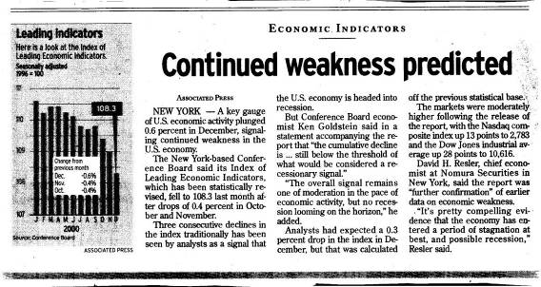
Revenue Assumptions: A Caveat
The revenue forecast reflects “cautious optimism.”
This isn’t guaranteed.

Slide 64
Expenditure Assumptions
Operating Costs
  CalPERS: Based on detailed analysis of projected employer contribution rates
  Mardi Gras costs decline from $374,000 base in 2004-05:
    2005-06: $325,000
    2006-07: $300,000
    2007-08 $275,000
    2008-09: $250,000
    2009-10: $225,000
  Other Costs: Grow by population and CPI based on 2004-05 budget (4% annually)
  Plus Damon-Garcia fields maintenance-operation: $250,000 in 2005-06.

Slide 65
Retirement Costs
Significant increases started in 2003-04
Main driver: CalPERS investment losses

Slide 66
CalPERS Investment Performance

Slide 67
Impact on Employer Rates

Slide 68
Debt Service
Current: $1.7 million.
New
  919 Palm: $384,700 “net” in 2005-06
    Assumes lease of 955 Morro at market rates
  Dispatch center: $165,800 in 2006-07
  Radio system: $372,200 in 2006-07

Slide 69
Forecast CIP Assumptions
Two-Year Average in 2003-05
  $3.1 million
Other Options
  “Maintenance-Only” CIP
    What’s it take to adequately maintain what we already have in place? $6.4 million annually
  2004-05 Budget
    $2.3 million

Slide 70
“Adequate Maintenance” CIP

Slide 71
“Adequate Maint” CIP by Function

Slide 72
Forecast: Adequate Maintenance CIP

Slide 73
Fund Balance Assumptions
Return to minimum policy level of 20% of operating expenditures
In addition to annual “gaps,” this means a “one-time” catch-up of $1.4 million from 2004-05
  Projected ending balance for 2004-05: 16%

Slide 74
What’s Not Here: Revenues
Grant Revenues
  CDBG
  Competitive Grants
Transportation Impact Fees
Park In-Lieu Fees

Slide 75
What’s Not Here: CIP Expenditures
$3.3 million needed to take care of what we already have
New Infrastructure or Facilities
  Public Safety Facilities
  Circulation Improvements (Intersections, RR Grade Crossings)
  Pedestrian/Bicycle Paths
  Flood Protection
  Community/Senior Center
  Parks
  Downtown Plan Improvements
  Railroad Square
  Mid-Higuera Area Improvements
  Open Space Acquisition

Slide 76
Critical Assumptions
What’s Most Likely to Change?
  Revenues
    Sales Tax, TOT, Development Review Fees, Other Fees
  Operating Cost Assumptions
  Debt Service Assumptions
  Mid-Year Budget Review
“Life is what happens while you’re busy making other plans.”
. . . . . John Lennon

Slide 77
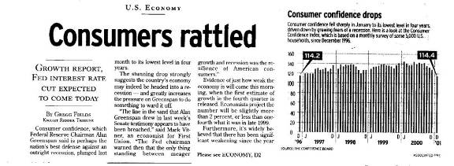
Final Forecast Caveat
And it may be worse in May 2005 than we’re projecting now.

Slide 78
Forecast Recap
Assuming CIP based on 2003-05 two-year average (about $3.1 million per year) and significant new sales tax and TOT outlets:
  2005-07 Annual Gap (Excluding carryover gap from 2004-05): $2.4 million
  Out-Year Annual Gap: $700,000

Slide 79
Recap: Key Drivers
Tepid outlook for key “base” revenues
  But assume significant new outlets
Reduced development review fees
Reduced interest earnings
Continued CalPERS cost increases
New service responsibilities
  Damon-Garcia fields maintenance & operations
  Debt service for 919 Palm, Dispatch Center Improvements, Radio System Upgrade

Slide 80
Budget-Balancing Will Be Tough
90% of General Fund costs are for operations.
  5% for debt service.
  5% for CIP: mostly maintenance.
Over 50% of our General Fund operating cost are for public safety.
80% of our General Fund operating costs are for staffing – and 90% of this is for regular staffing.
And many of the “non-staffing” costs are difficult to control: utilities, phones, insurance.

Slide 81
And Fewer Options Remain
Already cut operating costs by $1.7 million and CIP by $3.5 million: can’t count them twice, start on an already constrained base.
Implemented $1.1 million in new revenues.
  Some Prop 218 options remain, but if they were easy, we’d have done them already.
Lower Reserves
  Started 2003-05 with 30% reserves.
  Now at 16%.

Slide 82
So, Can We Afford New Initiatives?
Yes, But Very Difficult
  Re-prioritize existing resources
    Means deeper cuts in core operations and maintenance than will already be needed.
  Increase revenues
    Grow the economy better than forecasted.
    Implement some of the very limited revenue options.
  Voter-approved revenues (but probably not available as 2005-07 budget-balancer).
The option of changing current priorities and reallocating existing resources to accommodate new ones is always possible, but it’s much easier said than done.

Slide 83
Where to From Here?
“Plans are nothing; planning is everything.”
Dwight D. Eisenhower

Slide 84
The Task Ahead
Our struggle over the next several months will not be about “which new community goals should we accomplish with our added revenues?”
But how do we maintain core service levels, infrastructure and our fiscal health?
  Of the things we doing today, what will we still be doing tomorrow?

Slide 85
Next Steps
Fiscal Health Contingency Plan
  Already started implementing several “action steps”
  “Hard” freeze planned until development of budget-balancing strategy
Begin considering feasibility of:
  Storm drainage fees (1/4/05)
  Paramedic service charges (2/14/05)
  Revenue ballot measure (2/15/05)

Slide 86
Link to Goal-Setting in Tough Times
On its face, goal-setting and tough fiscal times may seem like conflicting concepts, but they aren’t.
In fact, identifying the most important, highest priority things for us to do is even more important when times are tight.

Slide 87
Goal-Setting in Tough Fiscal Times
This is the essence of the budget process
  Of all the things we want to do in keeping our community a good place to live, work and play, which are the most important?
  And what are the difficult trade-offs we have to make to do them?

Slide 88
Summary
Bad News, But Not “New” News
  Consistent with reported trends.
  Consistent with General Fiscal Outlook.
Good News
  Good fiscal shape
  Good information
  Solid systems and procedures in place.
  Excellent organization and capable staff
  Excellent Council leadership
  Great tradition of responsible stewardship

Slide 89
Questions?

Slide 90
General Fund
Five Year Forecast: 2007-12
Best Fiscal Outlook in Many Years
December 2006

Slide 91
The Short Story
Best fiscal outlook in many years
  Measure Y
  Structural budget balance to begin with
  Stronger beginning financial condition

Slide 92
Where We’ve Been
We’ve had to close annual budget gaps for three straight fiscal years:
  $7.1 million in 2003-04
  Another $1.4 million in 2004-05
  And another $2.1 million in 2005-06
We closed these gaps largely through service cuts.

Slide 93
How We Closed the Gaps
Expenditure Cuts: 68%

Slide 94
Closing the Gap
This required deep cuts in operating and capital programs, including:
  50% cut in infrastructure maintenance (including 67% cut in paving).
  Reduction of 25 FTE positions, including sworn police officers.

Slide 95
Where We Are Today
The City's financial condition continues to be strong by State and national standards:
  Stable underlying economy
  Diversified revenues
  Tough revenue and expenditure decisions—in good times and bad
  Strong fiscal policies
  Ongoing fiscal monitoring
  Use of the private sector to deliver services
  Goal-driven budget process—performance, outcome-oriented
  Controlling operating costs: ongoing commitment to increasing productivity and improving customer service
  Limited use of debt financing: conservative standards
Structurally Balanced Budget

Slide 96
Where We’re Headed: Forecast Summary

Slide 97
Forecast Summary
Results driven by key assumptions
  Current day-to-day service levels
  CIP based on 2005-07 two-year average (about $2.5 million per year)
  Modest underlying performance of key revenues
  Projected new sales tax and TOT outlets
  Prop 42 and 1B revenues
  Measure Y
Results
  Available for ongoing service restorations or new initiatives: $5.5 million annually
  One-time carryover above policy minimum in 2007-09: $3.5 million

Slide 98
2009-14 Fiscal Forecast
Another very tough budget season that would be even worse without Measure Y revenues

Slide 99
Fiscal Outlook: Where We’ve Been
Two years ago, we characterized our fiscal outlook as the best in many years:
  Measure Y
  Improved local economy
  Structural budget balance to begin with
  Strong beginning financial condition
  Absence of State budget threats
  Stable labor costs

Slide 100
This isn’t the case today
Measure Y continues to be a bright spot
  Helps make our situation “just” really, really tough instead of a crisis
But all the other bright spots have darkened
  Adverse economy
  Adverse State fiscal outlook
  Adverse binding arbitration decision

Slide 101
Fiscal outlook in a nutshell
Another very tough budget season that would be much worse without Measure Y revenues.
Key actors in our 2009-14 fiscal story
  Largest economic downturn since Great Depression results in declines or tepid growth in key revenues
  Binding arbitration
  Costs that grow while revenues stagnate or decline

Slide 102
Forecast Results: Background
Implemented “Fiscal Health Contingency Plan” in June 2008.
  Key Elements: Hiring chill, begin preparation of short-term budget actions
Short-term budget “rebalancing” actions on 9/30, largely in response to June 2008 binding arbitration decision: $4.8 million
“General fiscal outlook” presented on 11/20.

Slide 103
Forecast: The Good News

Slide 104
Actually, there is some …
Results consistent with General Fiscal Outlook.
Have a balanced budget now; end 2008-09 at policy reserve levels.
Slight improvement in the “out years” means that there is a structural solution.
In short, it may be disappointing news, but it’s not “new” news.

Slide 105
The Bad News
There is no “order of magnitude” ability to fund “new initiatives.”
In fact, we are looking at another significant “forecast gap” if we maintain current service levels.

Slide 106
Forecast Summary

Slide 107
Forecast Summary: Without Measure Y

Slide 108
Forecast Gap vs Budget Deficit
We have a “forecast gap” that we need to close as part of the budget process.
We do not have a “budget deficit.”
  We have never had one.
  And we don’t plan have one: we’ll adopt a balanced budget in June 2009.

Slide 109
Slides on Past Trends
Yes, I did them
But I emphasized that they were not as helpful as they were in the past.
Why?

Slide 110
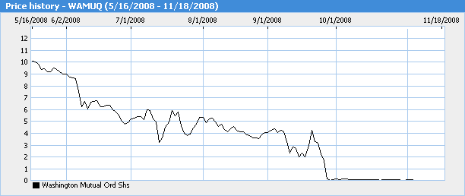
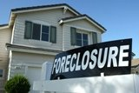
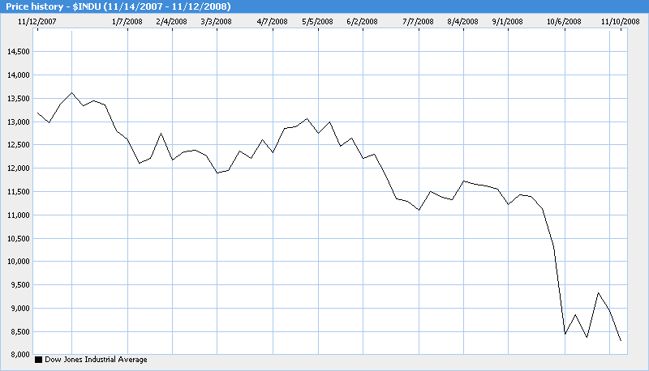
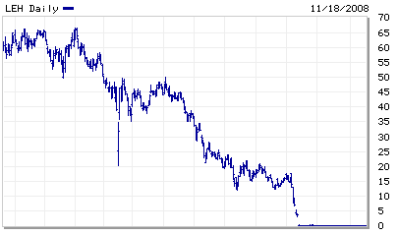
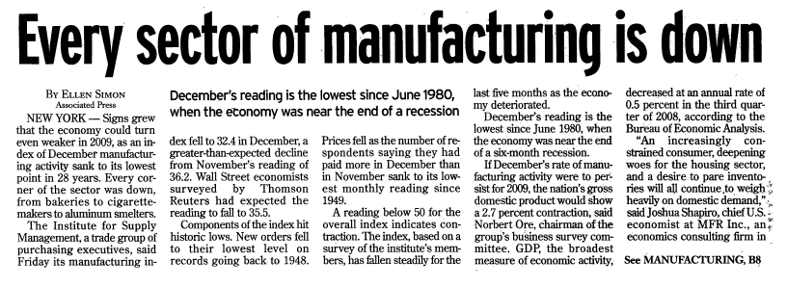
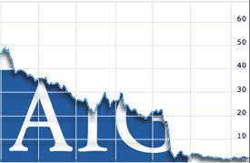
Where it began …. 2008: A lousy year

Slide 111
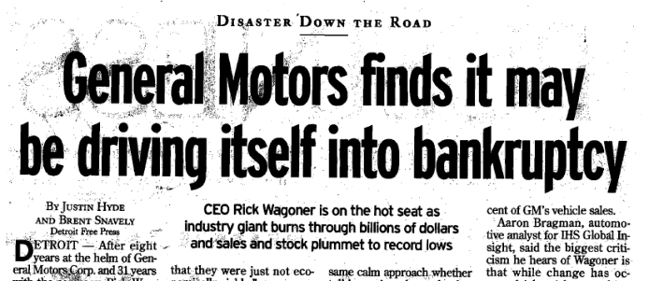

Even worse in Detroit
0-16: New Season Record

Slide 112

Economic Outlook
2009 UCSB Forecast

Slide 113
Recovery was not expected by most economists until 2010 – That’s happened, but tepid and jobless

Slide 114
2011-16 Interim Fiscal Forecast
A Road Map to Fiscal Sustainability

Slide 115
Notes:
If Measure Y is not renewed, the gap doubles again – to about $11 million
It is more important than the “core gap” and CalPERS rate increases combined

Slide 116

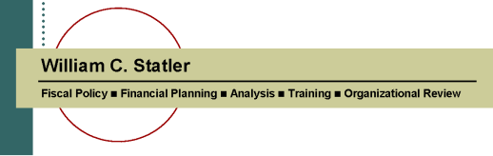
General Fund
Five-Year Fiscal Forecast
City of Salinas
www.bstatler.com

Slide 118
Assumptions Drive Forecast Results
Key Drivers
Revenues
  Generally assumes key revenues have hit bottom with modest recovery
Reserves
  End 2010-11 with reserves at 0.7% of expenditures
  No restoration to 5% policy level assumed in forecast
Expenditures
  Deferred compensation increases in 2010-11 return in 2011-12, adding $2.9 million to costs in 2011-12 and $3.7 million in 2012-13
  CalPERS contribution costs for sworn employees continue to rise ($3.1 million from 2010-11 to 2015-16)
  Minimal CIP (0.5% of revenues)
  Golf course support: $450,000
  Restoration of insurance fund contribution ($2.5 million)
  New debt service for public safety radio system: $570,000
  State Takeaways: $450,000
Much worse if Measure V is not renewed in 2016

Slide 119
Forecast Results
Three Key Findings
  Core gap: 2011-13. Structural gap assuming
    Current day-to-day service levels that retain cuts already made to-date
    No reserves
    Minimal capital improvement plan (CIP)
  Core gap plus 2013-14 CalPERS rate increases: The core gap gets larger based on projected increases in CalPERS contribution rates
  Core gap plus CalPERS rate increases less Measure V revenues. The gap grows even greater if Measure V revenues are not renewed in 2016

Slide 120

“Core” Gap

Slide 121


Slide 122
Forecast Summary
Without corrective action, the City is facing an annual gap beginning in 2011-12 of about $7.5 million - close to 10% of current expenditures.
Without corrective action, this grows to $9.8 million by 2015-16.
And much worse if Measure V is not renewed in 2016

Slide 124


General Fund
Five-Year Fiscal Forecast
City of Camarillo
www.bstatler.com

Slide 125
Down
14%

Slide 126
Key Forecast Drivers
Revenues
  Generally assumes key revenues have hit bottom with slow recovery
  One bright spot: TOT revenues
Expenditures
  Direct expenditure increases are projected to be modest
  However, transfers to other funds – most notably, gas tax, lighting & landscape maintenance, storm water management and transit – are projected to continue to increase, which is the main reason for the projected “forecast gap.”

Slide 130

General Fund
Five Year Forecast: 2008-13
May 2008
City of Pismo Beach

Slide 131
Summary of Forecast Findings
Confirms findings from four years ago:
  The City has adequate revenues to fund current day-to-day services and debt service obligations. In short, the City has a structurally balanced operating budget .
  However, funding improvements identified for 2008-13 in the ten-year CIP will require new revenues.

Slide 134


General Fund
Five-Year Fiscal Forecast
City of Bell

Slide 136
Forecast Overview: Positives
Key revenues have hit bottom and appear to be on the road to recovery, albeit modestly.
Structurally balanced budget in 2012-13.
Begin with $1.2 million in reserves.
While there is a significant “forecast gap” for the next two years, it improves in the “out-years.”
  This means there is a structural solution.
Committed Council and staff to a responsible, balanced and transparent budget process.

Slide 137


Slide 138
The Challenge Ahead
Closing the gap and adopting a balanced budget that responds to Council goal-setting.
  The forecast is not the budget.
  With Council guidance, the staff’s job is to develop ways of balancing the budget the coming year.

Slide 139
Limited Options
Unless the Bell economy performs much better than projected, significantly reducing the City’s expenditures is the only budget-balancing option available to the City.
  Use of reserves not recommended:
    Need to build them, not reduce them.
    Only defers the problem, doesn’t fix it.
  Given the City’s recent experience, significant new revenues are not a viable budget-balancing approach any time soon.

Slide 140
Expenditure Reductions
Further reducing service levels and related costs.
  Since 60% of General Fund expenditures are for staffing, this means further staffing reductions.
Cutting back on asset repair/replacement reserves.
  Not sustainable in the long-run.
Finding alternative service delivery methods that will retain service levels but reduce costs.
Reducing compensation levels.
  Each 1% reduction in compensation generates $75,000 in savings.

Slide 141


General Fund
Five-Year Fiscal Forecast
Board of Directors Briefing
February 14, 2013

Slide 142
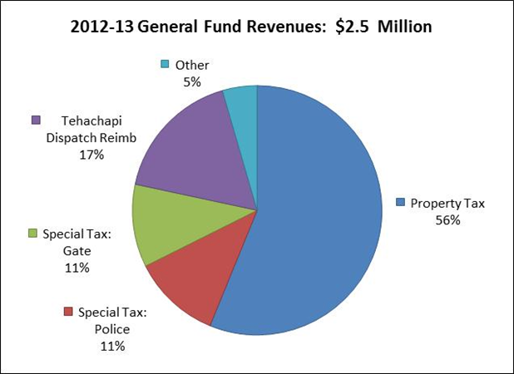

Slide 143
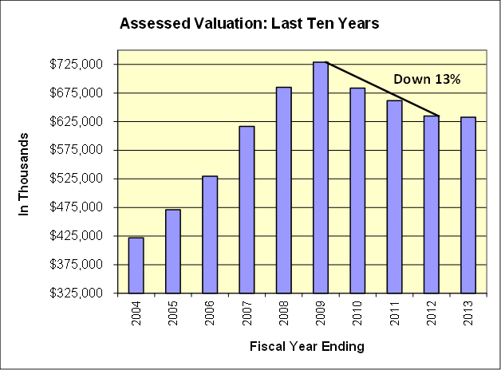

Slide 144
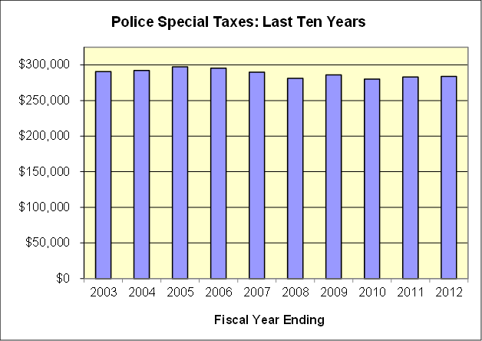

Slide 145
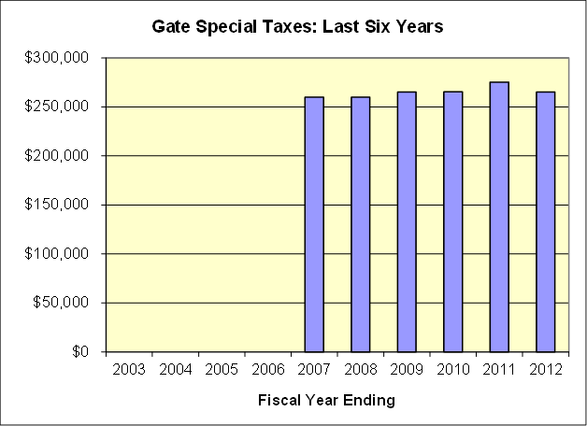

Slide 146
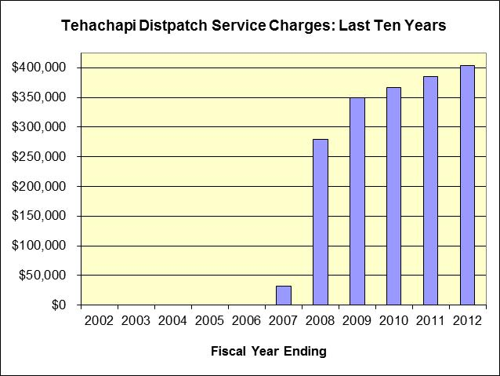

Slide 147
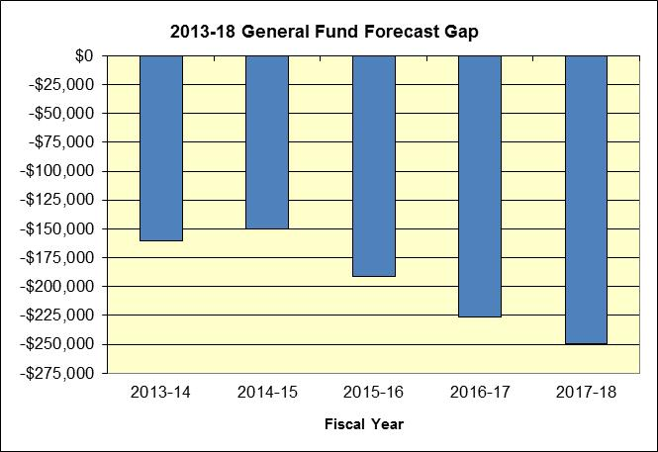

Slide 148
Key Factors
Systemic growing gap
  Modest cost increases
  But key revenues are flat or tepid growth

Slide 149
Recap
Similar analytical approaches but each has its own story to tell
  San Luis Obispo: Tough economy, Measure Y mitigation, binding arbitration, retirement costs
  Camarillo: Transfers to other funds
  Salinas: Tough revenue outlook, even tougher expenditure one, no reserves
  Pismo Beach: CIP
  Bell: Economy, egregious past revenues, need for reform
  Bear Valley: Systemic challenge - modest cost increases but flat key revenues

Slide 150
Summary
Forecasts force you to:
  Think about the factors that affect your future.
  Think about what you can do about them.
  Accept what you can’t do anything about so your efforts can be targeted on the things you can do something about.
  Have a context for “how are we doing?”
You’ll never know if you’ve arrived if you don’t know where you’re going.
Or: If you don’t know where you’re headed, any road will take you there.

Slide 151
A Suggestion: The “Thinking” Part
Consider preceding the forecast (or your budget) with a “general fiscal outlook:” What are the factors that will affect your fiscal future?
  State budget impacts
  Revenue/economy outlook
  Operating cost pressures: Retirement, insurance, fund subsidies, MOUs, major contracts, new service responsibilities, added debt service costs, other costs on the horizon
  Infrastructure and facility maintenance
  Other unmet needs, policy commitments
  Reserve levels: up or down?
  Revenue and other budget balancing options

Slide 152
What Now?
You’ve defined the problem …
So, what do you do now?
  You don't get points for predicting rain. You get points for building an ark.
‑ Louis Gerstner, Former IBM CEO

Slide 153
Tips on Building an Ark
Preparing for the Next Flood
  What were the drivers of forecast results?
    Focus on those
  Fiscal Policies
  Assess what you wish you had done differently the last time
    Suggestion: “Fiscal Health Contingency Plan”
  “Change-able” organizations

Slide 154

Long-Term Organizational Success
It is not the strongest of the species that survive, nor the most intelligent, but the ones most responsive to change.
  Charles Darwin

Slide 155
Fiscal Policies
Plans are good.
Policies are better.

Slide 156

The Power of Policies
Good times come and go.
But your values shouldn’t.
  And that’s what fiscal policies are all about.

Slide 157
Plans and Policies
Plans are good.
  General Plans (and Elements)
  Facility Master Plans (Pavement, Parks, Bicycles, Water, Sewer)
  Long-Term Forecasts
  Multi-Year Budgets
    Operating and CIP
Policies are better.

Slide 158
Fiscal Health
Fiscal heath is a lot like your personal health—it’s not what you live for . . . . but it’s hard to enjoy your life without it.
And like personal health, fiscal health is rarely luck.

Slide 159
Fiscal Policies
The best way to ensure your long-term fiscal health.
  Local economy important
    And no one is immune from economic downturns.
  But not the most critical feature . . . financial management counts!
    Just Think: Orange County
Not only for the “good times” — may be more important in the “bad times.”

Slide 160
When do fiscal challenges arise?
Roots of fiscal adversity for most governments take hold in the good times, by making commitments that are not sustainable
Rarely in the bad times, when most agencies act on the “First Rule of Holes”
  When you find yourself in one, stop digging.

Slide 161
Both Preventative and Curative
Clearly articulated policies help prevent problems from arising in the good times.
And help respond to bad times when they do occur.

Slide 162
Take on momentum of their own
What’s the most frequent answer to the question: “Why do we do it this way?”
And provide continuity as elected officials and staff change.
Most powerful when it put in place before the need for them arrives.

Slide 163

Plans Versus Policies
Plans change over time as actual results replace assumptions (like, as soon as the laser jet ink is dry).
But policies:
  Are your “north star” guiding preparation of plans.
  Help making tough decisions easier by telling you what your values are before they are put placed under stress by adverse circumstances.
  You might actually do something else, but they are a powerful starting point:
    But for “this,” I would do . . . what?

Slide 164
High-Level Policies
Balanced Budget (and what this means)
Multi-Year Budgets
Staff vs Council Budget Authority
Revenue Management
User Fees
Enterprise Funds:
  Do they subsidize the General Fund?
  Does the General Fund subsidize them?
Financial Reporting
Revenue Earmarking
Investments
Appropriations Limit
Minimum Fund Balance
CIP Management
Capital Financing & Debt Management
Human Resources
Contracting-Out
Productivity

Slide 165

Important Fiscal Management Policies
Very Significant
  Fund balance policy
  Debt affordability policy
Significant
  Pay-as-you-go capital financing
  Multi-year forecasting
  Quarterly reporting
  Quick debt retirement
Influential
  Contingency plans
  Non-recurring revenue policy
  Depreciation of fixed assets (GASB 34 implementation)
  5 Year CIP integrating operating cost impacts
  GFOA financial reporting award
  GFOA budgeting award

Slide 166

Top Ten Financial Management Practices
Established budget reserve
Regular economic and revenue reviews
Prioritized spending plans and established contingency plans
Formal capital improvement plan
Long-term planning
Debt affordability model
Pay-as-you-go financing
Multi-year financial plan
Effective management and information systems
Well-defined and coordinated economic development plan

Slide 167
S&P Rating Framework
Positive Adjustments
  Very strong income
  Very strong fund balance
Negative Adjustments
  Very weak market value
  Very low fund balance
  Weak liquidity
  Weak management
  Low budget flexibility
  Lack of willingness to pay
  Chronic negative fund balance
  Structural imbalance
Control 60% of factors

Slide 168
Policy Versus Actual
Set policies based on where you want to be – which may not be where you are today.
  Clearly stating where your agency wants to be (versus where it may be today) significantly enhances your ability to get there.
Consider following each policy with a brief “compliance status”
  In compliance
  In progress: what’s the plan for getting there?
168

Slide 169
City of Bell Example
Based on GFOA structured methodology, recommended minimum General Fund “unassigned” fund balance of 25% of operating expenditures
  12% at the time

Slide 170
Restoration Policy
Restore to policy level within 5 years
As revenues improve, 50/50 split between services and reserve restoration

Slide 171
So, does this really work?
Some quick examples: policy vs actual

Slide 172
An Example of the Power of Policies
Fund Balance Survey: 1996

Slide 173
Situation Ten Years Later

Slide 174
Unreserved, Undesignated General Fund Balance

Slide 175
Ratio of General Fund Debt Service to Revenues

Slide 176
Bond Rating Impact
With relatively low per capita income due to high number college students (about one-third of City residents), clear financial policies (and commitment to following them) key factor in raising SLO’s bond rating from Baa to AA.
Does this matter?
  With collapse of bond insurance market, underlying rating more important than ever
  Conservatively assuming 50 basis-points between Baa and AA, this results in saving of $1.2 million over the life $10 million issue of over 30 years ($583,000 in present value savings).
    About the size of recent SLO issue for public safety emergency communications improvements

Slide 177

Summary
Policies Are Powerful
  Fundamental foundation for long-term fiscal health: underlying basis for case-by-case decision-making.
  Articulates your values before they are under stress.
  Provides context for what you would “but for” – should be roadmaps, not straight jackets.
  Essential component of long-term financial planning.
  Key factor in staying out of fiscal trouble and then responding when you are.

Slide 178
Attachments
Fitch Ratings: Impact of Management Practices on Municipal Credit
Standard & Poor’s: Top Ten Management Characteristics of Highly Rated Credits in U.S. Public Finance
City of San Luis Obispo Budget and Fiscal Policies
City of Bell Budget and Fiscal Policies

Slide 179
Fiscal Health Contingency Planning
  Having a “fiscal health contingency plan” in place so you don’t address financial challenges flat-footed.

Slide 180

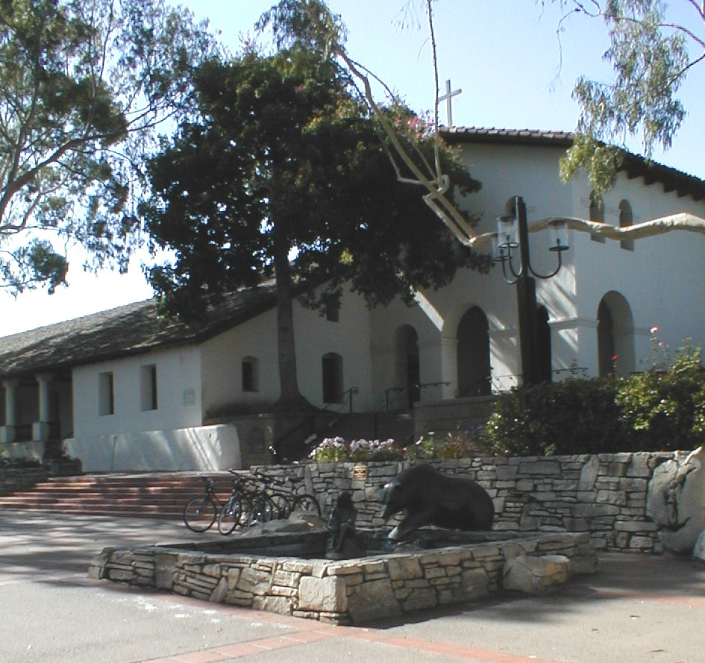
Purpose: Establish framework and general strategy process in responding to adverse fiscal circumstances in both the short and long term that:
  Ensures that employees and the community are meaningfully involved in the process.
  Takes a policy-based approach to decision-making.
  Reflects our organizational values.

Slide 181
What It’s Not
Specific “recipe” for expenditure cuts or revenue increases; this needs to be determined on a case-by-case basis.
Three problems with preparing detailed reduction or revenue options before they are truly needed:
  If not taken seriously, quality thought will not be given to them.
  If taken seriously, likely to result in needless anxiety; and sends a conflicting message if “times are good.”
  And even if these were not constraints, they would have a short shelf-life: needs and priorities change over time.
But it does set forth the foundation of principles and values upon which specific responses will be based.

Slide 182


Why is this “framework” important?
“Insanity is continuing to do the same things and expecting different results.”
“Very few cities get into fiscal trouble in the bad times; they get into trouble in the good times.”

Slide 183
Triggers
Any adverse fiscal circumstances as determined by the City Manager, such as
  Natural or human-made disasters.
  State takeaways
  Large, unexpected costs.
  Economic downturns.
Two consecutive quarters of adverse fiscal results in top five revenues
  Sales tax
  Property tax
  TOT
  Utility users tax
  VLF-Swap.
Adverse results are:
  Actual declines in revenues.
  Significant variances in projected revenues.
Clearly defining when “fiscal first aid” needed is key success factor in taking action on timely basis and keeping the problem from getting worse.

Slide 184
Key Plan Elements
◆ Maintaining minimum fund balance at policy levels.
❖ Following other key budget and fiscal policies.
⬥ Monitoring city’s fiscal health on an ongoing basis.
 Assessing the challenge: short or long-term problem?
 Identifying options.
 Preparing and implementing action plan.

Slide 185
Budget-Balancing Paradox
Balancing the budget and closing the “forecast gap” from a strictly numbers perspective is easy.
However, after cutting capital projects, reducing staff, and negotiating and implementing employee concessions, emerging from the process with a vibrant, high-morale, high-productivity organization is hard.
Which leads to the budget-balancing paradox: at a time when the organization is at its nadir with downsizing, the resulting smaller organization needs its employees to be even more energized, fired-up and motivated to perform.

Slide 186
Beating the Paradox
In my experience, there is only one way to beat this paradox: believing that the process used in communicating with employees and meaningfully engaging them in finding solutions matters.
  How we go about this process an opportunity to make deposits in our credibility bank, not just withdrawals.
  Opportunity to both show our organizational character and values, and to build them.

Slide 187

Th-th-th-that’s all folks!
For more information and forecast examples, visit my web site at:
  www.bstatler.com
For follow-up questions or information, send me an email at:
  bstatler@pacbell.net

