Slide 1
Barefoot Resorts - Love
Hole By Hole
August 2011

Slide 2
Barefoot Resorts - Love #1

Slide 3
Barefoot Resorts - Love #2
Barefoot Resorts - Love #2

Slide 4
Barefoot Resorts - Love #3
Barefoot Resorts - Love #3

Slide 5
Barefoot Resorts - Love #4
Barefoot Resorts - Love #4

Slide 6
Barefoot Resorts - Love #5
Barefoot Resorts - Love #5

Slide 7
Barefoot Resorts - Love #6
Barefoot Resorts - Love #6

Slide 8
Barefoot Resorts - Love #7
Barefoot Resorts - Love #7

Slide 9
Barefoot Resorts - Love #7
Barefoot Resorts - Love #8

Slide 10
Barefoot Resorts - Love #7
Barefoot Resorts - Love #9

Slide 11
Barefoot Resorts - Love #7
Barefoot Resorts - Love #10

Slide 12
Barefoot Resorts - Love #7
Barefoot Resorts - Love #11

Slide 13
Barefoot Resorts - Love #7
Barefoot Resorts - Love #12

Slide 14
Barefoot Resorts - Love #7
Barefoot Resorts - Love #13

Slide 15
Barefoot Resorts - Love #7
Barefoot Resorts - Love #14

Slide 16
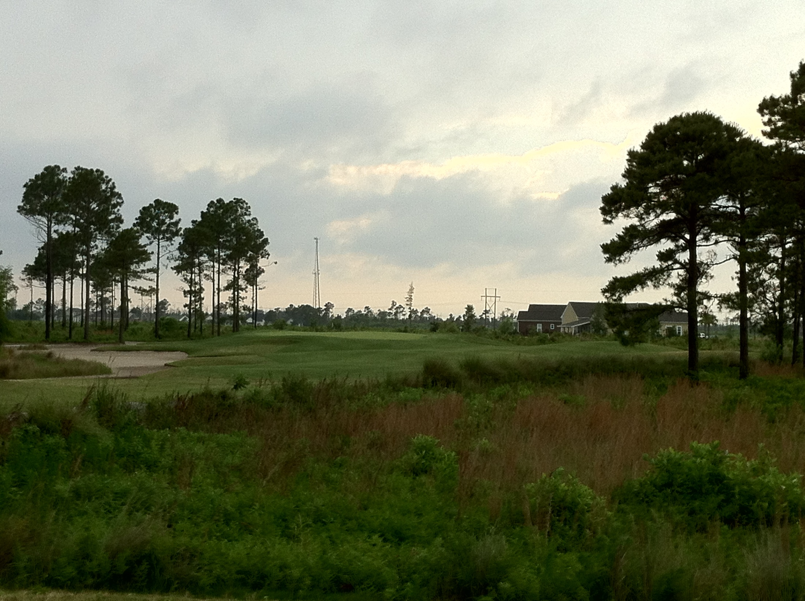
Barefoot Resorts - Love #15
Barefoot Resorts - Love #15
MISSING THIS PICTURE

Slide 17
Barefoot Resorts - Love #7
Barefoot Resorts - Love #16

Slide 18
Barefoot Resorts - Love #7
Barefoot Resorts - Love #17

Slide 19
Barefoot Resorts - Love #7
Barefoot Resorts - Love #18

