Slide 1
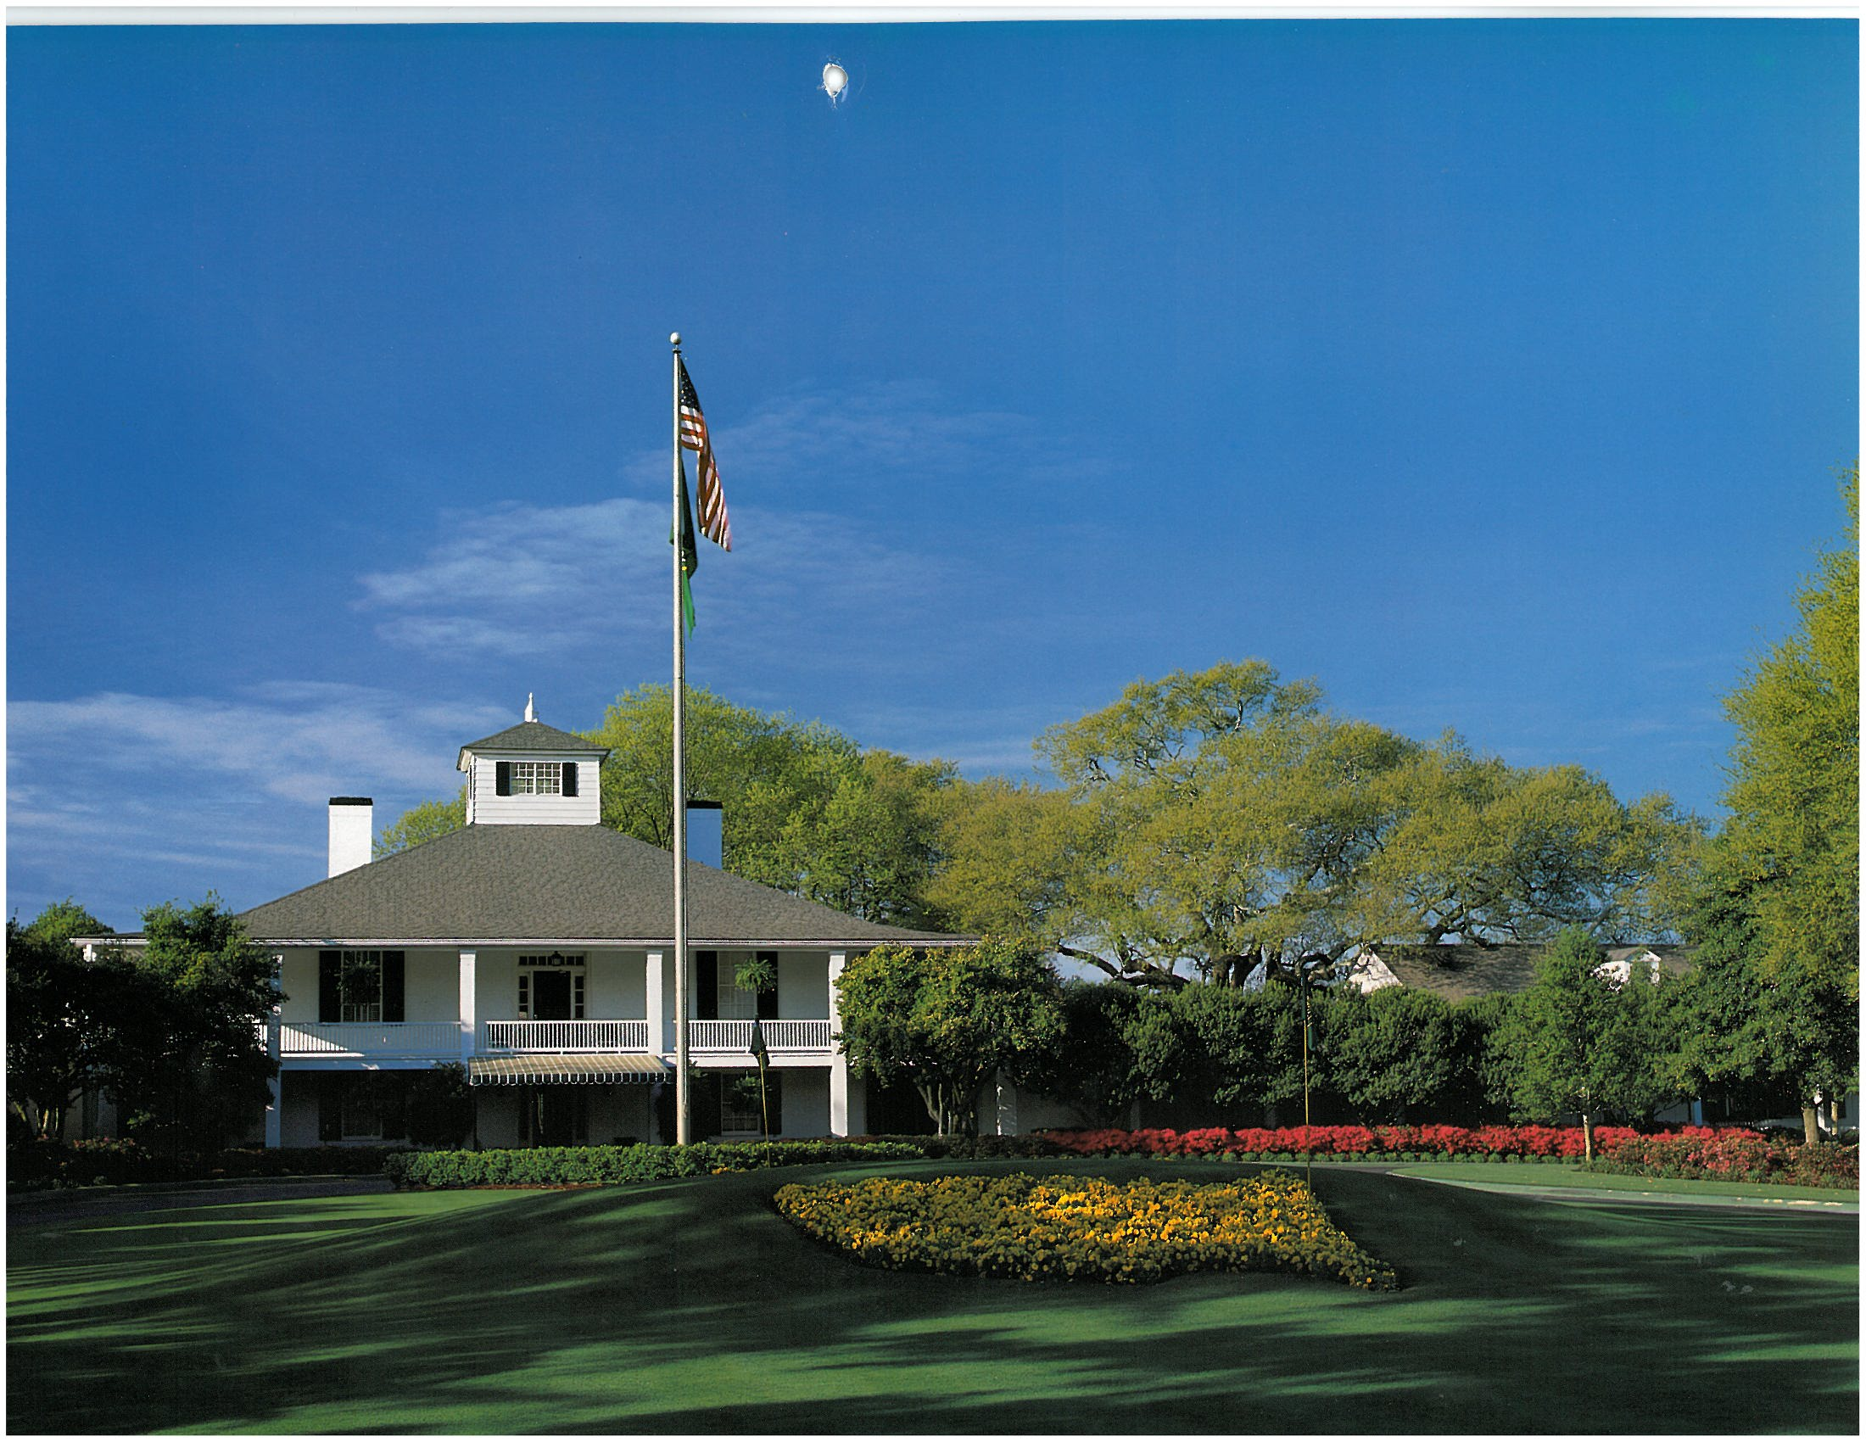
A Tradition Unlike Any Other –
The Masters and Augusta National from the view of a native Augustan
Palmer D. Ball
Spartanburg Day School
February 25, 2013

Slide 2
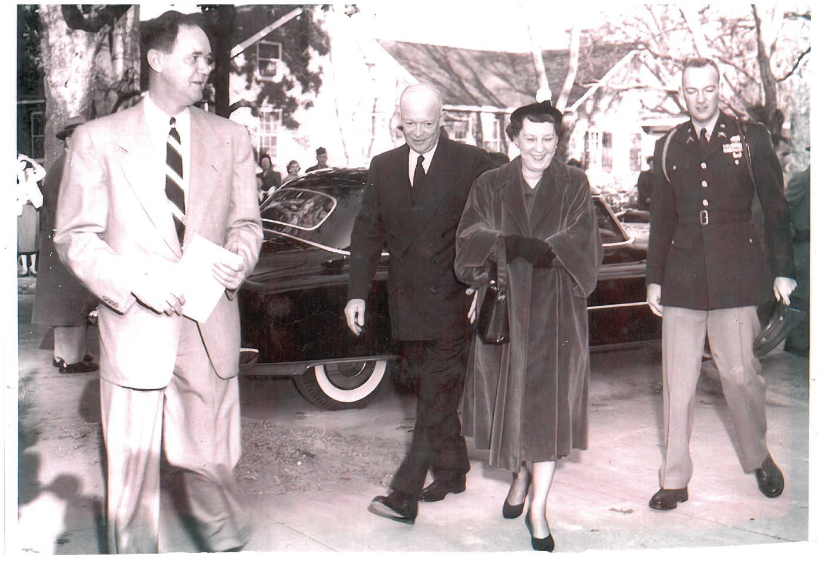
My grandfather escorting President and Mrs. Eisenhower and their son John into church one Sunday morning
President Eisenhower is the only president who has been a member of Augusta National
Notes:
Pew at church with presidential seal
Memories of seeing Mamie in church when I was a young girl

Slide 3
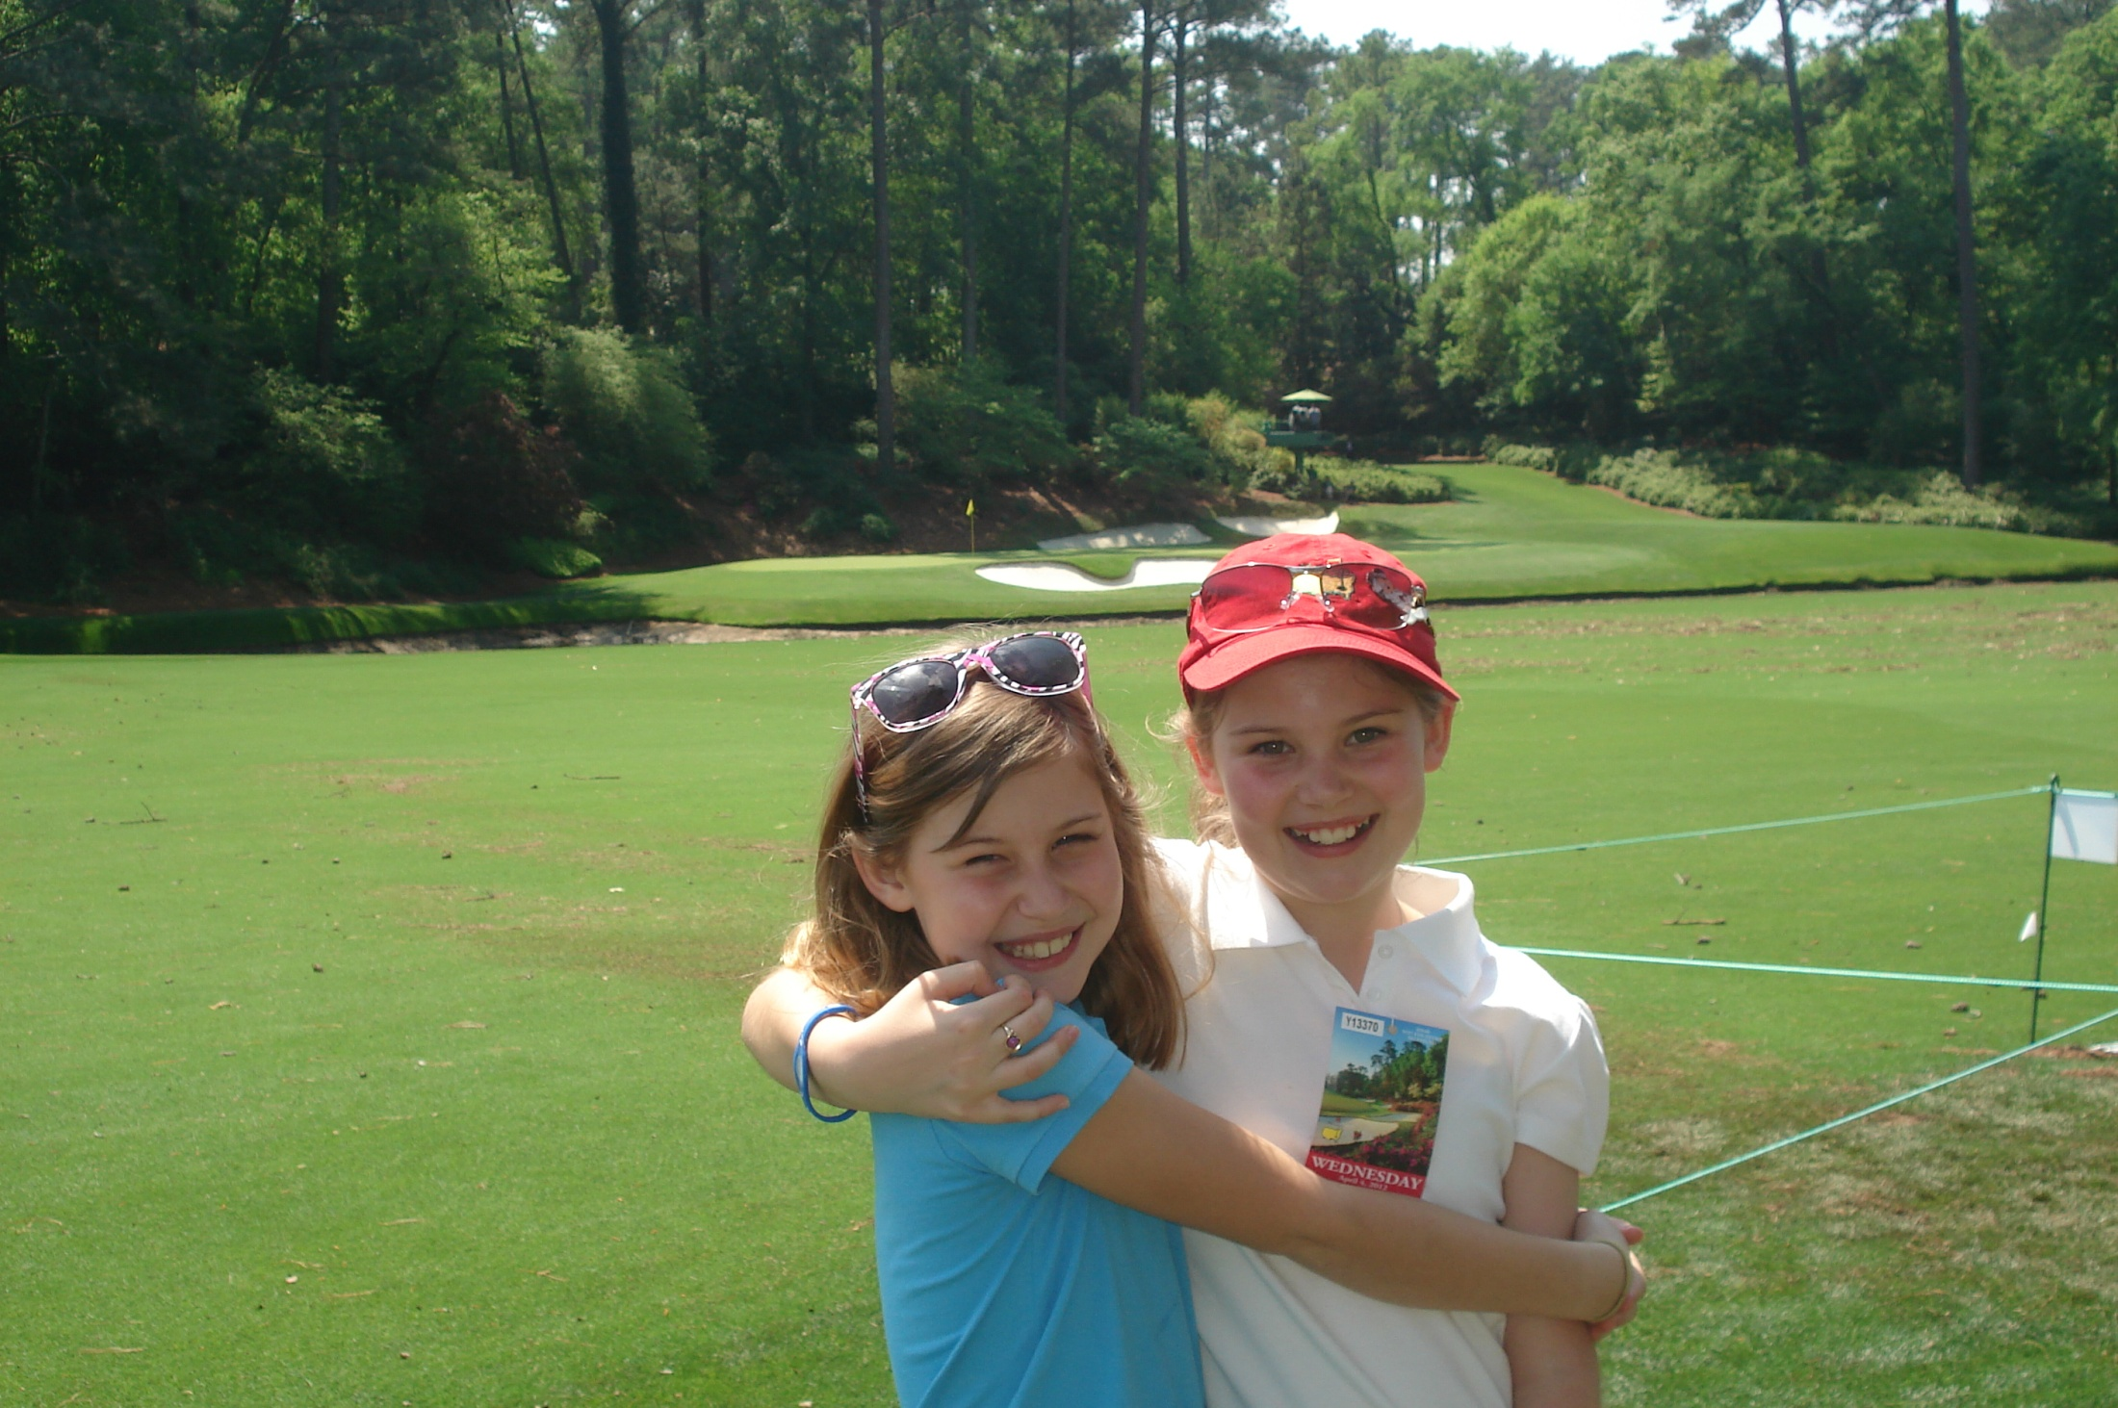
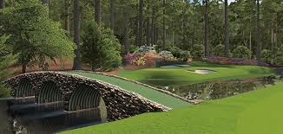
Rae’s Creek in front of
the 12th and 13th greens runs through my grandparents’ front yard
Notes:
Grew up having sweet gum ball races in Rae’s Creek
Grew up less than 2 miles upstream from ANGC – close enough to walk during tournament
Note land for 13th tee – tell more in a few slides

Slide 4
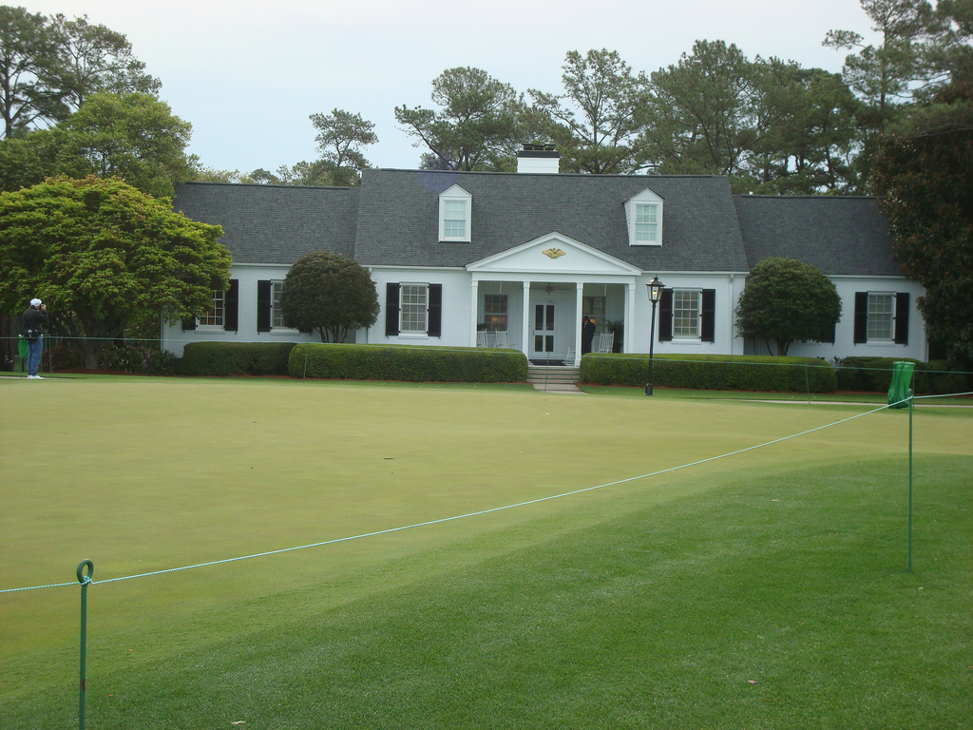
Eisenhower Cabin (“Mamie’s Cabin”)
In front of putting green (10 cabins total)
Notes:
Presidential Eagle on Mamie’s Cabin
Ronald Regan – hostage attempt – former high school classmate taken hostage; ANCG new rule – no sitting president play so Obama must wait another 4 years

Slide 5
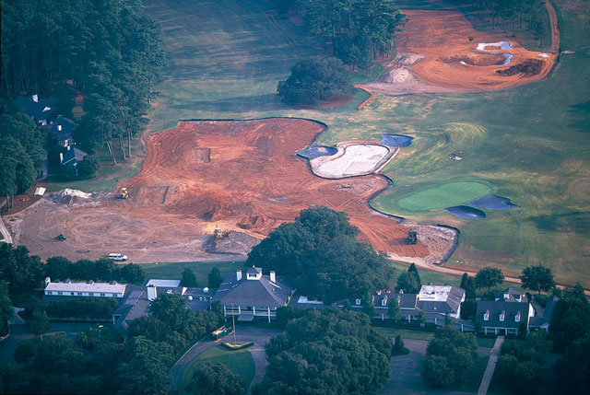
The only major played on the same course each year, Augusta National is only open 6 months a year (Nov – April)
(it started as a winter course for northerners)
Notes:
Friends’ dad was pro at ANGC for 6 months and Grandfather Mountain, NC 6 months

Slide 6
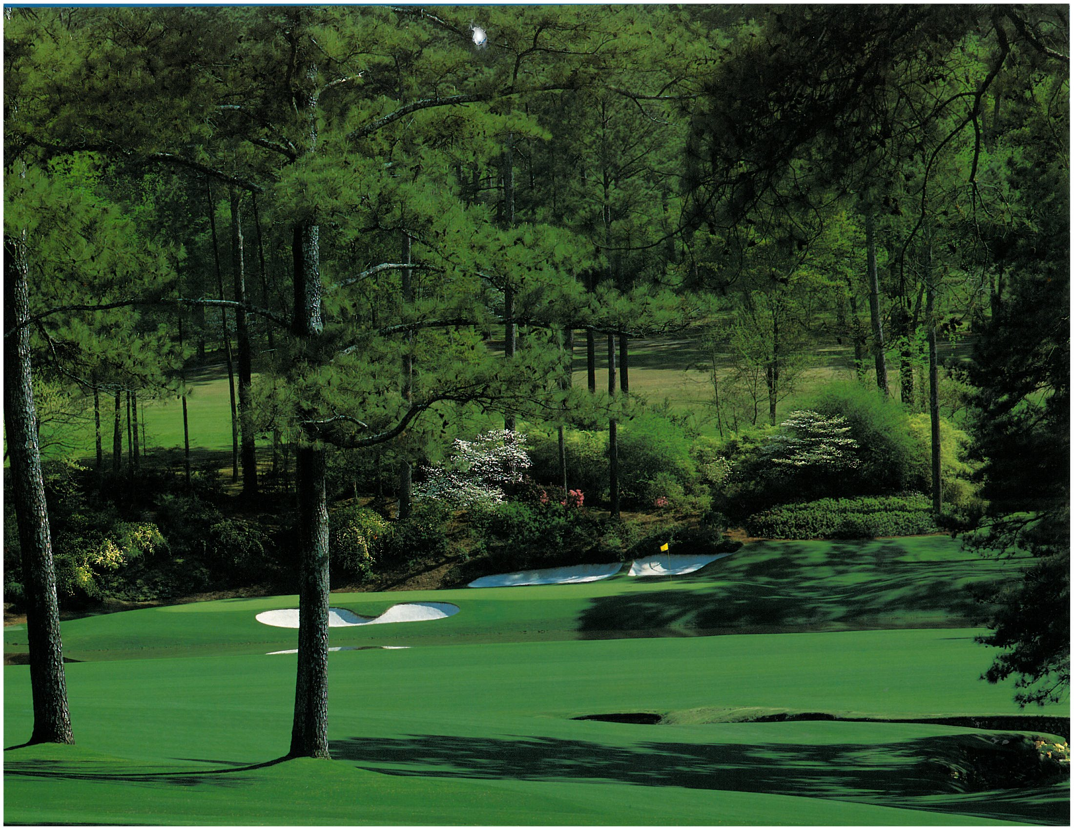
#12 at Augusta National backs up to #9 at Augusta Country Club
(today the trees have filled in and you can’t see the ACC hole)
Notes:
On our wedding day, Michael and his groomsmen all dropped balls and hit onto 12 so they could say they had “played” 12 at AGNC
Back in college, I saw Secretary of State George Schultz playing golf with 2 Secret Service members from ACC #9
ANGC bought land from ACC – 10 feet for $100,000 - $600,000 is rumor I heard

Slide 7
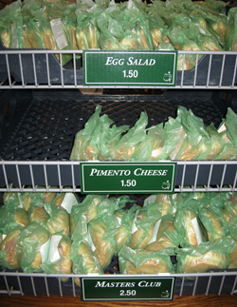
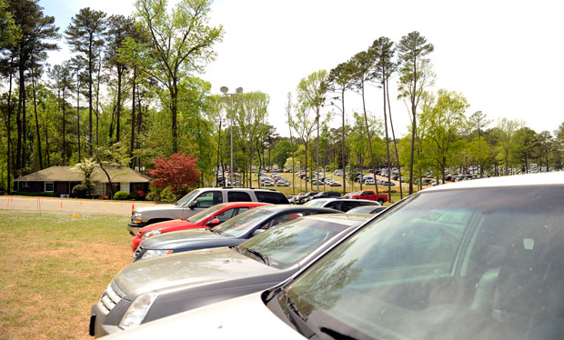
Absolutely no commercialism -
No Corporate Tents
No Vendor Names
(drinks are labeled cola and lemon lime)
4 day badge = $200
Sandwiches = $1.50
Beer = $3.00
Free parking (National bought 90 acres of land for $45 million and removed homes for 1 week of free parking)
Notes:
Scalpers sell tickets for thousands on e-bay; Super Bowl ticket – hundreds for 3 hours; Green wrappers;
Free umbrellas when closed pro shop during storm; wine cellar supposed to be one of the finest and most valuable in the world; only tournament that charges players for family tickets; even members severely limited in number of tickets – serious logistical wheeling and dealing; recently changed from 4 day passes to single day passes for members

Slide 8
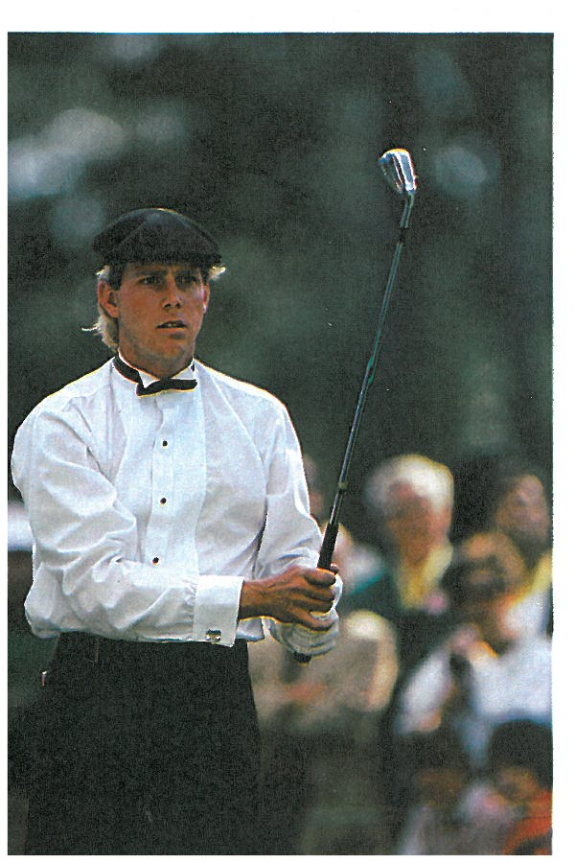
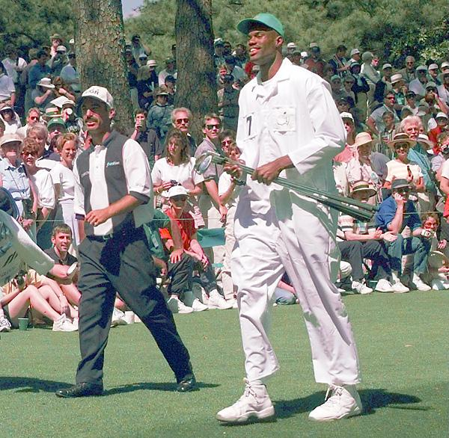
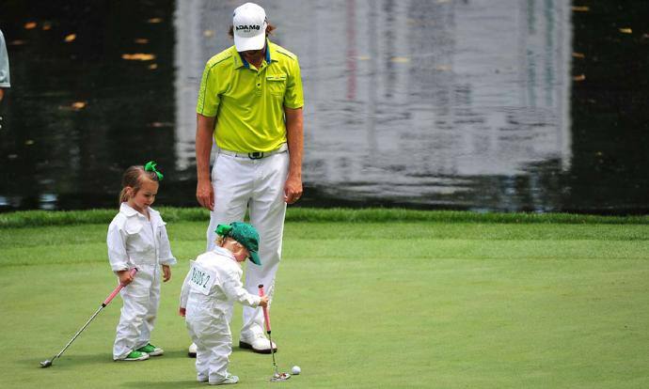
Par 3 Tournament
Wednesday Afternoons
(celebrities, wives, and kids are caddies)
Notes:
David Robinson, NBA player – 7’1” caddied for Corey Pavin 5’9”
Chris Evert caddied for Greg Norman
Andy Roddick, Matt Ryan, Drew Bledsoe, Kelly Tilghman, etc.
Par 3 jinx – let gallery members putt or hit for them; Practice rounds – skip the ball at 16

Slide 9
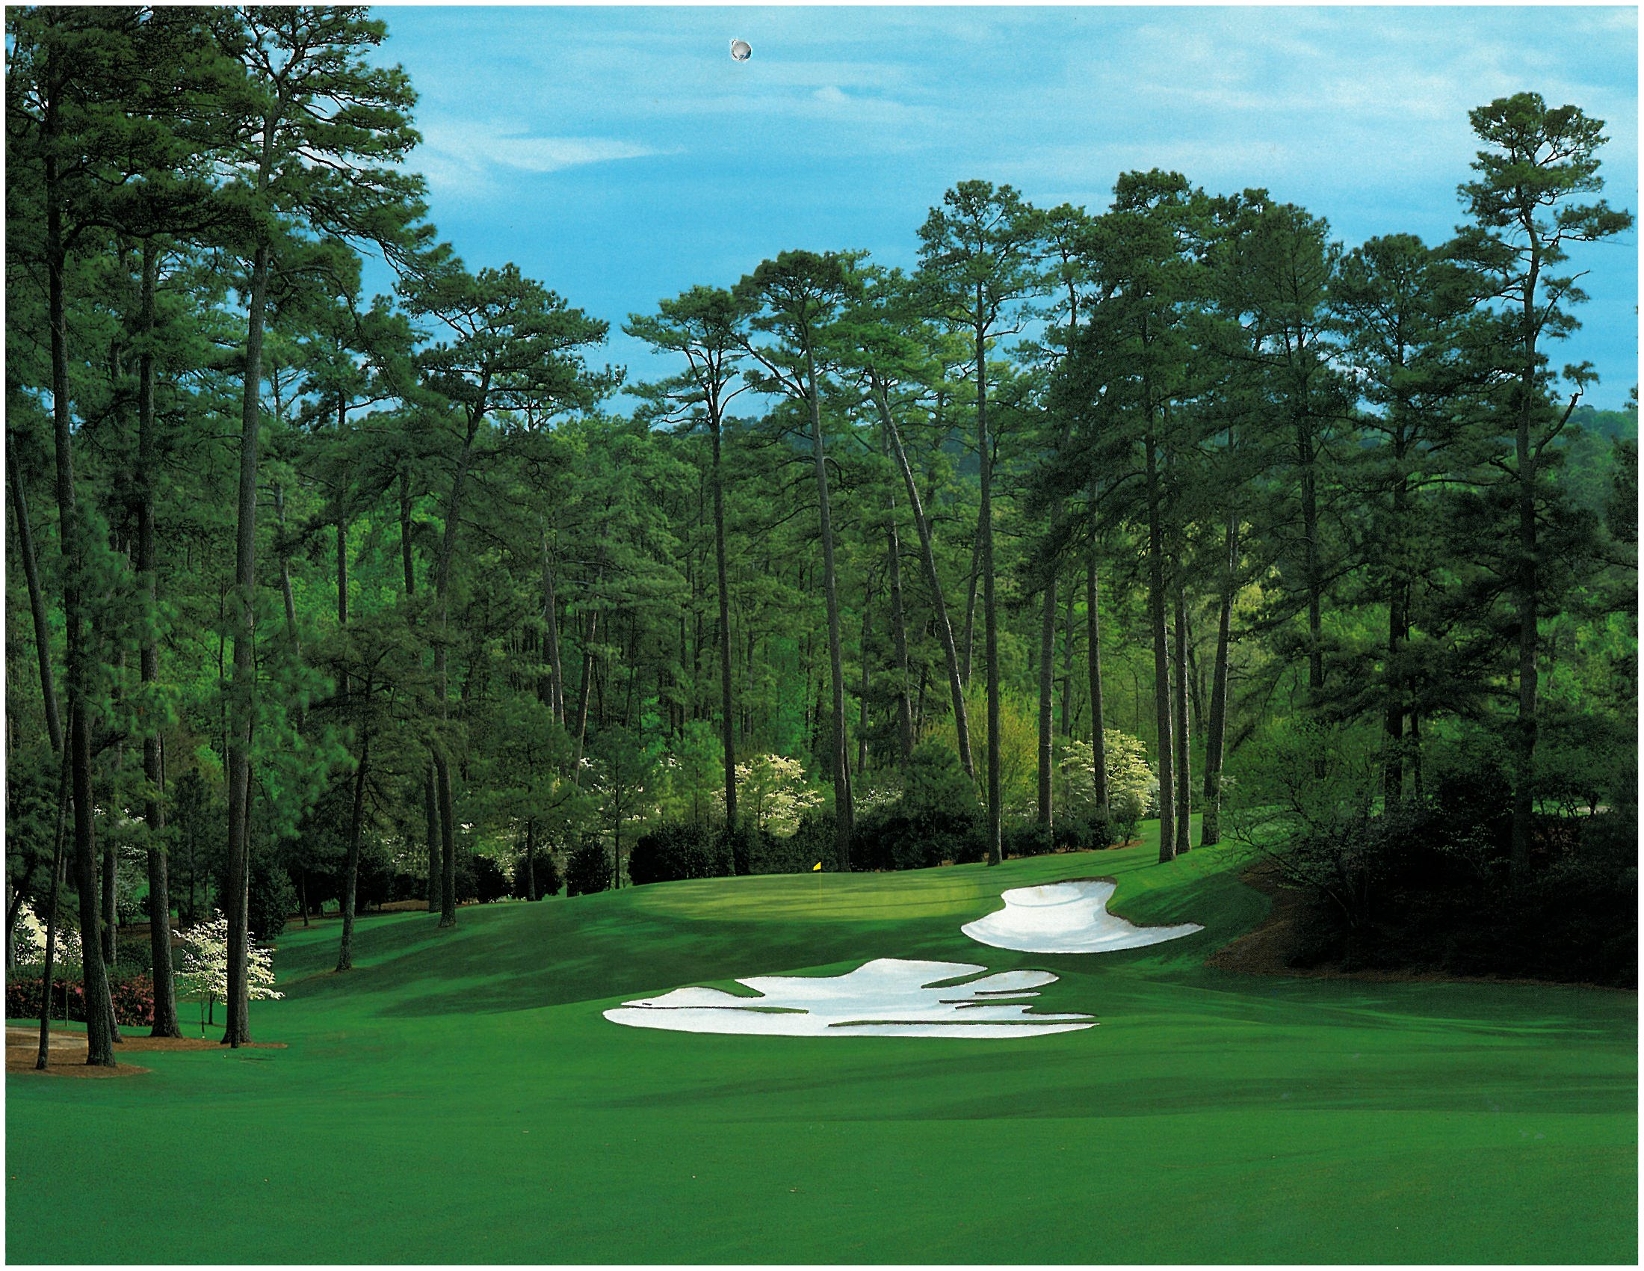
Sound reverberates through the tall Georgia pines – you can tell a roar on 7 from a roar on 15 – a roar for Phil or Tiger from a roar for someone else – a roar for an eagle from a roar for a birdie.
Notes:
Sounds unlike any other tournament – sportswriters confirm the difference
Familiarity with course – know which hole the applause is coming from

Slide 10
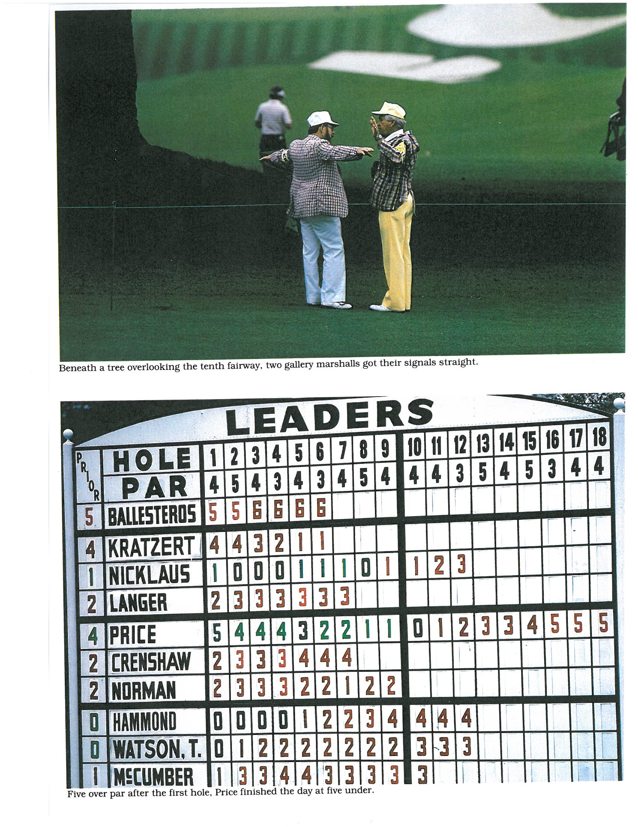
Old fashioned, hand posted leaderboards
Most tournaments today use electronic scoreboards – you can’t see a player’s history for the day, you can’t see who has made the biggest move, etc.
Tremendous suspense when you hear a roar and they pull down the slot and hesitate before posting a score
Notes:
Suspense as they pull down opening and hesitate before showing score
Man on left in picture was my Sunday School teacher – 18th hole gallery guard until recently retired

Slide 11
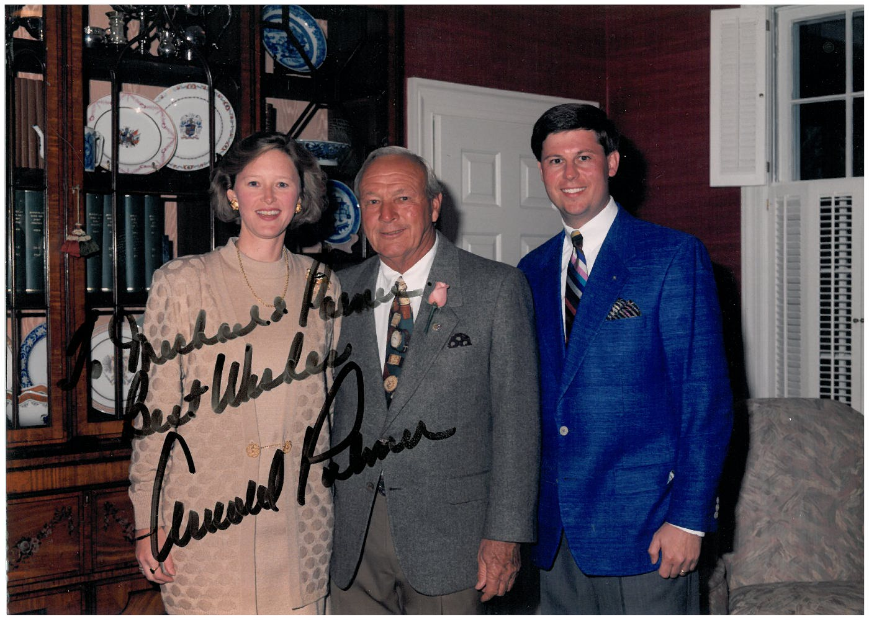
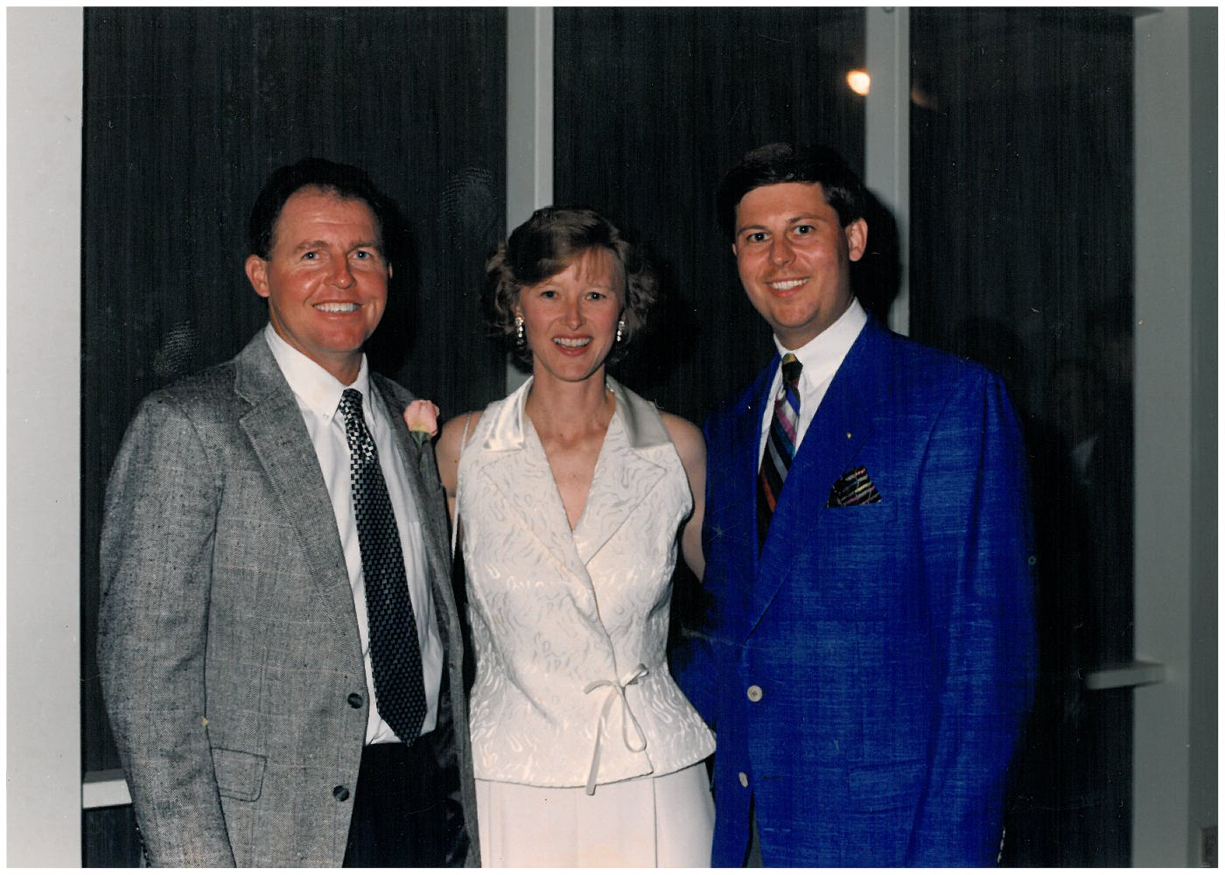
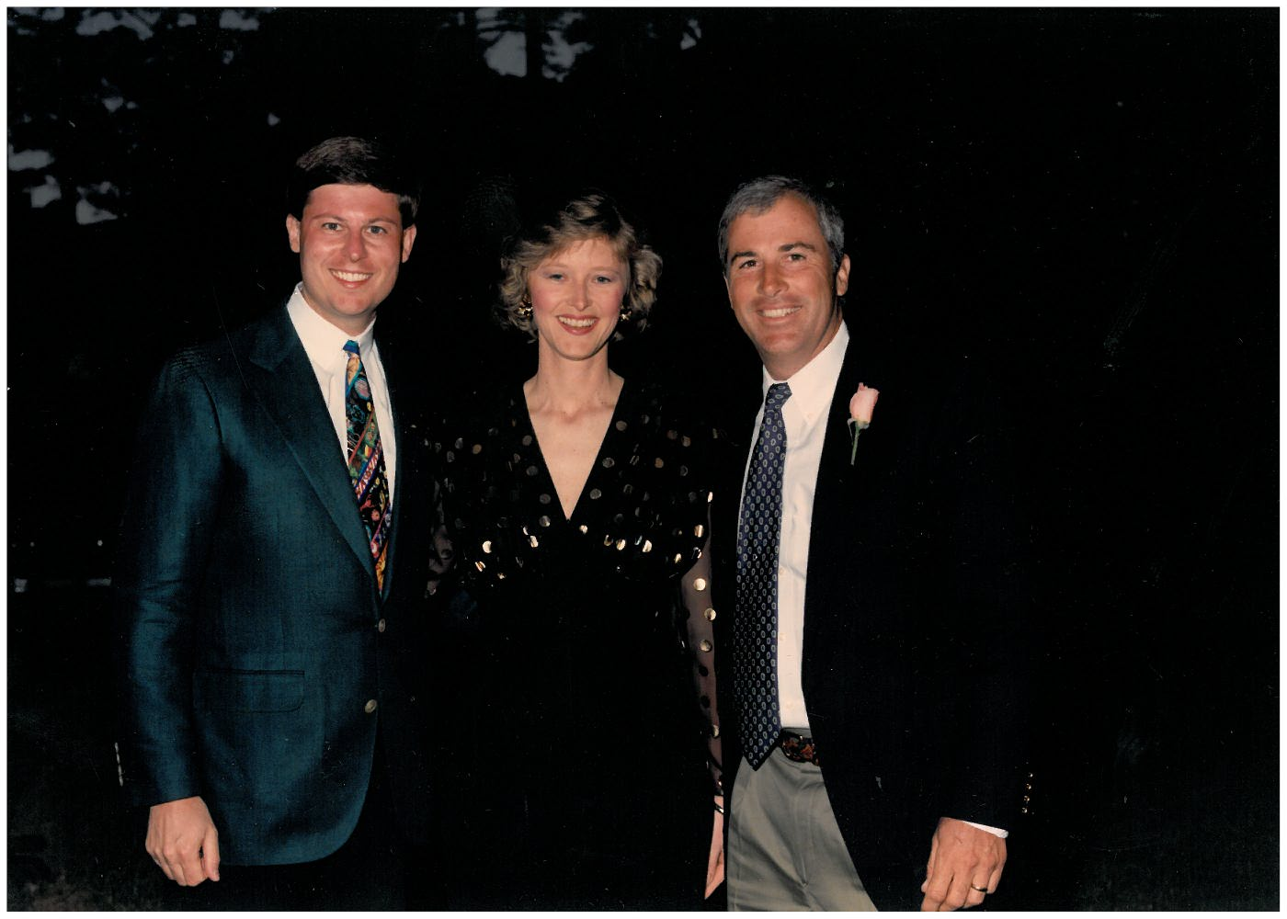
Wake Forest Masters Party,
Thursday Night of Masters
Wake Forest golfers – Arnold Palmer, Curtis Strange, Lanny Wadkins, Jay Haas, Scott Hoch, Billy Andrade, Bill Haas, Webb Simpson, etc.

Slide 12
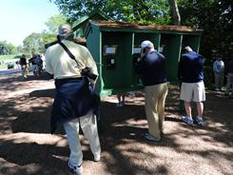
No cameras allowed during 4 days of tournament
No phones allowed the entire week
Free long distance phone provided throughout the course
Notes:
Cameras allowed during practice rounds ONLY
Will lose tickets if found with camera or phone
These rules apply to everyone – I have seen Jim Nantz standing in line for phone

Slide 13
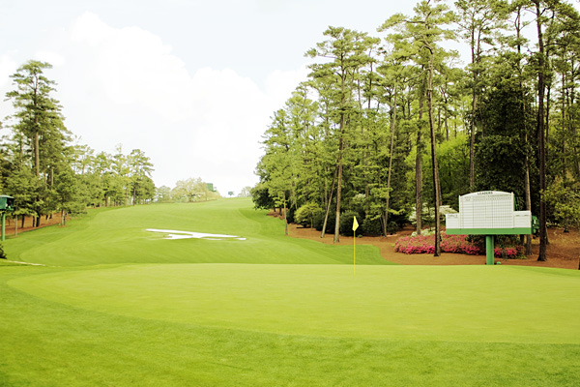
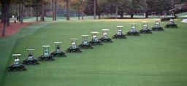
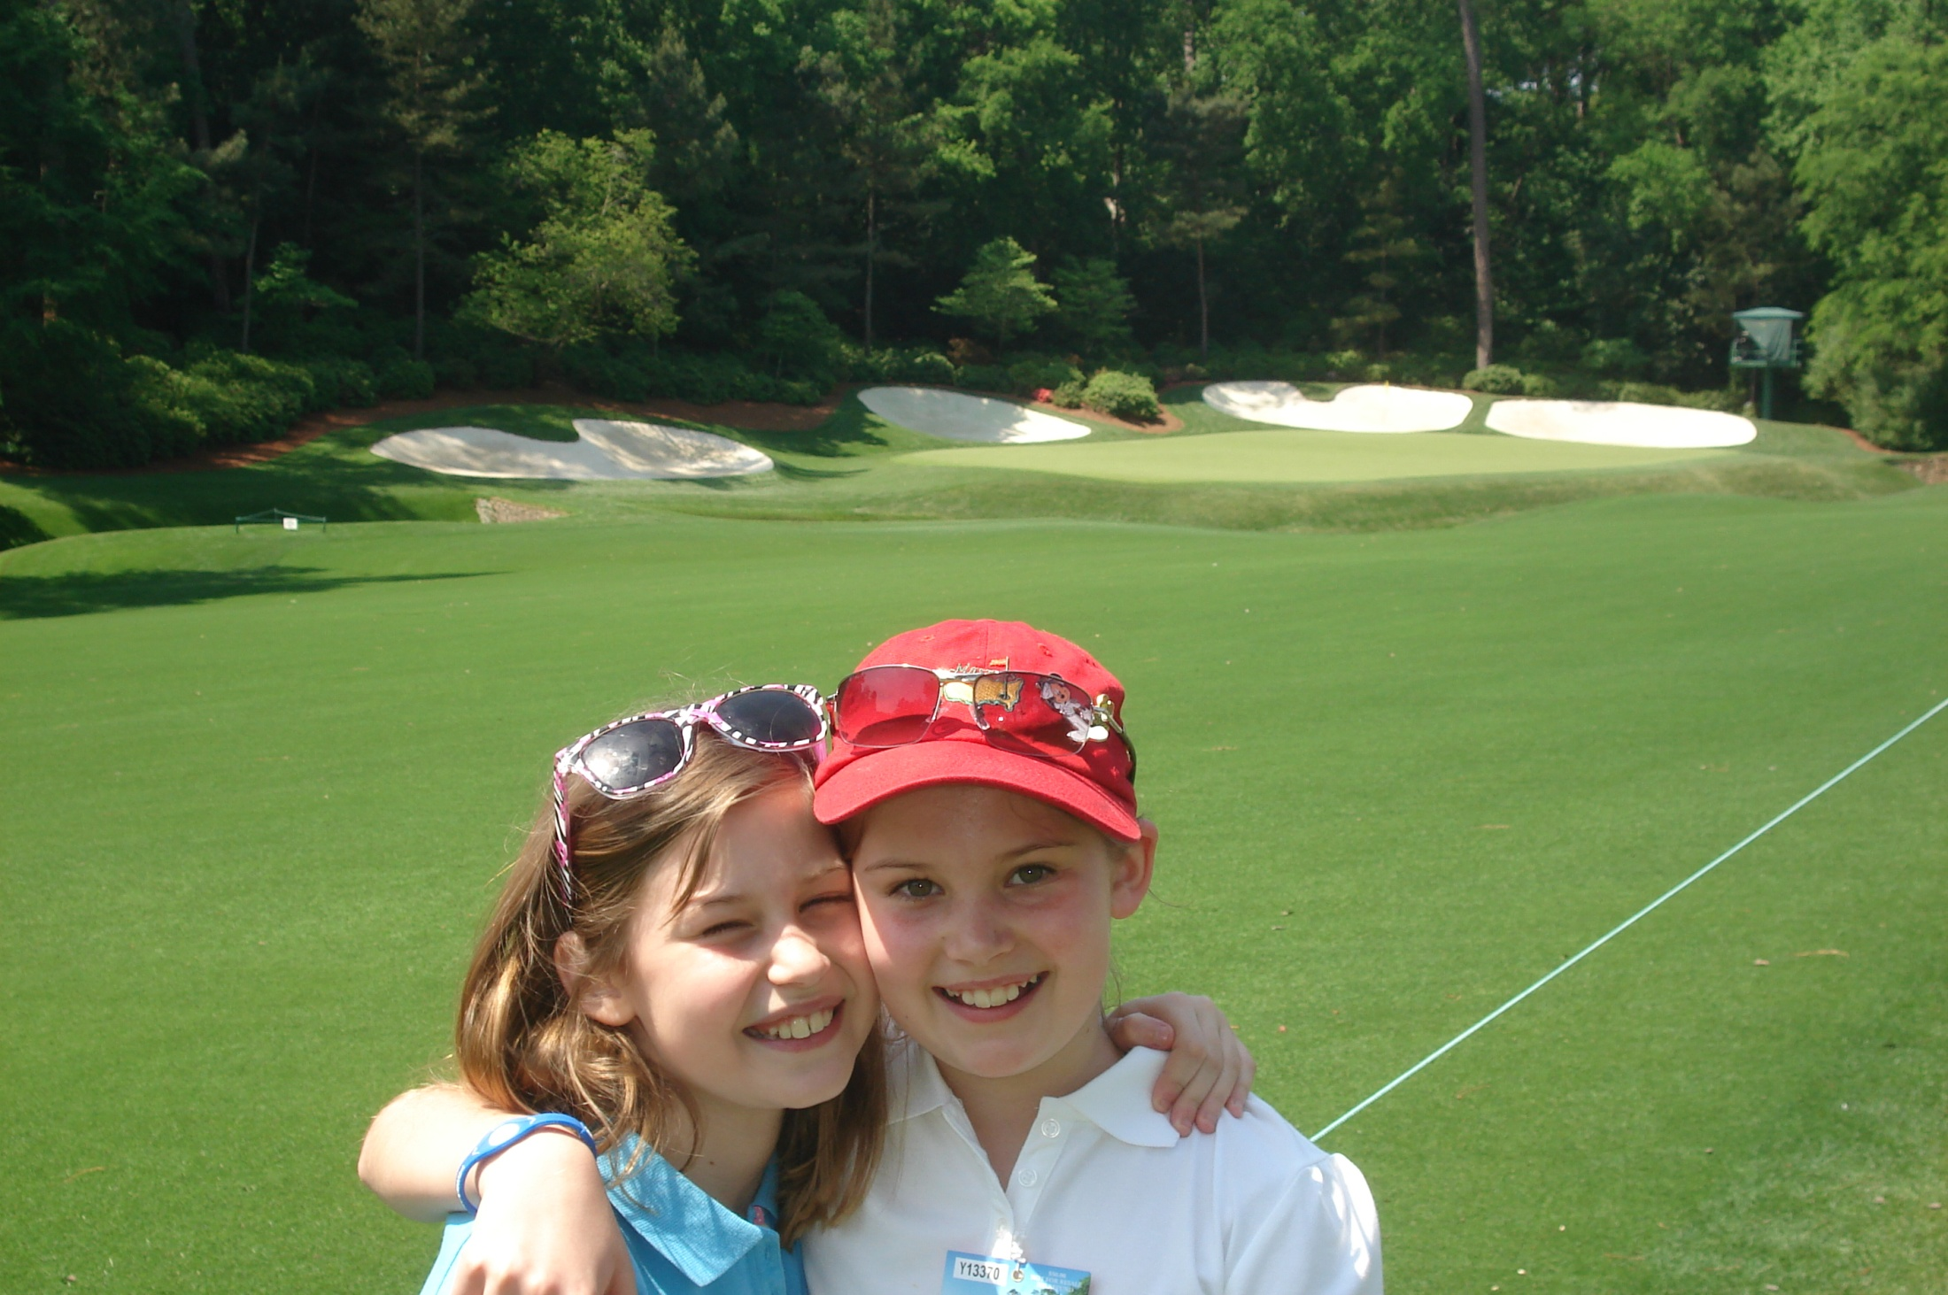
My favorite day is Saturday – park at the back lot, follow the leaders through 18, backtrack through Amen Corner with no crowds, and enjoy the beauty and afternoon shadows in peace and quiet
Notes:
Park at the back lot, follow the leaders through 18, walk backwards from 18 through 10 and Amen Corner
Virtually no one on the course enjoying the beauty and afternoon shadows in peace and quiet

Slide 14
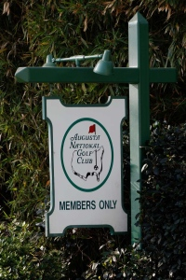
Who’s Who of the business world, but also Augusta doctors and lawyers and former high school classmates.
Member must be in every foursome, so Augusta members are frequently asked to play with Phil, Tiger, etc.
“Grey, Tiger will here on Thursday – want to play with him?”
Notes:
Warren Buffet, Bill Gates story with Mom and her sisters;
Who’s Who of powerful and influential people but also unknown Augustans;
Donald Trump will never be a member

Slide 15
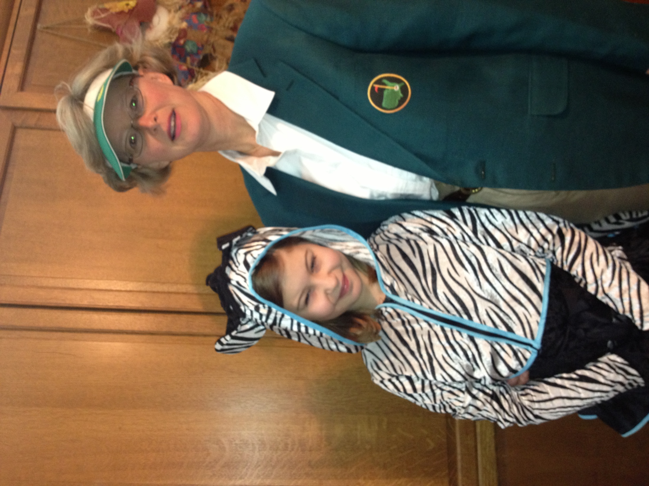
Condoleezza Rice and Darla Moore of SC added as the first female members in 2012.
I am dressed as Darla for Halloween (my daughter is a zebra).
Notes:
My prediction of first women members –Condi Rice, Darla Moore, and Sandra Day O’Conner (2 out of 3 aren’t bad)
BIGGEST surprise – they announced it in press release – normal ANGC protocol would have been for it to be discovered when someone spotted a female wearing a green jacket during the tournament

Slide 16
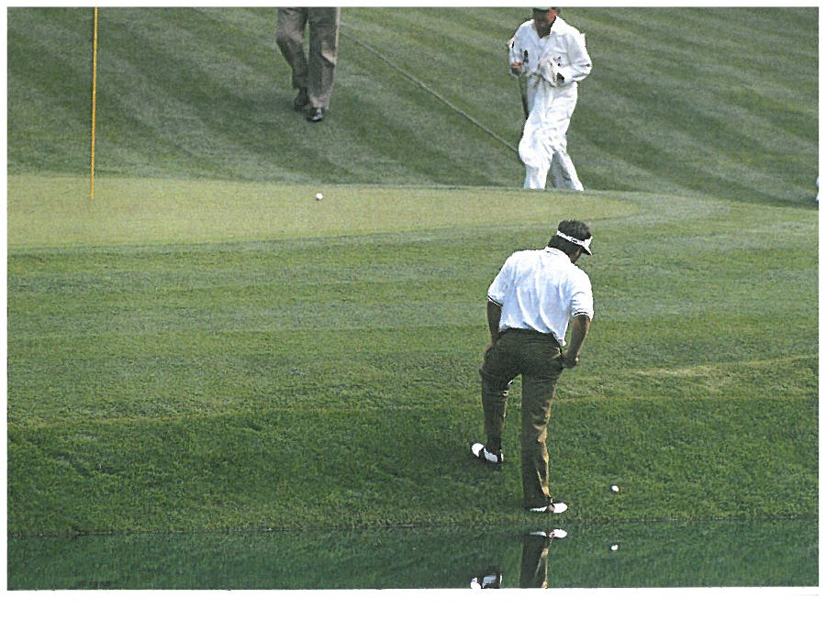
Memorable shots / occasions I have witnessed:
Larry Mize’s winning chip on 11 (1987)
Louis Oosthuizen’s historic double eagle on 2 (2012)
Freddie Couples on 12 (1992)
Tiger Wood’s chip on 16 (2005)
Ben Crenshaw’s 70 foot birdie on 10 (1984)
Bubba Watson playoff win on 10 (2012)
Greg Norman’s collapse (1996)
Phil’s miraculous shot through trees on 13 (2010)
Jack Nicklaus’ eagle on 15 and birdie on 16 (1986)
Every playoff since Billy Casper in 1970 (last 18 hole playoff)
Notes:
Playoffs at #11 – Mize chip in over Greg, Fuzzy, Faldo twice (once over Raymond Floyd – son sitting at our feet – crossed himself and then Raymond promptly put it in the water)

Slide 17
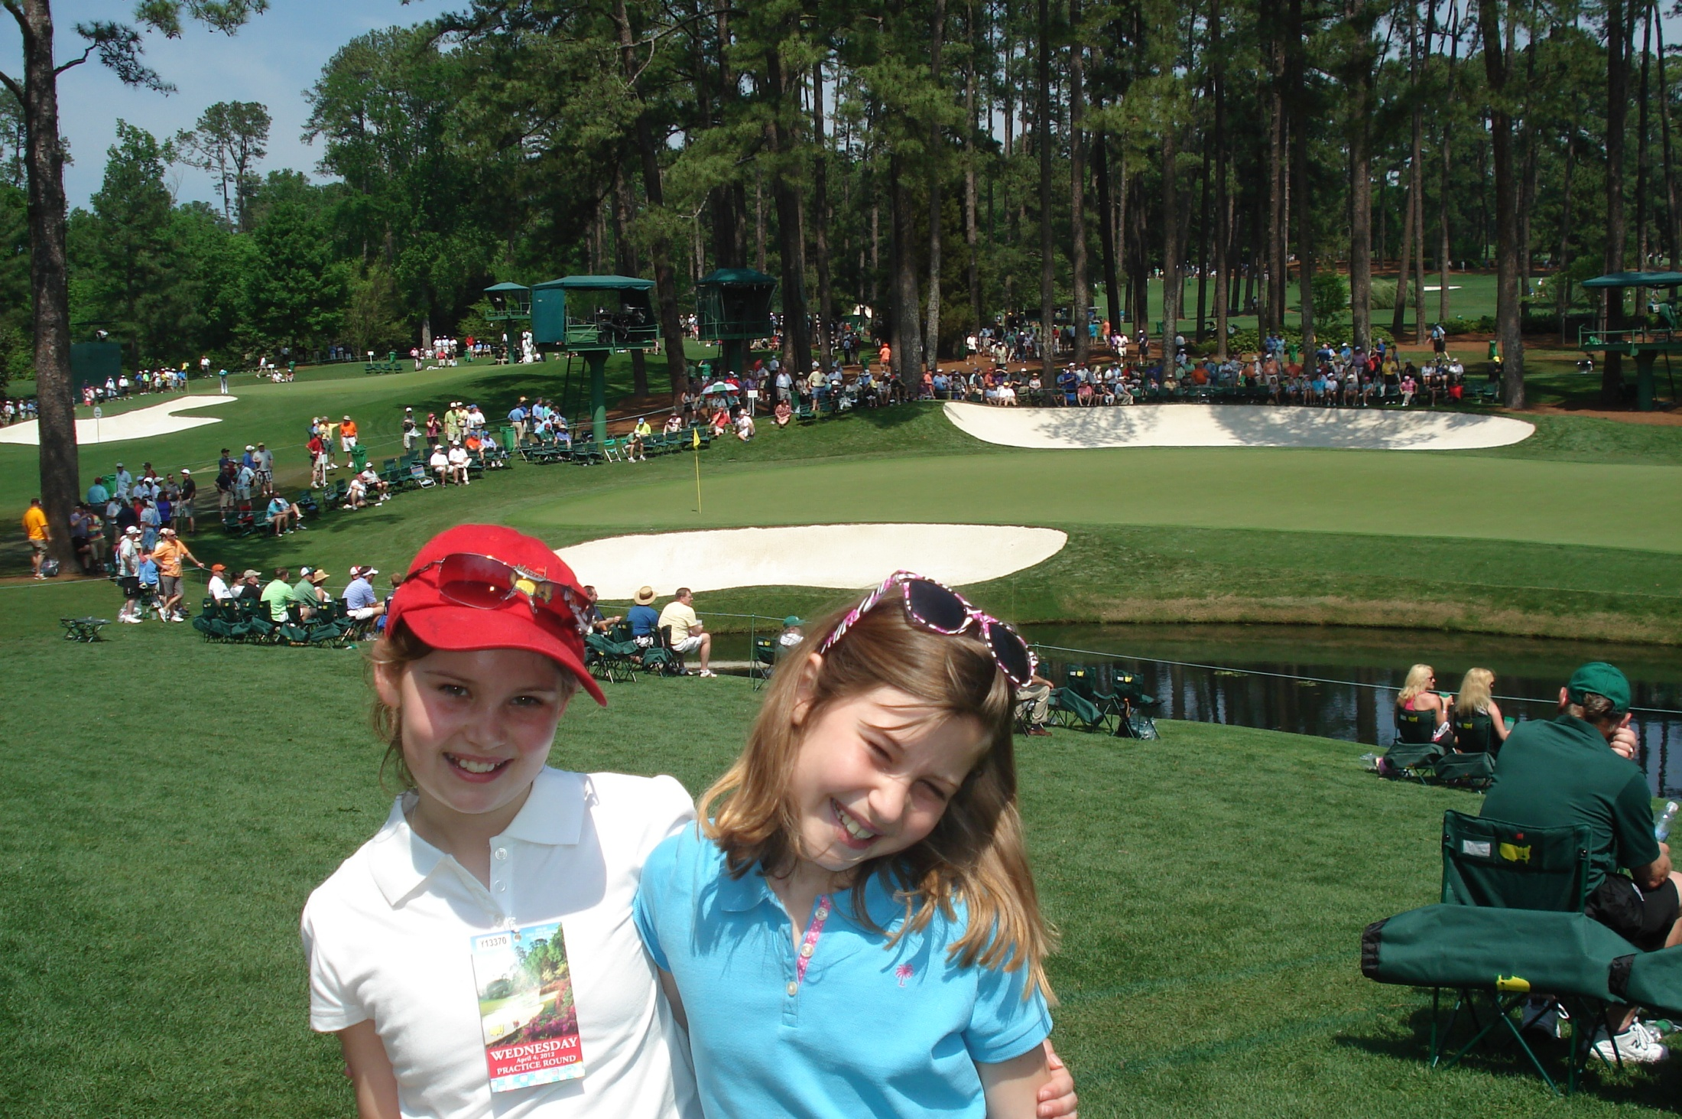
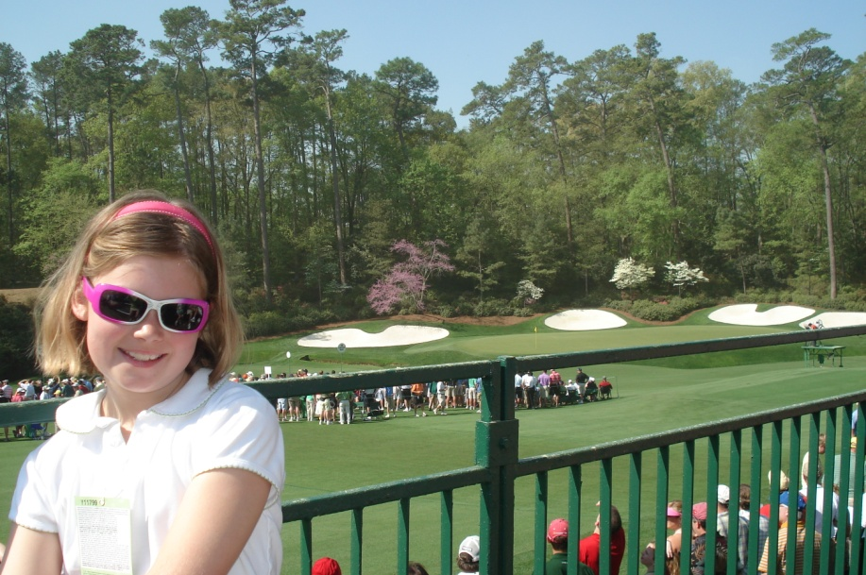
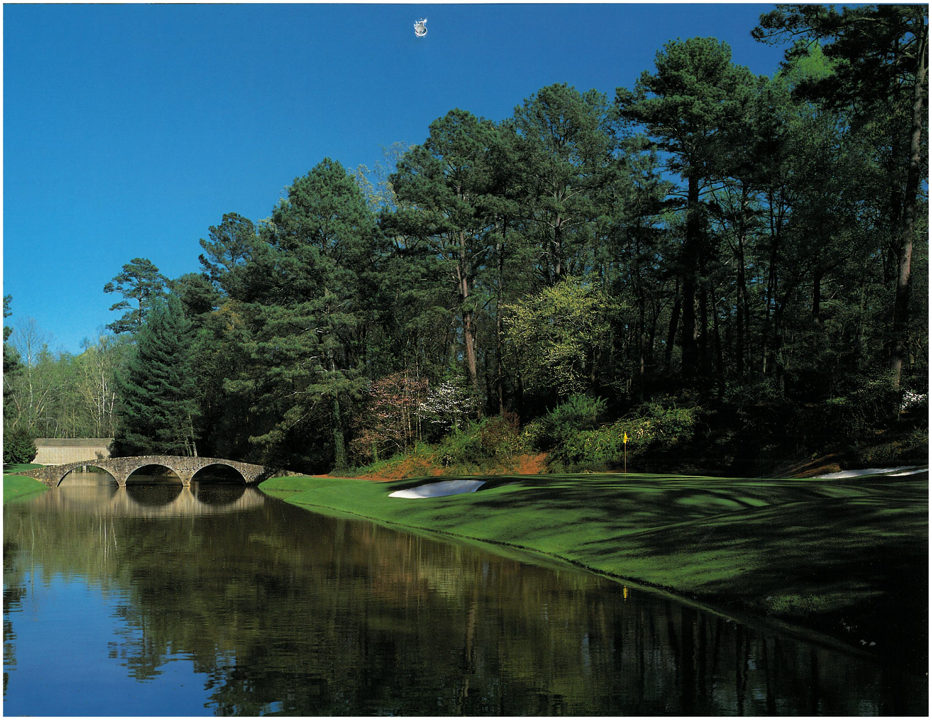
Sunday Strategy
# 2- Eagle hole
# 6- Par 3
# 10- start of the Back 9
# 17- Sit in Grandstands and watch the finish
# 11, 12 or 13 – Amen Corner
# 15- Eagle hole
Playoff – 18 tee then 10 green
Notes:
Even while 6 months pregnant, I am a walker (as child sat on 16 and distracted by fish and turtles when bored)
Want to see the eventual winner 6 or 7 times
Want to see the eventual winner potentially make a charge on the eagle holes (2, 13, and 15)

Slide 18
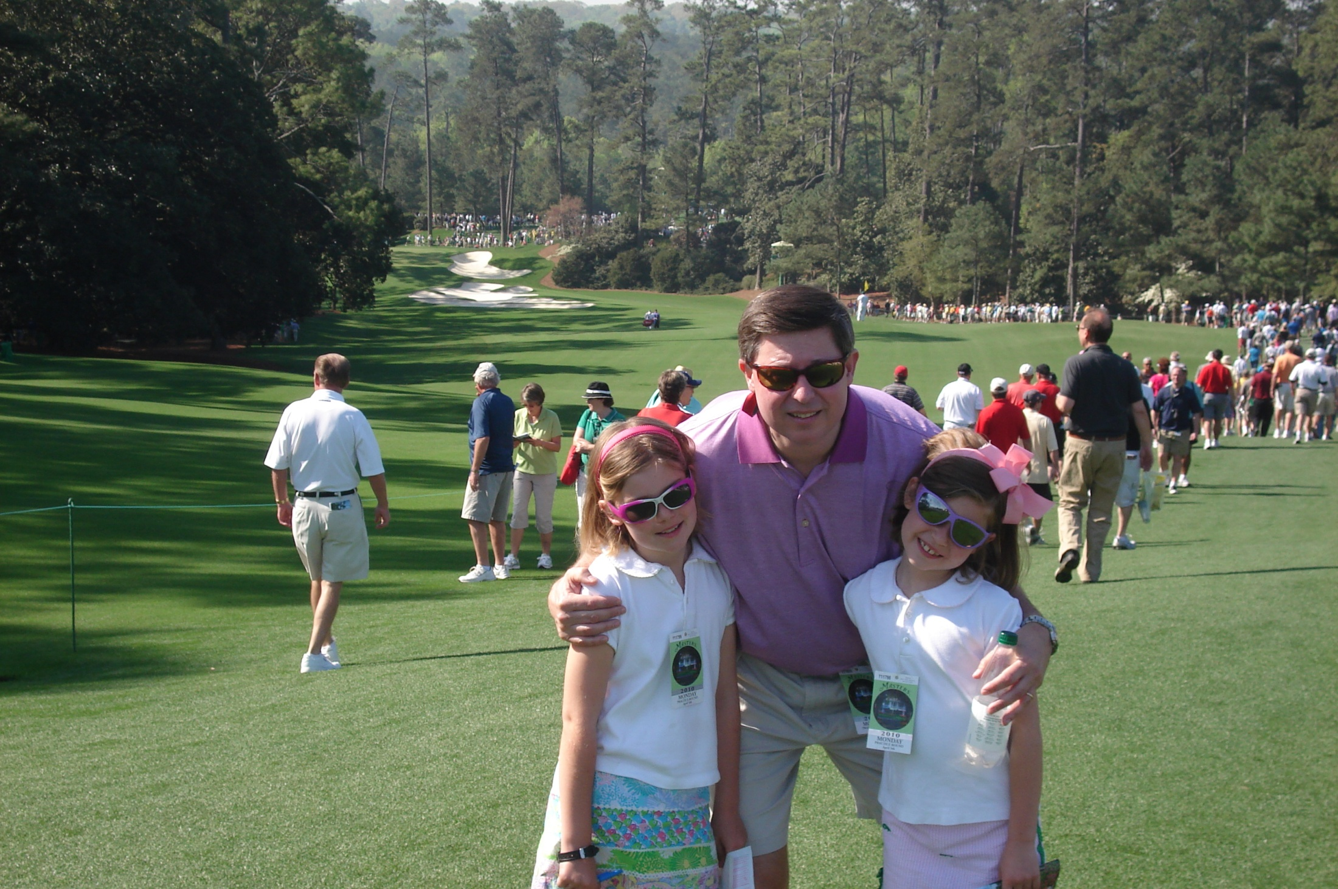
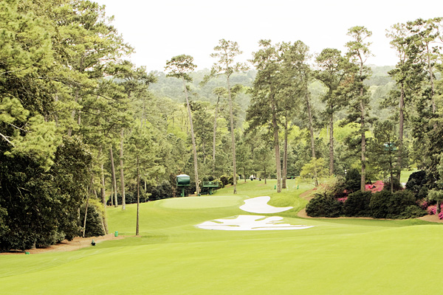
My favorite hole on the course –
Number 10 (Camellia)
“The Tournament Starts Here on Sunday”
5 Playoff wins on this hole (Stadler, Weir, Cabrera, Bubba and Adam Scott)
Notes:
Ben Crenshaw – 70 footer for birdie in 1984 that led to his first win
Rory McIlroy hit into the cabins off the tee – first person ever to do so during his final round collapse in 2011

Slide 19
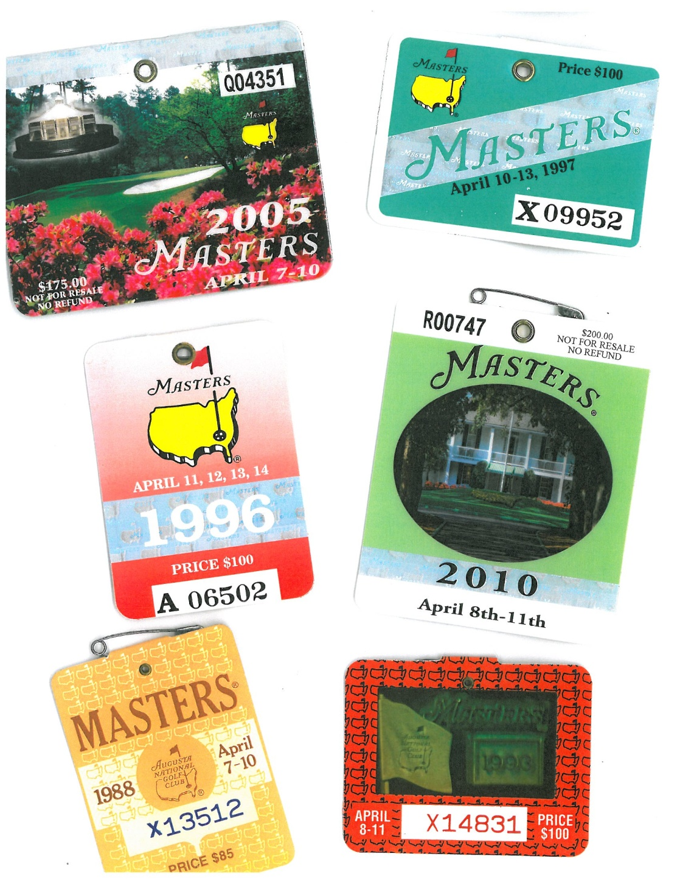
Will lose your tickets permanently for any violations – scalping, cell phones, cameras, etc.
Each person must have a ticket, even a 6 month old (most tournaments children under 12 are free)
Went for the first time at age 7, because parents couldn’t find a babysitter and had an extra ticket. I am very fortunate – I can count on one hand the number of tournaments I have missed since then.
Notes:
Grandfather started with 12 tickets when National asked local residents to support tournament – by time died in 1997, as Masters gained popularity, National cut him down to 2 tickets;
Lose tickets - snow angels in sand trip (Phil and Tiger)
No tickets since grandmother died in 1997 – due to generosity of friends have made it out almost each year since

Slide 20
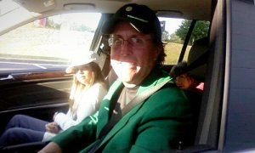
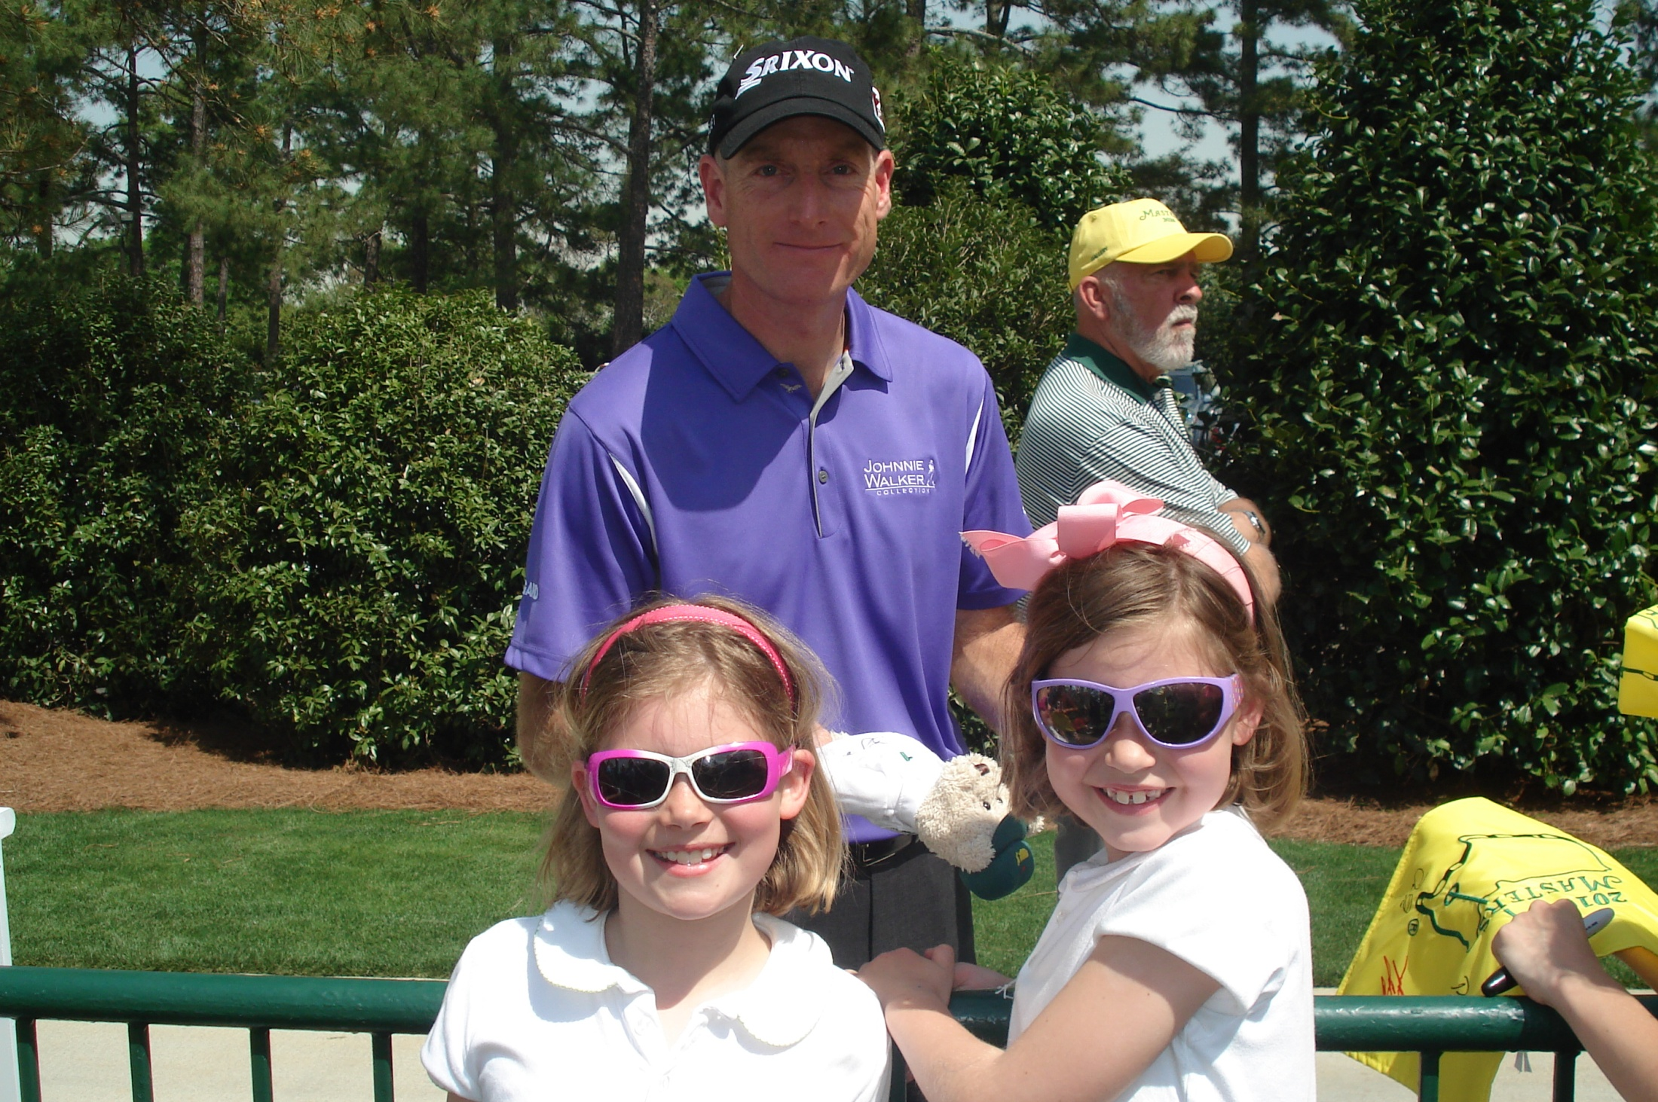
Players and corporations rent private homes for the week
“Jack Nicklaus slept here” sign in bar
Sports Illustrated rented grandparents’ house - Joe Namath stayed there
Met Greg Norman grilling steaks
Phil at Krispy Kreme, the morning after he won in 2010, complete with Green Jacket
Winner can take Green Jacket off premises for 1 year – members not at all
Notes:
rent houses – Nannie – Sports Illustrated – Joe Namath
“Jack Nicklaus slept here”; Greg Norman grilling with his kids at rental house next to Julie Ann Baggs; Jack at church Easter morning;

Slide 21
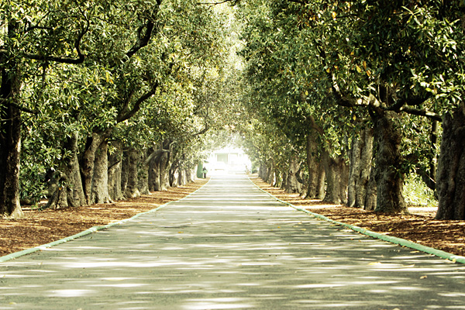
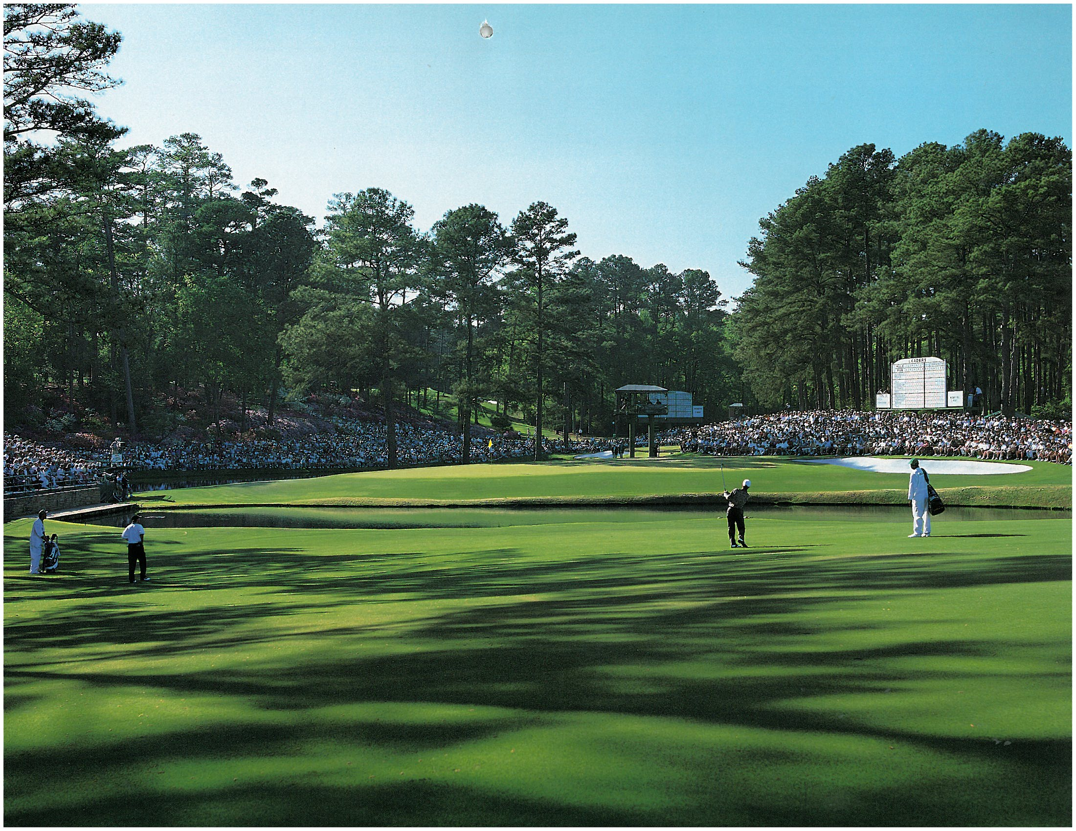
The National controls CBS and television coverage – will never hear reference to prize winnings, value of a putt, etc. The gallery is referred to as “patrons” not “crowds” or “mob.”
Magnolia Lane
Augusta National not a country club - no tennis courts, no debutante balls, no wedding receptions - just golf
Credits for pictures and logo – Masters.com, annual Masters calendars, annual Masters books, Frank Christian, Paul Christian, Mike Fiechtner, Sports Illustrated Golf Group, Augusta Chronicle, Mother Nature Network, USA Today and Golf Digest.
Notes:
If reincarnation is real, I want to come back as a turtle at 15
Only poor sportsmanship I have seen - applause when Seve hit in water in 1986; sang Happy Birthday to Seve on his 21st birthday – Green Jacket;
National RUNS CBS coverage – fired Gary McCord (bikini wax, body bags. Mob (vs. patrons)); Frank Chirkanian
NO mention of $ (that putt is worth $50,000) or prize money for winning Masters is $1.4 million

