Slide 1

Legislative Review & Election Update
Prep for Oct. 25, 2022 Annual Meeting
Sept. 14, 2022
Margaret Buckton, RSAI Professional Advocate
Dave Daughton, RSAI Grassroots Advocate

Slide 2
Agenda
About RSAI
List of Successes
Status of Legislative Activity on RSAI Priorities
Perfect Storm: School Choice and Tax Policy
November Election: Opportunities to Weigh In
Resources
Annual Meeting: Charting the Course for RSAI Advocacy in the 2023 Legislative Session

Slide 3
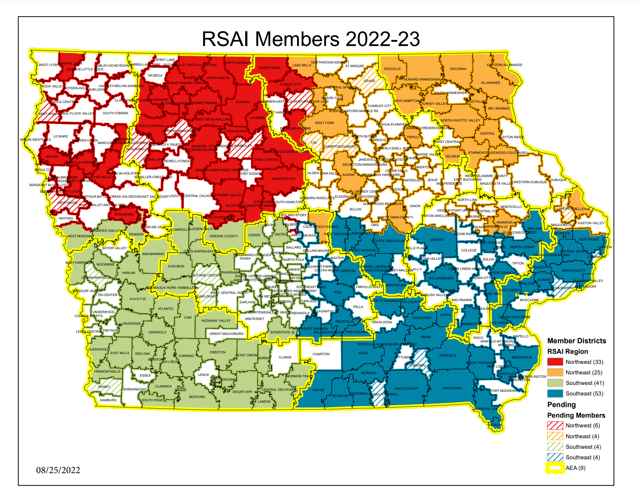

Slide 4


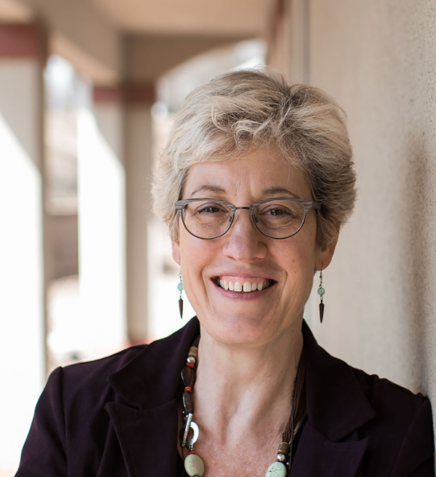
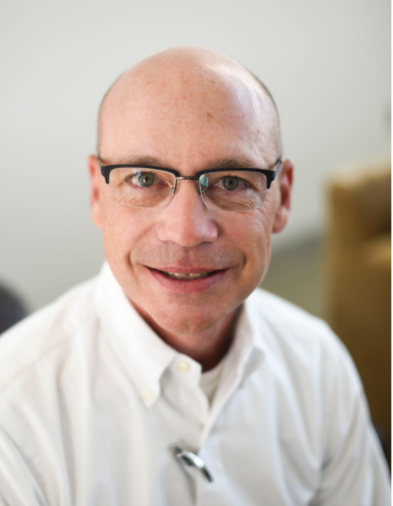
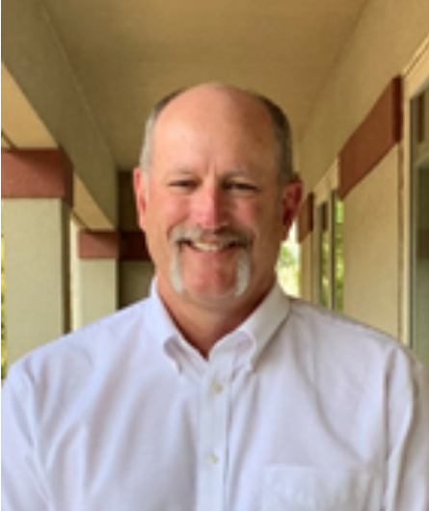

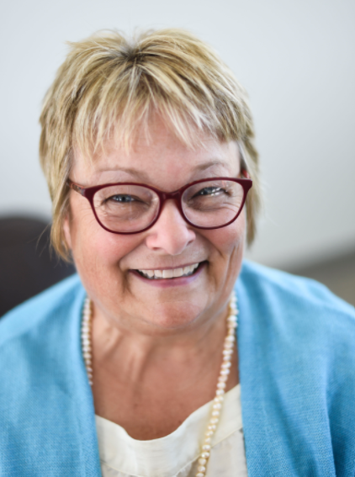
Staff & Support
ISFIS
Margaret Buckton
Professional Advocate
Larry Sigel
Data Guy
Jen Albers
Association Management
RSAI
Dave Daughton
Grassroots Advocate
Susie Olesen
School Improvement Enthusiast
James Passick
Technology Dude

Slide 5










Thanks to our RSAI Corporate Sponsors
RSAI website at www.rsaia.org/corporate-sponsors.html

Slide 6
RSAI Policy Timeline
2022 Session
Ends
RSAI 2023 Agenda Building
Regional Meetings
Leadership Group 9/15
2023 Session
Prep
Legislative Digest
List of Successes
Member Survey
Legislative Committee 8/30
Annual Meeting 10/25
Questions for Candidates
Advocacy Handbook
Coalition Building
Update Position Papers
List of Successes
Rules implementation for DE and Schools
2022 Review Webinar 9/15
Create urgency for priorities
Interim
Legis. Studies
Admin Rules
Nov. 8
Election
Caucus Priorities
2023 Session
  Position Papers
  Weekly Updates
  Calls to Action
  Supports for Capitol Visits and Lobbying at Home
Annual Meeting Oct. 25, 4:30pm
FFA Enrichment Center, DMACC Ankeny Campus. Sets the platform that become the RSAI agenda at the statehouse.
https://www.rsaia.org/annual-meeting.html

Slide 7

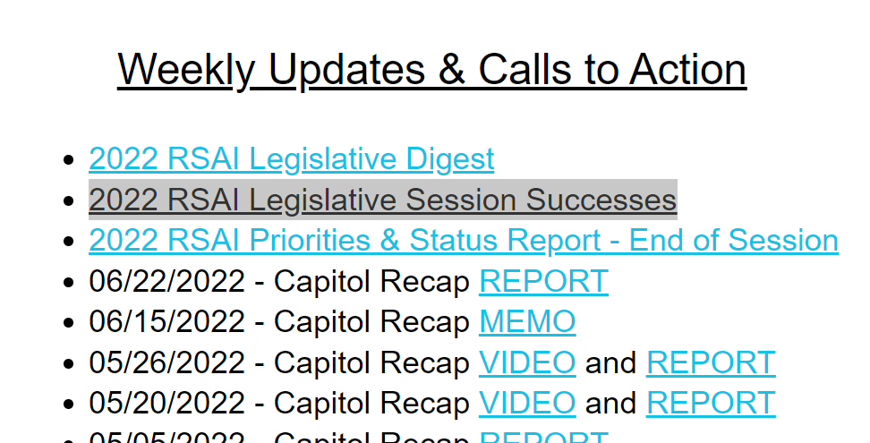
2022 List of Successes
Posted on RSAI Legislative Web Page
https://www.rsaia.org/2022-legislative-session.html
Despite the overall funding and school choice policy challenges of the 2022 Legislative Session, there are some notable successes for rural schools and students worthy of mention
When thanking Legislators and the Governor for their service, start with a mention of something they did that will help your school and students:

Slide 8
Staff Shortage Successes
HF 2081 PRAXIS: eliminated the need for college graduates to pass the PRAXIS test to obtain an Iowa teaching license.
HF 2165 Future Ready Workforce Scholarships: allows part-time students to qualify for scholarship support in shortage areas (includes educators.)
HF 2549 Mental Health Professional Loan Repayment Program: establishes a fund for loan forgiveness. Requires recipients to work in Iowa for a minimum of years to qualify for loan repayment grants. $520,000 was appropriated in the Education Appropriations bill HF 2575 to get the program started.
SF 2266 IPERS Earnings Limits: increases the income threshold of an under 65 IPERS benefits recipient employed by an IPERS employer from $30,000 to $50,000 without loss of IPERS income. Increases the conflict of interest threshold for a school board member who receives school district income from $6,000 to $20,000. (Note: IPERS retirees still need to fulfill the bona fide retirement period of four months.)
SF 2383 Licensure Reciprocity in Governor’s Workforce Omnibus Bill: eliminates the requirement for a person with a license from another state to have one year of experience to get a reciprocal license.
Teacher and Paraeducator Registered Apprenticeship Program: Governor Reynolds dedicated over $45.6 million in awards across the state impacting 134 districts, paid for with American Rescue Plan Act funds –Coronavirus State and Local Fiscal Recovery Funds. RSAI worked with Cherokee CSD as lead school district to create opportunity for over 30 rural districts which individually lacked the minimum number of participants to qualify. Find out more on RSAI web site: https://www.rsaia.org/tpra-pipeline-grant.html
DD

Slide 9
Other Policy Wins
Formula & Transportation Equity: An additional reduction of $5 per pupil in the formula equity gap was accomplished and transportation equity payments for above-average transportation costs were continued (HF 2316). The bill also appropriated an increase of $2 million, total of $29.5 million, for transportation equity payments to districts with above-average transportation costs.
Operational Sharing: Increased superintendent supplementary weighting to 9 students and created several new positions that would qualify for sharing incentives (SROs at 3 students, also adds college and career transition counselor or coordinator from SF 2589 at 3 students, and allows one individual to serve in different roles when shared between districts. HF 2080
Student Mental Health: $3.4 million appropriation to AEAs for mental health training and student supports and services (HF 2575), which is an increase of $200,000. See also Mental Health Professionals Loan Repayment Program above.
Radon Testing Local Control: although otherwise a state mandate, the bill expanded flexibility to use SAVE/State Penny for School Infrastructure funds for Radon Testing/ Mitigation and allowed districts to train local staff to conduct the testing and implement mitigation. (HF 2412)
SF 2366 Wind Energy Conversion: corrected a law allowing wind turbine repair to reset the valuation schedule, which has the effect of postponing valuation growth, lowers local levy capacity and increases the cost of state aid to account for it. Applies to future wind energy conversion property assessment schedules.
MB

Slide 10
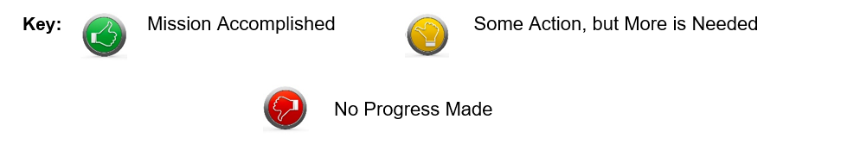
RSAI Legislative Priorities

Slide 11
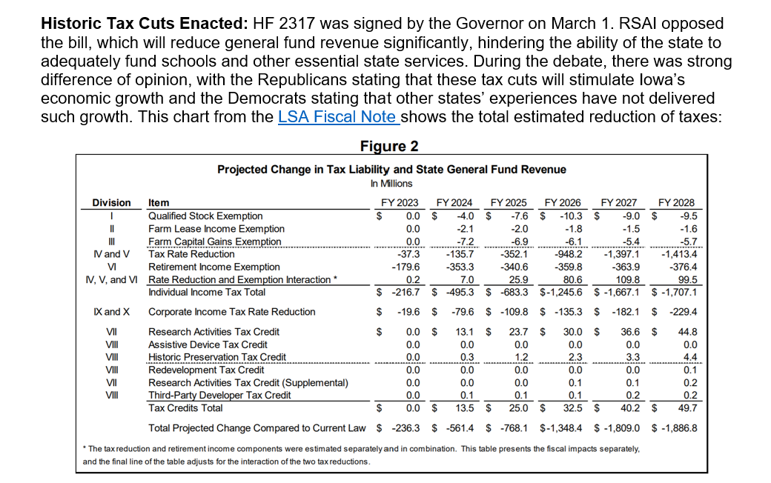
HF 2317 Historic Tax Cuts
MB

Slide 12
Adequate School Resources
SSA no lower than 3.75% and Formula and Transportation Equity
Priority Action: HF 2316 State Supplementary Assistance (SSA). The bill was signed by the Governor on Feb. 17. The bill does the following:
Establishes a 2.50% growth rate to be applied to the State cost per pupil (SCPP) for FY 2023, for an SSA of $181 per pupil.
Establishes a 2.50% growth rate to be applied to each of the State categorical per pupil amounts for FY 2023 (TLC, PD, TSS, EICS, and Transportation Equity).
Provides an additional increase of $5 to the FY 2023 regular program SCPP, separate from the SSA, to reduce the difference between the SCPP and district cost per pupil to $140.
Freezes the additional levy portion of the FY 2023 SCPP at $685 per pupil, regardless of the per pupil increase for FY 2023 (property tax relief)
Increases the appropriation to the Transportation Equity Program to equal the amount necessary to make all transportation equity aid payments.
HF 2315, Supplemental Education Funding, would have provided $19.2 million in supplemental funding to help schools with inflationary costs. The bill was approved in the House, 94:1, but died in the Senate Appropriations Committee with no further action.
MB

Slide 13

Adequate School Resources
SSA no lower than 3.75% and Formula and Transportation Equity
RSAI opposed HF 2416, Historic Tax Cuts, under consideration at the same time as HF 2316 School Funding, to which we registered as undecided. Here’s why:
The Legislature and Governor could have set the SSA rate at 3.75% and funded other RSAI priorities and still cut taxes significantly.
RSAI opposed the lower Senate funding amount and supported of HF 2315 (one time inflationary funding).
Although the 2.5% per pupil increase was below RSAI’s request for 3.75%, the bill also increased transportation equity appropriations and closed the formula equity gap by another $5 per pupil, now to $140.
The total funding provided to public schools was below what was requested by Rural School Advocates of Iowa members.
Some action but more is needed.
MB

Slide 14


Educator Shortage
Several actions were already covered on the success list. Here are some ideas that received some traction, but did not get all of the way through the process.
SF 2377 Teacher Shortage Omnibus: Teach Iowa scholar program eligibility, Teacher Intern license for grades 6-12 issued by the BOEE, and the use of revenues from the district management levy for teacher recruitment costs (limited to 10% of minimum teacher pay per teacher, no more than 5 years, and either early retirement or teacher recruitment each 5-year period.)
HF 2083 Changes eligibility for Teach Iowa Scholar Program (no longer must be in top 25% of class) and specifies that half of the lone forgiveness grants will go to teachers in districts, charter and private school below 1,200 enrollment and half above.
HF 2398 Permanent Teacher License for master’s or doctoral degree educators (no CEU’s required.) Requires charter schools and private schools to conduct background checks, adds a minimum ten-year work requirement for these teachers before waiving future licensure renewals, requires the BOEE to do a background check on these permanent teachers every 5 years and allows BOEE to charge a reasonable fee for the background check.
Other discussions about licensure issues continue: K-12 special education license (that doesn’t double the workload for the applicant), Flexibility to staff multiple classes in one classroom (overlap of learning standards, such as Ag in the Classroom, Financial Literacy, Math). Do you have ideas here? Please let us know.
DD
Although many bills were passed in 2022, there is still a lot more to be done.

Slide 15
Local School Board Authority
Priority Actions: several bills either promoted or limited local control. Most of those promoting flexibility involve teacher recruitment flexibility already discussed.
HF 2412 Radon Testing and Mitigation: pending Governor’s Signature. Requires testing every 5 years, mitigation under certain circumstances. Allows school employees to do the testing and mitigation if trained appropriately. Allows use of SAVE at board discretion to pay for testing and mitigation. RSAI undecided. Signed by the Governor.
SF 2369 Governor’s School Choice Omnibus: mandated high stakes civics test for graduation, transparency provisions regarding parents’ and community access to materials (unfunded mandate) and several appeals steps for library book decision-making process (overrides local district and school board determinations.) Senate improved the transparency provision with a parents’ rights bill that is more flexible for school compliance and does not include appeals. HF 2577 Transparency removes the high stakes test but still requires annual reporting of civics test scores and allows compliance by providing parents’ access to instructional management system. Still requires posting of core materials. Parent’s Rights SF 2205 resolved some of many of our concerns, but would still have required some process for checking out library books and providing access to instructional materials.
HF 2254 Online Learning: would have allowed school board to use up to 5 virtual days to make up snow days. The bill did not progress out of the House Education Committee. RSAI supported this bill.
HSB 574 Start Date: would have allowed schools to start school as determined by the school board, but did not progress out of the subcommittee. RSAI supported this bill.
Other recent examples of limitations on local school authority are worth additional mention.
DD

Slide 16
Laws and Sausage
Saxe, a popular poet in the mid-19th century, as early as 1869, stated “Laws, like sausages, cease to inspire respect in proportion as we know how they are made.” John Godfrey Saxe (1816-1887)
Several last minute amendments that limited school board and district authority were passed without committee discussion, which means without public input. This process has become the norm in education policy.
MB

Slide 17
This Process Stinks
Policy by previously unconsidered amendments is AWFUL.
Other Recent examples:
  Change in accreditation process, to include compliance with HF 802 and change from focus on educational standards to compliance with all state and federal requirements was amended onto an appropriations bill in late 2021 session
  Prohibiting schools from implementing mask mandates was amended onto an appropriations bill on a Thursday afternoon, signed by the governor and effective after midnight the same day.
  Limitation to superintendent severance was amended onto the Education Appropriations bill during House floor debate (later removed in the Senate)
Think Schoolhouse Rock: idea is introduced, gets discussed and perfected along the way, with public input and feedback, media coverage, education of legislators and consideration of local impact, in both chambers.
Encourage new legislators to commit to a thoughtful democratic process and stop this abuse of power that minimizes the voice of stakeholders. Stakeholders aren’t just teachers and education leaders, but parents, taxpayers and the business community.
MB

Slide 18

Quality Preschool
Priority Action: note about COVID-19 Impact: PK enrollments fell in the Fall 2020. PK does not have an on-time funding component or budget guarantee, so the 2021-22 PK budgets were based on the Oct. 1, 2020 enrollment count. FY 2022-23 PK budgets will be based on this Oct. 1 PK head count. PK enrollment bounced up last October, but Iowa was still 2,000 preschool students below pre-pandemic levels. DE guidance prohibits school districts from using general fund for PK expansion. Federal ESSER or ARP funds could be used for PK. Funds transferred to the Flexibility Account and Title I funds could also be used for PK expansion. However, there were no bills that moved forward out of a subcommittee and no process for spending authority or direct state appropriation for the FY 2022-23 school year.
HF 318 PK for Young 5s: would have allowed districts to serve and count young 5-year-olds in PK, was approved by the full House, Senate Education Committee and Senate Appropriations Committee, but died on the Senate Calendar in the 2021 Session. Although the bill remained alive for consideration this year, did not survive the second funnel deadline.
MB

Slide 19

Opportunity Equity/Poverty
Priority Action Poverty Weighting: despite the School Finance Interim Committee recommending in 2019 and the House Education Committee approving a bill, HF 2490, the study of the impact of poverty on education and funding formula options to meet the needs of students did not advance out of House Appropriations Committee in 2020. No bill was moved forward in either the House or Senate in 2021 or 2022, taking a step backwards in the policy discussions. FYI: Children from families with incomes at or below 130% of the poverty level are eligible for free lunch and those with income from 130-185% are eligible for reduced lunch.
Priority Action Dropout Prevention: HF 2008 and SF 2003 were both introduced and approved by subcommittees 2:0. The bill(s) would have phased all districts up to the full DoP capacity (5% of regular program district cost) over several years. The bills were not approved by either the House or Senate Education Committee.
MB

Slide 20
Sharing Incentives/Efficiencies
Sharing Incentives/Efficiencies: extension of Whole Grade Sharing, Reorganization and Operational Sharing Incentives. The 21-student cap should expand to allow access to any new flexibility. Weightings should be sufficient to encourage and support sharing opportunities. Note: Sharing incentives are currently authorized for submission with the Fall BEDS enrollment Oct. 1, 2023 which provides funding for the 2024-25 school year.
HF 2080 Superintendent Weighting –increased the shared superintendent weighting to the equivalent of 9 students. Added the new position of SRO for districts to share, equivalent to weighting of 3 students (which is lowered in statute to 2 students). Also allowed one individual to serve in multiple shared weighting roles. RSAI supports this bill. (HF 2589 Standings Appropriations Bill also added a new position, a college and career transition counselor or coordinator, at a weighting of 3 students which is lowered to 2 students in statute.)
DD

Slide 21
Sharing Incentives/Efficiencies
SF 2369 Governor’s School Choice Omnibus: would have created a new Students First Operational Sharing Fund. Extended incentives for 10 years (through 2034), added SRO as a position which qualifies for weighting of 3 students (which is really 2) and created a new process to go before the SBRC to expand the cap to 24 students. District must justify the need for the position. Although RSAI supported the extension, we did not support the bureaucratic process of SBRC approval and really do not support tying this program’s extension to a voucher program. The bill died in the House Appropriations Committee
DD

Slide 22

Student Mental Health
HF 2549 MH Loan Repayment Program: creates a new student loan forgiveness program for mental health professionals working in Iowa. Signed by the Governor.
HF 2575 Education Appropriations: Provides a new $520,000 appropriation to the College Student Aid Commission for the purpose of supporting a newly created Mental Health Practitioner Loan Repayment Program. Also appropriates $3.4 million, an increase of $200,000 to AEAs to provide mental health awareness training for educators and support mental health needs of students. Requires $200,000 to be used to implement a children's grief and loss rural pilot program to serve Iowa children in rural school districts or accredited nonpublic schools. The pilot program will be administered by, and $200,000 allocated to, an existing statewide not-for-profit health care organization that provides grief and loss services to children. In collaboration with the organization, requires DE to prepare a report detailing expenditures of the program and its outcomes to the General Assembly by Sep. 30, 2023. Also appropriates $500,000 to DE for therapeutic classroom transportation reimbursements and $2.4 million for the therapeutic classroom incentive fund (an increase of $725,000). RSAI was registered as undecided on the bill. The Governor signed it.
HF 2245 Telehealth Insurance Coverage/Out of State Providers: approved 94:0 in the House. Did not make it out of the Senate Human Resources Committee. RSAI supported this bill.
MB

Slide 23
Internet Connectivity and Access
No additional action was taken this year, but last year’s investment of state and federal resources was significant. RSAI is currently monitoring status as broadband Internet expands across the state with significant federal funding.
DD

Slide 24

Pic from https://www.filmstories.co.uk/features/how-the-perfect-storm-helped-quietly-change-blockbuster-cinema/
School Choice and Tax Cuts. The Big Squeeze.

Slide 25
If 2.5% is the best state effort when the state’s savings account is full and there’s a Billion plus surplus, what happens when revenues drop $1.8 Billion while religious private school support is increasing?
MB

Slide 26
HF 2317 Historic Tax Cuts
MB

Slide 27
Governor’s School Choice Omnibus:
ESA’s Approved in the Senate but Died in the House
SF 2369
Some Details and Reflections

Slide 28
Key Messages re ESA’s
Unlevel playing field (public schools have more stringent rules and privates do not have to accept all students)
Accountability (private schools are not transparent or accountable, no elected school board or stewardship for tax dollars)
Shifts money away from public schools (Fiscal note assumes a $79 million reduction in public school funding.)
No better results for students in controlled studies
Oh, and we already have lots of school choice in Iowa.
DD

Slide 29
Other Policies in SF 2369
Parent’s rights, transparency of curriculum and library books
Senate (parents’ rights) and House (transparency) both developed policy bills on these issues which did not advance
School Leaders can make progress on these issues without legislation this fall.
  Look through your policies and processes.
  Vigorously communicate with parents.
  Educate candidates about how you work with parents and provide them with information about what students are learning and accessing.
DD

Slide 30
ESA Examples in Other States
Remember, Iowa already has significant choice, so effects may not be applicable
Recent expansions in open enrollment may make the voucher call for action even less attractive for some House members.
Both Florida and Mississippi have come up as good models. Let’s take a look:
MB

Slide 31
ESA Examples in Other States
NAEP scores for public schools went up in Florida after vouchers. Other FL actions:
  Statewide initiative, Every Child Reads, which provided resources and training for public schools and new universal PK for 4-year-olds.
  Florida has also invested in increasing teacher pay along the way
  Retention of non proficient students in their prior grade
  Dig deep into the data . . . so many students with special education IEPs and nonproficient students received the vouchers, removing them from the testing pool.
  Iowa 8th grade students who are not receiving special education services scored 1 point higher than similar FL students.
MB

Slide 32
ESA Examples in Other States
Private schools participating in the FL scholarship program must comply with a long list of requirements, among them:
  ensure all staff submit to background checks,
  return any funds for which services were not provided,
  administer state assessments/norm referenced tests for all students attending via the scholarship annually,
  annually submit to an independent audit if the private school receives $250K in scholarship support from the STO.
Find more information on the FL DOE website here: https://www.fldoe.org/schools/school-choice/private-schools/requirements-for-participating-in-state-scholarship-programs.stml
There are no accountability requirements in SF 2369.
MB

Slide 33
ESA Examples in Other States
The Mississippi legislature did a review of their voucher program in 2020.
  Many vouchers weren't spent and had to be returned. 36% of surveyed parents said that no private school would take their child.
  Parents finding a school to accept their child had to sign a contract waiving special education rights if they enrolled in the private school.
  The Mississippi program started with just special education and for only $5 million.
  Less than 10% of what Gov. Reynolds suggested as the starting point for Iowa (and parents returned over $2 million.)
  Here's a link to the PEER Committee's Legislative Report: https://www.peer.ms.gov/Reports/reports/rpt649.pdf
MB

Slide 34

General Election Nov. 8, 2022

Slide 35
Election Nov. 8. What changes?
New biennium. No legislation carries forward. It must work through the entire process. Clean slate.
New Legislators. All House members will have won their election. About half of the Senators will have succeeded.
  Leadership is elected by the caucus
  New committee assignments (There will be a new House Education Committee chair. Senate could change.)
  What candidates hear before the election is very powerful.
Same Governor ??? Polling indicates that is likely, but there are always surprises.
MB

Slide 36
Where to Start
Find your Senate and House District #’s This Excel file lists all House and Senate districts by city, county, school https://www.legis.iowa.gov/docs/publications/REDST/2021/Updates/2023%20Districts%20Listed%20by%20CountyCitySchool%20DistrictZip%20Code.xlsx
Iowa Sec. of State Website has a list of all general election candidates and their contact information, along with other general election info here: https://sos.iowa.gov/elections/electioninfo/general/index.html
General Election Candidate List looks like this
MB

Slide 37
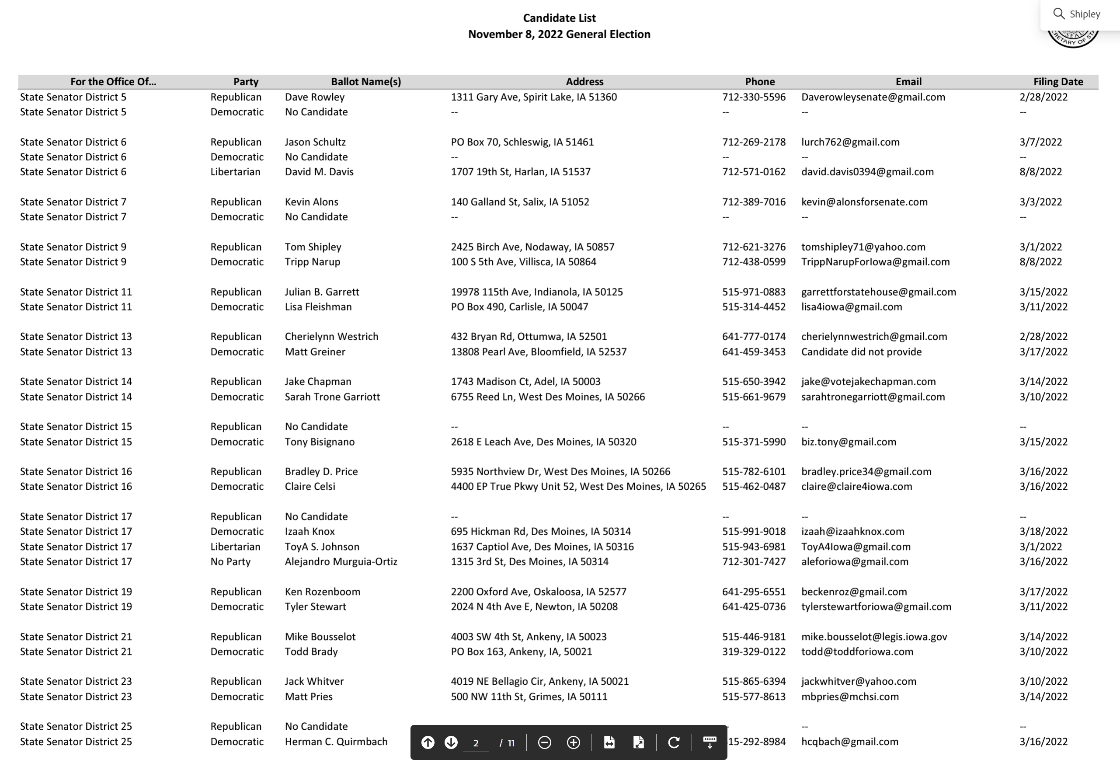
MB

Slide 38
Meet with candidates before Nov. 8
Get some questions to ask from your association contacts
Friendly conversations about their vision for education and your needs as a school district. Lobbying: “Gentle persuasion applied relentlessly”
Share resources and plan follow-up.
Encourage others to also reach out. Plan a follow-up.
MB

Slide 39
Interim Advocacy
Informal conversations with candidates
  I’m new. Can we sit down and talk about your view of education in the district. What’s your vision of the future for our ______ CSD school district? Where do you get information about how education proposals will impact your constituents? How should I contact you?
  You’re new. Here’s what I see in our schools. What are you hearing from voters? How can I help? Ditto from above.
Share Issue Briefs, Position Papers and other resources. E.g., Explanation of School Choice in Iowa, fiscal impact of Governor’s proposal, and per pupil funding May 2022
Talk about use of federal funds so far and future plans.
Ask for their support and commitment. Show up to support them if they confirm their support for your school district.
Work with others who could care: Business/Chamber of Commerce Leaders, parents, school staff, grandparents and retirees.
DD

Slide 40
Next Steps: Create a Coalition
Who could care?
Usual suspects: parents, teachers, board members, SIAC members.
Unusual suspects: Farm Bureau, Chamber of Commerce, Vendors, Taxpayer organization, city/county government, economic development, law enforcement (success examples include four-year-old preschool and the state penny)
Infiltrate and educate.
Find one or two persuasive voices from those groups
Be thinking about encouraging future school board candidates from these groups – the old two birds with one stone concept
MB

Slide 41
Is it worth it?
Joel Blackwell, the “Grassroots Guy”, says that so few people actually engage in the process, that those who do have disproportionate power.
If you can break through the social media noise and establish a good relationship, you can be one of those people.
MB

Slide 42
Ask Us for Help
Data from mapping tool to explain history
Talking points specific to your district
Edit letters to legislators or your local paper
Help you think about replies to email or questions from legislators
Prep for lobby days or local conversations
Quick resources to share with your board members to prepare them for advocacy moments.
Sample Press Release at the Annual Meeting – get the word out to your stakeholders and media about these issues of importance to your students and families.
MB

Slide 43
Strength in Numbers: Why join RSAI and recruit others to the effort?
Amplified advocacy
Value proposition
Shared experiences
Networking
Shared best practice
Share this recording with prospective members
DD

Slide 44

Learn More
Access Advocacy Handbook, Position Papers, List of Successes, Legislative Updates, Calls to Action and more, on RSAI’s Legislative Web page
https://www.rsaia.org/2022-legislative-session.html
MB

Slide 45
Thanks to our RSAI Corporate Sponsors
RSAI website at www.rsaia.org/corporate-sponsors.html
MB

Slide 46
THANK YOU FOR YOUR VOICE on behalf of Iowa students!
Margaret Buckton
RSAI Professional Advocate, margaret@iowaschoolfinance.com
1201 63rd Street, Des Moines, IA 50311 (515) 201-3755 cell
Dave Daughton,
RSAI Grassroots Advocate
dave.daughton@rsaia.org
(641) 344-5205 cell
Stay connected through the Interim and into the Legislative Session
Let us know what you need to beef up your advocacy efforts.
We’ll see you at the RSAI Annual Meeting on Oct. 25!!!
MB

Slide 47
Questions?

