Slide 1
Earning and Maintaining CDE® Certification: Facts, Myths, & More
®
South Dakota Presentation – 4/2/2019
National Certification Board for Diabetes Educators

Slide 2
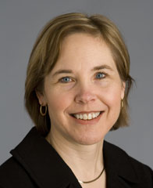
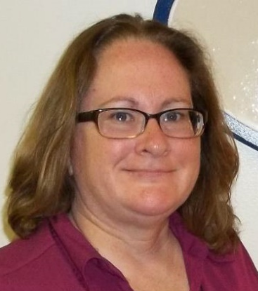
National Certification Board for Diabetes Educators
Sue McLaughlin, MOL, BS, RD, CDE®, past NCBDE Board chair (2015) and Board member (2012-2016) and current member of NCBDE’s Credentials Committee
Omaha, NE
Sheryl Traficano, MBA, CAE, NCBDE CEO
Arlington Heights, Illinois
Notes:
Welcome and introductions
For Sue – Introduction
Professional background
Background with NCBDE
Any other info you’d like to share
For Sheryl - introduction

Slide 3
Disclaimer
This presentation is being provided as an overview regarding the National Certification Board for Diabetes Educators (NCBDE) and the CDE® program.
It is important that you refer to the current Examination Handbook or the NCBDE web site for any clarifications on eligibility requirements or the examination application/administration process.
Presentation prepared 3/2019; updates to eligibility, application and administration processes may occur.

Slide 4
What We’ll Cover Today
NCBDE
Mission/What is NCBDE?
Becoming a CDE®
What is a CDE®?/Why become a CDE®?
Credentialing Concepts
Eligibility Requirements
Examination
Application
Preparation
Renewing the CDE ® Credential
Important Information
What’s New for Renewal?
Eligibility
Requirements
FAQs and Myths

Slide 5
NCBDE
NCBDE Mission
Promote comprehensive and ongoing quality diabetes clinical management, education, prevention & support by defining, developing, maintaining & protecting the certification and credentialing processes
®

Slide 6
NCBDE
What is NCBDE?
Not for profit certifying body – incorporated in 1986
First CDE® exam offered in 10/1986 with 1,248 health professionals becoming CDEs with initial launch
Autonomous specialty board overseen by a Board of Directors
Board made up of volunteer CDEs & public member
Committees & Task Forces – volunteer CDEs and Board’s public member
NOT a membership association or dues paying organization
Notes:
NCBDE is a national, nongovernmental, not-for-profit certification organization
Org has one job – administer certification program for diab educators
BOD: volunteer CDEs, volunteer public member, & CEO
w/ CDE members reflecting make up of various disciplines holding credential (e.g., RNs, 3 RDs, 1 Pharmacist, 1 physician, 1 “other”)
BOD sets direction, long term vision.
Committees
Examination Com – CDEs from different disciplines who:
– oversee exam development process – from development of items for examination to reviewing results of examination,
also oversee periodic practice analyses to ensure examination reflects current practice.
Credentials Committee – CDEs who
- oversee review of eligibility requirements, application review (exam and renewal) process
Outreach Committee – CDEs who
- oversee outreach and marketing efforts – of organization itself, to promote certification to other organizations/entities, people with diabetes, potential applicants
Advocacy TF – to help with legislative issues
Practice Analysis TF – CDEs – PA done every 5 years – verifies the content of the exam vs. what’s happening in the field

Slide 7
NCBDE
NCBDE Purpose
Conduct certification activities in a way that upholds standards for competent practice in diabetes self-management education and support (DSMES).
The Certified Diabetes Educator Program is accredited by the National Commission for Certifying Agencies (NCCA).
Notes:
NCBDE received NCCA accreditation of its CDE® program by submitting an application demonstrating the program’s compliance with the NCCA’s Standards for the Accreditation of Certification Programs.
NCCA is the accrediting body of the Institute for Credentialing Excellence.
Since 1977, the NCCA has been accrediting certifying programs based on the highest quality standards in professional certification to ensure the programs adhere to modern standards of practice in the certification industry.

Slide 8
Becoming a CDE®
What is a CDE®?
A health professional who….
Possesses comprehensive knowledge & experience in diabetes prevention, prediabetes, and diabetes management
Educates, supports, and advocates for people affected by diabetes, addressing the stages of diabetes throughout the lifespan
Promotes self-management to achieve individualized behavioral and treatment goals that reduce risks & optimize health outcomes
Notes:
A CDE serves as the patient’s mentor, confidant, cheerleader, and coach.
Valuable and respected members of the health care team
Make a difference in their patients’ lives and communities

Slide 9
Becoming a CDE®
Credentialing Concepts
Certification differs from entry level credentialing
Above and beyond mandatory, prescribed academic requirements (e.g., nursing license)
NOT intended to serve as entry to the specialty
“Mastery-level” practice-based certification requires accrual of professional practice experience
Notes:
Mastery-level” relates to the need to accrue practice experience in order to obtain or “master” the knowledge and application of the knowledge associated with the specialty.
Though there are some masters programs related to diabetes and diabetes education launched in recent years, there is no basic academic pathway for entry into the diabetes educator role. Therefore, the way to gain knowledge as a diabetes educator is to actually practice in that role/field. In the field, individuals obtain knowledge about diabetes and diabetes education, how to apply that knowledge in real-life situations, and learn to analyze a complex scenario to arrive at the best answer or approach.

Slide 10
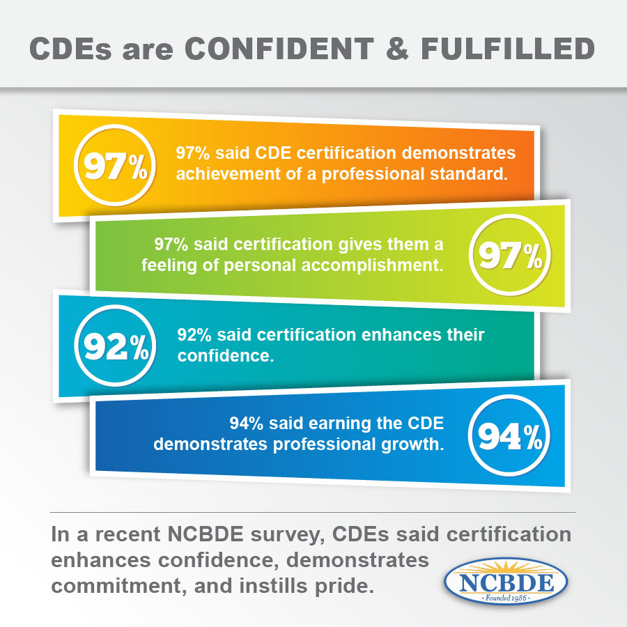
Becoming a CDE®
Why become a CDE®?
The CDE® credential is considered the “gold standard” - the embodiment of a true diabetes professional
2017

Slide 11
Becoming a CDE®
Benefits include:
Enhanced ability to contribute to the overall goal of improving outcomes
Demonstration to people with diabetes & prediabetes, colleagues & employers that you have comprehensive knowledge necessary to provide the high level of education and care needed
Recognition of knowledge & valued set of skills compared to other, non-certified practitioners, especially in a competitive market
Notes:
Under “Enhanced ability” – becoming CDE requires that you know obtain knowledge and grasp aspects outside of your discipline/license about the disease and how to help people manage it - helps individuals realize importance of other team members and what they contribute to successful outcomes.
Earning the CDE® credential can open up more professional opportunities – author, speaker, blogger, etc.

Slide 12
Becoming a CDE®
Eligibility: Discipline Requirement
License or registration as identified by NCBDE
Multidisciplinary certification:
RNs, RD/RDNs, RPhs, MDs, PAs, ACSM-CEP®, etc.
Myth: RNs must have a bachelors degree in nursing
Fact: Nurses ONLY need RN license
Handbook info:
http://www.ncbde.org/certification_info/examination-handbook/
Notes:
CDE credential one of very few multidisciplinary certifications – especially in the health care arena. Opens up lots of possibilities, as well as lots of confusion.
Myth - RN – was to go into place in 2000 – rescinded before ever put into place
Remind people @ handbook with all details

Slide 13
Becoming a CDE®
Just over 19,700 CDEs
(as of Jan 2019)
Notes:
Remainder of CDEs made up of health professionals in a variety of areas, including, but not limited to, MD/DO, PA, LP, Adv Deg Social Workers, Exercise Physiologists

Slide 14
Becoming a CDE®
Eligibility Requirements: Practice
Minimum 2 years of practice in your discipline
Myth: Two years of practice must be:
a) in diabetes or b) full time
Fact: Neither is true
Notes:
Practice req – 2 components – 2 years and 1000 hours
Both must be met after meeting discipline requirement and prior to applying for exam
2 years – e.g., if you are applying under the discipline requirements as a RD, 2 years experience working as a RD is needed.
DOES NOT have to be diabetes related, but certainly can be. It also does not have to be full-time – can be part-time. Can be volunteer vs. employment role.

Slide 15
Becoming a CDE®
Eligibility Requirements: Practice
Minimum 1000 hours of professional practice experience in diabetes education, with at least 400 hours obtained in most recent year
Maximum 4 years to accrue hours; all must be accrued in US/territories
Notes:
1000 hours
We’ll talk bit later about definition of diabetes education.
How do you track your hours?
No logs are required when you apply – individuals attest to the fact they meet ALL of the requirements when submitting an application.
However, a random audit process exists, so you’ll need to be able to provide proof of all requirements, including diabetes education practice hours if you are audited.
Therefore, before you apply – or even better – as soon as you begin to think about applying - talk with your supervisor to be sure you both are on the same page with your role and your diabetes education hours.
Come to an agreement with your supervisor on how you’ll track your hours. Note: NCBDE does not have a required format.
Be sure to follow through…
Full time estimate for one year: 50 weeks/year x 40 hours/week = 2000 hours.
Myth: Job must be full-time diabetes education
Fact: Four year window allows part-time diabetes education hours to count
Myth: Diabetes education hours don’t count unless doing a minimum of 4 hours per week
Fact: Not true since changed in 2010
Myth: Job title must be “Diabetes Educator” (DE)
Fact: Job title of DE is NOT required; applicant must have responsibilities that include direct provision of diabetes education

Slide 16
Becoming a CDE®
Eligibility Requirements: Practice
Mentorship Program available to accrue hours
Volunteer diabetes education hours also count outside of mentorship program (since 2014)
Notes:
Mentorship program – created to provide opportunities for obtaining volunteer diabetes education hours – not normally allowed under current requirements – mentored by CDE approved through the program.
Looking to expand the program in relation to news below about approval of volunteer diabetes education hours in general (below), e.g., remove restriction on the number of hours allowed, requirements for CDEs to serve as mentors may be changed to open up who can serve as a mentor, etc.
For volunteer hours –
Must be diabetes education, e.g., not just general diabetes presentation to an audience at a church
Must be verifiable – person must be available to verify your volunteer hours just like
No limit to number of volunteer hours allowed in meeting eligibility requirements.
Myth: Participation in the Mentorship Program REQUIRED prior to applying
Fact: Mentorship program is OPTIONAL
Over 100 new CDEs in last few years through the mentorship program.

Slide 17
Becoming a CDE®
Eligibility Requirements: Continuing Education (CE)
Minimum of 15 clock hours of continuing education activities applicable to diabetes within the 2 years prior to applying for certification
Notes:
Content-wise – any topic found on exam content outline (which we’ll talk about bit later) is considered applicable to diabetes – wide ranging list of possibilities
Myth: CE program title MUST include the word “diabetes”
Fact: Title or brief description of program must verify that topic is applicable to diabetes.

Slide 18
Becoming a CDE®
Eligibility Requirements: Continuing Education (CE)
What organizations are recognized?
Check the website for listing of recognized providers
Notes:
Be sure to check accreditation information on program/activity web site or brochure so you know the activity has been approved for c.e. hours by one of NCBDE’s recognized providers.

Slide 19
Becoming a CDE®
Eligibility Requirements: Diabetes Education Practice Hours – What Counts?
Any component of performing diabetes education can count
Myth: Every step of the diabetes education process must be completed with each person for the hours to qualify
Fact: Any component of performing diabetes education can count with any person
Notes:
Visit web site with the details (use link)
Myth – FACT: Including follow-up calls, documentation time; also program administration time, etc
Myth: Diabetes education must take place as part of an accredited or recognized diabetes education program to count
Fact: NOT TRUE!
Myth: Hours count only if provided in 1-on-1 session
Fact: Group classes and 1-on-1 sessions count – just not 6 people x 1 hour = 6 hours. If you do individual follow-up after the class with each one – that time counts, the time to document the session and follow up time counts, etc.

Slide 20
Becoming a CDE®
Eligibility Requirements: Diabetes Education Practice Hours – What Does Not Count?
Demonstration of a skill that does not include some or all of the components of the diabetes education process
Supervising and managing other professionals
Providing medical assessment, diagnosis, or treatment
Conducting or participating in research activities which do not include provision of diabetes education
Notes:
The following are a few examples of such activities. But refer to the web site or current Exam handbook for more details.
Expand on these bullets
Rest for reference:
dispensing/prescribing medications, unless part of the diabetes education process
promoting or selling medications or diabetes supplies and products

Slide 21
Becoming a CDE®
Eligibility Requirements
Are you a health professional with an advanced degree in a health related concentration who does not have a license or registration currently listed under NCBDE’s standard discipline listing?
Notes:
Launched in 2014 – Unique Qualifications Pathway
Advanced degree in health related concentration or major or verified equivalency if degree obtained outside the U.S.
2,000 hours of diabetes education experience, with 400 hours in last year, max 4 year window
30 hours of acceptable continuing education hours, with 2 years prior to applying
Two recommendations re: experience – at least 1 from a CDE®
Pre-approval process
Pre-approval process – application handled by national office & various committees. Those approved are able to sit for the exam within approx. 6 month time frame

Slide 22
Becoming a CDE®
Examination - Application
PSI/AMP (AMP) administers the examination process for NCBDE, including application submission.
How to contact AMP:
www.goamp.com • info-AMP@goAMP.com
Voice: 913-895-4600 • Fax: 913-895-4651
Notes:
2019 fee - $350 initial/expired; $250 renewal
Started in 2016 – NEW – before the year-round option, 2 two month testing windows, spring/fall, with need to apply a number of months before testing window.
NOW – year-round availability for applying/testing
APPLY – online/paper
APPROVAL – w/ online app (restrictions apply, see handbook) – “instantaneous”; paper app – longer time frame
AUDIT – random process
CAVEAT – do need to take the test no later than 90 days from date of approval; DON’T wait until very end of your 90 days to schedule – 1st come 1st served for seats and limit to the number of seats per day, etc

Slide 23
Becoming a CDE®
Examination – Details
Computer-based test offered at over 190 different test centers
Exams through 6/2019 based on examination content outline (ECO) developed from 2013 practice analysis surveying CDEs about tasks they perform (Note: 2018 analysis completed in July 2019 testing – see exam handbook for full details)
Each question is linked directly to a task or tasks on ECO

Slide 24
Becoming a CDE®
Examination - Details
200 multiple-choice, objective questions, including 25 pre-test (unscored) questions
4 hour time frame
Normally, score reports provided upon completion of examination.

Slide 25
Becoming a CDE®
Examination - Preparation
Review Exam Content Outline (ECO)
Responsible for knowledge over all of ECO
Consider your typical patient profile– be sure to study aspects of the ECO outside of that profile
Notes:
Bullet 1 – found in handbook/NCBDE web site
- Look at the ECO in terms of questions that may not be a part of your day to day experience - do you mainly work with adults w T2? Look over ECO when thinking about other populations, e.g., children w T1 or women w gestational diabetes
– also think about areas of weakness related to your background/training - e.g., perhaps medications if you are a dietitian or wound care if you are a pharmacist, etc.

Slide 26
Becoming a CDE®
Examination - Preparation
Review Handbook information on studying for the exam and references
Check around for other resources e.g., continuing education activities, review courses and materials
Consider forming a study group

Slide 27
Becoming a CDE®
Examination - Preparation
Still nervous about exam day?
Consider making use of the Practice Examination.
Notes:
Bullet 4
Developed by NCBDE and available through PSI. PE is taken via the internet – provides “feel” for actual exam experience; 50 questions - $55 fee.

Slide 28
Becoming a CDE®
You’ve passed! Now what?
Congratulations! Take some time to savor your accomplishment!
Let others know – you’ll receive information to create a news release – do it!
Update your linkedin and other professional social media accounts.

Slide 29
Becoming a CDE®
You’ve passed! Now what?
Though your certification is valid for five years, be sure to check out the requirements to maintain your certification.
Know your accrual date for renewal practice requirement (and for completing c.e. activities if you’ll renew that way).
Add “@ncbde.org” to your safe senders/friends list.
Read NCBDE communications that come your way.
Notes:
Accrual information is normally provided in your certificate packet, so be sure to read that information.
Check out the NCBDE web site information renewal requirement information
Contact the NCBDE office if you’re not sure of the steps needed
NCBDE values your time and works hard not to overwhelm you with communications, but they do send out news as needed – be sure to open and read those messages.

Slide 30
Renewing the CDE® Credential
Important Info
What’s new for renewal?
Eligibility
Requirements
FAQs and Myths

Slide 31
Renewing the CDE® Credential
Important Info About Renewal
1. Know your expiration date and accrual dates
2. Review the renewal practice requirement
3. Be sure NCBDE has your current contact info
Notes:
– with a time frame of every 5 years and with all the licenses and other credentials you might hold, can get lost
- But do need to be aware of the date - where is that date?
On your certificate and wallet card
Log in to the NCBDE CDE portal
Call or email the NCBDE national office
- Like other situations, you must renew prior to your expiration date to keep the credential continuous
- Want to be aware of the accrual dates for your own renewal process and deadlines for the different renewal options
2. Why?
- Courtesy reminders are sent via mail and email beginning the fall before you renew (e.g., expiration date is 12/2018, the first official reminder was sent by mail in October 2017 with all the pertinent details, with email and postcard reminder in Spring 2018)
- With above, be aware that it’s important to read email messages and correspondence from NCBDE
2. How update?
- Use record update form available in annual newsletter or 24/7 via web site
- call or email the office
- be sure to contact NCBDE directly with your change
3. Why?
- Need to know if you will meet it before being able i.e. renewal options

Slide 32
Renewing the CDE® Credential
What’s New for Renewal of Certification?
Reminder– Retired status available – for those no longer practicing in diabetes education (volunteer or employment) – small one time fee, recognition on NCBDE web site
Practice Requirement – no changes
Notes:
Retired status – for those truly retired, CDE for at least 10 years, recognition via certificate and web site page.
We will review Practice requirement and how to document it in a future slide.
.

Slide 33
Renewing the CDE® Credential
What’s New for Renewal of Certification? (continued)
Exam Option – year-round testing in approximately 190 exam sites
Continuing Education Option – Expanded CE Activities
Additional deadline – “Grace period” – available from December 16 – March 31
Notes:
Exam Option: Examination – now can be done year-round (no more application windows). Register online and test at your convenience.
Continuing Education Activities (we’ll talk later on the updates)
Grace period – accrual period for practice/CE still stays at Dec 15, but can apply (via special app) between Dec 16-March 31 for grace period CE – additional fee, only via paper, see HB for full details
.

Slide 34
Renewing the CDE® Credential
Renewal: Eligibility Requirements
Maintain original license/registration held at the time of your initial certification
Accrue minimum of 1,000 hours of professional practice experience during five-year certification cycle
Document 75 hours of continuing education activities or pass exam.
Apply and pay application fee for renewal method chosen
Notes:
License/reg – must be current, active unrestricted while holding credential
Review practice requirement and how they document. Talk on renewal professional practice expanded vs. initial certification.
75 hours of continuing education – can mix and match with the Formal and Expanded categories…we’ll get into that later
Be sure you earn your hours prior to applying

Slide 35
Renewing the CDE® Credential
Renewal: Eligibility Requirements Professional Practice
What it is?
Providing direct/indirect professional contribution to the care and self-management education of people with diabetes
What it is not?
Employment in manufacture, direct sales or distribution of diabetes-related products or services
Notes:
What it is:
Also includes prediabetes and diabetes prevention
Meant to be as inclusive as possible
Includes volunteer activities, clinical roles in diabetes industry, etc.
Not:
Plus jobs/volunteer activities unrelated to diabetes

Slide 36
Renewing the CDE® Credential
Renewal: Continuing Education Option - Expectations
Health professionals specializing in diabetes education will demonstrate through renewal of certification: knowledge and skills are up-to-date, ability to practice proficiently, safely, and in a manner consistent with current National Standards of Diabetes Self-Management Education and Support (NSDSMES).
All CDEs who select renew by continuing education will engage in a personal assessment to identify professional needs and participate in appropriate activities that are inclusive of the Examination Content Outline in the current Handbook.

Slide 37
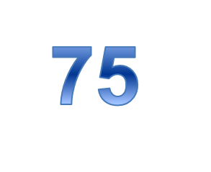
Renewing the CDE® Credential
75
75
Renewal: Continuing Education Option
Minimum total of 75 clock hours of continuing education in content areas applicable to diabetes within your accrual cycle. You can earn hours through both the Formal and Expanded Continuing Education Activities.
Formal CE:
Activities need to be related to Diabetes
At professional level that enhances the quality and effectiveness of diabetes education practice
Does NOT have to be discipline-specific, nor does it have to be in any specific area of concentration.
Notes:
NEW – started with CDEs renewing last year
The addition of Expanded activities for CE hours. One does NOT need to earn through the Expanded, but the expanded give our CDEs with additional options of which to earn CE hours. (more to come later).
FORMAL ACTIVITIES:
At professional level that enhances the quality and effectiveness of diabetes education practice. Professional level: E.g., Basic Life Support (BLS) course for health care providers would not be considered an acceptable activity. Does not enhance the quality of DSME practice
Does NOT have to be discipline-specific, nor does it have to be in any specific area of concentration. Not specific: E.g., RD, CDE may attend a diabetes-related activity about wound management approved for nursing CE hours. Often areas of weakness, knowledge-wise, are outside normal discipline – encouraged to “cross-train” or find CE to help bolster areas of weakness.

Slide 38
Renewing the CDE® Credential
Renewal: Continuing Education Option – Formal Activities
Formal Continuing Education Activities (Traditional CEs)
Need to be approved by a provider on the NCBDE List of Recognized Providers
A minimum of 45 of the 75 hours must be earned from this Formal Activities categories (remaining 30 under the Expanded Activities).
Not required to earn hours under the Expanded.
Note that if you are NOT using hours from the Expanded Activities, you will need to earn all the hours under the Formal Activities.
Notes:
Formal Continuing Education Activities – the ‘traditional way to earn’.
Must be approved by a provider on our list. And keep copies (either electronic or paper) of your supporting documentation for these activities.
You still can earn all 75 hours from the Formal activities.

Slide 39
Renewing the CDE® Credential
Renewal: Continuing Education Option – Expanded Activities
Expanded Activities
Includes taking academic courses, giving presentations, writing publications, and Service as Mentor in NCBDE mentorship program
Maximum of 30 hours can be used from the Expanded. See Table B in the renewal handbook for individual limits for each Expanded Category.
Using Expanded CE hours is not required to renew.
If you will not be using hours from the Expanded Activities, then all your CE will need to be earned from the Formal Activities.
Expanded activities need to be related to diabetes
Notes:
Expanded activities are NOT required. Again, the expanded provides additional opportunities for CDEs to earn CE hours.
The expanded include— and, of course, need to be related to diabetes
Academic courses
Giving presentations
Writing publications (not to be confused with just READING) publications
Service as a mentor in the NCBDE mentorship program
NOTE; There are Category limits on the Expanded – you can use only a maximum of 30 hours from Expanded. Also note that there are also limits on the individual expanded categories. If you are going to consider Expanded Activities, be sure to review the limitations.
(link on next slide)

Slide 40
Renewing the CDE® Credential
Renewal: Continuing Education Option - Guidelines
For additional details on the Formal and Expanded Activities Categories, please refer to Tables A and B in the:
Renewal by Continuing Education Update for CDEs Renewing in 2017 and Later: Guidelines for Reporting Continuing Education Activities or the current Renewal Handbook.
Download available on the NCBDE web site at:
https://www.ncbde.org/assets/1/7/RenewalGuidelinesExpDoc_final.pdf

Slide 41
Renewing the CDE® Credential
FAQs & Myths
How do I track renewal experience?
Myth – Working in industry is not acceptable.
Myth – Must accrue 200 hours/yr.
Myth – I have to be working full time as a diabetes educator to renew.
Myth – I have to be directly providing DSMES to people living with diabetes for experience to count for renewal.
Myth – The word “diabetes” must be in the ce activity’s title to count.
Notes:
How track – You will be asked to sign a statement that attests to meeting all of the current eligibility requirements, including the 1000 hour practice requirement. If an application is chosen for audit, you will need to have a supervisor (or for those in private practice, another health professional) sign a similar statement that confirms you have fulfilled the practice requirement. Of course, if you are renewing by the continuing education pathway, you will need to maintain copies of your continuing education credits/certificates in the event they need to be submitted as part of an audit.
Myth – working in industry - not acceptable – NOT True. Clinical roles in industry related to diabetes ARE acceptable
Myth – 200 hrs/yr – NOT True - 1,000 hours ANY TIME over the cycle is acceptable
Myth - full- time – 1,000 hours over 5 year cycle – means do not have to be working full-time; also volunteer experience counts
Myth – people vs. health professionals – INITIAL ONLY is with PWD
Myth – title – Refer to ECO above w/ a caveat - reviewers need to be able to identify content from title, e.g., “Annual Conference” – rather than “Annual Diabetes Conference of SE States” or “In It To Win It” vs. “In It To Win It – How to Help People Lower their Blood Pressure”.

Slide 42
Questions?
If you have questions, contact NCBDE:
www.ncbde.org • info@ncbde.org
Voice: 877-239-3233 (toll free) or 847-228-9795
Fax: 847-228-8469
National office:
330 E. Algonquin Rd, Suite 4
Arlington Heights, IL 60005
Facebook page: CertifiedDiabetesEducators

Slide 43
Why I became a CDE®…
Of all of my credentials, may I say I am most proud of the CDE®. The experiences necessary to earn and maintain it are rigorous. They require a repertoire of fresh knowledge to educate each patient based upon their unique abilities.
It is a disease that is more manageable currently than ever before, largely because Certified Diabetes Educators care deeply to impart accurate information to patients.”
~ HG, MS, RD, CDE®, LDN, Seekonk, MA

Slide 44
Why I became a CDE®…
“As an addition to my RD credential the CDE® has provided me invaluable status and credibility with physicians and peers, as well as advanced salary increases and secured career opportunities. The CDE ® is well worth the time and money.”
~ MO, RD, LD, CDE ®, Fairbanks, AK

Slide 45
Why I became a CDE®…
“I am making a small, but important, difference in my community... The look of understanding and relief on their faces is priceless when they realize that they can manage their disease with knowledge and support.”

Slide 46
Why I became a CDE®…
“The CDE® enables me to demonstrate to patients, colleagues & employers that I have comprehensive knowledge necessary to provide the high level of education and care needed.”

Slide 47
Why I became a CDE ®…
“The CDE® enables me to stand out from other non-certified practitioners, especially in a competitive market.”

