Slide 1

DCF LLC Funding Process
NADCO 2014 Annual Meeting
May 1, 2014
Colorado Springs, CO

Slide 2
SBA 504 Capital Markets Team
Fiscal Agent — DCF LLC. Manage the funding process to obtain the best available debenture rate for borrowers.
Frank Keane – Fiscal Agent, DCF LLC.
Underwriters — BAML and Credit Suisse. Market, pool debentures, sell and trade DCPC, take capital risk, provide product research.
Leland Bunch III – Managing Director, Bank of America Merrill Lynch – SBA 504 underwriter.
Karen Cady – Director, Credit Suisse – SBA 504 underwriter
Issuing Agent and Trustee — The Bank of New York Mellon. Hold debentures issued by CDCs, issue DCPCs as SBA's agent, distribute P&I to DCPC holders, report outstanding pool statistics.
Glenn McKeever – Vice President, Bank of New York Mellon – SBA 504 trustee.
Central Servicing Agent — Wells Fargo Corporate Trust Services. Process loans, report new pool statistics to DCF LLC, collect loan payments, pay out proceeds..
Brian Gagnon – Program Group Leader, Wells Fargo CSA Team
Rupinder Suri– Servicing Manager, Wells Fargo CSA Team
Legal Counsel — Bingham McCutchen LLP. Program and transaction legal advisors to Underwriters.
Jeff Johnson – Partner, Bingham McCutchen LLP - SBA 504 program bond counsel.
2014 DCFLLC No distribution without permission

Slide 3
From Borrowers to Investors: The Process
Small
Business
Loans
Small
Business
CDCs/CSA
Loans
Debentures Issued
DCF LLC
Debentures and Guarantee Agreement provided by SBA sold under Debenture Purchase, Pooling and Exchange Agreement
Underwriters
Debentures and Guarantee Agreement transferred to Trustee under Trust Agreement
BNYM
Participation Certificates (DCPCs) issued under Trust Agreement
BAML/CS
DCPCs
Investors
2014 DCFLLC No distribution without permission

Slide 4
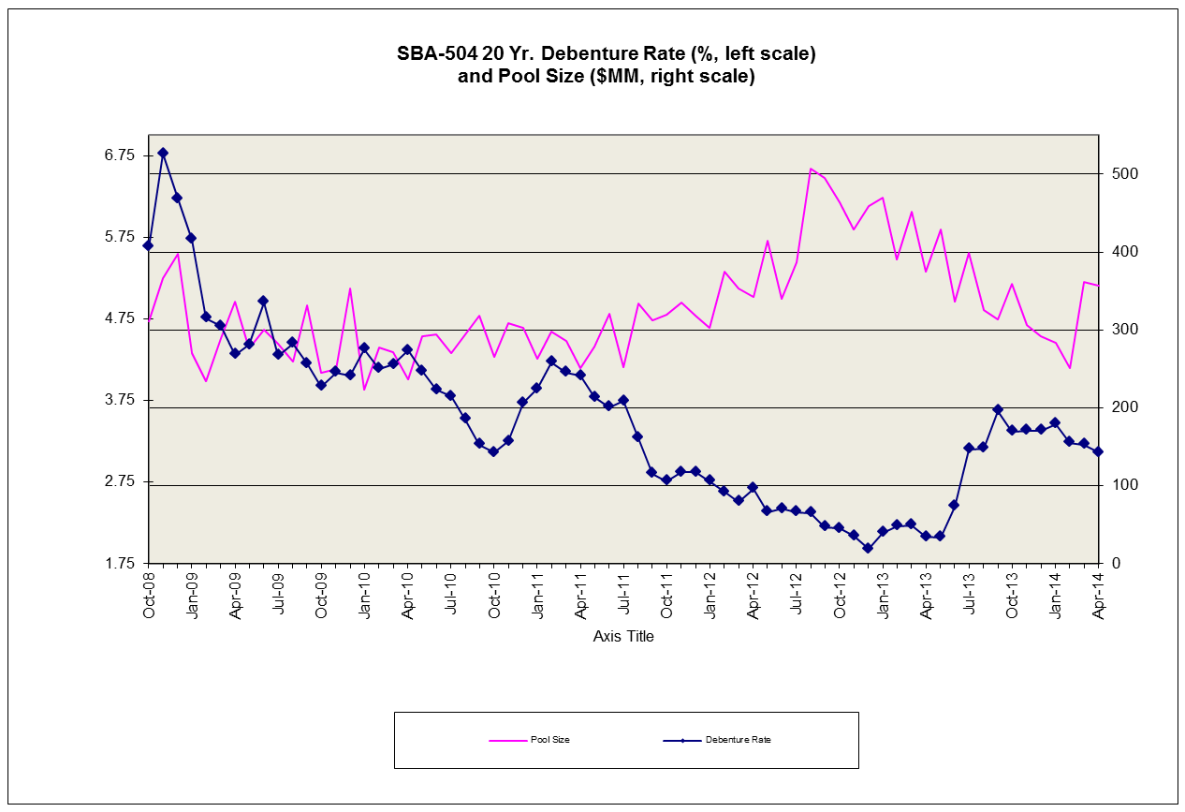

Slide 5
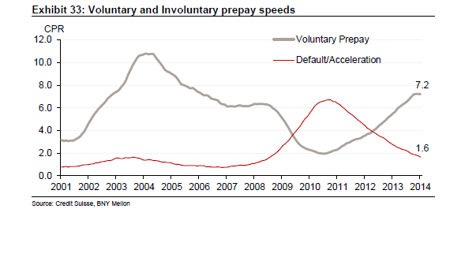

Slide 6
SBAP Funding Process
with Deadlines for April 2014 Sale
February 28 – March 13 – CDC submission of forms to Sacramento for No Adverse Change.
February 28 – March 13 – Upon approval of No Adverse Change by Sacramento request file be placed in legal folder for District Counsel review.
Thursday , March 27 –Cut -Off Date - Upon District Counsel approval, send documents to Wells Fargo for review and resolution of Loan Package errors.
Monday, March 31 – Wells Fargo sent CDC Confirmation Emails to CDCs.
Friday, April 4 – Wells provides Fiscal Agent with preliminary numbers for the sale, identifying the number of loans and total size.
Monday, April 7 – Pulled Loan Deadline. CSA and CDC’s have resolved all loan documentation issues.
Tuesday, April 8 – official Announcement Date for the sale.
2014 DCFLLC No distribution without permission
Notes:
6
2012 DCFLLC – No distribution without permission

Slide 7
Problem Loans
Problem Loans
Total Funded Loans
On average, 119 loans each month are submitted with missing/incorrect information
23%
(119)
77%
(399)

Slide 8
Inquiry Tracking
Received more than 1,500 calls from borrowers – 250 more than from CDCs – which stretches staff resources

Slide 9
Role of Underwriters
Total SBA 504/CDC issuance: $60.6 billion, with $27.6 billion outstanding.
When the underwriters launch each SBA deal, that announcement is sent to each banks’ mortgage, agency, corporate and interest rate products sales teams across their network of global offices in US, Europe and Asia.
Goal is to get as many customers interested at the "talk" level, and depending upon investor demand, attempt to tighten spread so that borrowers get the best possible interest rate available. The objective of every sale is to be strongly over-subscribed, balancing the interests of borrowers and investors.
Research teams publish market primers to educate and broaden the investor base. Monthly default and prepayment statistics are provided to investors for security analysis.
2014 DCFLLC No distribution without permission

Slide 10
Role of Underwriters
Underwriters: marketing, sale, pricing, hedging and swaps.
New issues: 27 investors across 16 states purchased the new SBAP transactions year-to-date 2014 from BAML and Credit Suisse.
Secondary market trades: BAML and CS traded $1.8 billion DCPC bonds in 2013 and $900 million in 2014 ytd.
2014 DCFLLC No distribution without permission

Slide 11
SBAP Funding Process with Deadlines
For April 2014 Sale
By the Announcement Date Bingham has prepared and circulated an updated draft of the Offering Circular, requested CUSIP, and drafted the transaction documents to be executed by Underwriters, SBA and Fiscal Agent.
Prior to Pricing Date, Bingham receives signature pages from Underwriters and SBA, sign-off for tax and ERISA disclosure in the Offering Circular, E&Y’s sign off on Offering Circular and confirmation of deal size from Wells Fargo. Fiscal Agent and Funding Committee have conference call Wednesday April 9 to discuss terms of the sale.
Wednesday, April 9 - Fiscal Agent and Funding Advisory Committee discuss status of sale. Wells Fargo delivers sale file to the Trustee.
2014 DCFLLC No distribution without permission

Slide 12
SBAP Funding Process w/Deadlines
For April 2014 Sale
Thursday, April 10 – Pricing Date. 2014-20D DCPCs are priced on a 10:30 conference call with the Underwriters, who execute sales and swap transactions with investors. Fiscal Agent calls and e-mails U.S. Treasury and SBA for approval of the rate, e-mails rate to Bingham for completion of the Offering Circular and posting with FINRA, also e-mails rate to Ernst & Young to complete calculation of WAL’s. Fiscal Agent then sends e-mail with terms of the sale to the Trustee, the CSA, and Funding Advisory Committee, completes the Offering Circular markups and has telephone read through with Bingham. Bingham sends Fiscal Agent, SBA Secondary Markets Director and SBA in-house legal counsel the completed transaction documents to be executed and returned to them for the closing table. Offering Circular when completed is released to Underwriters to be used to market the transaction.
Thursday, April 10 – The Trustee delivers sale file back to Wells Fargo updated to include Debenture prepayment premium and amortization schedules.
2014 DCFLLC No distribution without permission

Slide 13
SBAP Funding Process w/Deadlines
For April 2014 Sale
Friday, April 11 – Wells Fargo generates and loads amortization schedules and provides NADCO with Effective Rates. Wells Fargo delivers physical Debentures to the Trustee.
Tuesday, April 15 - Pre-Closing Date. Bingham sends executed copies of transaction documents and opinions to the Trustee and confirms with Lead Underwriter and SBA closing table is complete. Bingham contacts Wells Fargo and Lead Underwriter to confirm wire amount and time of transmission of the wire.
2014 DCFLLC No distribution without permission

Slide 14
SBAP Funding Process with Deadlines for
April 2014 Sale
Wednesday, April 16 – Funding Date. Bingham conducts a conference call with Fiscal Agent, Lead Underwriter, the Trustee, the CSA, and a Funding Advisory Committee representative to confirm proceeds of the sale. Lead Underwriter with the Trustee calls DTC to close the deal and release the DCPC /certificates (which are in electronic book-entry form) to the Underwriter’s account. Immediately after the closing the Underwriters distribute DCPC/certificates to the investors. Wells Fargo verifies and releases net debenture proceeds to interim lenders.
Trustee delivers reports to Wells Fargo detailing amounts due for May 1st payment to investors for related previous issuances.
2014 DCFLLC No distribution without permission

Slide 15
SBAP Funding Process with Deadlines for
April 2014 Sale
April 21-30 – Trustee mails copies of Debentures with amortization and prepayment premium schedules to CDCs.
Wednesday, April 30 – Wells Fargo sends funds via wire transfer to Trustee for payment of semi-annual principal and interest to investors of related previous issuances.
Thursday, May 1 – Trustee releases funds for above to investors through DTC. Trustee releases monthly reports (pool status etc.) to Fiscal Agent and investors.
Post-Closing- Within 30 days of funding, Bingham prepares a CD with all closing documents for the working parties.
2014 DCFLLC No distribution without permission

Slide 16
SBA 504 Coupons
Source: NADCO, Credit Suisse
2014 DCFLLC No distribution without permission

Slide 17
504 refinancing program boosted SBA deal sizes
Debt refi program expired in September 2012.
504 deal sizes became smaller as the remaining loans in the pipeline have since been processed.
Source: NADCO, Credit Suisse
2014 DCFLLC No distribution without permission

Slide 18
SBA 504 Investors by Type
Source: Credit Suisse, BofAML
Based on 2013 and ytd 2014 SBAP deals
2014 DCFLLC No distribution without permission

Slide 19
SBA 504 Investors by Geography
Source: Credit Suisse, BofAML
Based on 2013 and ytd 2014 SBAP deals
2014 DCFLLC No distribution without permission

Slide 20
CRE lending is rebounding
Total originations in 2013 was $358 billion, exceeding 2005 volume.
Source: MBA, Credit Suisse
2014 DCFLLC No distribution without permission

Slide 21
Wall of maturity for small balance CMBS loans
Over four thousand small balance CMBS loans are scheduled to mature between 2015 – 2017.
Opportunity for SBA lenders to meet the financing gap.
Many small balance loans that have yet to mature have high coupons relative to current market rates, representing additional opportunities for SBA lenders.
Source: Credit Suisse, BofAML, Trepp
2014 DCFLLC No distribution without permission

Slide 22
CMBS lenders focus less on small loans
  Many pre-crisis small balance lenders no longer exist or are not participating in the market (e.g. Washington Mutual, LaSalle, etc.).
Only 6% of loans in new CMBS deals are small balance loans ($2.5 million or less).
Prior to the recession, small balance loans represented 20% of the conduit CMBS loans.
Source: Credit Suisse, BofAML, Trepp
2014 DCFLLC No distribution without permission

Slide 23
10-year Treasury Rate
10yr UST rates are likely to go up, not down, given the QE3 is ending.
With rates expected to rise, the incentives for refi one’s own portfolio is not that compelling.
Source: Credit Suisse, BofAML, Bloomberg
2014 DCFLLC No distribution without permission

Slide 24
Disclaimer
The information herein has been obtained from sources that we believe to be reliable, but we do not guarantee its accuracy or completeness.
Development Company Finance LLC 2014
.
All rights reserved.

