Slide 1
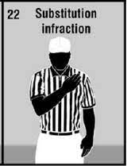
Illegal substitution (Rule 3-7)
Reading (PA) Chapter Football Officials
10/27/21
Notes:
‹#›

Slide 2
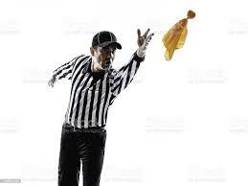
True or False?
An illegal substitution foul is always a dead-ball foul.
Notes:
‹#›

Slide 3
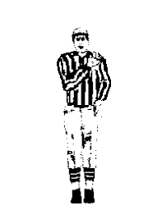
False
Illegal substitution can be a live-ball or dead-ball foul.
Notes:
‹#›

Slide 4
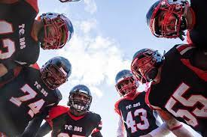
True or False?
In NFHS, it is a foul if a team breaks the huddle with 12 players.
Notes:
‹#›

Slide 5
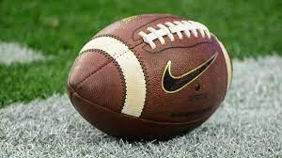
False
Replaced players shall begin to leave the field within 3 seconds (3-7-1).
There is no rule against breaking the huddle with 12 or more players.
Notes:
‹#›

Slide 6
What is a player? 2-32-1
A player is 1 of the 22 team members who is designated to start either half of the game or who subsequently replaces another player.
A player continues to be a player until a substitute otherwise becomes a player.
Notes:
‹#›

Slide 7
What is a substitute ? 2-32-15
A substitute is a team member who may replace a player or fill a player vacancy.
A substitute becomes a player when he enters the field and communicates with a teammate or game official, enters the huddle, is positioned in a formation or participates in the play.
Notes:
‹#›

Slide 8
Live-ball or dead-ball illegal sub?
A replaced player does not begin to leave the field within 3 seconds of becoming a replaced player.
Notes:
‹#›

Slide 9
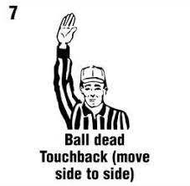
Dead-ball (3-7-1 Pen.)
Notes:
‹#›

Slide 10
Live-ball or dead-ball illegal sub?
A replaced player or sub unsuccessfully attempts to leave the field, but does not participate in or affect the play.
Notes:
‹#›

Slide 11
Live-ball (3-7-4 Pen.)
Notes:
‹#›

Slide 12
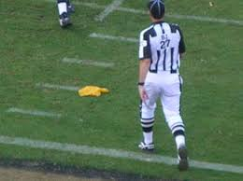
Live-ball or dead-ball illegal sub?
A sub enters the field, but does not participate.
Notes:
‹#›

Slide 13
Live-ball (3-7-4 Pen.)
Notes:
‹#›

Slide 14
Live-ball or dead-ball illegal sub?
A departing player leaves the field on the opponent’s sideline or the end line.
Notes:
‹#›

Slide 15
Dead-ball
(3-7-1 Pen. & 3.7 Comment 5)
Notes:
‹#›

Slide 16
Case book 3.7 Comment 5
When a replaced player or substitute leaves on the wrong side of the field or goes across the end line prior to the snap, it is a dead-ball foul for illegal substitution.
Notes:
‹#›

Slide 17
True or False?
Team B has 10 players on the field at the start of the snap. During the play, team B’s 11th player runs onto the field on his team’s side of the LOS.
This is an illegal substitution.
Notes:
‹#›

Slide 18
True
Live-ball illegal substitution foul (3-7-6 Pen).
From where is this foul enforced?
Notes:
‹#›

Slide 19
From where is this foul enforced?
Hint: This is a non-player foul.
5 yards from the succeeding spot
Rule 10-4-5c: The basic spot is the succeeding spot: c. for a nonplayer foul.
Notes:
‹#›

Slide 20
Why is this a non-player foul?
Rule 3-7-1: Between downs any number of eligible substitutes may replace players.
Rule 3-7-4 Note: Participation by a replaced player or substitute is illegal participation as in 9-6.
Notes:
‹#›

Slide 21
What is participation? 2-30
Participation is any act or action by a player or non-player that has an influence on play.
Notes:
‹#›

Slide 22
Thanks for your attention.
Notes:
‹#›

