Slide 1
Sample IIPS Presentation
Sample Slide 1

Slide 2
Sample Slide 2
Can you see this from the back of the room
Can you hear me
Are my slides too crowded
Are my points clear
Does this make any sense
Have I lost my mind

Slide 3
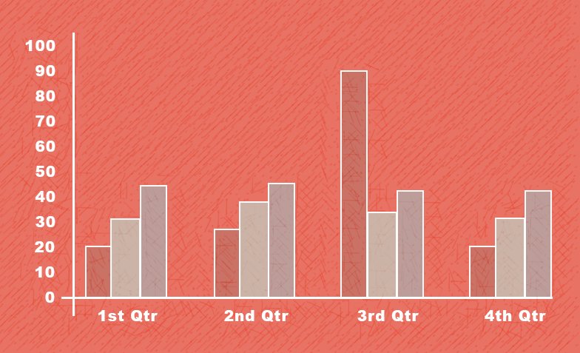
Sample Slide 3

