Slide 1
EM Program Success
Savannah River Site
Defense Waste Processing Facility (DWPF)

Slide 2
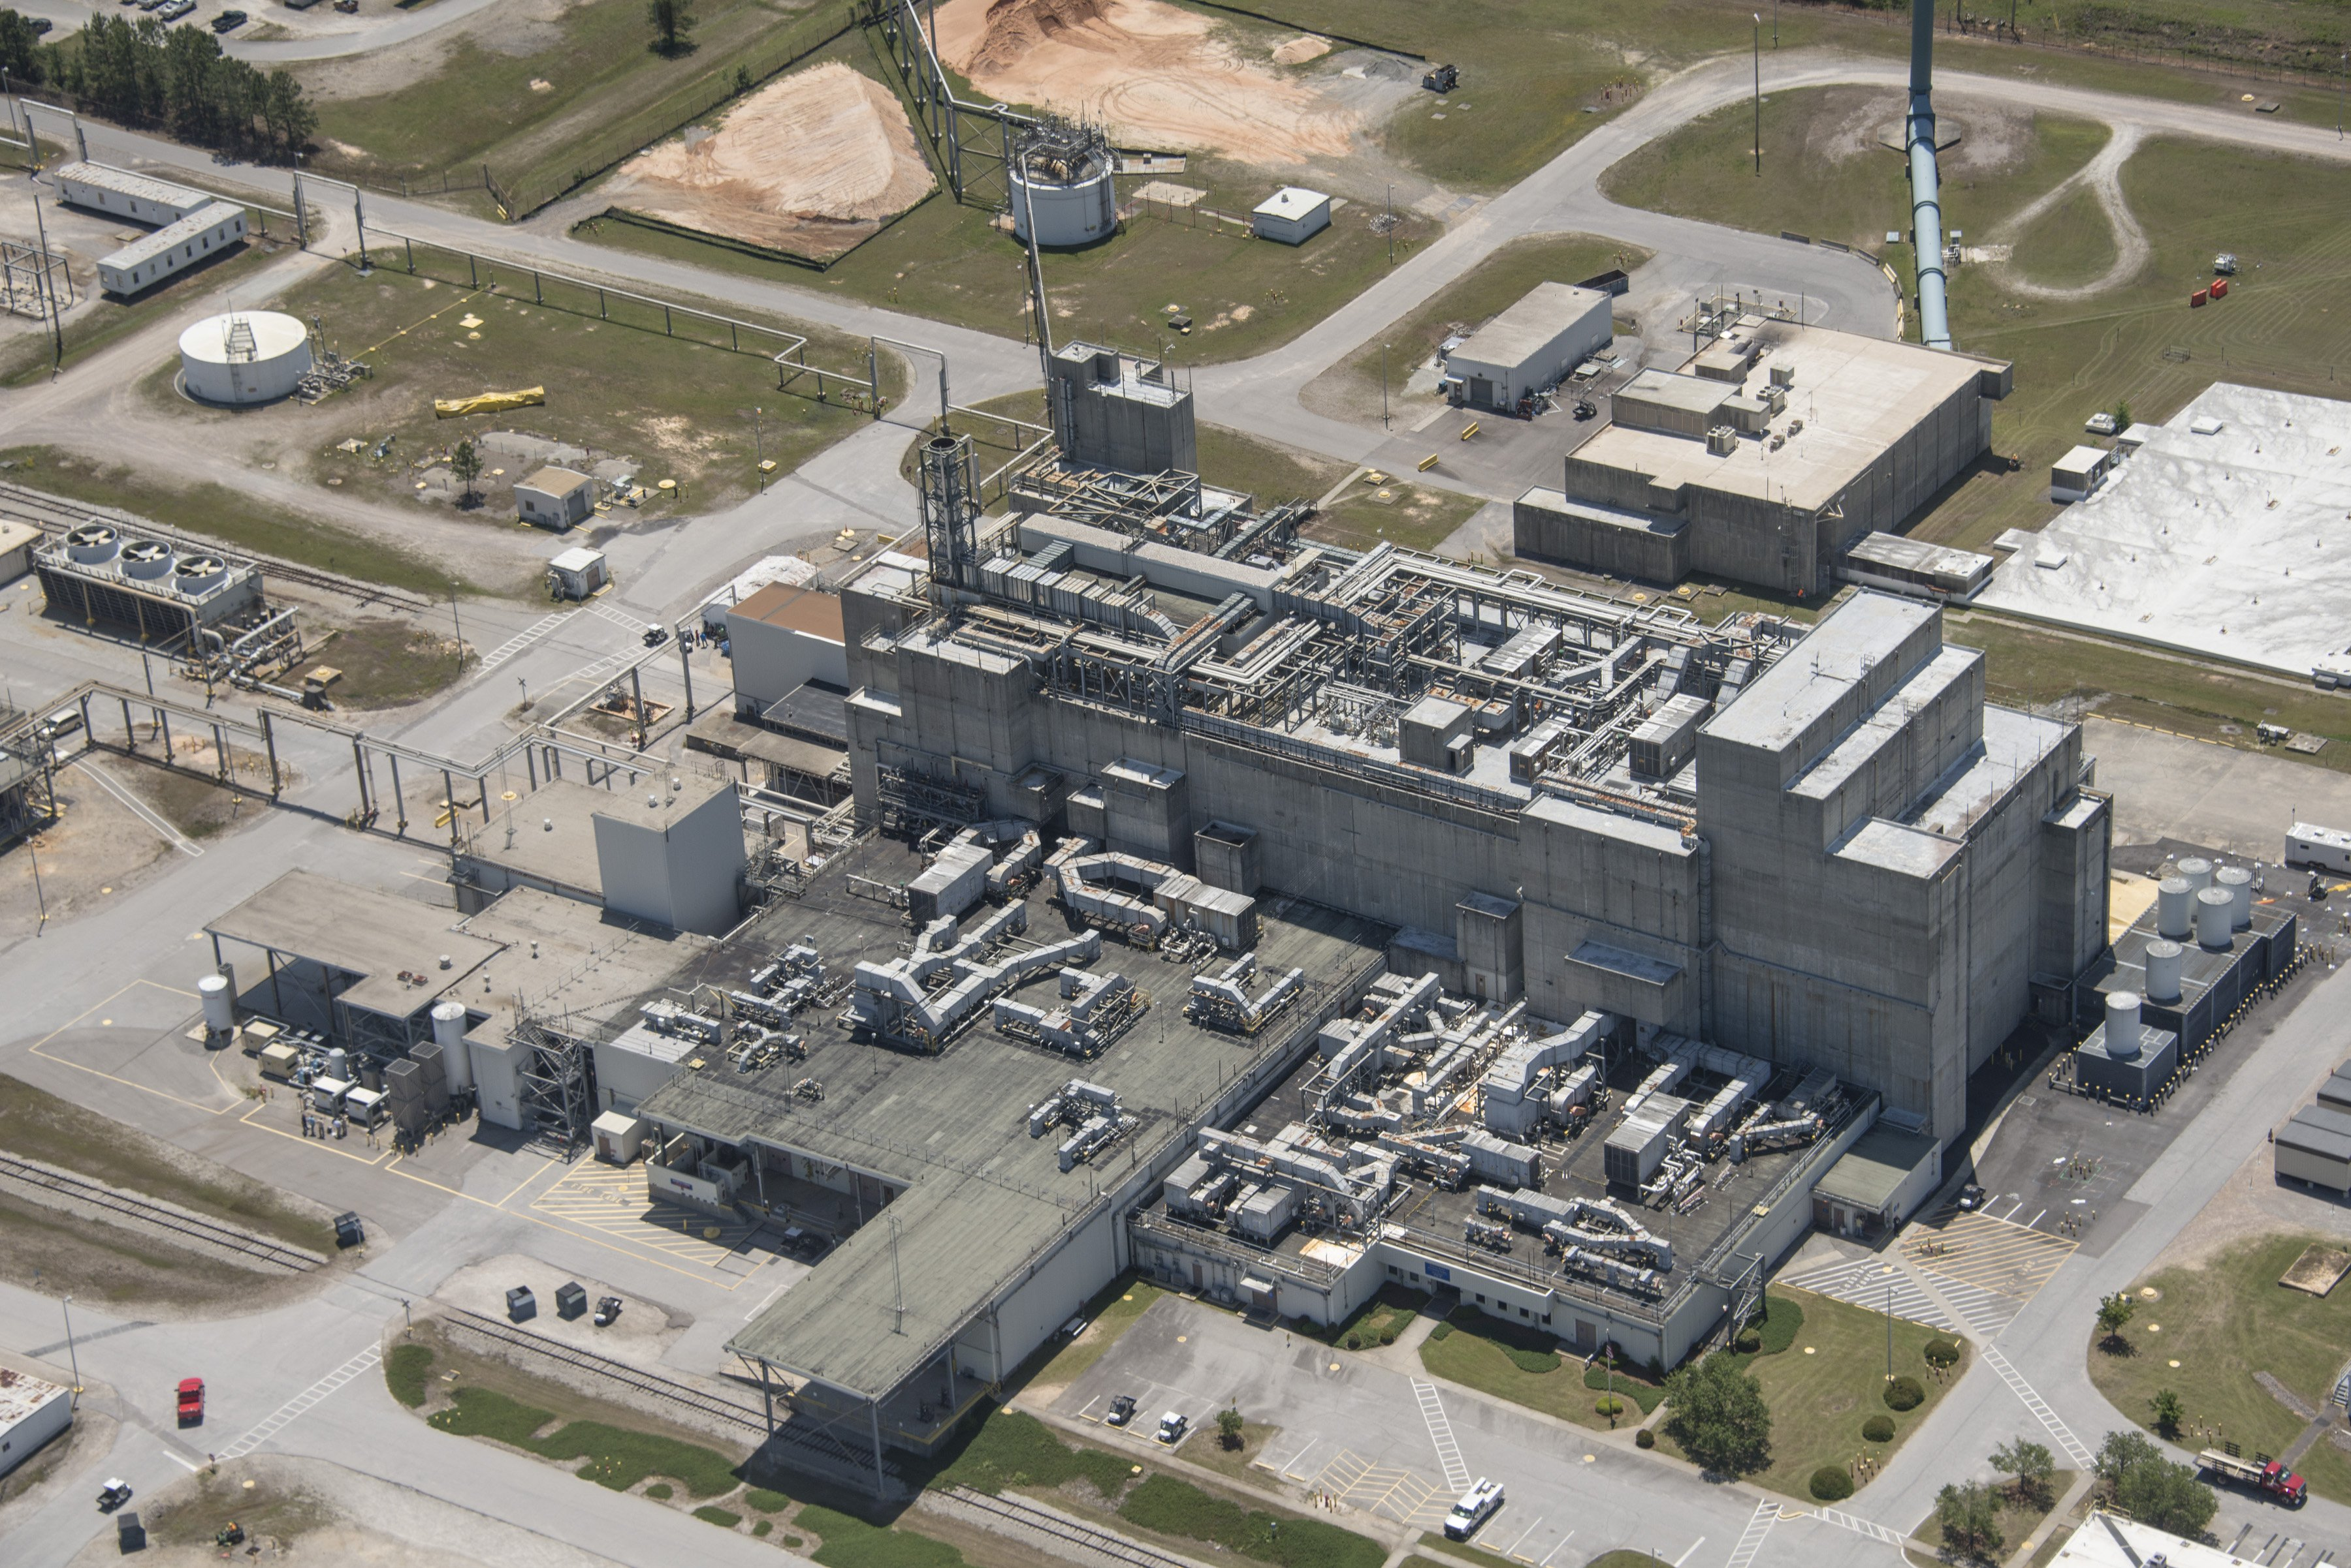
EM Program Success - DWPF

Slide 3
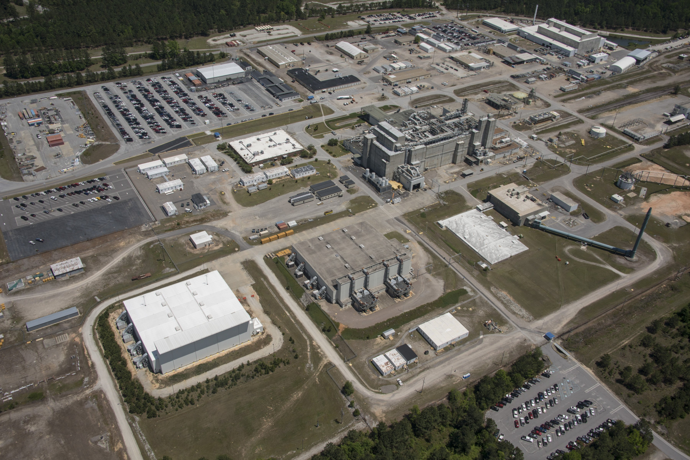
EM Program Success - DWPF

