Slide 1
STATISTICS IN GEOGRAPHY
TESTING FOR DIFFERENCES BETWEEN SAMPLES /SETS OF DATA

Slide 2
In the last powerpoint the differences between Chesil Beach samples 1 and 2 was obvious.
Sometimes the differences are not so obvious and need to be statistically tested.
Look at these two samples from Chesil Beach, they are from sites only about 1 km apart.
These two samples of the long axes of pebbles from two sites on Chesil Beach are different, but are they statistically significantly different.
Lets call them sample 1 (from the last powerpoint) and sample 1a
8 | 13 | 12 | 10 | 18 | 13 | 11 | 11 | 18 | 10
12 | 14 | 10 | 12 | 8 | 12 | 11 | 10 | 9 | 11
8 | 14 | 9 | 12 | 10 | 8 | 11 | 16 | 12 | 10
Sample 1
16 | 16 | 18 | 15 | 14 | 16 | 15 | 15 | 17 | 18
14 | 13 | 14 | 16 | 11 | 13 | 12 | 15 | 13 | 12
14 | 12 | 13 | 15 | 15 | 15 | 11 | 11 | 12 | 16
Sample 1a

Slide 3
The first way to compare the two samples is to look at the DISPERSION DIAGRAMS.
Sample 1
Sample 1a
20
20
**
*
*****
*******
****
****
****
***
**
*
**
**
*******
****
******
**
****
Median
median
10
10
These two samples look quite similar, so lets do some statistics to look at the differences.
Mean sample 1 = 11.5mm
Mean sample 1a = 14.2mm
Median sample 1 = 11mm
Median sample 1a = 14.5mm
Inter Quartile Range sample 1 = (12-10) 2
The two samples do have real statistical differences.
Inter Quartile Range sample 1a = (16-13) 3

Slide 4
So lets compare the BOX and WHISKER DIAGRAMS of samples 1 and 1a
Sample 1a
Sample 1
Although there is some overlap of data the median and upper quartile of sample 1 is outside the inter quartile range of sample 1a, so we can presume that the two samples are statistically significantly different

Slide 5
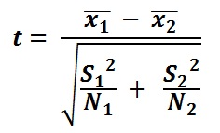
The best way to test for statistical difference between two samples is STUDENT’S t TEST.
The NULL HYPOTHESIS – The two sets of data come from two identical normally distributed populations.
We assume that any difference in the means of the two sets of data is due to chance.
The aim is to disprove the NULL HYPOTHESIS and so accept the ALTERNATIVE HYPOTHESIS that the samples have been taken form statistically different populations.
In this case beach material at the two sites is really different.
The Student’s t test is to test the probability that the difference in the two means could have happened by chance.
The formula is
X̄ = mean of each sample
S = standard deviation of each sample
N = size of each sample
Again it looks complex, but it’s just a case of substituting the correct values into the formula.

Slide 6
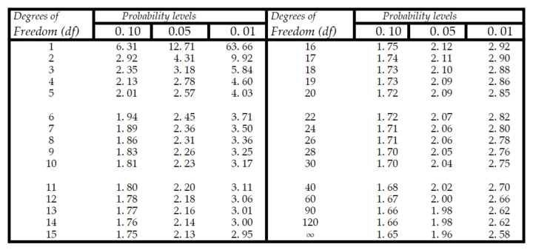
Substituting the data into the ‘t’ test formula the result = 4.57
But what does this mean? We need to look at the values in the ‘t’ test critical values table, if the result is higher than that in the table for the correct degrees of freedom, then we have proved that the samples came from statistically different population.
Degrees of freedom = (n + n) -2, or (30 + 30) -2 = 58
So our ‘t’ score of 4.57 is above 2.66 on the significance tables for approximately 58 degrees of freedom.
Therefore there is only a 0.01 probability that the two samples could have come from the same site / parent population of pebbles. We have proved the samples are different at the 99.9% confidence level.

