Slide 1
Midlands Trauma Networks
Seven Years On
Data & Trends

Slide 2
Midlands Trauma Networks
Seven Years On
Eight Ago

Slide 3
When NHSE was proposing the networks, it was modelled that around 450-600 lives could be saved each year once the system bedded in
It was estimated that around 60 of these would be within the West Midlands
Local commissioning team and relevant clinicians met to start planning….

Slide 4
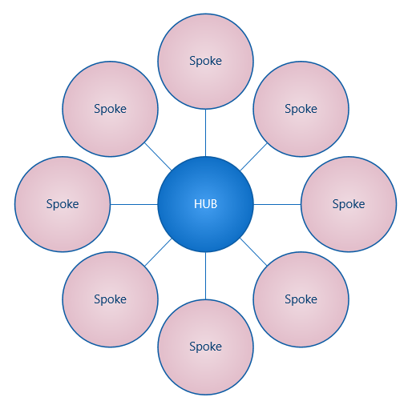
TU’s
LEH’s
Ambulance Services
Rehab Services

Slide 5
How many Major Trauma Centres would we need?
Where would they be located?
What would the network(s) look like?
How busy would they be?

Slide 7
Worked through several scenarios around location and numbers:
1 adult MTC wouldn’t be enough
2 would probably suffice, but who isn’t designated
With 45min isochrones, you really need 3,
The existing footprints around Stoke and Coventry aren’t big enough (need 2m+)
Final decision to incorporate North Wales and Northamptonshire

Slide 8
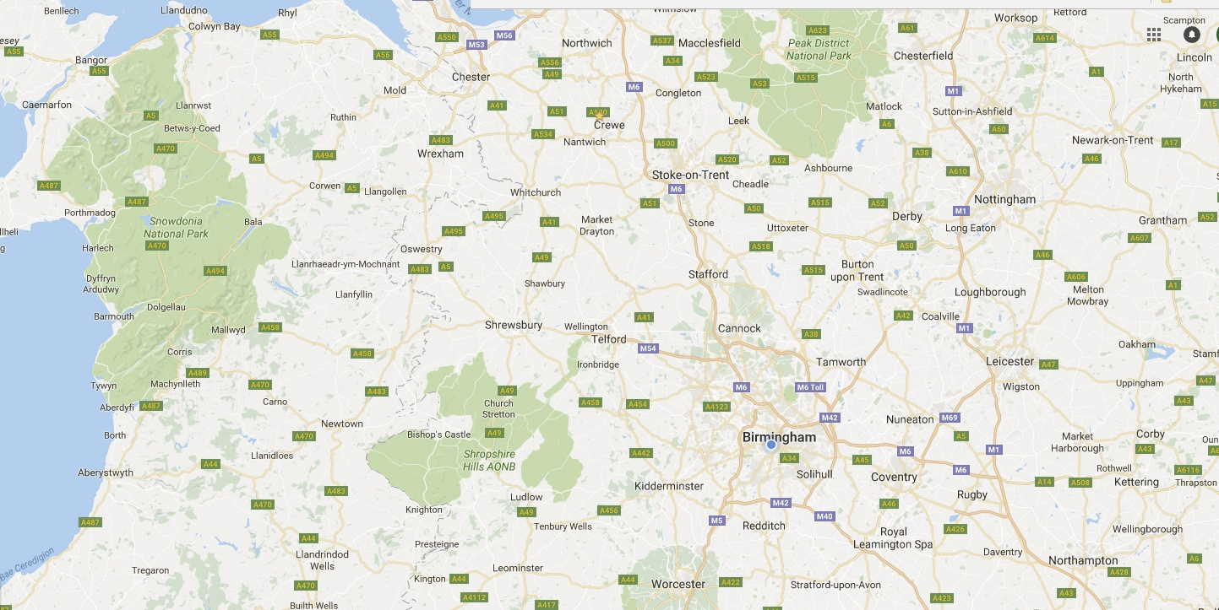
Glan Clwyd
Bangor
Leighton
Royal Stoke University Hospital
Wrexham Maelor
North West Midlands Network
The County
Key:
Birmingham Black Country Network
Central England Network
Royal Shrewsbury
MTC
TU
Princess Royal
Walsall
LEH
New Cross
Russells Hall
Sandwell
Good Hope
Birmingham Children’s
City
George Eliot
Heartlands
University Hospital Birmingham
Solihull
University Hospital Coventry & Warwickshire
Warwick
Kettering General
Worcester Royal
Northampton General
Alexandra
Hereford County
Population-wise, our trauma networks covers just under 7m

Slide 9
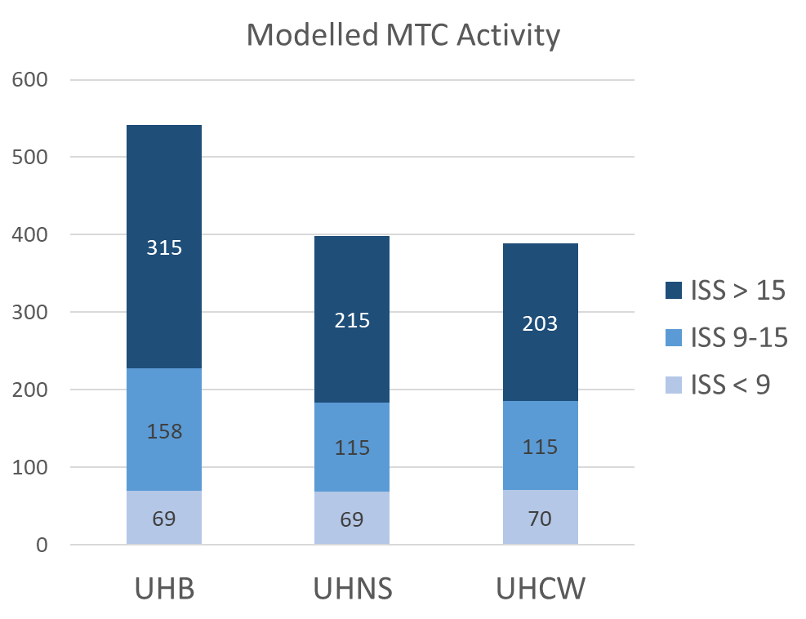
How busy would the MTC’s be:
120 ISS>15 per million population (revised to 130)
100 ISS 9-15 per million population (revised to 135)
Existing ISS 1-8 largely unchanged

Slide 10
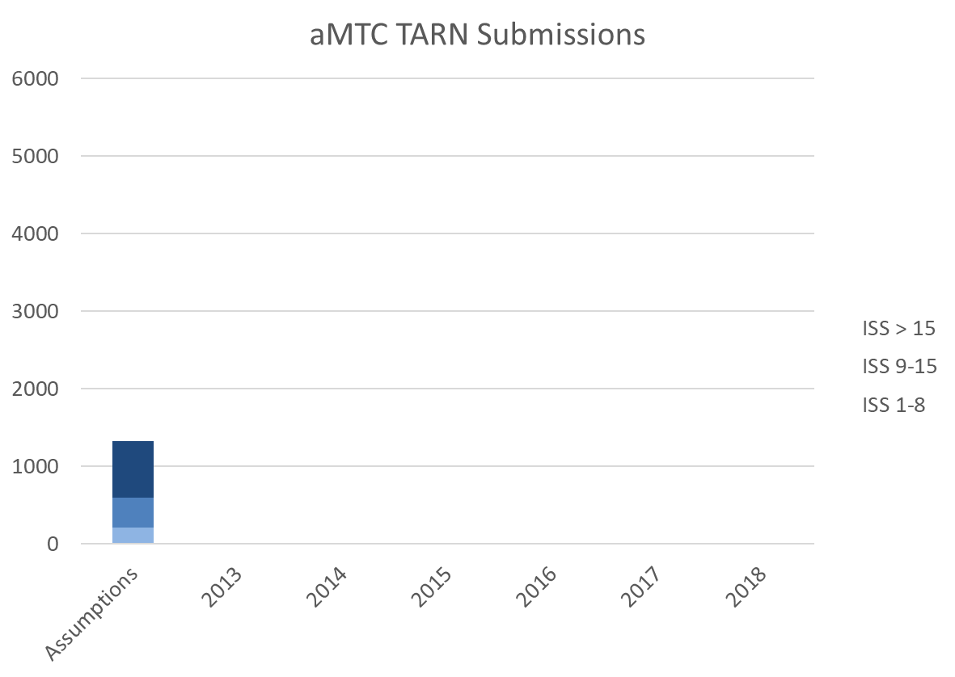

Slide 11
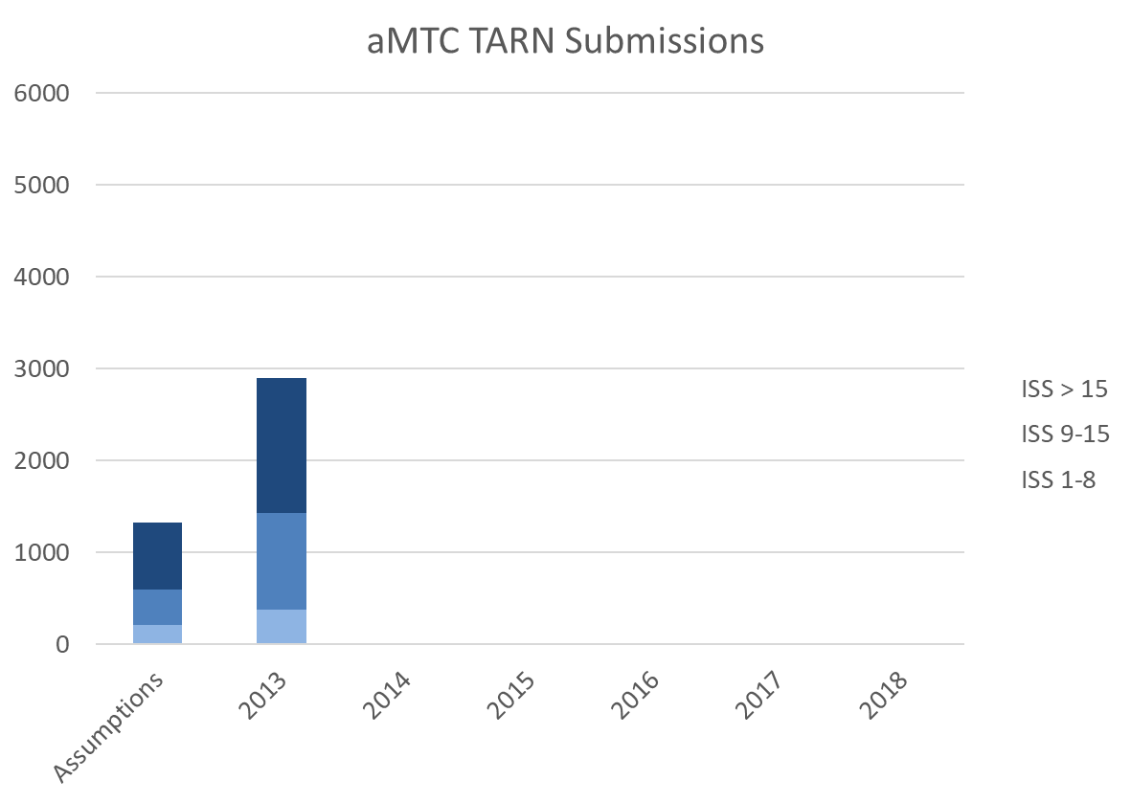

Slide 12
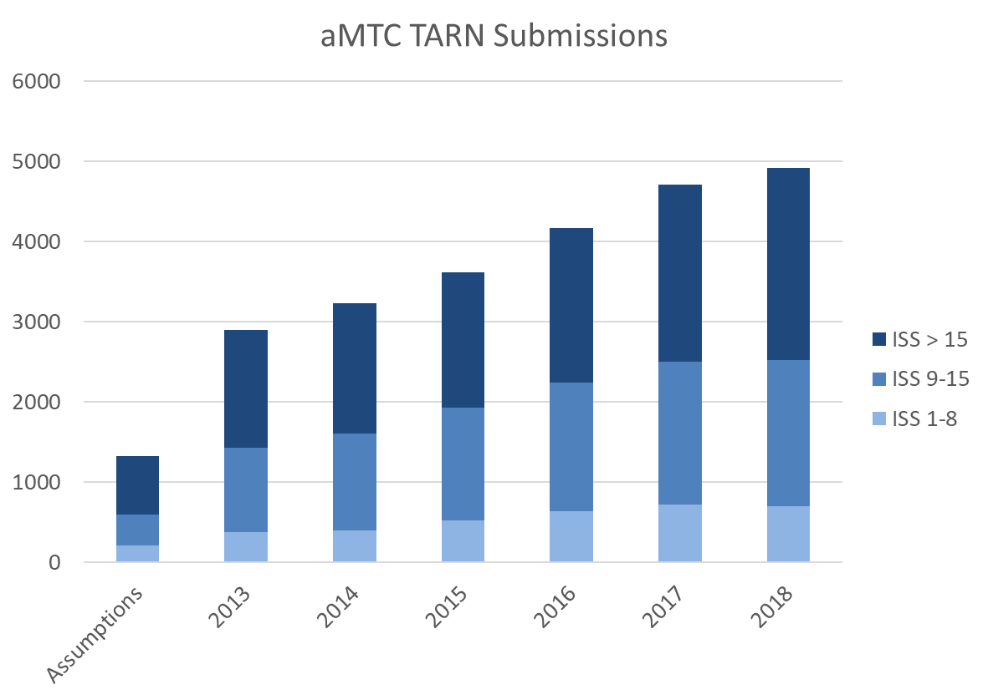

Slide 13
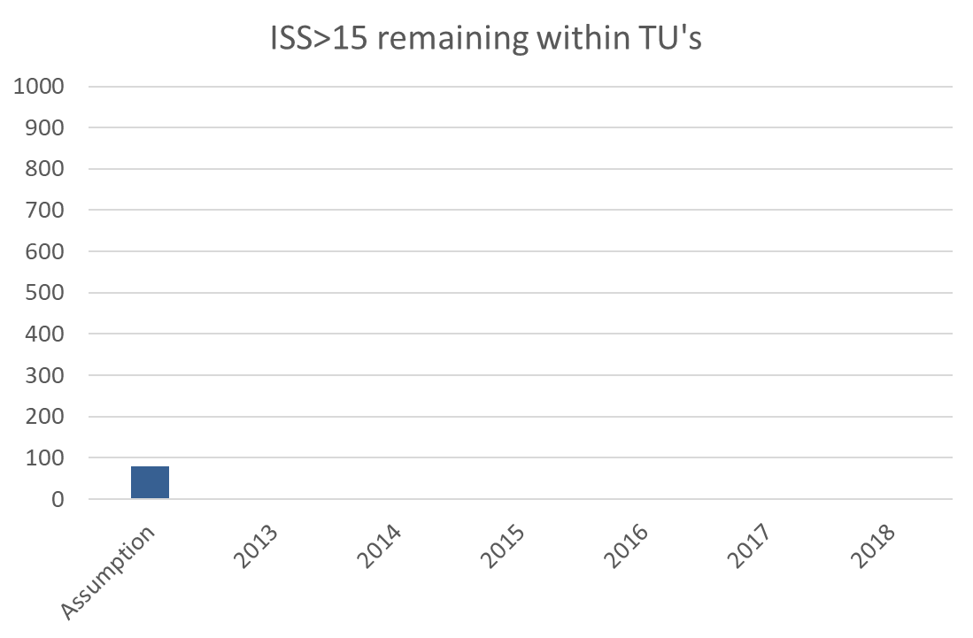
They also thought there would be an extra 80 patients in the region with an ISS>15 that wouldn’t necessarily end up at an aMTC

Slide 14
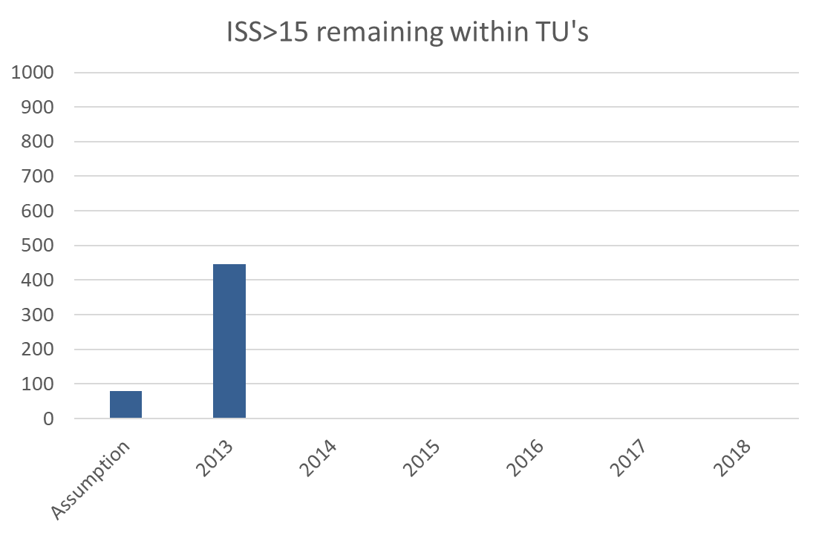
They also thought there would be an extra 80 patients in the region with an ISS>15 that wouldn’t necessarily end up at an aMTC

Slide 15
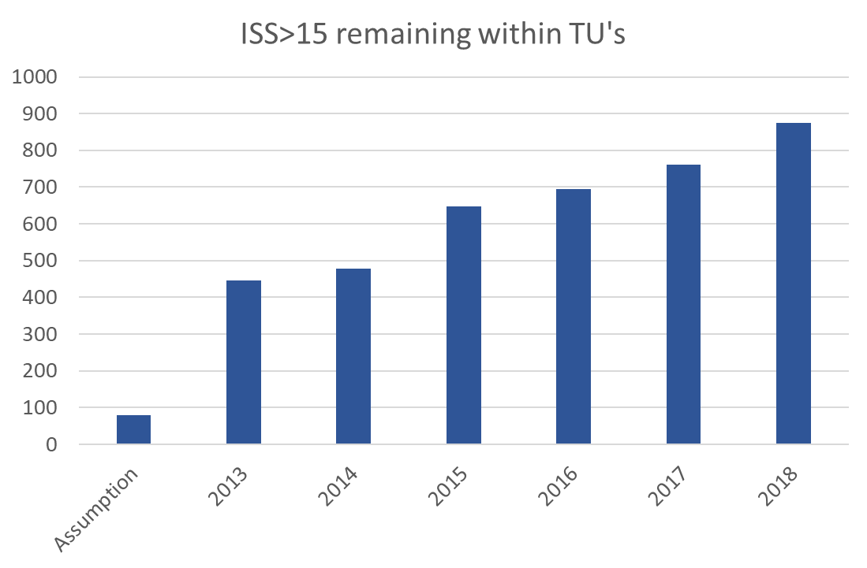
They also thought there would be an extra 80 patients in the region with an ISS>15 that wouldn’t necessarily end up at an aMTC

Slide 16
Preconceptions
“Trauma is the leading cause of death among children and young adults of 44 years and under.”
Injury Mechanism
Vehicle incident/collision
Stabbing
Shooting
Fall more than 2m
Crush
Blow(s)
Burn
Blast

Slide 17
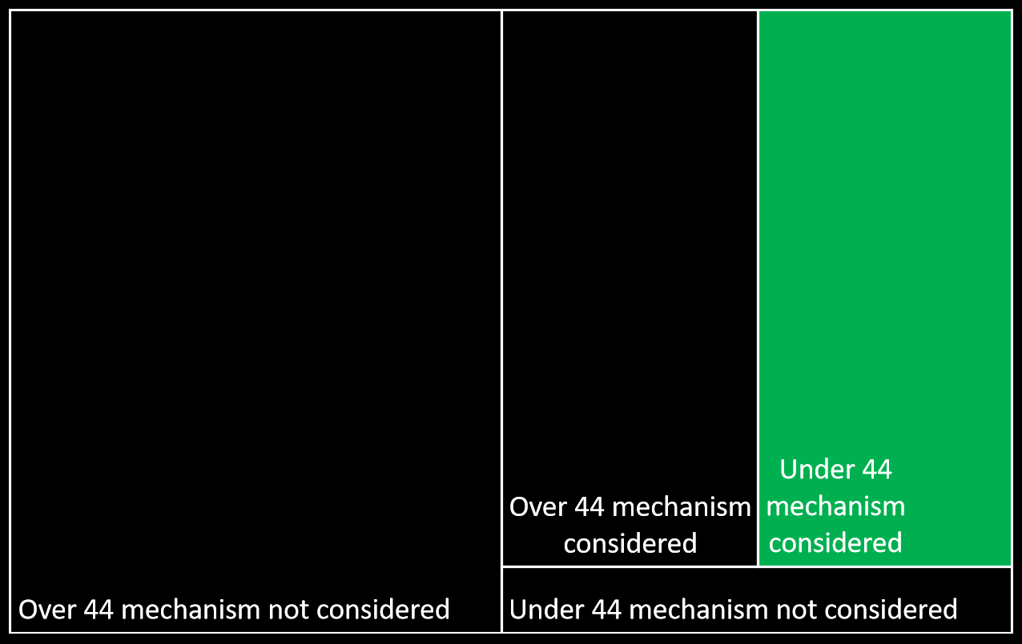

Slide 18
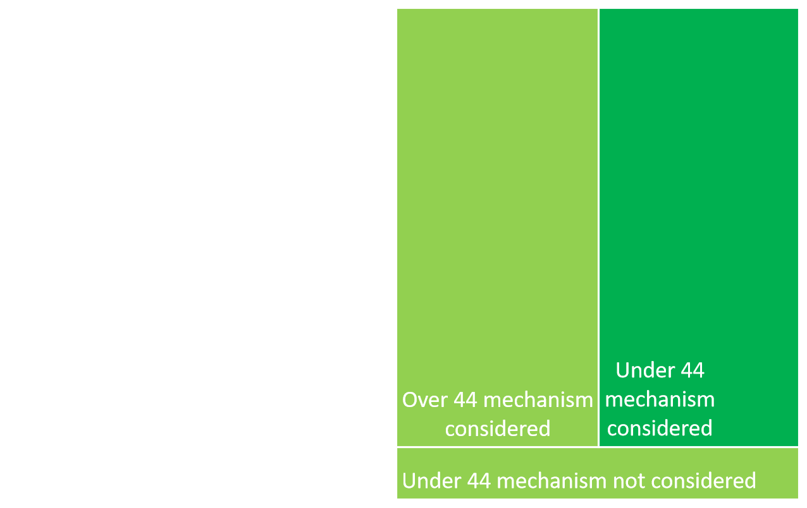

Slide 19
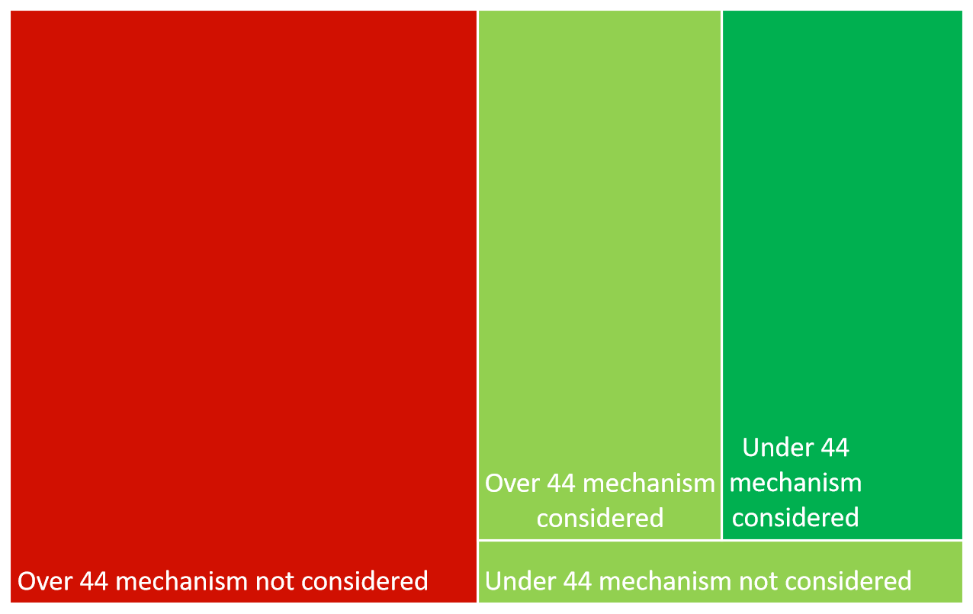

Slide 20
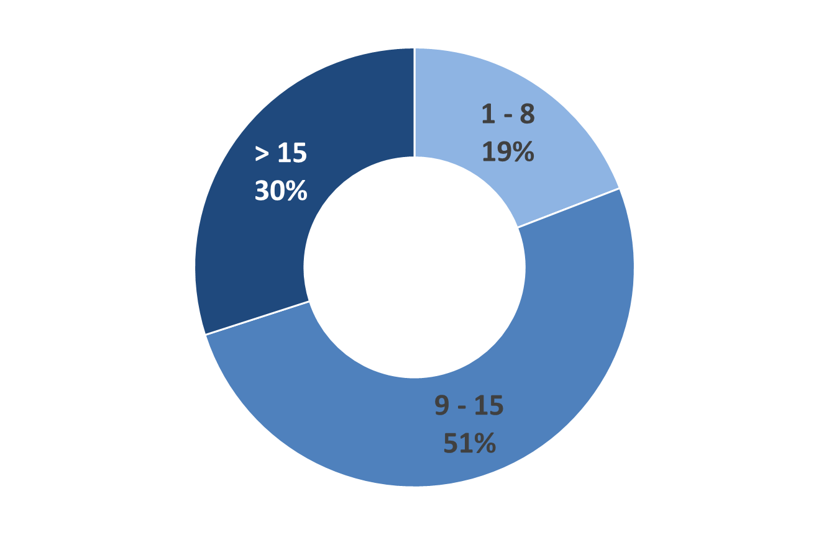
ISS bands of the 44yrs+, mechanism not considered:

Slide 21
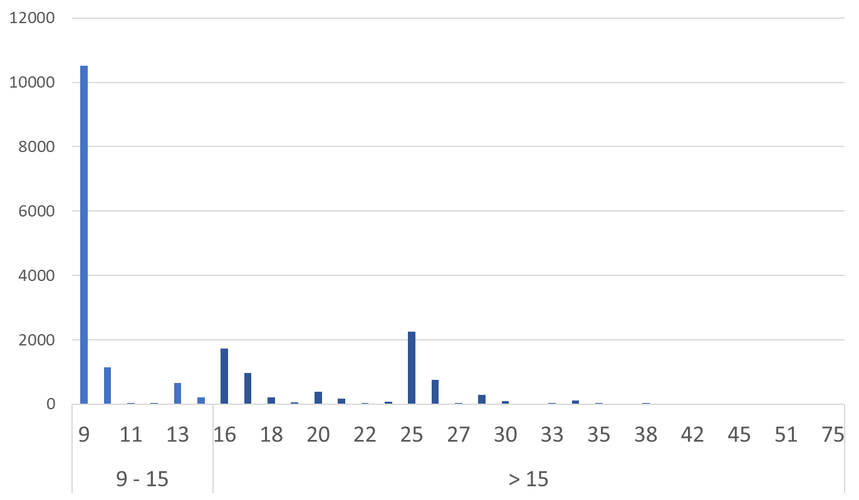
ISS distribution of the 44yrs+, mechanism not considered:

Slide 22
Preconceptions
“Trauma is the leading cause of death among children and young adults of 44 years and under.”
Injury Mechanism
Vehicle incident/collision
Stabbing
Shooting
Fall more than 2m
Crush
Blow(s)
Burn
Blast
Fall less than 2m

Slide 23
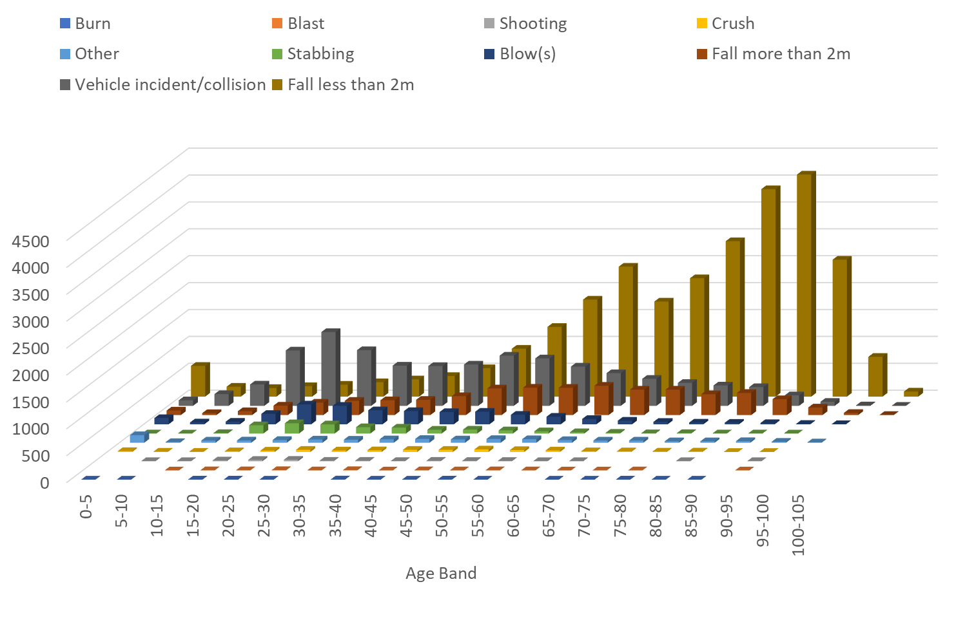

Slide 24
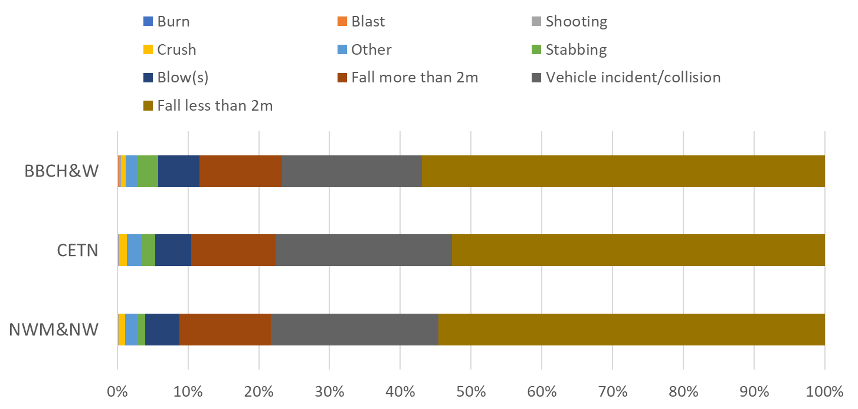

Slide 25
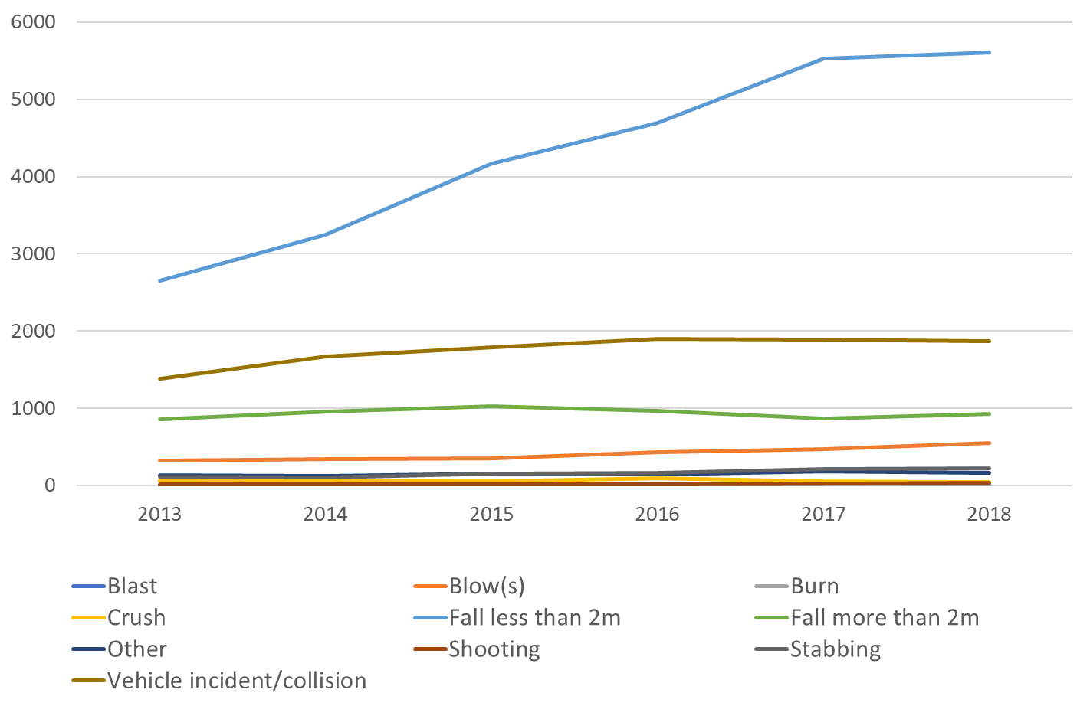

Slide 27
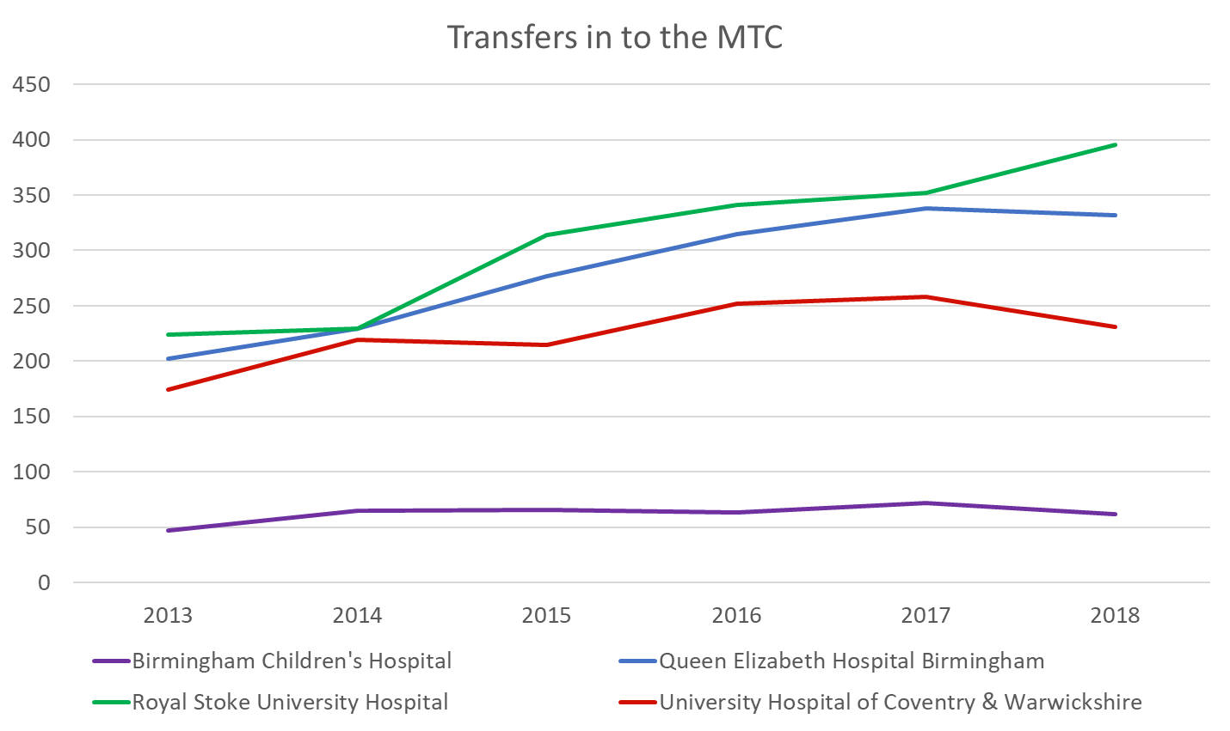

Slide 28
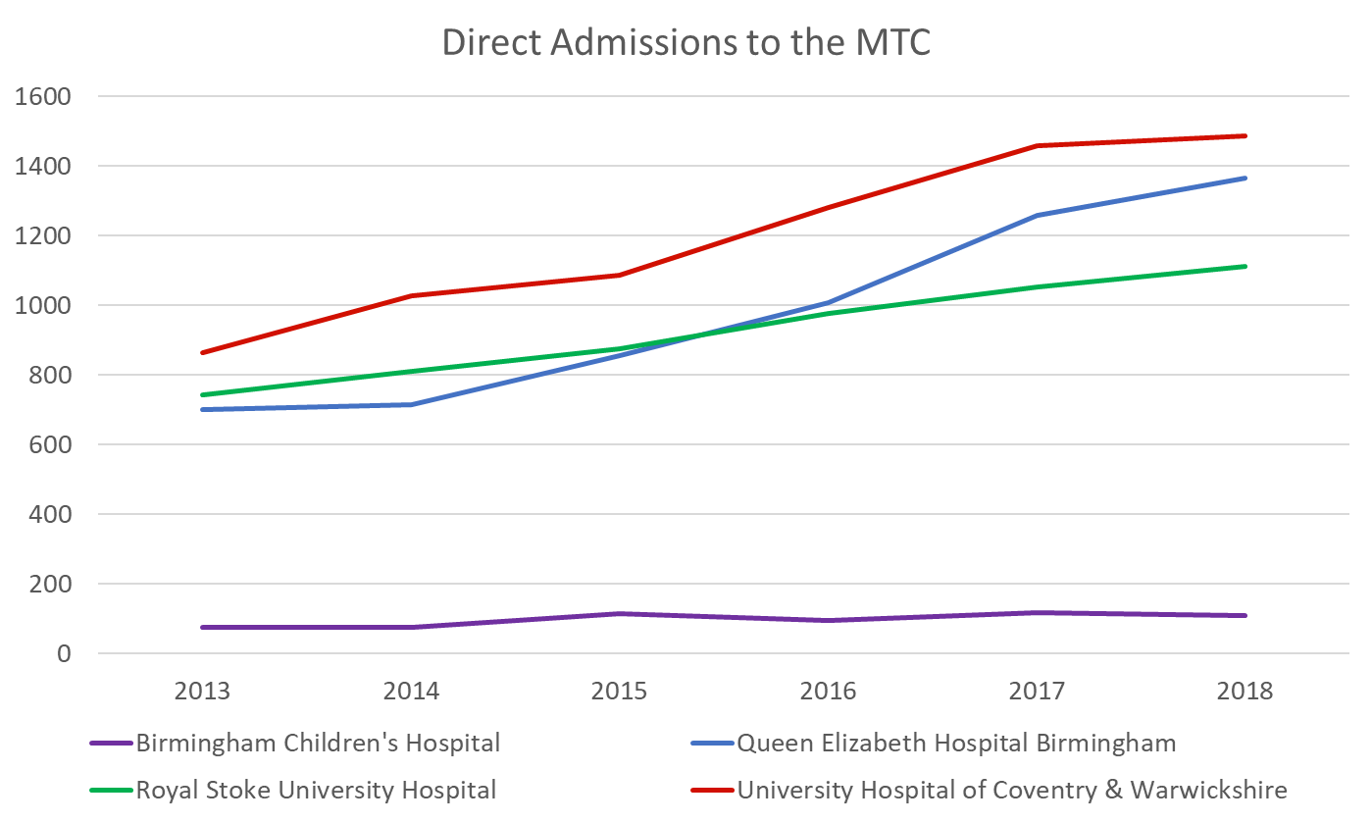

Slide 29
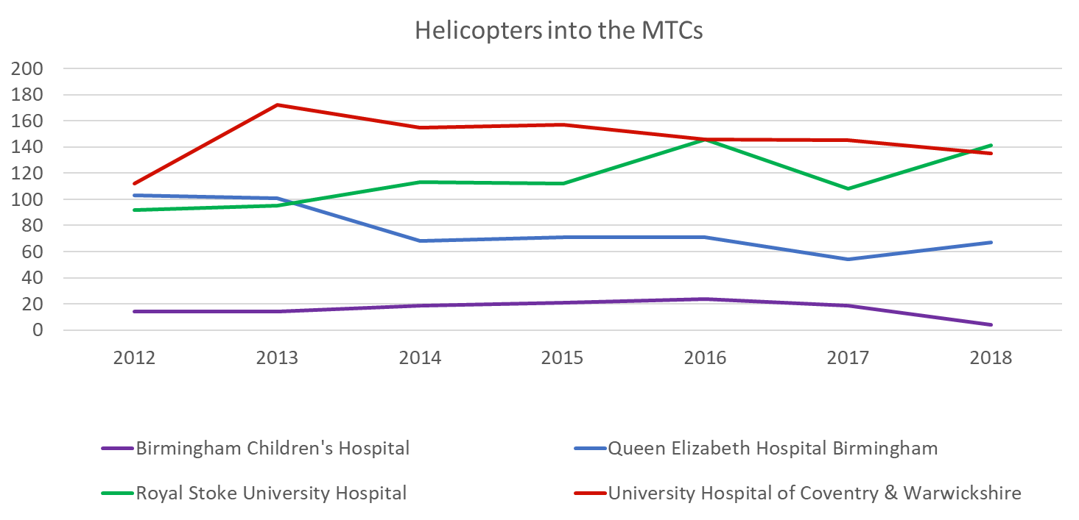

Slide 30
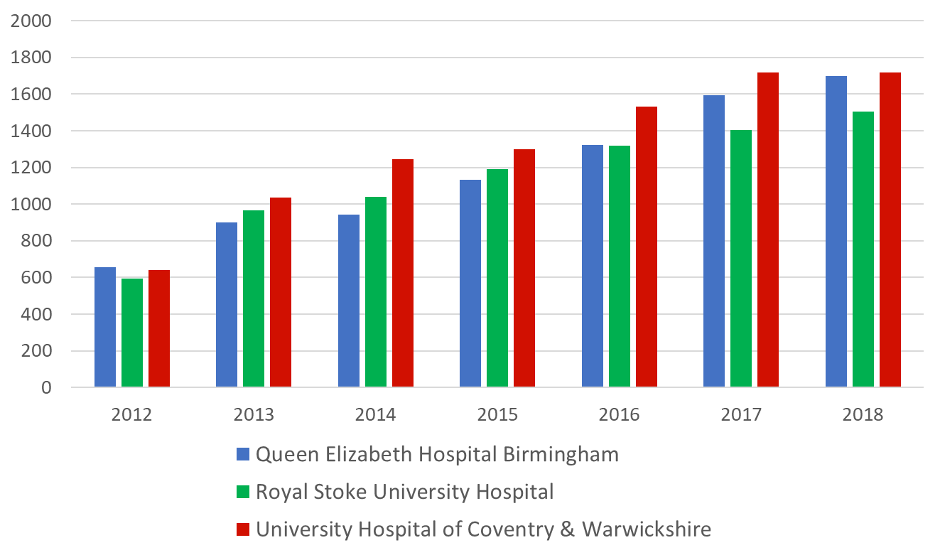
TARN Submissions

Slide 31
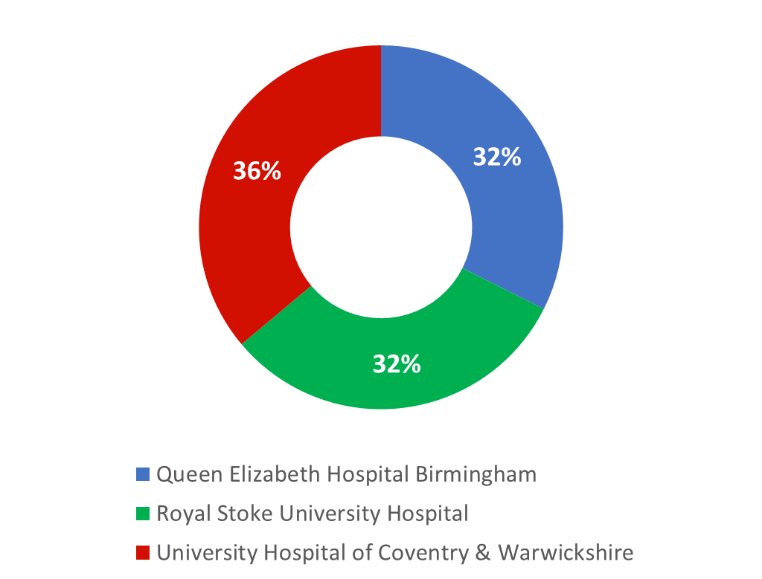
TARN Submissions

Slide 32
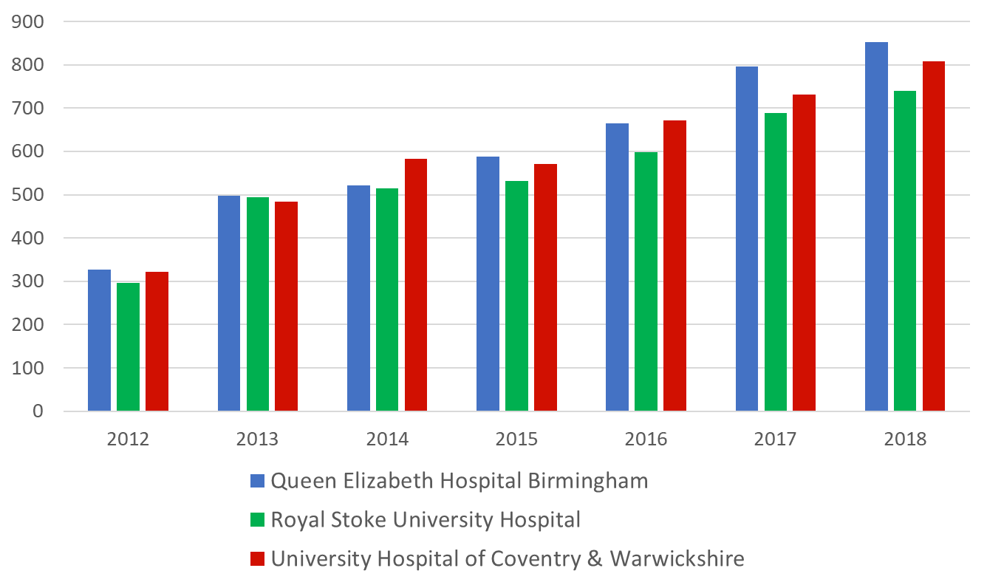
TARN Submissions: ISS>15

Slide 33
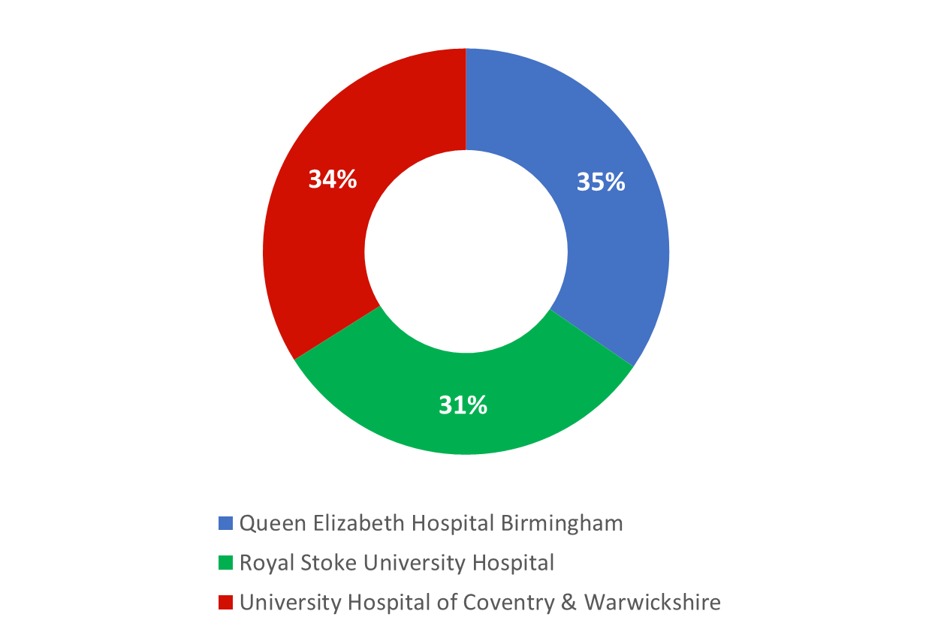
TARN Submissions: ISS>15

Slide 34
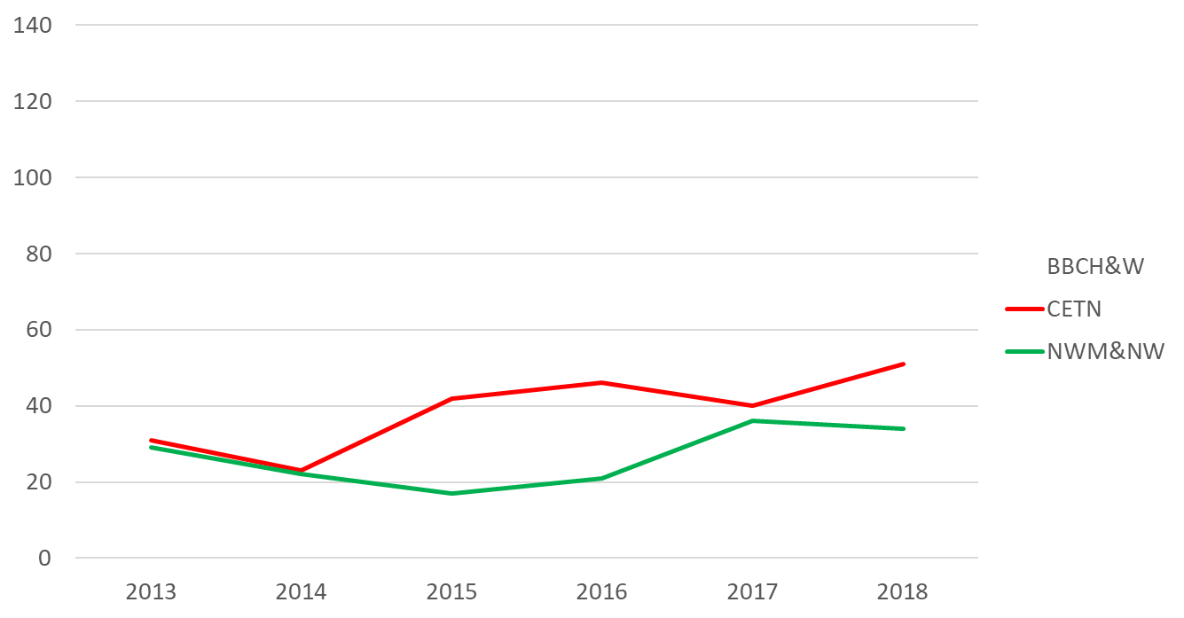
Stabbings within the region

Slide 35
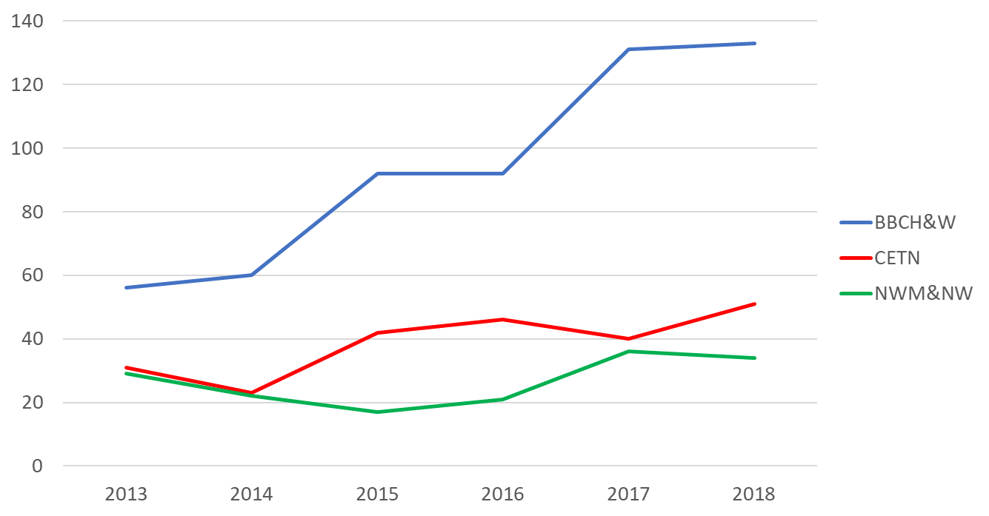
Stabbings within the region

Slide 36
Stabbings within the region
989.6 Expected
995 Actual

Slide 37
Coventry: 18/19 Q2

Slide 38
Coventry: 18/19 Q2

Slide 39
QEHB: 18/19 Q2

Slide 40
Stoke: 19/20 Q1

Slide 41
BCH:

Slide 42
Coventry

Slide 43
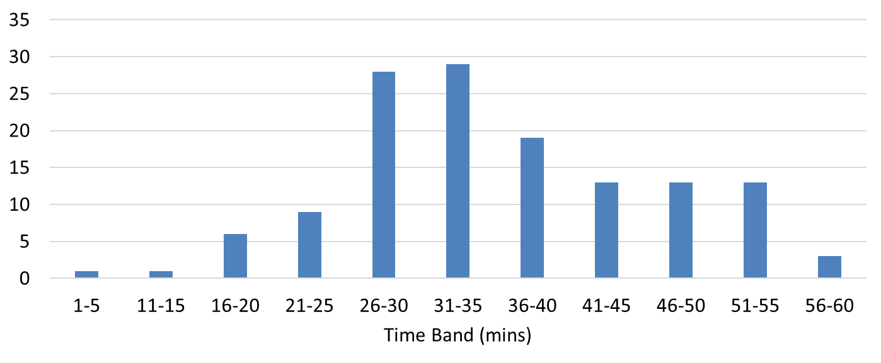
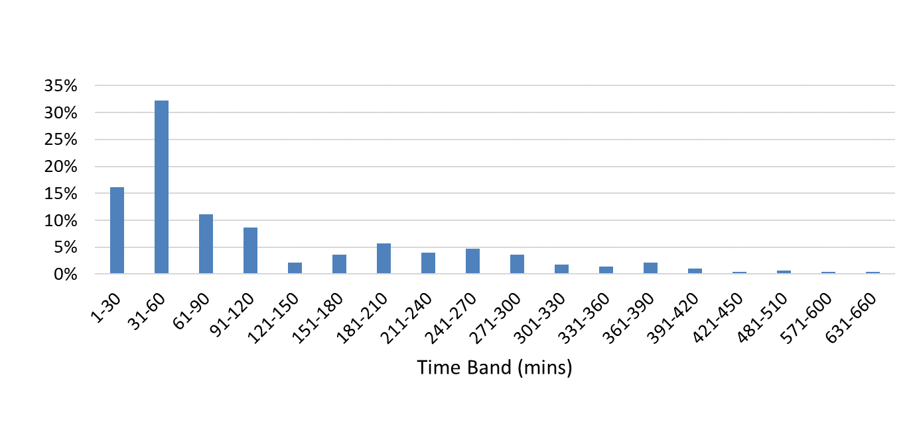
Coventry

Slide 44
Stoke

Slide 45
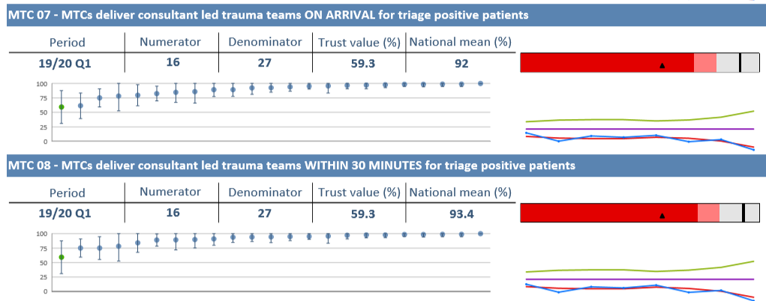
QEHB

Slide 46
TARN
UKROC

Slide 47
Spring 2018, Leicester:
RTC Head on Collision Car v Car. 3 x fatalities in same vehicle.
EMAS Helicopter with PH Dr - GCS 3/15 increased 5/15 with jaw thrust.
Unstable, clinically bleeding, MHP activated (HR 155, BP 80/46 , RR 45)
RSI at scene
TXA administered
Flown to UHCW:
Met by Consultant led trauma team
Several units blood products
CT within 30mins
Theatre in just over an hour; Cons led teams packing abdo, stabilising fractures. 14 further units blood products
4 further operations
24 days LOS in CC (3 tubed)
20 days on the trauma and neuro ward
ISS 66
Ps 21.48%

Slide 48
Bilateral SDH, Left frontal and Right cerebellar occult contusions, Tight temporal contusions + SAH
Extensive liver and mesenteric laceration, bleeding from left hepatic artery. Significant perihepatic haematoma. Pancreatic contusion
Small volume pneumopericardium
Right pneumothorax
Left 3rd to 8th rib fractures
Left 9th posterior displaced rib fracture
Complex facial fractures involving maxillary sinuses, inferior orbital walls with herniation of orbital contents into maxillary sinuses, medial and lateral pterygoids bilaterally, nasal bones. Blood in the paranasal sinuses
Complex Left tibial plateau & Femoral Shaft fracture
Occipital scalp laceration
Periorbital haematoma and emphysema on left
Right Complex Upper Limb Fracture
Right leg wounds
L2 Transverse Process Fracture
Right clavicle fracture
Superior and Inferior pubic rami fracture

Slide 49
15/3/18 – Referred to CERU
15/3/18 – Assessed by CERU
22/3/18 – Ready for admission
28/3/18 – Admitted
RCS 16
Impairment Data 19
FIM FAM 85
Discharged 20d ahead of proposed date, after a LOS of 73d
RCS 7
Impairment Data 7
FIM FAM 192
Assessment | Motor | Cognitive | Total
Admission | 33 | 52 | 85
Discharge | 99 | 93 | 192

Slide 52
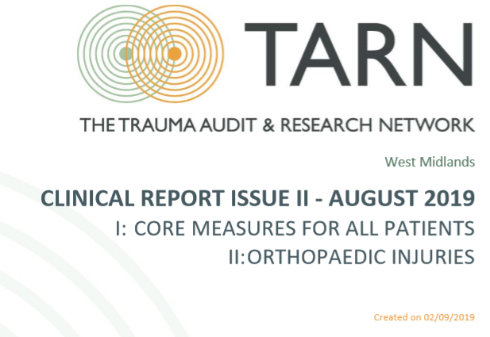
2011 assumptions
When the networks were being planned, it was modelled around 450-600 lives could be saved each year
It was estimated that around 60 of these would be within the West Midlands
The networks actually grew by 1.5m by incorporating NW and NN, so I think the recalibrated figure would be around 74

Slide 53
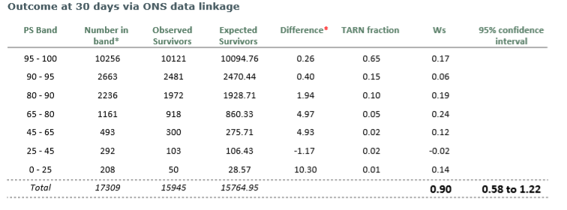
180 additional survivors for the 2 year period

Slide 54
Questions?

