Slide 1
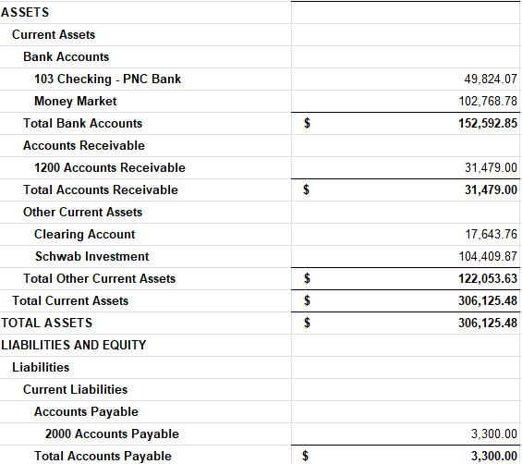
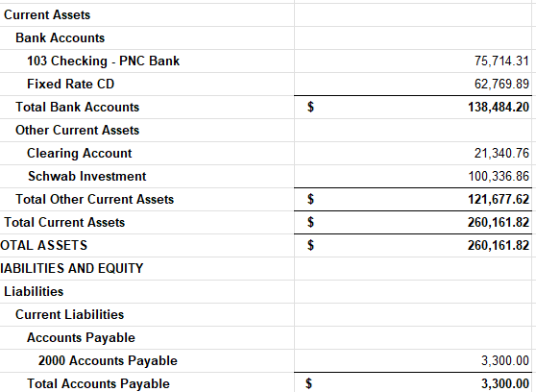
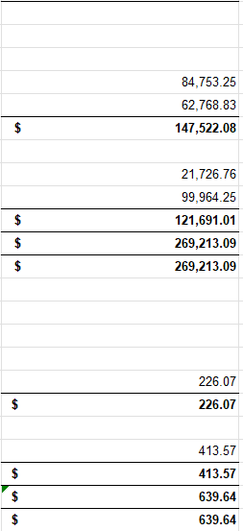
END OF MAY 2025 APRIL 2025 MARCH 2025
UP 13%
Since March

Slide 2

CMR BOARD BRIEFING
JUNE 2, 2025

Slide 3


Slide 4
17,816 Households
$5,826.13 Printing
$ 746.00 Shipping
$1,882.00 CES MAIL
$2,716.40 USPS
$11,170.53 Total Cost
.62/ household

Slide 5


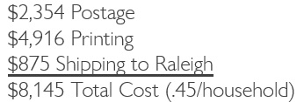
Mailing Each Board Member a Dozen
18K
HOUSEHOLDS
+ CES MAIL WOULD MAKE IT .55/household

Slide 6


Slide 7

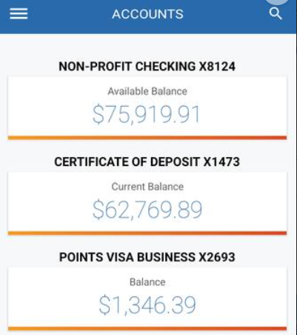
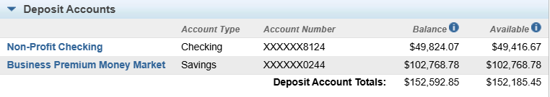
MATURED CD = $62,769.89
MOVED FROM CHECKING = $40,000.00
MONEY MARKET SAVINGS 4% APY

Slide 8
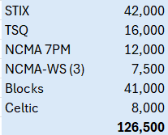
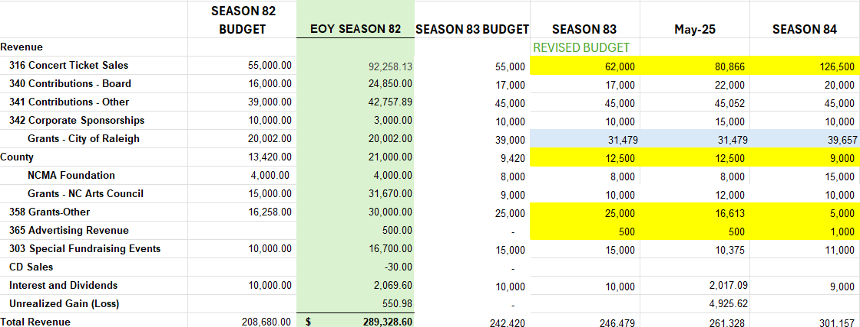

Slide 9
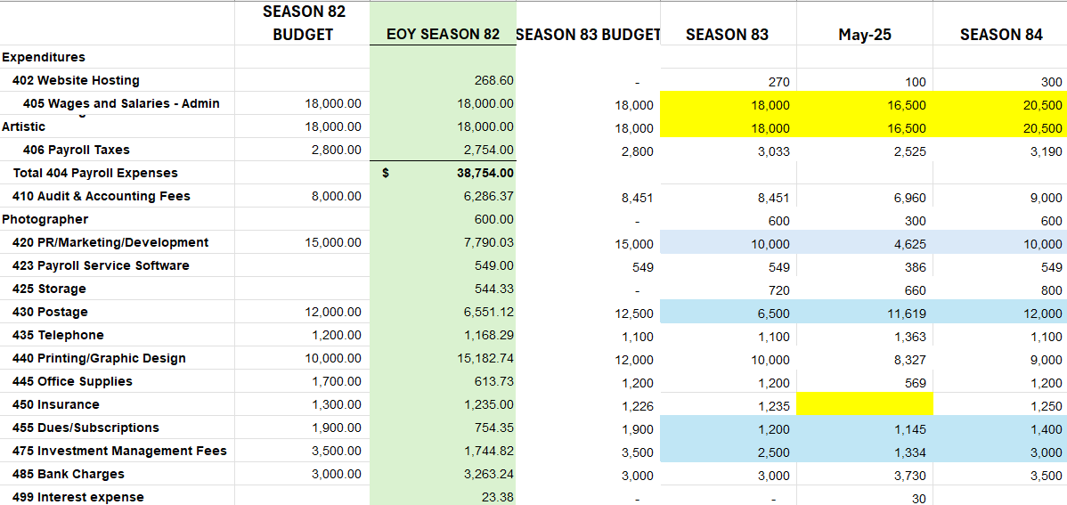

Slide 10
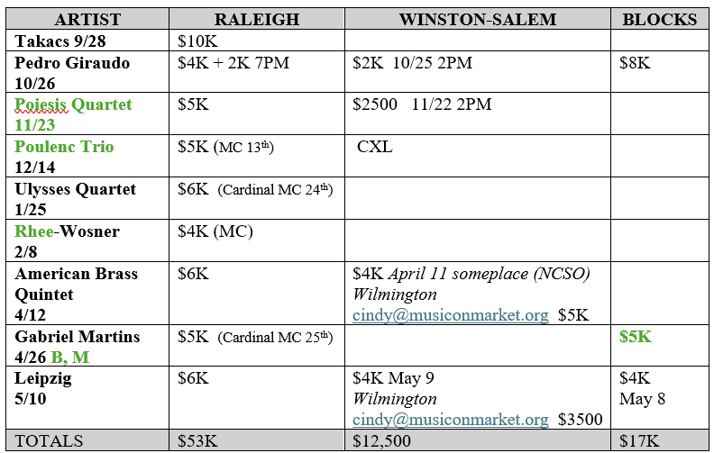
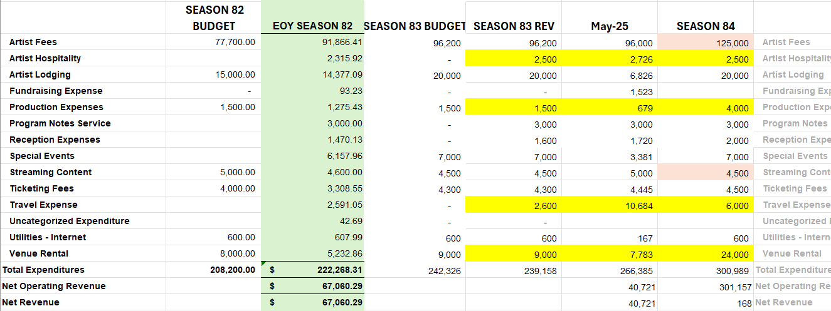

Slide 11
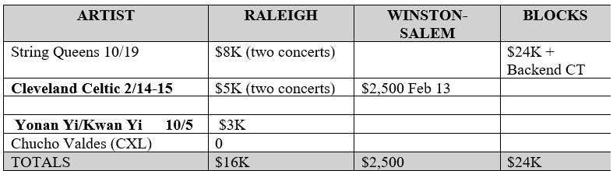

Slide 12
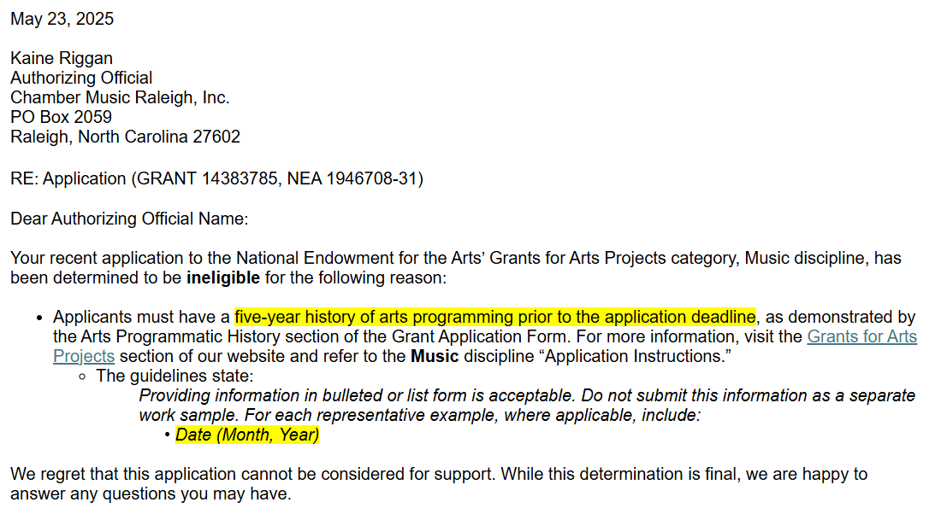

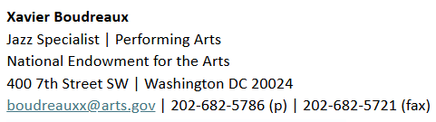

Slide 13
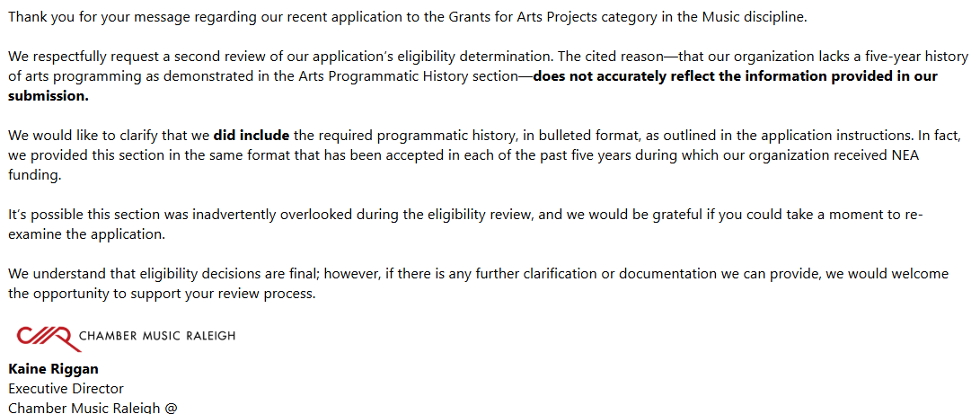

Slide 14
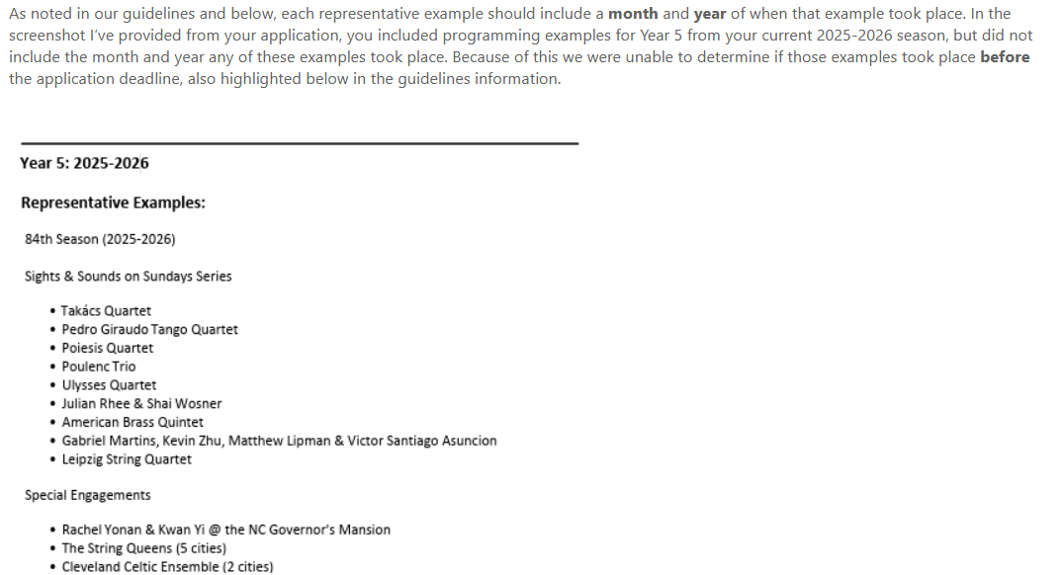

Slide 15
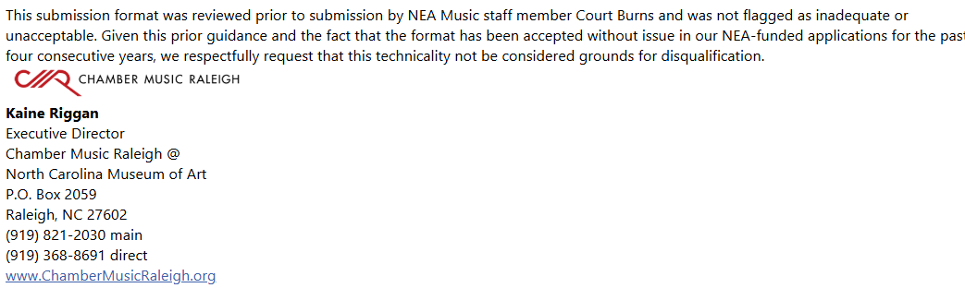

Slide 16
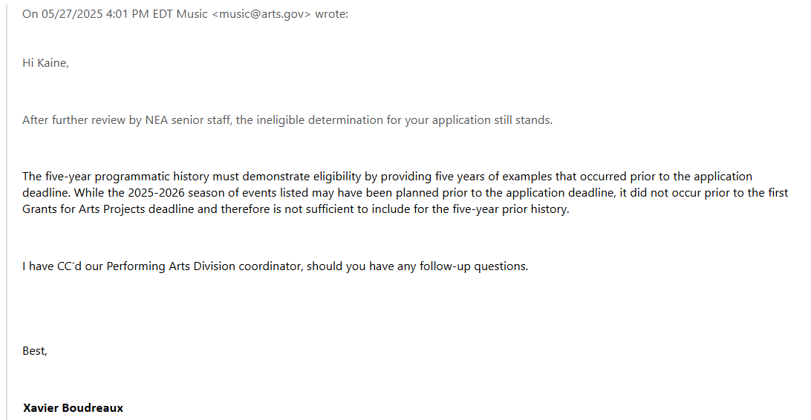

Slide 17
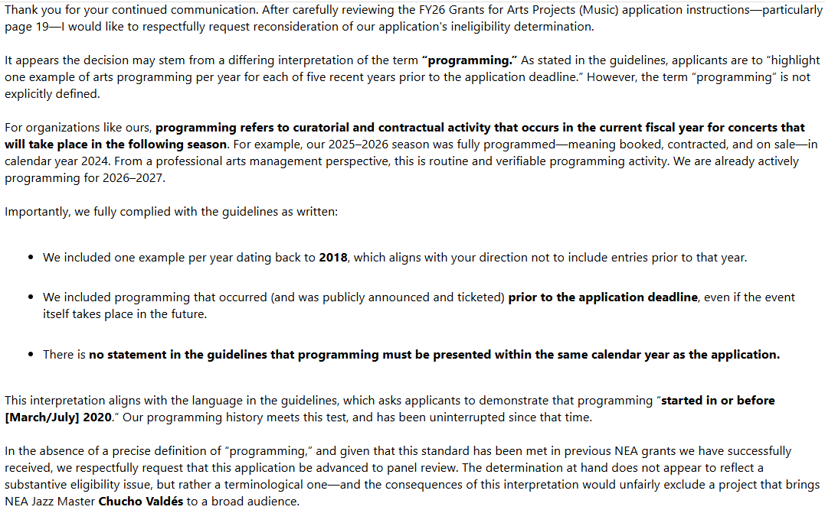

Slide 18
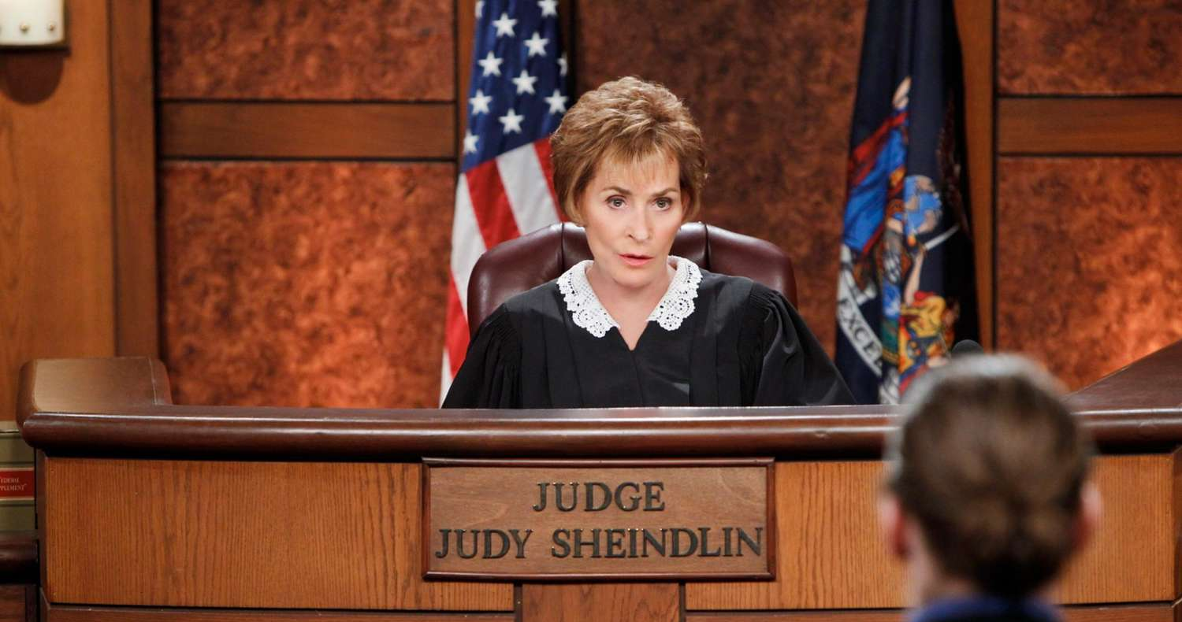
I’d say we can kiss the NEA grant goodbye for this year.

Slide 19
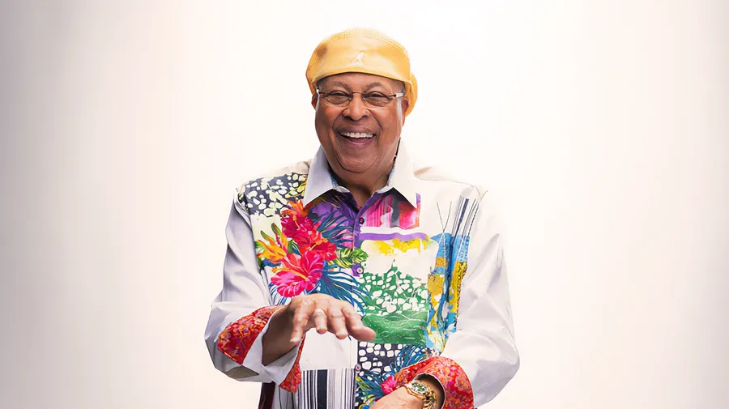
Contract No Signed Yet
$20-$25K with ensemble
Max Box Office $16K

Slide 20
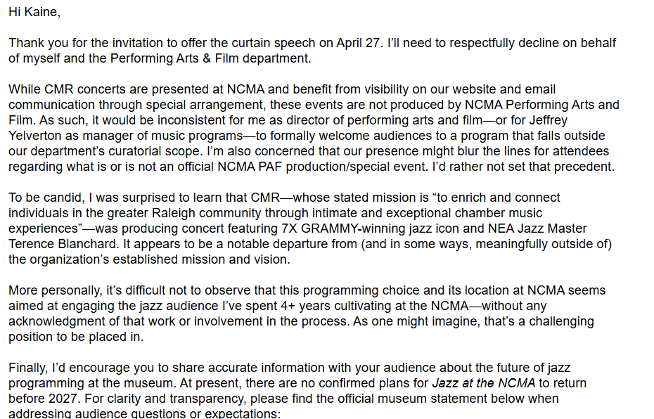
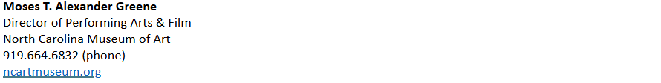

Slide 21
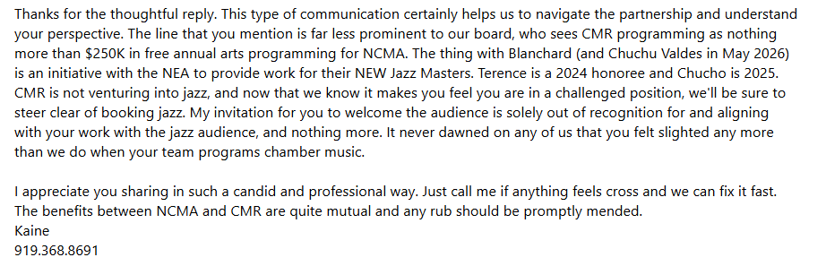

Slide 22

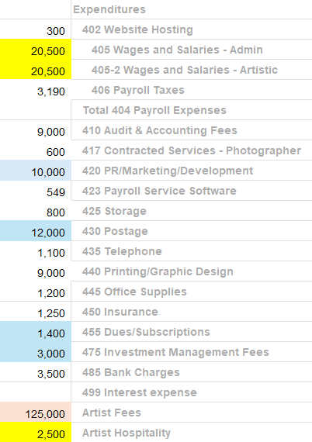
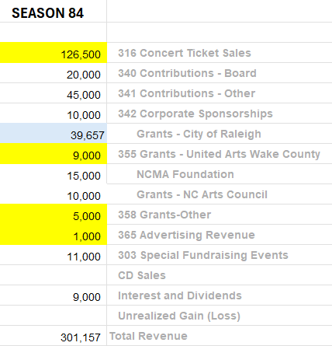
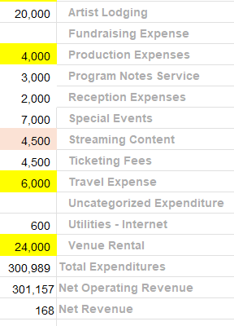

PROPOSED FY 2025-2026 BUDGET
REVENUE = $301,157
EXPENSES = $300,989

Slide 23
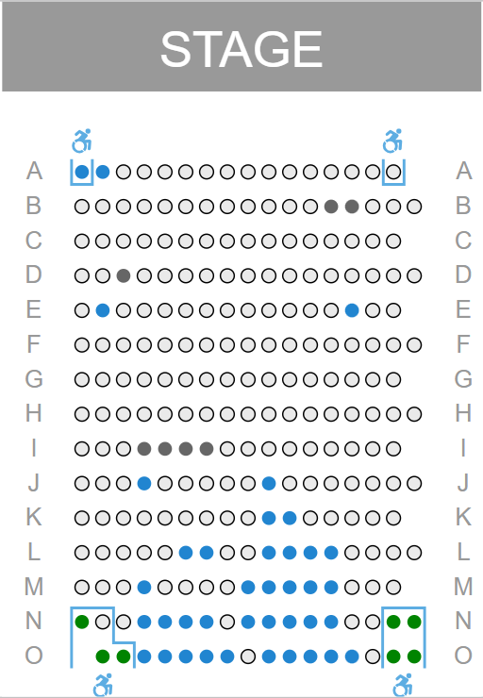

RENEWAL RATE 180 of 212 or 84%
$20/Concert Full Attendance
$25.66 if they donate 1 back
$29.11 if they donate 2 back

Slide 24




