Slide 1

Integrated and Adaptive PHYSICAL EDUCATION and Access to Athletics for students with disabilities
Presented by:
Tara Moffett, Esq, Girvin & Ferlazzo, P.C.
Maureen Moffett, Health and Physical Education Teacher

Slide 2
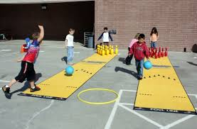
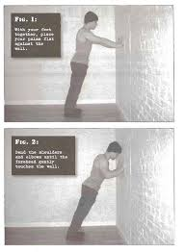
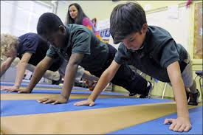

Instruction in Physical Education
New York State Education Law §803
  All students above the age of 8 years old
  MUST participate in a proscribed course of instruction in physical education
  Course should be designed to:
    Support well-rounded education
    Develop character and citizenship
    Promote physical fitness
    Encourage healthy activities

Slide 3


Slide 4
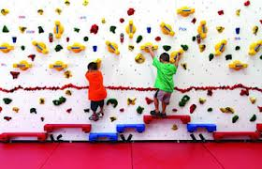
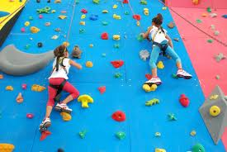
Adaptive Physical Education
8 NYCRR § 135.1
Specially designed program of developmental activities, games, sports and rhythms suited to the interests, capacities and limitations of students with disabilities who may not safely or successfully engage in unrestricted participation in the activities of the regular physical education program

Slide 5
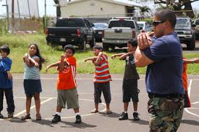
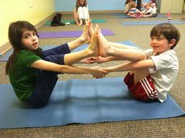
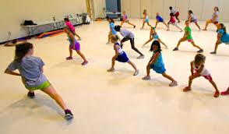
Physical Fitness Activities 8 NYCRR §135.1(r)
Physical Fitness Activities
  Activities designed to develop endurance, strength and agility
  Activities that develop the fitness to perform the task(s) repeatedly without undue fatigue and retain the ability to meet unexpected stresses and hazards.

Slide 6
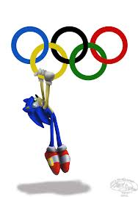
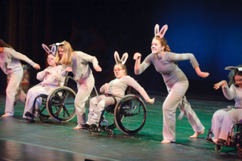
All Physical Education (PE) is Adapted PE
Students of all abilities may participate in a regular PE class with appropriate adaptation or accommodations.
PE is not training for Olympics, NBA, NFL, etc, the focus is to encourage lifelong fitness.
PE teachers should be modifying all portions of PE to fit the needs of all their students, regardless of disability.
Because of the adaptability of physical activities, every student has an ability to shine in an area where they have strength.

Slide 8
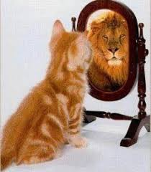


What are the benefits of inclusion in the Physical Education program ?
Gives students with disabilities an opportunity to participate and interact with their peers in common activities.
  Helps with motivation
  Helps with self-esteem
  Helps with peer connections (1:1 partner feedback, prevent intimidation)
  Helps with communication
  Cross-curricular (can reinforce other class activities or vocabulary)
Provides all students the ability to be proud of themselves

Slide 9
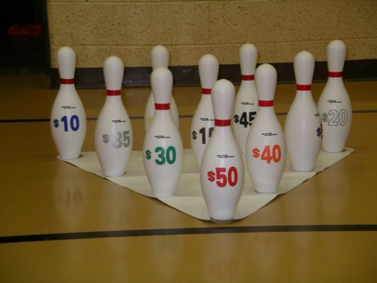
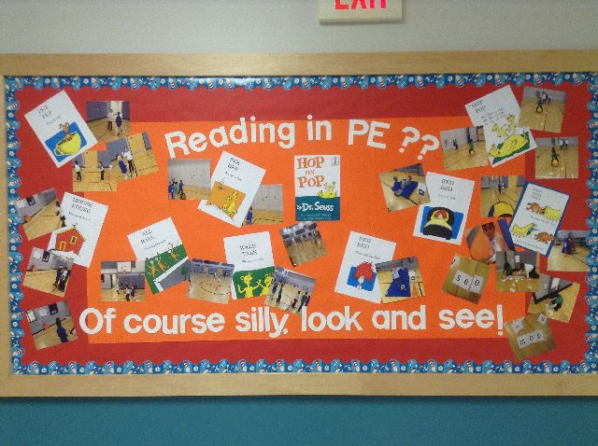

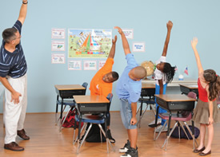
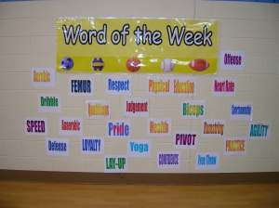

Cross-curricular PE

Slide 11
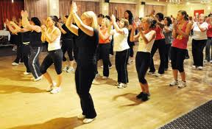
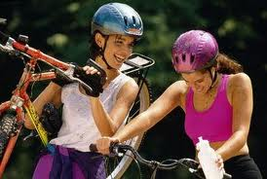
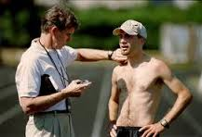
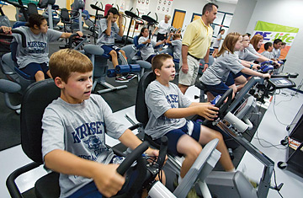
Physical Education skills for the 21st Century Student
Students should be able to take their target heart rate
Students should know about performing proper warm-up stretching, and cool-down
They should know the different components of fitness
Understand fitness intensity and time (FIT) concepts.
The goal is for students to carry over the skills they learn into their post-high school lives to maintain fitness as a component of their lives.

Slide 12



Strategies to make fitness a lifelong goal
Students may create fitness plan books that they can use and refer to in the future.
Students should be encouraged to think about and plan out activities to help with maintaining fitness going forward. (i.e., what do you want to do? What skills do you need to be successful)- Executive functioning- planning, organizing, executing, reviewing.

Slide 13
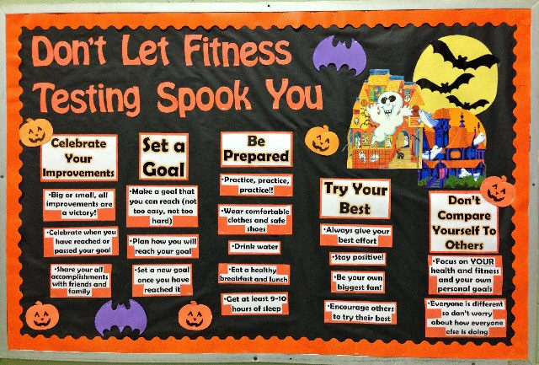

Slide 14
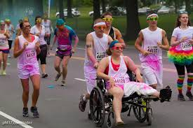
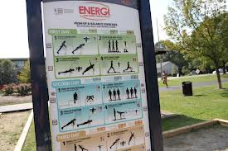
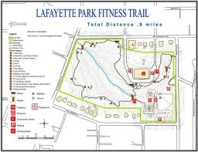
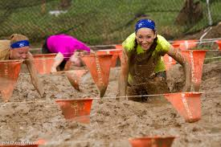
Strategies to make fitness a lifelong goal
Students need to be aware of resources available to support their fitness skills in their community (parks, fitness centers, community workout teams, community events, on-line activities promoting fitness, etc).
  Show them that they don’t always need the gym or equipment- there are lots of ways to be healthy
Empower students with the knowledge and willingness to try new activities and to develop skills that support activities that they are currently interested in. (i.e., running club, local leagues, competition)

Slide 15
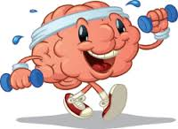
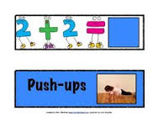
Examples of how to use Physical Education to Reinforce 21st Century skills and curriculum
Motivation- can incorporate meaningful quotes from English Class
Being able to make projections and to justify the purpose of an activity ( I.e., what can I do, how will this make me stay in shape)
Set goals for benchmarks
Determine how many calories they will consume/need to burn (incorporate Health Class and Math Class)
Students can take before and after photos for their plan book (technology class)
Display and share books with classmates during presentations (public speaking class)

Slide 16
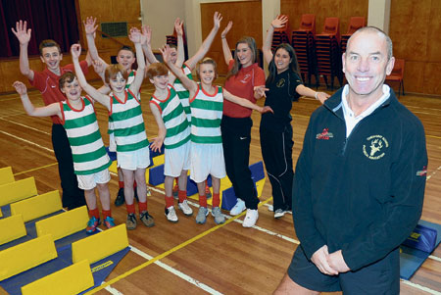
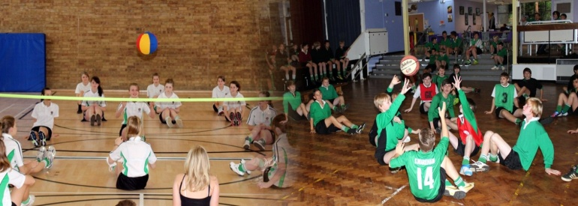
Back to Basics for Inclusive Physical Education Units
How to set the stage for positive behavior and full integration in physical education class

Slide 17

First Things First-Start with the PE Contract
Start of year contract- make expectations clear
  Students and parents /guardians will read and sign agreement- keep on file
    If parents /guardians don’t sign, student and teacher sign, making the commitment.
Review integrity expectation (key!!!)
  Locker room behavior and etiquette
  Review and discuss attendance policy
  Expect them to change into appropriate clothes
  Keep at least 2 (two) PE appropriate outfits in locker (incase students take one home to wash and forget to return)
    Try to eliminate challenges for preparedness
  Sportsmanship Policy – paramount
    There will be no taunting, teasing, put downs (even of yourself) or bullying.
    Use positive comments- I can’t yet…I am getting there…
Challenge by Choice agreement

Slide 18





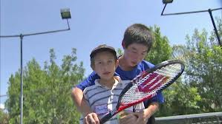
Handling challenges – when students unprepared for class
I didn’t come to class prepared for PE Form ☹
  Have students complete alternate assignment
    Next class they need to come prepared with stretches pertaining to the lesson, warm up to the lesson or the history of the sport/activity
  Keep student involved during the class period- this is not a study hall reward or free time
  Spotting other students
  Cheer the others on
  Progress measurement support
  Set up equipment

Slide 19
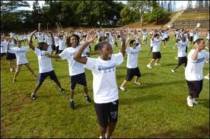
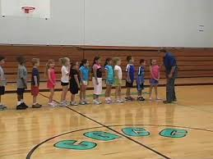
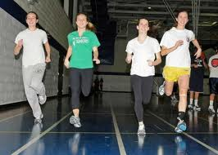
Warm Up- the Inclusive Way
Offer variety of options
  3-4 different warm up activities – model them (or ask for volunteer- this also provides leadership roles)
Ask students to decide their level of effort for the day
  Olympic/Varsity, Modified/Intermediate, Beginner/Basic
    Self-awareness and decision-making, allows for change of level if the student needs to upgrade or downgrade.
Encourage students to rotate
  If there is partner stretching, the students need to rotate partners between each activity
Run/jog/walk – use time, not distance, to allow for difference of abilities
Elliptical/rower/treadmill – for period of time, not to hit a specific level

Slide 20
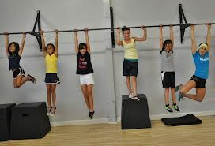
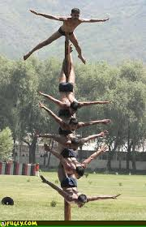
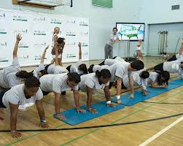
Challenge of the Day
Each class select a challenge for the students to try
  EX: wall sit- arm hang- hold plank position (rotates every class)
    Each student will start at the same time.
    Ensure they have the proper form to prevent injury
    Students can compete to see who can hold the challenge the longest
    Once they “tap” out they can do another aerobic activity
      walk/run laps/ jacks until the challenge is done
      cheer on others for the challenge while staying in motion
Post top scores on the board – motivator for other classes

Slide 21
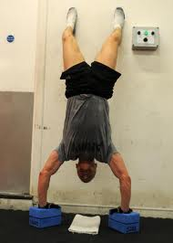
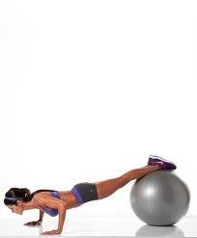
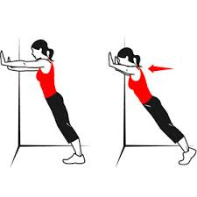
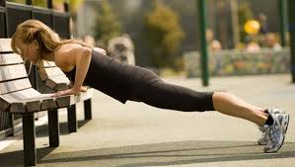
Inclusive Strength Training
Demonstrate a variety of ways to perform the activity for students to choose from
EX: 90 degree push up, modified pushup, diamond push up, clap in-between pushups, knuckle, fingertip
  Students will choose an option within their own comfort zone and ability
  Provide the minimum amount they must do- it’s up to them to see how far they want to push day to day
  Some students will compete with others while others will work by themselves – either way is fine- they are engaging in the class

Slide 22
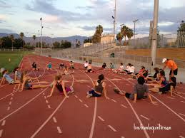
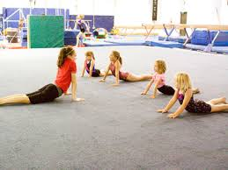
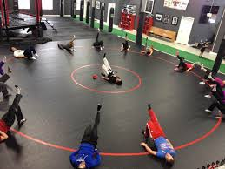
Circle Up and Stretch
Demonstrate stretches while you can still see each student stretching in the circle setting
  Students get to see the variety of flexibility in the class
  Students continue to improve throughout the year
Mark progress on toe reach every 5 weeks
  Students set individual goals
Assign students to prepare stretches for particular lessons to demonstrate to class
  Gives a chance for peer leadership and to take direction from peers in a positive manner
  Public speaking

Slide 23
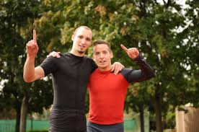

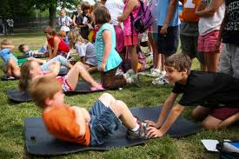
Partner Physical Education
Many warm up activities can be done with partners
Each time you partner students up is chance for them to learn something new about a classmate
  Create questions to ask partners
  Quiz one another on skills knowledge
  Work on good sportsmanship skills
Find a compliment about partner’s skills and high five
  Partners can help build skills with each other and offer challenges
  Partners can provide feedback
  Thank partner for working with you
Rotate to a new partner- keep switching until each student has worked with all other before repeating

Slide 24
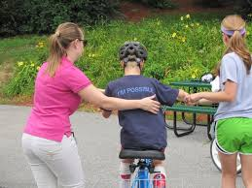
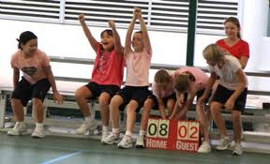

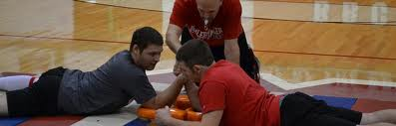
Ways to Modify and Integrate different Units in Physical Education
Encourage students to be trained as “PE assistants” (they can get signed off on skills and then work with other students to demonstrate leadership)
  Provide feedback to classmates
  Increase self-esteem, responsibility to classmates
Acting as a spotter for activities
Demonstration of an activity
Feedback (if they have expertise or special knowledge)
Allow the students with advanced moves to work with the higher levels during breakout sessions, allows more time for PE teacher to work with students at the other levels.
“BEST” students- Basic Education in Student Teaching- (allows students to pursue elective credits for assisting teachers)

Slide 25
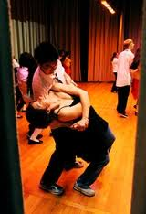

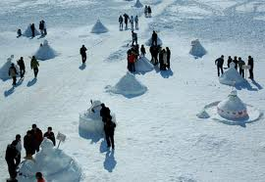
Unit – Modification and Adaptations
Soccer Unit
Volleyball Unit
Gymnastics Unit
Dancing Unit
Rock Climbing Unit
Winter Unit
Use Variety and Modification Options For Student Success!
Focus on using Cross Curricular themes to reinforce lessons in other subjects.
Don’t forget about knowledge based assessment

Slide 26
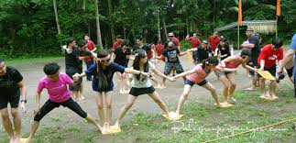



Team Building Unit
Use cross-curricular teaching finding variety of problems based on math, science, history, foreign language to solve problems
Students take turns being leaders/followers
Analytical students shine while leading class to answers with problem solving skills
Teamwork is the goal- not so much solving the problem
Break the team up and rotate team members often
Students out on injury can still participate by reading the problems or delegating tasks
Debrief what they learned after each activity

Slide 27


Slide 28


Strategies for any Unit
Offer at least 3 different modifications at each station (varsity, intermediate, beginner)
Students will perform the exercise/skill seen on the card for a set period time, then rotate
Students can evaluate partners at each station
Play upbeat music to keep students motivated and focused to their own station
We do set time not reps so everyone rotates at the same time
Score keeping is not a factor- based on individual pace and improvement.
Integrate a testing station into the rotation for skills assessment
Progress monitoring- have the students self-monitor and review their progress and recognize publically goal achievement

Slide 29

Athletic Competition
Eligibility for Athletic competitions and extra curricular sports

Slide 30

Special Proceedings to Determine the Ability of a Student with Physical Limitation to Participate in Athletic Programs
NY Educ. Law §3208(a)
If the school physician determines that a student who has a physical impairment may not participate in an athletic program, the student may appeal by:
Commencing a special proceeding in the supreme court to enjoin the District from prohibiting their participation.
      Requires the Student to have two (2) licensed physicians who provide affidavits saying the student is physically capable of participating in the program AND
      Their participation would be reasonably safe AND
      Identify any special or preventive measures or devices needed to protect the student.

Slide 31


Special Proceeding Eligibility
If the Court grants the petition, the District may not be held liable for any injury sustained by the student during the student’s actual participation in the athletic program
District is not responsible to provide or bear the cost of preventive measures or devices, unless they are included in the student’s IEP.

Slide 32

Special Circumstances-
Extension of Eligibility
8 NYCRR 135.4(c)(7)(ii)(b)(1)(i)
Typically, a student is subject to the 4-year limitation for participation in a high school athletic competition
If a student with a disability was unable to participate in athletics due to illness, accident or similar circumstances beyond the control of the student, they may request extension of eligibility
If granted, student may be permitted to participate an additional year.

Slide 33

Athletic Competitions- Waiver of Four Year Limitation for Non-Contact Sports
8 NYCRR 135.4(c)(7)(ii)(b)(1)
  Provides for a special waiver application for students with disabilities to extend eligibility beyond 4 years
  Only applies to non-contact sports
  If granted, the student’s participation is NOT scored for purposes of that competition.
If waiver is denied, Student may appeal to the Commissioner of Education

Slide 34


Eligibility for Waiver of 4 year Limitation for Athletic Competitions
  Student must meet the following criteria:
    Must have not graduated from High School
    Otherwise qualified to participate
    Cannot have participated in an additional season of competition
    Must meet physical evaluation requirements
    Superintendent must determine that an additional year of participation will not adversely affect the opportunity of other students to participate in the competition.

Slide 35


Why is there a Waiver for Students with Disabilities for Athletic Competitions?
Recognizes that students with disabilities may have been otherwise unable to participate due to their age or years in school
Only allows them to participate for one additional season
Allows students to continue to be part of the team and to maintain social connections
Does not present unfair advantage by experience, as participation would not be scored.

Slide 36


Slide 37


THANK YOU!
Any questions?
ANY Comments?
(ANY emotional outbursts of excitement or sadness that this presentation has come to an end?)
We are here for you!
Tara Moffett, Esq. tlm@girvinlaw.com
Maureen Moffett, mmoffett@duanesburg.org

