Slide 1
Zoom with Interpreters
Randall MacGill
Magruder High School PTSA

Slide 2
Why Zoom with Interpreters
MHS is ~40% Latino/Latina (we are not unique)
Most PT(S)A meetings are in English (in my experience)
Providing meetings in a native language is key to being accessible
Learned about this potential at an early MCCPTA Engage mtg - (Thank you Tracie)

Slide 3
Zoom Aug2020 is not the same as Zoom Nov2020
Zoom has better integrated translation into base plans
You no longer need the webinar add-in to have interpreters
Now just $15 (base pro) or $55/mo (pro + lg meeting)

Slide 4
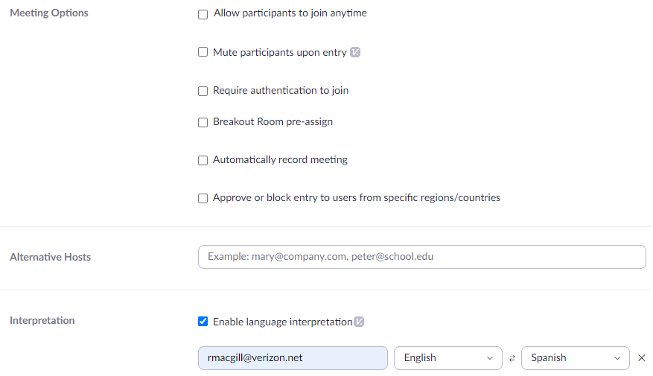
Zoom with Interpreters – How To Set-Up
Schedule meeting with Zoom Web Interface (not Outlook)
Below Meeting Options – Select [Interpretation]
Add yourself as the interpreter

Slide 5
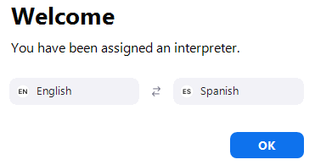
Zoom with Interpreters – In your Meeting
Activate Interpretation
Assign the interpreter and language from meeting participants
And Start the interpretation
Interpreter(s) will be notified
Participants then select their preferred language

Slide 6
Zoom with Interpreters – Considerations
Meeting hosts can hear questions from all languages
Meeting host does not hear the real time interpretation
Unless switching over to that side of the meeting
Meeting recordings are not multi-lingual
Interpreting is tiring, consider shifts (20 min) of interpreters for longer meetings
Possible to have breakout rooms with interpreters. Just need at least one interpreter per room

Slide 7
Questions???
???
I am not a Zoom expert…
Comments, questions, advice (2-way)…rmacgill@verizon.net

