Slide 1

Financial Analysis and Reporting
CSMFO Weekend Training
November 22, 2014

Slide 2
Presentation Overview
Telling Your Fiscal Story in 3 Acts
  Financial Analysis
  Financial Reporting
  Financial Planning
And Along the Way
  8 tips on telling your fiscal story
  And almost any other “data” story, too!

Slide 3
Financial Analysis
“The unexamined life is not worth living.”
  . . . . . . . Socrates – a long time ago
“Unexamined data is not worth having.”
  . . . . . . . Bill Statler – pretty recently

Slide 4
❶ Pareto Principle
Find the fewest things that explain the most amount of stuff.

Slide 5
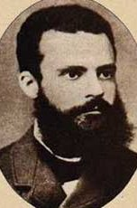
An example of “80-20” …
Distribution of world GDP, 1989
Quintile of Population | Income
Richest 20% | 82.7%
Second 20% | 11.7%
Third 20% | 2.3%
Fourth 20% | 1.4%
Poorest 20% | 1.2%
Vilfredo Pareto
1848-1923
United Nations Development Program Report, 1992

Slide 6
❷ Asking Why to the Fifth Level
“Before we try to explain something, we should be sure it actually happened.”
- Ray Hyman
“It ain’t what you don’t know that will get you in trouble. It’s what you know for sure that just ain’t so.”
- Mark Twain

Slide 7
❸ Zen Data
Data has no meaning unless placed in some context, usually in comparison with something else:
  Others
  Time
  Expectation

Slide 8
Others: “Cross Section”
Comparisons With Others
  Different things, same timeframe
    Other cities
    Other departments
☞ How to best show this?
    Charts
    Graphs
☞ Piece of the pie stuff

Slide 9
Cross Section Samples

Slide 10
Cross Section Samples

Slide 11
Cross Section Samples

Slide 12
City-Wide Resources

Slide 13
General Fund Uses

Slide 14
General Fund Uses: Operating

Slide 15
General Fund Uses: Operating

Slide 16
General Fund Resources

Slide 17
Time Series
What’s Happened Over Time to the Same Things
  ☞ How to best show this?
  Charts
  Graphs—Line/bar graph stuff
  ☞ What other factors might you want to look at?

Slide 18
Time Series Example

Slide 22
Trend Data: In Relation to What?
Increase in service demand?
  Population?
Increase in costs?
  City costs?
  External index (like CPI)?

Slide 30
Using Charts and Graphs
Beyond Just “Numbers”

Slide 31
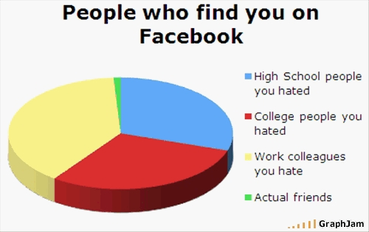

Slide 32
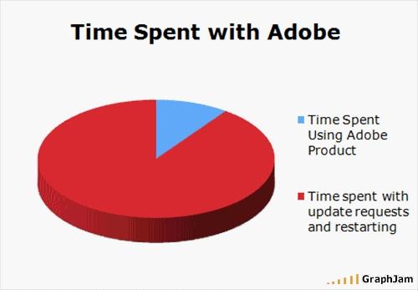

Slide 33
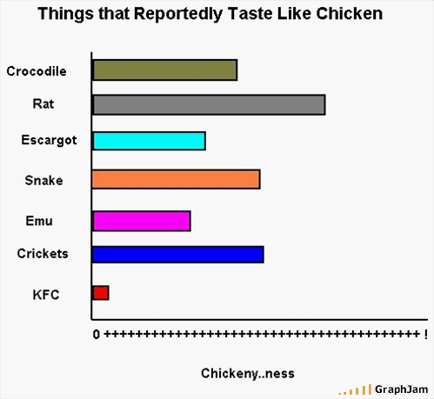

Slide 34
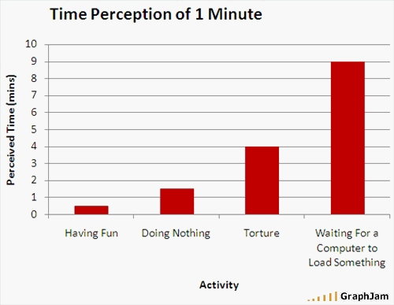

Slide 35
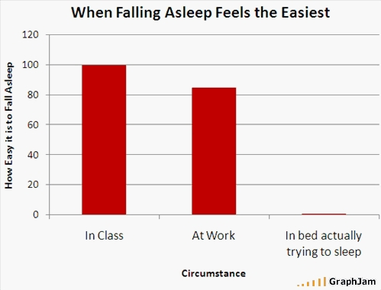

Slide 36
Variance Analysis
What did you expect?
  How does the actual result compare with what you expected?
  Why is it different?
  What’s it mean?

Slide 37
Variance Analysis
* Includes encumbrances of $571,000.

Slide 38
Variance Analysis
* Includes encumbrances of $571,000.

Slide 39
Or …
* Includes encumbrances of $571,000.

Slide 40
Variance Analysis

Slide 41
Variance Analysis

Slide 42
Variance Analysis

Slide 43
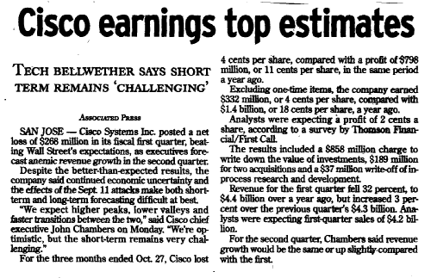
Not Just in Government

Slide 44
❹ Results Aren’t What You Expected
Always assume you’re right and the data’s wrong.
  See No. 2 for what to do if the data’s right.

Slide 45
Presenting the Results
Timely, accurate data is important, but . . .
  What’s it mean?
  What should you do about it? . . . . . . and why?

Slide 46

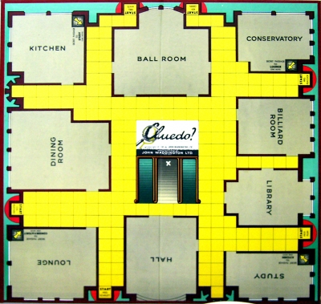


Financial reports and mystery novels

Slide 47
❺ The Data Triangle
❒
Three Chapters in
Your Fiscal Story
Narrative
  Short, punchy
  What’s it mean?
Summary Charts
  The fewest things that explain the most stuff
Raw Data
  Timely, accurate
  Exhibit or “on file”

Slide 48
❻ There’s no good news or bad news
Only unexpected news

Slide 49
❼ Tell your story (in a compelling way)
Know the fiscal story you want to tell.
  And tell that one.
    What’s the plot?
    Who are the characters?
    Why do we care what happens to them?
    What’s the moral?

Slide 50
Financial Reporting
Who, what, why, when, where and how

Slide 51
What We’re Going to Cover
Overview
  Importance of financial reporting
  Governmental financial reporting environment
  Accounting standards
  Types of financial reporting
Generally Accepted Accounting Principles
  Fund accounting—what it is and why we do it
Annual Reporting
  Basic Financial Statements Under GASB 34
  Comprehensive Annual Financial Report
Interim Reporting

Slide 52
Overview
Why are financial reports important?
  Does this affect how we prepare them?
The governmental reporting environment
  Is it the same as the private sector?
Accounting standards for local and state governments
  Who sets them?

Slide 53
Types of Reports
Annual
  Basic Financial Statements
  Comprehensive Annual Financial Report
Interim
  On-Line: 24/7
  Monthly
  Quarterly
  Special Ad Hoc Reports
  Mid-Year Budget Review
  Budget

Slide 54
Fund Accounting Concepts
Or what makes governmental accounting and financial reporting different
Governmental Funds
  General Fund
  Special Revenue Funds
  Capital Project Funds
  Debt Service Funds
  Permanent Funds (Old-Term: Non-Expendable Trust)
Proprietary Funds
  Enterprise Funds
  Internal Service Funds
Fiduciary Funds
  Pension Funds
  Investment Trust (pools)
  Private-Purpose Trusts
  Agency Funds (pure custodial)
Account Groups
  General Fixed Assets
  Long-Term Debt

Slide 55
Measure of Financial Success
Governmental Funds
  Budget vs actual
  Resources available for appropriation
Proprietary Funds (in Theory)
  Net income
  Retained earnings

Slide 56
Basic Operating Statement Model
Governmental Fund

Slide 57
Basic Operating Statement Model
Enterprise Fund

Slide 58
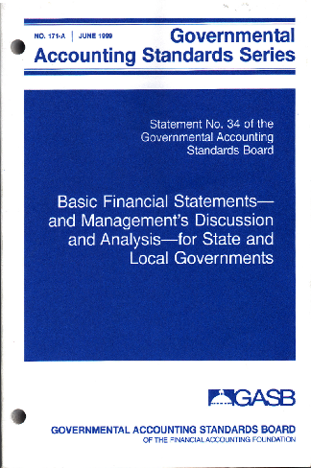
Financial Model Overview
Two Distinct Financial Statements
  Government-Wide (Relatively New)
  Fund-Based (Similar to 1979 Model)

Slide 59
Government-Wide Statements
Consolidated financial statements for all of the agency’s operations
Full accrual basis of accounting
Depreciation on all assets
Not presented on fund basis; two major activities
  Governmental
  Business-Type
Net asset focus:
  Assets - Liabilities = Net Assets
Excludes interfund transactions (like internal service funds) and fiduciary funds (like pensions and assessment districts)
Costs shown both “gross” and “net” of related revenues such as fees and grants
  Can include allocated indirect costs

Slide 60
Fund Statements
Meet Stewardship and Accountability Concerns
  Presented on fund basis similar to 1979 model
    Modified accrual for governmental funds
    Full accrual for proprietary funds
  Significant—but not obvious—differences between these two financial statements
  Detailed reconciliation between the two statements required
  Focus on major (large) individual funds rather than combined fund type

Slide 61
Required Supplementary Information
Management’s Discussion & Analysis
  Specific content requirements: no more, no less.
Budget Reporting
  Comparisons of “budget-to- actual” results for the governmental funds not required as part of the financial statements—but it’s “RSI.”
  Both original and final budget must be presented.
Pension Information

Slide 62
Basic Financial Statements

Slide 63
Other Cool Features
No account groups
Depreciation for governmental activities
Longer and more complicated notes to meet disclosure requirements
The BIG One: Recording infrastructure as capital assets—and expensing them through depreciation
  Streets, sidewalks, bridges, storm drains, street lights, traffic signals, stop signs

Slide 64
Do the “two views” make sense?
New Model Goals
  Improve financial reporting.
  Enhance awareness of fiscal issues facing states and local governments.
  Recognize the importance of adequately maintaining infrastructure.
Does it do a better job of telling the City’s fiscal story?
  Probably not, but it’s GAAP . . . . .

Slide 65
CAFR’s
Three Common Sections
  Introductory
  Financial
  Statistical
One Frequently Used
  Single Audit Act Report

Slide 66
CAFR’s
Introduction
  Transmittal Memo
  Organizational Chart
  Awards
  Principal Officials
Financial
  Basic Financial Statements
    Auditor’s Opinion
    MD&A
    Basic Financial Statements
    Notes
    Other RSI
  More Detailed Statements By Fund
Statistical
  Overview
  10 Year Financial Trends
  10 Year Long-Term Indebtedness Trends
  10 Year Economic and Demographic Trends
Single Audit Act (Optional)

Slide 67
❽ Communicating Complex Numbers
Don’t communicate complex numbers.
  Communicate what they mean.

Slide 68
CAFR’s are good but …
Sometimes too comprehensive
  Introduction: 20 pages
  Opinion, basic statements: 27 pages
  Notes: 24 pages
  RSI: 7 pages
  Supplemental schedules: 26 pages *
  Statistical section: 31 pages
  Total: 135 pages
Solution?
  Great transmittal memo that focuses on key issues—and where you’re at financially (in ways you actually care about).
* This is an improvement: 66 pages pre-GASB 34

Slide 69
Transmittal Memo & MD&A
Formal Transmittal
  Legal requirements
  Management’s responsibility
  Internal controls
  Audit requirements
  Reference to MD&A
Government Profile
  Description
  Services provided by the City and others
  Geography, population, history
  Reporting entity
  Budget policy, control and process
  Other key policies (purchasing, personnel, interim reporting)
“Useful Information”
  Local economy
  Long-term financial planning
  Significant projects
  Cash management and investments
  Risk management
  Debt financing
  Pension programs
Awards
Acknowledgements
MD&A
General Fund Budget and Actual: Page 29

Slide 70
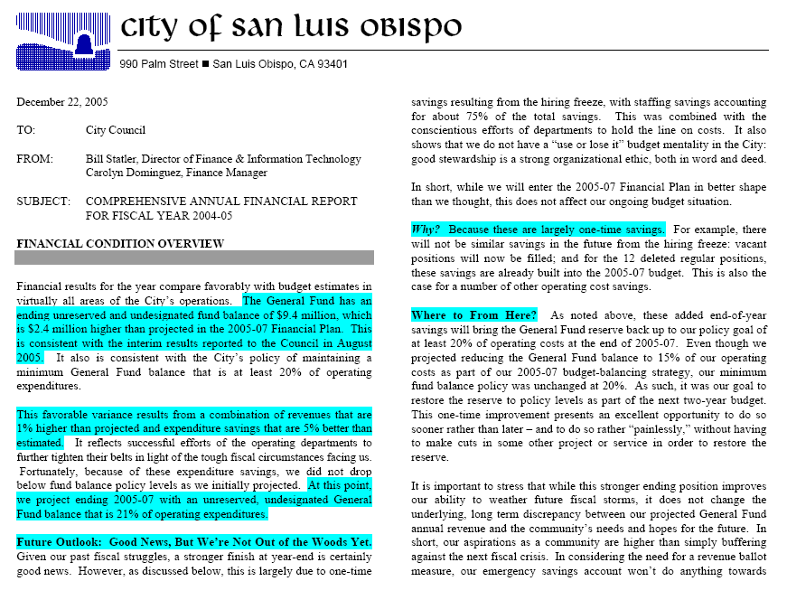

Slide 71
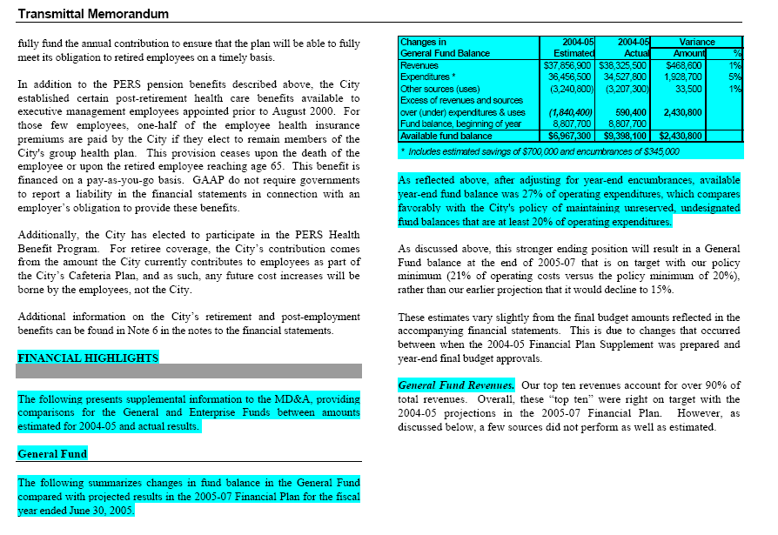

Slide 72
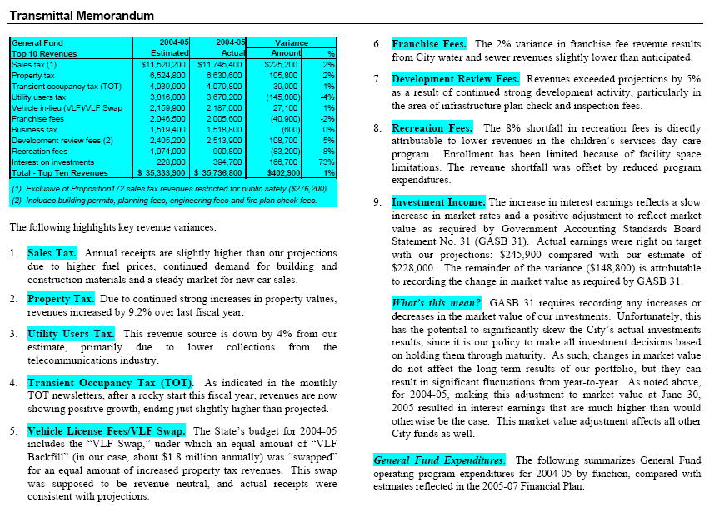

Slide 73
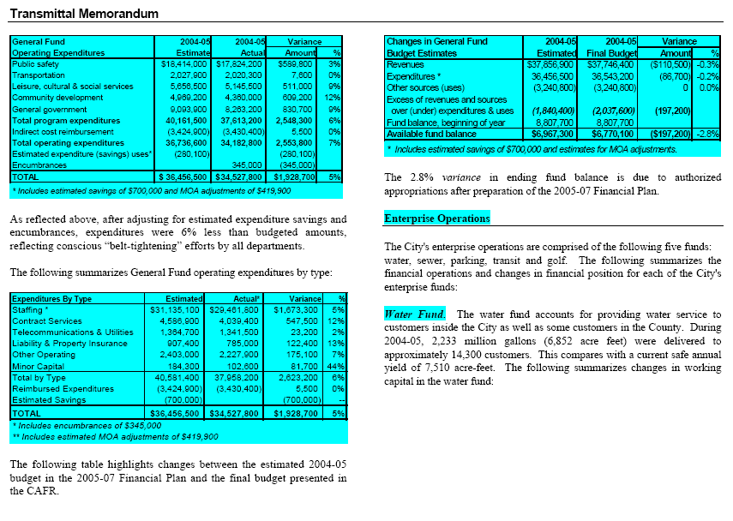

Slide 74
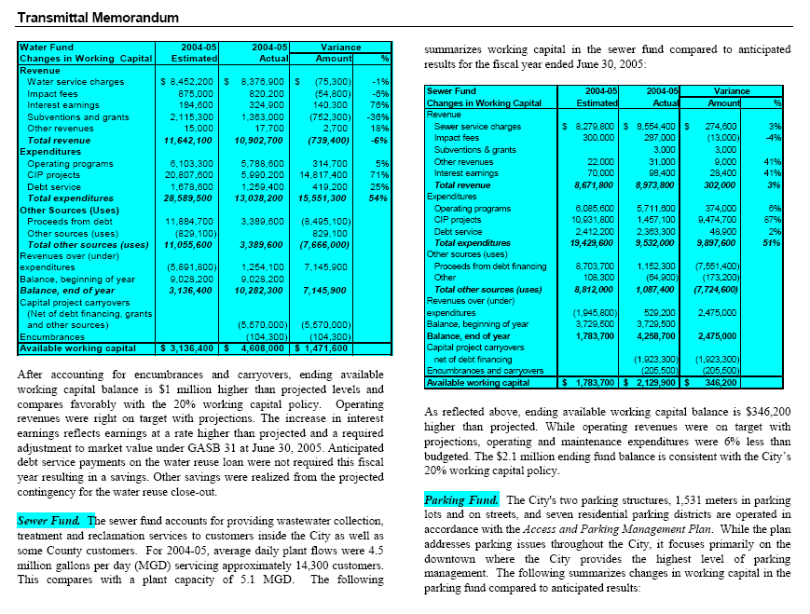

Slide 75
Interim Financial Reporting
No “guidelines” for this.
  No “awards.”
But more important than annual reports.

Slide 76
Interim Financial Reporting
Types
  On-Line “24/7”
    Transparency software: data visualization
  Monthly
  Quarterly
  Special Ad Hoc Reports
  Mid-Year Budget Review
  Budget
Who are they for?
Remember to ask me who I do this for

Slide 77
Monitoring Fiscal Performance
Core Principles in San Luis Obispo
  Strong Systems
  Meaningful Reports
  Timely, Open Reporting
  Organizational Responsibility
    Revenues: Finance & IT
    Expenditures: Departments

Slide 78
Quarterly
Financial
Report
Page 1

Slide 79
Quarterly
Financial
Report
Page 2

Slide 80
Interim Year
End Report
Page 1

Slide 81
Interim Year
End Report
Page 2

Slide 82
Interim Year
End Report
Page 3

Slide 83
Quarterly
Sales Tax
Newsletter

Slide 84
Monthly
TOT
Report

Slide 85
Monthly
Investment Report

Slide 86
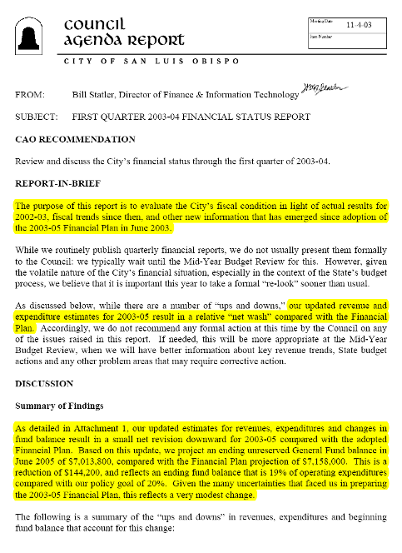
Formal First Quarter Status Report
Don’t usually do this.

Slide 87
Again in
2008

Slide 88
And Again in
2009

Slide 89
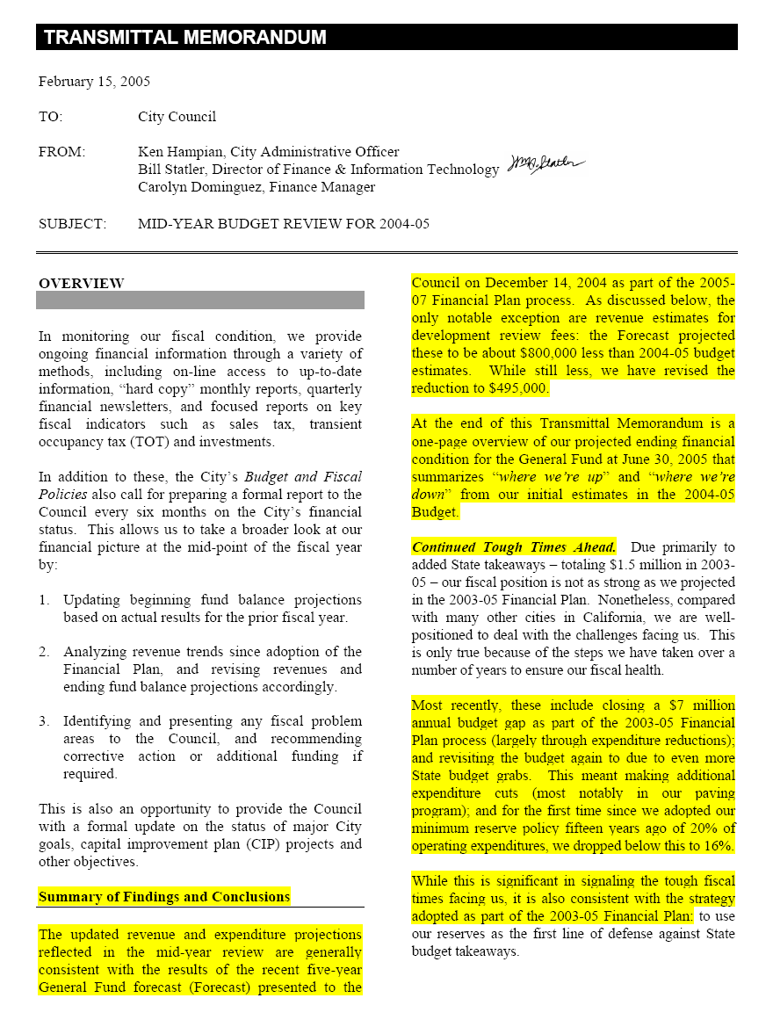
Mid-Year Budget Review

Slide 90
Ups & Downs Summary

Slide 91
Special Reports
Quarterly “Budget Review Team” briefings with City Manager
Year-end expenditure reports by each department
  Compare budget with actual by program and by type.
  Identify reasons for any significant budget overages or underages and analyze their impact on future operating budgets
    Are the variances one-time in nature or will they continue into the foreseeable future?
    If the variances reflect continuing trends, are they reflected in current budgets?
  Comparing operating budget versus actual for the department by program.
  Compare operating expenditures budget versus actual for the department by type.
  Year One Only: Itemizes multi-year carryover amounts and requested general carryover balances.
  Finance & IT prepares summary report.

Slide 92
Year-End Expenditure Report Summary

Slide 93
Fiscal Story Telling Recap
Find fewest things that explain the most amount of stuff.
Ask "why" to the fifth level.
Data only has meaning in context of something else, such as comparisons with others, over time or what you expected.
When results aren't what you expected, always assume you're right and the data's wrong.
The "Data Triangle.“
  Colonel Mustard in the study with a knife
There’s no good news or bad news: just unexpected news
Know the fiscal story you want to tell.
  And tell that one.
Don’t communicate complex numbers
  Communicate what they mean.

Slide 94
Policy Attachments
Monitoring Fiscal Performance
Year-End Department Expenditure Reports

Slide 95
Questions?
Notes:
KEN

