Slide 1
Imaging
With Dell Kace K2000 Systems Deployment Appliance

Slide 2
Overview
Windows AIK and ADK
Windows PE 5.0
Audit mode 8.1 Ent.
Capturing the Image
Model Drivers
Pre, Mid and Post Scripts
Deploying the Image

Slide 4
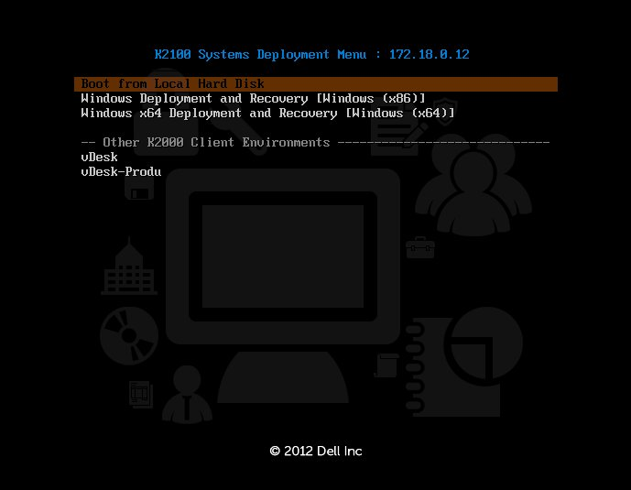
Capturing the Image

Slide 5
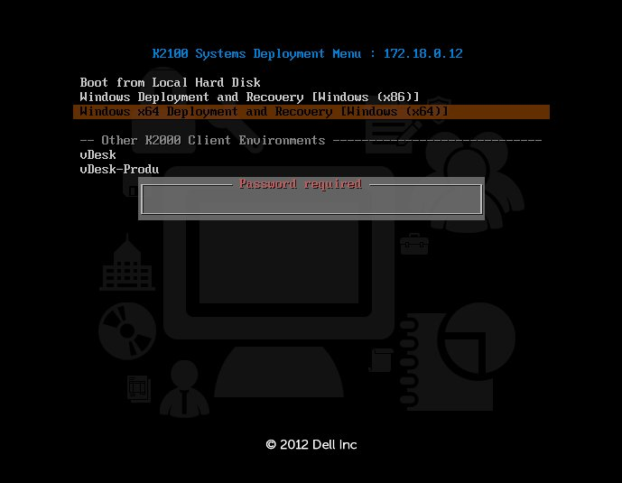
Capturing the Image

Slide 6
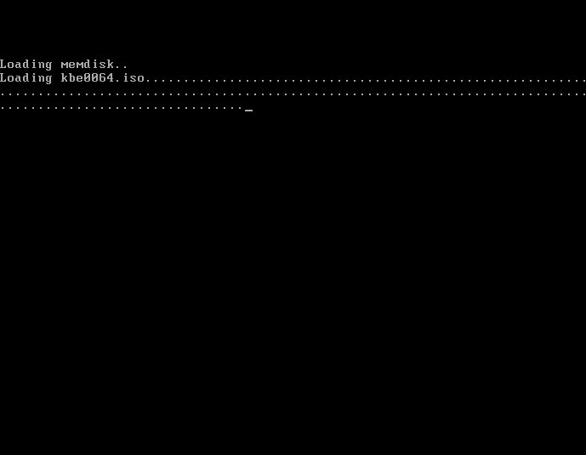
Capturing the Image

Slide 8
Deploying the Image

Slide 9
Deploying the Image

Slide 10
Deploying the Image

Slide 11
Thanks you for your time!
Zachary Brazel
Cape Fear Community College
PC Technician

