Slide 1

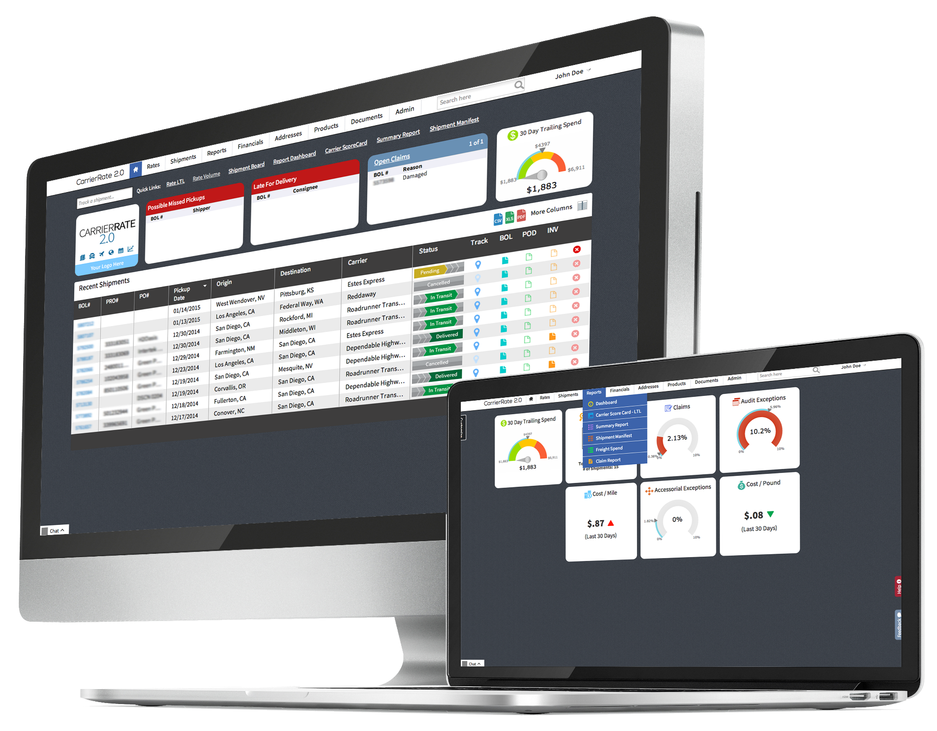
AGENT OWNER CALL

Slide 2

  AGENDA > MONTHLY BRIEFING
Mark Your Calendars
  Every 2nd Wednesday, each month
  10AM and 2PM (Arizona Time)
  Next Call will be held November 11th
Submit your topic suggestions
  Due 1st Wednesday of each month
  Email to: msinicrope@globaltranz.com

Slide 3
  AGENDA > TOP 10
1. Global Freight Source
2. One Source Logistics
3. Volition Logistics, Inc.
4. Freight Pro Logistics
5. GTN Cincinnati
6. Global Forwarding
7. Logex Xpert Logistics
8. REI, LLC
9. Global Source Logistics
10. Supply-Chain Associates
$3,435,393
$634,234
$633,759
$618,966
$572,685
$533,298
$516,373
$428,776
$423,100
$422,261

Slide 4

  AGENT SUPPORT

Slide 5
  AGENT SUPPORT > HELP DESK
Please continue to send all questions to the Help Desk, as this allows GTZ to track Agent issues and Corporate response times – helpdesk@globaltranz.com
Please refrain from contacting Agent Support via email to their personal accounts as this makes requests un-trackable
  Agent Support works mainly through the Help Desk portal rather than their emails
  Please visit the Help Desk website for additional tips and announcements
    https://service.globaltranz.com
Reminders to all Agents of the following:
  Ask potential customers if they are already working with a GlobalTranz Agent or have used CarrierRate Software in the past
  Do not provide quotes for any customer that is not in your CommandCenter

Slide 6
  AGENT SUPPORT > HELP DESK
General Rate Increase – October 17, 2015
REMINDER – A General Rate Increase (GRI) of 1% will take place Saturday, October 17th, 2015. The minimum value in the pricing matrix that you established for your clients will increase by 2% at that time, and all other boxes within the matrix will increase by 1%.
For Example: if you currently have a client set at 23% margins for a 5000 lb., 1200 mile shipment, on October 17th they will be moved to a 24% margin. This will be done automatically and no action is required on your part. All clients will be effected. The following illustration on the next slide should help clarify the change.

Slide 7
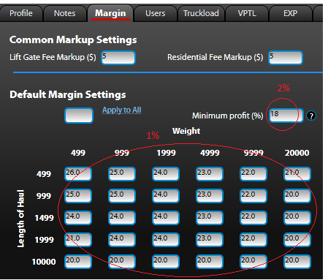
  AGENT SUPPORT > HELP DESK
If you want to exclude a client (or clients) from the 1% GRI, please email helpdesk@globaltranz.com with the name and ID number(s) of the client(s), along with the statement that you want this client excluded from the GRI. Please complete this email by Wednesday, October 15th.
If you want to exclude all of your clients from the 1% GRI, please email helpdesk@globaltranz.com
stating that you would like all of your clients excluded from the GRI, and please include your agency number. Please complete this email by Wednesday, October 15th.
GRI Continued

Slide 8
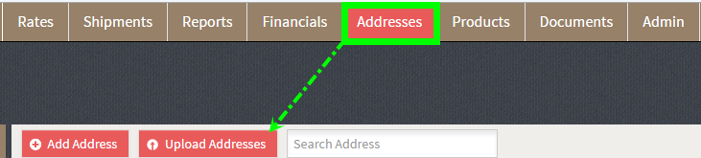
  AGENT SUPPORT > HELP DESK
CR2.0 Address Book Format
  There is a template excel sheet that Agents and Customers can utilize to upload multiple addresses at one time
  The template is located in CR2.0 under the Addresses tab via Upload Addresses

Slide 9
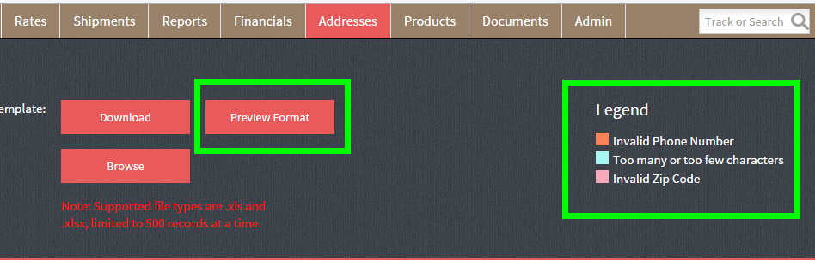
  AGENT SUPPORT > HELP DESK
CR2.0 Address Book Format – Continued
  The Preview Format option provides an at a glance look at how the spreadsheet should be filled out in order to properly upload the customer’s addresses
  Customers and Agents can reference the Legend to the right if there are any errors in uploading the excel sheet

Slide 10

  AGENT EARNINGS

Slide 11
  AGENT EARNINGS > SHIPMENT REASSIGNMENT POLICY
NEW POLICY - Effective 10/16/15
In the instance where an agent builds a load under the incorrect customer causing GlobalTranz to have to reassign the load to the correct customer, the agent may be charged a fee of $50.
The fee(s) will be deducted from the agent’s next earnings following the
reassignment date.
***If you build a load under the incorrect customer, please email Accounts Receivable ardpt@globaltranz.com ASAP to resolve the issue.

Slide 12
  AGENT EARNINGS > EARNINGS ADJUSTMENTS CHANGES
April 120 Report – Distributed 10/7/15
Will be deducted from 10/15/15 agent earnings
Final standalone 120 Report – will be combined with a monthly adjustments report moving forward
Earnings – 10/15/15
A Bills will no longer be paid as part of standard earnings
  Agents will still be compensated for A Bills, however, the A Bill profits will be rolled into the monthly Adjustments Report moving forward
  Note: A Bills account for less than 2% of all agent profit
3rd Quarter Adjustments Report – Distributed 10/23/15
Final quarterly adjustments report
Will be combined with the 120 report into a single monthly report

Slide 13
  AGENT EARNINGS > EARNINGS ADJUSTMENTS CHANGES
Advantages
A single report (Adjustments + 120) distributed to agents monthly
  No more large quarterly adjustment reports
Will smooth the adjustments process – less scenarios where there is a payout and then pullback on the same shipment
Each shipment evaluated on a predictable timeline:
  No shipment evaluated until 60 days from invoice in order to properly calculate true margin
  A bill margin treated as adjustments to the original invoices as opposed to a standalone invoice

Slide 14

  RATE DEPARTMENT

Slide 15
  RATE DEPARTMENT > ROLLOUTS
Rollout Projects
Grouping of shipments that requires a specialized team to provide a higher level of expertise, planning, coordination, & communication
Benefits of using Rollout Pricing:
  Single point of contact
  Constant monitoring of shipments to hit specific delivery due date
  Time definite deliveries (AM/PM) and weekend deliveries
  Shipments move as guaranteed and are flagged in carrier’s system
  Carrier project team designs a load plan to reduce transfers and handling, offering cleaner deliveries
  Additional customized solutions as required
Contact:
  Please direct any questions or completed roll-out forms to ltlclientspecific@globaltranz.com

Slide 16
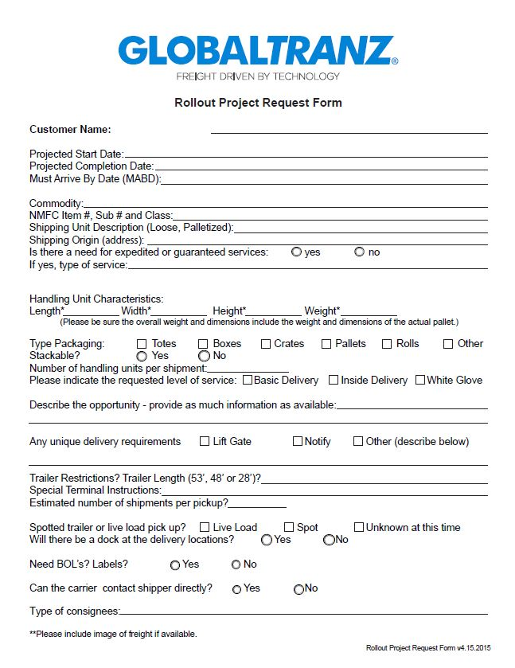
  RATE DEPARTMENT > ROLLOUTS
What Is Required:
Signed Letter of Authorization from client
Excel file including lanes, pallet dimensions, class, and weight
Photos of palletized freight if possible
Completed Rollout Form

Slide 17

  ACCOUNTS RECEIVABLE

Slide 18
  TL POD > TL POD REQUESTS
  All customers marked as “TL POD Required” will automatically receive a POD with their invoices
  If you need to request a TL POD send your request to TLPOD@globaltranz.com

Slide 19
  ACCOUNTS RECEIVABLE > PAYMENTS
ACH Payments
  To set your customer up with ACH payment please email ardpt@globaltranz.com
  ACH payments are a quick and easy way for the customer to pay
  ACH payments post to customers accounts within 24 hours
  Online Payments
  Paying online is the quickest way and most convenient way to make a payment
  Online payments post within 30 minutes

Slide 20
  ACCOUNTS RECEIVABLE > PAYMENTS
Payments by Fax/Email
Please make sure you are sending your customers the most up to date forms for payment
The most up to date forms can be found in the top right corner in CommandCenter
These forms must be completely filled out with no added verbiage as it is a legal binding document
Payments by fax/email will post to customers accounts within 1 hour

Slide 21
  ACCOUNTS RECEIVABLE > PAYMENTS
Mailing Payments
Please make sure that your customers are mailing payments to our lockbox address below and not to the corporate address
GlobalTranz
P.O. Box 203285
Dallas, TX 75320-3285

Slide 22
  ACCOUNTS RECEIVABLE > INVOICING
TL Invoicing Time Line
  Once a TL shipment is completed the shipment will invoice when: (A) The vendor bill has been received (OR) (B)14 days has past from the completion date, which ever comes first.
The carrier should be contacted prior to completion to confirm the load has delivered and to confirm the rate.
LTL Invoicing Time Line
Once a LTL shipment is Finalized, the shipment will invoice once the vendor bill has been received (OR) 14 days has past from the finalized date, which ever comes first.

Slide 23
  ACCOUNTS RECEIVABLE > INVOICING
Cash Terms Invoicing
Customers on Cash Terms (Open Credit Card or Open Check Draft Authorization) will be invoiced and charged within 48 hours of completion.
Please note that shipments move into an invoiced status throughout the day. However, once a shipment moves to an invoiced status in CommandCenter it will not invoice until the following day as invoicing is processed every morning.

Slide 24

  EXPEDITED SERVICES

Slide 25
  EXPEDITED SERVICES > OVERVIEW
On Time Delivery Is Top Priority
Our technology, relationships, and team of industry professionals provide an unparalleled ability to meet your most important shipping needs. The Expedited Services department is a fully operational Freight Forwarder designed to assist you with your every shipping need. No matter where you’re shipping to or what you’re up against, our professional team of experts can help. From NFO’s to economy ground services, we have the resources available to manage your shipment so you don’t have to.

Slide 26
  EXPEDITED SERVICES > SERVICE OFFERINGS
Service Offerings
Next Flight Out (NFO’s)
Next Day by 1030
Exclusive Use Vehicles (E.U.V.’s)
Next Day by Noon
Local Pickup/Delivery
Next Day by 5pm
2nd Day by 1030
2nd Day by Noon
2nd Day by 5pm
3rd Day by 1030
3rd Day by Noon
3rd Day by 5pm
3-5 Day Economy Ground
Trade Show Pickup/Delivery
Weekend Pickup/Delivery
Export/Import Freight
After Hours Pickup/Delivery
Project Freight/Distributions
Aircraft Charters
Ocean Services

Slide 27
  EXPEDITED SERVICES > SERVICE OFFERINGS
Alaska & Hawaii
Expedited Services currently offers online rate quotes for shipments originating from the Lower 48 States to both Alaska and Hawaii. We provide a “multi-modal” service which blends your choice of LTL carrier with our ocean providers to ensure you receive the most competitive rate available. We use only the best and most reputable carriers to Alaska and Hawaii and provide up-to-date tracking via our tracking email address: gtzexptrack@globaltranz.com. Rest assured when shipping to these points, we’ve got you covered so your shipment can enjoy “smooth sailing” to its final destination.
International Air/Ocean
Expedited Services also offers a variety of International solutions via our air and ocean partners to destinations such as Puerto Rico, Guam and the US Virgin Islands. We have a dedicated International team ready to assist you in sorting through all the necessary documents required to ship internationally. Let them help by requesting a quote today at: esintquote@globaltranz.com

Slide 28
  EXPEDITED SERVICES > QUOTING
Please see below for a general guideline by Origin and/or Destination and where to send your quote request:
Considered International Quotes:
Puerto Rico
Guam
US Virgin Islands
Australia {AIR Only)
South America (AIR Only)
China (Al R Only)
Europe (Al R Only)
Canada (AIR Only)
Mexico (Al R Only)
Email International Quote requests to: esintquote@globaltranz.com
Considered Domestic Quotes:
All U.S. Points within Continental US
AK/HI shipments NOT available online Eastbound Moves from Hawaii
Southbound Moves from Alaska
Full Containers to/from Hawaii
Full Containers to/from Alaska
Canada (GROUND only) no LTL services Exclusive Use Vehicles (US to Canada)
Email Domestic Quote requests to: esdomquote@globaltranz.com
To/From: Ocean services to the points highlighted in yellow have been temporarily suspended until further notice

Slide 29
  EXPEDITED SERVICES > QUOTING CON’T
Most Domestic quotes are available online thru CommandCenter. If the system does not return a rate, then please make sure to include the following information when submitting your quote requests via email:
Origin Zip Code
Destination Zip Code
Number of Pallets Shipping
Number of Pieces Shipping
Weight per Pallet or Piece
Dimensions (must be in inches and L x W x H format)
Commodity Shipping
Service Level Requested
Any additional information required to quote accurately
Please Note: Alaska and Hawaii requests not available online must include the class and NMFC# (when available)

Slide 30
  EXPEDITED SERVICES > CONTACT INFO
For Domestic Quotes (not available online): esdomquote@globaltranz.com
For International Quotes: esintquote@globaltranz.com
For Tracking/Shipment questions: gtzexptrack@globaltranz.com
For General questions/All Department Personnel: gtzexp@globaltranz.com
Michael Owen: Ext. 4147
General Questions/TSA/Spot Rates/Projects/Int’l Backup
Michelle Cuadra: Ext. 5539
Quoting/TSA Info/Tracking/Cust. Svc/Ops

Slide 31
  EXPEDITED SERVICES > CONTACT INFO
DOMESTIC:
Anthony Olivas: Ext. 4215
Domestic Ops Agent/Quoting
Sam Breitling: Ext. 5535
Domestic Ops Agent/Hawaii Quotes
Michael “Rob” Sienicki: Ext. 4197
Domestic Ops Agent
Joanna Olivas: Ext. 4174
Domestic Ops Clerk/Hawaii & Alaska Invoicing
Cynthia “Cat” Peach: Ext. 4138
Domestic Ops Clerk/Alaska Quotes
James Cole: Ext. 3659
Domestic Ops Clerk/Tracking
INTERNATIONAL:
Vito Leto: Ext. 4123
International Ops/Quotes/Tracking
Department Hours:
0530-1800 Monday – Friday (Arizona Time)
Toll-Free Phone: 866-275-1407
Direct Department Line: 602-218-4249
(on call telephone number)
Expedited Fax: 877-566-1507

