Slide 1
NC Department of IT Overview

Slide 2

+68%
All Traffic

Slide 3
+68%
All Traffic

Slide 4
+68%
All Traffic

Slide 5
Service Delivery
Operate and Serve - Services
Who we are.
What we do.
Common collaboration.
Product Management and Engineering
Enterprise Applications and Infrastructure Operations
Customer Service/ Service Support
IT Service Excellence
The Service Delivery Division provides a wide range of information technology services to State agencies, local governments, and educational institutions across North Carolina. Our services include enterprise applications, hosting, network, telecommunications, desktop computing, and unified communications such as email and calendaring. Providing IT Service Excellence through our service delivery across agencies allows the State to realize efficiencies and cost savings through economies of scale.
State Agencies
Local Governments
Educational Institutions

Slide 6
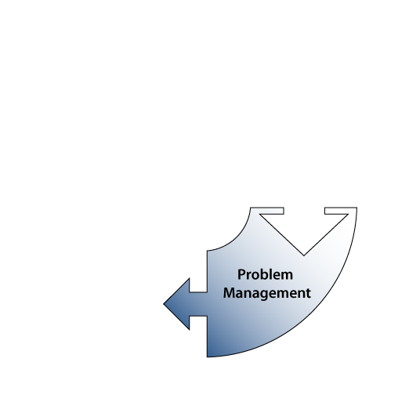
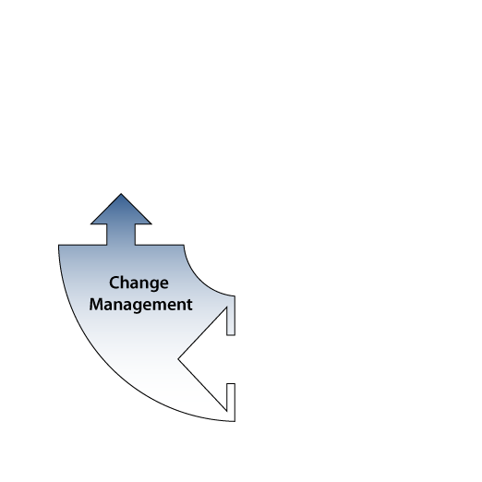
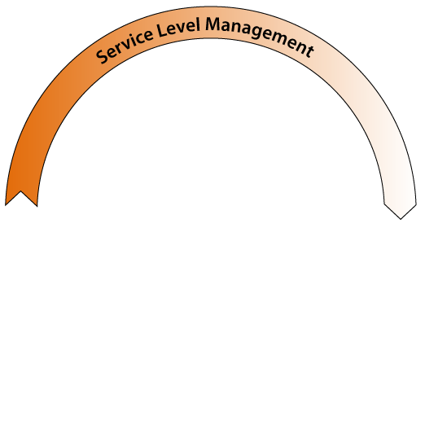
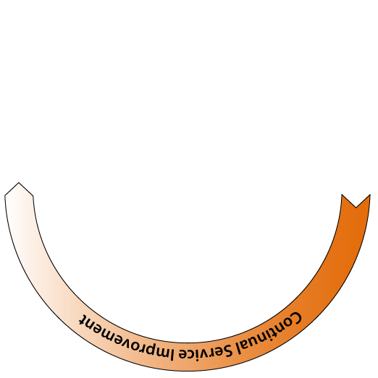
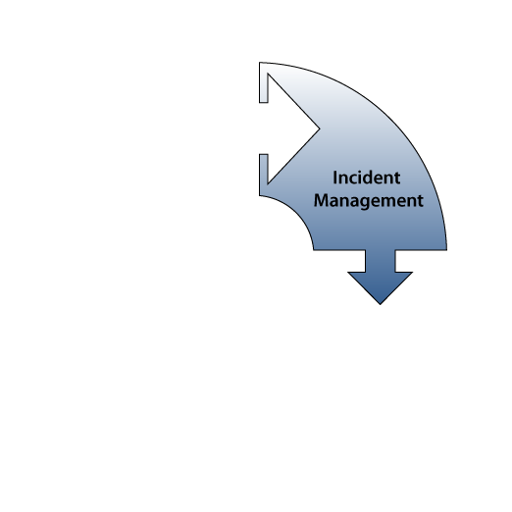
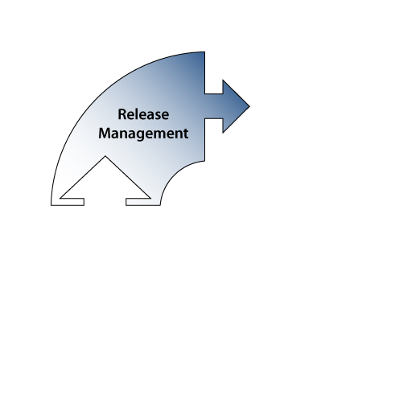
IT Service Excellence
The IT Service Excellence Team oversees the development of IT Service Management (ITSM) policies, processes and procedures that govern the delivery of DIT services utilizing the Information Technology Infrastructure Library (ITIL) framework.
Service Level Management (SLM) establishes the agreement between a service provider and customer, documented in a Service Level Agreement (SLA)
Release Management is similar to Change Management but on a much larger scale, often combining Changes into manageable bundles
Incident Management ensures that any and all services that have been impacted (service disruption, limited availability, etc.) are restored to “normal operation” as soon as possible
Change Management is designed to protect the production environment by minimizing the potential for adverse impact or incidents to production services during the transition from build
Problem Management seeks to prevent Incidents from reoccurring and minimize the impact of Incidents that cannot be prevented, it is both proactive and reactive in nature
Continual Service Improvement (CSI) strives to improve all aspects services and processes, asking the simple question; “What can be done better?”

Slide 7
Service Delivery- Highlights
Operate and Serve - Services
Hosting Options
Storage Options
Network Options
Western Data Center
Security
Project Management
Innovation Center

Slide 8
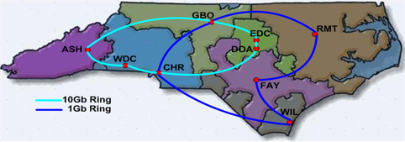
Network Options
Operate and Serve - Services
Private network provides up to 20Gbps of connectivity
40Gbps of redundant Internet access connectivity.
Over 2000 locations utilizing managed WAN service
Secure access to the Internet
IP Address Management, including DNS and DHCP services
24x7 support with automated monitoring and ticketing
Customer access to bandwidth and availability reports
Ability to provide private communications between devices connected to the State network
Hardware refresh included in rates

Slide 9
Hosting Services
Managed Hosting Services (over 2000+ hosts) across Data Centers
Fully Managed Services include the following:
  Distributed Hosting (AIX, Linux, Solaris, Windows)
  Business Continuity and Disaster Recovery
  Hardware Platform Support and Maintenance
  Operating System Support & Maintenance
  User Management
  Service Desk Support
  Functional Area Performance & System Monitoring
  Data Base Services
  Data Backup & Retention
  Storage Services
  Security & Vulnerability Scanning
  Implementation Project Coordination
*(Applications are typically managed by the customer/client)
Operate and Serve - Services

Slide 10
Eastern Data Center (EDC) Raleigh,
Western Data Center (WDC) Forest City, NC
Floor Hosting includes the following:
  DIT provides physical rack space
  DIT provides data center environment
  Customer/Client provides own hardware, such as servers, switches, and storage
  Customer/Client manages their servers and applications
  Customer/Client has access as needed to upgrade existing or install additional hardware.
Disaster Recovery- Two 24 x 7 Data Centers
Operate and Serve - Services
Eastern Data Center (EDC) Raleigh, NC
Western Data Center (WDC) Forest City, NC
  Floor Hosting includes the following:
  DIT provides physical rack space
  DIT provides data center environment
  Customer/Client provides own hardware, such as servers, switches, and storage
  Customer/Client manages their servers and applications
  Customer/Client has access as needed to upgrade existing or install additional hardware.

Slide 11
Eastern Data Center (EDC) Raleigh,
Western Data Center (WDC) Forest City, NC
Floor Hosting includes the following:
  DIT provides physical rack space
  DIT provides data center environment
  Customer/Client provides own hardware, such as servers, switches, and storage
  Customer/Client manages their servers and applications
  Customer/Client has access as needed to upgrade existing or install additional hardware.
Structured Cabling (Wiring) Services
Operate and Serve - Services
Economical menu pricing for small cabling implementations (both inside building and outside plant)
Registered Communications Distribution Designers (RCDD)’s provide design consulting and submit detailed specifications to pre-qualified cabling vendors for competitive bidding (large projects)
Manage large implementations including project planning, construction coordination, and quality control assurance along with receipt and evaluation of as-built deliverables
Experience in overseeing a 10M contract over last 4 Fiscal years including over 65 different customer projects

Slide 12
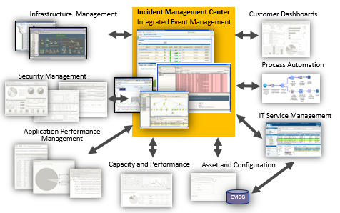
Eastern Data Center (EDC) Raleigh,
Western Data Center (WDC) Forest City, NC
Floor Hosting includes the following:
  DIT provides physical rack space
  DIT provides data center environment
  Customer/Client provides own hardware, such as servers, switches, and storage
  Customer/Client manages their servers and applications
  Customer/Client has access as needed to upgrade existing or install additional hardware.
NCDIT Enterprise Integrated Incident Management Center
Operate and Serve - Services

Slide 13
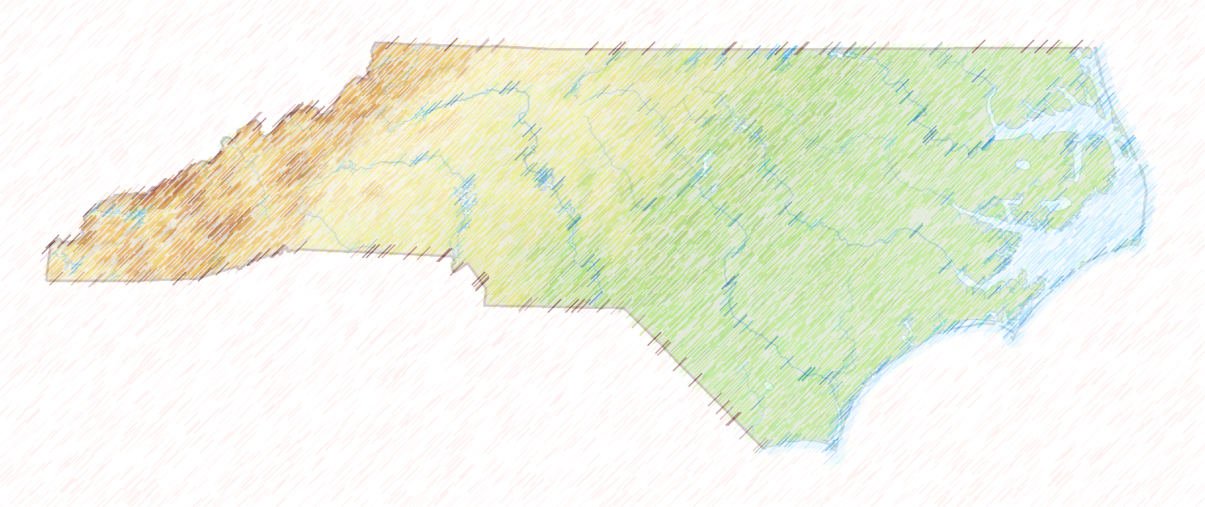
Eastern Data Center (EDC) Raleigh,
Western Data Center (WDC) Forest City, NC
Floor Hosting includes the following:
  DIT provides physical rack space
  DIT provides data center environment
  Customer/Client provides own hardware, such as servers, switches, and storage
  Customer/Client manages their servers and applications
  Customer/Client has access as needed to upgrade existing or install additional hardware.
The NCDIT Incident Management Center
Operate and Serve - Services
Phase I
  Physical Set Up
  Process Standardization
  Tool establishment
  Services Monitored/Provided
    Service Desk
    Network by Device
    Hosting by Device
      Windows
      Linux
    Mainframe
    DIT Facilities
Phase 2
  Services Monitored/Provided
    Voice
    Security
    Hosting by Device
      Unix
      AIX
  Dashboards
    By Device
    Customer
  IMC Disaster Recovery
Phase 3
  Services Monitored/Provided
    Service Views
    Enterprise Applications
      NCID
      Exchange
  Dashboards
    By Service
    Mobile
  Enterprise Monitoring Service

Slide 14
Eastern Data Center (EDC) Raleigh,
Western Data Center (WDC) Forest City, NC
Floor Hosting includes the following:
  DIT provides physical rack space
  DIT provides data center environment
  Customer/Client provides own hardware, such as servers, switches, and storage
  Customer/Client manages their servers and applications
  Customer/Client has access as needed to upgrade existing or install additional hardware.
The NCDIT Incident Management Center- Before redesign
Operate and Serve - Services

Slide 15
Eastern Data Center (EDC) Raleigh,
Western Data Center (WDC) Forest City, NC
Floor Hosting includes the following:
  DIT provides physical rack space
  DIT provides data center environment
  Customer/Client provides own hardware, such as servers, switches, and storage
  Customer/Client manages their servers and applications
  Customer/Client has access as needed to upgrade existing or install additional hardware.
The NCDIT Incident Management Center- After redesign
Operate and Serve - Services

Slide 16
Eastern Data Center (EDC) Raleigh,
Western Data Center (WDC) Forest City, NC
Floor Hosting includes the following:
  DIT provides physical rack space
  DIT provides data center environment
  Customer/Client provides own hardware, such as servers, switches, and storage
  Customer/Client manages their servers and applications
  Customer/Client has access as needed to upgrade existing or install additional hardware.
NCDIT Voice Contracts
Operate and Serve - Services
State Term Contract 725A: Provides access to all forms of telephony equipment, maintenance, and professional services from seven major manufactures. Manufacturers on the contract include Avaya, Cisco, Mitel, NEC, ShoreTel, Toshiba, and Unify (f/k/a Siemens). http://www.phonepurchase.nc.gov/
State Term Contract 725T: Provides access to IP based SIP trunking for PSTN access. Also provides Hosted VOIP services for on premise single and multi-site implementations. Vendors are AT&T, CenturyLink, and Level 3. http://www.siptrunking.nc.gov/
State Term Contract 915A: Provides mobile and wireless services across the entire state. Contracts provide for voice, mobile data, user devices, and a wealth of other services. All participating vendors offer discounts on service plans and equipment to all governmental agencies and all governmental employees. Service providers on the contract include AT&T, Sprint, T-Mobile, US Cellular, and Verizon. http://it.nc.gov/services/service-directory/telephony/cellular-telephone

Slide 17
Eastern Data Center (EDC) Raleigh,
Western Data Center (WDC) Forest City, NC
Floor Hosting includes the following:
  DIT provides physical rack space
  DIT provides data center environment
  Customer/Client provides own hardware, such as servers, switches, and storage
  Customer/Client manages their servers and applications
  Customer/Client has access as needed to upgrade existing or install additional hardware.
Need more information on services?
Operate and Serve - Services
Contact our Service Desk to engage a Service specialist 919-754-6000 or Toll Free 1-800-722-3946
Refer to the Service Catalog on our Web Page for more information visit: http://it.nc.gov/services/service-directory

Slide 18
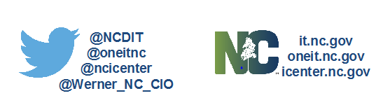
Eastern Data Center (EDC) Raleigh,
Western Data Center (WDC) Forest City, NC
Floor Hosting includes the following:
  DIT provides physical rack space
  DIT provides data center environment
  Customer/Client provides own hardware, such as servers, switches, and storage
  Customer/Client manages their servers and applications
  Customer/Client has access as needed to upgrade existing or install additional hardware.
Continuing the conversation
Operate and Serve - Services

