Slide 1
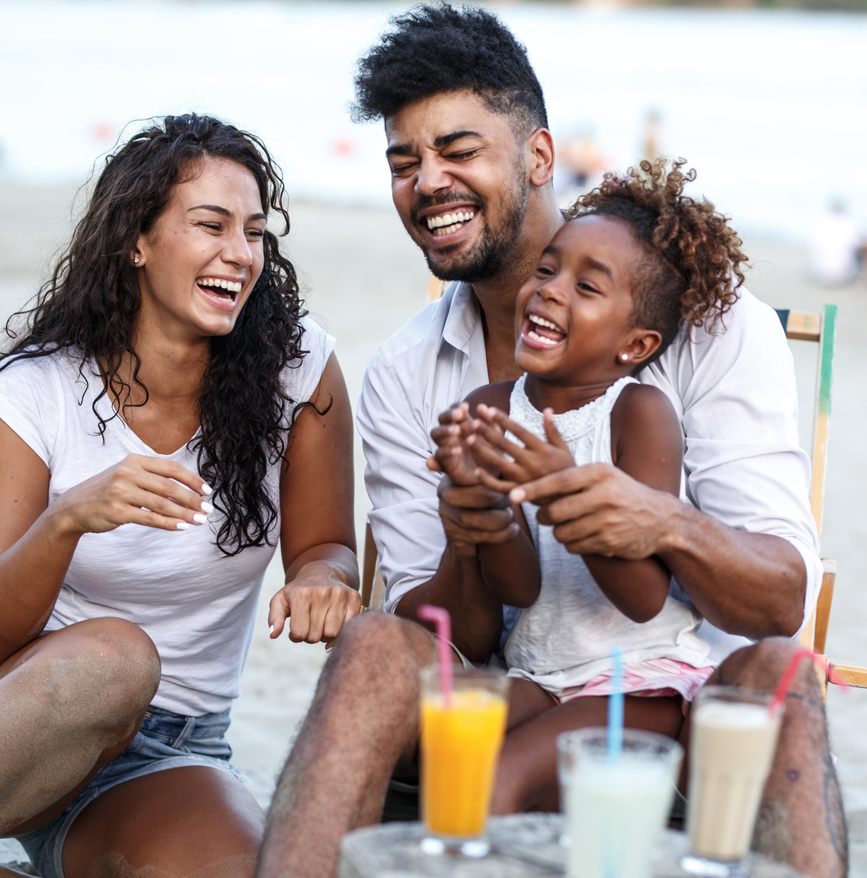
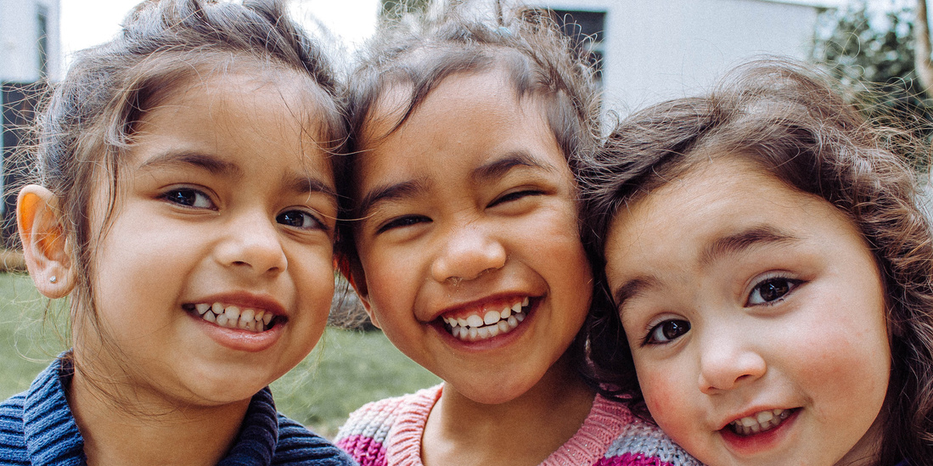
Protect your family
How to Keep Them Safe At Home

Slide 2
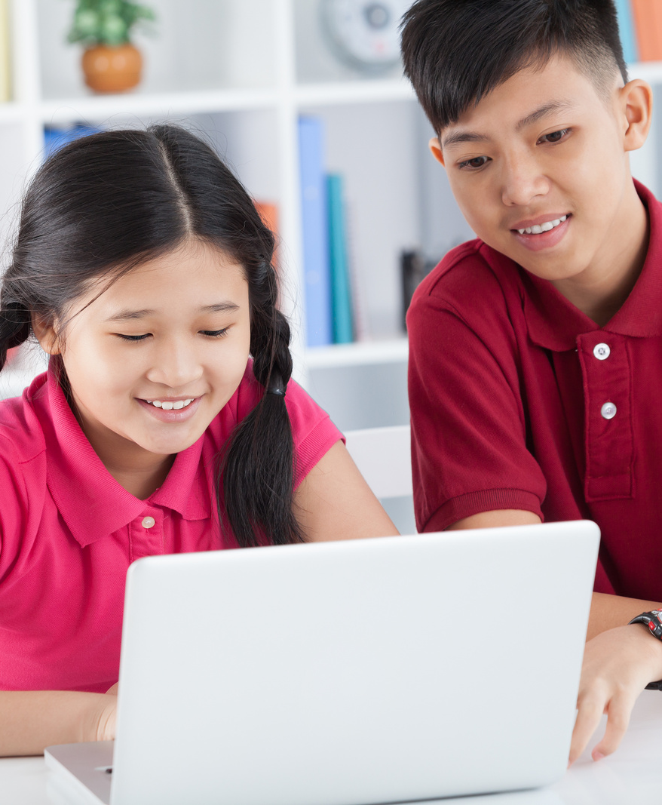
Prepare your home for Independent Virtual Learning
As many parents & guardians return to work, school remains virtual
Tweens and teens may spend hours home alone
Consider these tips to make your home safe
Take steps to prevent suicide and substance misuse

Slide 3
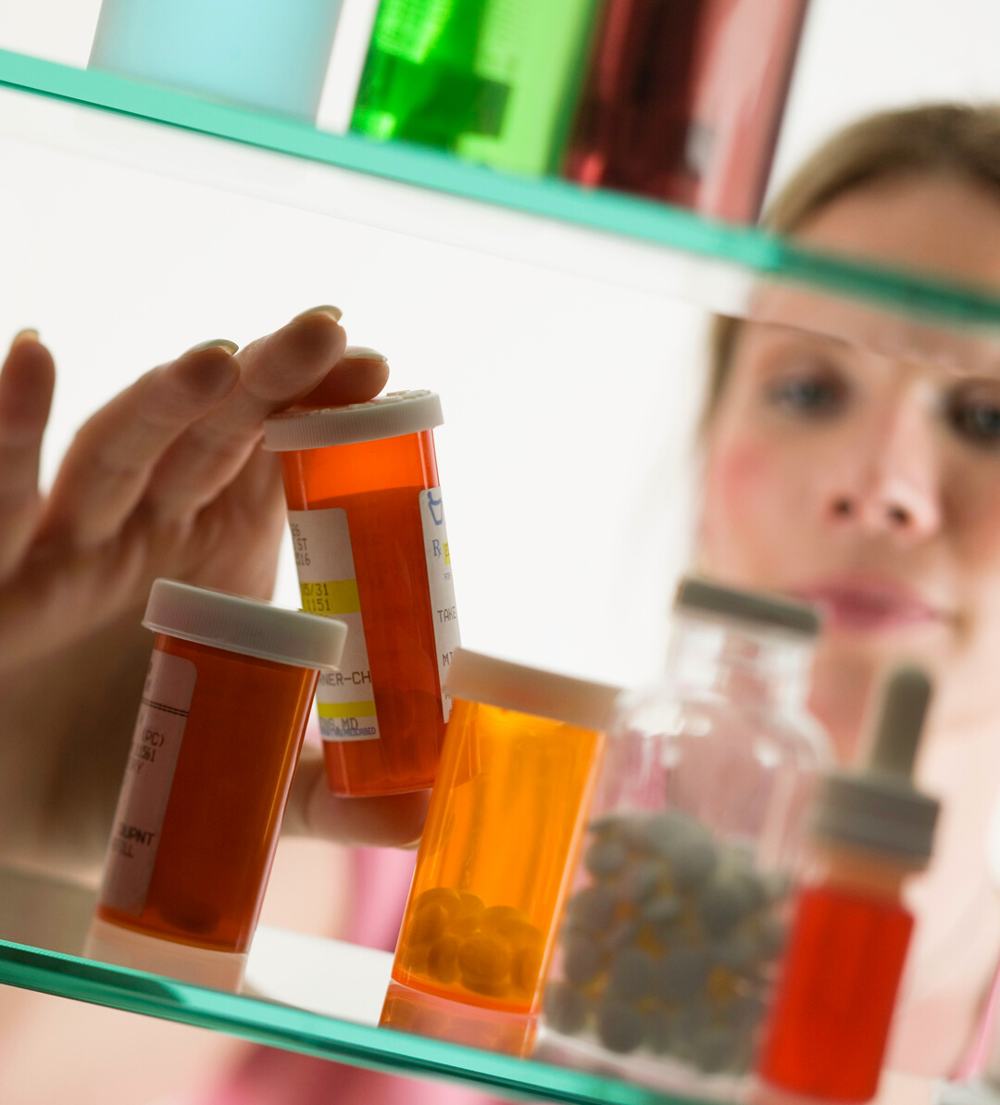
2/3 teens who misused pain relievers got them from family and friends, including their home’s medicine cabinets.
Remove or Secure all medications in a safe
25% of teenagers believe that prescription ADHD drugs can be used as a study aid and nearly 1/3 of parents agree meds can improve grades, even if they do not have ADHD.

Slide 4
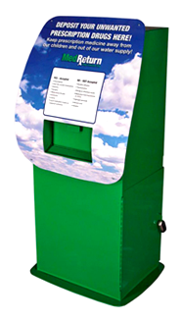
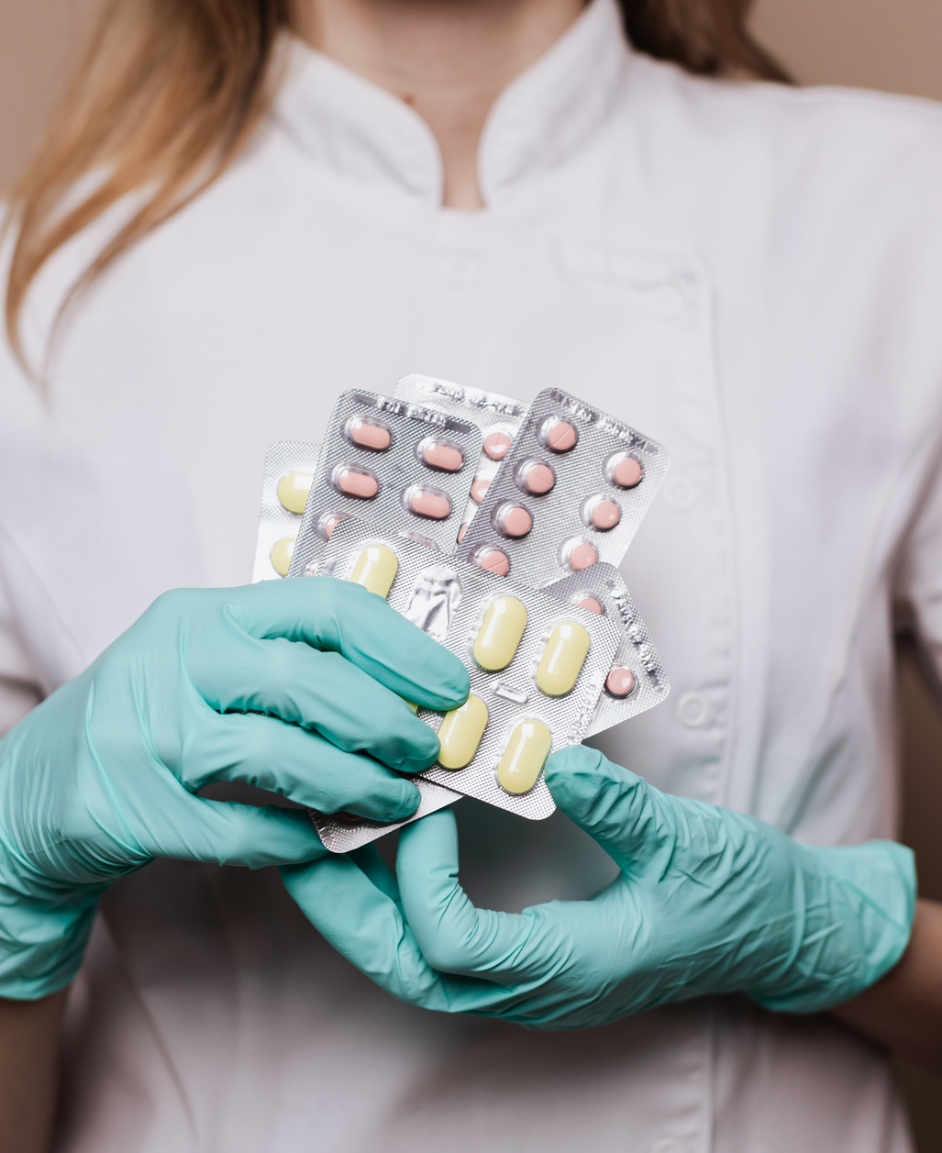
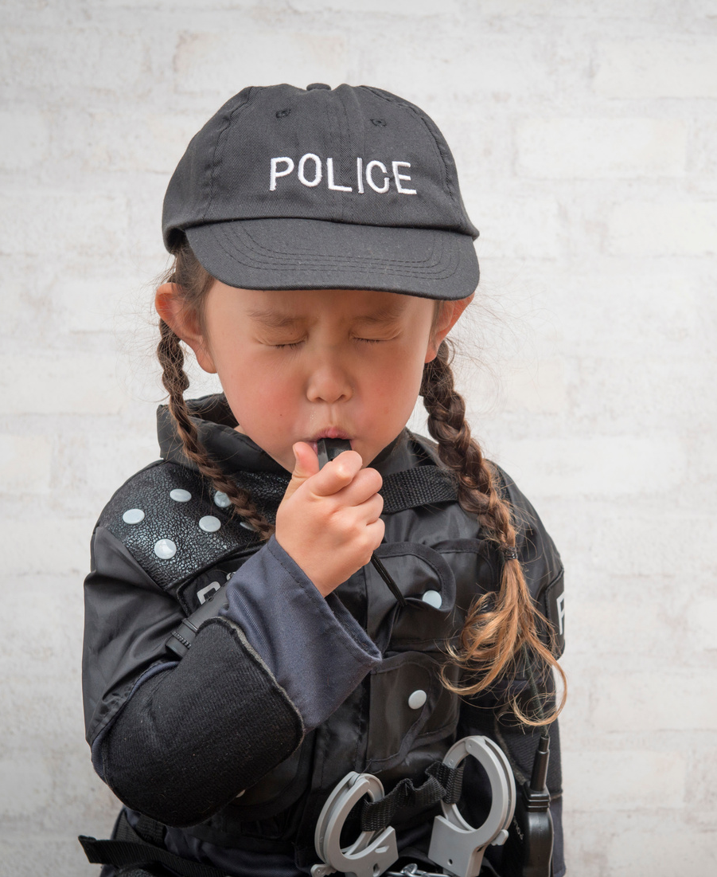
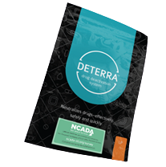
Take drugs to a drop off box at a police station or pharmacy
Deactivate medications before throwing in trash
Got Drugs?
Never flush medications in your sink or toilet!

Slide 5
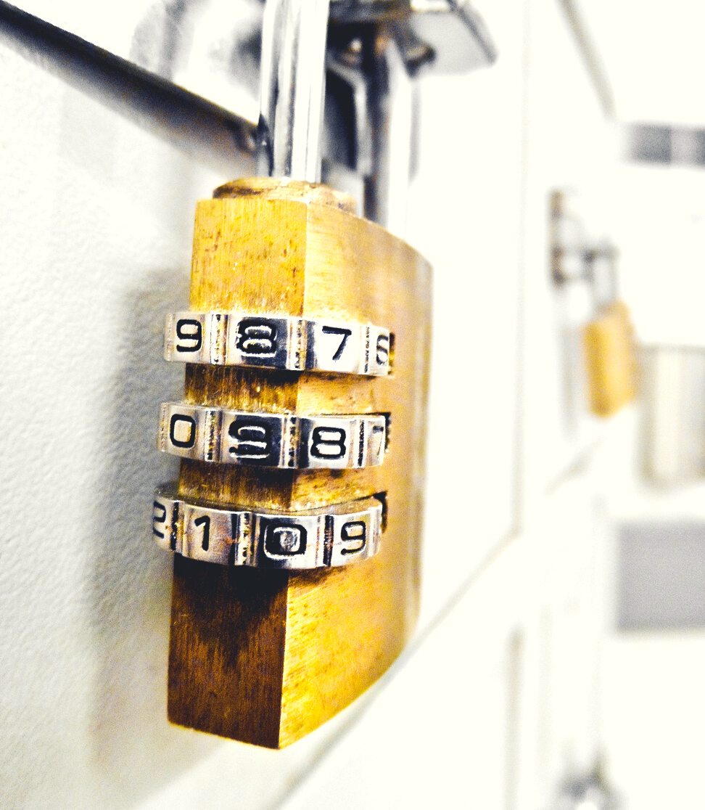
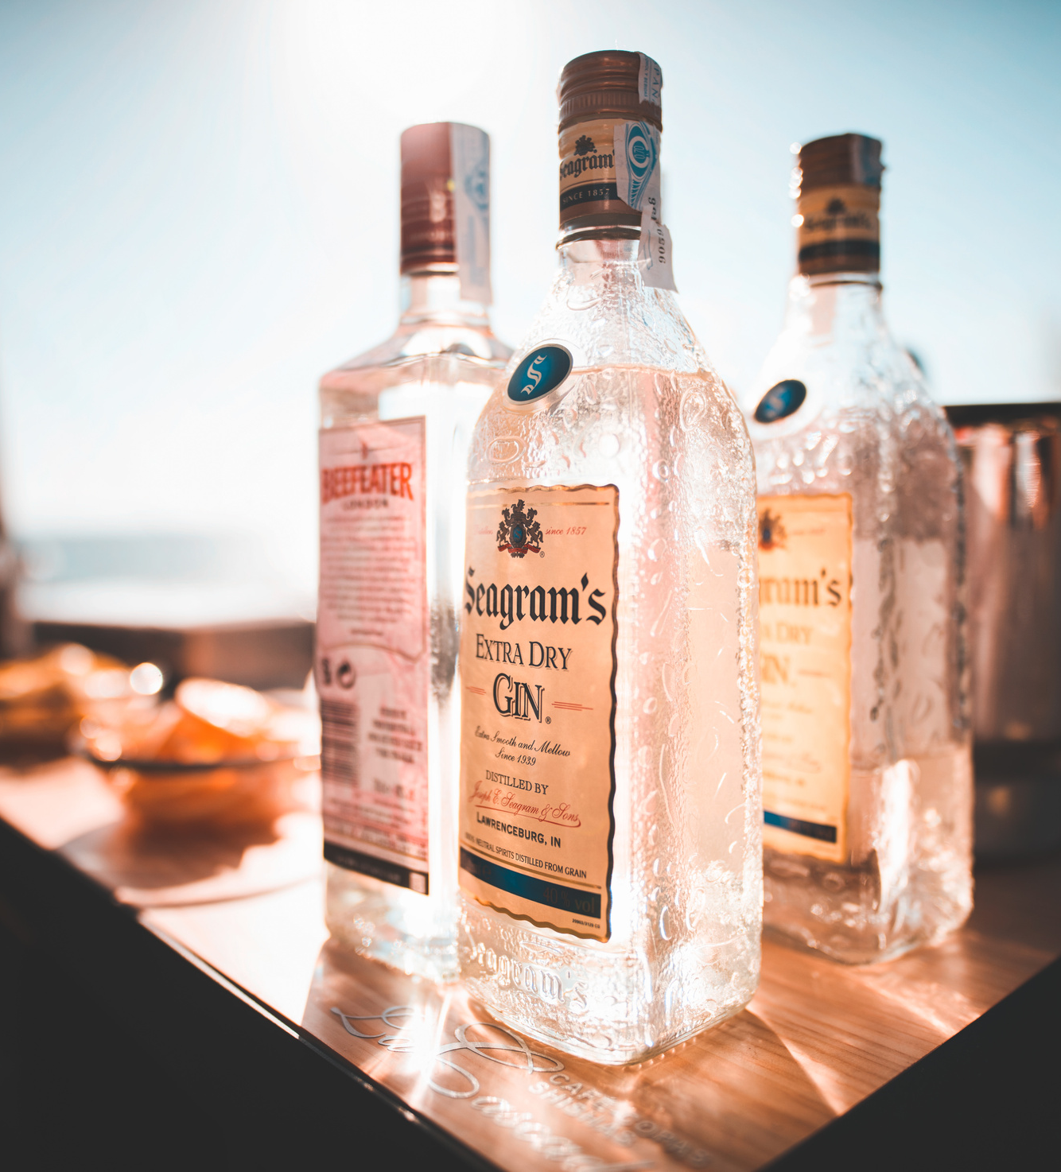
R|R
By age 15, about 29.8 percent of teens have had at least 1 drink.
Remove or Secure all alcohol in a locked cabinet
In 2018, 7.1 million young people ages 12–20 reported that they drank alcohol beyond “just a few sips” in the past month.

Slide 6
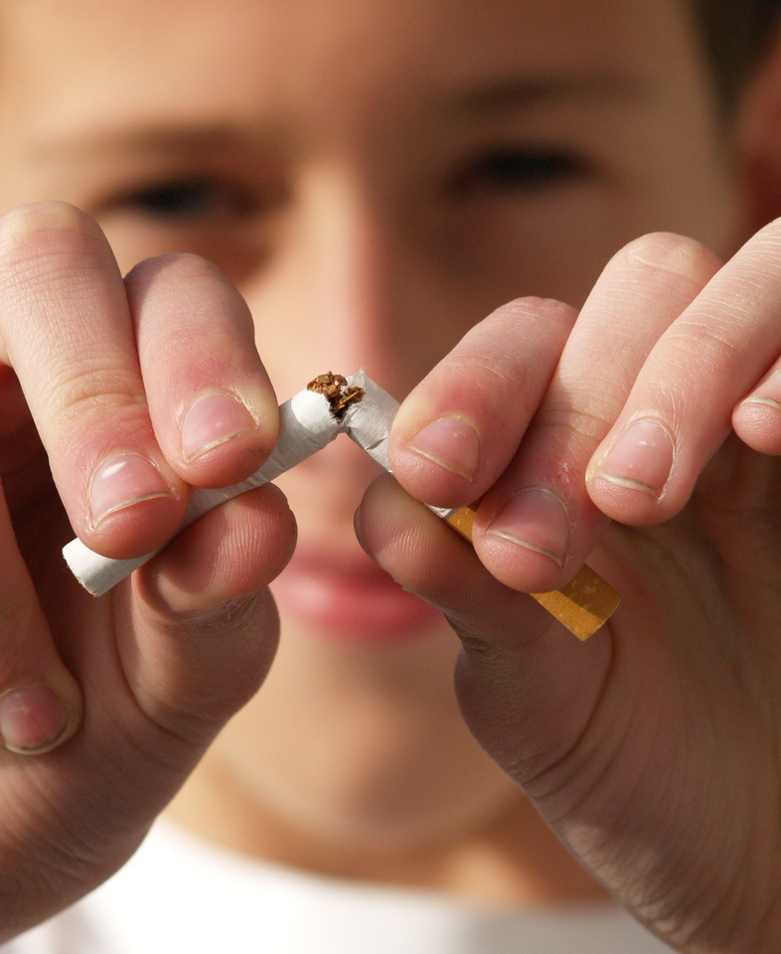
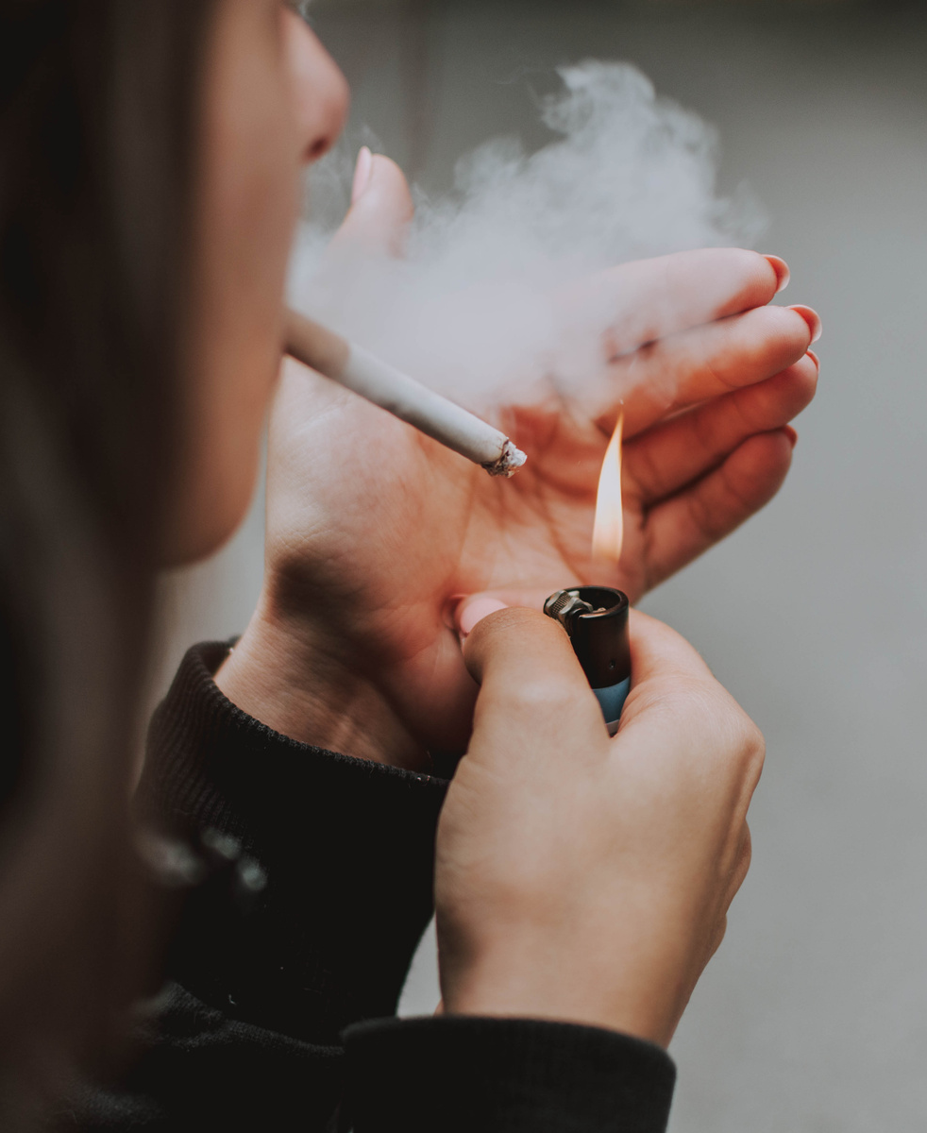
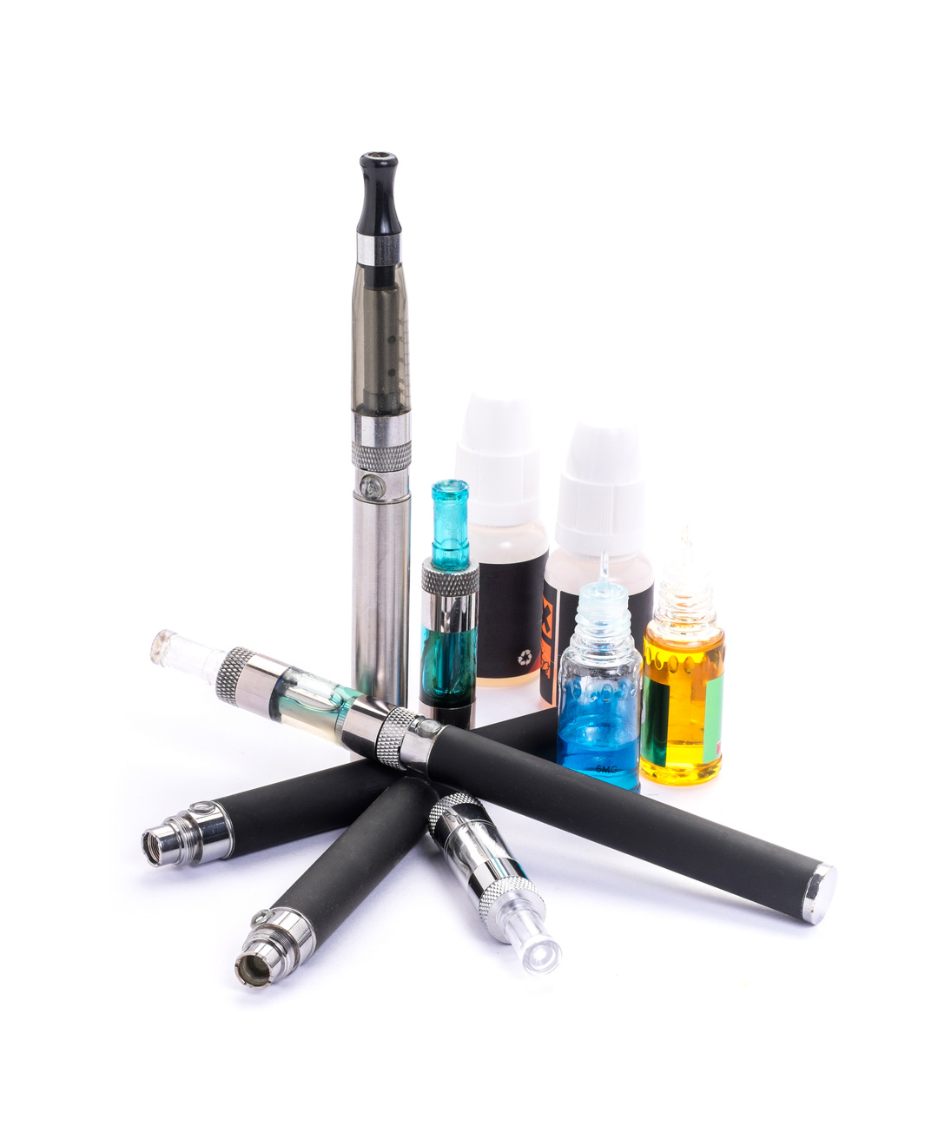
Youth use of tobacco products in any form is unsafe, regardless of whether it is smoked, smokeless, or electronic. If smoking continues at current rates, 5.6 million—or 1 out of every 13—of today’s children will ultimately die prematurely from a smoking-related illness.
Most e-cigarettes contain nicotine which is highly addictive and can harm adolescent brain development and cause permanent lung damage.
Remove or Secure all
tobacco products
E-cigarettes can contain other harmful
substances, including THC.

Slide 7
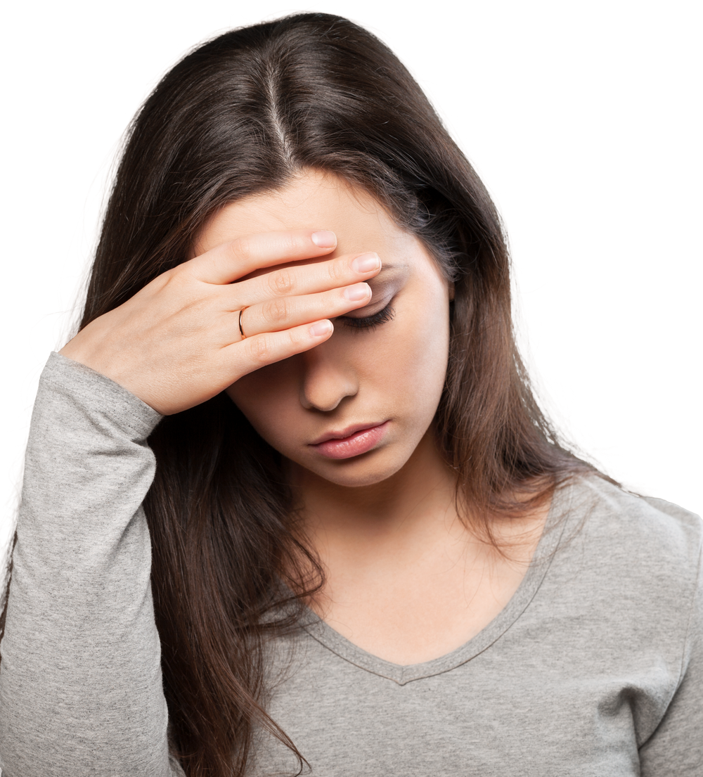
Violence involving firearms is a leading cause of death among US youth ages 14 to 24.
Remove or Secure all weapons
Store firearms
Locked
Unloaded
Out of Reach
Out of Sight (no glass front cabinet)
Separate From Ammunition
Adolescents, in particular, are at a higher risk for suicide when there is a gun in the home.

Slide 8
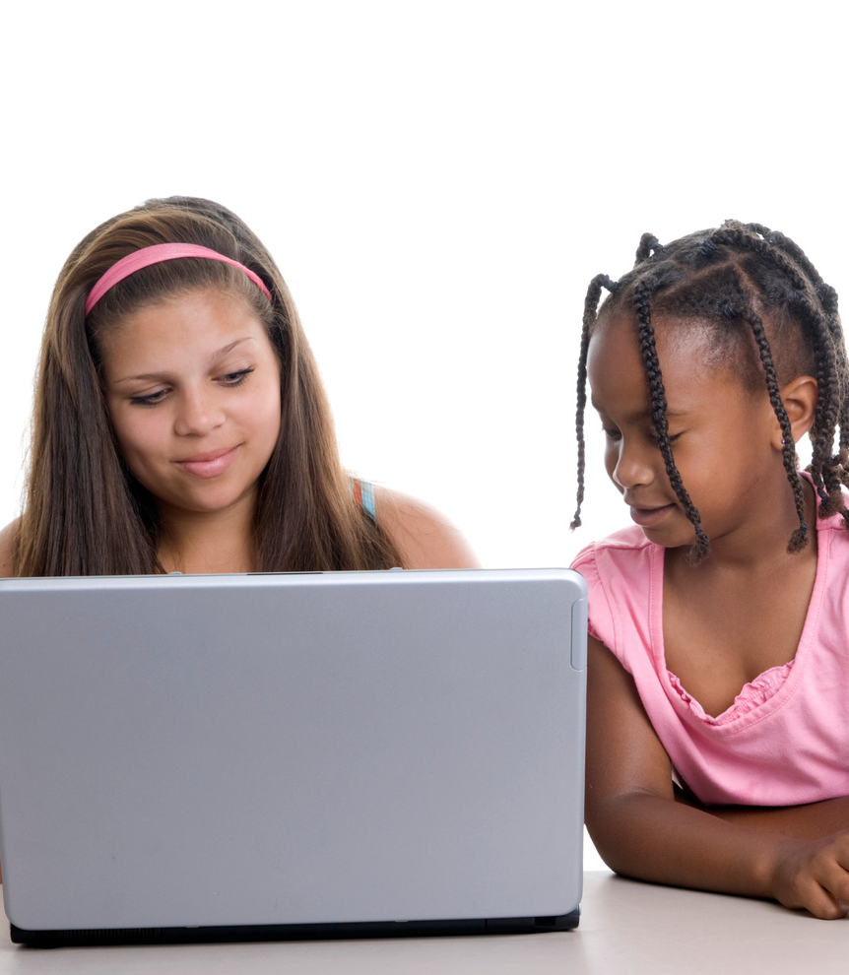
Remind kids not to share personal information or pictures, or use revealing or suggestive screen names or emails.
Set up strong online parental
controls & monitoring
Teach kids that they should NEVER chat online, or meet in person, with people you meet online!

Slide 9
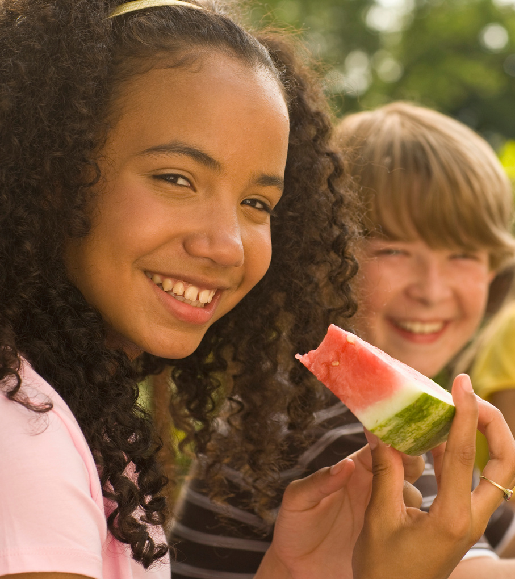
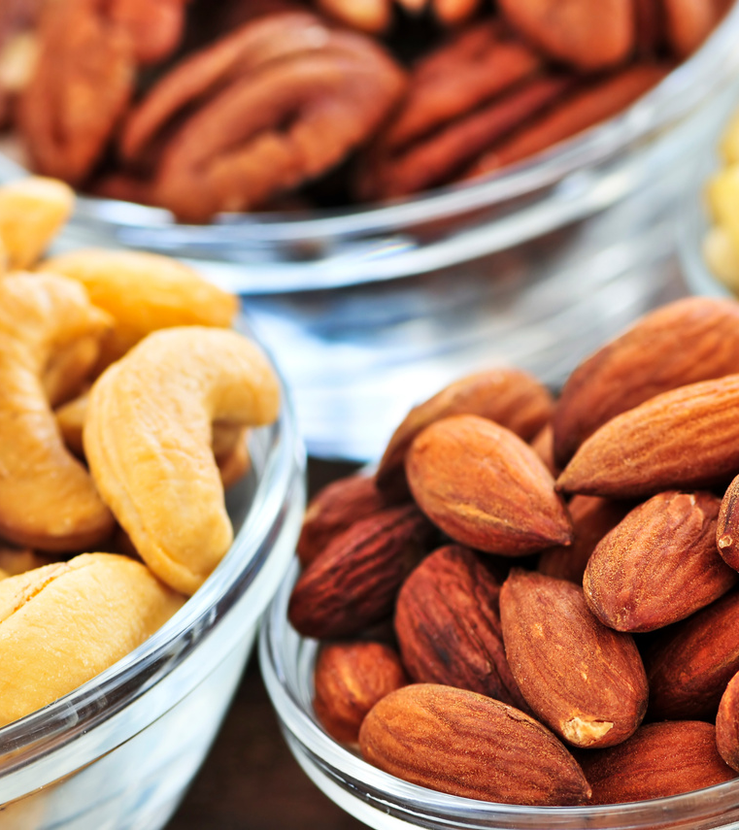
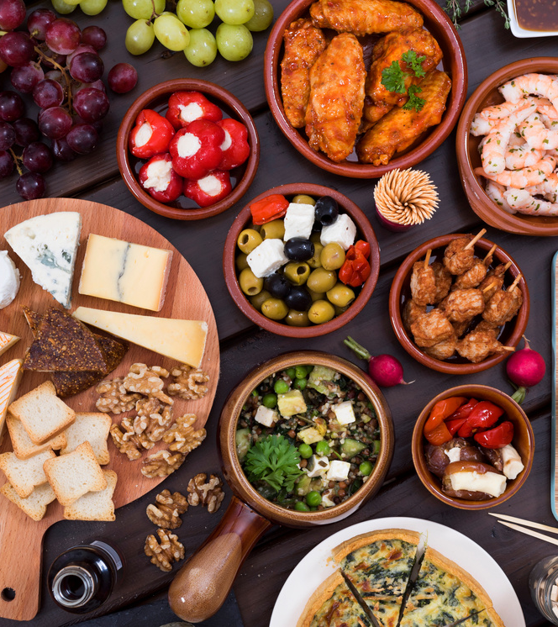
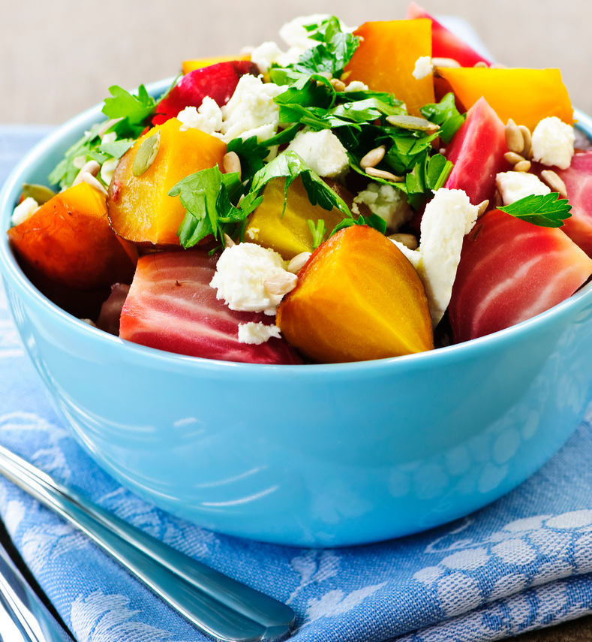
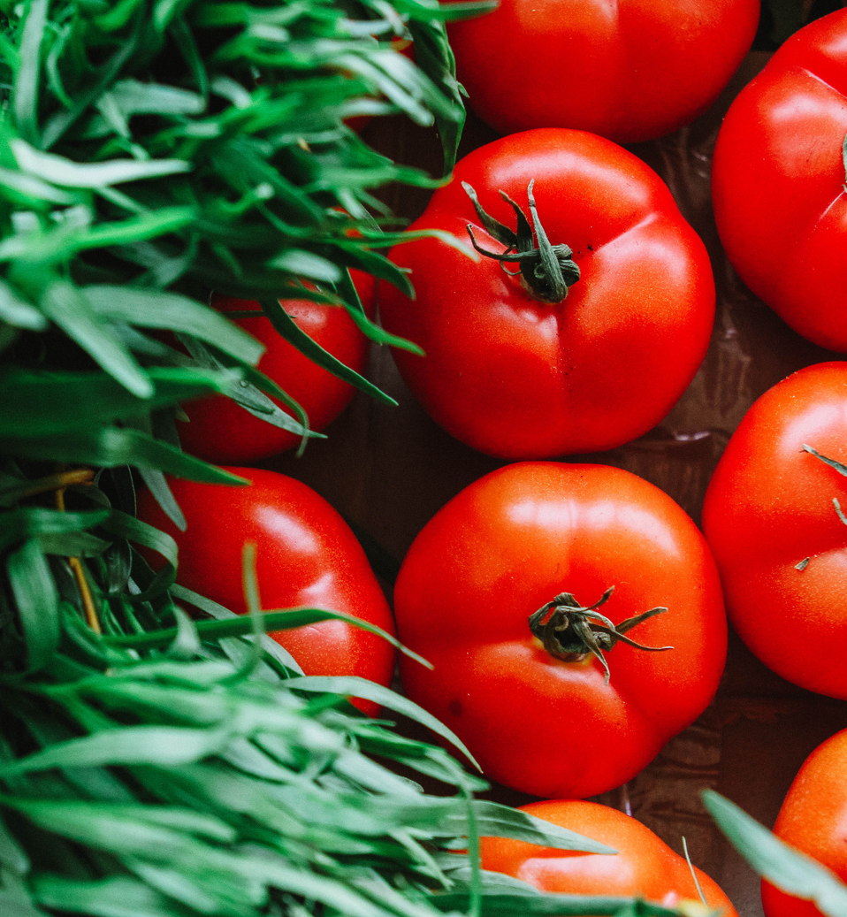
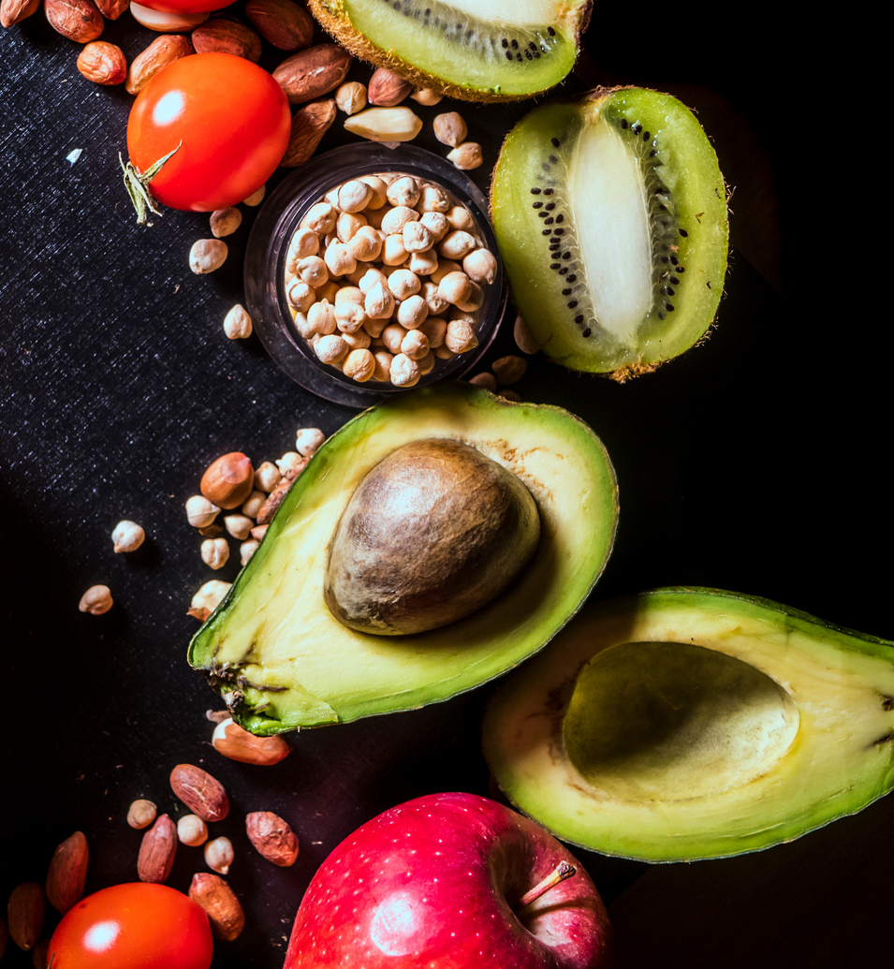
Supply healthy meals and snacks
Food pick up is available at 74 MCPS schools
Provide a variety of foods
New Employee Starter Kit
Minimal or no cooking
Foods low in sugar
Company swag
Easy to grab and eat
Boredom can lead to skipping meals or binge eating
Breakfast, Lunch and Snacks
Presentations are communication tools that can be used as demonstrations, lectures, speeches, reports, and more. It is mostly presented before an audience. It serves a variety of purposes, making presentations powerful tools for convincing and teaching.

Slide 10
Initiate meaningful
conversations to
stay connected
Ask unique, open ended questions such as:
What was your favorite part of the day?
Who did you play with at school?
Who did you talk to today from school?
How were you kind to someone today?
What are you proud of?
What are you thankful for?
What's one good thing you're really good at?
Who's the nicest person you know?
Don’t be afraid to ask direct questions if you suspect a person is considering self harm/suicide

Slide 11
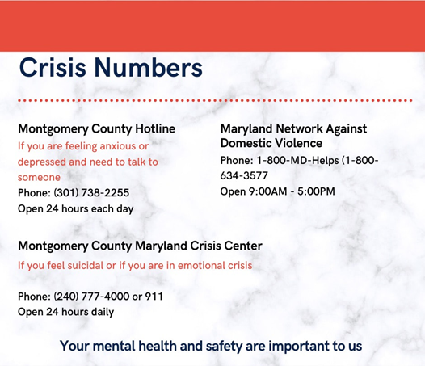
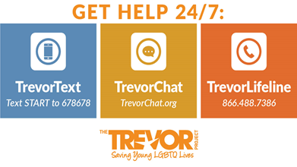
Maintain Mental as well as Physical Health
Please reach out if you need help

Slide 12
Want to
know more?
Visit MCCPTA.org

