Slide 1
Why Do We?
Rituals /Practices Explained

Slide 2

Namaste
Na ma (not me) te (you)
Common Indian greeting (gesture with folded hands and bowed down head) which means “I bow to the God within you”.
Bowed head - humility or surrendering your ego.
Folded palms - “may our minds meet”.

Slide 3

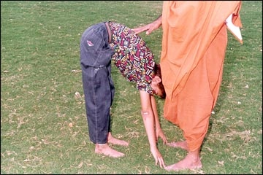
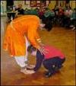
GREETING ELDERS

Slide 4
Greeting elders
Traditionally elders are greeted by prostration or touching of the feet. The elder in turn blesses us by placing his/her hand on or over our heads.
The act of touching the feet is a sign of respect for the age, maturity, nobility and divinity that elders personify.
Touching of the feet is a way of humbly acknowledging the greatness of another person.
This tradition is part of manners/etiquette most Indian children are taught at an early age.

Slide 5
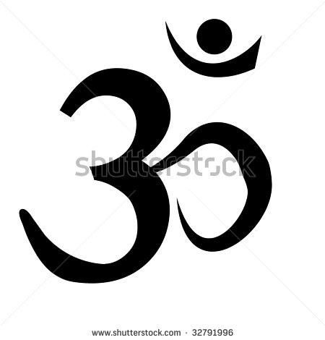
OM or AUM
Hindus believe that before creation began there was emptiness or void. When creation began, the divine, all-encompassing consciousness took the form of the first and original vibration manifesting as sound "OM".
The mantra "OM" represents name of God, the vibration of the Supreme.
When taken letter by letter, A-U-M represents the divine energy united in its three elementary aspects: Brahma (creation), Vishnu (preservation) and Shiva (liberation, and/or destruction).[

Slide 6


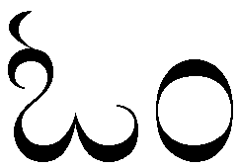

OM (in different indian languages)
Sanskrit, Hindi, Marathi, Gujarati
Kannada and Telugu
Tamil
Malayalam

Slide 7
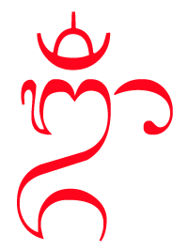
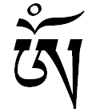
OM (in other languages)
Tibetan
Balinese

Slide 8
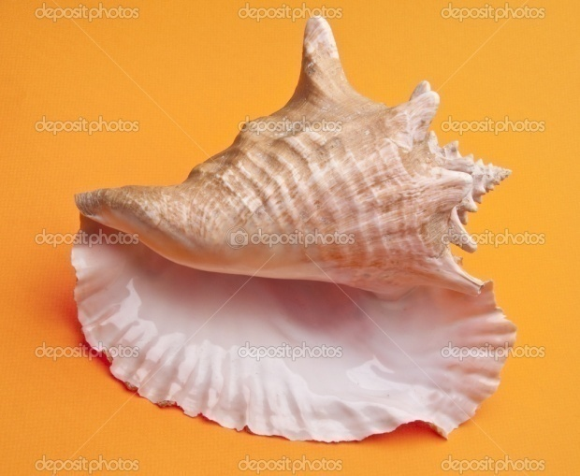
Blowing the SHANKHA
When the conch shell is blown, the primordial sound OM emanates. The conch shell replicates the auspicious OM sound during poojas & festivals.
Another well-known purpose of blowing the conch and other instruments during pujas/aartis is to drown out other noises, talking, negative comments etc, so one can focus on God.

Slide 9
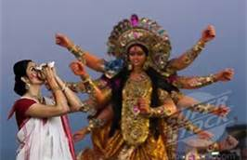
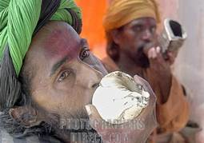
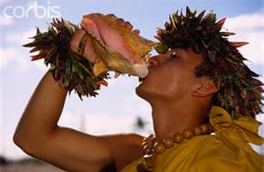
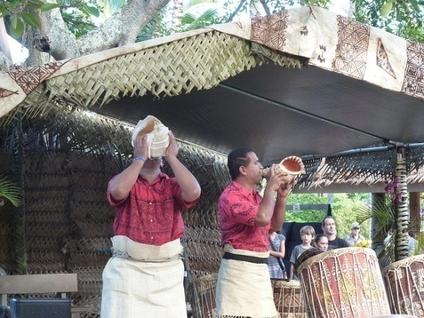
Blowing the conch shell
Durga Pooja in Calcutta
Northern India
Conch shell (Pu) is part of Hawaiian traditions & celebrations

Slide 10
Ringing Bells & Gongs (Ghanta)
It is an age old tradition to ring the bell before entering a temple and during Puja and Aarti. Ringing bells is sometimes accompanied by the sounds of conches, gongs and other musical instruments while performing Aarti in temples.
A priest when rings the bell gives a signal to the devotees to pay attention to the Puja.
Ringing of a bell or ghanta during prayer or worship in the temples or home, eliminates distracting sounds from outside and helps the mind to concentrate on the object of worship.

Slide 11
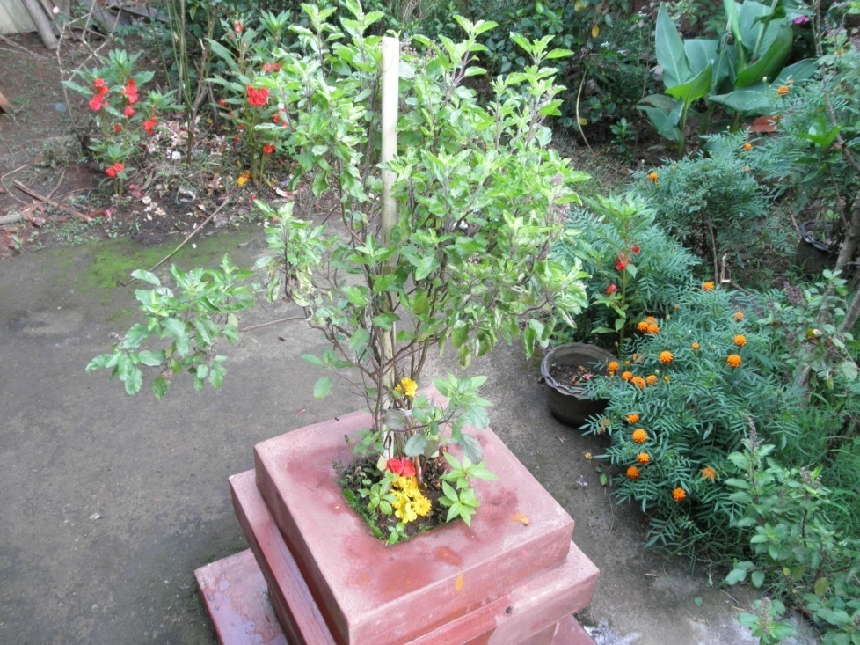
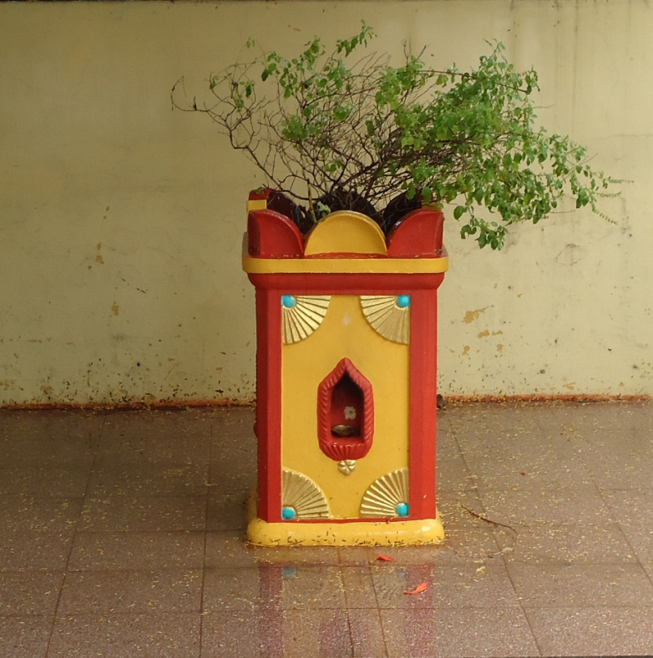
What’s this plant called?

Slide 12
Why do we worship tulasi?
Tulasi is one of the most sacred plants for Hindus.
The word Tulasi means “incomparable”.
Tulasi leaves are offered as part poojas; no pooja is complete without Tulasi. These leaves are considered to be purifying.
The Tulasi leaf has great medicinal value and is used to cure various ailments.
Most Hindu households in India grow Tulasi plants.

Slide 13
Shanthi Shanthi Shanthi Hi
Shanthi or peace is disturbed by three sources:
Aadidaivika – acts of God such as which we have no control over such as earthquakes, floods, volcanoes, tornados, etc.
Aadibhoutika – caused by creatures/humans around us such as crime, war, pollution, etc
Aadyatmika – internal agitations within oneself at the spiritual level.
We chant Shanthi thrice to emphasize our intense desire for peace from all of the above sources.

Slide 14
PANCHAMRUTA
Pancha – Five
Five ingredients used to make it
Recipe:
Milk – 1 tbsp
Yogurt – 1 tbsp
Ghee – 1 tbsp
Honey – 1 tbsp
Sugar – 3 tbsps
Tulsi leaves
Chopped Fruit (optional - bananas, grapes, apples etc)
Saffron & Powdered Cardamom (optional)

Slide 15
Significance of panchamruta
Panchamruta distributed after the pooja. Its ingredients symolize the following blessings:
MILK – the blessing of purity of thoughts
YOGURT – the blessing of prosperity
HONEY – the blessing of sweet speech
GHEE – the blessing of victory or success
SUGAR – the blessing of happiness

