Slide 1
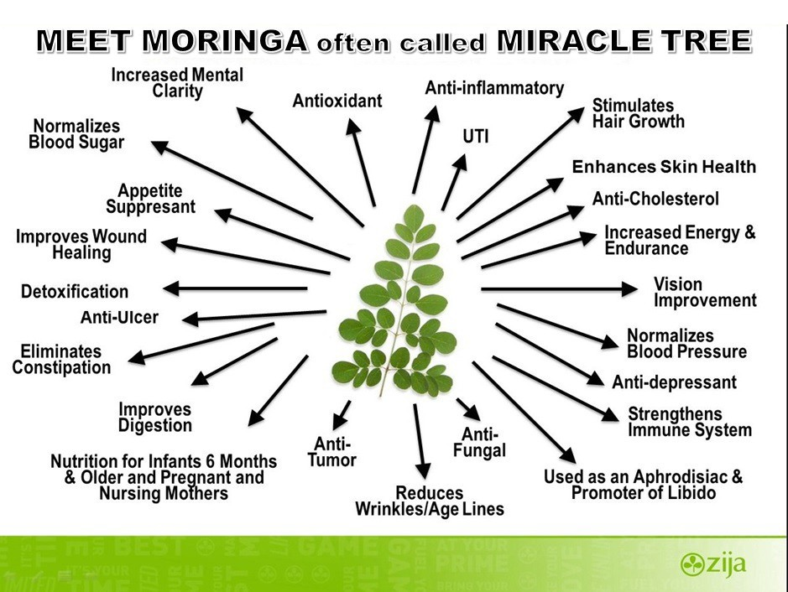
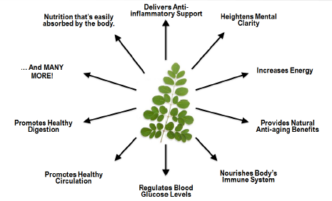
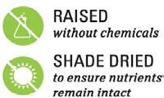
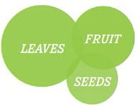
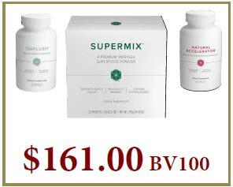
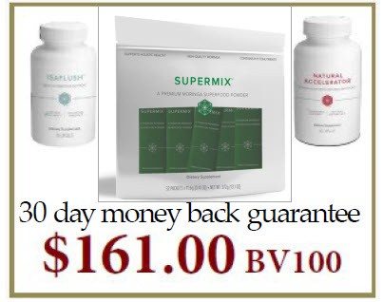



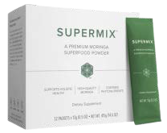




MEET MORINGA
often called
MIRACLE TREE
Alphabetical List of Verified Nutrients
28-Isoavenasterol
4-(Alpha-L-Rhamnosyloxy)-Sen 4-(Alpha-L-Rhamnosyloxy)-Ben Alanine
Alpha-Carotene Arinine Arschidic-Acid Aspartic-Acid Behenic-Acid Beta-Carotene Beta-Sitosterol Biotin Brassiicasterol
Caffeoylquinic Acid Calcium Campestanol Campesterol Carotenoids Chlorophyll Cholesterol
Cobalt Copper Cystine
Delta-7 & 14-Stigmastanol Delta-5-Avenasterol Delta-7-Avenasterol
EFA Omega 3
EFA Omega 6
EFA Omega 9 Ergos tadienol Fiber Flavonoids Flavonols Fluorine
Folate (Folic Acid)
Gadoleic-Acid Glucosinolates
Glutamine (Glutamic-Acid Glutathione
Glycine Histidine
Indole Acetic Acid Indoleacetonitrile Iodine
Iron Isoleucine Kaernpferal Leucine
Lignoceric-Acid Lithium Lutein Lysine
Magnesium Manganese Methionine Molybdenum Myristtc-Acid Neoxanthin Niazimicin Niaziminins A & B Niazinin A Niazinin B
Oleic-Acid Palmitic Acid Phenylalanine Phosphoros Potassium Prolamine Proline Protein
Quercetin Rutin Selenium Serine Silicon Sodium Stearic-Acid Stigrnasterol Sulfur
Superoxide Dismutase Threonine Tryptophan
Tyrosine Valine Vanadium Violaxanthin Vitamin A
Vitamin B (Choline) Vitamin B1 (Thiamin) Vitamin B12
Vitamin B2 (Riboflavin) Vitamin B3 (Niacin) Vitamin B6 (Pyridoxine) Vitamin C (Ascorbic-Acid) Vitam D
Vitamin E
Vitamin E (Alpha Tocopherol) Vitamin E (Delta Tocopherol) Vitamin E 9Gamma Tocopherol) Xanthins
Xanthophylls Zeatin Zeaxanthin Zinc Zirconium
BOB DECANT 419-944-0006
www.massiveresults.org
Hundreds of published peer-reviewed white papers on pubmed.gov studying the benefits of Moringa Oleifera.
Backed up by the NIH to medically help over 300 disease’s.
MORINGA RESEARCH
PROFILE SUMMARY
Google or ask Siri on Iphone "What is the most nutritious tree on EARTH" ?
30 day money back guarantee
“Plant of the Year 2008”
Moringa is recognized as an amazing source of nutrition by hundreds of organizations.

