Slide 1
RSAI 2022 Priorities and Advocacy Actions

Slide 2
Agenda for today
Report of the RSAI Annual Meeting
Highlight on two RSAI Priorities:
School Funding
Teacher Shortage
Advocacy Actions to make a difference
Strength in numbers
Basics of Influence (message and media)
RSAI Supports
Specific Actions now through the Session

Slide 3
Report of the Annual Meeting
Conducted annual meeting business on Oct. 26, 2021
received and approved financial report and audit, approved budget, received report of membership and dues.
amended RSAI bylaws to allow additional Legislative Committee liaisons from an RSAI region (NW, SW, NE, SE) to be from multiple AEAs.
elected Dan Petersen, Central DeWitt, to 3-year term for at-large member of the Leadership Group
Presentation of status of 2021 Legislative Priorities. Access the PPT from RSAI’s 2022 Legislative Page here
Discussed, debated and approved a slate of priorities for the 2022 Session.

Slide 4
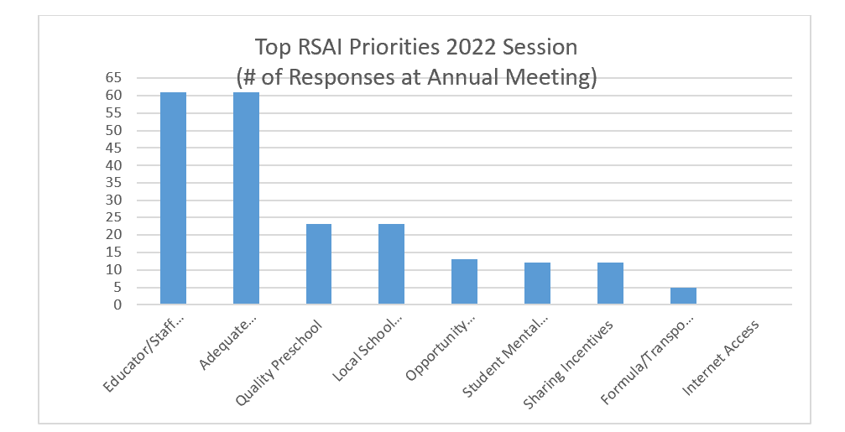
Prioritized issues:
Here’s some data about the top two:

Slide 5
School Funding: How does Iowa stack up when compared with other states?

Slide 6
https://www.census.gov/data/tables/2019/econ/school-finances/secondary-education-finance.html

Slide 7
Table 8. | Per Pupil Amounts for Current Spending of Public Elementary-Secondary School Systems
 | by State: Fiscal Year 2019
(Dollars.)
Geographic area |  |  |  |  | Instruction |  |  | Support services
 |  |  |  |  |  |  |  |  |  | Instructional
 |  |  | Salaries and | Employee |  | Salaries and | Employee |  | Pupil | staff | General | School
 |  | Total ¹ | wages | benefits | Total ¹ | wages | benefits | Total ¹ | support | support | administration | administration
United States................................................................ |  | 13,187 | 7,498 | 3,299 | 7,963 | 4,996 | 2,206 | 4,701 | 818 | 638 | 257 | 738
Iowa.............................................................................. |  | 11,907 | 7,550 | 2,564 | 7,148 | 4,994 | 1,678 | 4,271 | 716 | 755 | 301 | 673
 |  | $ (1,280) | 52 | (734) | (816) | (2) | (529) | (429) | (102) | 117 | 44 | (65)
$1,280 less spending per pupil
$734 less per pupil in benefits
$816 less per pupil in instruction
$429 less per pupil in support services of which $65 per pupil is less in school administration
US Census SOURCE: 2019 Annual Survey of School System Finances. Data are not subject to sampling error, but for information on nonsampling error and definitions, see introductory text. Data users who create their own estimates from these tables should cite the U.S. Census Bureau as the source of the original data only.

Slide 8
Increase in Per Pupil Spending 2014-2019: Iowa ranks 40th
2019 US Census data updated May 2021 https://www.census.gov/data/tables/2019/econ/school-finances/secondary-education-finance.html
Iowa slipped to 30th in per pupil public elementary and secondary school system expenditures, which is $1,280 below the national average.
Since 2014, Iowa elementary and secondary education spending has increased 11.6%, while the national average increase has been 19.9%. In the Midwest region, Nebraska is the only state outpaced by Iowa.
Iowa ranks 40th in per pupil expenditure increase since 2014.

Slide 9
NASBO Annual School Expenditure Report
Nov. 2020 soon to be updated. ISFIS Note: Increase to 16.9% may be more about PTRP through the formula than a relative increase in education total revenue.

Slide 10
Table 5. | Percentage Distribution of Public Elementary-Secondary School System Revenue by Source and State:
 | Fiscal Year 2019
(Detail may not add to total because of rounding. For meaning of abbreviations and symbols, see footnotes.)
Geographic area |  |  | Federal sources |  | State sources |  | Local sources
 |  |  |  |  |  | General |  | Taxes and parent
 |  |  |  |  |  | formula |  | government | Other local
 |  | Total | Total ¹ | Title I | Total ¹ | assistance | Total ¹ | contributions | governments | Charges
United States |  | 100.0 | 7.7 | 1.9 | 46.7 | 31.4 | 45.6 | 39.2 | 1.3 | 2.0
Iowa |  | 100.0 | 6.9 | 1.3 | 52.8 | 37.3 | 40.3 | 35.4 | 0.1 | 2.5
Difference (Iowa – USA) |  |  | -0.79 | -0.53 | 6.10 | 5.85 | -5.31 | -3.82 | -1.27 | 0.42
Federal funding is 0.79% below the national average
State percent of funding is 6.10% above the national average
Local percent of funding is 5.31% below the national average
More state funding in the mix means the state is more on the hook to fund inflation and costs that schools experience in addition to new programs.

Slide 11
$1.2 Billion surplus
PLUS
Full EEF and CRF

Slide 12
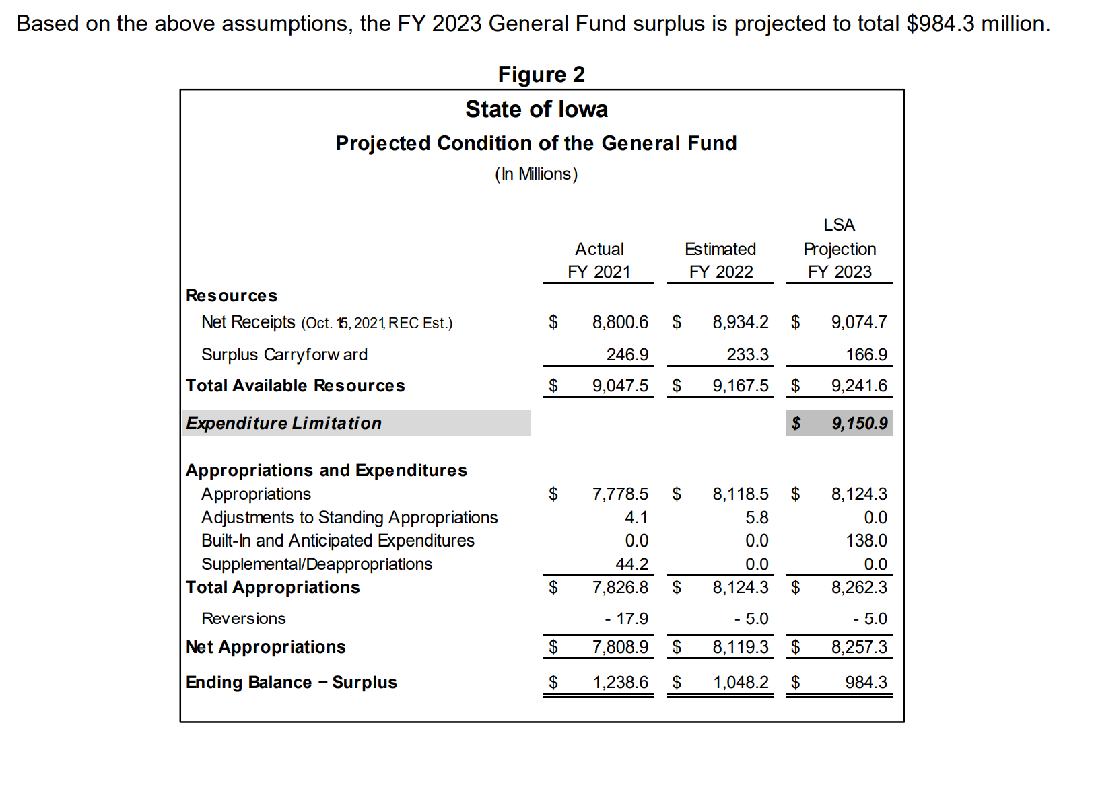
LSA General Fund Balance Sheet Update (October 2021)
Document published location: https://www.legis.iowa.gov/docs/publications/BL/1231137.pdf
FY 2021 Actual Surplus - $1.24 Billion
LSA revised balance sheet estimates another $1.048 billion surplus for FY 2022.

Slide 15
SSA rates:
4.0 4.0 4.0 4.0 4.0 2.0 0.0 2.0 2.0 4.0 1.25 2.25 1.11 1.0 2.06 2.3 2.4

Slide 16
SSA Compared to State Revenue
Since FY 2016, state general fund revenue has grown by about $1,990 million ($1.99 Billion).
Since FY 2016, SSA state appropriations have grown by $449.9 million, or 23% of total revenue growth (well below the metric of Education funding at 40% of the state general fund budget.)
By FY 2023, the state pick up of the formula that would otherwise increase property taxes has grown to $86.6 million. (State dollar instead of property tax dollar for education). So of that $449.9 million, about one fifth of it is property tax relief, not additional dollars for students.
Gov. Reynolds and Republican leaders have publicly stated that the surplus positions Iowa for significant income tax cuts, despite the Oct. 18 REC estimate of 1.5% revenue growth in FY 2022 and FY 2023.

Slide 17
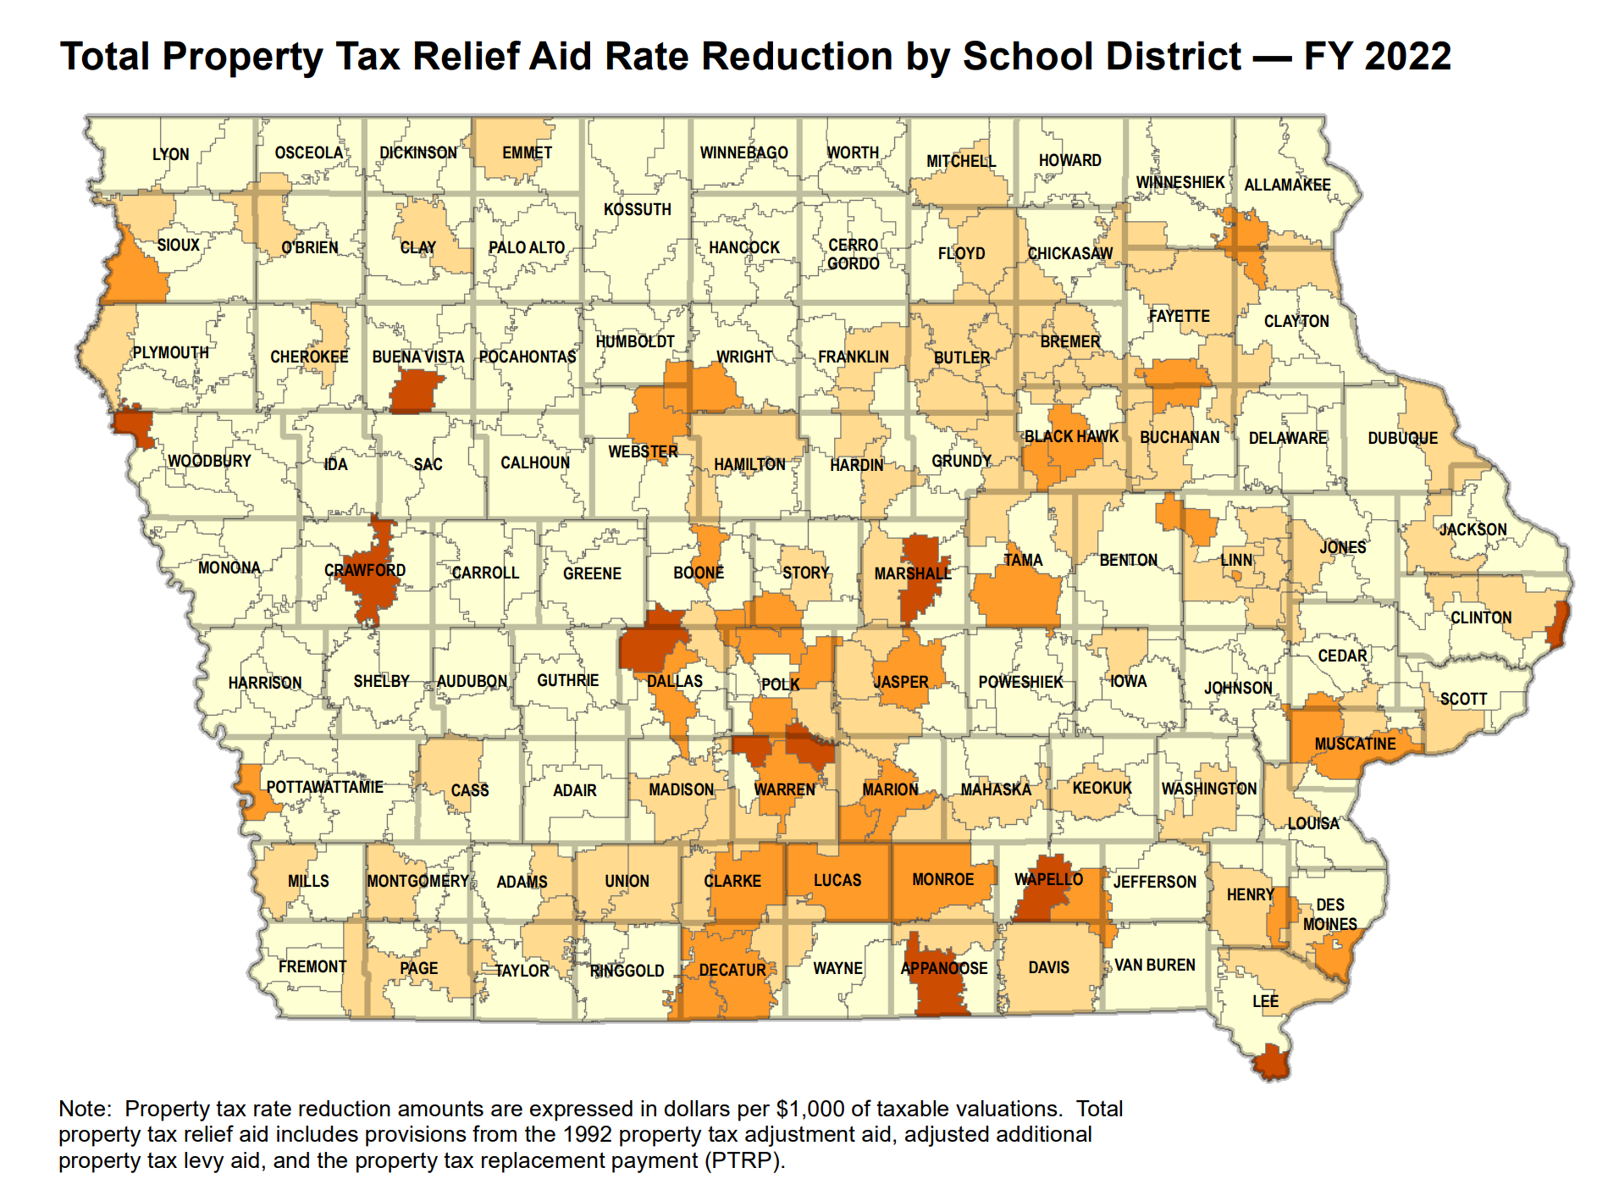
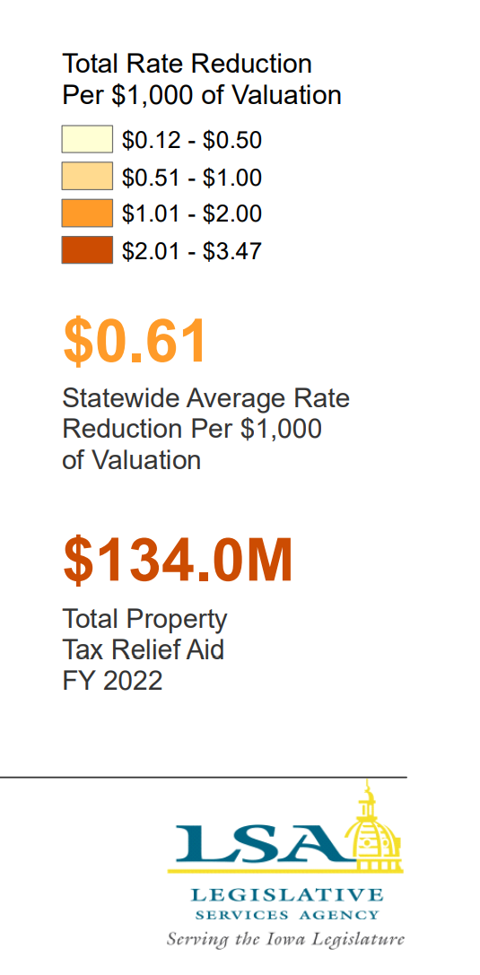
https://www.legis.iowa.gov/docs/publications/MOW/1230723.pdf

Slide 18
What about all of that federal money?
Help policy makers (and the public) understand the federal ESSER funds:
It’s reimbursement for expenditures – they didn’t send you a truckload of money
It’s got strings (e.g., Davis Bacon wage requirements for construction, at least 20% must be spent on COVID learning recovery.)
Pandemic increases expenditures (technology, staffing, health and safety, mental health supports, supply chain delays & inflation)
It’s already gone in districts that received low per pupil amounts (Title I distribution formula based on census tract poverty, yet all districts had COVID-19 costs for safely holding in person school)
Short term – used through Sept. 2024, so even if districts with large per pupil amounts, you can’t count on it to hire staff that you need to keep around for the long term.
Pull together your list of federal pandemic fund expenditures and be ready to talk it through with policy makers.

Slide 19
Resource Needs:
Adequate increase in SSA to fund:
Inflation (costs go up). Arbitration ceiling will be 3%, but CPI-U calculation on PERB Website for arbitrations in April 2022 shows inflation at 6.6%.
Continued programs and new expectations: computer science, dyslexia training, school safety and emergency plans, internships and college-level coursework
Educators to teach and lead our schools; adequate salaries, benefits, training and ongoing support
Bus drivers and support staff (paras, food service, custodians, secretaries)
Course supports: science lab materials, career and technical education costs, fees to community colleges or other school districts for shared courses and content, music/art/drama opportunities for students
Student needs: offset fees waived, provide instructional materials (online and at school), social workers and mental health supports, translators and ELL instructional materials and supports, behavior supports all the way up to therapeutic classrooms and mental health placements, talented and gifted content, library materials and technology
Extra- and co-curriculars: not just the heart of the community, but in many cases where students find their passion, learn to set goals and work collaboratively with others. Connect to peers and caring adults.
______________________________________________________________
______________________________________________________________

Slide 20
Question of the day:
How many of our RSAI priorities would fall off the list if schools had been adequately funded in the past or were adequately funded going forward?

Slide 21
Educator Shortage and Quality Instruction
HF 2627 Licensure Reciprocity (2020 Session). Reciprocity w/states for teachers, admin, and other licensed staff with 1 year experience.
SF 466 Occupational Therapists: this bill expands the list of providers which are allowed to provide concussion services for extracurricular events.
SF 532 Licensed Behavior Therapists and Mental Health Professionals: this bill requires the BOEE to create a Statement of Professional Recognition for these positions.
HF 675 Substitute Authorization: this bill carries forward pandemic flexibility from the public health emergency declarations, allowing AA degree for subs or 60 hours of post-secondary credit. Has a process to extend the 10-day assignment to one classroom under certain circumstances.
HF 770 Professional Development CEU’s: this bill allows specified PD to count for ½ of required continuing education units (CEUs,) required for licensure renewal. The BOEE is required to allow either work on individual PD plan or courses offered by BOEE approved provider (AEAs, MISIC, etc.) to count for this credit.
RSAI supported all of these bills.

Slide 22
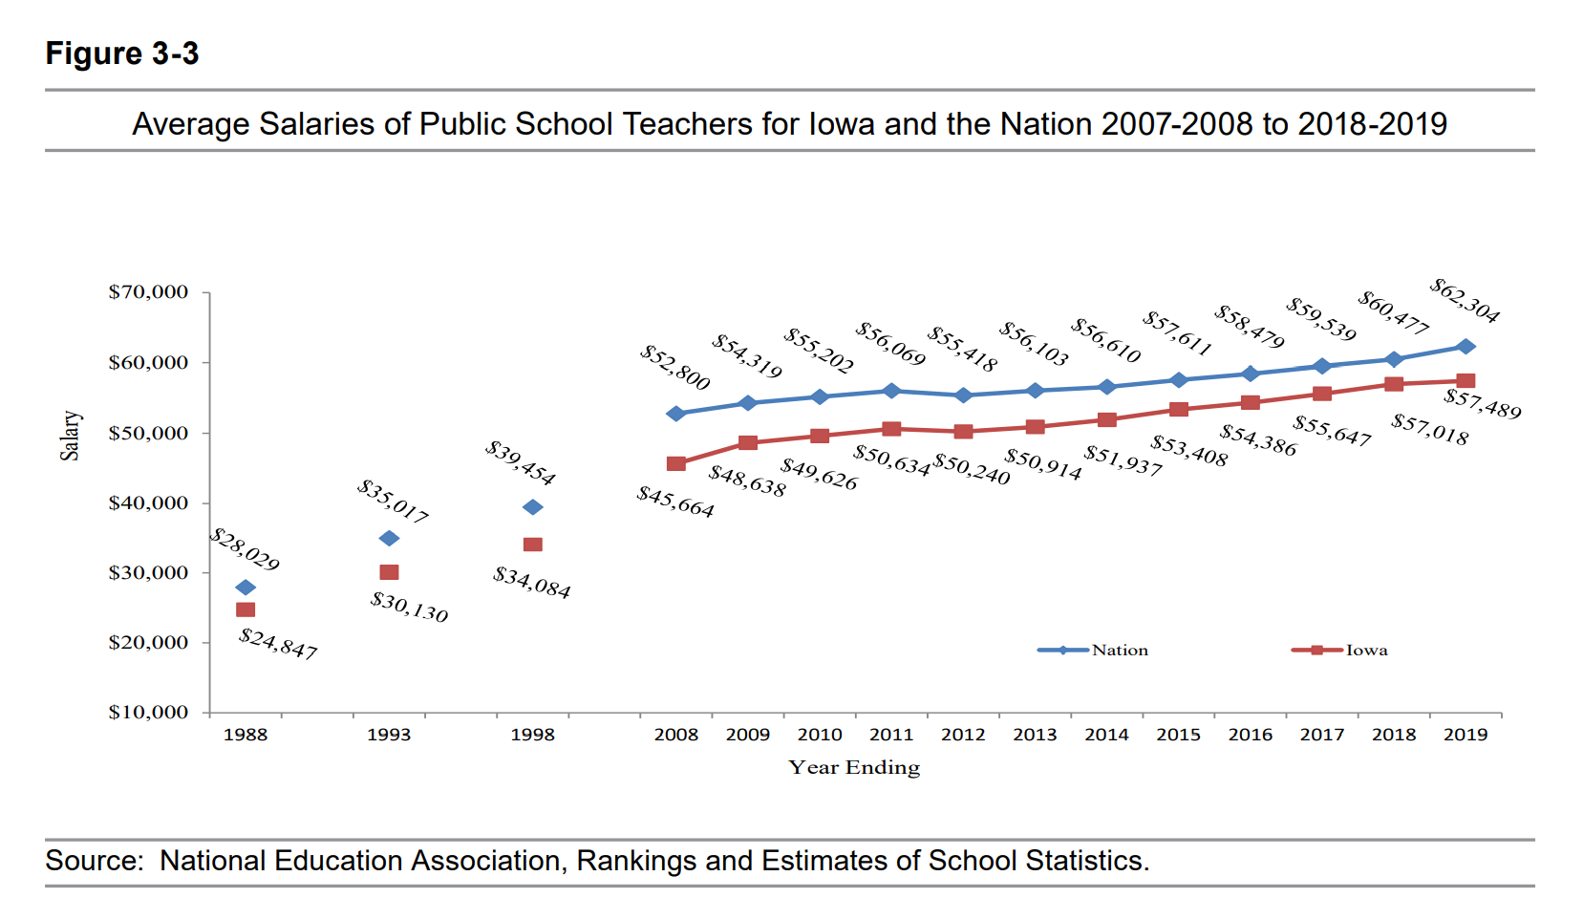
DE Annual Condition of Education 2020
Gap between Iowa Average Teacher Salary and the National Average in 2019 is $4,815 (in 1988, the gap was $3,182). With significant teacher shortages across the nation, beginning teacher pay is also a critical comparison.

Slide 23
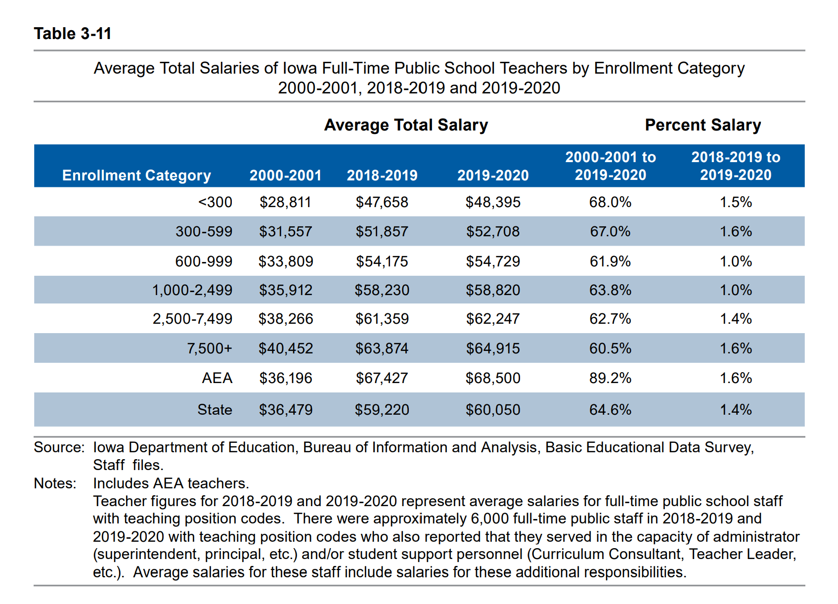
DE’s Annual Condition of Education Report shows average salary by school size (which is a good but not perfect predictor of rural districts), showing a growing difference in pay between the averages of the smallest and largest category of school size, now at $16,520, and more than $11,000 below the state average.
Rural schools tend to have younger teachers and lower class sizes, both of which can contribute to lower pay.

Slide 24
DE Annual Condition of Education 2020

Slide 25
Educator Shortages
Money isn’t everything, but competitive salaries are important
Culture and climate of the school district, adequate support and good leadership also matter to teacher retention
Iowa’s Teacher Leadership and Compensation is improving retention of teachers in Iowa schools* (see your own goals for retention in your TLC plan) For young teachers, student loan debt requires a sufficient salary to make payments. Young teachers are also attracted to communities with amenities.
There’s a shortage if your school experiences either 1) not enough applicants and/or 2) no qualified applicants and/or 3) more teachers working under conditional licensure and/or full time subs in the classroom
*Reported prior to COVID-19 pandemic.

Slide 26
Understanding Teacher Shortages: 2018 Update A State-by-State Analysis of the Factors Influencing Teacher Supply, Demand, and Equity https://learningpolicyinstitute.org/product/understanding-teacher-shortages-interactive
IL | $38,820
ND | $38,032
MN | $37,644
SD | $37,419
WI | $36,983
IA | $35,766
KS | $34,883
MO | $31,842
IA 6 out of 8 in Midwest.
IA is in the second to lowest quintile, ranking 30th in starting teacher pay.

Slide 27
Teacher Retention and Recruitment:
Shortages in Iowa/Nation
50-state Comparison of Strategies
Policies Iowa Legislature Could Consider
Education Commission of the States

Slide 29
Completers Iowa and the Nation

Slide 30
What does this mean?
Teacher production and overall teacher supply in the United States has grown steadily since the mid-1980s. However, national data trends show an overall decrease in educator preparation program enrollment and completion in recent years. Although new teacher supply data provide an incomplete* picture of a state’s teacher labor market, a decrease in new teacher supply may contribute to new shortages and exacerbate already present shortages within a state. This chart details trends in educator preparation program completion in Iowa, compared with the United States average. *New teacher supply data do not capture whether graduates are prepared to teach in high-demand subject areas or willing to teach in underserved schools. They do not capture whether graduates meet the requirements for licensure and go on to teach within the state or at all. They also do not capture teachers who are prepared out-of-state or teachers who temporarily leave the profession and then re-enter. Finally, they do not capture the quality of the individuals seeking employment. Supply and demand considerations vary considerably within states. State leaders can consider multiple factors — including, for example, district and school staffing, vacancy data and educator equity gaps — when evaluating their teacher labor market and considering policy solutions. Last updated: August 2019. To view 50-State Comparisons, click here.

Slide 31
Midwest total reduction in teacher prep completions was 8,183 over this 10-year period, for an average loss of 17%.

Slide 32
Direct impact: states with growing enrollment are producing less teachers, so as Iowa is producing less teachers, other-state recruiting strategies are competing for our completers
Indirect impact: low unemployment generally means private sector business also competes for teachers to fill their labor-pool needs

Slide 33
Teacher Shortage Data
ECS asked: Has the state published state-specific teacher shortage data within the past five years?
Iowa is one of 8 states that has not published teacher shortage data.
Last report was the EARLY CAREER TEACHER RETENTION IN IOWA by DE evaluated 2006-07 BEDS data. That report stated, at that time, Iowa was better at retaining teachers beyond the initial 5 years (30% leakage) compared to the rest of the nation (around 40-50% leakage)
Studying the problem in Iowa would be a good first step.

Slide 34
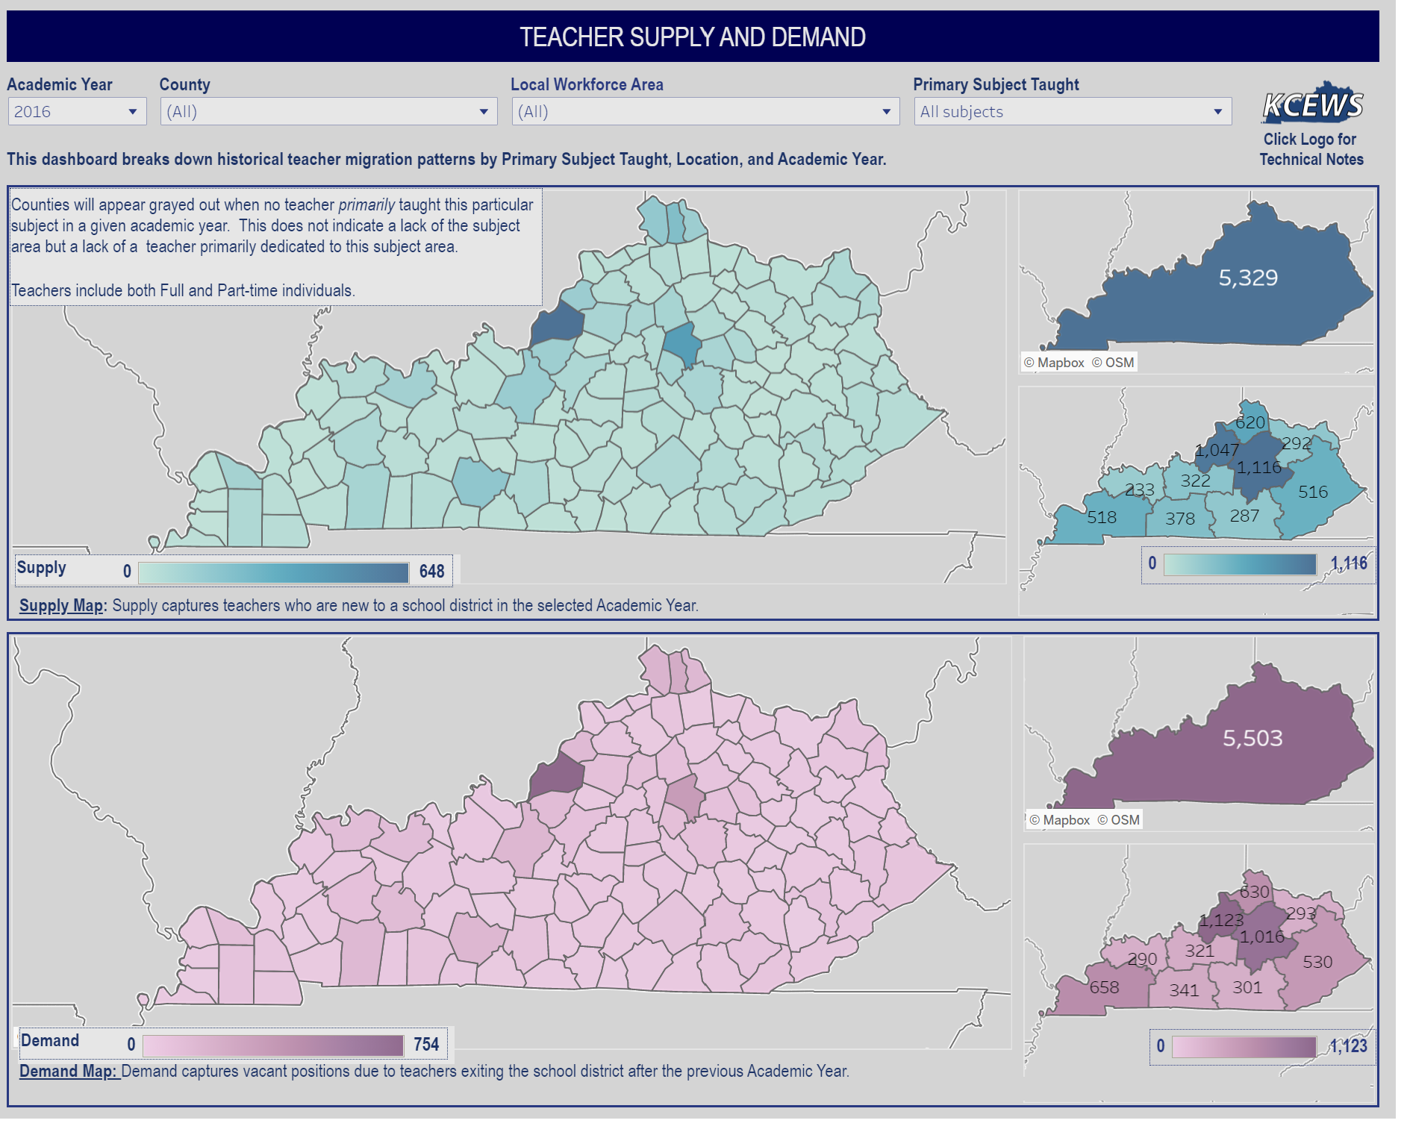
Example Kentucky
https://kystats.ky.gov/Reports/Tableau/TSD

Slide 35
ECS Policy Inventory
Expanding the pool of teacher candidates
Does the state offer a pathway, program or incentive through statute or regulation to recruit high school students into the teaching profession?
Does the state offer a pathway, program or incentive through statute or regulation to recruit paraprofessionals into the teaching profession?
Does the state create opportunities for teacher residency programs through statute or regulation?
What percentage of educator preparation program graduates came from alternative preparation programs in the year the data were last reported (2016-17)?
Teacher pay and financial incentives
Does statute establish requirements for minimum teacher pay?
Does statute define at least one statewide scholarship or grant program to help recruit teachers to underserved schools and/or shortage subject areas?
Does statute define at least one statewide loan forgiveness program to help recruit teachers to underserved schools and/or shortage subject areas? (Teach Iowa loan forgiveness targets high achieving students but doesn’t recruit to underserved or shortage area positions)
Teacher pay and financial incentives Cont’d
Does statute require or explicitly encourage additional pay for teachers who work in underserved schools and/or shortage subject areas? (high needs schools grants from 2013, never funded, originally intended to do this)
Does statute define at least one statewide financial incentive program for teachers of color?
Does the state require or explicitly encourage additional pay for teachers who obtain advanced licensure?
Does the state require or explicitly encourage additional pay for teachers who obtain National Board Certification?
Early and ongoing supports
Does the state require induction and mentoring support for new teachers? If so, what is the required length? (part of TLC local plans)
Does the state require or explicitly encourage reduced teaching loads for new and/or mentor teachers?
Does the state require that an established portion of a teacher’s work day/week be designated exclusively for teacher planning?

Slide 36
Promising Practices
Indiana AA degree at High School Graduation, 2 years of University, articulated community college credits, plus support to attract diverse and talented high school students into teaching
Western Governor’s University, online program for Iowans in full time jobs, wanting to complete degree and transition to teaching. Allows rural districts to support and recruit paras and others connected to community into teaching.
Others?? Many shared at the NREA annual conference last week. We will learn more and share down the road.
Common themes: 1) partnerships with universities, community colleges and school districts 2) recruiting early (in high school) or later (nontraditional college students from paras or more seasoned private sector people ready for a second career) 3) supports needed - help with FAFSA or Praxis, tutoring, mentoring, pay for or alternative route for student teaching, 4) credit for competency or content knowledge rather than seat time/hours.

Slide 37
Advocacy Actions to Make a Difference

Slide 38
Who else is at the party? 992 Registered Lobby Groups
Anti-tax organizations
Business groups
Farmers organizations
Unions
Utilities
Builders
Civil Liberties groups
Lawyers
Hospitals/Health Care
Law Enforcement
Cities and Counties
Colleges and Universities
Doves Hunters and PETA
Textbook Companies
Testing Companies
Environmental Groups
Insurance companies
Bus builders
Truckers
Religious groups
Nursing homes
Home schools/private schools
Media
Alcohol distributors
Gaming Institutions
Gun Owners
Gun Control Advocates

Slide 39
Is it worth it?
Joel Blackwell, the “Grassroots Guy”, says that so few people actually engage in the process, that those who do have disproportionate power.
If you can break through the social media noise and establish a good relationship, you can be one of those people.

Slide 40
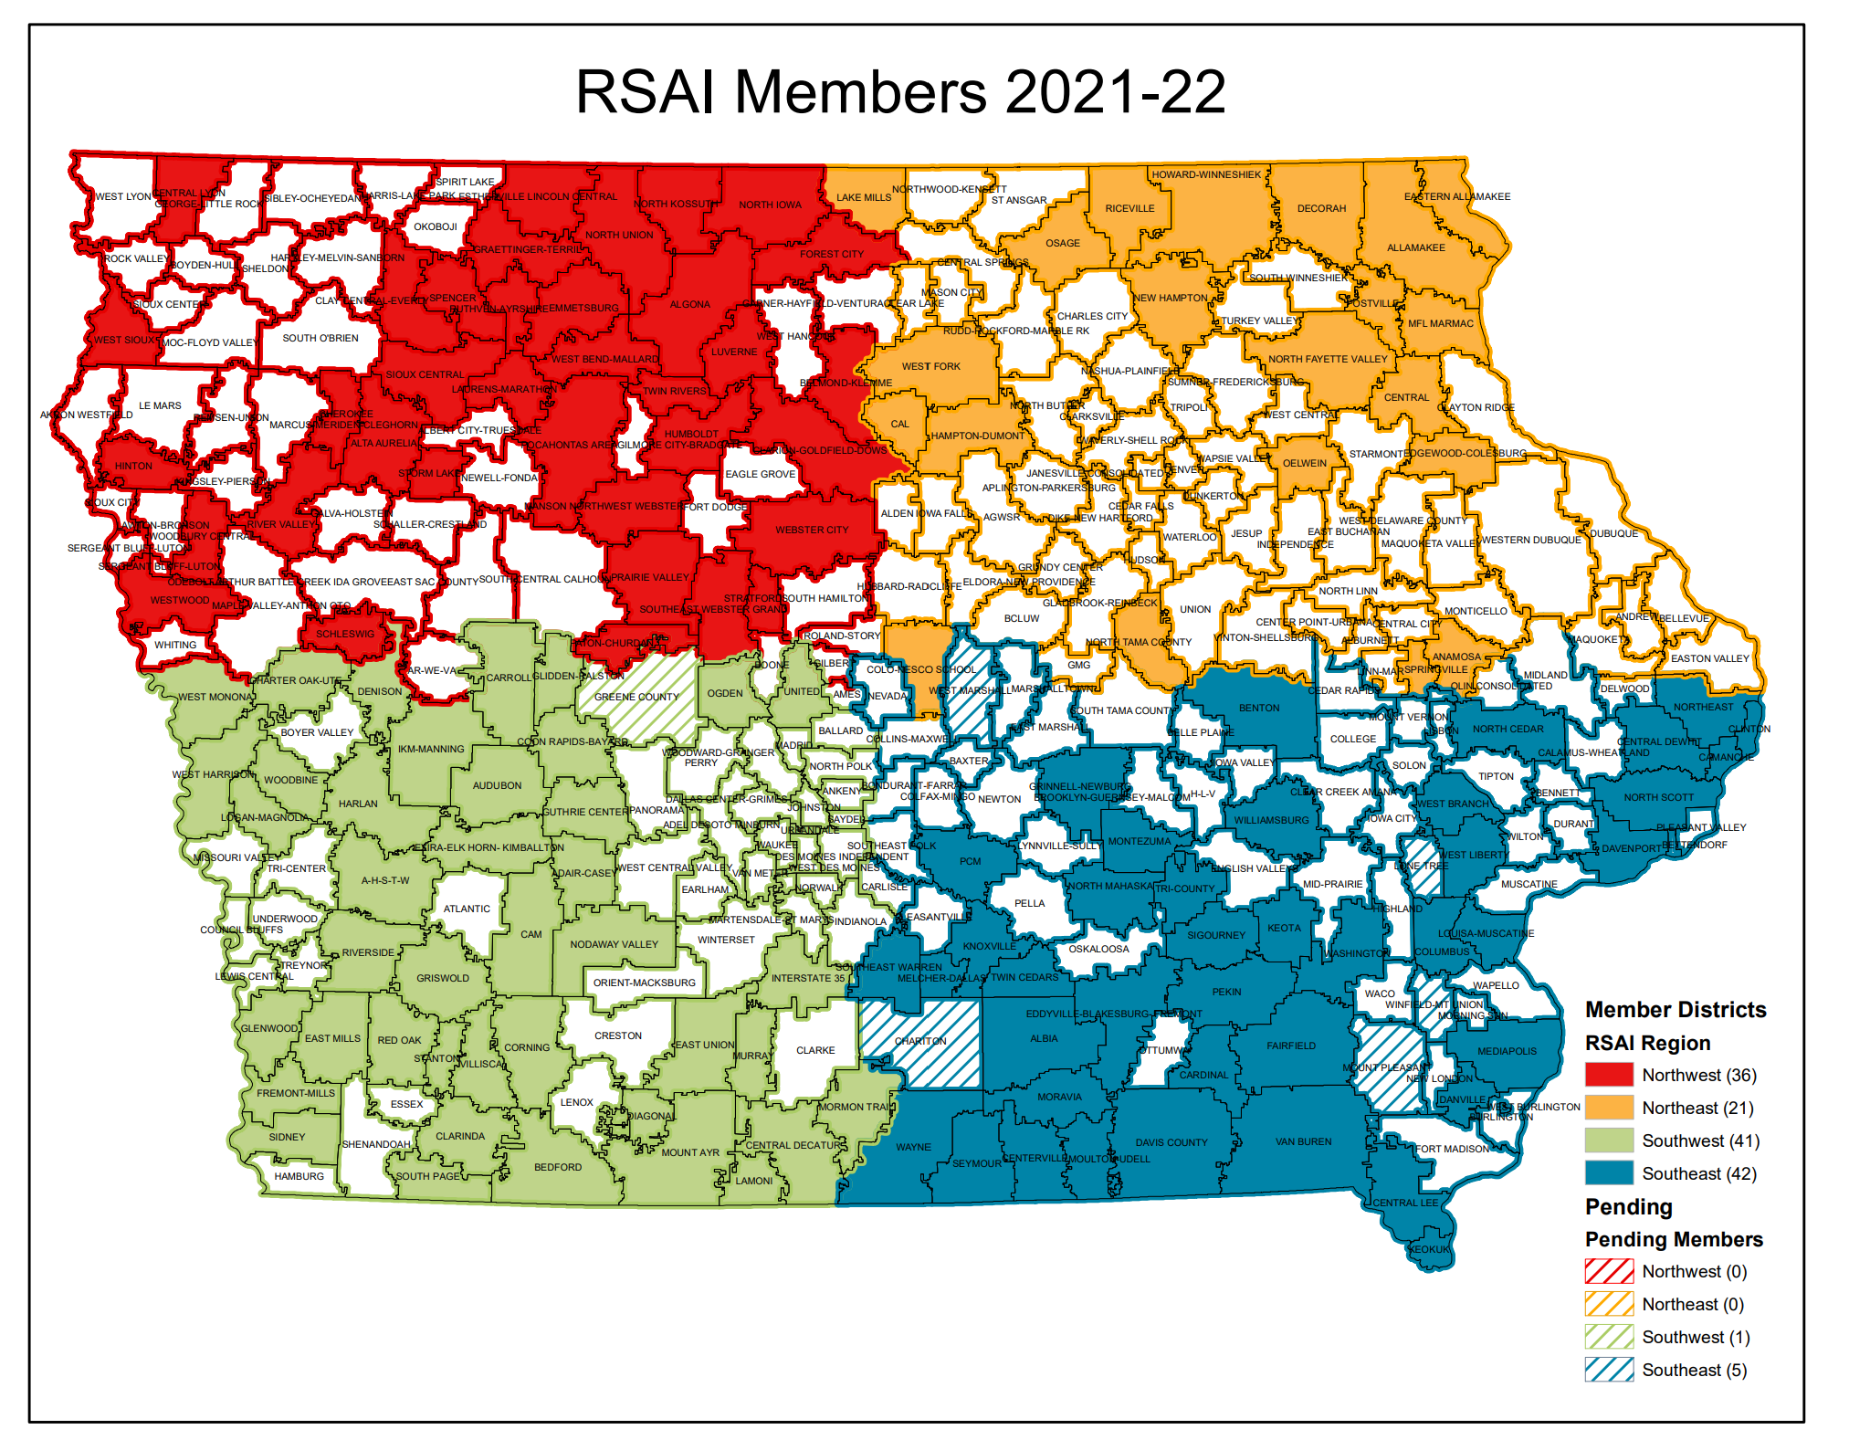
Strength in Numbers: Why join RSAI and recruit others to the effort?
Amplified advocacy
Value proposition
Shared experiences
Networking
Shared best practice

Slide 41
Examples of Success
Universal PK (business and school advocates together in 2007)
Statewide penny for school infrastructure (Original passage in 2008 and extension in 2017) (Ag, Business, Education and Master Builders)
Parents of students with Dyslexia (Just parents of students with Dyslexia)
Private school advocates (STO’s) (Parents and nonpublic school leaders)
Public school flexibility champions (2017-2021) (Education stakeholders, anti-bureaucracy voices)
Transportation and formula equity inroads (2017 to current and ongoing – education stakeholders and Ag/Business)

Slide 42
Advocacy that Works
The Grassroots Guy, Joel Blackwell
Two Books:
“Empowering School Leaders: Personal Political Power for School Board Members and Administrators”
“Keep on Voting After the Election: How ordinary people get what they want from government”

Slide 43
Blackwell's Basic Concepts of Getting What you Need from Politicians
Our political system is not designed to decide who is right and who is wrong. It is designed to decide who has the majority.
If you can’t prove that lots of people are with you, you will fail.
There are no right or wrong positions in politics, just decisions made by human beings for good reasons or bad reasons, or out of indifference.
If you have the votes in the legislature or Congress, you’re right. If you don’t, you’re wrong.
No political decision is permanent’ the fat lady never sings.
All things being equal, politicians will go with the flow. Your job is to create the flow.

Slide 44
Different Levers
Message:
Personal is better – it’s a continuum
It all counts – some counts more than others
Two-way street – mutual back scratching
Media:
Amplifies the message
Important to legislators
Get strategic about it
“That so few people vote, that far fewer write letters or make phone calls to politicians and almost none give money or time, gives disproportionate power to those who do.” Blackwell

Slide 45
Message: Finding Core Values/Common Ground
As Americans, we have more in common, despite all claims to the contrary in the current political environment, than you might think.
“Public decisions involve choices and public choices always involve values.”
Liberty: freedom, autonomy, choice, opportunity, individuality, privacy;
Community: safety, security, belonging, social order, quality of life;
Equality: fairness, justice, tolerance, diversity, equal treatment, equal opportunity; and
Prosperity: productivity, efficiency, growth, markets.
Phillip Boyle, Local School Board Governance, Spring 2004
Which of these core values is critical in any particular policy choice?

Slide 46
Message: Finding Core Values/Common Ground
Find out what is central to your legislators’ framework.
Tie your goals back to that central theme (translate your needs into their language)
Example: Prosperity/Growing the Iowa Economy
Future Ready Workforce: private sector needs good employees. Schools need good teachers to prepare students to succeed in the workforce.
Investments in PK save tax dollars down the road (prevention is worth a pound of cure or efficient use of tax dollars)
Quality schools prepare a quality workforce (prepared graduates become tax contributors rather than tax eaters)
Economic market factors – what does it take for a quality teaching workforce? Sufficient salaries and benefits to compete for human capital.

Slide 47
Media - Sample Press Release
Word Doc template regarding annual meeting – use it for sharing any local board discussions about priorities
Fill in any quotes or comments from a local source about the annual meeting, participation, or priorities important to your district.
Choose/delete any other information in the template. Make it your own.
Send to your local media and include a local contact person name, role and contact information.
Send copy of articles to your legislators, too, or meet with them to discuss.

Slide 48
Media - Reverberation
If local media covers any issue related to school need, send a letter to the editor (or recruit another advocate to do it)
Refer back to the legislative responsibility
Start with thanks and include the ask
Reply to negative and positive stories alike – keep the issue alive
Updated position papers will be posted on the Legislative Page http://www.rsaia.org/2021-legislative-session.html soon and will include data and relative talking points that can assist.
Send a thank you note to legislators and give them visibility for their support.

Slide 49
https://www.rsaia.org/2022-legislative-session.html

Slide 50
Prove People are with You
Who in your community could care?
Grassroots (several people who can carry a simple message, such as “fund our schools” or “our school needs resources to keep good teachers here longer” or “my child and my neighbors’ children are counting on you to fund our future.”)
Grasstops (community leaders – chamber or business leader, county ag leader, newspaper editor, political party leaders, school board president, mayor or county supervisor, economic development director, etc.)
Ask them to take an action and make it easy for them (use RSAI resources to easily connect – calls to action always include what to ask or say and how to reach your legislators)
If your district is represented by a legislative leader, it’s even more important that you engage.

Slide 51
Advocacy 101: First Steps
Send a note – include contact information and offer to be an informational resource (offer to review legislation for them, share impact of proposals on your district, staff, students or taxpayers, or just answer questions)
Share organizational priorities before the Session (caucuses set priorities for the Session typically in Nov/Dec, so don’t delay)
Find out what committees they are on – if education, local government, ways and means or appropriations are on that list, pay attention.
Get a meeting – zoom or coffee or DQ
Introductions
Exchange contact information
Give them a position paper or two or ask about their priorities for education
Learn something about them – where did they go to school? How about their children, or grandchildren? Anyone in their family ever teach or get elected to school board? Why did they run for office?

Slide 52
Next Steps: Create a coalition
Who could care?
Usual suspects: parents, teachers, board members, SIAC members.
Unusual suspects: Farm Bureau, Chamber of Commerce, Vendors, Taxpayer organization, city/county government, economic development, law enforcement (success examples include four-year-old preschool and the state penny)
Infiltrate and educate.
Find one or two persuasive voices from those groups
Be thinking about encouraging future school board candidates from these groups – the old two birds with one stone concept

Slide 53
First Month of Session
Joint effort with other school leaders, with school boards or individually.
Go to their home-based forums (eggs and issues) during the Session. Take someone with you who can ask a question.
Reach out to us to get resources before you go and get some timely questions to ask or updated materials to share.
School funding is typically decided (or supposed to be) within 30 days of release of the Governor’s budget, so ask about that up front.
Share the impact of various proposals on your budget, your students, and your community.
Send a thank you note whenever you can – even if you don’t agree on the vote or outcome, let them know you appreciate their work to represent your district and constituents (you can even say, “I hope you’ll be able to support our position in the future to help our school and students.”)

Slide 54
Advocacy Actions
See the RSAI Advocacy Handbook on Legislative Page of Website
https://www.rsaia.org/2021-legislative-session.html

Slide 55
Ask for help
Data from the ISFIS mapping tool to explain history
Talking points specific to your district
Edit letters to legislators or your local paper
Help thinking about replies to email or questions from legislators
Prep for lobby days or local conversations
Quick resources to share with your board members to prepare them for advocacy moments.
Sample Press Release – get the word out to your stakeholders and media about these issues of importance to your students and families.

Slide 56
THANK YOU FOR YOUR VOICE on behalf of Iowa students!
Margaret Buckton, ISFIS Partner, RSAI Professional Advocate, UEN Executive Director, margaret@iowaschoolfinance.com 1201 63rd Street, Des Moines, IA 50311 (515) 201-3755 cell
Dave Daughton,
RSAI Grassroots Advocate
dave.daughton@rsaia.org (641) 344-5205 cell
Retired Wayne CSD Superintendent
Stay connected through the Interim and into the Legislative Session
Let us know what you need to beef up your advocacy efforts.

