Slide 1
Appraisal: An estimation of a home’s market value by a licensed appraiser based on comparable recent sales of nearby homes.
Good Faith Estimate (GFE): A form used by lenders to give to borrowers with an estimate of fees due at closing. This form was replaced by the Loan Estimate in 2015.
Backup offer: An offer on a home under contract that becomes active if the primary contract falls through.
Homeowners Association: A management organization within a community, subdivision or neighborhood that creates and enforces rules for properties within its jurisdiction.
Contingent offer: An offer that is accepted by the seller, but certain conditions must be met before the sale is final.
Down payment: The percentage of the home purchased price (usually between 5% and 20%) paid upfront in cash.
Inspection: An examination of a property and its systems performed by a qualified professional, usually before the sale of a home.
Escrow: A neutral third party that holds funds from the buyer and distributes them when all conditions have been met.
Jumbo mortgage: A mortgage that exceeds the conforming-loan limit, commonly used for luxury home purchases.
Federal Housing Administration (FHA): The government agency that insures loans designed for low- to moderate-income borrowers.
Key rate: An interest rate set by the federal government that determines the cost to borrow money—in this case, a mortgage to buy a new home.

Slide 2
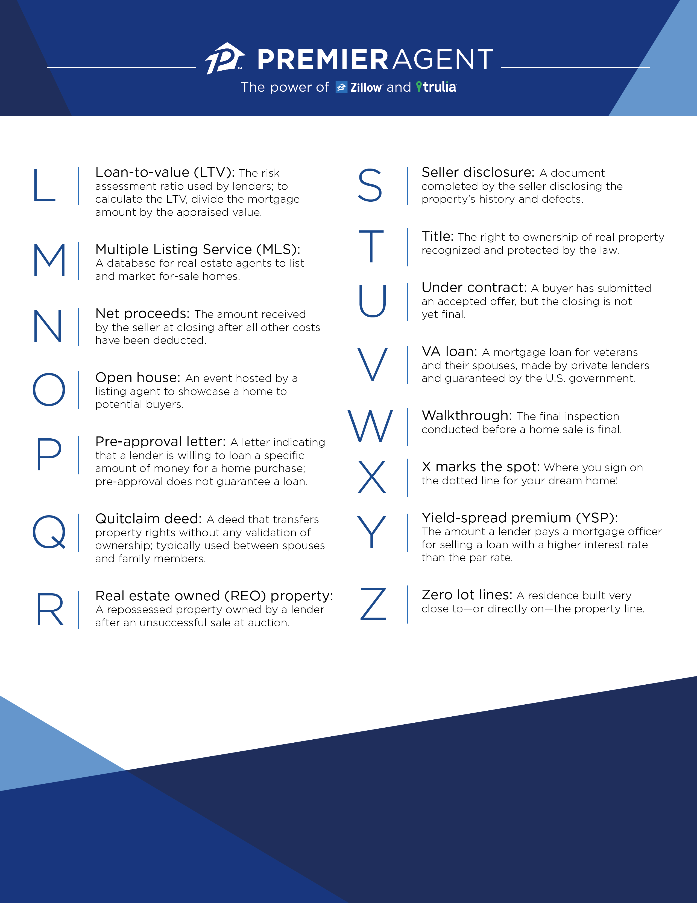
Loan-to-value (LTV): The risk assessment ratio used by lenders. To calculate the LTV, divide the mortgage by the appraised value.
Seller disclosure: A document completed by the seller disclosing the property’s history and defects.
Multiple Listing Service (MLS): A database for real estate agents to list and market for-sale homes.
Title: The right to ownership of real property recognized and protected by the law.
Under contract: A buyer has submitted an offer and the seller has accepted, but the closing is not final.
Net proceed: The amount received by the seller at closing after all other costs have been deducted.
VA loan: A mortgage loan for veterans and their spouses, made by private lenders and guaranteed by the U. S. Government.
Open house: An event hosted by a listing agent to showcase a home to potential buyers.
Walkthrough: The final inspection conducted before a home sale is final.
Pre-approval letter: A letter indicating that a lender is willing to loan a specific amount of money for a home purchase; pre-approval does not guarantee a loan.
X marks the spot: Where you sign for your dream home!
Quitclaim deed: A deed that transfers property rights without any validation of ownership; typically used between spouses and family members.
Yield-spread premium (YSP): The amount a lender pays a mortgage officer for selling a loan with a higher interest rate than the par rate.
Real estate owned (REO) property: A repossessed property owned by a lender after an unsuccessful sale at auction.
Zero lot lines: A residence build very close to—or directly on—the property line.
Lara Anderson, Broker, Lic# 01901537
949.677.4099
LA@AndersonSeaside.com

