Slide 1

RSAI Annual Meeting
October 24, 2018
NREA Annual Conference update

Slide 2

Update from NREA Annual Conference
Oct 10-14, Denver, CO

Slide 3

NREA Annual Convention
2018 National Forum to Advance Rural Education
October 11-13, 2018
Hyatt Regency Tech Center, Denver, CO

Slide 4
2018 Highlights
Battelle for Kids, Columbus OH, organizes and supports the conference
Attracting and Recruiting and Supporting rural teachers
Career and Technical Education Partnerships
Creative programs to meet student needs
University and rural school partnerships
Research on effects of initiatives and what it means to be rural
Trade show – examples:
  peachjar which automates newsletter, flier and other communication with parents and
  NIET | National Institute for Excellence in Teaching, 1250 Fourth Street | Santa Monica, CA 90401, office: 310 570-4860 | cell: 225 715-4588
  EyeSpy2020 computer software vision screening license
Convention program link:
https://drive.google.com/file/d/1TbW4EOPEWafDmtcRjPCJn-X_qAfX75iH/view

Slide 5
NREA partnership and support
NASDTEC – free check of the 50-state teacher licensure database for all RSAI member districts.
Checks all employees for dings on their license in another state
If you use 3DS, aka, ISFIS Program What’s Their Background, Iowa based company, for your regular background checks, there’s a check box to do the NASDTEC and it’s automatic. Otherwise, email Marissa@iowaschcoolfinance.com

Slide 6
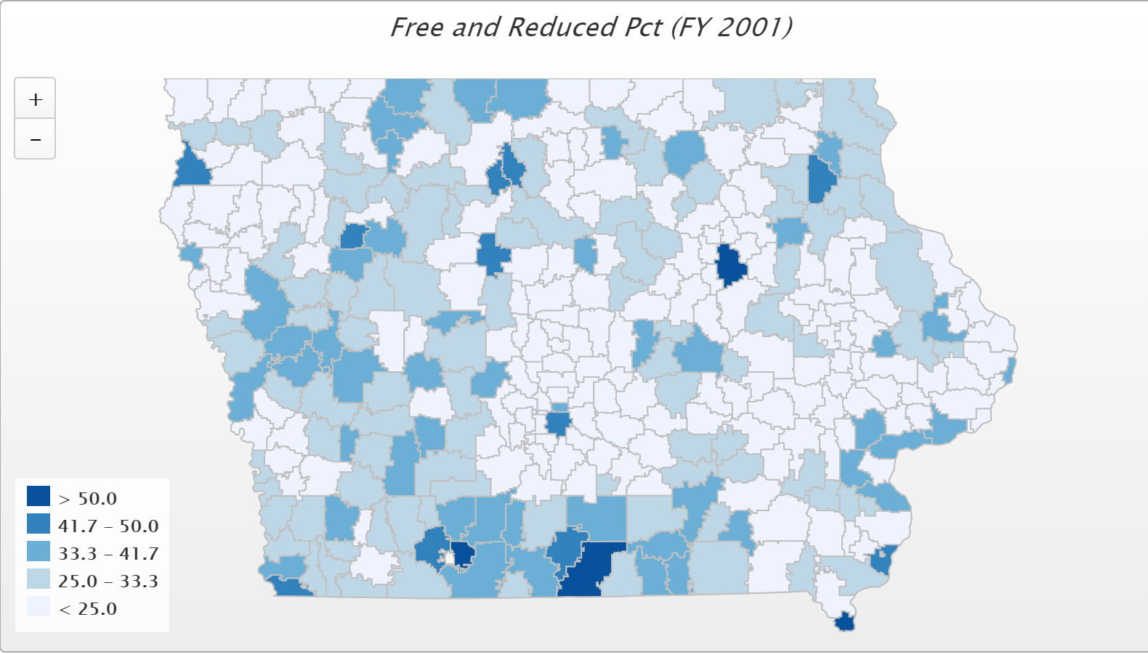
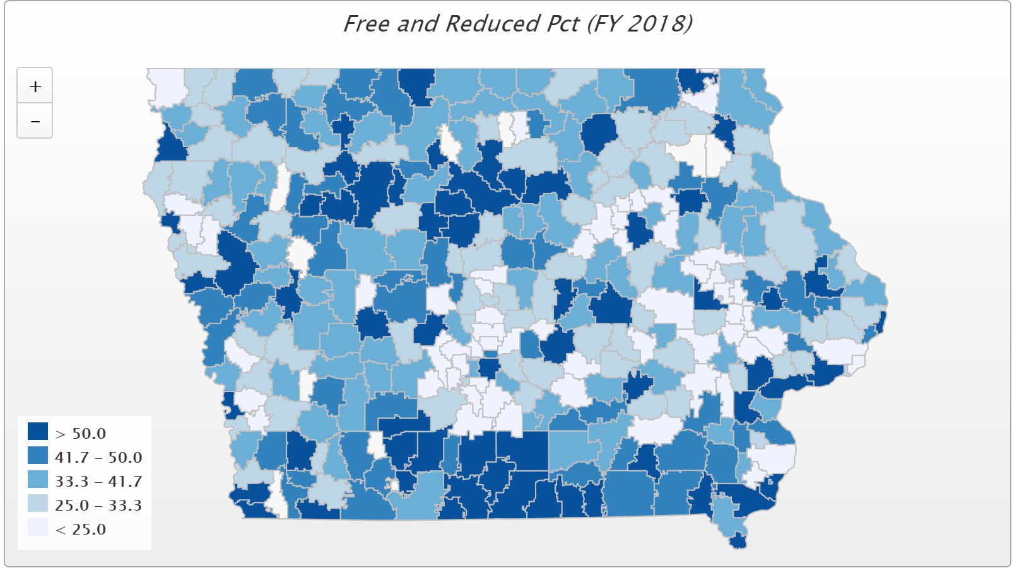
Poverty Changes

Slide 7
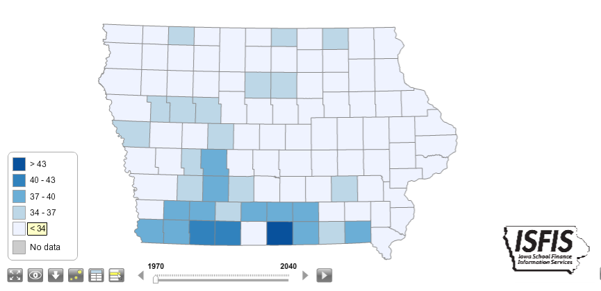
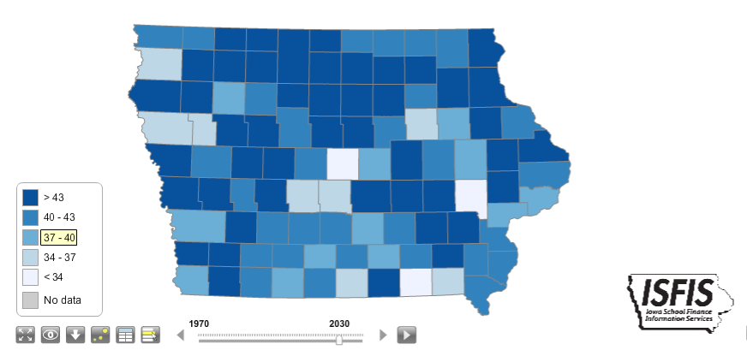
Median Age 1970 vs. 2030

Slide 8
Another potential partner
AARP and RSAI – connecting people in rural communities
Convening a conversation with a few rural leaders to see how schools and seniors might connect
  Volunteering with students
  Access to facility for walking
  Recruiting teacher assistants with CTE work experience
  Coffee shop in the school
  Senior citizens taking high school classes
Email Margaret@isfis.net if you are interested in participating in a focus group to brainstorm about this.

Slide 9

2019 Legislative Issues
Background on RSAI Priority Issues
October 2018

Slide 10
Agenda of 2019 Issues Video on RSAI legislative site
Larry Sigel, Partner, ISFIS
Margaret Buckton, Professional Advocate, RSAI
State Budget: Setting the Stage for the 2019 Session
2018 Accomplishments – check some off the list
2019 Issues
Advocacy Actions

Slide 11


the state of the State Budget

Slide 12
Revenue Estimates
FY 2018 ended with $127 million Surplus
REC set revenue estimates on Oct. 16 (December estimate is binding):
  FY 2019 4.9%
  FY 2020 1.7% $131.8 million new money
  State’s reserve funds (EEF and CRF) are full
Impact of tax cuts:
  Last year’s federal tax cut package increases state revenues due to federal deductibility
  Last year’s state tax cut package is a mixed bag; estimated to increase sales tax revenues and decrease income tax revenues, with triggers in place to ensure economic growth is sufficient to afford the tax cut. For FY2019, the net fiscal impact is a loss of $100.1 million. For FY 2020, another $168.2 million will be off the table.

Slide 13
State of the State Budget
A note about tax credits and exemptions:
  The RSAI Legislative Digest includes a list of tax credits on page 12, which estimates a total of $429 million. That is a 29% increase since FY 2017 (just two years.)
  Commercial and Industrial Property Tax credits and local government hold harmless payments also cost the state a lot. $123.9 million Business Property Tax Credit, $152.2 million appropriation to local governments, and another $39.7 million increase to the state for the school aid formula due to lower valuation. $315.8 million total

Slide 14
Accomplishments over 4 Sessions
Before 2018:
  Management fund authority to pay for retirements over age 65 and costs of arbitration
  PPEL flexibility to pay for repairs over $1,500
  DoP Flexibility
  Home Rule Statute
  Categorical Fund Flexibility
In 2018 Session
  Even more DoP Flexibility
  Even more Categorical Fund Flexibility
  Staff Flexibility – CTE options for hard-to-staff content and local offerings of on-line learning
  Progress on Transportation and Formula Equality
  Extension of Operational Sharing Incentives
  State Penny Extension through the House 95:3 – not done yet!

Slide 15
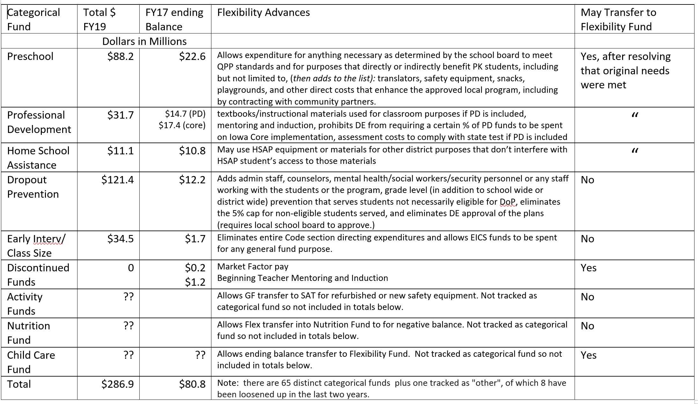

Slide 16
2018 Accomplishments
FLEXIBILITY for Local School Leaders:
  HF 2441 Eliminates DE role in approving dropout prevention plans and turns that over to local school boards. Allows expenditure for “any purpose determined by the board of directors that directly benefits students participating in the adopted program,” proration of staff costs including but not limited to administrative staff, mental health staff/services and school security personnel. Also allows Early Intervention/Class size funds to be used for any general fund purpose.
  RSAI initiative to eliminate 5-year maximum lease of school property to a private entity and created a property tax exemption for private property that is generating electricity for a school on school property.

Slide 17
2018 Accomplishments
OPERATIONAL SHARING Extension
HF 633 Extends sharing incentives to June 30, 2024.
  Adds social workers as an allowable shared position at 3.0 weighting
  Eliminates 5-year limit for a position to be shared
  Will revisit for extension in the future

Slide 18
2018 Accomplishments
TRANSPORTATION and FORMULA EQUITY
SF 455 addressed both issues:
  $11.2 M in transportation grants for FY 2019 – one time grant in FY 2019 budget - will need to be considered for FY 2020.
  Adds $5 to the minimum State Cost Per Pupil to close the gap to $170 – this is a permanent correction but just a start to closing the gap.
  Didn’t go as far as we originally wanted. Still work to do on both issues.

Slide 19
Transportation and Formula Equality
Transportation expenditure differences are the biggest remaining inequity for students in Iowa. Money spent on busing is not available for teachers, textbooks and programs.
Formula inequality still remains, with a $170 difference between the state cost per pupil, which serves as a ceiling for half of Iowa school districts with the other half of districts allowed to tax locally for up to $170 per pupil more.
Legislative Education Committee leaders have indicated their support to continue to address these inequities.

Slide 20
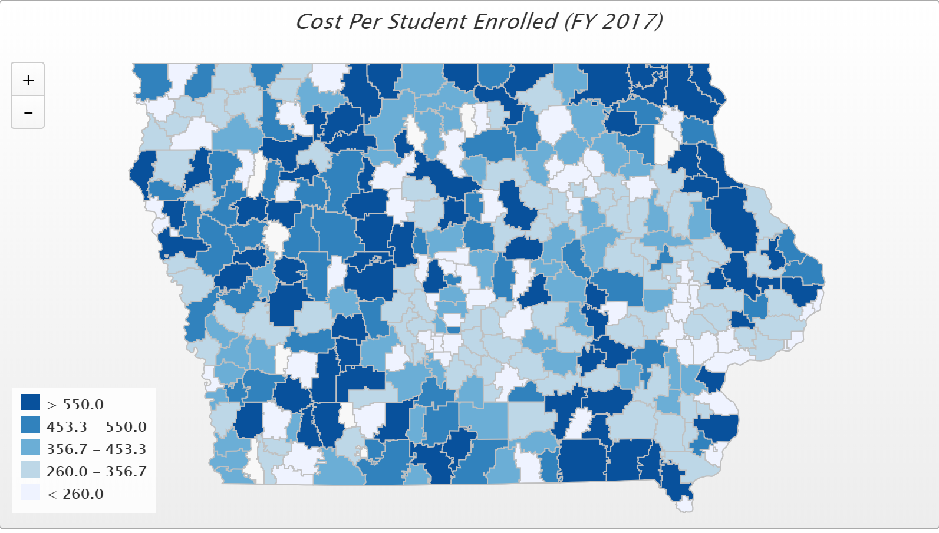
Transportation
FY 2017 State cost per pupil was $6,591. There were an estimated 30 Iowa school districts that required at least 10% of that general fund cost per pupil for transportation.
FY 2017 DE transportation report: The range in transportation expenditures varies from a low of $9.60 to a high of $969.60 per student enrolled. Square miles per district range from a low of 2 to a high of 555 square miles, and route miles range from a low of 958 to a high of 1,227,106 miles.

Slide 21
School Funding & Mandates
  SSA set at 1.0%, set early and stayed at that level despite lower REC estimates and additional reductions to the budget later in the session.
  Appropriation for new State Assessment: $2.7 million to be distributed to school districts for the statewide student assessment.

Slide 24
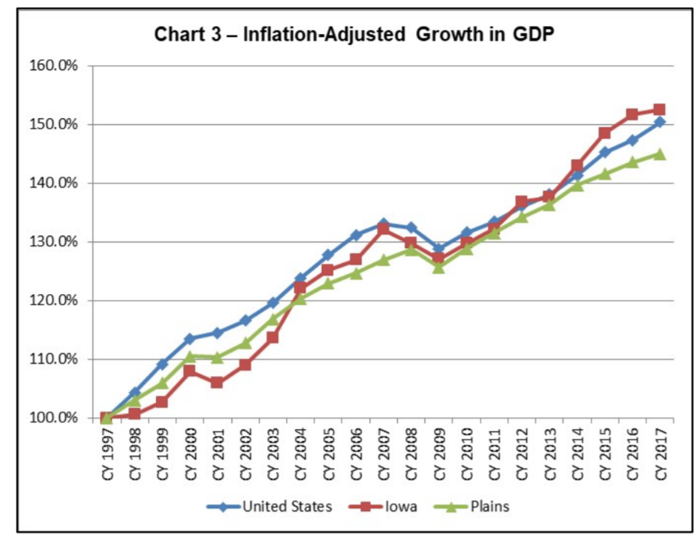
https://www.legis.iowa.gov/docs/publications/FTNO/966760.pdf
About 20% Iowa GDP growth controlling for inflation from 2011 to 2017
“Chart 3 shows the relative inflation-adjusted growth in total GDP for Iowa, the plains states, and the nation. From CY 1997 through CY 2017, Iowa’s 52.4% growth leads the plains states’ 45.0% growth and the nation’s growth of 50.4% as a whole. Iowa surpassed the plains states beginning with CY 2004 and the nation beginning with CY 2014.”

Slide 25

How big is $765 million???
58 Cents/pp
 | $ 765,000,000 | State aid over 8 years (true number)
minus | $ 90,000,000 | property tax relief
minus | $ 85,700,000 | state funding for 13,802 new students
minus | $ 159,000,000 | Teacher Leadership Initiative
equals | $ 430,300,000 | Net new money to the classroom
divided by | 512,971 | PK-12 enrollment
equals | $ 838.84 | Dollars per student over 8 years
divided by 180 days | $ 4.66 | Dollars per student per day of instruction over 8 years
divided by 8 equals | $ 0.58 | annual increase dollars per student per day

Slide 26

Student Inequities and Needs
Student Mental Health: Mental health reform set a structure in place, with unanimous legislative support. It did not includes services for students or appropriate any funds.
Governor Reynolds appointed a task force to make recommendations on student mental health systems.
Mr. Hubbell said we already know what to do, but we have to fund it.
Both Reynolds and Hubbell are talking about this issue.

Slide 27
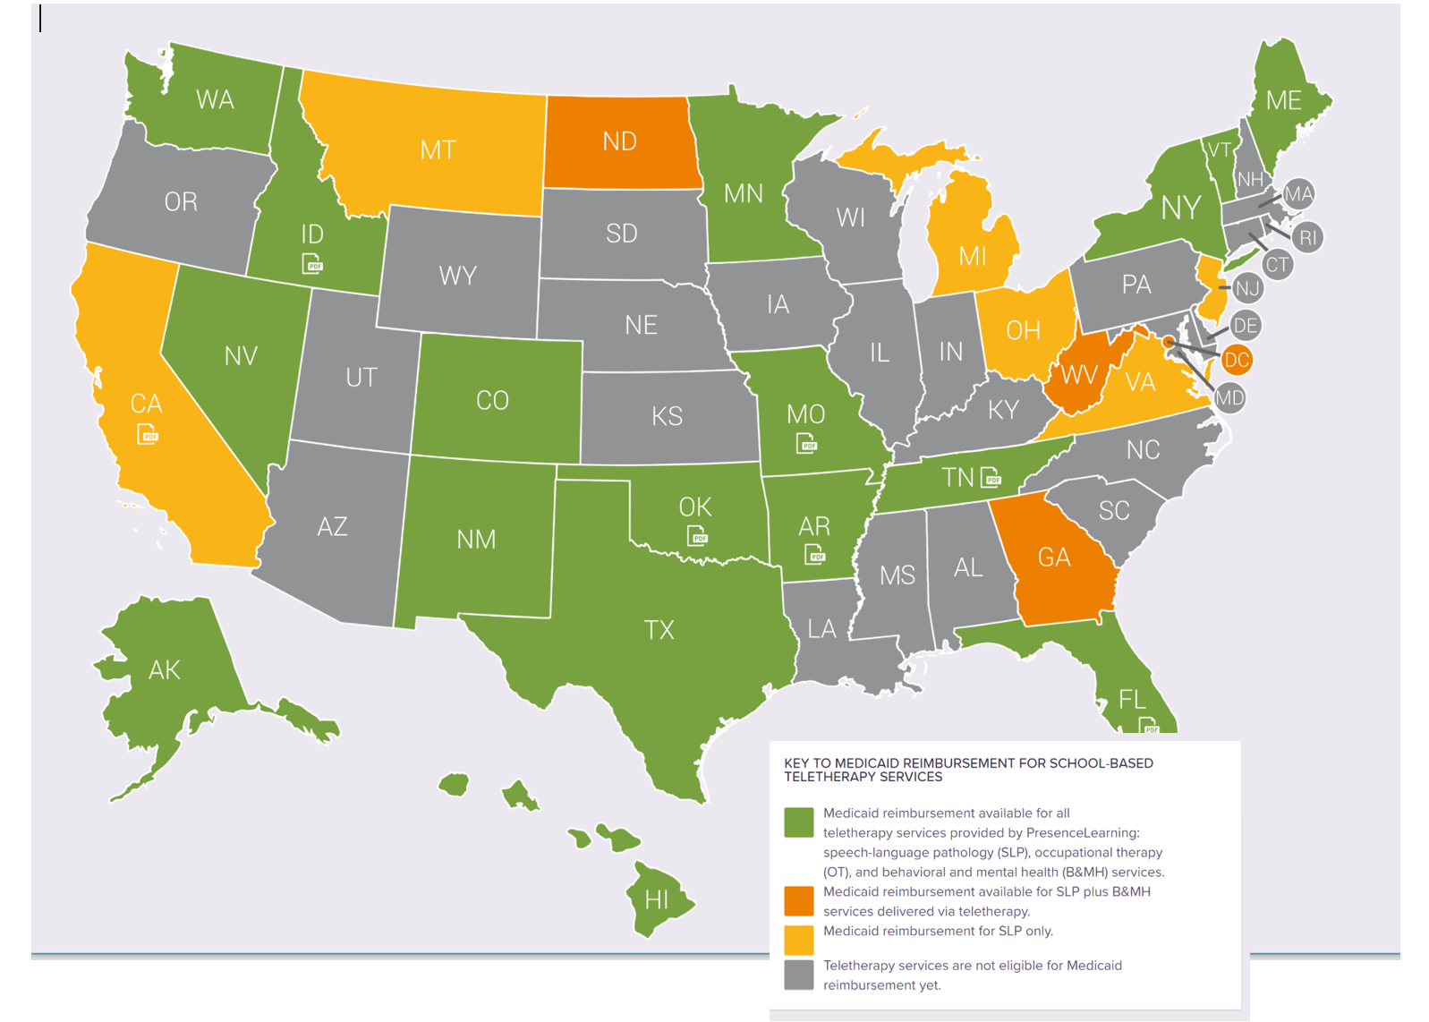
Comparison state-by-state of Medicaid reimbursement for online therapy:
https://www.presencelearning.com/resources/medicaid-reimbursement-for-online-services/

Slide 28
Student Inequities and Needs
Funding Equity for At-risk Students: Resources for serving at-risk students should be based on need, such as the percentage of students eligible for Free and Reduced Price Lunch, in addition to enrollment of the district.
The current disparity in dropout prevention capacity ceiling, with some districts held to 2.5% and others allowed to access up to 5% of regular program district cost is unfair, arbitrary, and based on old history no longer relevant to supporting student needs.

Slide 29
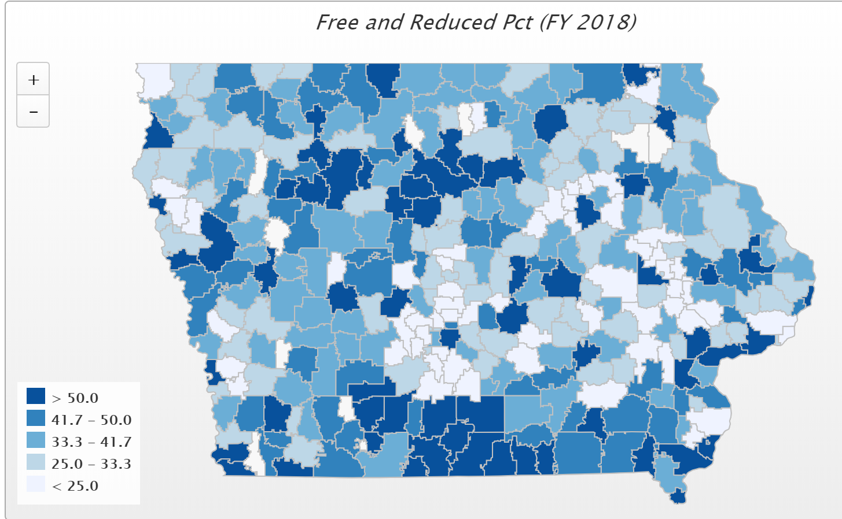
Children from families with incomes at or below 130% of the poverty level are eligible for free lunch those 130-185% eligible for reduced lunch, according to the National School Lunch Program. Districts in the largest and smallest enrollment categories had the highest percentage of students eligible for free or reduced price lunch (Table 1-7).

Slide 30
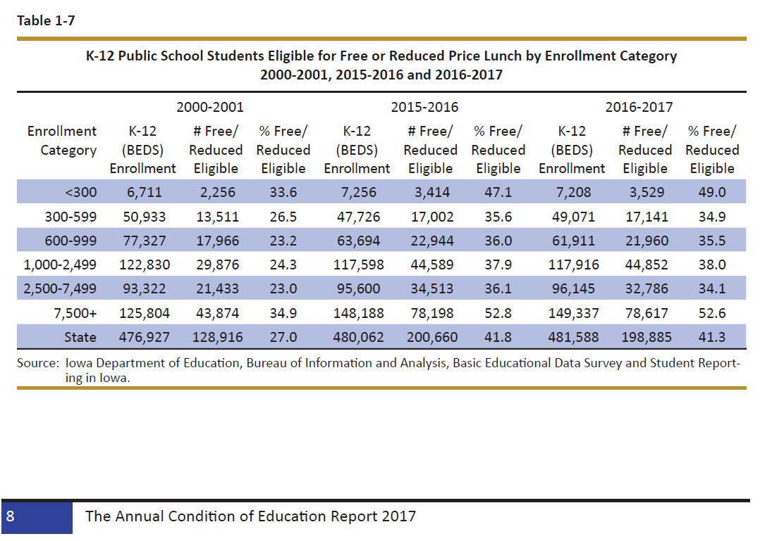

Slide 31
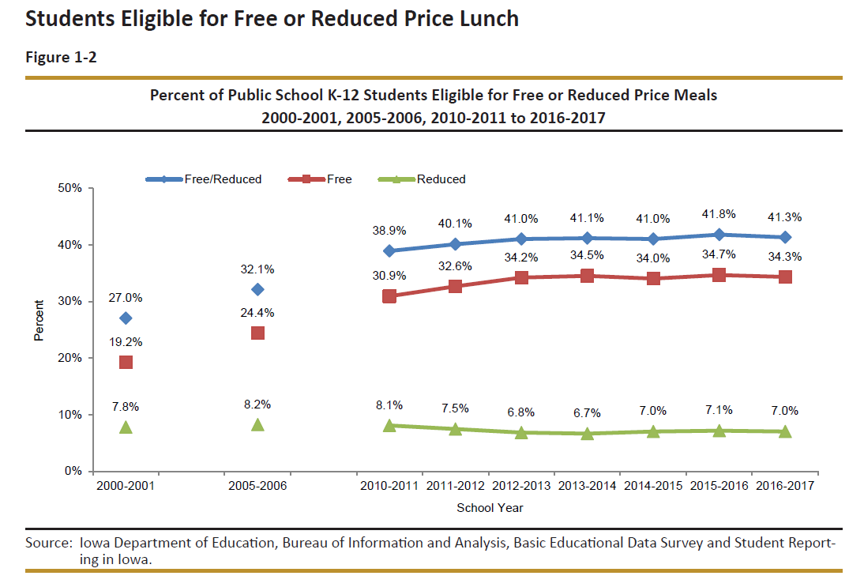

Slide 32
Student Inequities and Needs
Quality Preschool: RSAI supports full funding of quality preschool. Due to changing demographics in rural Iowa, significant transportation costs, and lack of quality day care access, preschool should be fully funded at the regular student count at 1.0 per pupil cost.

Slide 33
Why does preschool matter?
  The Perry Preschool Project (40 years), PK saves $17 for every dollar invested.
  The majority of states now view access to high-quality PK programs as a critical long-term economic investment in the future workforce.
  Education Commission of the States, Oct. 2014, http://www.ecs.org/docs/early-learning-primer.pdf: Six Rigorous long term evaluation studies have found that children who participated in high-quality preschool programs were:
    25% less likely to drop out of school.
    40% less likely to become a teen parent.
    50% less likely to be placed in special education.
    60% less likely to never attend college.
    70% less likely to be arrested for a violent crime.
  NCSL quotes studies on long term return on investment. http://www.ncsl.org/research/human-services/new-research-early-education-as-economic-investme.aspx

Slide 34
Teacher Shortage and Quality Instruction
Rural school districts require maximum flexibility to provide great instruction to all Iowa students. RSAI supports
  1) district flexibility to meet offer and teach requirements CTE courses allowed to count if <600 enrollment in SF 475 which also included on-line learning options for all districts
  2) elimination of barriers to teacher licensure such as Praxis test requirements Some progress in both chambers, but couldn’t agree between them on the solution. Will try again in 2019.

Slide 35
Teacher Shortages in Iowa
HF 291 Chapter 20 Changes –possible motivation for experienced teachers to leave the field
TLC demand for teacher leaders
Wage and workload competition
General economics of teacher supply with 2% unemployment in Iowa
Public perception of the rewards of teaching
Rural Schools have additional challenges with lack of economies of scale, inability to attract young teachers to rural communities, lack of resources to compete with larger districts.
Its not just Iowa

Slide 36
Teacher Shortages: Economics
The wage gap between public school teachers and similar workers, grew from a negative 5.5% in the 1979 to a record -17% in 2015, according to Education Week. “In their findings, authors Lawrence Mishel, who is president of the Economic Policy Institute, and labor economist Sylvia A. Allegretto, who is chair of the Center on Wage and Employment Dynamics at the Institute for Research on Labor and Employment at University of California, Berkeley, cite recruiting and retaining high-quality teachers as crucial issues in K-12 education today, and say that in order to draw new teachers to the profession, fair compensation is necessary.
"Continued budget austerity at all levels of government have created pressure to restrain teacher compensation," Mishel wrote in an email.
According to the Learning Policy Institute, in 2016, there were an estimated 108,757 teachers not fully certified for their teaching position and 6,424 reported vacancies in 36 states. (IA and some other states do not report)

Slide 37
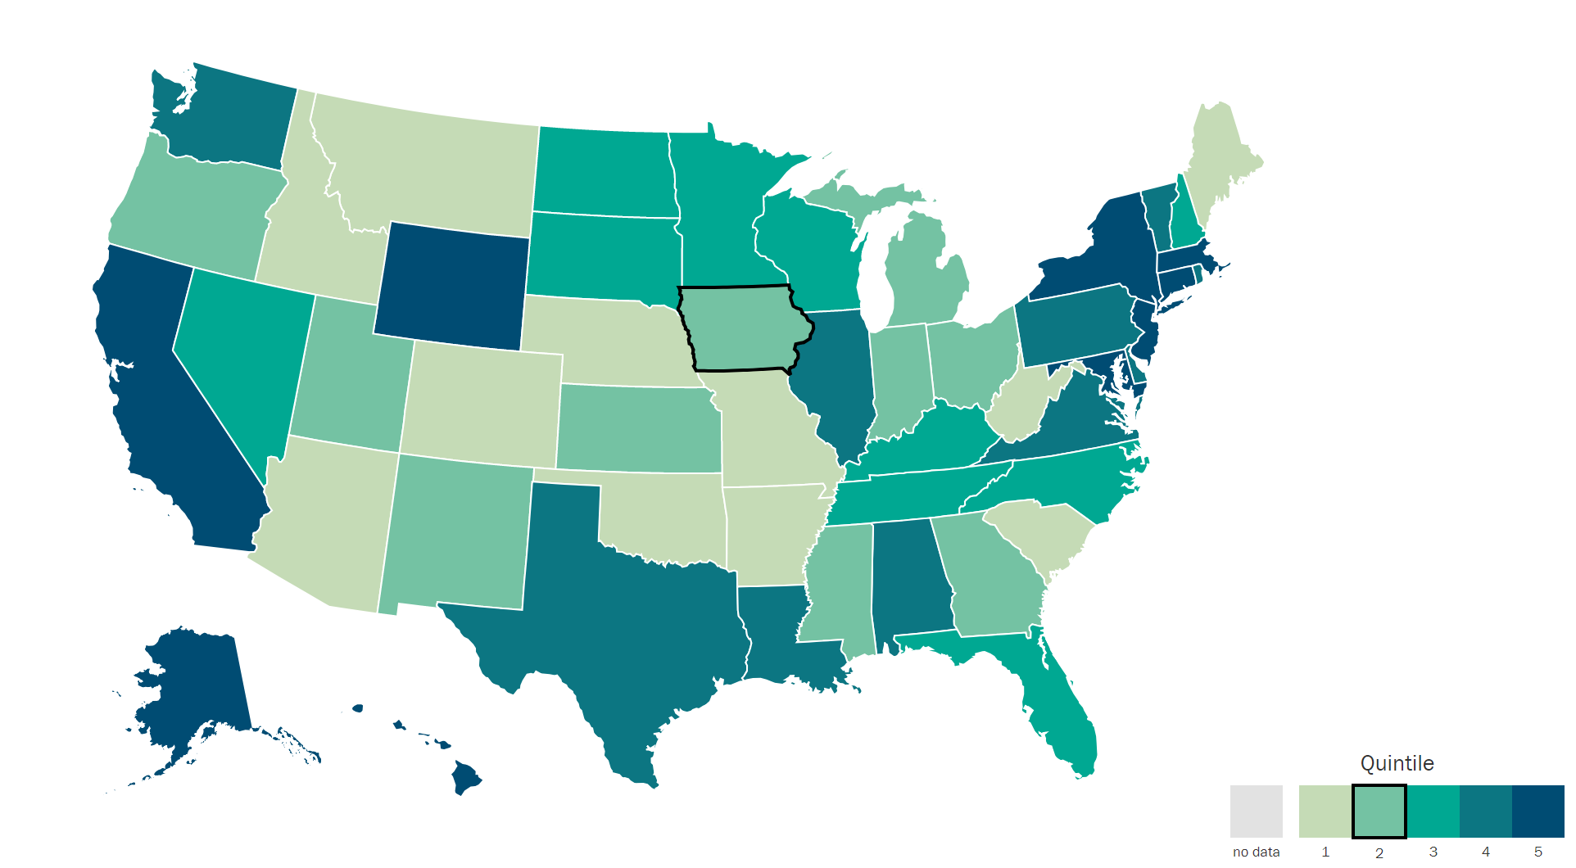
Understanding Teacher Shortages: 2018 Update
A State-by-State Analysis of the Factors Influencing Teacher Supply, Demand, and Equity https://learningpolicyinstitute.org/product/understanding-teacher-shortages-interactive
IA $35,766
SD $37,419
ND $38,032
MN $37,644
WI $36,983
IL $38,820
WY $45,207
IA is in the second to lowest quintile, ranking 30th in starting teacher pay.

Slide 38
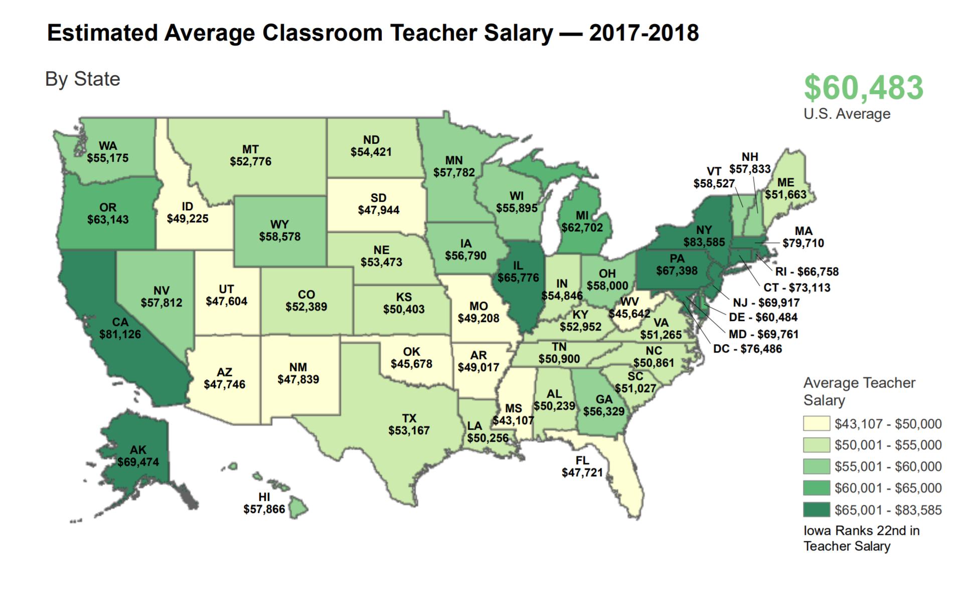
https://www.legis.iowa.gov/docs/publications/MOW/970927.pdf

Slide 39
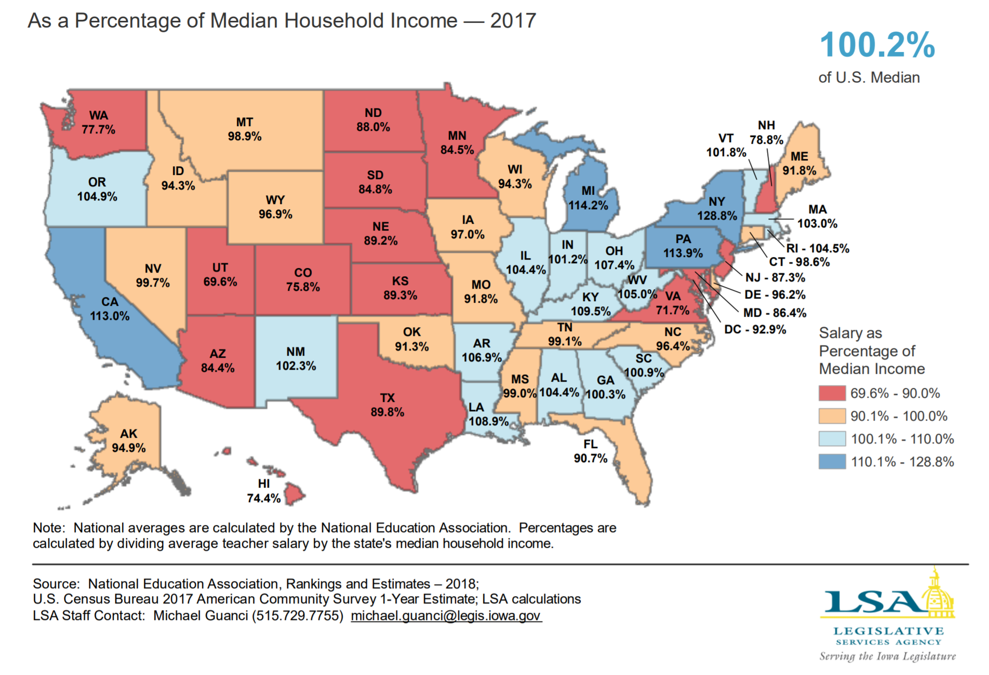

Slide 40
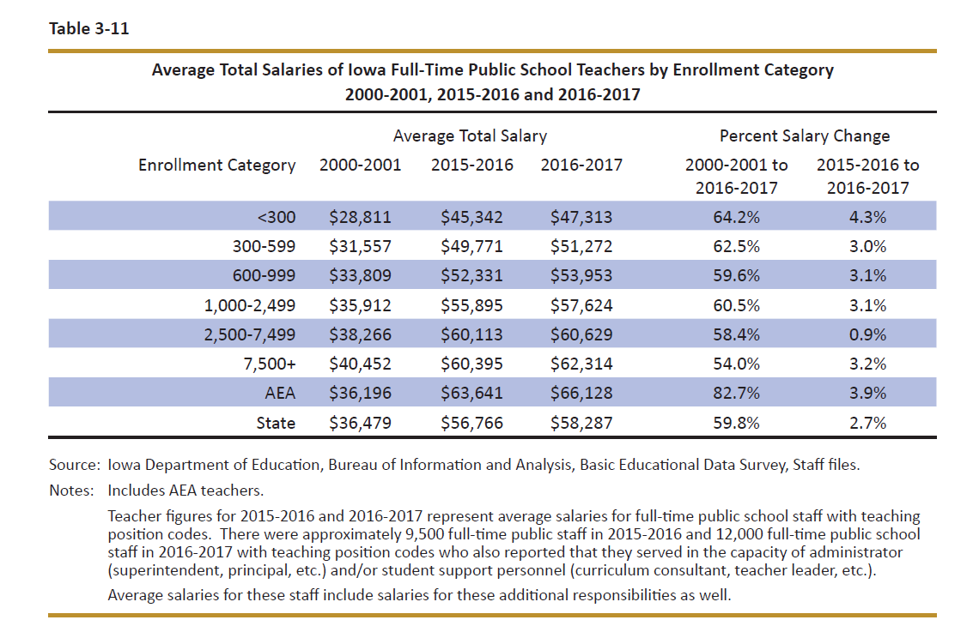
DE’s Annual Condition of Education Report shows average salary by school size (which is a good but not perfect predictor of rural districts), showing an almost $15K difference in pay between the averages of the smallest and largest category of school size.

Slide 41
Sharing Incentives
  Extension of operational sharing plus added position of social worker/mental health counselor.
  Suggested to add SRO to the list
  Will need to work on Reorg and WGS extension next, since those incentives expire in 2020.

Slide 43
Note: 2 years after low AG or SSA, drop in number of districts

Slide 44
School Choice Defense
Bills for ESA’s/vouchers in 2018 Session did not advance
Tax bill did expand STOs to $13 million, increased eligibility to 400% of FPL, and created 529 plan for tax free private school tuition
Costly – tight budget applies to this issue to (state already invests over $52 million)
Nonpublic school and home school advocates are expert, adamant and very politically active.
Advocate for investing in public school first.
Public dollars require public accountability; advocate for a level playing field (testing accountability, serve all students, require all mandates, oversight on expenditures).
Voters in 9 states have rejected vouchers on the ballot – none have approved.
Consider vouchers as a shift of resources from rural to urban communities since few nonpublic schools exist in rural Iowa.

Slide 45
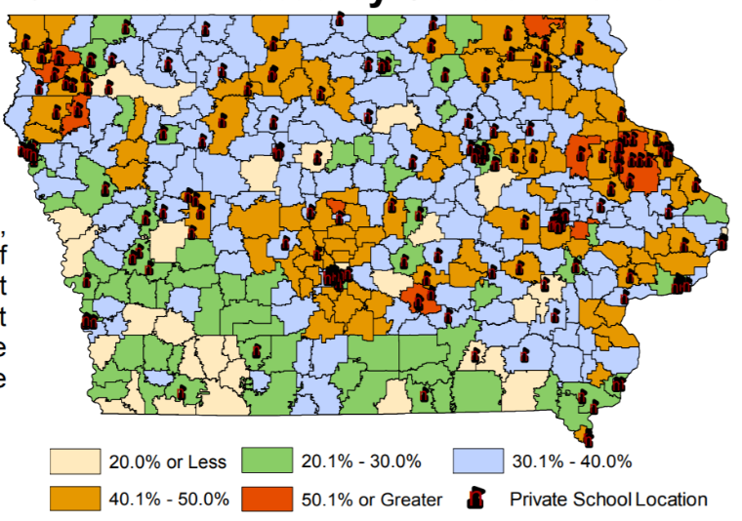
Map from Legislative tax Expenditure Committee DOR Report (in RSAI School Choice Position Paper)
Note location of existing private schools related to legislative seats

Slide 46
Advocacy Strategies
Build relationships during the Interim and make introductions before the election. “Gentle persuasion applied relentlessly”
Engage parents and the business community
Get real – talk about the ongoing impact on the ability of your school to educate all children for the 21st Century.
Share position papers, impact on your district, with staff, stakeholders and your legislators and invite legislators into your school
Don’t forget the media – letters to the editor, coverage of school budget events, stories of changes in student needs, successes too – tell the good news.
Thank legislators for their work last session and offer to help them if you can.
Call RSAI for help!

Slide 47
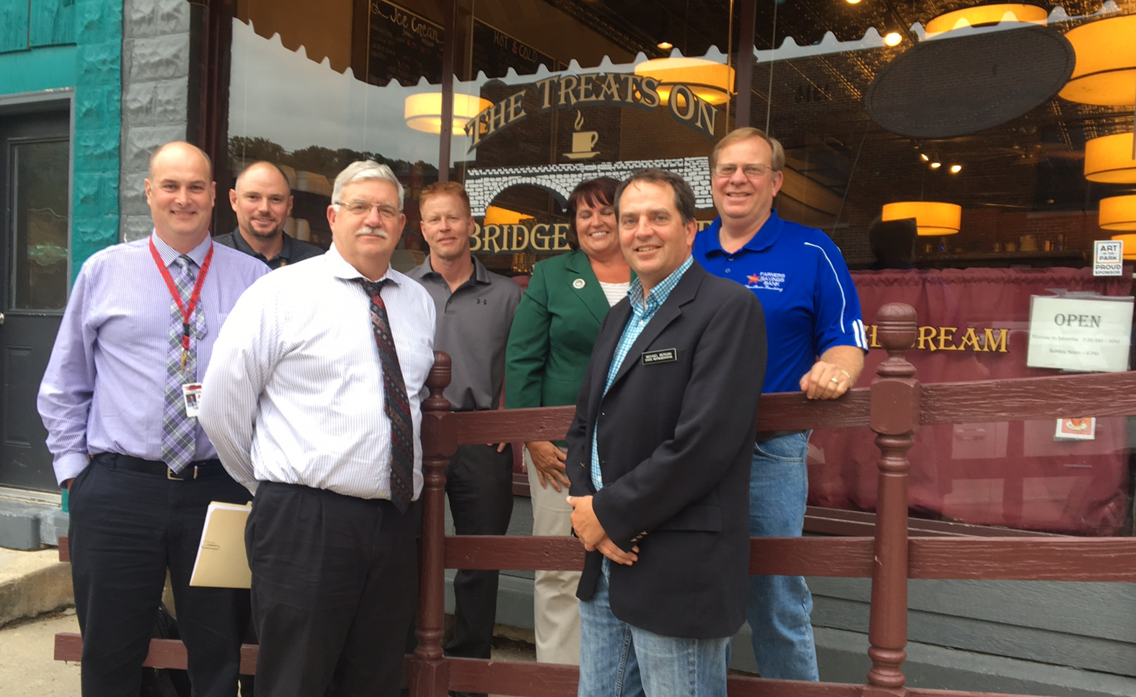
3 Legislators and 4 Sups

Slide 48
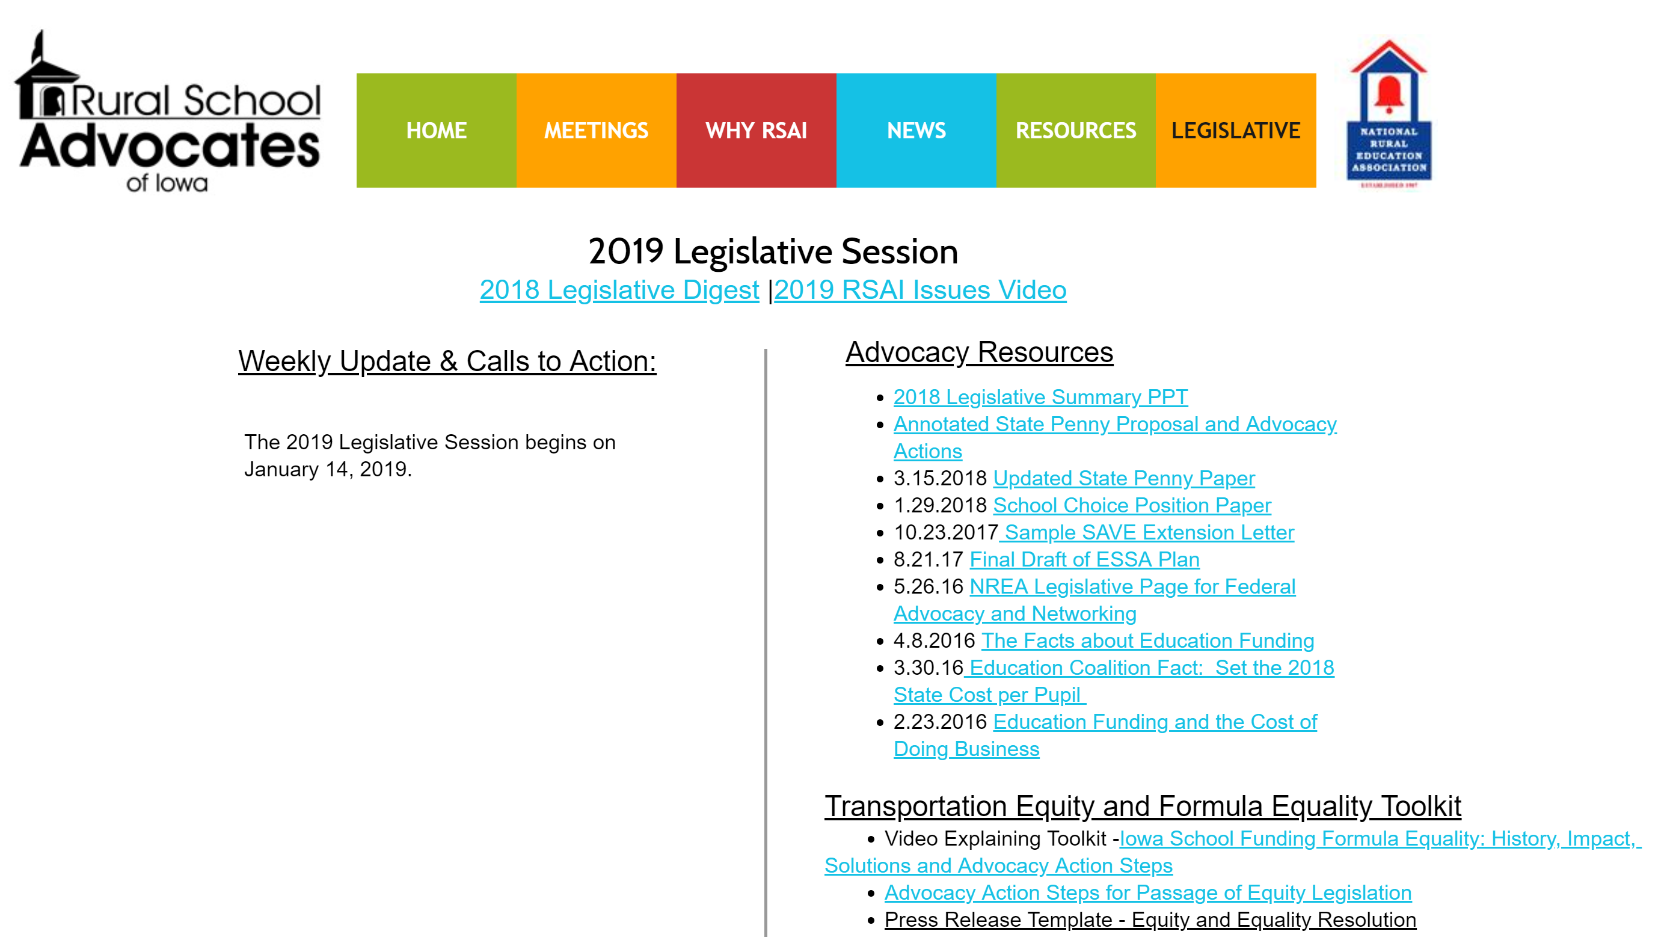
Resources:
http://www.rsaia.org/legislative.html

Slide 49

RSAI Priorities for 2019 you get to set them tonight!!!

Slide 50

Questions or Comments?
LARRY SIGEL – ISFIS PARTNER
Cell: 515-490-9951
larry@iowaschoolfinance.com
MARGARET BUCKTON – ISFIS PARTNER
CELL: 515-201-3755
Margaret@iowaschoolfinance.com
Iowa School Finance Information Services
1201 63rd Street
Des Moines, IA 50311
Office: 515-251-5970
www.isfis.net

