Slide 1
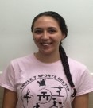
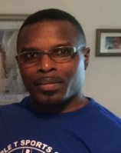
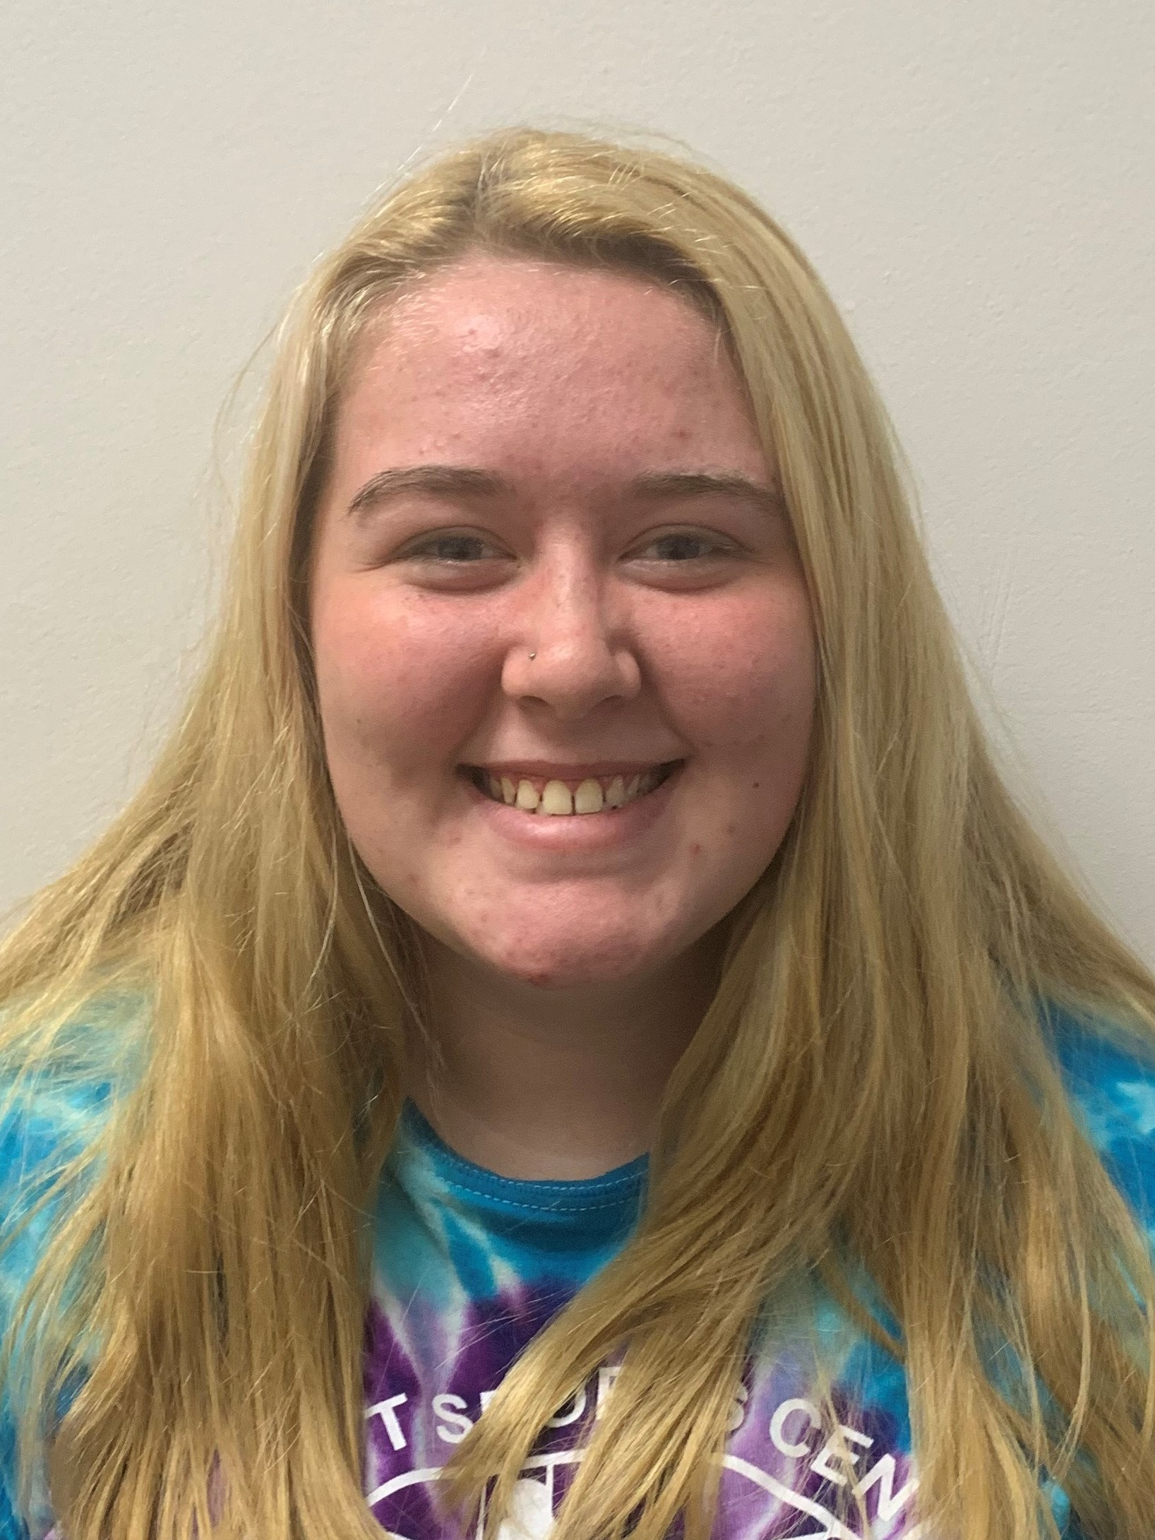
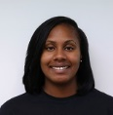
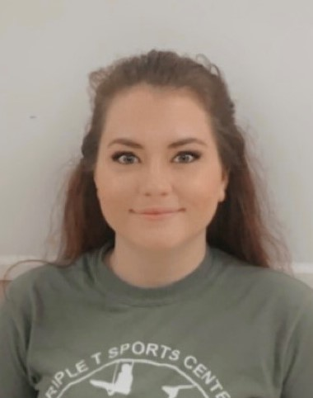
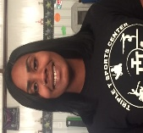
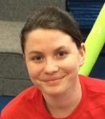
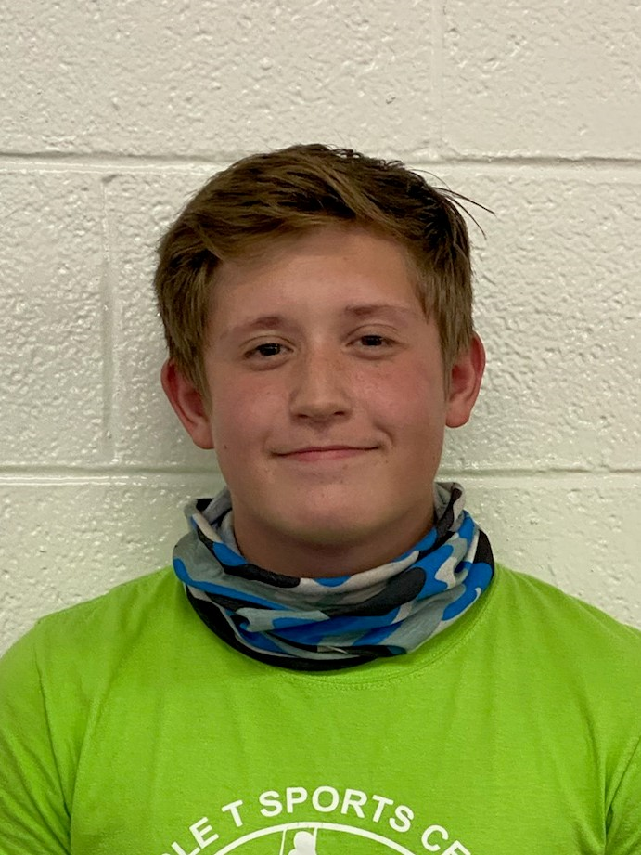
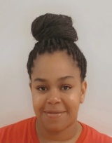
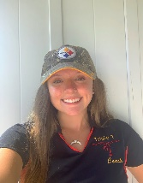
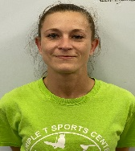
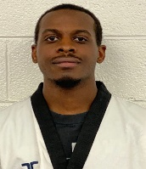
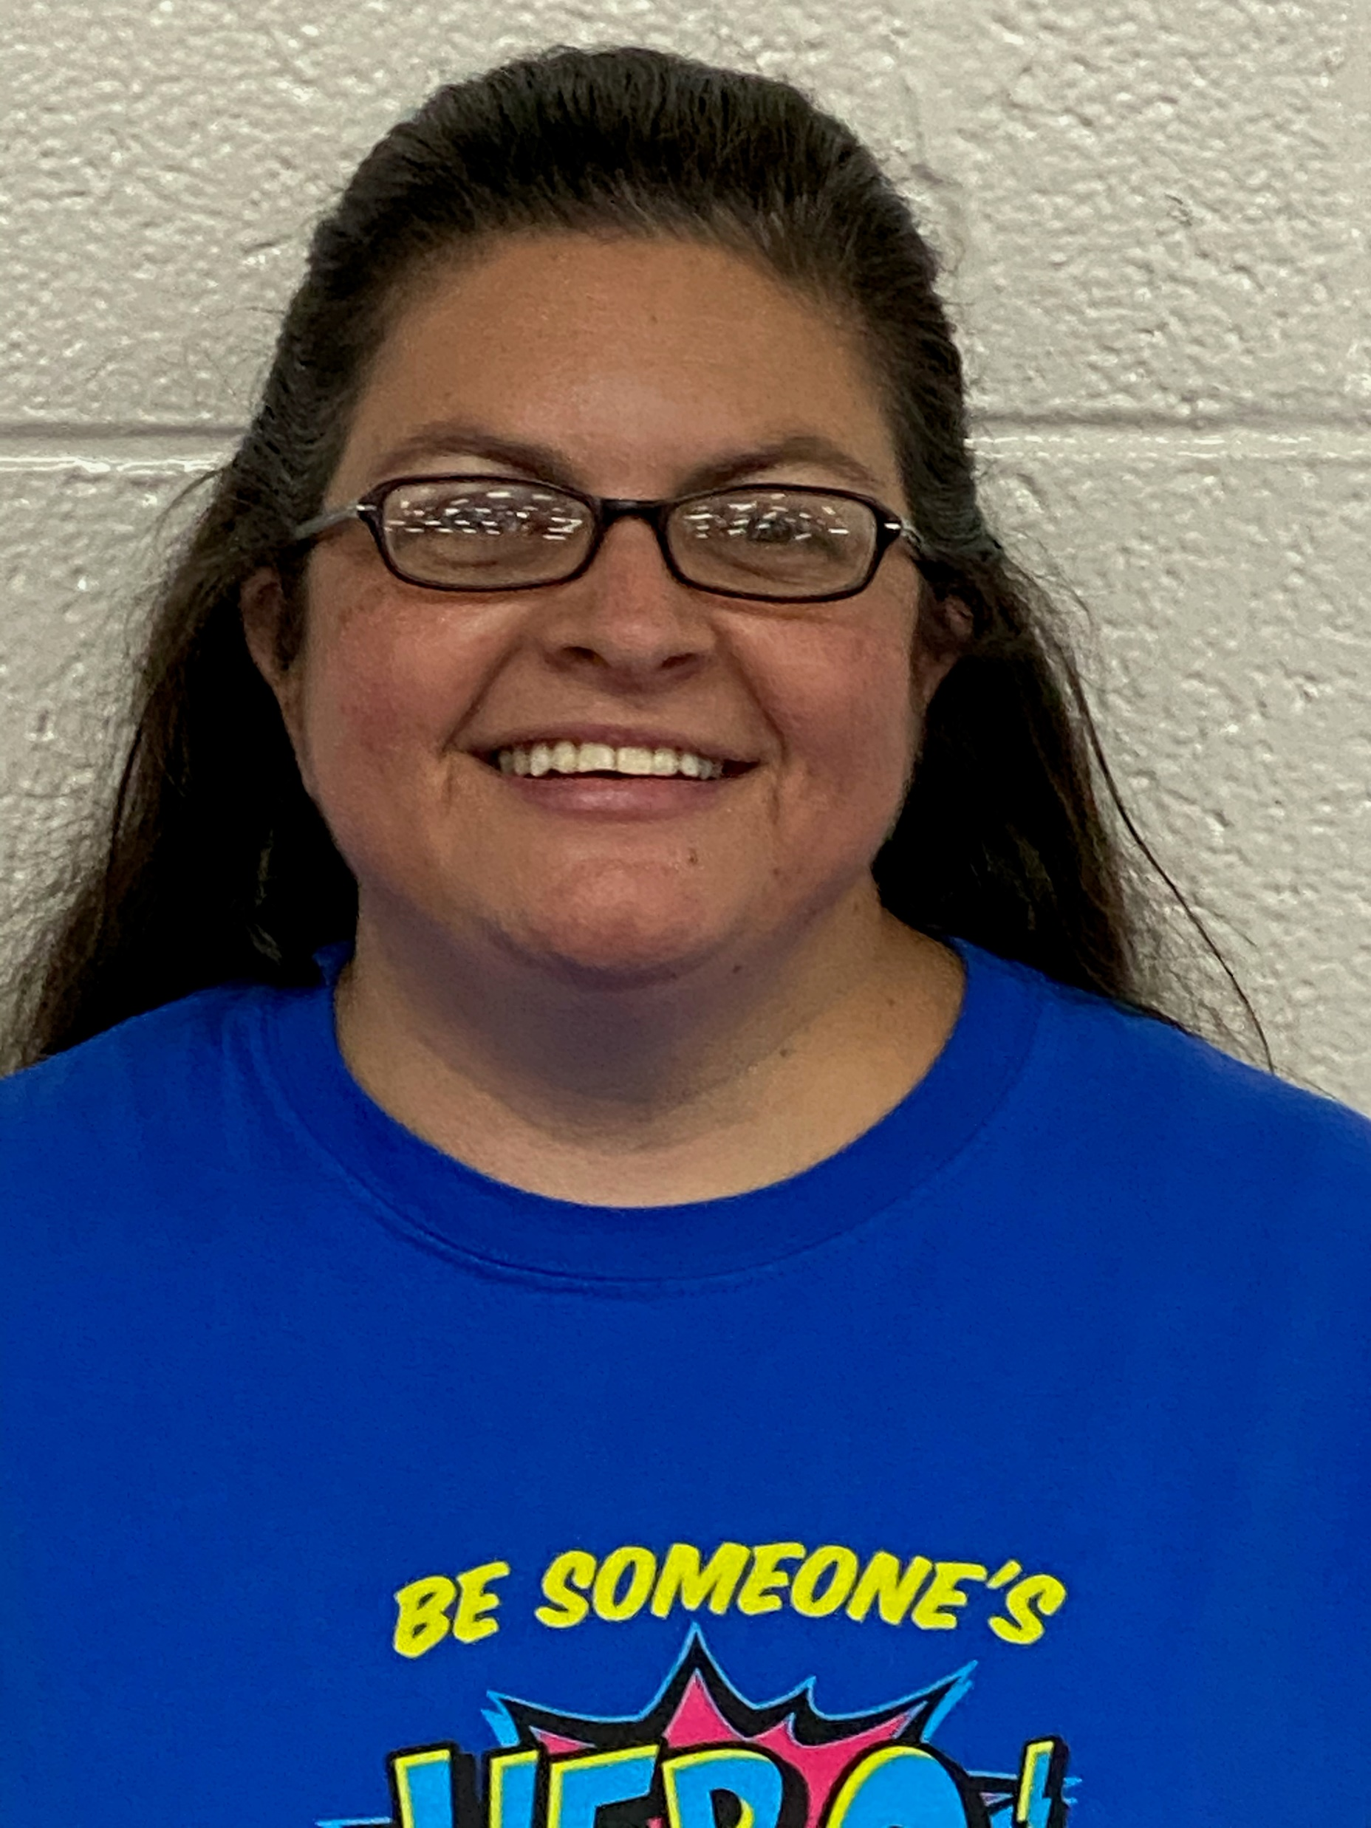
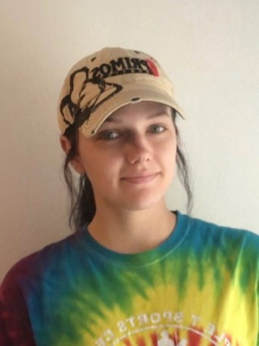
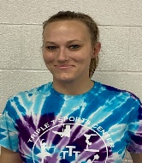
Triple T’s Amazing Staff
Childcare Staff
Tyrone Burks: Head Gymnastics Coach/Owner
Cheryl Burks: Business Manager/Owner
Kaitlyn Sabatino
Childcare Director
Lead Teacher
Kylia Luna
Asst Director
Lead Teacher
Team Gymnastics Coaches
Recreational Gymnastics Instructors
Tyrone Burks
Head Coach
Derk Gregory
Hot Shots / Pre-Team Instructor
Madison Balog
Recreational Gymnastics Instructor
Dashea Collins
Lead Teacher
Sydney Woods
Lead Teacher
Dashea Collins
Rec Director
Compulsory Girls / Xcel Team Coach
Kaitlyn Sabatino
Recreational and Advanced Gymnastics
Instructor
Charlie Fellers
Boys Gymnastics and Ninja Warrior Instructor
Madison Balog
Lead Teacher
Margret Jackson
Lead Teacher
Ashley Bodnar
Compulsory / Excel
Girls Team Coach
Cheryl Simpson
Adv Lions Instructor
Zoser Mateen
Boys Gymnastics and Ninja Warrior Instructor
Ashley Bodnar
Lead Teacher
Leslie Keith
Lead Teacher
Rebecca Dixon
Excel Girls Team Coach
Jennifer Hitchcock
Recreational Gymnastics Instructor
Rebecca Dixon
Recreational Gymnastics Instructor
Taekwondo
Cheerleading
TKD Lead Instructor
Zoser Mateen
Jennifer Hitchcock
Lead Cheer Instructor
Office
Margret Jackson
Recreational Instructor
Sydney Woods
Office Customer Service

