Slide 1
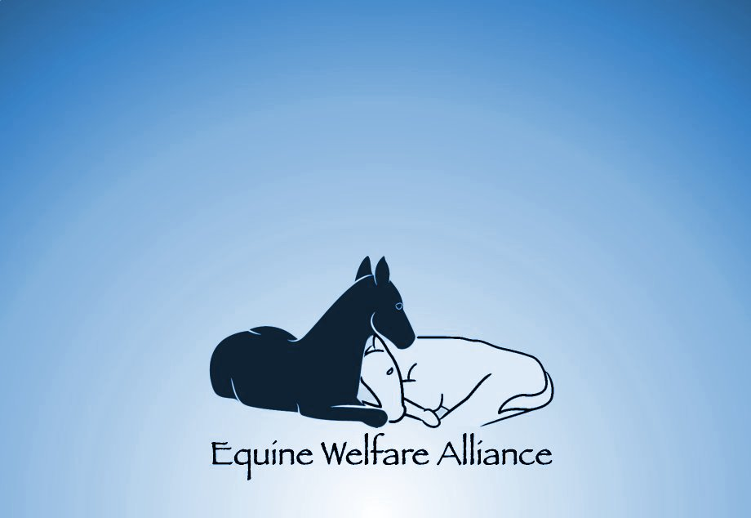
Unwanted and Retired Race Horses
The Scope of the Issue
John Holland, President

Slide 2
The Scope of the Issue
Before we can begin to solve the problem of providing a future for ex-racehorses, we must come to terms with the true nature of the issue and then use analytic methods to determine its scope and measure our progress.

Slide 3
The “Unwanted Horse” vs the Excess Horse
According to the Unwanted Horse Coalition:
"Unwanted horses are defined as those no longer wanted by their current owner because they are old; injured; sick; unmanageable; fail to meet their owner's expectations; or the owner can no longer afford to keep them".

Slide 4
The “Unwanted Horse” vs the Excess Horse
This definition hides the true nature of the problem, by framing it an issue of undesirable and unusable horses. This is not the case. The nature of the issue is an excess of horses being bred for very short careers in the sport horse industry. Only when we understand this reality can we begin to address the issue.

Slide 5
“Unwanted” Slaughter Horses
93.3% are healthy and without behavioral issues.
96% are under ten years old.
Approximately 70% are Quarter Horses.
16-20% are Thoroughbreds.
Most horses that go to slaughter are sport horses at the end of a very short career.

Slide 6
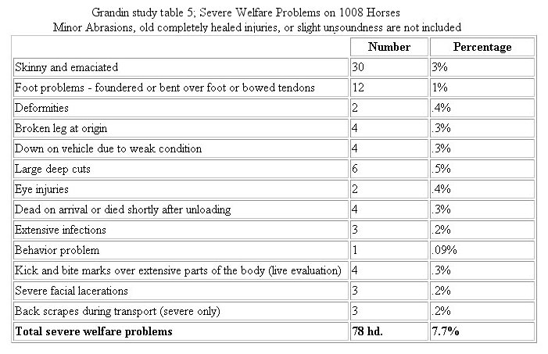
Slaughter Horses – Grandin Study

Slide 7
Possible Fates Awaiting an Ex-racehorse
Transition to another sport
Transition to recreational ownership
Retirement (warehousing)
Euthanasia or slaughter

Slide 8
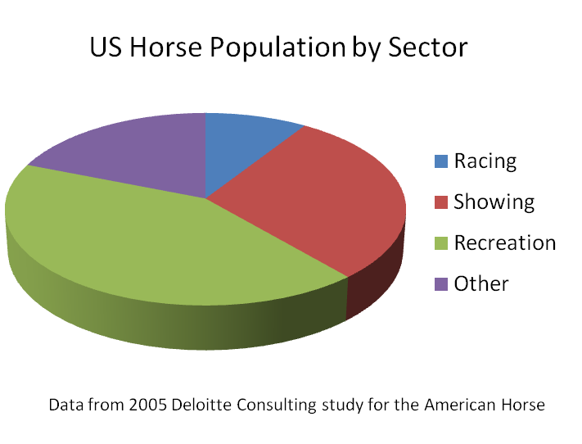
The Traditional Way of Viewing the Horse Population

Slide 9
The Problem with this Representation
The traditional way of showing the horse population does not show a critical factor; the length of time that the equines in a sector remain there.
The recreational sector may look very large, but it holds onto its horses considerably longer than the sport horse sectors do.

Slide 10
Horse-Years and Life Charts
In order to understand the problem of absorbing sport horses into the recreational sector, we must think in terms of both how many horses are in a sector and how long they are there.
Sectors can be represented by rectangles where their height is the number of horses, and their width is the average number of years each horse remains in the sector.
The resources required are thus represented by the area of these rectangles and are in horse-years, not just horses.

Slide 11
Each of the tiny tiles in the background represents one year of care for 1,000 horses!
An annual foal crop of 27,000 produces a life-time care obligation of 756,000 horse-years! Assuming 22,000 have racing careers of 4 years, then racing will absorb only 88,000 horse years of the obligation.

Slide 12
The Magnitude of the Problem
If all the horses in Life Chart 1 were simply retired to farms supported by the industry then each horse actively racing would have to support 7.28 horses in retirement (641,000 / 88,000).
This is clearly impossible.

Slide 13
The Recreational Sector
The Deloitte Study in 2005 estimated that there were 3.9 million recreational horses.
If we assume they are owned for an average of 18 years, then the recreational sector absorbs about 3.9M/18 or 216,666 horses a year.
Assuming 16% of these are from thoroughbred racing, then 34,666 thoroughbreds could be absorbed a year. To be more conservative, we will assume only 16,000 a year are absorbed.

Slide 14
If these 16,000 are retrained for half a year each, then each active race horse must support only .08 horses in training (8,000/88,000).

Slide 15
Now we see what would happen if we instituted reforms such as racing without drugs and starting horses later. Since racing supplies an extra 2 years of support, the recreational sector can absorb more horses per year.

Slide 16
When the support of the breeding herd is taken into account, and some of the recreational sector is allocated to foals that never race, we begin to get a more complete picture.

Slide 17
The Bad News
Any strategy to deal with retiring racehorses must have recreational ownership as one of the primary destinations.
Unfortunately, demand for horses in this sector has been down significantly because of hyper inflationary pressures brought on in large part by the recession and government policy.
The horse industry must use its influence whenever possible to curb these policies if recreational ownership is to remain a significant part of the answer.

Slide 18
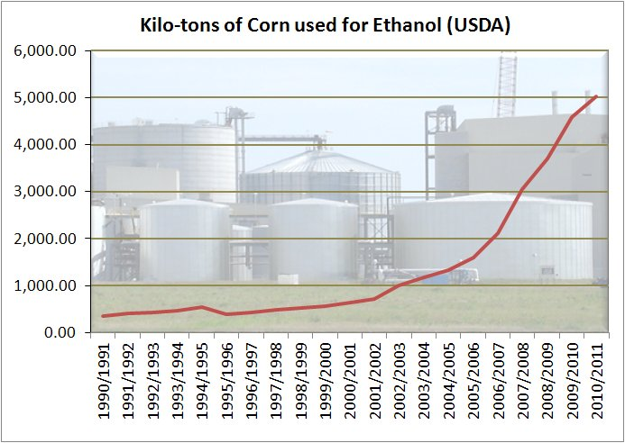

Slide 19
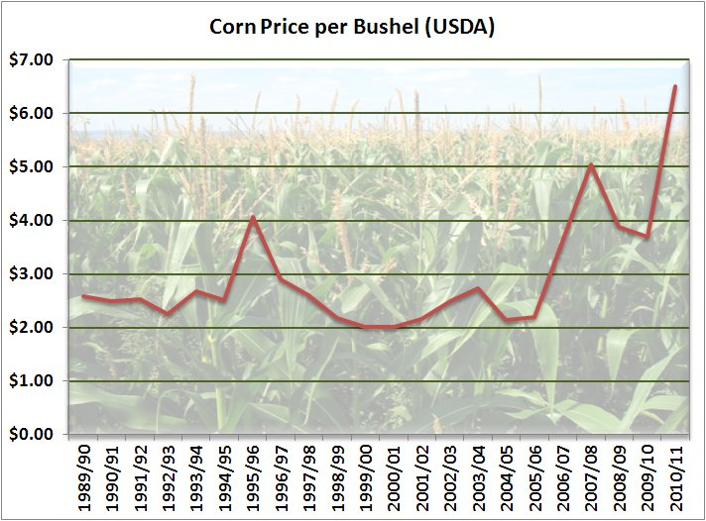

Slide 20
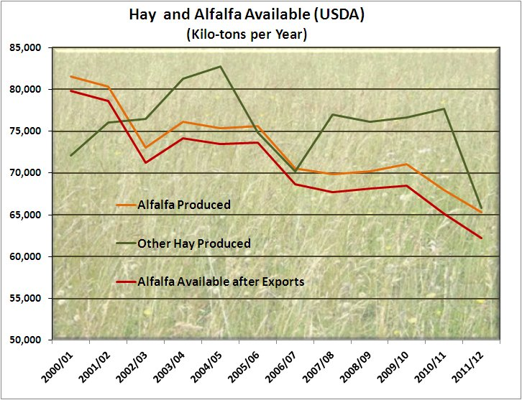

Slide 21
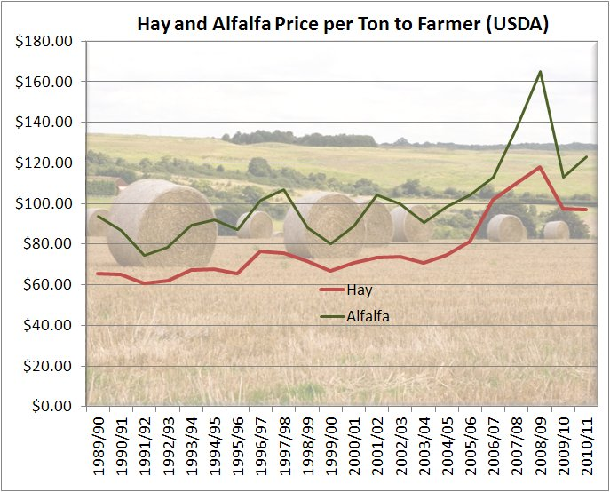

Slide 22
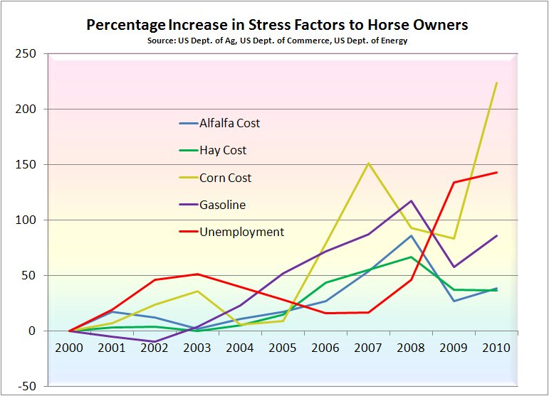
The Recreational Sector

Slide 23
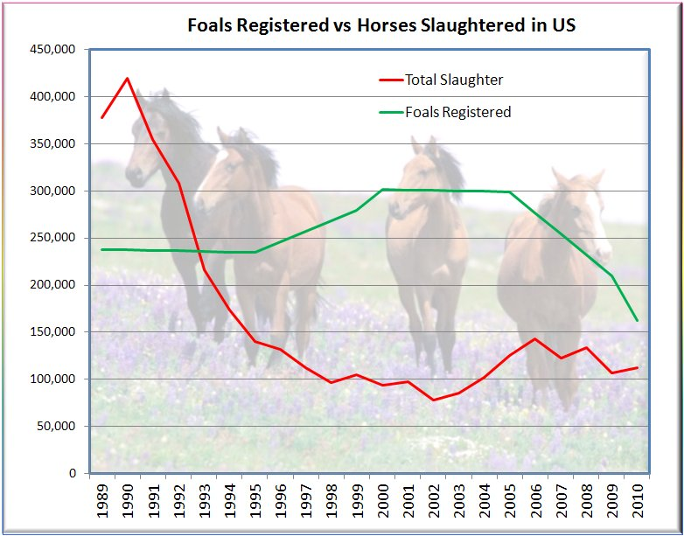
The Good News

Slide 24
For more information visit: www.equinewelfarealliance.org

Slide 25
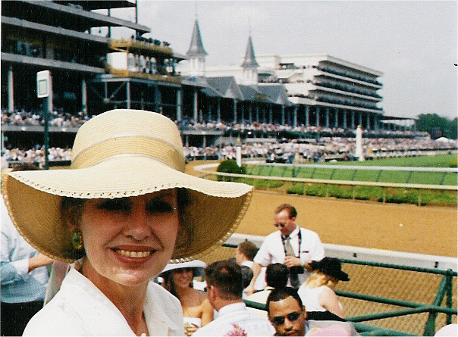
Restructuring an Industry
Form a planning committee and get buy in.
Track the industry’s horses.
Adopt policies that minimize excess foals.
Assess event fees to pay for transitioning.
Adopt strict policies to minimize injuries.
Create classes/events for older horses.
Determine best 2nd careers and establish retraining programs.
Form team to serve as “placement councilors”.
Promote the mystique of your athletes.

Slide 26
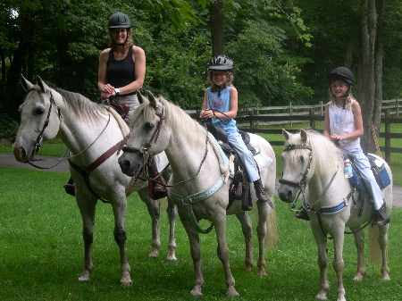
Nurture the Adopting Sectors
(recreational, eventing, hippotherapy, etc.)
Fight government programs that increase costs to horse owners.
Promote recreational uses (riding trails, etc.).
Sponsor adoption events.
Provide assistance to horse related charities such as rescues, hippotherapy groups, etc.
Support programs that aid owners in temporary crisis such as “rescue in place” and hay banks.

Slide 27
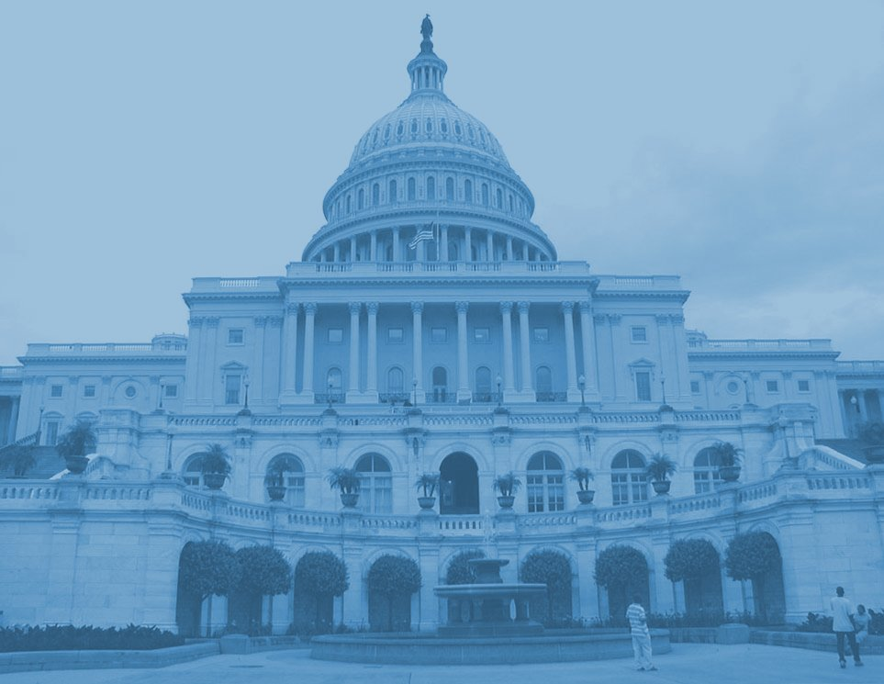
Legislative Reform
Repeal tax subsidies for breeders!
Replace breeding subsidies with tax initiatives that encourage re-tasking horses.
Fight government subsidies and initiatives that increase costs to horse owners.
Support humane legislation.
Institute registration policies that discourage “lotto breeding”.

