Slide 1
Data Tools to Inform Adult Ed Regional Planning
Santa Monica Adult Education Regional Consortium
November 19, 2018
Santa Monica College – Office of Institutional Research

Slide 2
‘
‘
If you can’t measure it, you can’t improve it.
-Peter Drucker
Notes:
Data are signposts to help you understand the changes you want
Data don’t always provide you with the clear answers; but helps you ask more precise ones (where to start digging; treasure map metaphor)
Share data tools to help you as practitioners in the adult ed work to inform strategies and programming and evaluate the things that are already in place
Not expected to become experts on tool; not a technical
Disclaimer: not the developer of tools; just an end user like everyone else; hopefully my experience as a researcher can help facilitate your exposure to the tools

Slide 3
Tools to Inform Data Conversations
What needs of the community are unaddressed (in terms of the workforce)?
Who are my potential students?
How effective are our courses/programs in moving the economic mobility needle for students?

Slide 4
Tools to Inform Data Conversations
Who are my potential students?
What needs of the community are unaddressed (in terms of the workforce)?
How effective are our courses/programs in moving the economic mobility needle for students?

Slide 5
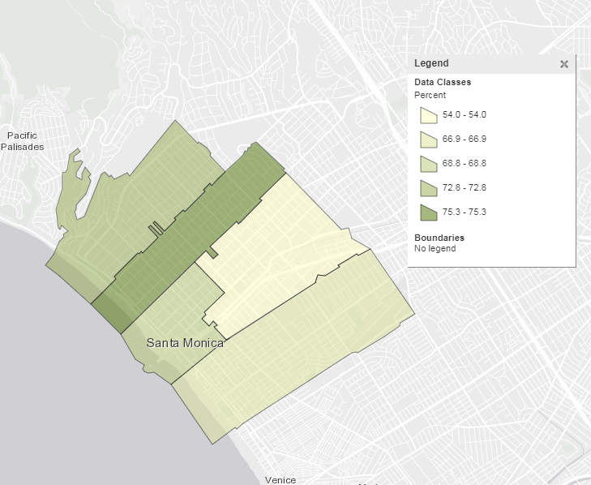
Who are my potential students?
1
What percentage of the population (18 and older) has a bachelor’s or higher degree and where do they live?

Slide 6
What workforce needs of the community are unaddressed?
2
VS
Demand
Supply

Slide 7
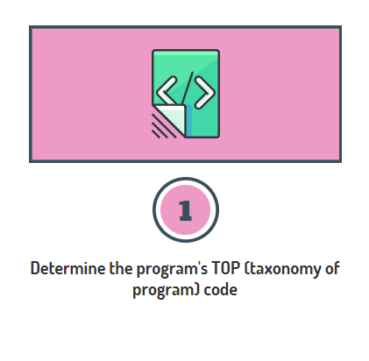
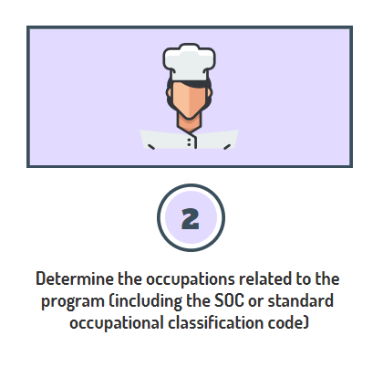
Steps to Determine Labor Market Demand
Identify the right program and occupation codes

Slide 8
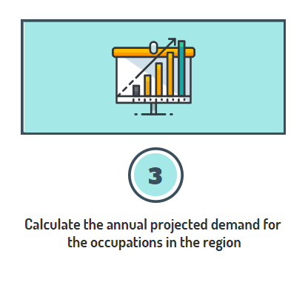
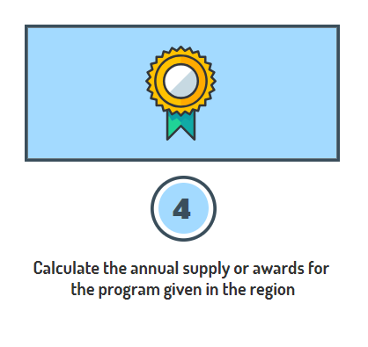
Steps to Determine Labor Market Demand
Determine the demand and supply numbers

Slide 9
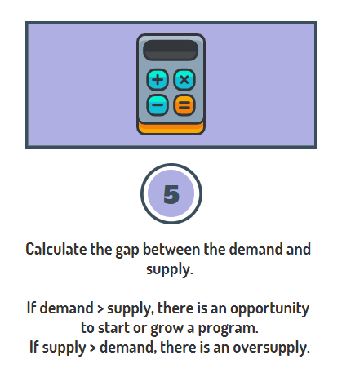
Steps to Determine Labor Market Demand
Subtract the supply # from the demand #

Slide 10
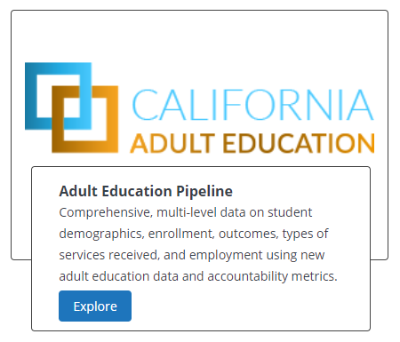
How effective is my program?
3
Adult Education Tab in the LaunchBoard Tool:
http://calpassplus.org/launchboard

