Slide 1
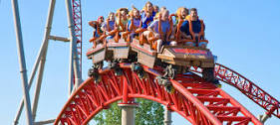
A Roller Coaster Ride
Parenting Young Gifted Children
March 2015
Susan R. Rakow, Licensed Professional Counselor (LPC)
Ph.D. in Education
susanrakow@earthlink.net
216-570-4976

Slide 2
Developmental Perspective: Gifted Child, Gifted Tween, Gifted Teen
Preschool through Elementary School
Middle Grades
High School
Beyond High School…

Slide 3
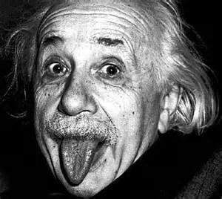
Definition of Giftedness
Not Genius!! Not Prodigy!!
Individual who is performing significantly above and beyond what would be expected/typical for his or her chronological age in one or more areas.
State of Ohio defines these areas as: Superior Cognitive Ability; Specific Academic Ability in Math, Reading/Language Arts, Science or Social Studies; Visual and/or Performing Arts; Creative Thinking.
Continuum of Giftedness: mild, moderate profound (How far is the child from what is “typical”)
Asynchronous Development

Slide 4
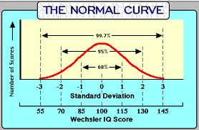
What’s “typical?” “normal?”

Slide 5
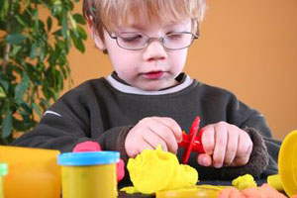
Nature of Young Gifted Children Identification
“Young children’s development is dynamic and individual.”
• When did you first notice that your child
might be gifted?
• What behaviors did you notice?
Did others notice (grandparents, neighbors, teachers, etc.)
• Possible Indicators: Intense fascination with a particular subject; advanced play behavior; early language development; advanced literacy and/or vocabulary; ability to ask unusually reflective, deep, and probing questions; exceptional memory; rapid pace of learning

Slide 6
Nature of Young Gifted Children Identification
• FORMAL IDENTIFICATION
• Individual or group
• behavioral checklists, observations, interactions
• IQ (WPPSI, WISC, Naglieri, CogAT) and Achievement Tests (ex. Woodcock-Johnson, Iowa and/or Stanford Achievement Tests)

Slide 7
Choice, Challenge, Control, & Caring: At Home and at School
Whole Grade and Subject Acceleration an Early Entrance
Who? When?
How? (Iowa Acceleration Scale)
Follow-Up Support
Classroom Enrichment/Acceleration

Slide 8
Social-Emotional Characteristics of Young Gifted Children
Emotional Intensity and High Sensitivity
Enhanced Capacity to Empathize
Highly Developed Sense of Fairness and Justice
Interests that are more common in older children
Advanced Play Patterns
Intense and Lengthy Task Commitment (don’t want to be interrupted!)

Slide 9
Social-Emotional Characteristics of Young Gifted Children (2)
Preference for older children as friends and being with adults
May need little sleep; lots of energy
More advanced sense of humor
Vocabulary that may contribute to alienation from others their age
Frustration when their small motor coordination limits don’t allow them to produce artwork or writing that expresses fully what is in their imaginations

Slide 10
Unique Needs of Gifted Subpopulations
2e individuals
Cultural and Ethnic Minorities, including ELL
Gifted Girls
Profoundly Gifted

Slide 11
Pressures and Stress for Young Gifted Children
Physical and Gender Expectations
Academic
Perfect v. Excellent v. Good Enough (Perfectionism)
School-Home Partnership
“boredom”
Over-attention to kids’ negative comments
Social
• Bullying (?)
Parental/Family Expectations
Over-Empowerment

Slide 12
Perfectionism and Anxiety
Books
Exercise
Down time
Meditation and Breathing
Breaking the chain of negative/anxious thoughts
Socializing
Arts and Creative outlets/visualizations

Slide 13
Achievement and Underachievement
Achievers:
self-efficacy/internal locus of control,
resilience,
high frustration tolerance,
realistic expectations by self and others,
growth mindset,
history of meeting challenges,
family security

Slide 14
Organization and Academic Behaviors
Time
Place
Materials
Procedures
Supervision and Support
Teach how to ask for help from teachers

Slide 15
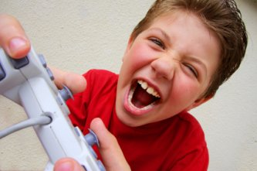
Technology Use and Abuse: Adults and Kids
How much? When and Where? What?
• Impact on Sleep and Eating Disorders including obesity
Impact on Attention
Impact on ability to have real-world social interactions and conversations
American Academy of Pediatrics recommendations:
No tech/screen time for under 2’s
“screen-free” zones and times (dinnertime; no tv, computer, cellphones or video games in kids’ rooms)

Slide 16
“The V of Love” (Rimm)
V
Birth
⬆Independence ⬆Responsibility

Slide 17
Siblings and Family Dynamics
Dethroning
Over-Empowerment
Family Changes
Gifted, Typical and Special Needs

Slide 18
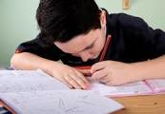
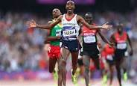
Self-Esteem, Self-Worth, and Self-Confidence
✔Growth Mindset: Work and Practice
✔
✔
How to Give Praise:
Specific Action
No “est”
Referential Speech

Slide 19
Building Resilience
Teach and model connections with others and empathy.
Age appropriate volunteer work and helping others (family, friends, neighbors)
Regular Routines and Self-Care
But also, acceptance that change is part of life.
Goal-setting and progress (breaking things down into small achievable parts)
Nurture positive self-view (but not perfection!)
Nurture Hope and How to keep things in Perspective.
Learning from our Mistakes and from Adversity

Slide 20
Questions and Concerns

Slide 21
Reaching Out and Resources

Slide 22
Reaching Out and Resources: People and Places
School Counselor and Psychologist
http://mcgt.net/how-can-i-help-my-gifted-child-plan-for-college
Community Agencies
Your Physician
http://therapists.psychologytoday.com/rms/state/OH/North+Canton.html
Resilience Guide for Parents and Teachers http://www.apa.org/helpcenter/resilience.aspx#
Family Achievement Clinic
Dr. Sylvia Rimm (www.sylviarimm.com)
Susan Rakow, LPC (susanrakow@earthlink.net)

Slide 23
Reaching Out and Resources: A Few Books
Sylvia Rimm: How to Parent So Children Will Learn; Parenting Preschoolers
James Delisle: Parenting Gifted Kids; The Gifted Kids Survival Guide
Michael Piechowski – “Mellow Out,” they Say. If I Only Could
Maureen Garth – Moonbeam, Starbright (two books of meditations for children)
OAGC and NAGC Parent Divisions/Networks (www.nagc.org www.oagc.com )
www.sengifted.org

