Slide 1
Top 10 Traits of Successful Entrepreneurs

Slide 2
Do You Have What it Takes?
So, are you wondering if you have what it takes to be a successful entrepreneur? Would you like some confirmation that this lifestyle is for you? Here are 10 ways we’d describe a powerful business mogul’s personality, in a nutshell:

Slide 3
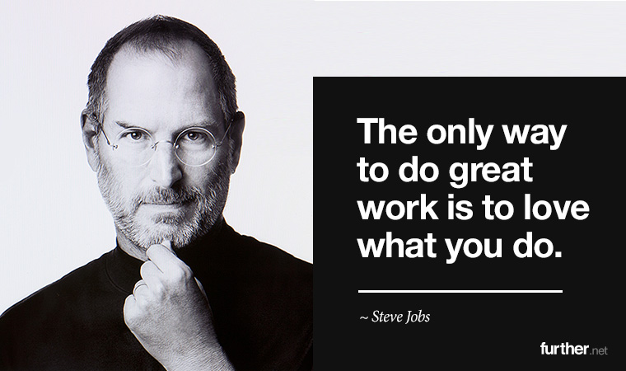
Passionate
The most successful entrepreneurs are in it for the love, not just the money. They’re so passionate about the idea or solution they’ve created that they’re happy to work relentlessly on making it happen. It’s that unshakeable sense of purpose that stops them from quitting when things get really tough.

Slide 4
Motivated and Determined
An unwavering motivation to get out of bed every day and work tirelessly towards your goal is a huge part of the recipe for business success. Entrepreneurs are dedicated and don’t need external motivation to keep them moving towards their goals. In fact, they use their energy and momentum to inspire others to work harder, and this commitment is what makes wild dreams become a reality.

Slide 5
Visionaries
Would you call yourself an innovator? Are you always on the lookout for new ideas or opportunities? True entrepreneurs see things differently; they see abundant potential in every situation. Their minds are full of visions, ideas, and inspiration just waiting to be put into action. They have a clear picture of their business’ purpose, goals, and mission in mind.

Slide 6
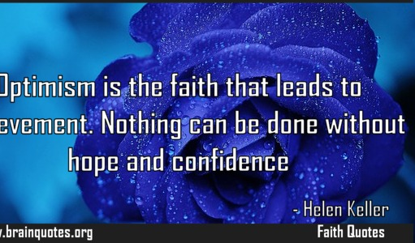
Optimists
Successful entrepreneurs are the kind of people who see sunshine in every situation. They keep going through those early struggles despite feeling that their idea might never get off the ground. Their minds are just wired that way – always seeing the silver lining or golden opportunity ahead.

Slide 7
Communicators
Communication skills are pivotal for an entrepreneur. They come in handy for networking, selling, collaborating, and even rallying the troops during team meetings. As a leader, you have to be able to promote yourself and your business to customers, suppliers, and staff. Everyone must be fully on board with your mission or the results you crave will never come.

Slide 8
Creative and Adaptable
This one’s all about problem solving and flexibility. The ability to be open-minded and inquisitive when it comes to finding solutions is critical. This means looking at an issue from all angles, constantly digesting new information and then pivoting or adjusting your strategy accordingly. Savvy businessmen and women aren’t afraid to change tact or reflect on their blind spots.

Slide 9
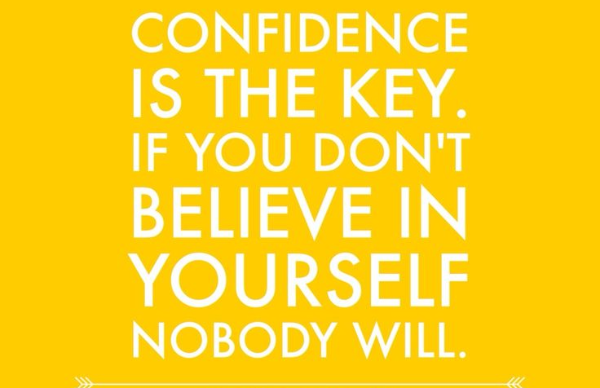
Confident and Decisive
Successful entrepreneurs are making decisions numerous times each day. They take charge of any situation they’re faced with, maintaining belief in their abilities throughout all of the ups and downs. They don’t let doubt overcome them and they know they are inherently worthy of success.

Slide 10
Continuous Learners
Entrepreneurs repeatedly fail – it’s part of the game. However, the winners always get back up. It’s important to be able to dust yourself off and try again with an attitude of continuous improvement. Successful entrepreneurs stay ahead of the game by keeping up with industry news, watching competitor behavior, upskilling, and networking with like-minded people. They are sponges for information that will help grow their business.

Slide 11
Risk-Takers
There’s no avoiding risk-taking when you’re a fully-fledged entrepreneur. The factor that sorts the wheat from the chaff here is a person’s attitude towards risk… does taking risks scare you or are you able to take those leaps? Uncertainty should not be enough to prevent you from taking action – after all, you might just be treated to the reward!

Slide 12
Gritty
When you combine passion and perseverance, what do you get? Grit.

