Slide 1

Long-Term Financial Planning
Financial Management Skills

Slide 2
Long-Term Financial Planning
Why do it?
Some tips on doing it.

Slide 3
Different Reasons
Pismo Beach
  Assess financial condition and ability to fund “new initiatives”
  Prepare for revenue ballot measure
San Luis Obispo
  Framework for Decision-Making
    Introduce the budget process: framework for goal-setting and budget process to follow; ability to fund “new initiatives”
    Prepare for revenue ballot measure
    Contingency planning
Fairfield, San Clemente
  Formal integration into the Budget
Sunnyvale
  Ten-year budget balancing
Salinas, Bell
  Better assess long-term impact of short-tem budget decisions

Slide 4
Common Feature
They all require making long-term forecasts about revenues and expenditures.
And this requires making assumptions about revenues and expenditures.
  Many which will be out-of-date before the laser jet ink is dry . . . . .

Slide 5
Long-Term Financial Planning
Is it really worth it?
“ Never make forecasts, especially about the future.”
. . . . Sam Goldwyn

Slide 6
Why You Don’t Want to Do This
It’s Risky!
  It’s hard to predict what’s going to happen next week, let alone next year – or even more daunting, five or ten years from now
  The chances you’ll get the number wrong are far greater than you’ll get it right.

Slide 7
Why You Do
Effective forecasts require clearly-stated assumptions.
  This forces you to think about the factors that affect your fiscal health.
  And what you can and can’t do about them.
Making good resource decisions today requires taking into account their impact on your fiscal condition tomorrow.
The question of “how are we doing” can only be answered in the context of “compared with what?”
Forecasts are the best way to frame the policy decisions ahead of you: you can’t fix a problem you haven’t defined.

Slide 8
Forecasting
The secret to successful forecasts . . . .
  Give ‘em a number
  Give ‘em a date
  But never give ‘em both at the same time!

Slide 9



Slide 10
Forecasting
The real secret to success . . . . .
  Recognize perils
  Act anyway
  Have clear assumptions.
  Identify where you’re likely to be wrong
“Life is what happens while you’re busy making other plans.”
. . . . . John Lennon

Slide 11
Where to Start: In the Past
Environment
  Inflation
  Population growth
  Business & job growth
  New construction
  State economic and demographic trends
  Regional trends
  Legal & intergovernmental
Fiscal Factors
  Revenue trends
  Expenditure trends
  Debt trends
  Fund balance trends

Slide 12
About the Past
The past does not determine the future.
But if the future is going to be different than the past . . . . why?

Slide 13
Key Components
Revenues
  Focus on top revenues
Expenditures
  Operating
  Debt service
  CIP: Toughest component
    Average from the past
    Different scenarios
    “Forecast CIP”
      Maintenance only?
      New stuff?
      Combination?
One “forecast?”
Or several scenarios?

Slide 14
What Do the Results Tell You?
What’s the problem?
What are the best options for solving it?
What is the best one
  . . . . . and why?
“ A problem well-stated is a problem half-solved.”
. . . . . . . Charles Kettering

Slide 15

General Fund
Five Year Forecast: 2005-10
Tough Fiscal Past, Tough Fiscal Future
December 2004

Slide 16
Forecast Purpose
Identify “order of magnitude” ability over the next 5 years (2005-10) to:
  Continue current day-to-day services.
  Maintain existing infrastructure and facilities.
  Preserve our fiscal health.
Approach
  Project revenues.
  Subtract operating, debt service and CIP costs
  Remaining balance is available for “new initiatives.”
  Or if negative, shows the “Budget Gap.”

Slide 17
Tough Fiscal Past
2003-05 Budget toughest in over 10 years
Facing $7 million gap – closed with
  Expenditure cuts (74%)
  New revenues (15%)
  Reserves (11%)
Expenditures: 74%

Slide 18
Tough Fiscal Past, Redux
Had to revisit the two-year budget in 2004-05 due to added State raids ($1.5 million)
  More expenditure cuts (most notably in our paving program: $200,000)
  Reinstated hiring and travel “chill”
  Went below minimum reserve policy for first time since we adopted one 15 years ago.
    Significant, but consistent with our budget strategy if the State took away even more.

Slide 19
One Bright Spot: Passage of Prop 1A
Improves stability and certainty by shielding us from added State raids.
But it only helps prevent more cuts in the future; it doesn’t return any past takeaways.
  $22 million over last 16 years.
  $3 million each and every year.
Not an impervious firewall: State raids can still happen, but much harder:
  2/3’s emergency declaration by State Legislature.
  Loan, must be repaid in 3 years.
  Can’t be more than $1.3 billion.
  Can’t occur more often than twice in years.
  No new takeaways if past one outstanding.

Slide 20
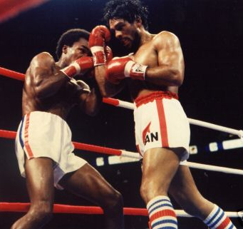
Prop 1A Summary
“No Mas, No Mas” assurance (but not guarantee) is critical to our future fiscal health and stability.
But it doesn’t improve our current situation: it just keeps it from getting worse.

Slide 21
Tough Fiscal Future
Key Actors in Our 2005-07 Fiscal Story
  Uncertain revenue outlook
  Operating cost pressures
  Infrastructure and facility maintenance

Slide 22
Forecast: The Good News

Slide 23
The Bad News
There is no “order of magnitude” ability to fund “new initiatives.”
In fact, we are looking at another significant “forecast gap” if we maintain current service levels and continue to severely limit infrastructure and facility maintenance.

Slide 24
Forecast Summary

Slide 25
Forecast Summary
Assuming CIP based on 2003-05 two-year average (about $3.1 million per year) and significant new sales tax and TOT outlets:
  2005-07 Annual Gap (Excluding carryover gap from 2004-05): $2.4 million
  Out-Year Annual Gap: $700,000

Slide 26
Background
Forecast Is Not a Budget
  It doesn’t make expenditure decisions.
  It doesn’t make revenue decisions.
  It doesn’t answer the question: can we afford . . . . . “x”?
  This is a question of priorities, not fiscal capacity.

Slide 27
So What Does the Forecast Do?
Identifies key factors that affect our fiscal outlook.
Assesses how difficult balancing the budget will be.
Helps us understand the fiscal challenges facing us as we make trade-offs between funding priorities.
Which is what the budget is all about: determining the highest priority uses of our limited resources.

Slide 28
Some Context: 2004-05 Expenditures

Slide 29
General Fund Budget By Type

Slide 30
Operating Costs By Function

Slide 31
Operating Costs By Type

Slide 32
General Fund Revenues

Slide 33

Demographic and Financial Trends
Past doesn’t determine the future.
But if the future won’t look like the past, why not?
Took a detailed look at 15 year trends.
Demographics
  Population, Housing, CPI
Revenues
  Top Eight = 80% of Total: Sales tax, property tax, TOT, UUT, “VLF Swap,” business tax, franchise fees, gas tax
Expenditures
  Operating, CIP, Debt Service
“Hindsight is an exact science.”
. . . . . . . . Guy Bellamy

Slide 45
Balancing Past Budgets
Every Financial Plan since 1991 has relied upon new, Council-approved revenues to balance the budget and fund major City goals.
Very limited revenue options remain for the Council under Proposition 218.
  And if they were easy, we would probably have done them already.

Slide 46
Overview of Forecast Assumptions
State Budget
  $680,200 takeaway each year in 2004-05 and 2005-06.
  Repayment of 2003-04 “VLF Gap Loan” in 2006-07: $756,500.
  No booking fee reimbursements in 2005-10 ($105,400 annually).

Slide 47
Some “Anomalies”
Triple Flip
  State takes away 25% of our sales tax (City rate now ¾% instead of 1%)
  State adopts “new” ¼% tax dedicated to repayment of deficit reduction bonds
  State promises to backfill lost city revenues with transfer from ERAF (now required)
VLF for Property Tax Swap

Slide 48
VLF-for-Property Tax Swap

Slide 49
Revenue Assumptions
How Did We Prepare Them?
  Long and short-term trends: key City revenues.
  Economic forecasts (UCLA, UCSB).
  Economic trends reported in national media.
  Fiscal and economic data developed by the LAO, State Department of Finance and State Controller.
  Legislative analysis by the League.
  Ultimately, staff’s best judgment about economic, fiscal and legislative outlook for the next five years.
www.lao.ca.gov

Slide 50
Uncertain Revenue Outlook
At best, mixed results in our two of our top three revenues:
  Sales tax
  TOT

Slide 51
Sales Tax: Recent Trends

Slide 52
Sales Tax: Cars Are Important
Statewide, “business-to-business” sales are 35% of the total.
Four categories - autos, general consumer goods, “business-to-business” and restaurant - account for about 75% of the total.

Slide 53
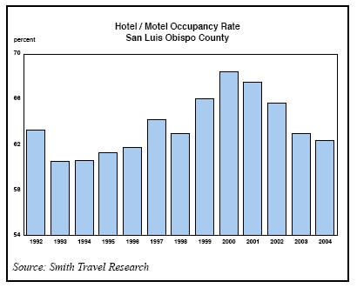
TOT Revenues
City
  2001-02: Down 3%
  2002-03: Up 1%
  2003-04: Up 2%

Slide 54
TOT Revenues: Recent Trends
Projected for 2004-05: 3%

Slide 55
Interest Earnings
Actual in 2001-02: $700,800
Actual in 2002-03: $766,000
Actual in 2003-04: $220,000
  Historically low yields (less than 2%)
  Lower investable balances

Slide 56
Key Revenue Assumptions

Slide 57
Sales Tax Assumptions
Underlying Growth:
  2004-05: Flat
  2005-10: 2.5%
New Outlets:
  Costco: $500,000 in 2005-06.
  Copeland’s/Court Street: $200,000 in 2005-06.
  Airport Area Annexation: $450,000 in 2006-07.
  San Luis Marketplace: $580,000 “net” after transfer affects/interchange revenue-sharing in 2007-08.

Slide 58
TOT Assumptions
Underlying Growth
  2004-05 and 2005-06: 3%
  2006-07: 4%
  2007-08, 2008-09 and 2009-10: 5%
Plus
  Marriott Courtyard in 2006-07: $225,000
  Hampton Inn in 2007-08: $150,000
  San Luis Marketplace in 2007-08: “net” $177,000.

Slide 59
Other Key Revenue Assumptions
Interest earnings at $220,000 annually.
Development review fees: 2003-04 level.
  Down by $780,000 from 2004-05 budget estimate.
Airport Area Specific Plan reimbursements: $323,800 in 2005-06.
Margarita Area park fee reimbursements: $650,000 per year starting in 2006-07.
Includes approved “pantry items” starting in 2005-06 ($143,000)

Slide 60
New Revenue Producers

Slide 61
Forecast: No New Outlets After 2005-06

Slide 62
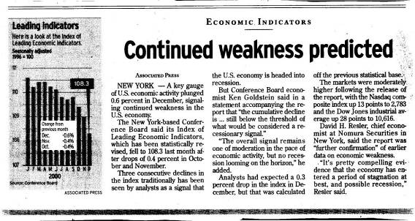
Revenue Assumptions: A Caveat
The revenue forecast reflects “cautious optimism.”
This isn’t guaranteed.

Slide 63
Expenditure Assumptions
Operating Costs
  PERS: Based on detailed analysis of projected employer contribution rates
  Mardi Gras costs decline from $374,000 base in 2004-05:
    2005-06: $325,000
    2006-07: $300,000
    2007-08 $275,000
    2008-09: $250,000
    2009-10: $225,000
  Other Costs: Grow by population and CPI based on 2004-05 budget (4% annually)
  Plus Damon-Garcia fields maintenance-operation: $250,000 in 2005-06.

Slide 64
Retirement Costs
Significant increases started in 2003-04
Main driver: PERS investment losses

Slide 65
PERS Investment Performance

Slide 66
Impact on Employer Rates

Slide 67
Debt Service
Current: $1.7 million.
New
  919 Palm: $384,700 “net” in 2005-06
    Assumes lease of 955 Morro at market rates
  Dispatch center: $165,800 in 2006-07
  Radio system: $372,200 in 2006-07

Slide 68
Forecast CIP Assumptions
Two-Year Average in 2003-05
  $3.1 million
Other Options
  “Maintenance-Only” CIP
    What’s it take to adequately maintain what we already have in place? $6.4 million annually
  2004-05 Budget
    $2.3 million

Slide 69
“Adequate Maintenance” CIP

Slide 70
“Adequate Maint” CIP by Function

Slide 71
Forecast: Adequate Maintenance CIP

Slide 72
Fund Balance Assumptions
Return to minimum policy level of 20% of operating expenditures
In addition to annual “gaps,” this means a “one-time” catch-up of $1.4 million from 2004-05
  Projected ending balance for 2004-05: 16%

Slide 73
What’s Not Here: Revenues
Grant Revenues
  CDBG
  Competitive Grants
Transportation Impact Fees
Park In-Lieu Fees

Slide 74
What’s Not Here: CIP Expenditures
$3.3 million needed to take care of what we already have
New Infrastructure or Facilities
  Public Safety Facilities
  Circulation Improvements (Intersections, RR Grade Crossings)
  Pedestrian/Bicycle Paths
  Flood Protection
  Community/Senior Center
  Parks
  Downtown Plan Improvements
  Railroad Square
  Mid-Higuera Area Improvements
  Open Space Acquisition

Slide 75
Critical Assumptions
What’s Most Likely to Change?
  Revenues
    Sales Tax, TOT, Development Review Fees, Other Fees
  Operating Cost Assumptions
  Debt Service Assumptions
  Mid-Year Budget Review
“Life is what happens while you’re busy making other plans.”
. . . . . John Lennon

Slide 76
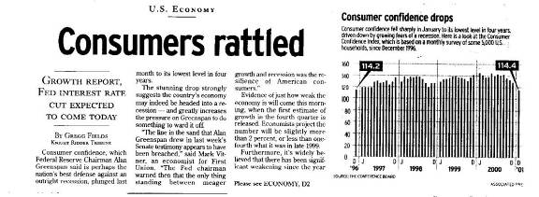
Final Forecast Caveat
And it may be worse in May 2005 than we’re projecting now.

Slide 77
Forecast Recap
Assuming CIP based on 2003-05 two-year average (about $3.1 million per year) and significant new sales tax and TOT outlets:
  2005-07 Annual Gap (Excluding carryover gap from 2004-05): $2.4 million
  Out-Year Annual Gap: $700,000

Slide 78
Recap: Key Drivers
Tepid outlook for key “base” revenues
  But assume significant new outlets
Reduced development review fees
Reduced interest earnings
Continued PERS cost increases
New service responsibilities
  Damon-Garcia fields maintenance & operations
  Debt service for 919 Palm, Dispatch Center Improvements, Radio System Upgrade

Slide 79
Budget-Balancing Will Be Tough
90% of General Fund costs are for operations.
  5% for debt service.
  5% for CIP: mostly maintenance.
Over 50% of our General Fund operating cost are for public safety.
80% of our General Fund operating costs are for staffing – and 90% of this is for regular staffing.
And many of the “non-staffing” costs are difficult to control: utilities, phones, insurance.

Slide 80
And Fewer Options Remain
Already cut operating costs by $1.7 million and CIP by $3.5 million: can’t count them twice, start on an already constrained base.
Implemented $1.1 million in new revenues.
  Some Prop 218 options remain, but if they were easy, we’d have done them already.
Lower Reserves
  Started 2003-05 with 30% reserves.
  Now at 16%.

Slide 81
So, Can We Afford New Initiatives?
Yes, But Very Difficult
  Re-prioritize existing resources
    Means deeper cuts in core operations and maintenance than will already be needed.
  Increase revenues
    Grow the economy better than forecasted.
    Implement some of the very limited revenue options.
  Voter-approved revenues (but probably not available as 2005-07 budget-balancer).
The option of changing current priorities and reallocating existing resources to accommodate new ones is always possible, but it’s much easier said than done.

Slide 82
Where to From Here?
“Plans are nothing; planning is everything.”
Dwight D. Eisenhower

Slide 83
The Task Ahead
Our struggle over the next several months will not be about “which new community goals should we accomplish with our added revenues?”
But how do we maintain core service levels, infrastructure and our fiscal health?
  Of the things we doing today, what will we still be doing tomorrow?

Slide 84
Next Steps
Fiscal Health Contingency Plan
  Already started implementing several “action steps”
  “Hard” freeze planned until development of budget-balancing strategy
Begin considering feasibility of:
  Storm drainage fees (1/4/05)
  Paramedic service charges (2/14/05)
  Revenue ballot measure (2/15/05)

Slide 85
Link to Goal-Setting in Tough Times
On its face, goal-setting and tough fiscal times may seem like conflicting concepts, but they aren’t.
In fact, identifying the most important, highest priority things for us to do is even more important when times are tight.

Slide 86
Goal-Setting in Tough Fiscal Times
This is the essence of the budget process
  Of all the things we want to do in keeping our community a good place to live, work and play, which are the most important?
  And what are the difficult trade-offs we have to make to do them?

Slide 87
Summary
Bad News, But Not “New” News
  Consistent with reported trends.
  Consistent with General Fiscal Outlook.
Good News
  Good fiscal shape
  Good information
  Solid systems and procedures in place.
  Excellent organization and capable staff
  Excellent Council leadership
  Great tradition of responsible stewardship

Slide 88
Questions?

Slide 89
General Fund
Five Year Forecast: 2007-12
Best Fiscal Outlook in Many Years
December 2006

Slide 90
The Short Story
Best fiscal outlook in many years
  Measure Y
  Structural budget balance to begin with
  Stronger beginning financial condition

Slide 91
Where We’ve Been
We’ve had to close annual budget gaps for three straight fiscal years:
  $7.1 million in 2003-04
  Another $1.4 million in 2004-05
  And another $2.1 million in 2005-06
We closed these gaps largely through service cuts.

Slide 92
How We Closed the Gaps
Expenditure Cuts: 68%

Slide 93
Closing the Gap
This required deep cuts in operating and capital programs, including:
  50% cut in infrastructure maintenance (including 67% cut in paving).
  Reduction of 25 FTE positions, including sworn police officers.

Slide 94
Where We Are Today
The City's financial condition continues to be strong by State and national standards:
  Stable underlying economy
  Diversified revenues
  Tough revenue and expenditure decisions—in good times and bad
  Strong fiscal policies
  Ongoing fiscal monitoring
  Use of the private sector to deliver services
  Goal-driven budget process—performance, outcome-oriented
  Controlling operating costs: ongoing commitment to increasing productivity and improving customer service
  Limited use of debt financing: conservative standards
Structurally Balanced Budget

Slide 95
Where We’re Headed: Forecast Summary

Slide 96
Forecast Summary
Results driven by key assumptions
  Current day-to-day service levels
  CIP based on 2005-07 two-year average (about $2.5 million per year)
  Modest underlying performance of key revenues
  Projected new sales tax and TOT outlets
  Prop 42 and 1B revenues
  Measure Y
Results
  Available for ongoing service restorations or new initiatives: $5.5 million annually
  One-time carryover above policy minimum in 2007-09: $3.5 million

Slide 97
2009-14 Fiscal Forecast
Another very tough budget season that would be even worse without Measure Y revenues

Slide 98
Fiscal Outlook: Where We’ve Been
Two years ago, we characterized our fiscal outlook as the best in many years:
  Measure Y
  Improved local economy
  Structural budget balance to begin with
  Strong beginning financial condition
  Absence of State budget threats
  Stable labor costs

Slide 99
This isn’t the case today
Measure Y continues to be a bright spot
  Helps make our situation “just” really, really tough instead of a crisis
But all the other bright spots have darkened
  Adverse economy
  Adverse State fiscal outlook
  Adverse binding arbitration decision

Slide 100
Fiscal outlook in a nutshell
Another very tough budget season that would be much worse without Measure Y revenues.
Key actors in our 2009-14 fiscal story
  Largest economic downturn since Great Depression results in declines or tepid growth in key revenues
  Binding arbitration
  Costs that grow while revenues stagnate or decline

Slide 101
Forecast Results: Background
Implemented “Fiscal Health Contingency Plan” in June 2008.
  Key Elements: Hiring chill, begin preparation of short-term budget actions
Short-term budget “rebalancing” actions on 9/30, largely in response to June 2008 binding arbitration decision: $4.8 million
“General fiscal outlook” presented on 11/20.

Slide 102
Forecast: The Good News

Slide 103
Actually, there is some …
Results consistent with General Fiscal Outlook.
Have a balanced budget now; end 2008-09 at policy reserve levels.
Slight improvement in the “out years” means that there is a structural solution.
In short, it may be disappointing news, but it’s not “new” news.

Slide 104
The Bad News
There is no “order of magnitude” ability to fund “new initiatives.”
In fact, we are looking at another significant “forecast gap” if we maintain current service levels.

Slide 105
Forecast Summary

Slide 106
Forecast Summary: Without Measure Y

Slide 107
Forecast Gap vs Budget Deficit
We have a “forecast gap” that we need to close as part of the budget process.
We do not have a “budget deficit.”
  We have never had one.
  And we don’t plan have one: we’ll adopt a balanced budget in June 2009.

Slide 108
Slides on Past Trends
Yes, I did them
But I emphasized that they were not as helpful as they were in the past.
Why?

Slide 109
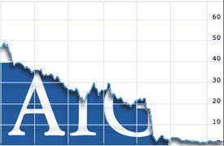
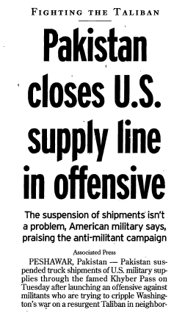
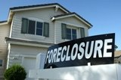
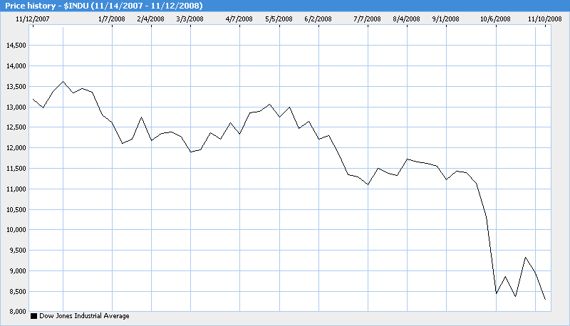
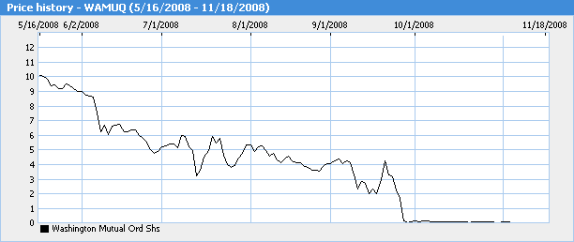
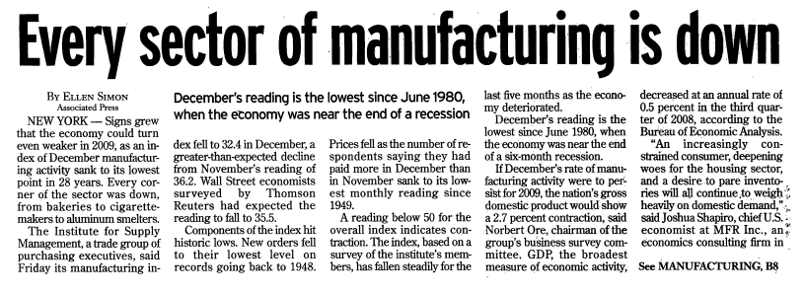
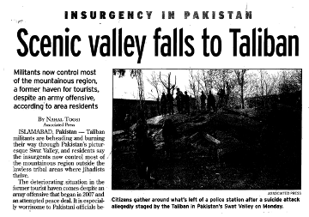
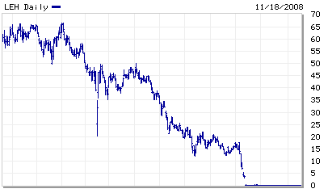

Where it began …. 2008: A lousy year

Slide 110
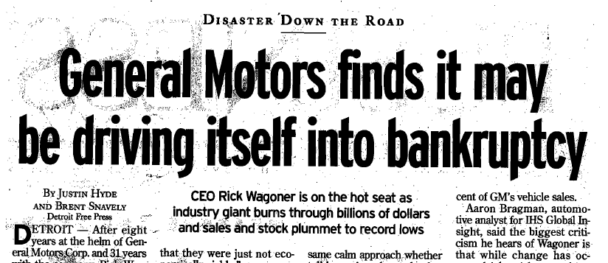

Even worse in Detroit
0-16: New Season Record

Slide 111

Economic Outlook
2009 UCSB Forecast

Slide 112
Recovery was not expected by most economists until 2010 – That’s happened, but tepid and jobless

Slide 113
2011-16 Interim Fiscal Forecast
A Road Map to Fiscal Sustainability

Slide 114
Notes:
If Measure Y is not renewed, the gap doubles again – to about $11 million
It is more important than the “core gap” and CalPERS rate increases combined

Slide 115

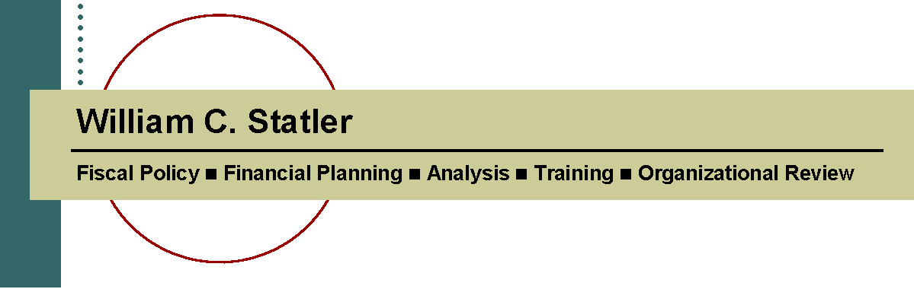
General Fund
Five-Year Fiscal Forecast
City of Salinas

Slide 117
Assumptions Drive Forecast Results
Key Drivers
Revenues
  Generally assumes key revenues have hit bottom with modest recovery
Reserves
  End 2010-11 with reserves at 0.7% of expenditures
  No restoration to 5% policy level assumed in forecast
Expenditures
  Deferred compensation increases in 2010-11 return in 2011-12, adding $2.9 million to costs in 2011-12 and $3.7 million in 2012-13
  CalPERS contribution costs for sworn employees continue to rise ($3.1 million from 2010-11 to 2015-16)
  Minimal CIP (0.5% of revenues)
  Golf course support: $450,000
  Restoration of insurance fund contribution ($2.5 million)
  New debt service for public safety radio system: $570,000
  State Takeaways: $450,000
Much worse if Measure V is not renewed in 2016

Slide 118
Forecast Results
Three Key Findings
  Core gap: 2011-13. Structural gap assuming
    Current day-to-day service levels that retain cuts already made to-date
    No reserves
    Minimal capital improvement plan (CIP)
  Core gap plus 2013-14 CalPERS rate increases: The core gap gets larger based on projected increases in CalPERS contribution rates
  Core gap plus CalPERS rate increases less Measure V revenues. The gap grows even greater if Measure V revenues are not renewed in 2016

Slide 119

“Core” Gap

Slide 120


Slide 121
Forecast Summary
Without corrective action, the City is facing an annual gap beginning in 2011-12 of about $7.5 million - close to 10% of current expenditures.
Without corrective action, this grows to $9.8 million by 2015-16.
And much worse if Measure V is not renewed in 2016

Slide 123

General Fund
Five-Year Fiscal Forecast
City of Camarillo

Slide 124
Down
14%

Slide 125
Key Forecast Drivers
Revenues
  Generally assumes key revenues have hit bottom with slow recovery
  One bright spot: TOT revenues
Expenditures
  Direct expenditure increases are projected to be modest
  However, transfers to other funds – most notably, gas tax, lighting & landscape maintenance, storm water management and transit – are projected to continue to increase, which is the main reason for the projected “forecast gap.”

Slide 129

General Fund
Five Year Forecast: 2008-13
May 2008
City of Pismo Beach

Slide 130
Summary of Forecast Findings
Confirms findings from four years ago:
  The City has adequate revenues to fund current day-to-day services and debt service obligations. In short, the City has a structurally balanced operating budget .
  However, funding improvements identified for 2008-13 in the ten-year CIP will require new revenues.

Slide 133


General Fund
Five-Year Fiscal Forecast
City of Bell

Slide 135
Forecast Overview: Positives
Key revenues have hit bottom and appear to be on the road to recovery, albeit modestly.
Structurally balanced budget in 2012-13.
Begin with $1.2 million in reserves.
While there is a significant “forecast gap” for the next two years, it improves in the “out-years.”
  This means there is a structural solution.
Committed Council and staff to a responsible, balanced and transparent budget process.

Slide 136


Slide 137
The Challenge Ahead
Closing the gap and adopting a balanced budget that responds to Council goal-setting.
  The forecast is not the budget.
  With Council guidance, the staff’s job is to develop ways of balancing the budget the coming year.

Slide 138
Limited Options
Unless the Bell economy performs much better than projected, significantly reducing the City’s expenditures is the only budget-balancing option available to the City.
  Use of reserves not recommended:
    Need to build them, not reduce them.
    Only defers the problem, doesn’t fix it.
  Given the City’s recent experience, significant new revenues are not a viable budget-balancing approach any time soon.

Slide 139
Expenditure Reductions
Further reducing service levels and related costs.
  Since 60% of General Fund expenditures are for staffing, this means further staffing reductions.
Cutting back on asset repair/replacement reserves.
  Not sustainable in the long-run.
Finding alternative service delivery methods that will retain service levels but reduce costs.
Reducing compensation levels.
  Each 1% reduction in compensation generates $75,000 in savings.

Slide 140

General Fund
Five-Year Fiscal Forecast
Board of Directors Briefing
February 14, 2013

Slide 141
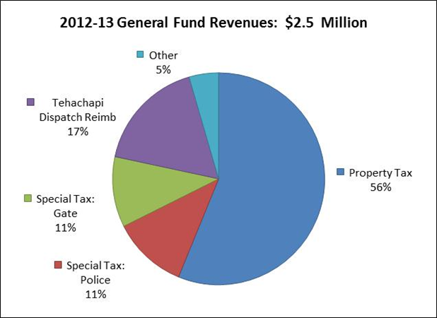

Slide 142
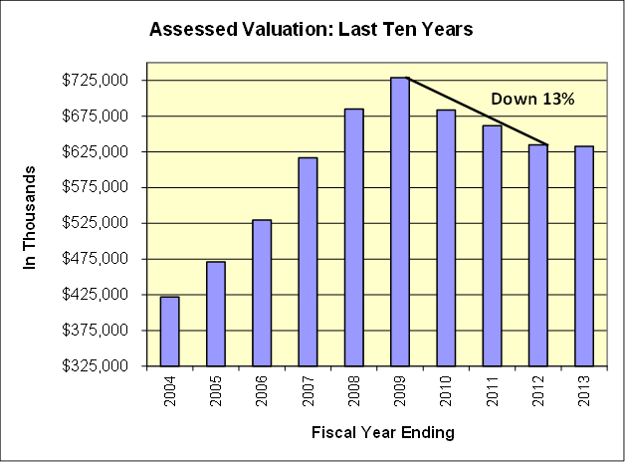

Slide 143
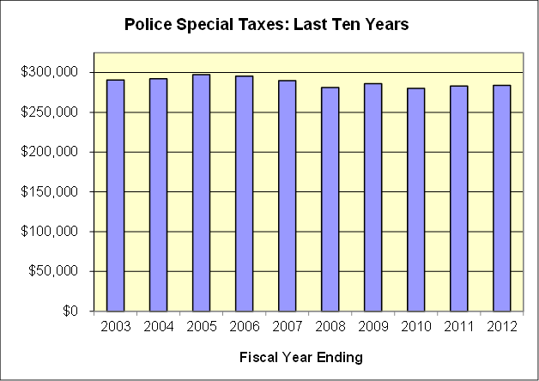

Slide 144
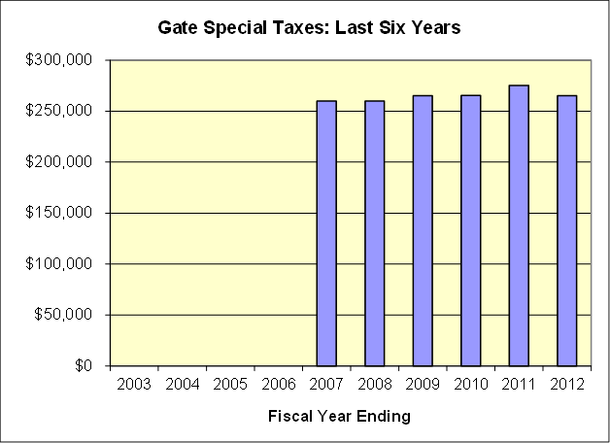

Slide 145
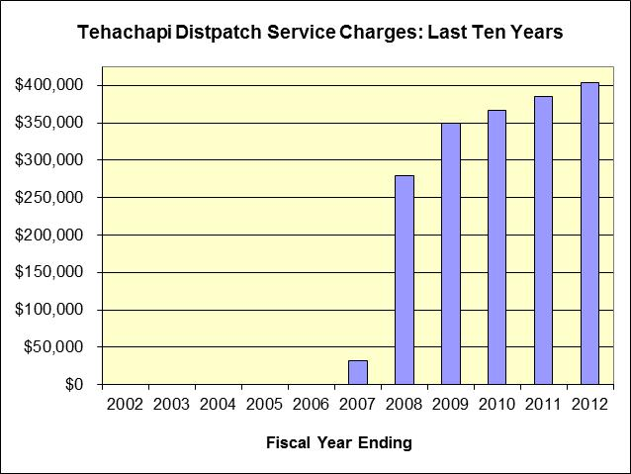

Slide 146
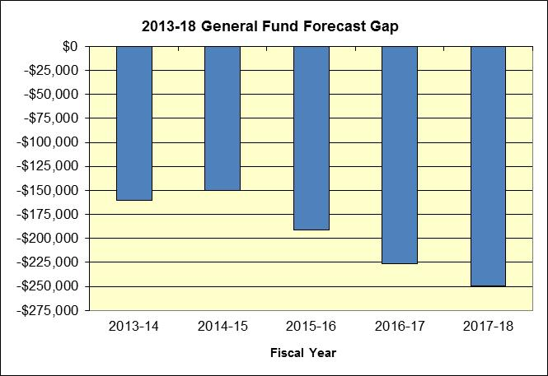

Slide 147
Key Factors
Systemic growing gap
  Modest cost increases
  But key revenues are flat or tepid growth

Slide 148
Recap
Similar analytical approaches but each has its own story to tell
  San Luis Obispo: Tough economy, Measure Y mitigation, binding arbitration, retirement costs
  Camarillo: Transfers to other funds
  Salinas: Tough revenue outlook, even tougher expenditure one, no reserves
  Pismo Beach: CIP
  Bell: Economy, egregious past revenues, need for reform
  Bear Valley: Systemic challenge - modest cost increases but flat key revenues

Slide 149
Summary
Forecasts force you to:
  Think about the factors that affect your future.
  Think about what you can do about them.
  Accept what you can’t do anything about so your efforts can be targeted on the things you can do something about.
  Have a context for “how are we doing?”
You’ll never know if you’ve arrived if you don’t know where you’re going.
Or: If you don’t know where you’re headed, any road will take you there.

Slide 150
A Suggestion: The “Thinking” Part
Consider preceding the forecast (or your budget) with a “general fiscal outlook:” What are the factors that will affect your fiscal future?
  State budget impacts
  Revenue/economy outlook
  Operating cost pressures: Retirement, insurance, fund subsidies, MOUs, major contracts, new service responsibilities, added debt service costs, other costs on the horizon
  Infrastructure and facility maintenance
  Other unmet needs, policy commitments
  Reserve levels: up or down?
  Revenue and other budget balancing options

Slide 151
What Now?
You’ve defined the problem …
So, what do you do now?

Slide 152
On the value of forecasts
You don't get points for predicting rain. You get points for building an ark.
‑ Louis Gerstner
Former IBM CEO

Slide 153
Fiscal Health Contingency Planning
San Luis Obispo’s approach
  Having a “fiscal health contingency plan” in place so it doesn’t address financial challenges flat-footed.

Slide 154
Where did this idea come from?
After serving as Assistant City Manager for 11 years, new City Manager identified need for plan to address adverse fiscal times when they occur.
Not driven by any difficulties we were experiencing at the time
  In fact, late 1990’s and very early 2000’s among the best fiscal times in my 32-year career as a city finance officer.
Came from experiences ten years earlier from 1992 to 1994 with financial downturns compounded by deep State takeaways.
Ken knew then what we all know now: good times come and go.
And because of this, it makes sense to plan for the inevitable bad times when they do come (and maybe stay).

Slide 155
Our Experience
Little did we know at the time that almost before the LaserJet ink was dry, we would be implementing it so soon in the wake of the dot.com meltdown, corporate scandals and 9/11.
And since then, the City had to “pull the trigger” and implement the plan three more times,
On one hand, it’s not a “good thing” that we’ve had to use the plan several times since its development
  The best insurance policy is the one you never have to use.
On the other hand, because we had this plan in place when adverse fiscal times hit, the City was able to navigate our way through some very tough fiscal times in ways that just wouldn’t have been possible without it.

Slide 156
Presentation Approach
General concepts, issues and possible plan strategies
Samples from San Luis Obispo

Slide 157
First Things First
What’s it for?
  Specific recipe?
  General strategy?
  Restatement of current policies?
When is it for?
  How will you know when to use it? (Triggers)
Who’s it for?
  City Manager?
  Council?
  Department Heads?
  Organization?
  Community?
  You?
What’s its scope?
  General Fund?
  All Funds?
Answers critical in determining what the plan will look like and cover.

Slide 158

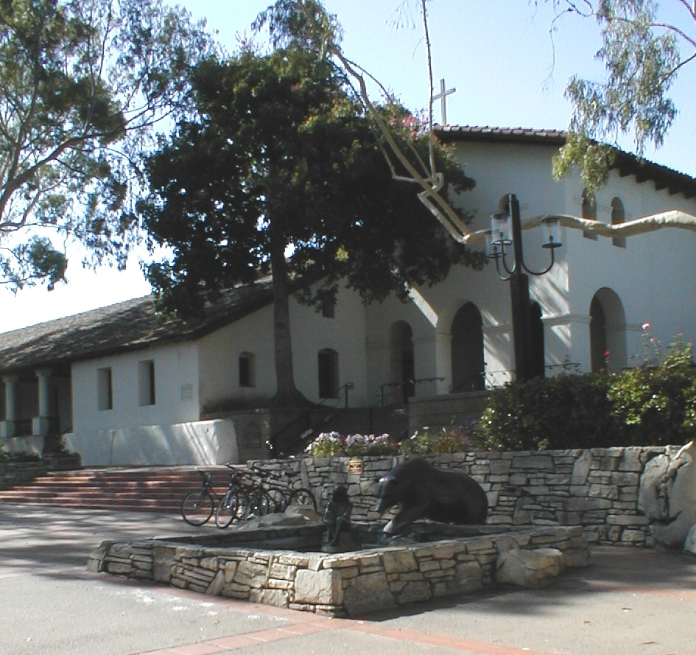
Purpose: Establish framework and general strategy process in responding to adverse fiscal circumstances in both the short and long term that:
  Ensures that employees and the community are meaningfully involved in the process.
  Takes a policy-based approach to decision-making.
  Reflects our organizational values.

Slide 159
What It’s Not
Specific “recipe” for expenditure cuts or revenue increases; this needs to be determined on a case-by-case basis.
Three problems with preparing detailed reduction or revenue options before they are truly needed:
  If not taken seriously, quality thought will not be given to them.
  If taken seriously, likely to result in needless anxiety; and sends a conflicting message if “times are good.”
  And even if these were not constraints, they would have a short shelf-life: needs and priorities change over time.
But it does set forth the foundation of principles and values upon which specific responses will be based.

Slide 160


Why is this “framework” important?
“Insanity is continuing to do the same things and expecting different results.”
“Very few cities get into fiscal trouble in the bad times; they get into trouble in the good times.”

Slide 161
Triggers
Any adverse fiscal circumstances as determined by the City Manager, such as
  Natural or human-made disasters.
  State takeaways
  Large, unexpected costs.
  Economic downturns.
Two consecutive quarters of adverse fiscal results in top five revenues
  Sales tax
  Property tax
  TOT
  Utility users tax
  VLF-Swap.
Adverse results are:
  Actual declines in revenues.
  Significant variances in projected revenues.
Clearly defining when “fiscal first aid” needed is key success factor in taking action on timely basis and keeping the problem from getting worse.

Slide 162
Scope: General Fund Focus, But . . .
This plan is focused on the General Fund but Enterprise Funds (water, sewer, parking, transit and golf) will also participate for two key reasons:
  One organization: all parts need to participate.
  Strategically important to limit Enterprise Fund rate increases (rate decreases would also be nice) at a time when we may be considering General Fund revenue increases.

Slide 163
Key Plan Elements
◆ Maintaining minimum fund balance at policy levels.
❖ Following other key budget and fiscal policies.
⬥ Monitoring city’s fiscal health on an ongoing basis.
 Assessing the challenge: short or long-term problem?
 Identifying options.
 Preparing and implementing action plan.

Slide 164
◆ Minimum Fund Balance
First Line of Defense in Adverse Circumstances
  Allows continued operations and projects in responding to short-term problems.
  Provides bridge – “breathing room” – in addressing longer-term problems while comprehensive response plans are developed.
  Especially important under Proposition 218: limited opportunities to implement new revenues.

Slide 165
❖ Other Key Fiscal Policies
Help prevent problems to begin with.
  Very few cities get into trouble in the “bad times.”
Keep them from getting bigger when they do happen.
  Balanced budget
  Conservative investment practices
  Budget authority and financial reporting
  Diversified revenues
  User fee cost recovery
  Enterprise funds
  New development pays its own way
  Limited use of debt financing
  Equipment replacement
  Contracting for services
  Productivity improvements

Slide 166
⬥ Fiscal Health Monitoring
Ongoing Systems for Reporting Fiscal Condition and Trends
  Annual
    Preparing audited financial statements in accordance with generally accepted accounting principles and highest standards.
  Interim
    Reliable automated financial management systems.
    On-line access.
    Monthly reports.
    Quarterly reports.
    Mid-year budget reviews.
    Special reports: sales tax, investments, TOT

Slide 168
Other Reports
Quarterly “Budget Review Team” briefings with City Manager
Year-end expenditure reports by each department

Slide 169
 Assessment: Short or Long-Term Problem?
Different Strategies for Different Problems
  Short-Term: One-time event or downturn that is not likely to continue indefinitely.
    “One-time” fixes appropriate response for “one-time” problems.
  Long-Term: Ongoing downturn in revenues or increases in costs that are systemic.
    “One-time” fixes won’t work.
    Requires new ongoing revenues or ongoing expenditure reductions.

Slide 170
Assessment: Short-Term Problem
Hiring Chill: City Manager approval required to fill vacant regular positions.
  Must meet direct public health/safety need that cannot be met through contract, overtime or temporary staffing.
  Goal is not just short-term savings, but preserving future options if problem turns-out to be ongoing.
Travel Chill: Limit travel and training; City Manager approval required for TA’s.
CIP Project Deferrals: CIP Review Committee identifies candidate projects for possible deferral.
“One-Time” Operating Cost Review: Budget Review Team identifies special projects in the operating budget for possible deferral.
Fund Balance: Consider use of fund balance below policy levels.
Other short-term expenditure curtailments as appropriate.

Slide 171
Assessment: Long-Term Problem
Three Basic Steps
  Implement “short-term” actions until completion of “action plan”
    First “rule of holes”
  Prepare long-term forecast to define the problem.
  Prepare revenue increase and expenditure reduction options tailored to problem definition via the forecast.
    Likely to take 3-6 months to prepare plans; another 3-6 months to implement them.
    Underscores importance of strong fund balance and short-term expenditure reductions to create the time needed to prepare and implement reasonable long-term plans.

Slide 172
Expenditure Reduction Options
Tough But Simple Fact
  Meaningful ongoing expenditure reductions require reductions in regular staff costs, including public safety personnel.
In San Luis Obispo
  85% of General Fund costs are operating.
    5% for debt service.
    10% for CIP: mostly maintenance.
  80% of General Fund operating costs are for staffing.
    90% of General Fund staffing costs are for regular staffing.
  And many of the “non-staffing” costs are difficult to control: utilities, phones, insurance
  50% of General Fund staffing costs are for public safety.

Slide 173
General Strategy
Who prepares expenditure reduction options?
Who prepares revenue options?
What are the general guidelines?
How is the organization engaged?
How is the Council engaged?
How is the community engaged?

Slide 174
SLO General Strategy
Departments craft expenditure reduction options that are real, doable and:
  Reflect least service impacts to the community—no game-playing in proposing least-likely reductions and “non-starters.”
  Are ongoing.
  Describe service impacts.
  Are within the City’s ability to do independently—no speculative reductions contingent upon actions by others.
  Can be implemented within three months after adoption.
  Are net of any related revenues from fees or grants.
  Maintain essential facilities, infrastructure and equipment at reasonable levels—no deferred maintenance posing as genuine cost reductions.
  Reflect participation from throughout their organization.

Slide 175
Expenditure Reduction Options
Targets
  Who? (Any exceptions?)
  How based?
  How big?
  What will you do with them?

Slide 176
SLO Option Targets
Targets for reduction options will generally be:
  Based on percentage reductions from current operating budgets, less significant one-time costs.
  The same for all departments.
Targets are likely to exceed “gap” identified in forecast in order to surface an array of reasonable policy choices based on priority considerations, and not driven by arbitrary across-the-board decreases.
  Like making choices at a restaurant, making priority-based decisions depends on having more options on the menu than we plan on ordering.
Expenditure reductions are not likely to be sole “budget-balancers,” but identifying their service impact is critical to attracting support for new revenues and other mitigation strategies.

Slide 177
SLO Principles in Preparing Options
Any service reductions will be balanced and ensure that highest priority services are retained.
Reductions will be based on service priorities, not vacant positions: attrition is a helpful tactic, but not the driving factor in reducing costs.
On the other hand, one of the key purposes of the “hiring chill” is to create flexibility in making reductions based on priorities while mitigating the need for lay-offs.
Focus will be on retaining “front-line” core services, and reducing services with least impact on community at-large.
  But we also need to preserve “organizational” infrastructure, and ensure appropriate internal review functions remain.

Slide 178
CIP Projects
CIP Review Committee identifies reduction opportunities.
Projects intended to maintain existing infrastructure and facilities will generally have higher priority over “new” facilities.
Likely exceptions:
  Direct adverse impacts to public health and safety.
  Outstanding contractual commitments.
  Significant outside resources or related one-time revenues.

Slide 179
Revenues: Limited Options
Budget Review Team, working with representatives from the operating departments, will have the lead responsibility for identifying revenue options.
However, it is likely that any new significant revenues will require voter approval under Proposition 218.
And most likely, this election cannot be held until the next regular municipal election (November of even-numbered years).
Exceptions:
  Emergency declared by unanimous vote of the Council.
  Two-thirds voter approval.

Slide 180
Revenues: Voter Support Required
Voter approval will require time for effective preparation before a measure is placed on the ballot.
Critical Success Factor: Effective, community-based group that will work hard to pass measure.

Slide 181
Engaging the Organization in Revenue Ideas
On the other hand, there may be options for increased user fees, fines or use of property.
  But if these were easy to do, you would probably have already done them!
Employees throughout the organization will be encouraged to surface revenue-raising options, with the recognition that expenditure reductions are likely to play the play the leading role in balancing the budget.

Slide 182
Legislative Advocacy
What’s its role?
City of San Luis Obispo
  Depending on the reason for the adverse circumstances (and especially if they are driven by state or federal budget actions), the City will work closely with its elected representatives and others (such as the League) in mitigating service (and related cost) reductions.

Slide 183
Unlikely Long-Term Budget Balancers
Fund balance below policy levels
  Using fund balance is a one-time course of action; it cannot fix a structural imbalance.
Training
  With fewer employees, it will be even more important to ensure that we have a highly-skilled, well-trained work force.

Slide 184

Involvement and Participation
Organization
Unions
Community Groups
Communication
  With these stakeholders
  With affected employees

Slide 185
Budget-Balancing Paradox
Balancing the budget and closing the “forecast gap” from a strictly numbers perspective is easy.
However, after cutting capital projects, reducing staff, and negotiating and implementing employee concessions, emerging from the process with a vibrant, high-morale, high-productivity organization is hard.
Which leads to the budget-balancing paradox: at a time when the organization is at its nadir with downsizing, the resulting smaller organization needs its employees to be even more energized, fired-up and motivated to perform.

Slide 186
Beating the Paradox
In our experience, there is only one way to beat this paradox: believing that the process used in communicating with employees and meaningfully engaging them in finding solutions matters.
  How we go about this process an opportunity to make deposits in our credibility bank, not just withdrawals.
  Opportunity to both show our organizational character and values, and to build them.

Slide 187
Employee Involvement
Department heads will encourage employee participation and involvement in preparing expenditure reduction options.
City will strive to identify likely position reductions resulting from this plan six months before implementation in order to:
  Be straight forward with affected employees about their employment outlook.
  Provide transfer opportunities.
  Allow affected employees a reasonable amount of time to make other plans.

Slide 188
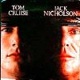
Key Value: Respect
There are downsides to this approach and many organizations consciously keep force-reduction actions under wraps as long as possible because of them.
But treating employees with respect means informing them about City plans that affect them as soon as possible.
It also means sharing the hard facts (and consequences) in a straightforward and timely way, even if this is painful at times for the organization.
Because ultimately, respect means believing (contrary to Jack Nicholson's Marine Colonel Jessup in A Few Good Men) that employees can handle the truth.

Slide 189
Communication: SLO Sample
Whenever the Fiscal Health Contingency Plan is placed in effect, the City will strive to effectively communicate with the community and employees about its status.

Slide 190

Approaches
Employees
  Ongoing face-to-face employee briefings by City Manager/Finance & IT Director.
  Ongoing updates via voice mail or email.
  Periodic “newsletters” and “rumor control corner” on the Intranet
  Ongoing briefings with employee association leadership.
  Special organization-wide briefings as appropriate
Community
  Viewpoint articles in The Tribune and editorial board briefings
  New releases.
  Presentations to interested community groups.
  Periodic “newsletters” via direct mail or utility billing inserts.
  Web site updates.
  Community forums and workshops.
The goal is not necessarily “consensus,” but “no surprises” when any specific action plans are adopted by the Council.

Slide 191
Community Advisory Group
Should you use one?
If so, when in the process?
Who should be on it?
What’s their role?

Slide 192
 Finalize and Implement Action Plan
With advice from Department Heads and Budget Review Team, City Manager is responsible for preparing recommended action plan.
Council approval required for implementation.
Finance will closely monitor results of action plan in achieving its goal, and will quickly report any significant deviations to the City Manager and Council.

Slide 193
Summary
Planning—not a plan
  (verb, not a noun)
  Risks
    Just the act of preparing the guidelines will cause a lot of anxiety.
    Consider this in deciding what to do with this and when to do it .
  Benefits
    Clarifying your own thinking.
    Early start.
    General direction on destination, with specific route to follow.

Slide 194
Key to Long-Term Success
While the specifics of both the process and outcomes have changed with the circumstances, having a clear strategy in place as the foundation for decision-making in tough fiscal times that reflects our organizational values has been a key factor in the City’s success in preserving its long-term fiscal health and organizational vitality.

Slide 195

Th-th-th-that’s all folks!
For more information and forecast examples, visit my web site at:
  www.bstatler.com
For follow-up questions or information, send me an email at:
  bstatler@pacbell.net

